Slide 1


Advanced topics in single-cell transcriptomics - streamed
27 - 29 May 2020 Alma Andersson, Panagiotis Papasaikas, Mike Smith, Charlotte Soneson, Avi Srivastava, Michael Stadler

Slide 2
Course Overview (Program)
Wednesday, May 27
9:00 - 9:30 | Welcome and setup of working environment (C. Soneson)
 | Zoom, slack workspace, HackMD document Introducing participants (ice breaker)
9:30 - 10:00 | Introduction to Renku (R. Roskar)
10:00 - 10:30 | Introduction to the course (M. Stadler) Course overview, expected background Prepare renku workspace
10:30 - 10:45 | Break
10:45 - 11:15 | Combining the best of two worlds: Python + R (introduction, M. Stadler)
11:15 - 11:30 | Break
11:30 - 12:30 | Combining the best of two worlds: Python + R (interactive exercise)
12:30 - 13:30 | Lunch
13:30 - 14:30 | Python + R (continued)
14:30 - 14:45 | Break
14:45 - 15:30 | Beyond cellranger: Quantification of gene expression (presentation, A. Srivastava)
15:30 - 15:45 | Break
15:45 - 16:45 | Quantification of gene expression (exercises, A. Srivastava)
16:45 - 17:00 | Break
17:00 - 18:00 | Quantification of gene expression (continued)
introduction and tools
Python + R
quantification

Slide 3
Course Overview (Program)
Thursday, May 28
9:00 - 10:00 | RNA velocity (presentation, C. Soneson)
10:00 - 10:15 | Break
10:15 - 11:15 | RNA velocity (exercises, C. Soneson)
11:15 - 11:30 | Break
11:30 - 12:30 | RNA velocity (continued)
12:30 - 14:00 | Lunch
14:00 - 15:00 | Spatial transcriptomics (presentation, A. Andersson)
15:00 - 15:15 | Break
15:15 - 16:15 | Spatial transcriptomics (exercises, A. Andersson)
16:15 - 16:30 | Break
16:30 - 17:30 | Spatial transcriptomics (continued)
RNA velocity
spatial transcriptomics

Slide 4
Course Overview (Program)
Friday, May 29
9:00 - 10:00 | Working with on-disk data formats (presentation, M. Smith)
10:00 - 10:15 | Break
10:15 - 11:15 | Working with on-disk data formats (exercises, M. Smith)
11:15 - 11:30 | Break
11:30 - 12:30 | Working with on-disk data formats (continued)
12:30 - 13:30 | Lunch
13:30 - 14:30 | Deep Generative Networks (presentation and exercises, P. Papasaikas)
14:30 - 14:45 | Break
14:45 - 15:45 | Deep Generative Networks (continued)
15:45 - 16:00 | Break
16:00 - 17:00 | Deep Generative Networks (continued)
17:00 - 17:30 | Wrap-up (feedback form, slack workspace, all)
on-disk data
deep generative networks

Slide 5
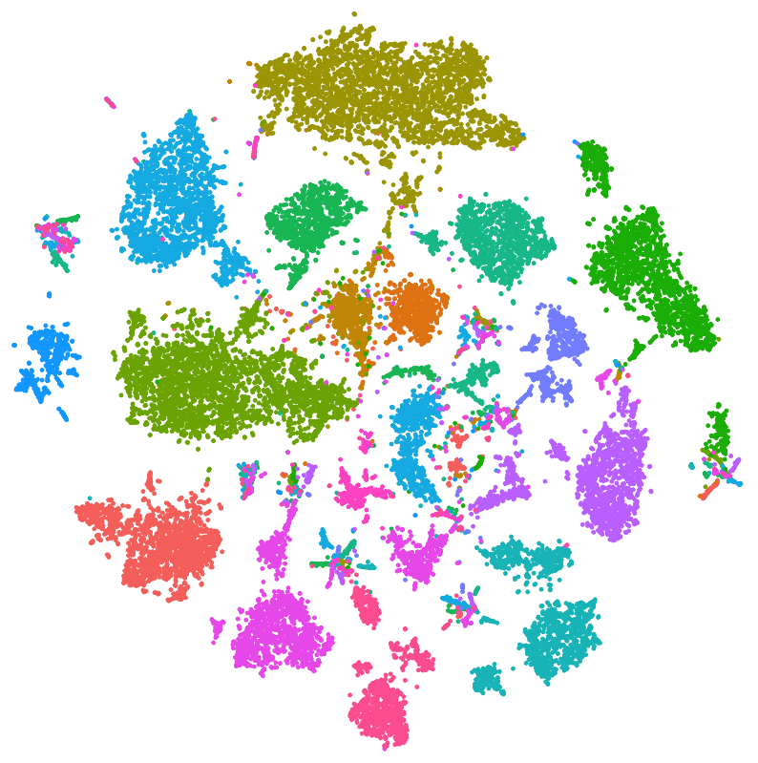
Expected Prerequisites: Single-cell Analysis
Typical steps of a single cell RNA-seq experiment and analysis
Cell/nucleus isolation
RNA capture/amplification/sequencing
Alignment and quantification
Normalization
Dimensionality reduction
Batch correction
Clustering
Differential expression analysis
Cell fate mapping & trajectories

Slide 6
Expected Prerequisites: Computational
R/Python scripting
Writing your own scripts
Installing packages (Bioconductor, PyPi)
Renku setup: Docker, conda environments
Bash shell
Basic commands to navigate a file system and create/copy/rename/remove files and directories
Git
Version control in general
Cloning a repository
Add/commit/pull/push

Slide 7
Expected Prerequisites: Course-specific
Zoom client: https://zoom.us/
Renku account
Course repo on GitHub: https://github.com/fmicompbio/adv_scrnaseq_2020
Slack workspace (invite link in the email)
HackMD document link (link in the email)

Slide 8
Prepare Renku workspace
Login to renku at: https://renkulab.io/
Navigate to Renku project (public, but read-only): https://renkulab.io/projects/stadler.michael/adv_scrnaseq_2020/
Fork project for yourself (writable)
Start an environment (/lab or /rstudio)
Open a terminal
Clone the course GitHub repo (slides handouts, exercises)
Push the changes to the master branch
Update slides from GitHub

Slide 9
Useful Links
SIB course page:
https://www.sib.swiss/training/course/2020-05-adv-scrna (announcement)
https://edu.sib.swiss/course/view.php?id=458 (moodle, participants only)
Course GitHub repository (slides, handouts, exercises):
https://github.com/fmicompbio/adv_scrnaseq_2020
Renkulab project (compute environment):
https://renkulab.io/projects/stadler.michael/adv_scrnaseq_2020
R/Python/git:
https://rstudio.github.io/reticulate/
https://rpy2.github.io/
https://rogerdudler.github.io/git-guide/ or https://git-scm.com/doc
Single cell RNA-seq analysis:
https://osca.bioconductor.org/

