Slide 1


Advanced topics in single-cell transcriptomics - streamed
27 - 29 May 2020 Alma Andersson, Panagiotis Papasaikas, Mike Smith, Charlotte Soneson, Avi Srivastava, Michael Stadler

Slide 2
Welcome

Slide 3
Setup of working environment
Zoom
Test important functionality (breakout rooms, feedback signs, polls)
Slack workspace
Exchange between course participants, quick questions, technical support
Will exist beyond the course
HackMD document
Collaborative note taking, questions
This is a professional environment – we expect professional behaviour

Slide 4
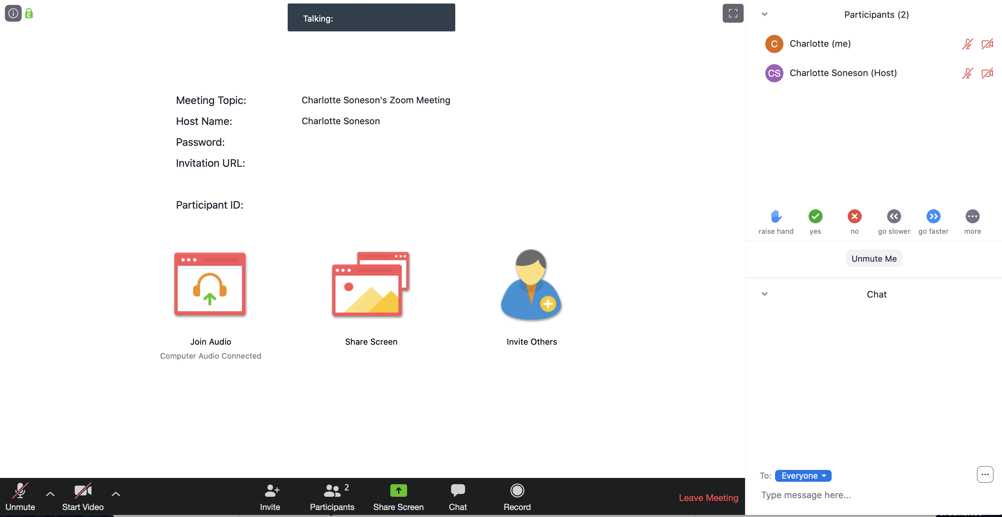

Slide 7
“Ice-breaker” + Zoom feedback testing

Slide 8
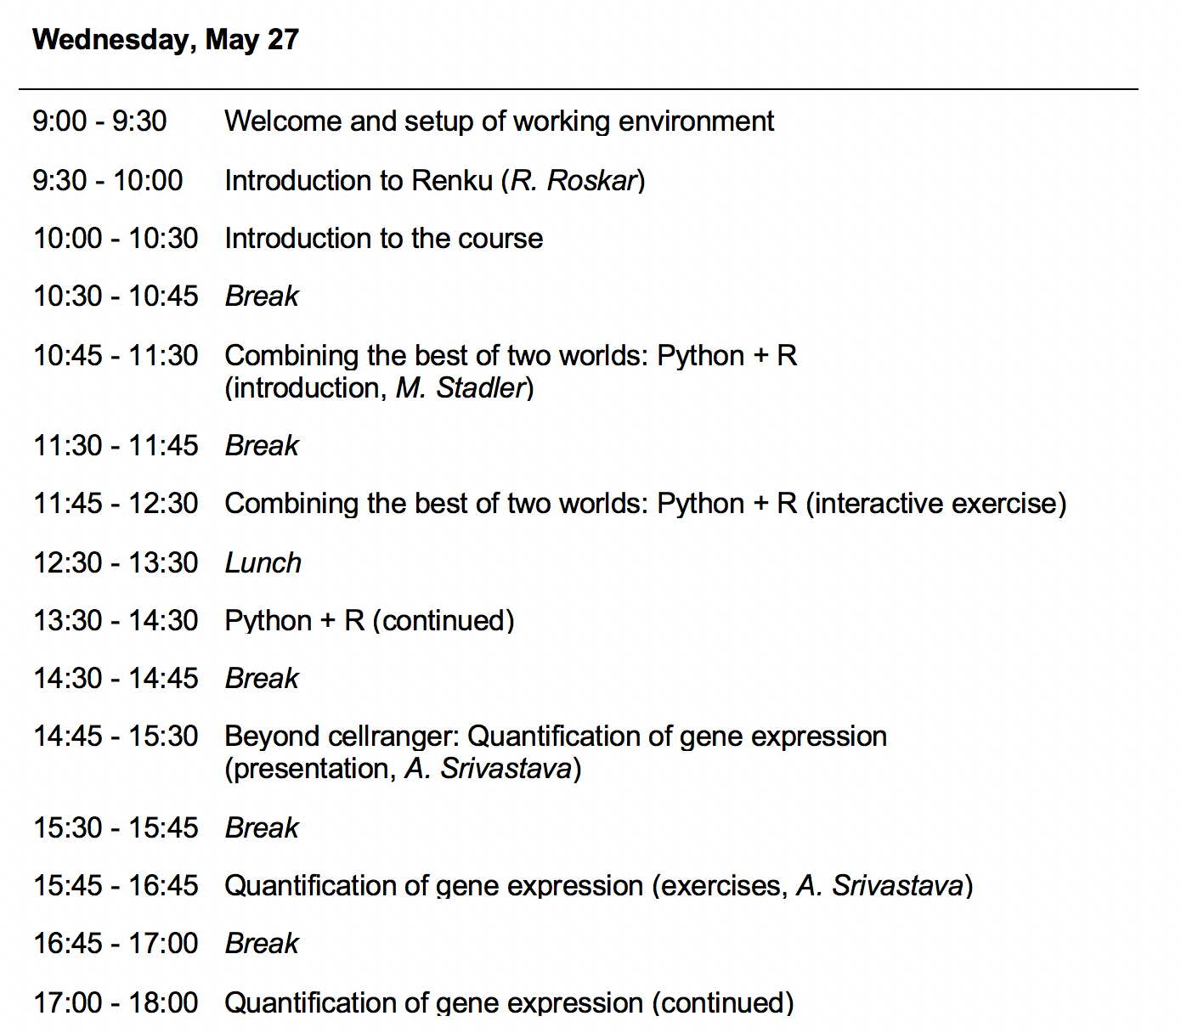
Course Overview (Program)

Slide 9
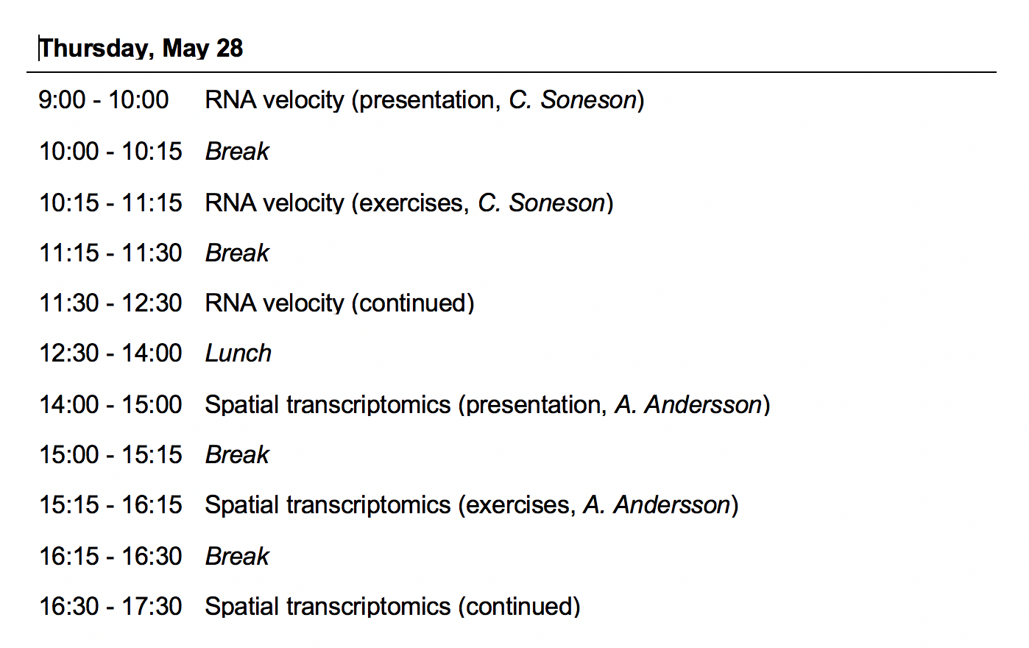
Course Overview (Program)

Slide 10
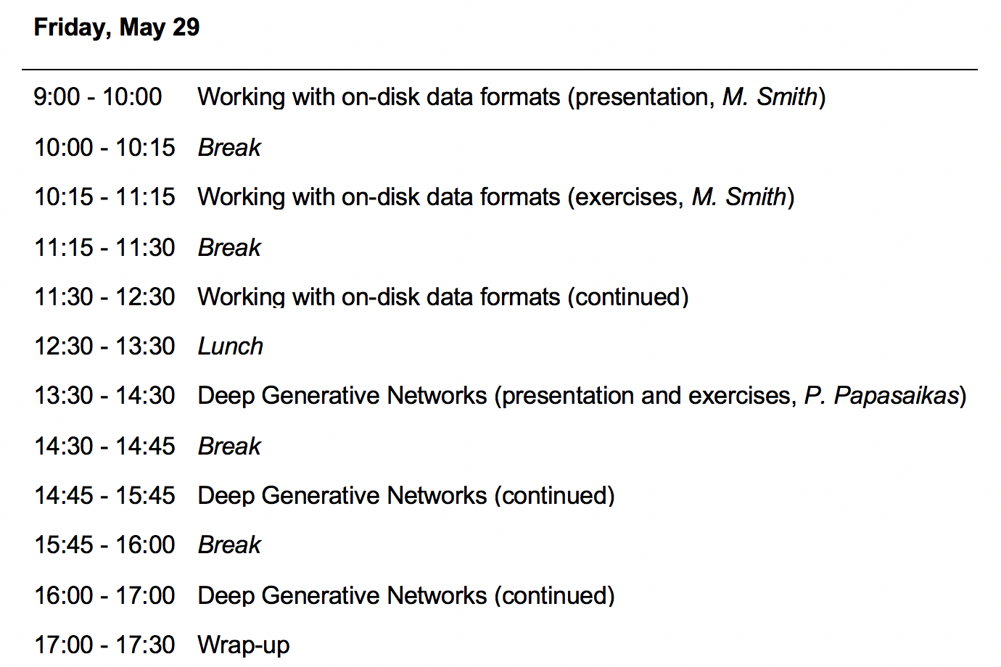
Course Overview (Program)

Slide 11
Expected Prerequisites
R/python scripting (link1, link2)
git
Single cell analysis workflow (link1, link2)

Slide 12
Useful Links
SIB course page:
https://www.sib.swiss/training/course/2020-05-adv-scrna (announcement)
https://edu.sib.swiss/course/view.php?id=458 (moodle, participants only)
Course GitHub repository (slides, handouts):
https://github.com/fmicompbio/adv_scrnaseq_2020
Renkulab project (compute environment):
https://renkulab.io/projects/stadler.michael/adv_scrnaseq_2020
R/Python:
https://rstudio.github.io/reticulate/
https://rpy2.github.io/
Single cell RNA-seq analysis:
https://osca.bioconductor.org/

