Slide 1


Advanced topics in single-cell transcriptomics - streamed
27 - 29 May 2020 Alma Andersson, Panagiotis Papasaikas, Mike Smith, Charlotte Soneson, Avi Srivastava, Michael Stadler

Slide 2
Prepare Renku workspace
Login to renku at: https://renkulab.io/
Navigate to Renku project (public, but read-only): https://renkulab.io/projects/stadler.michael/adv_scrnaseq_2020/
Fork project for yourself (writable)
Start an environment (/lab or /rstudio)
Open a terminal
Clone the course GitHub repo (slides handouts, exercises)
Push the changes to the master branch
Update slides from GitHub

Slide 3
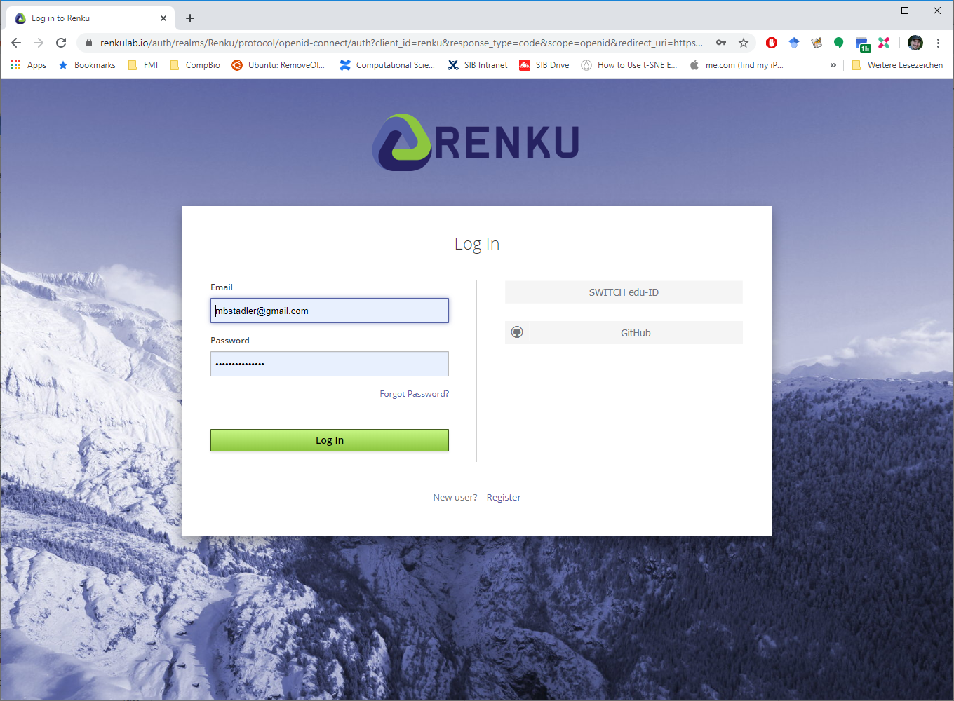
1. Login to renku at https://renkulab.io/

Slide 4
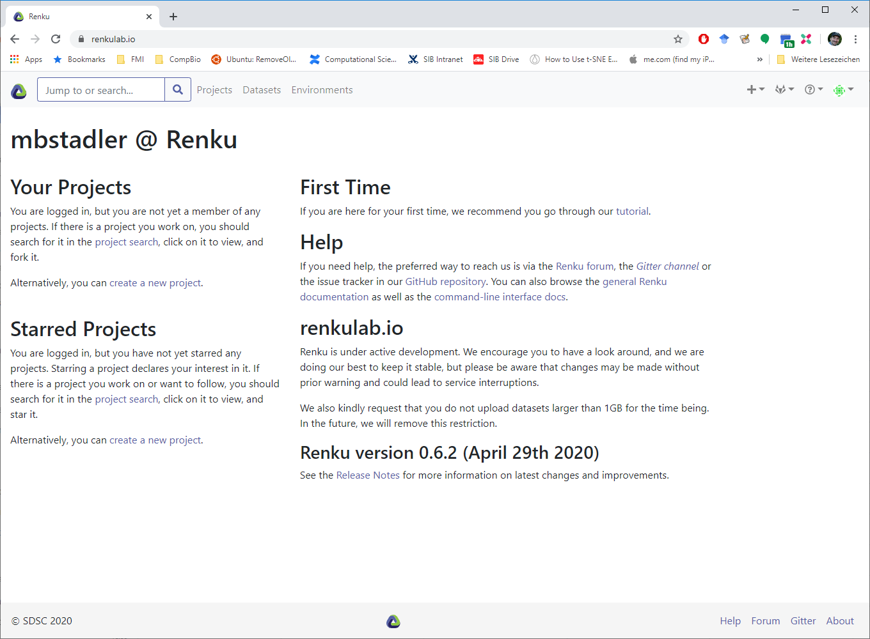
1. Login to renku at https://renkulab.io/

Slide 5
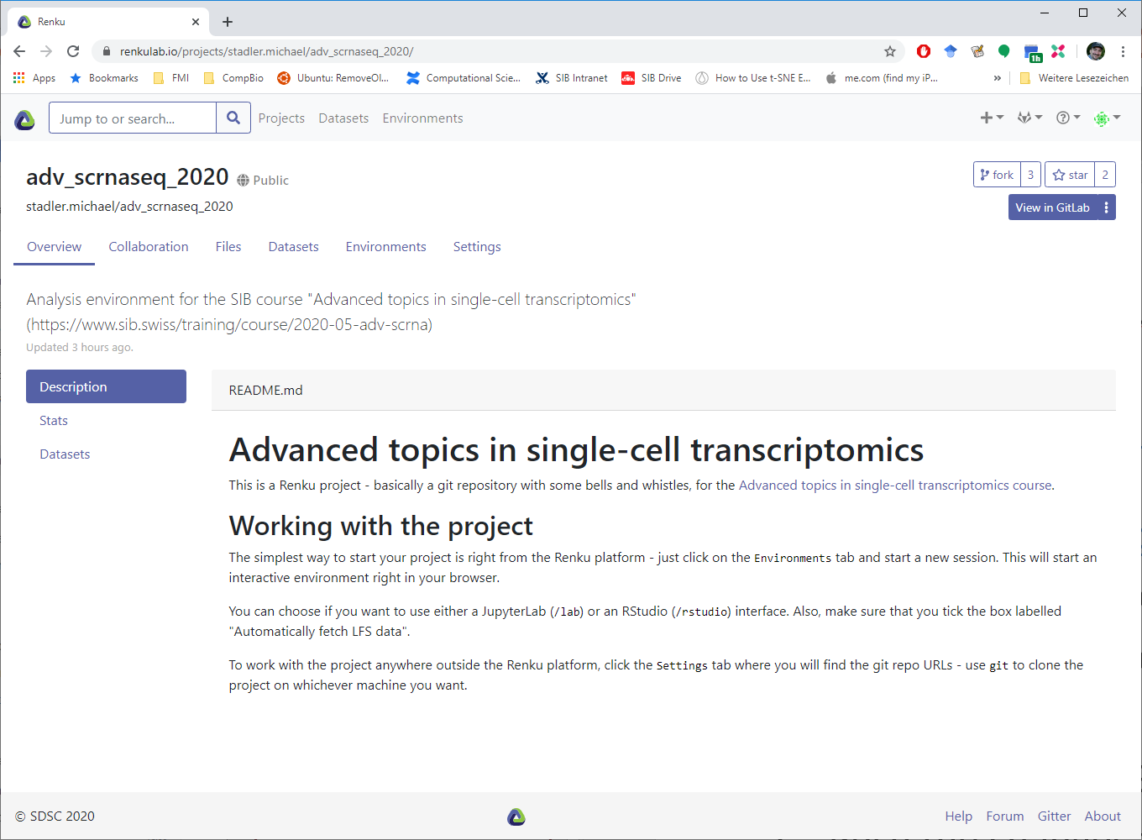
2. Go to project: https://renkulab.io/projects/stadler.michael/adv_scrnaseq_2020/

Slide 6
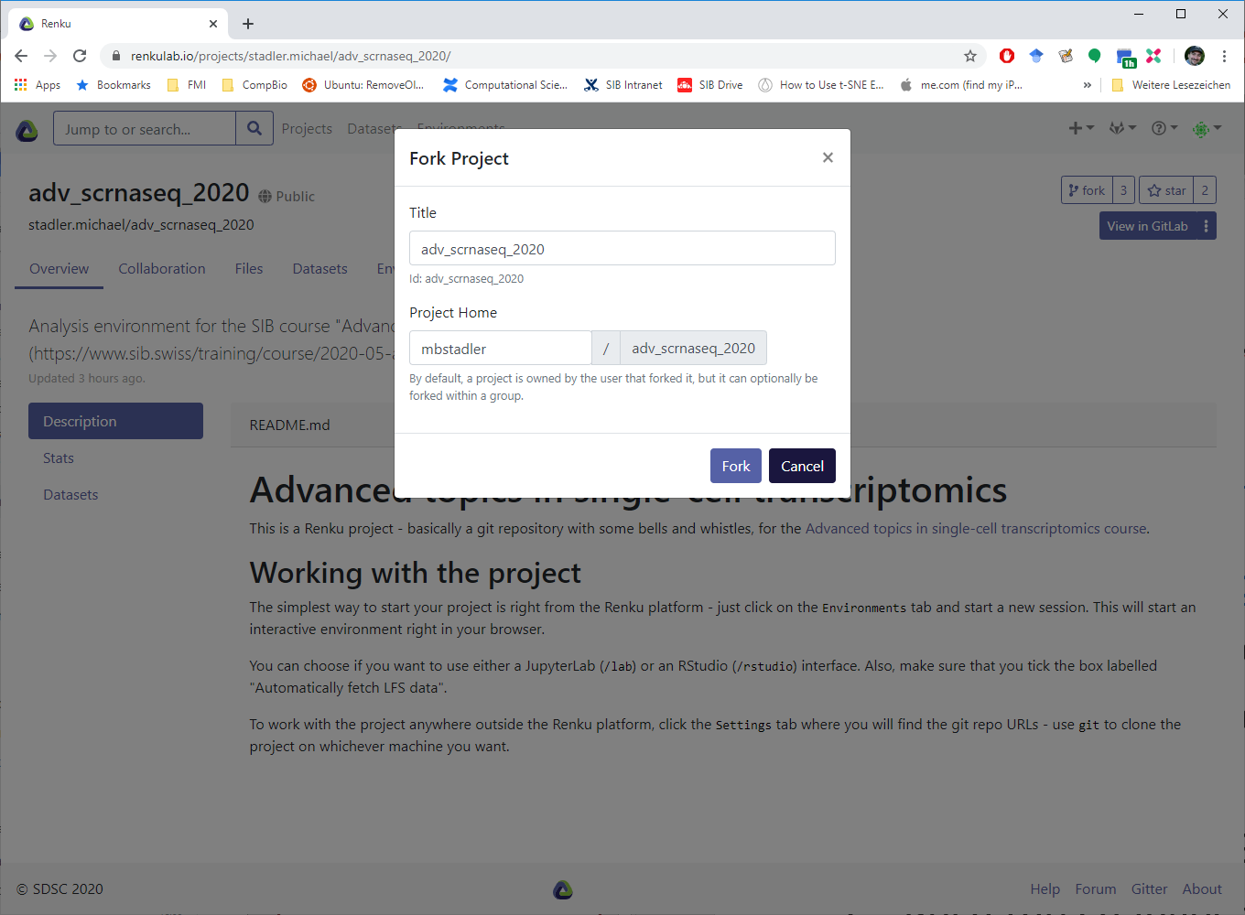
3. Fork project

Slide 7
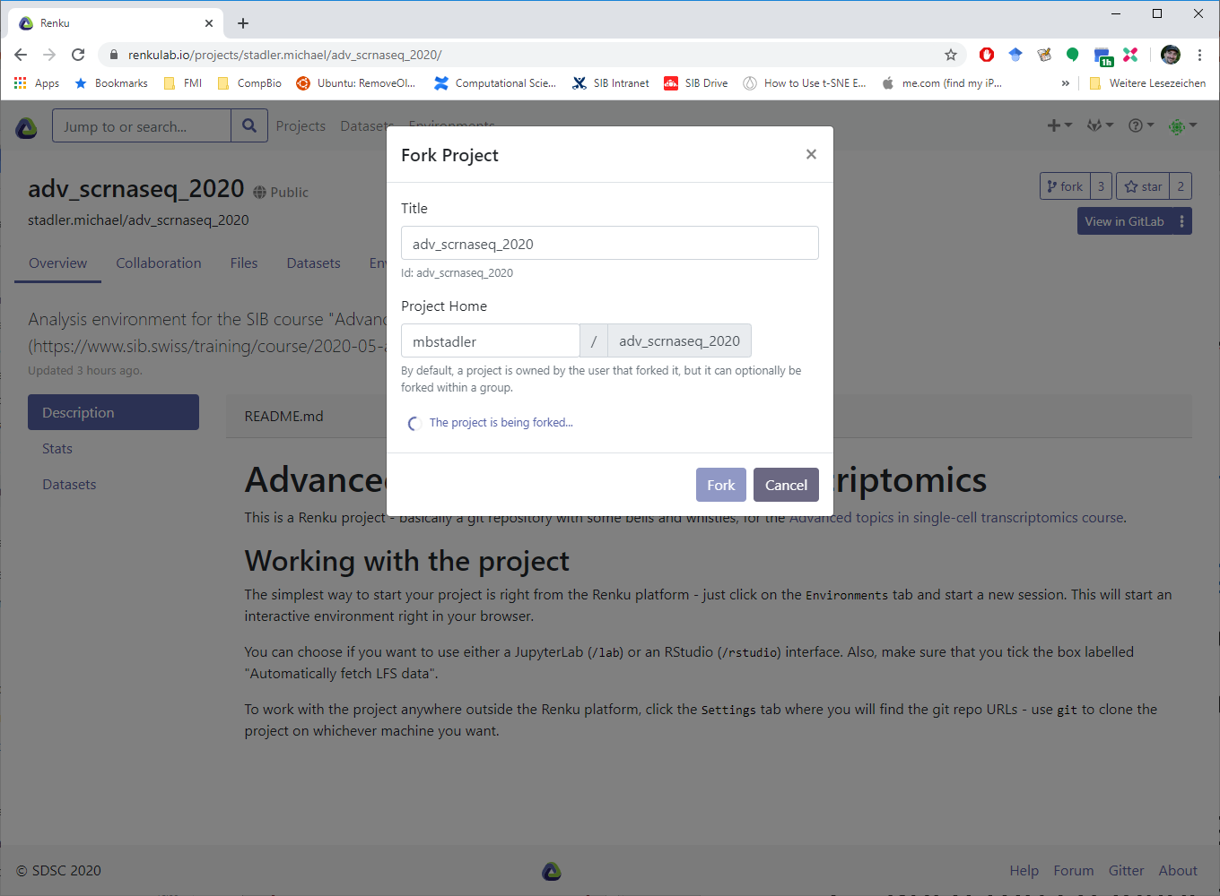
3. Fork project

Slide 8
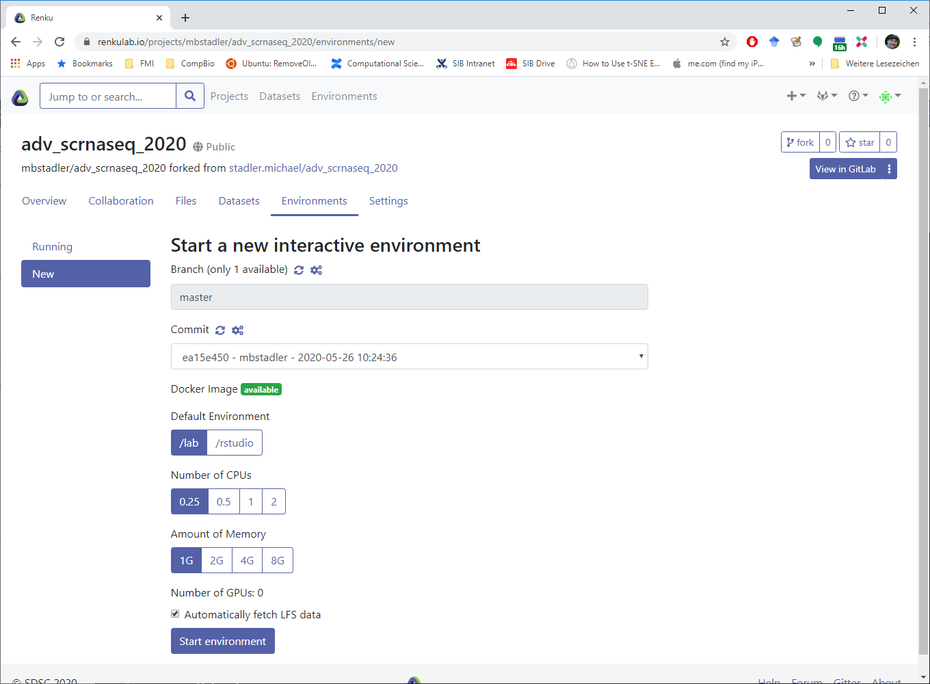
4. Start an environment

Slide 9
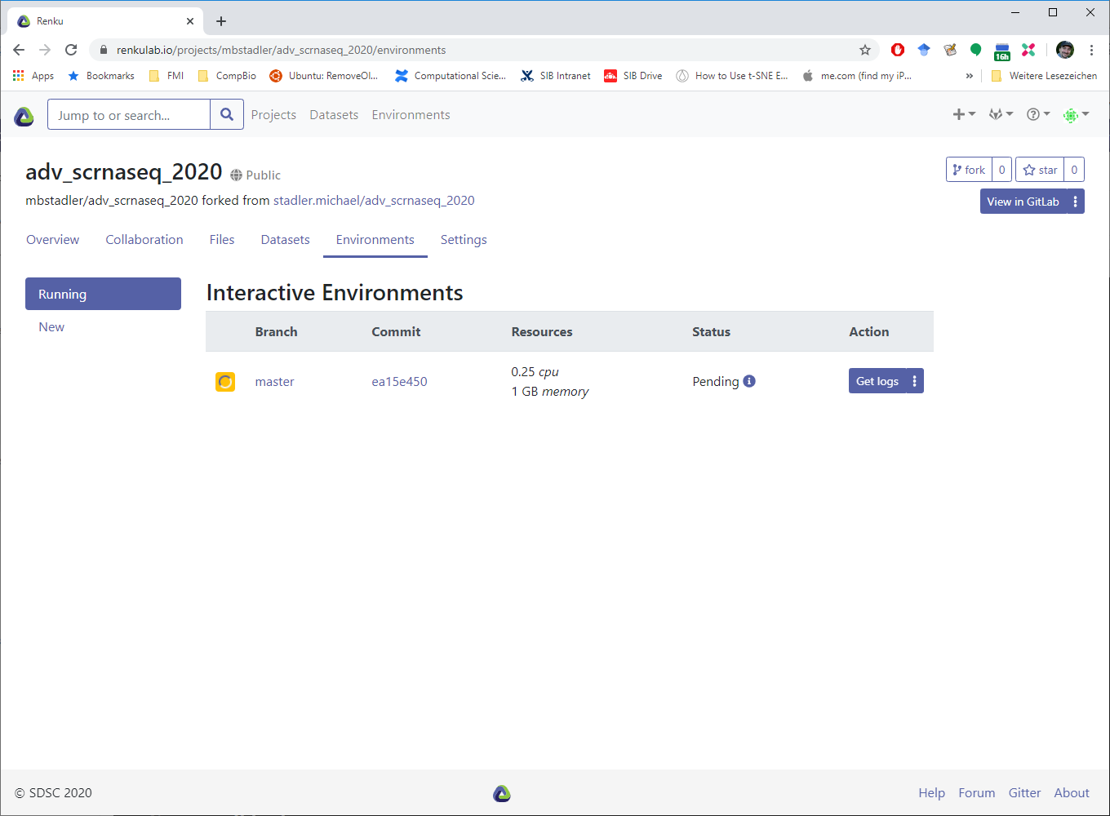
4. Start an environment

Slide 10
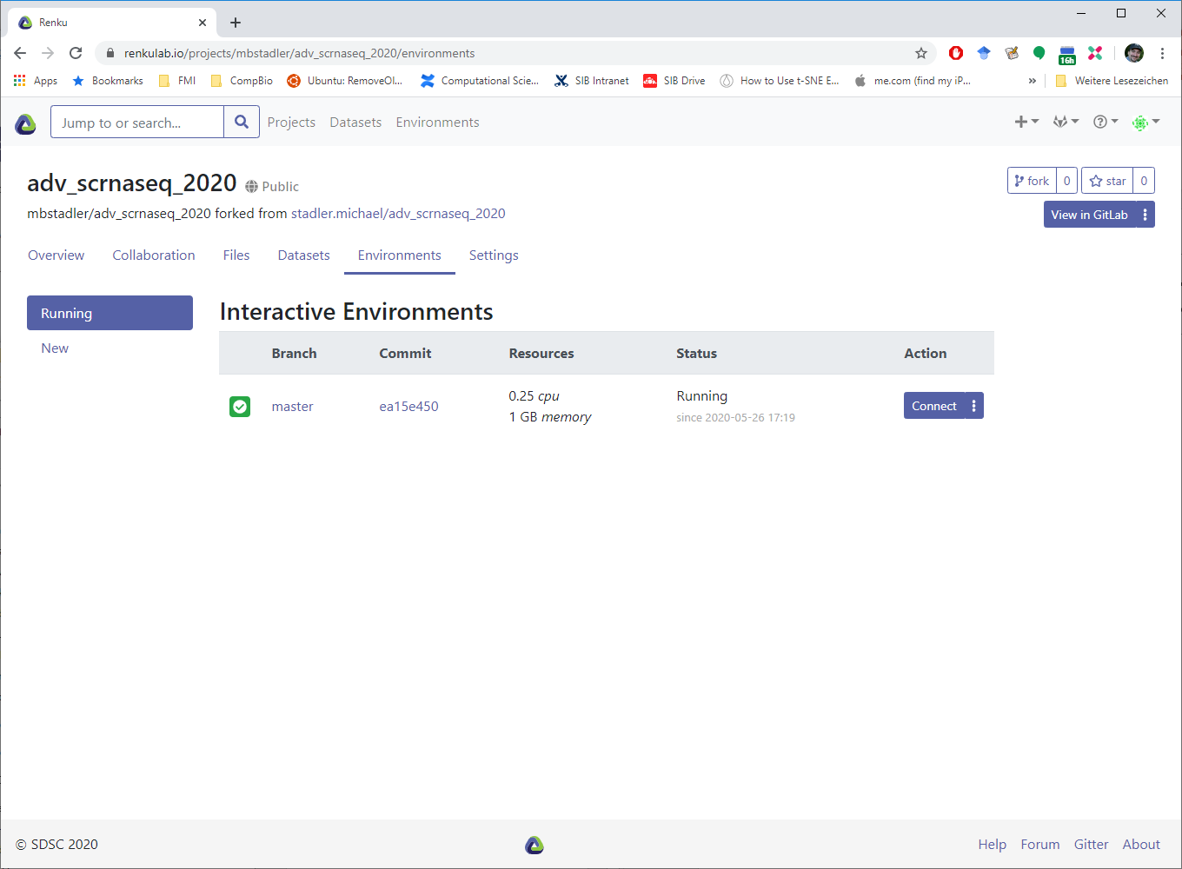
4. Start an environment

Slide 11
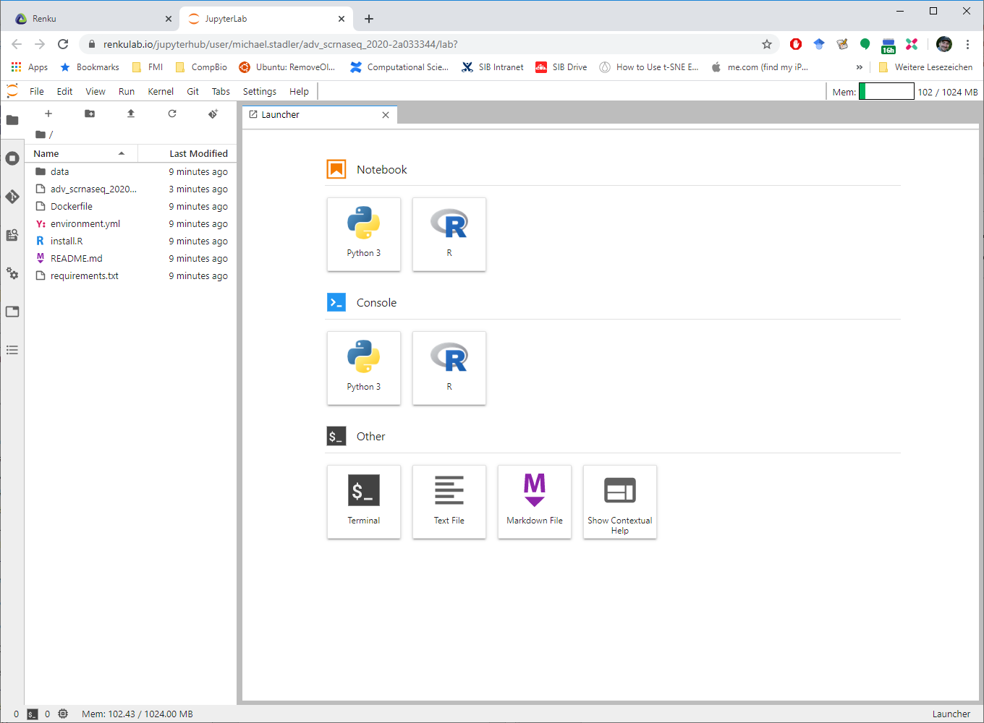
5. Open terminal

Slide 12
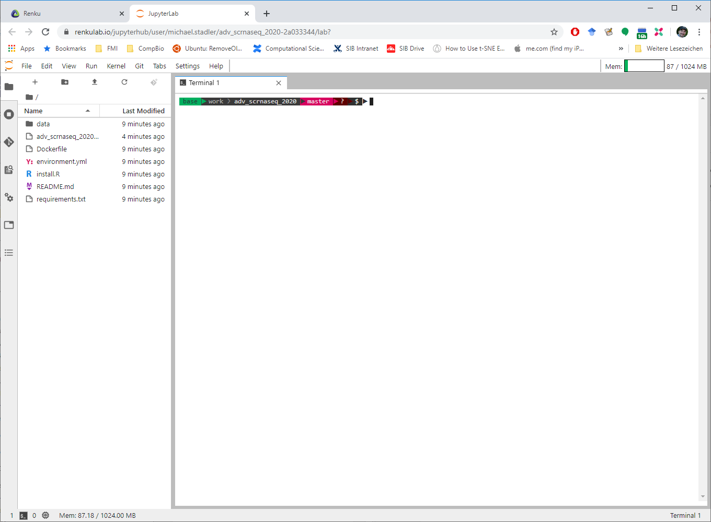
5. Open terminal

Slide 13
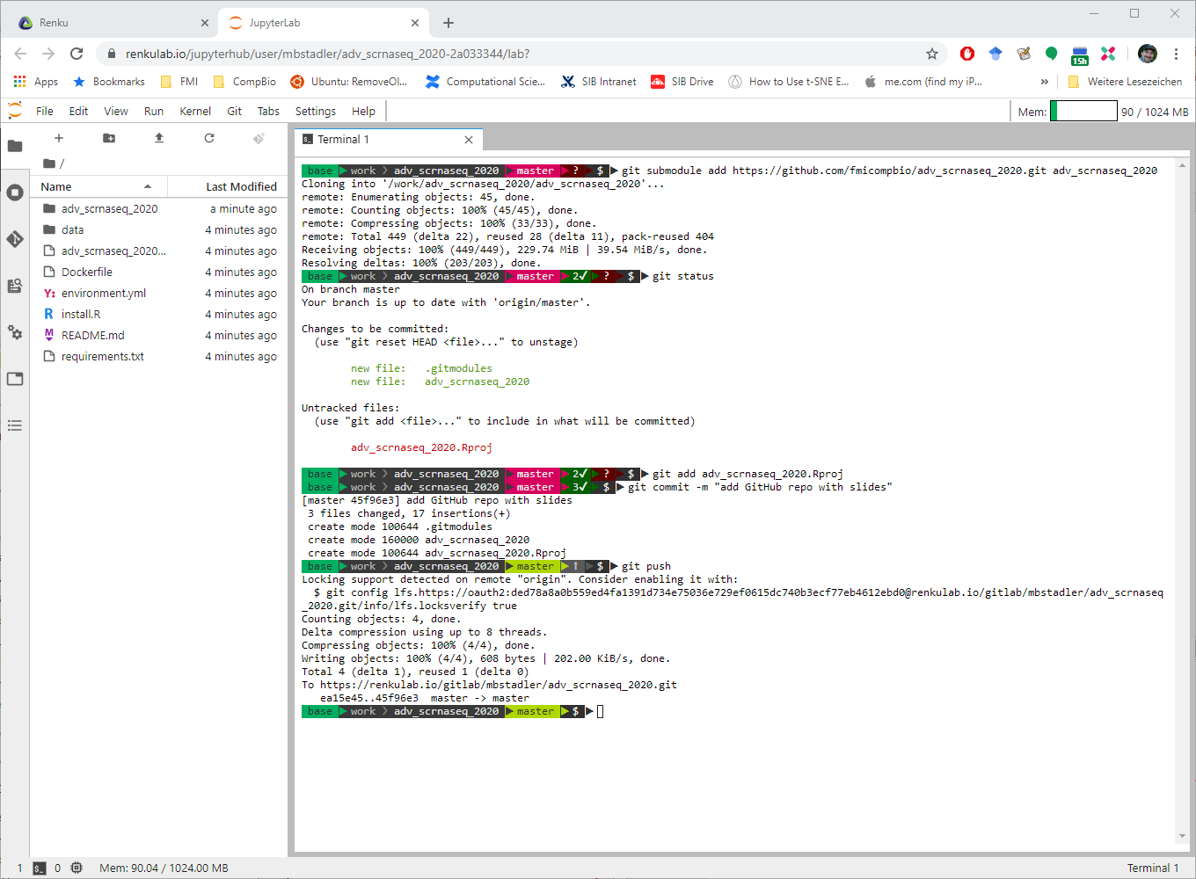
6. Clone the course GitHub repository
git submodule add https://github.com/fmicompbio/adv_scrnaseq_2020.git adv_scrnaseq_2020
git status

Slide 14
7. Push the changes to the master branch
git add adv_scrnaseq_2020.Rproj
git commit -m "add GitHub repo with slides"
git push

Slide 15
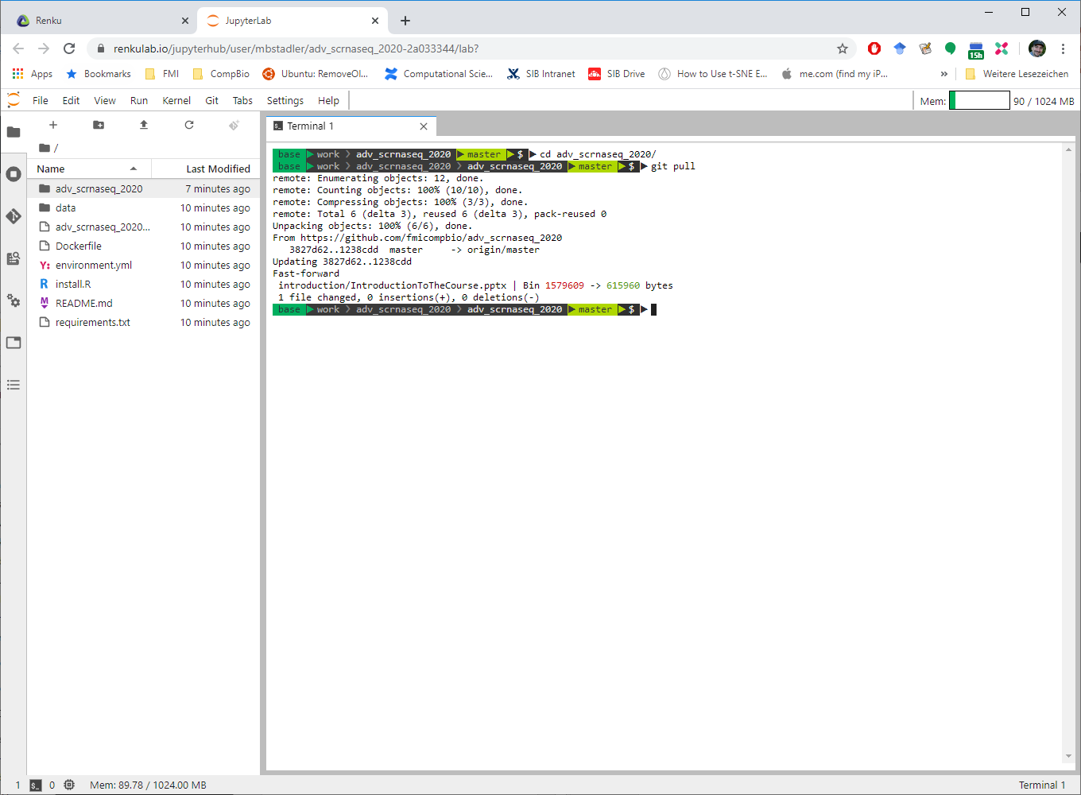
8. Update slides from GitHub
cd adv_scrnaseq_2020
git pull

Slide 16
Remarks on saving your edits
Remember that you are working in a git repository
If you want to edit existing files, it’s best to first copy them under a new name – this avoids merge conflicts when you next “git pull”
To avoid any issues: Think of the GitHub repo submodule in the “adv_scrnaseq_2020” subfolder as read-only
To store your edits in your repo, use the standard “git add”, “git commit” and “git push” before closing the environment
If you did not push your edits to the “master” branch, renku will save them in a “renku/autosave/…” branch

Slide 17
Useful Links
SIB course page:
https://www.sib.swiss/training/course/2020-05-adv-scrna (announcement)
https://edu.sib.swiss/course/view.php?id=458 (moodle, participants only)
Course GitHub repository (slides, handouts, exercises):
https://github.com/fmicompbio/adv_scrnaseq_2020
Renkulab project (compute environment):
https://renkulab.io/projects/stadler.michael/adv_scrnaseq_2020
R/Python/git:
https://rstudio.github.io/reticulate/
https://rpy2.github.io/
https://rogerdudler.github.io/git-guide/ or https://git-scm.com/doc
Single cell RNA-seq analysis:
https://osca.bioconductor.org/

