Slide 1


Advanced topics in single-cell transcriptomics - streamed
27 - 29 May 2020 Alma Andersson, Panagiotis Papasaikas, Mike Smith, Charlotte Soneson, Avi Srivastava, Michael Stadler

Slide 2
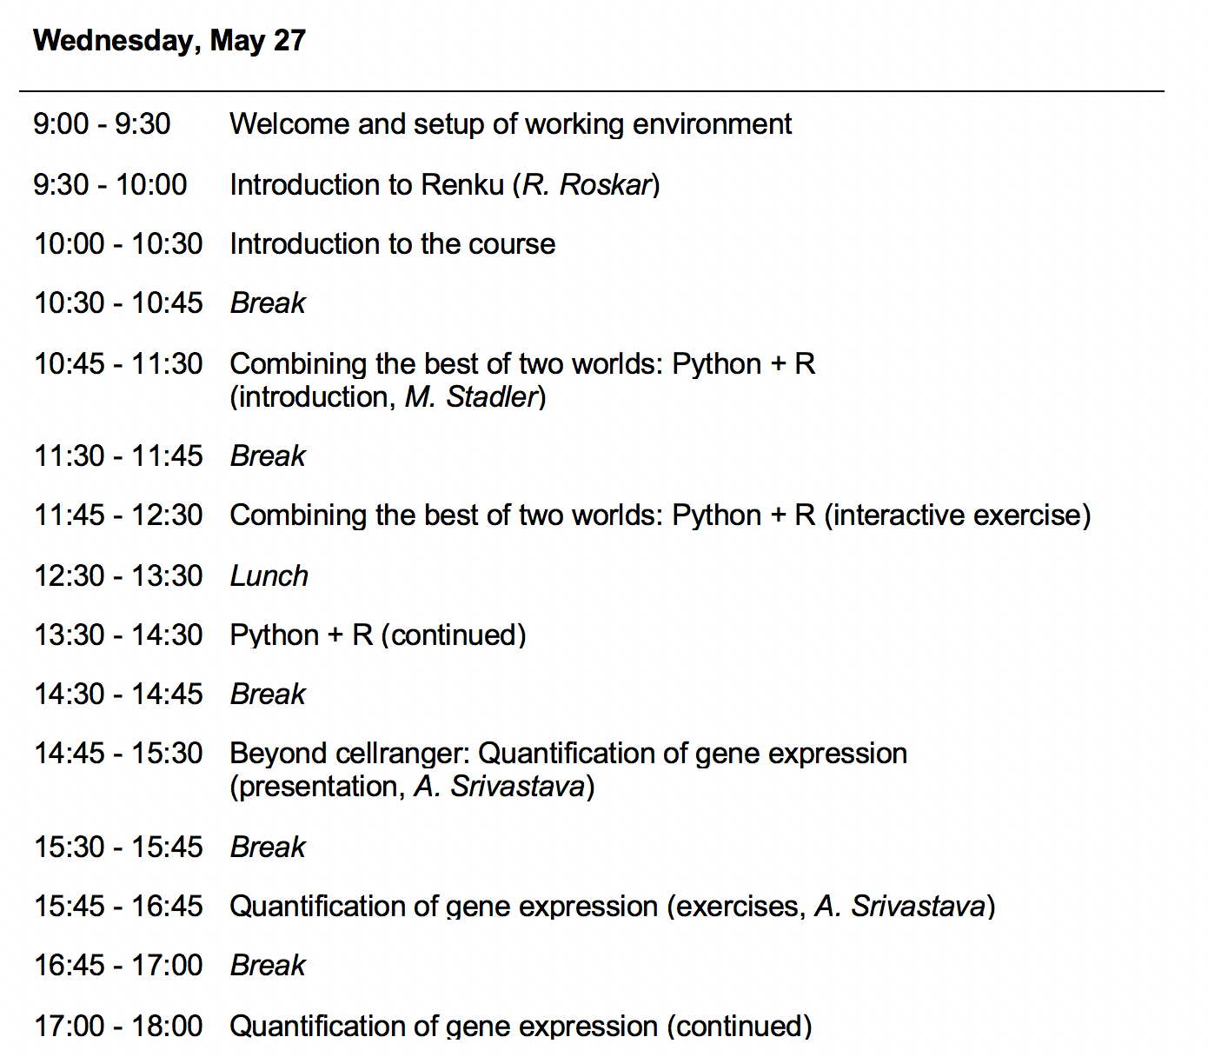
Course Overview (Program)

Slide 3
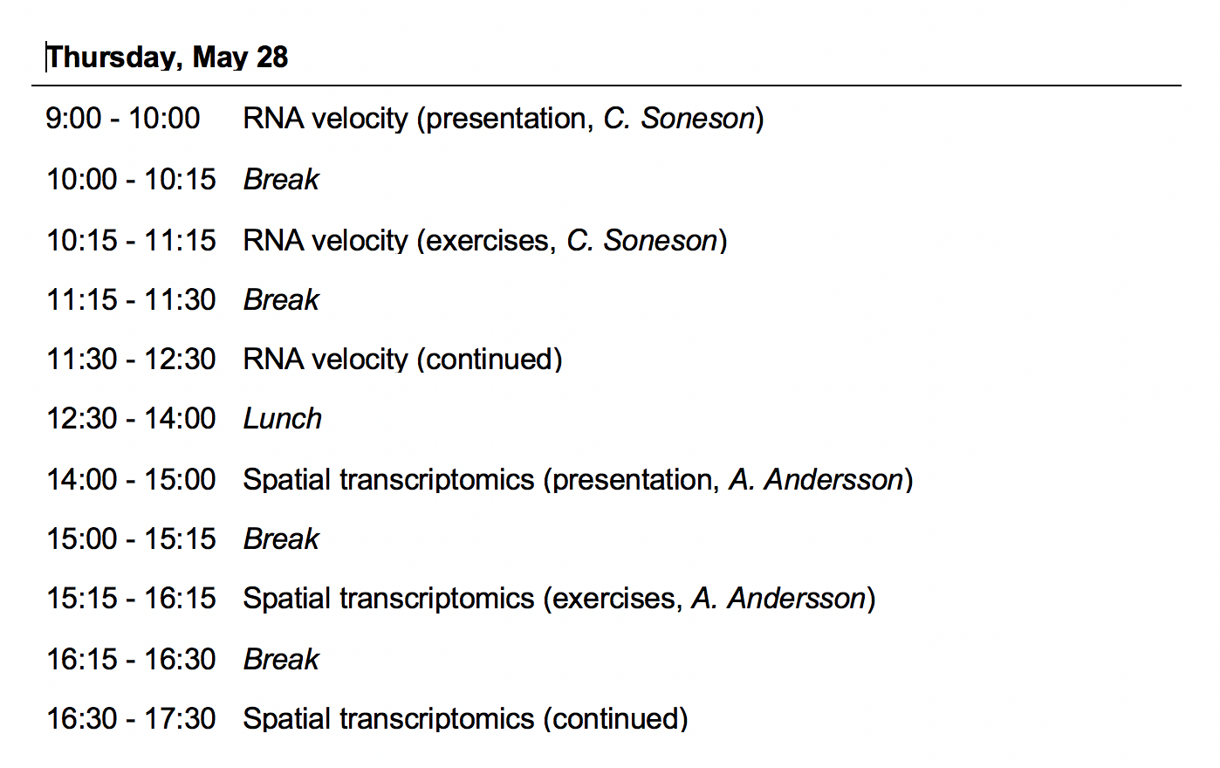
Course Overview (Program)

Slide 4
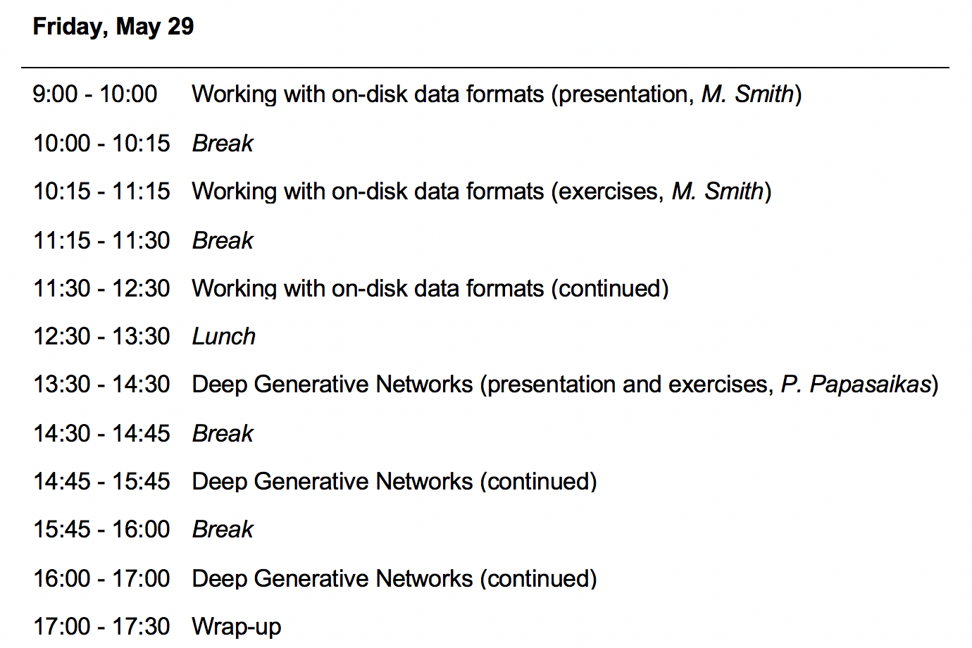
Course Overview (Program)

Slide 5
Expected Prerequisites
R/python scripting (link1, link2)
git
Single cell analysis workflow (link1, link2)

Slide 6
Useful Links
SIB course page:
https://www.sib.swiss/training/course/2020-05-adv-scrna (announcement)
https://edu.sib.swiss/course/view.php?id=458 (moodle, participants only)
Course GitHub repository (slides, handouts):
https://github.com/fmicompbio/adv_scrnaseq_2020
Renkulab project (compute environment):
https://renkulab.io/projects/stadler.michael/adv_scrnaseq_2020
R/Python:
https://rstudio.github.io/reticulate/
https://rpy2.github.io/
Single cell RNA-seq analysis:
https://osca.bioconductor.org/

