Slide 1
PSCSTA Mini Hackathon
Lauren Bricker

Slide 2
Schedule
Introduction
“Presentation” (10 minutes)
Low fidelity prototyping and App Inventor
Determine teams (5 minutes)
One App Inventor “expert” per team
Low fidelity prototyping exercise
Develop prototype (10 minutes)
Test with another team (10 minutes)
Coding (80 minutes)
Sharing apps and Debrief (15 minutes)

Slide 3
What is a Hackathon?
Weekend long “innovation efforts”
Competition exists, but “Really about making something cool to you”
Usually 24-36 hours
Registration
Opening introduction and presentation
Coding
Spaces with “learning seminars”
Rooms with mentors (iOS room, HTML room)

Slide 4
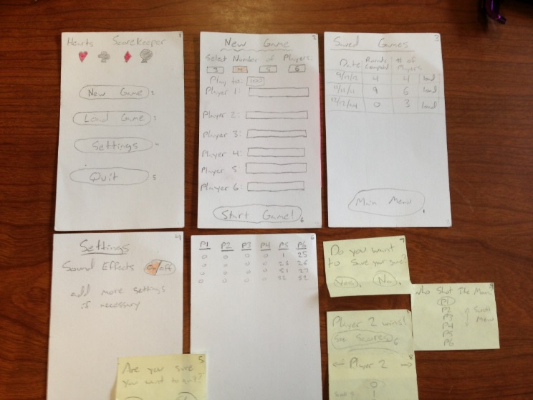
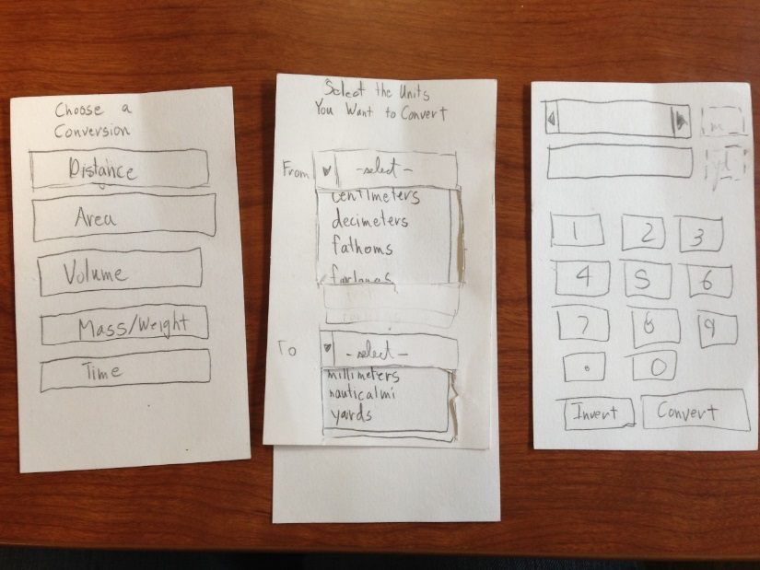
Part 1: Low Fidelity Prototyping
Sketches of your user interface
Quick exploration with minimal investment
Communicates design concepts and structure
Can test and iterate quickly
Facilitates brainstorming
Invites discussion!!!

Slide 5
Materials
Paper: heavy paper for base interface screens
Overlays: show changes in content
Post-it notes: show changes in content
Adhesives: glue sticks, correction tape
Colored markers and pencils: enable highlighting, drawing in color
Scissors: cut content to size
Library: Pre-fabricate menus, buttons, tabbed panes, dialogs, etc.

Slide 6
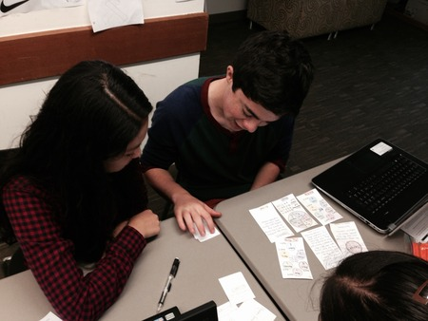
Evaluate
have a user perform a task with prototype
manipulate prototype to make it interactive
identify trouble points and solutions
revise prototype and perform again

Slide 7
App Inventor
Demo….
Good for rapid prototyping
Somewhat limited but …
Design screens, us blocks to program
Storage can be done using TinyDB

Slide 8
No ideas? Here are some
List manager
Musical Instrument or Metronome
Tic Tac Toe game
Clock or timer
Happiness Machine
Magic 8 Ball
Truth or Dare app
???

Slide 9
Local Hackathons
Startup Weekend Sports Nov 14
Startup Weekend EDU Nov 21 http://seattle.startupweekend.org/
Code Day Seattle, Feb 14-15 https://codeday.org/seattle

Slide 10
Information and Resources
http://en.wikipedia.org/wiki/Hackathon
http://en.wikipedia.org/wiki/Paper_prototyping
http://www.labnol.org/internet/design/create-mockup-designs-quickly-with-yahoo-stencils/3483/
https://moqups.com/#!/
A course taught by James Landay, Stanford
http://appinventor.mit.edu/explore/

