Slide 1
Bri’s Battery Documentation
7/6/2026-8/13/2026

Slide 2
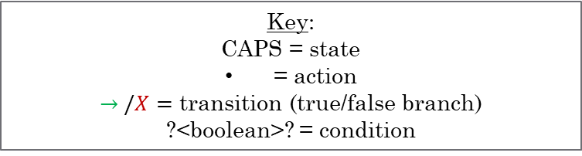
State Machine Prototype (C++)
Key:
CAPS = state
= action
$→ /X=$ transition (true/false branch)
?<boolean>? = condition
START
grid offset demand
NETWORK_ERROR
MQTT_ERROR
X
X
PARSE_ERROR
RETRY_NETWORK (x3)
RETRY_MQTT (x5)
X
X
X
PARSE_MESSAGE
decode payload
determine message type
organize metadata
validate
?message_processed?
CHECK_NETWORK
check wifi
?network_ready?
MQTT_INIT
create clients
subscribe to topics
?mqtt_initialized?
EVAL_CONTROL_PATH
based on message type and metadata route each dataset to paired logic
?control_mode_chosen?
CHECK_BROKER
check availability of host port
?broker_available?
(no packet)
DATA_WAIT
subscribe for callback waiting
idle
?packet_recieved?
(packet)
EVAL_CURRENT_STATE
check current stats
compare current readings to boundaries/goal
?current_state_chosen?
APPLY_CONTROL_PATH
set commanded action
validate response
X
X
RETRY_BROKER (x5)
RETRY_SUBSCRIBE (x3)
X
X
CHARGE,OUTPUT,IDLE,OFF
set commanded action
validate response
?command_enabled?
BROKER_ERROR
SUBCRIBE_ERROR
RESPONSE_ERROR
mark unhealthy unit
Connect all components across the network of the IoT through MQTT over WiFi (hotspot)
Pi receives data from ESPs and correlates identifiers to classes/structs
Battery is commanded based on the current grid demand

Slide 3
Class vs Struct Data
AC/DC Output Commands
Plug/Relay On/Off Commands
Telemetry Reads
Log Data
Publish MQTT
Connect
Disconnect
Poll Scheduling/Timing
Checks
Detect/Categorize Faults
Retry Failed Connection
User Human Readable Alerts
Save/load Configuration
Total Battery Percentage (SoC)
AC/DC Output On
AC/DC Input Power
AC/DC Output Power
Power Generation
Plug Voltage (V)
Plug Current (A)
Plug Power (W)
Plug Energy (kWh)
Plug Frequency (Hz)
MQTT Status
Uptime
Firmware Version
Wifi-RSSI
IP Address
Serial
Dsp Version
Arm Version
Error Flags
Alarm Flags
ESP32 Uptime
ESP32 Temperature
Notes:
encapsulation

Slide 4
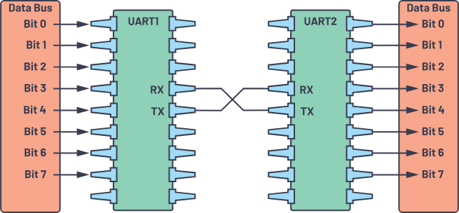
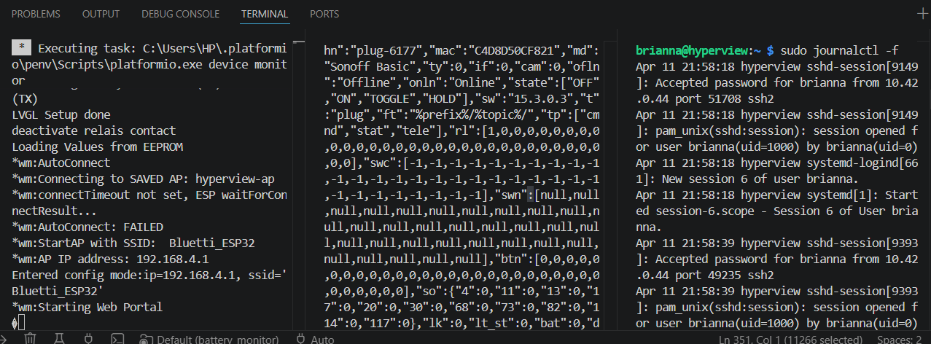
Troubleshooting the ESP to Pi MQTT Bridge Using UART
Command | Result
Serial.begin(<baud>); void loop(){ Serial.println(“<string>”);} | Establishes shared connection transmission speed and tells the UART peripheral to transmit data bytes

Slide 5
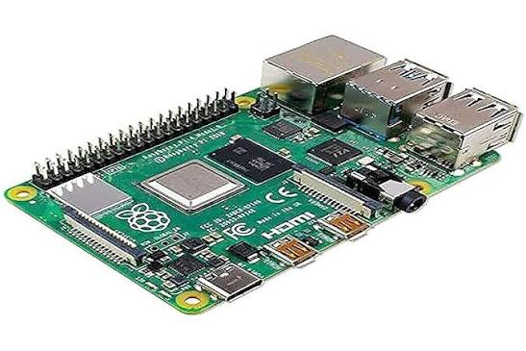
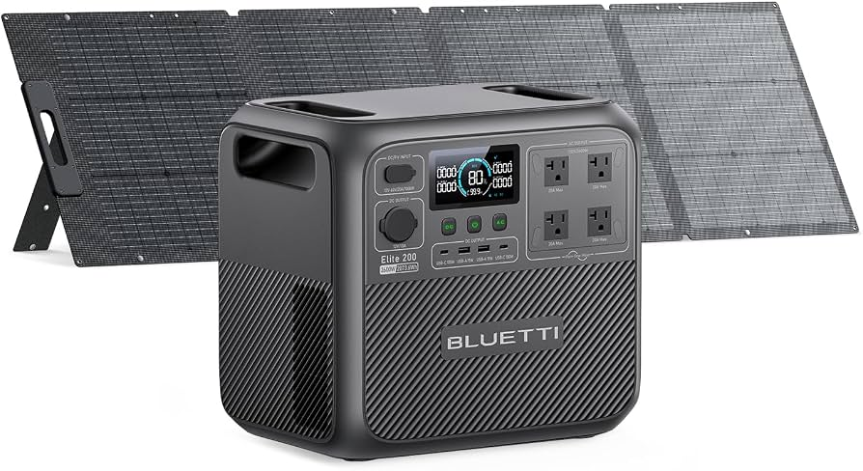
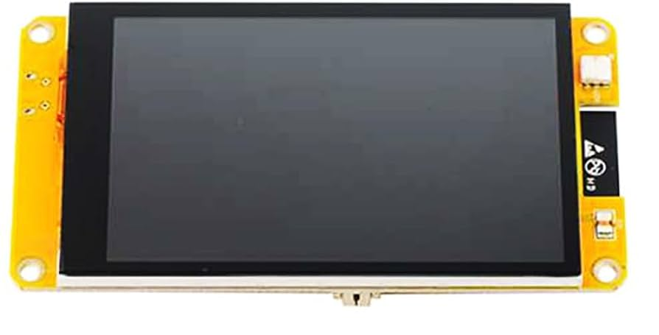

System Inter-Language Coms Prototype:
C++ Controller:
config: Constants and parameterized inputs
devices: Topic identification, variable initialization
mqtt_client: Establish MQTT Client and functions
controller: State machine, networking, battery health logic and faults
debug: All prints for easy removal
main: initialize the controller once at startup, then move into the main controller run loop
JSON
BLE Network
MQTT Network
Python BLE Service:
Pi Broker:
MQTT Network
Fleet Organization (topics)
Command Publish/Subscribe
Data Publish/Subscribe
Encrypted BLE Packets
JSON
JSON
Go Dashboard:

Slide 6
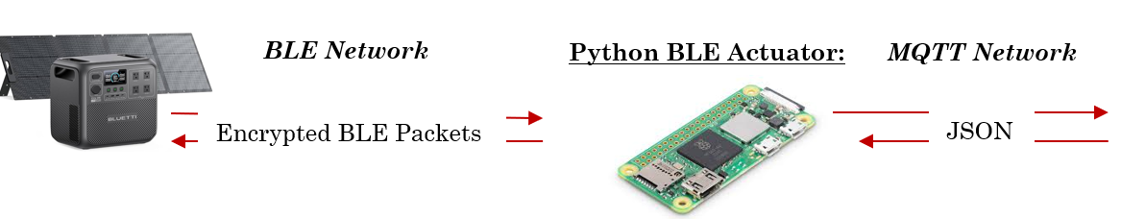
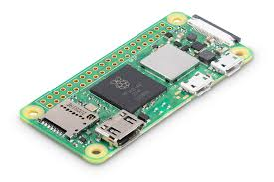
System Prototype:
Battery Fleet
Local Broker
Remote Management
C++ Controller:
Tracks data from battery fleet and evaluates health/faults
Takes input grid demand, determines schedule
Sends command packet back to actuator
MQTT Network
JSON
BLE Network
MQTT Network
Python BLE Actuator:
Pi Broker:
Fleet organization (topics)
Command publish/subscribe
Data and telemetry publish/subscribe
Encrypted BLE Packets
JSON
MQTT Network
JSON
Go Dashboard:
Displays data
Tracks trends across time

Slide 7
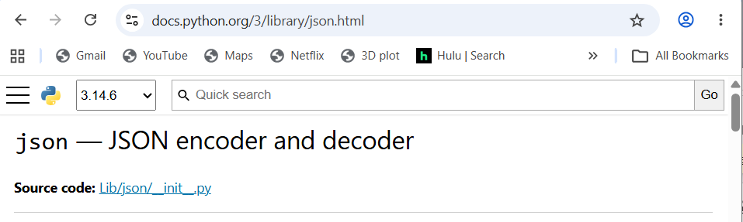
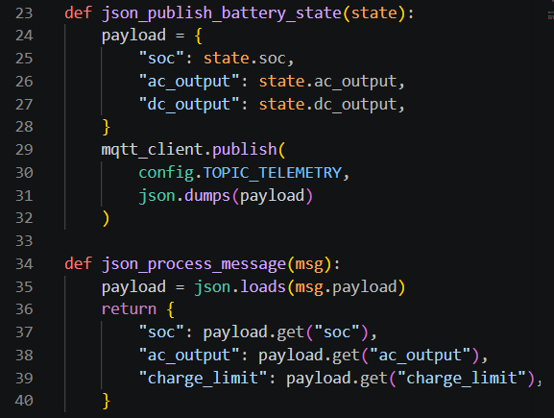
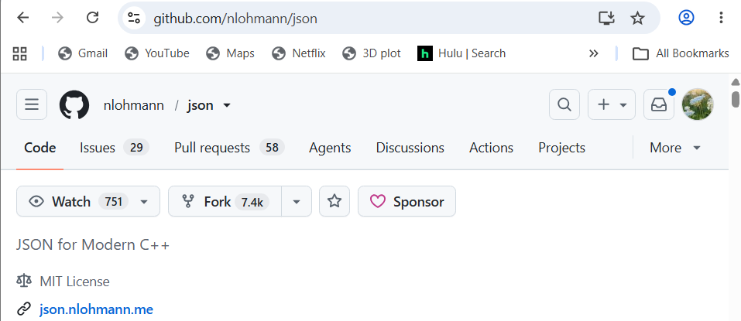
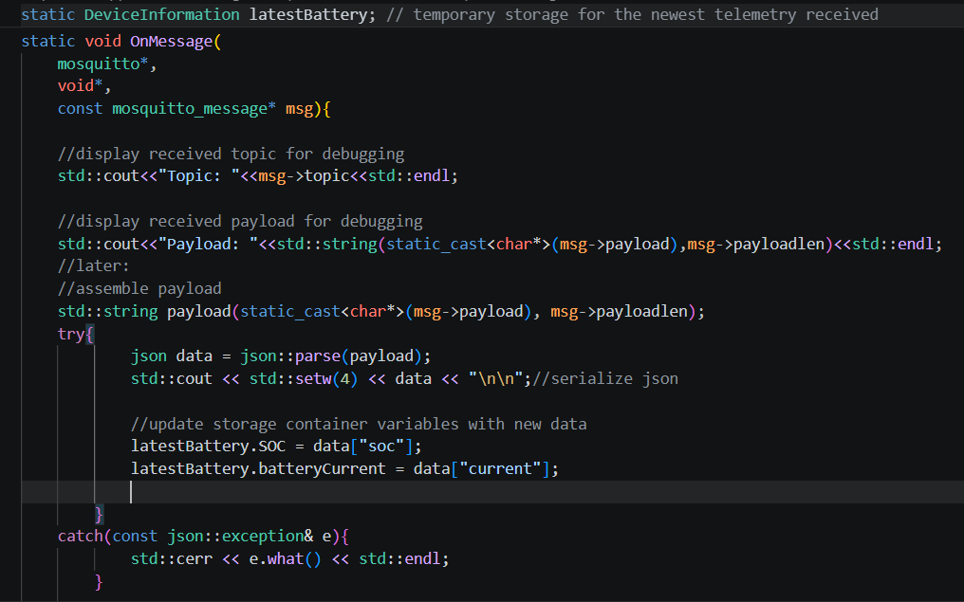
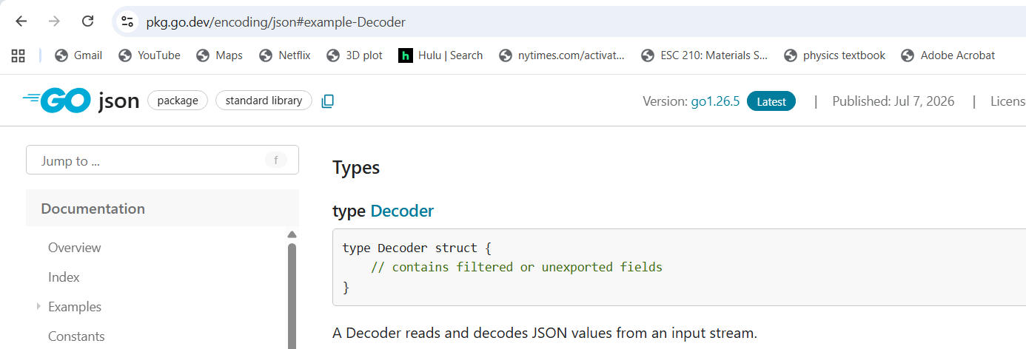
JSON Parsing (Python, C++, and Go)

Slide 8
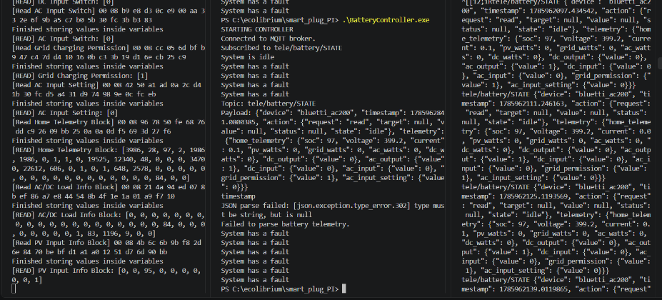
Successful Automated Package Delivery From Python to C++ Through JSON!

