Slide 1
Django - Video Conferencing Web App
DPR - Detailed Project Report

Slide 2
Objective:
The main purpose of video conferencing is to enable face-to-face communication between two or more people in different locations.
It is a popular alternative to phone conferencing for businesses and provides individual users with an inexpensive means of communication with distant friends and family.

Slide 3
Benefits:
Sharing of presentations .
It allows immediate, full two way communication of content; verbal, pictorial objects etc.
Greater access to experts/specialists (nationally and internationally).
More productive use of time (eliminates wasted travel time) and significant travel cost savings.
Reduced environmental impact through less travel and reduced pressure, stress and fatigue from travel.
Facilitating short notice meetings between individuals in distant locations thus decisions can be
made more quickly.
Increased meeting attendance by participants who would otherwise be unable to join in.
Greater accessibility and allows geographical reach even to rural or remote locations.

Slide 4
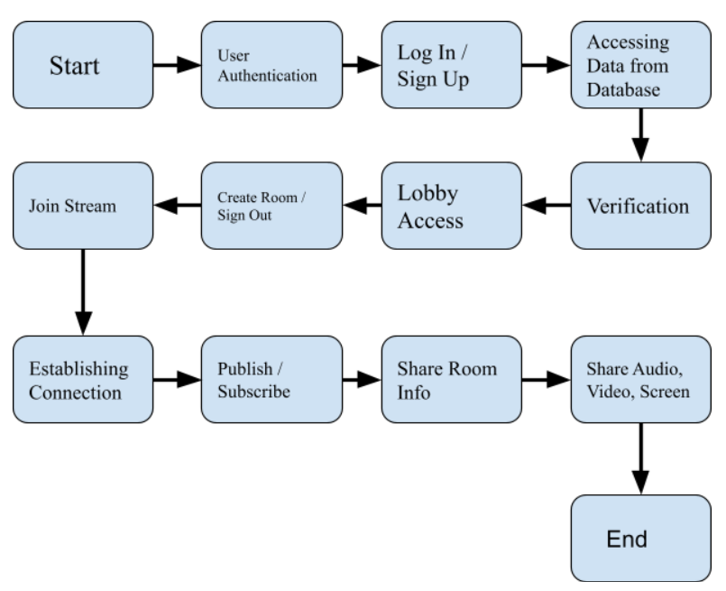
Architecture

Slide 5
Video Conferencing
Videoconferencing is a method of communicating between two or more locations in which sound, vision
and data signals are conveyed electronically to enable simultaneous interactive communication.
Much more personal and effective than audio conferencing, all parties involved can see the facial expressions
and body language that are so vital to the way we communicate.
Video conferencing works by using a few different technologies. Some of these technologies are hardware while
others are software related.
A Video conference can be between two sites, i.e. locations which are connected to each other via the video conference, or the conference can connect multiple locations.
The communication can take place in a special video conferencing studio, or on a normal home computer
equipped with a webcam or even a video call on a modern 3rd generation mobile phone
falls into this scope.

Slide 6
Application of Video Conferencing
Teaching: VC allows easy access to remote expertise. When the number of expertise is small, one lecturer can teach various virtual classes at a go thus, travelling to various campuses is significantly reduced.
Meetings: Using VC leads to cost savings on travel, accommodation and staff time. Several sites can be linked together. Having a set time and duration for a meeting encourages punctuality and focused discussion.
Data sharing: Images from a personal computer (PC), such as spreadsheets, PowerPoint illustrations etc.can be shared to enhance a presentation.
Interviews: Cost savings can allow more candidates to be interviewed from remote locations. With data sharing, CVs can be viewed and discussed online.
Telemedicine: In rural areas, specialist medical help may not be available on hand. By linking to a regional centre, cottage hospitals and clinics can receive help in diagnosing patients' disorders.
Legal work: VC helps reduce intimidation of vulnerable court witnesses. Particularly sensitive cases e.g.
children or rape cases can be made more acceptable by separating the victims physically from the court.

Slide 7
Components of Video Conference
Videoconferencing has three essential components:
The Hardware.
The intervening network that carries the signals between sites.
The conference environment or room.

Slide 8
Conclusion
Video conferencing could lead the way for a dual approach, giving students more responsibility for their
learning, working in groups, and doing educational tasks; all of which would benefit conventional
teaching, but video conferencing provides an opportunity to implement them. It does not replace the use
of print or other methods used in the conceptualization process. It can be used to encourage construction
and it's true use lies in encouraging dialogue and increasing the scope for dialogue.
With the advancement and ease of availability of high speed and cheap internet connections, it is expected that video
conferencing will increasingly become popular thus, leading to more interest and use of distance learning.
In this paper, an introduction to video conferencing and its application in distance learning was presented
as an effective way of delivering subject matter in classrooms

Slide 9
Q & A:
How users can join the room?
-Once host publish the room, using that room name users can join.
Which framework is used to build this app?
-Django Framework is used.
How users are managed?
-Using Django Admin we can manage the users.
Is this app secured ?
-Yes, Django provides Cross site scripting (XSS) protection, Cross site request forgery (CSRF) protection, SQL injection protection, Clickjacking protection, SSL/HTTPS, Host header validation etc.,

