Slide 1
JIDA
Janeesh Kaur Bansal, Isabel Rachel Thompson, Diego Alejandro Pava Mejia and Aravind Venkata Pattisapu

Slide 2
What is JIDA?
Web application that retrieves SNP information
Search by RS id, gene name, gene alias or genomic position
Returns summary statistics for populations in CSV or graphical format

Slide 3
Demonstration

Slide 4
Limitations
Deployment
More gene alias
Faster user outputs
Pagination

Slide 5
Expanding JIDA
More output information
More chromosomes
Indels
Database manager

Slide 6
So how did we make it...

Slide 7
Software architecture
1000 genomes project
Ensembl
Entrez
VCF
Gene name
Gene alias
Backend
CSV
Website
SQL
Pandas dataframe
Statistical calculations
Frontend
User input
Website
Website
User output

Slide 8
Software architecture
1000 genomes project
Ensembl
Entrez
VCF
Gene name
Gene alias
Backend
CSV
Website
SQL
Pandas dataframe
Statistical calculations
Frontend
User input
Website
Website
User output

Slide 9
Data sources
VCF
Gene name
Gene alias
1000 genomes project
NCBI ftp – data needs
BCFtools
SNVs only
Populations and samples
Pyensembl
Well-developed database
Easy integration
Rapid querying
CSV
Entrez
20+ databases integrated
Biostars
Refining and altering
CSV
Notes:
Diego: how we chose our input VCF. Talk about chromosome size and presence of samples, rs ids and phased genotypes. Also, talk about how you downloaded it and subset it to population VCFs

Slide 10
Data sources
VCF
Gene name
Gene alias
1000 genomes project
NCBI ftp – data needs
BCFtools
SNVs only
Populations and samples
Pyensembl
Well-developed database
Easy integration
Rapid querying
CSV
Biostars
Entrez
20+ databases integrated
Refining and altering
CSV
Notes:
Janeesh: talk about the python scripts you wrote to get the gene names and gene aliases
Pyensembl
Well developed and annotated database
Contains info for several species
Integration of ensemble and python easy
Fast querying
Function was utilised to get the gene names for the CSVs
Gene alias
The entrez database integrates over 20 databases
Extract many gene names across databases
Code used from biostars
Code looked into the records and extracted information such as symbol, aliases, other names, chromosome, annotations (NC)
Altered code slightly to get the gene alias list and remove any charcters
Developed a CSV so each gene name had the alias in each row

Slide 11
Software architecture
1000 genomes project
Ensembl
Entrez
VCF
Gene name
Gene alias
Backend
CSV
Website
SQL
Pandas dataframe
Statistical calculations
Frontend
User input
Website
Website
User output

Slide 12
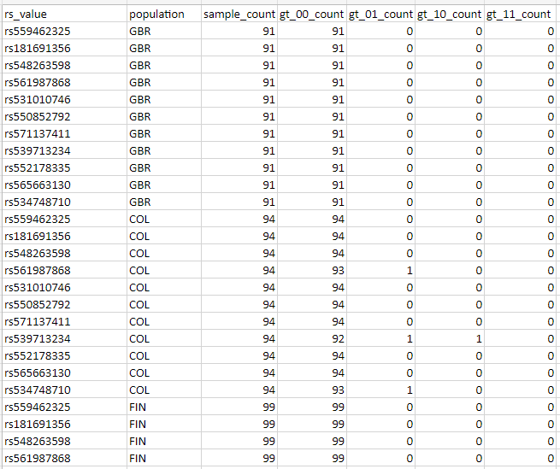
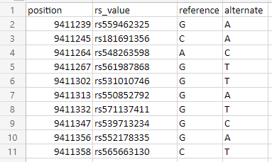
VCF to CSV
SNP table
SNP characteristics table
Notes:
Isabel: talk about the script to convert VCFs to pandas df, and then the scripts to convert VCFs and gene name information to CSVs. REMEMBER JANEESH WROTE THE SCRIPT TO GET GENE NAME FROM ENSEMBL BASED ON GENOMIC POSITION
Open vcf into pandas df using my function. Iterate over each row and pull out and calculate information. For SNP table, only needed to iterate over one population VCFs as all the population VCFs shared the same variants. For SNP characteristic table, needed to iterate over all population VCFs, create an output CSV for each, then merge those CSVs together to form a final output.

Slide 13
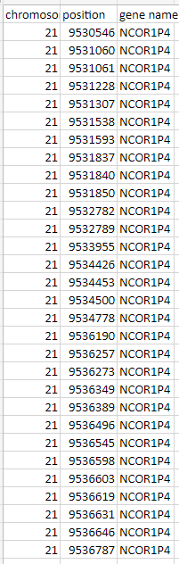
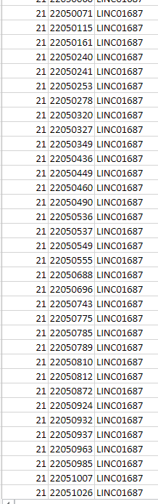
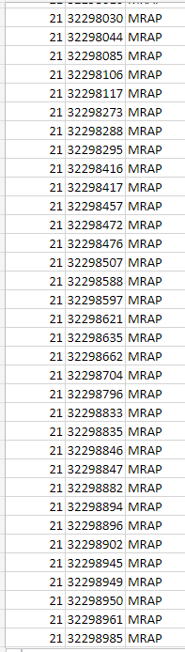
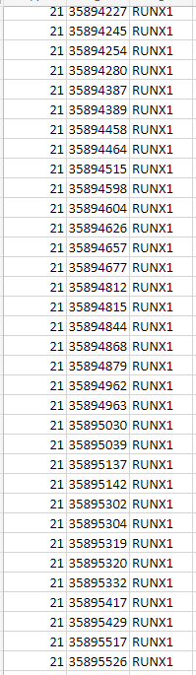
VCF to CSV
gene name table- lots of SNPs per gene
Notes:
Isabel: talk about the script to convert VCFs to pandas df, and then the scripts to convert VCFs and gene name information to CSVs. REMEMBER JANEESH WROTE THE SCRIPT TO GET GENE NAME FROM ENSEMBL BASED ON GENOMIC POSITION
Again I used my function to open and iterate over every row of a single population VCF, but this time I used Janeesh's function to extract the gene name associated with the genomic position of each variant. If no gene name was associated with a genomic position, it was excluded from the table.

Slide 14
Software architecture
1000 genomes project
Ensembl
Entrez
VCF
Gene name
Gene alias
Backend
CSV
Website
SQL
Pandas dataframe
Statistical calculations
Frontend
User input
Website
Website
User output
Notes:
Janeesh: talk about how you converted the gene alias info to a csv
- for each gene name the alias was placed adjacent in the csv file
- and if there were no aliases they were written as nan

Slide 15
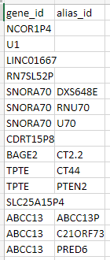
Gene Alias CSV
Gene name | Alias
1 | 1.1
1 | 1.2
2 | 2.1
2 | 2.2
2 | 2.3
... | ...
Notes:
- used alias function
- used csv containing gene names and then

Slide 16
Software architecture
1000 genomes project
Ensembl
Entrez
VCF
Gene name
Gene alias
Backend
CSV
Website
SQL
Pandas dataframe
Statistical calculations
Frontend
User input
Website
Website
User output
Notes:
Diego: How did you take our CSVs and put them into SQL? Here's the SQL schema. He is beauty, he is grace.
So the database is now ready and waiting. What about the users and their interaction with the website?

Slide 17
CSV to schema
Python script
CSV
A python script was used for:
Database creation
Database population
Indexing
Database querying
SQL
Pandas dataframe
Tables
Query
Indexes
Notes:
Diego: How did you take our CSVs and put them into SQL? Here's the SQL schema. He is beauty, he is grace.

Slide 18
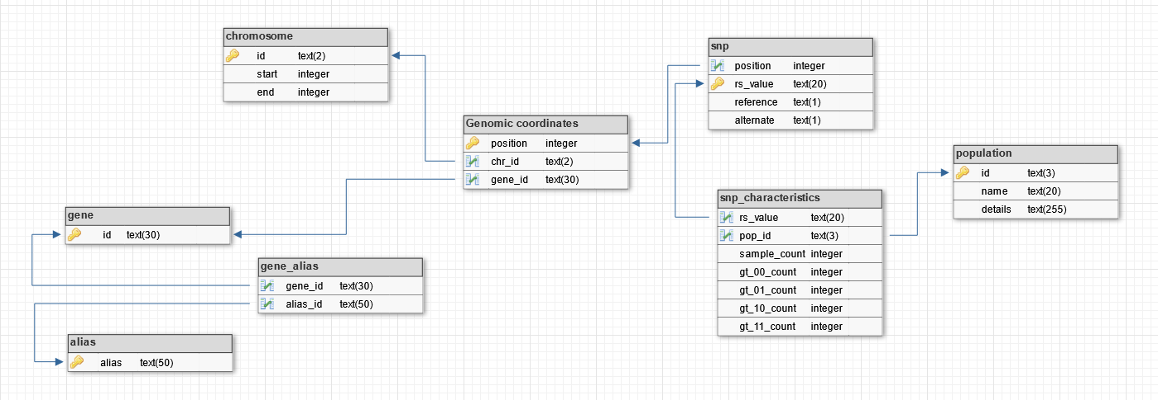
Schema
SNPs and population
Gene and alias
Notes:
Diego: How did you take our CSVs and put them into SQL? Here's the SQL schema. He is beauty, he is grace.

Slide 19

SQLite3 and Database
Local and transferable database between developers.
Suitable for low/medium traffic applications
Developer-friendly and easily linked with Flask
Queries in SQL syntax
Notes:
https://commons.wikimedia.org/wiki/File:Sqlite-square-icon.svg

Slide 20
SciKit allel
Python!
Genotype and haplotype array
Published articles
Notes:
Statistics by SciKit allel
- integrated in python
- required genotype and haplotype arrays which can be easily produced from the VCF
- statistical functions utilised where carried out in published articles so reassurance they are reliable

Slide 21
Statistical analysis
Nucleotide diversity
Haplotype diversity
Genetic diversity
Probability that two nucleotides are different
Probability that two alleles are different
Regions of interest
Notes:
Nucleotide diversity
- measure of genetic diversity
- probability that two nucleotide are different when comparing two randomly selected DNA sequences
- smaller values (similar) and larger values (different)
Haplotype diversity
- probability that two randomly sampled alleles are different
- smaller values (similar) and larger values (different)

Slide 22
Statistical analysis
Tajima's D
FST
Neutrality test
Observed – expected variation
Selective sweep (-) / Population contraction (+)
Population differentiation
Hudson FST
Relations between populations
Notes:
Tajima's D
- neutrality test – population is evolving randomly or via a non random process
- user can see more/less variation than expected
- negative (population not evolving randomly) and positive (population evolving randomly )
FST
- measure of population differentiation
- used Hudson FST as values are more stable compared to the weir cockerham FST where the FST values diverged for identical populations and identical people
- value close to 1 (no overlaps) and close to 0 (populations similar)
- kept negative values --> shows more variation within the population than between

Slide 23
Primary functions
Secondary functions
Tertiary functions
Derived from primary and scikit allel functions
Derived from primary and secondary functions
SQLtoHapDiv(df)
haplotype_list(dataframe)
haplotype_diversity(haplotypelist)
SQLtoHapDiv_window(dataframe, window_size)
SQLtoNucDiv(df, start, end)
nucleotide_diversity(genotype_list, start, end)
nuc_div_sliding(dataframe, window_size)
SQLtoTD(df)
genotype_list(dataframe)
Tajimas_D(genotype_list, POS)
SQLtoTD_window(dataframe, window_size)
hudson_FST(pop1_genotype_list, pop2_genotype_list)
SQLtoFST(df_pop1, df_pop2)
SQLtoFST_window(df_pop1, df_pop2, window_size)
Notes:
Isabel: show the statistics output tables and briefly talk through the stats and how they were made, and how they relate to each other. Mention window size in bases and why

Slide 24
Software architecture
1000 genomes project
Ensembl
Entrez
VCF
Gene name
Gene alias
Backend
CSV
Website
SQL
Pandas dataframe
Statistical calculations
Frontend
User input
Website
Website
User output
Notes:
So the database is now ready and waiting. What about the users and their interaction with the website?

Slide 25
HTML
BACKEND
HTML
RS ID
WTFORM, VALIDATORS, ERRORS
GENE NAME
STRING
CHROMOSOME
SQL QUERY
SELECT
DF
POSITIONS
INTEGER
BOOLEAN
SNP INFORMATION
WINDOW
SUBMIT
CHECKBOXES
EMPTY COLUMS + GF, AF
DROPPING COLUMS
SUBMIT BUTTON

Slide 26


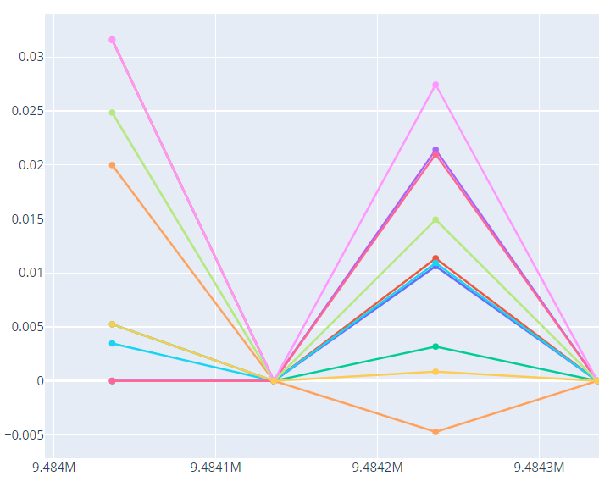
HTML
BACKEND
HTML
POPULATION SELECTION
TABLE
FOR LOOP
APPEND IF REQUESTED
SORT POPULATION
STATISTICS SELECTION
INPUT Genomic coordinates Gene name
APPEND IF REQUESTED
DYNAMIC TABLES
WINDOW SIZE
GLOBAL
SHOW AS GRAPH
STATISTICS FUNCTIONS
BOOLEANS
GLOBAL
FINAL STAT DICTIONARY
APP ROUTE FOR GRAPHS

Slide 27
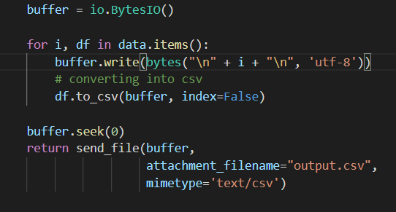
Download button
Converting the statistics calculations into a data frame
Into binary data using BytesIO
Writing data into CSV
Returning a CSV file
Notes:
Aravind: demo the download button and talk about how u made it

Slide 28
Thank you for listening!

Slide 29
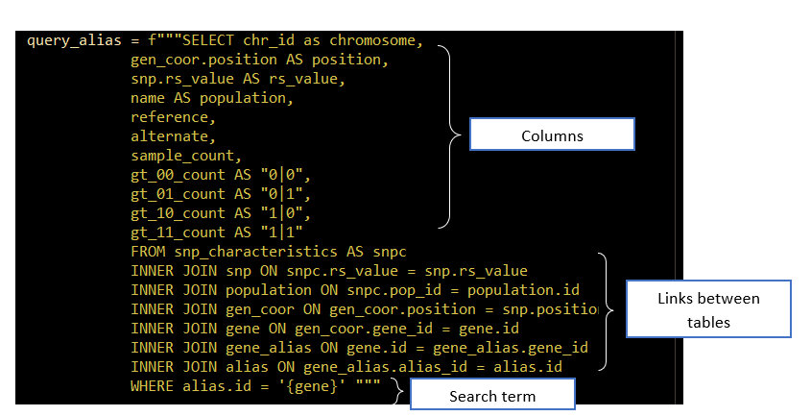





After clicking submit...
Querying:
4 queries stored in a dictionary
Filtering
User input

Slide 30
Demo time!!!
Show home page - aravind
Glossary - aravind
Contact information + hyperlinks- aravind
Search by RS id - diego
Search by gene name - diego
Search by gene alias – diego – gimme an alias
Search by genomic positions – diego -
Output: overall table - isabel
Output: statistics table - isabel
Output: download function - aravind
Output: non windowed graphs - janeesh
Output: windowed graphs - janeesh
Errors: - isabel what if positions are not searchable? What if the gene name does not exist? What if a user tries to search by both gene name and rs id? What if the user deselects all populations? What if the user puts the start and end genomic coordinates the wrong way round? What if the user tries to put a gene name in the rs value field?

