Slide 1
Prototype of “priceasy”

Slide 2
DATASET FEATURES FOR VARIOUS ITEMS :
Product Brand
Manufacturing year ( for second hand items)
Physical condition (scratches , torning etc)
Material of the product
Since how much time item is being used

Slide 3




BASIC WORKFLOW :
Data Model
Data Pre-processing
Train Test Split
Linear & Lasso Regression Model

Slide 4

FINAL
PRICE
New Data
Trained Linear & Lasso Regression Model
Prediction

Slide 5
Roadmap of implementation :
Getting ready made Data model containing standard key features and price in iterative phase
Coding part with Jupyter’s notebook with Python language
Getting basic working idea and familiarity with libraries such as Pandas , Matplotlib , Seaborn
Importing Linear Regression model
Importing Lasso regression model from sklearn
Importing metrics module
Data collection and processing
Loading .csv file to panda data frame
Inspecting data row wise simultaneously

Slide 6
Forming predictive logic by quantity of different dependant attributes
Also we have to keep record of missing attribute values
Checking the distribution of categorical data
Encoding this categorical data in numerical values , so that Machine Learning model can understand it.. For example, let processors type for laptop is mainly INTEL or RYZON so it can be encoding like “0” for INTEL , “1” for RYZON .Further for it can be encoded like 101 stands for INTEL i3 , 110 stands for INTEL i5 , 111 stands for INTEL i7 and similar in this kind of other things according to frequency digits can be decided .In this way data will be converted in suitable numbers.
Splitting the Data into Training data and Test Data
Size and variability in the dataset effects on the accuracy. The larger the data set , the more it will be precise.
Model training via Linear regression model .Simply using Y = mX + C

Slide 7
Prediction on Training data
Then evaluating R square error defined as difference between the predicted value and original value. It depends on each on the magnitude of the value that we are using.
Visualization of the actual prices and predicted prices by plotting their values on graph.
Then the same way prediction on Testing data as well as R squared value and visualization.
Then all these will be done with Lasso Regression
By following this steps this project can be implemented at very initial level and then it can be expanded.

Slide 8
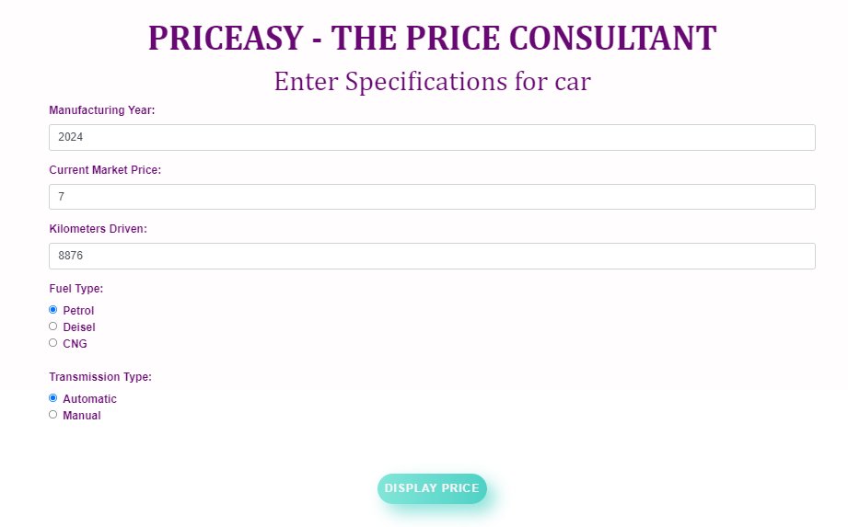
DEMO INTERFACE :

Slide 9
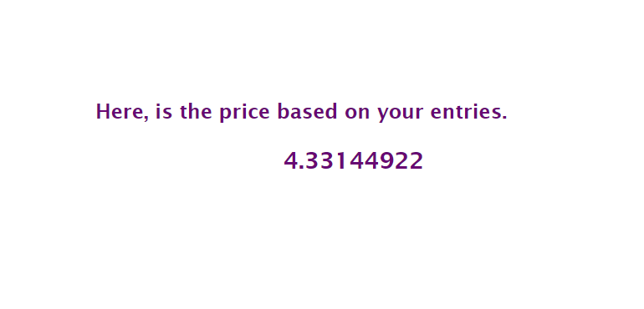

Slide 10
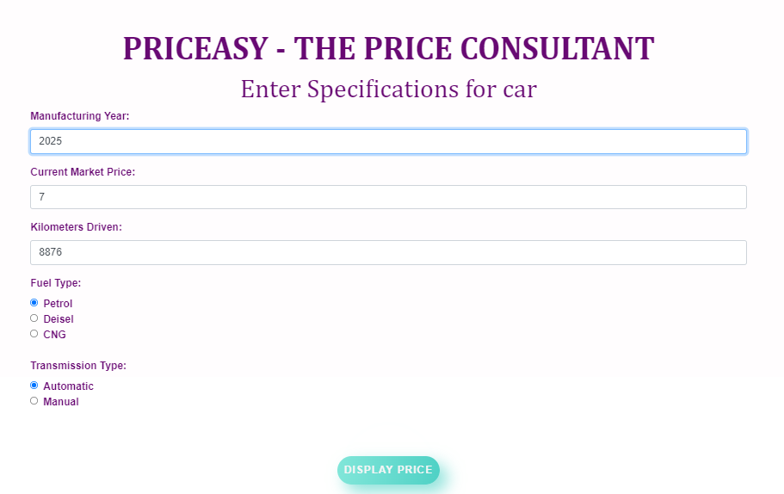

Validation in year :

Slide 11
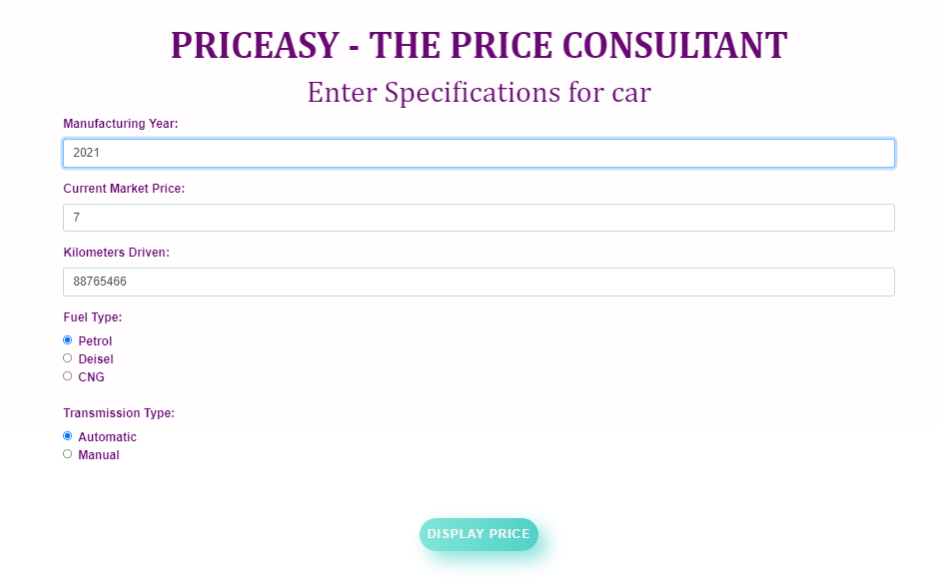

Validation in KMS DRIVEN :

