Slide 1
Simple Web App/MongoDB on Kubernetes
Demo

Slide 2
Prerequisites
Install Docker Desktop
Python 3.7 installed
Git installed
You can also download Kubernetes by following https://kubernetes.io/docs/setup/
Install minikube for windows

Slide 3
View the Dashboard
Before viewing the Dashboard, type on command prompt
>> minikube tunnel
>> minikube dashboard

Slide 4
Create RBAC token

Slide 5
Create RBAC Authentication Token
Create a folder Kubernetes-samples
Copy my code by git clone https://github.com/vnarayanan12/kubernetes.git
Cd Kubernetes
Run the following at command prompt
>> kubectl apply –f adminuser.yaml
>> kubectl apply –f cluster.yaml
Then create a token by running
>> kubectl -n kubernetes-dashboard get secret $(kubectl -n kubernetes-dashboard get sa/admin-user -o jsonpath="{.secrets[0].name}") -o go-template="{{.data.token | base64decode}}“
Copy and store the token in token.txt

Slide 6
Copy the token and Sign into Dashboard
You will see this http://localhost:8001/api/v1/namespaces/kubernetes-dashboard/services/https:kubernetes-dashboard:/proxy/#/workloads?namespace=default

Slide 7
UI
Pod
Pod
PostgreSQL
query
API Server
Key value
store- etcd
Volumes
Worker Node
Validates Request
File Folder
Pod
Pod
Kubernetes
Master Node
Controller Monitors a Pod and calls scheduler when Pod dies
Scheduler schedules a Pod
MongoDB
Worker Node

Slide 8
Pod
MongoExpress
My-App
Secret DB
Pod
DB URL
MongoDB
Mongo Express
External Service
MongoDB
Internal Service
My-App service
My- app ingress
Web URL
https://my-app.com
Pod
Ingress Controller
Volumes

Slide 9
Pod
Deployment
My App container
Config Map
Secret DB
Pod StatefulSet
MongoExpress Container
reads
MongoDB
Internal Service
NFS
MongoDB
My-App service
Persistent Volume Claim
My- app ingress
Web URL
https://my-app.com
Pod
Ingress Controller
Persistent Volume
Local storage

Slide 10
Install all clients and service
Git clone vnarayanan12/mongodb-deployment
Make sure Docker desktop is running
Minikube start
Minikube status – check if it is all configured
Minikube update-context if stale
Follow the "mongodb-deployment\k8s-commands.md"

Slide 11
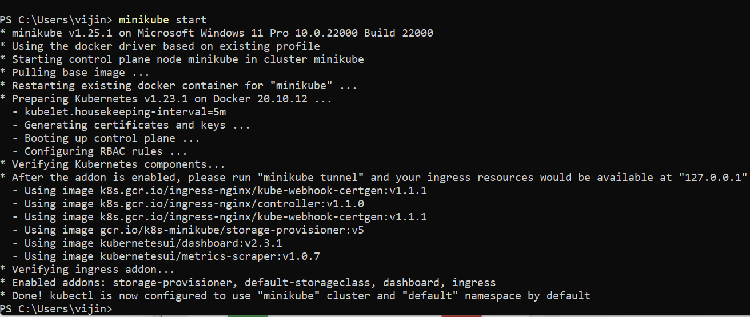
Minikube start screen

Slide 12
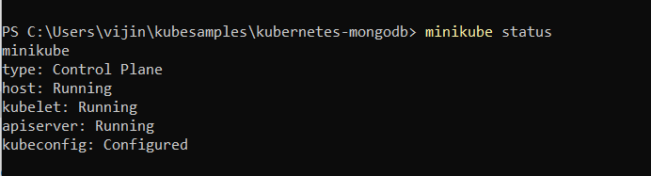
Minikube status

Slide 13
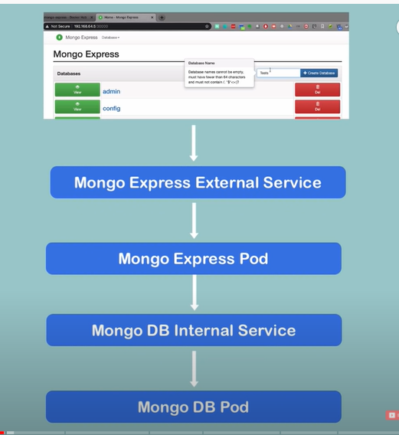
How the mongo db works

Slide 14
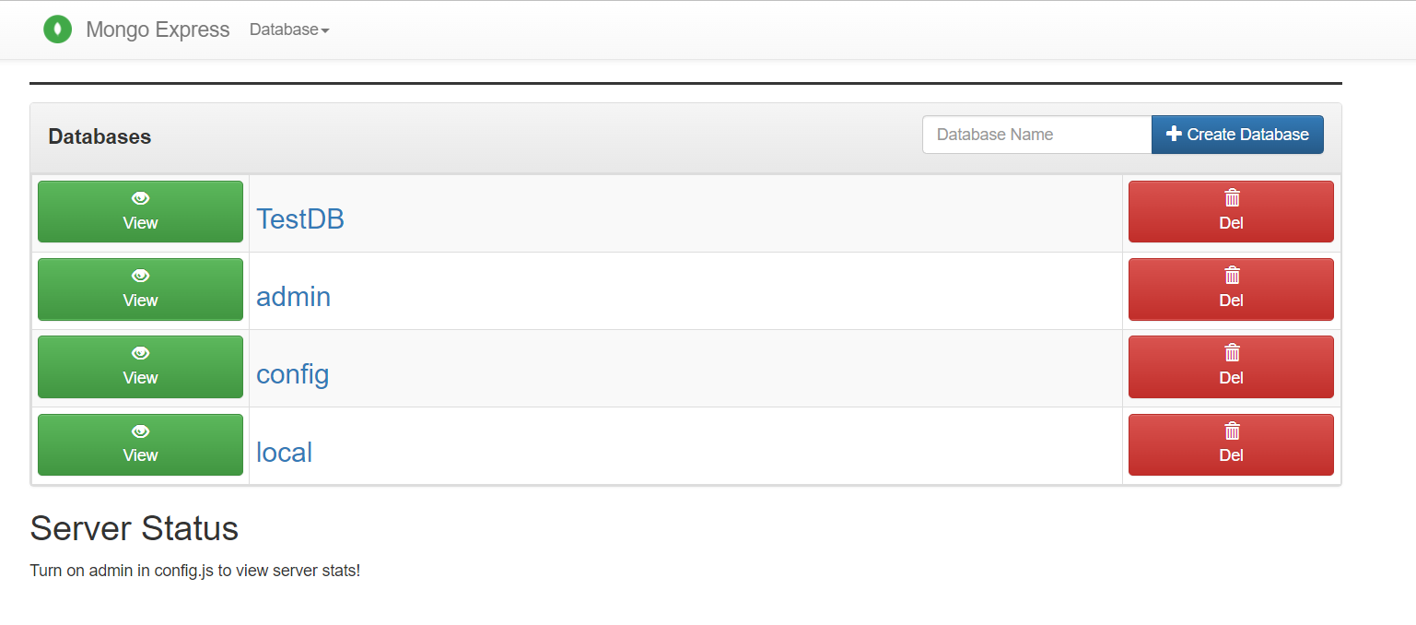
Mongo express service URL

Slide 15
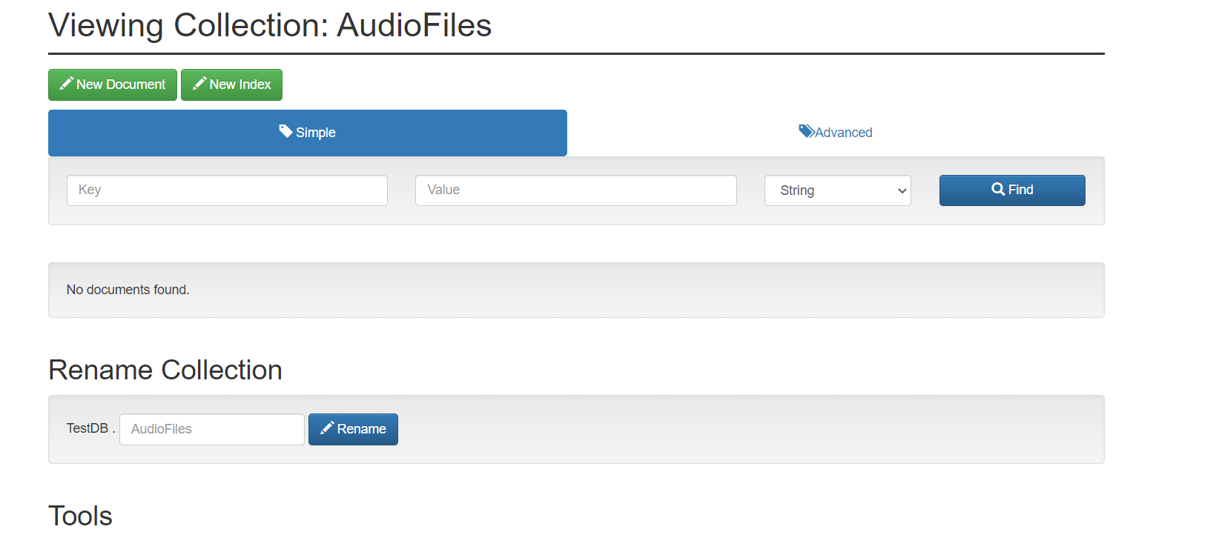
Create a collection and New Document

Slide 16
New Document
Add a new document given in this JSON
"C:\mongodb-deployment\simpleInput.json“
Copy this when you click on new Document and see if it gets added.
Explore Mongodb

