Slide 1
Simple Web App/MongoDB on Kubernetes
Demo

Slide 2
Prerequisites
Install Docker Desktop
Python 3.7 installed
Git installed
You can also download Kubernetes by following https://kubernetes.io/docs/setup/
Install minikube for windows

Slide 3
View the Dashboard
Before viewing the Dashboard, type on command prompt
>> minikube tunnel
>> minikube dashboard

Slide 4
Create RBAC token

Slide 5
Create RBAC Authentication Token
Create a folder Kubernetes-samples
Copy my code by git clone https://github.com/vnarayanan12/kubernetes.git
Cd Kubernetes
Run the following at command prompt
>> kubectl apply –f adminuser.yaml
>> kubectl apply –f cluster.yaml
Then create a token by running
>> kubectl -n kubernetes-dashboard get secret $(kubectl -n kubernetes-dashboard get sa/admin-user -o jsonpath="{.secrets[0].name}") -o go-template="{{.data.token | base64decode}}“
Copy and store the token in token.txt

Slide 6
Copy the token and Sign into Dashboard
You will see this http://localhost:8001/api/v1/namespaces/kubernetes-dashboard/services/https:kubernetes-dashboard:/proxy/#/workloads?namespace=default

Slide 7
UI
Pod
Pod
PostgreSQL
query
API Server
Key value
store- etcd
Volumes
Worker Node
Validates Request
File Folder
Pod
Pod
Kubernetes
Master Node
Controller Monitors a Pod and calls scheduler when Pod dies
Scheduler schedules a Pod
MongoDB
Worker Node

Slide 8
Pod
MongoExpress
My-App
Secret DB
Pod
DB URL
MongoDB
Mongo Express
External Service
MongoDB
Internal Service
My-App service
My- app ingress
Web URL
https://my-app.com
Pod
Ingress Controller
Volumes

Slide 9
Pod
Deployment
My App container
Config Map
Secret DB
Pod StatefulSet
MongoExpress Container
reads
MongoDB
Internal Service
NFS
MongoDB
My-App service
Persistent Volume Claim
My- app ingress
Web URL
https://my-app.com
Pod
Ingress Controller
Persistent Volume
Local storage

Slide 10
Install all clients and service
Git clone vnarayanan12/mongodb-deployment
Make sure Docker desktop is running
Minikube start
Minikube status – check if it is all configured
Minikube update-context if stale
Follow the "mongodb-deployment\k8s-commands.md"

Slide 11
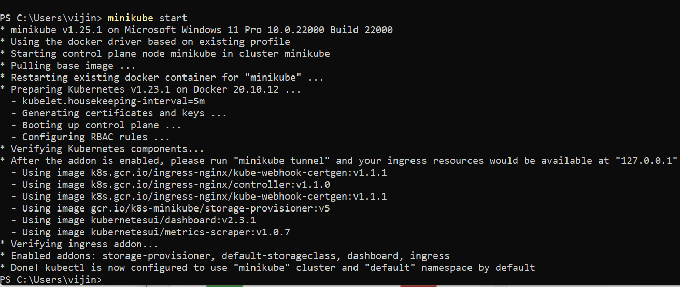
Minikube start screen

Slide 12
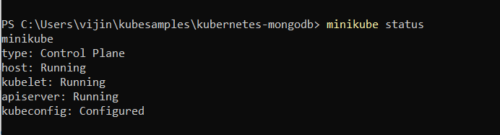
Minikube status

Slide 13
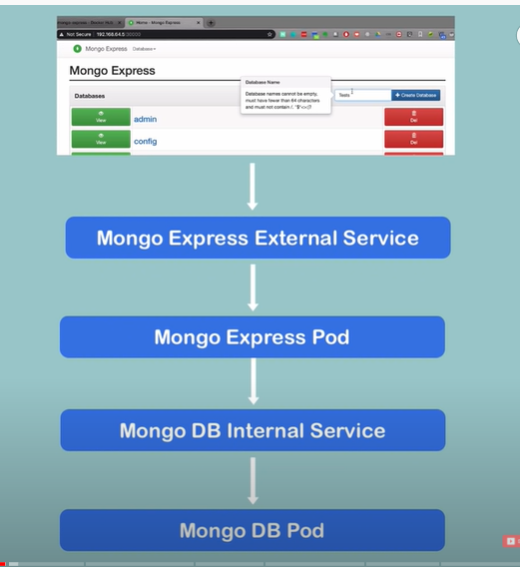
How the mongo db works

Slide 14
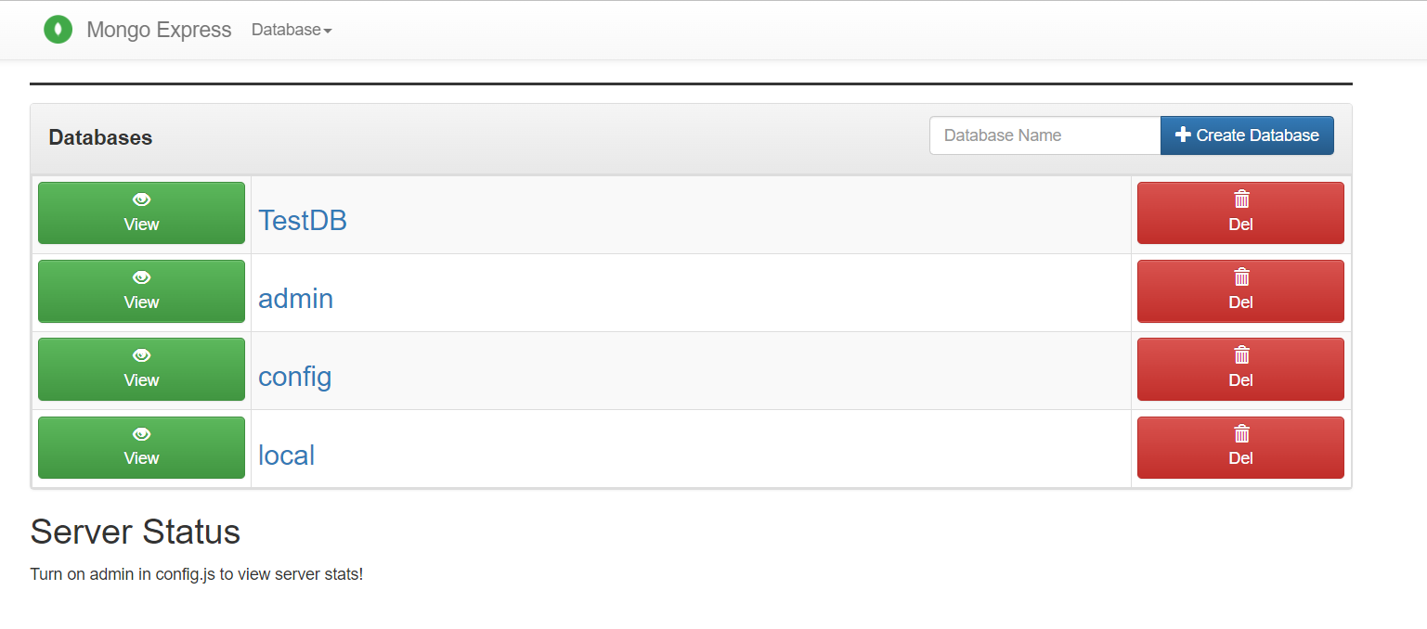
Mongo express service URL

Slide 15
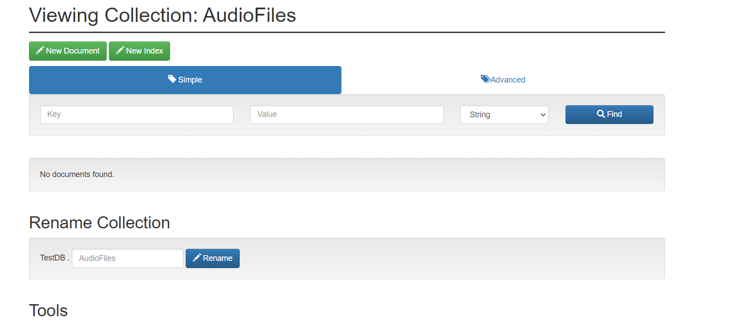
Create a collection and New Document

Slide 16
New Document
Add a new document given in this JSON
"C:\mongodb-deployment\simpleInput.json“
Copy this when you click on new Document and see if it gets added.
Explore Mongodb

Slide 17
Create a Mount
For example, if you are using Minikube, you can open a shell to your Node by entering >> minikube ssh
In your shell create /mnt/data directory
>> sudo mkdir /mnt/data
sudo sh -c "echo 'Hello from Kubernetes storage’ > /mnt/data/index.html"

Slide 18
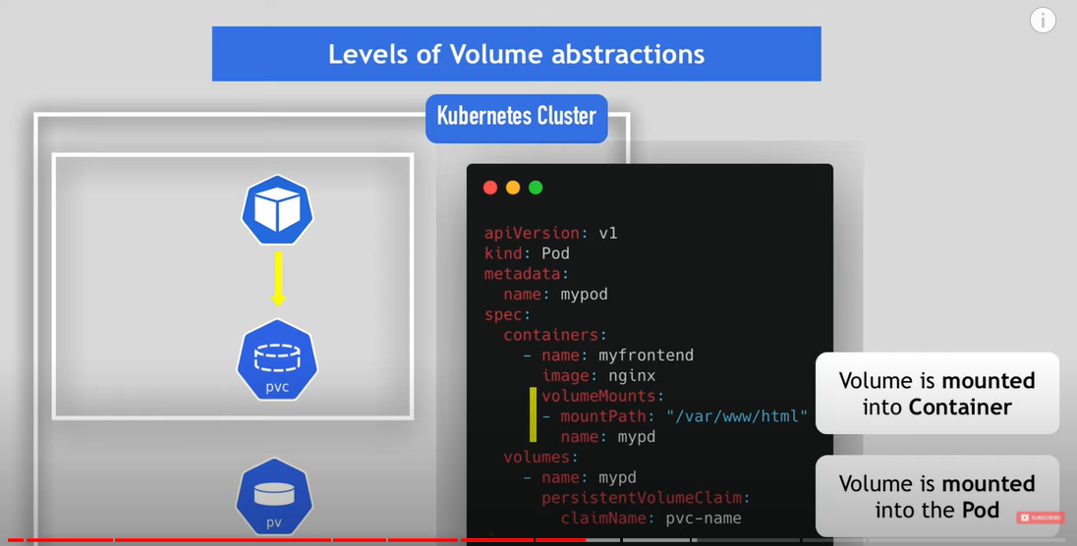
Volumes defined
Reference: https://www.youtube.com/watch?v=0swOh5C3OVM

Slide 19
Storage
Persistent Volume- external plugin to your cluster to indicate where the storage is
It defines the spec for physical storage
Admin manages the storage and backups
Storage can be in local disk, cloud or NFS server
Persistent Volume is available to the whole cluster and not namespaced and defines the storage backend
Then the Pods requests that Volume through their claim in their spec
Persistent Volume claim then goes and finds that volume defined in its spec in the cluster
Claims should be in the same namespace as Pod

Slide 20
Deploy Persistent Volume
Mongo-data-pv is PersistentVolume.yaml
The configuration file specifies that the volume is at /mnt/data on the cluster's Node. The configuration also specifies a size of 1 gibibytes and an access mode of ReadWriteOnce, which means the volume can be mounted as read-write by a single Node. It defines the StorageClass name manual for the PersistentVolume, which will be used to bind PersistentVolumeClaim requests to this PersistentVolume
>> kubectl apply –f mongo-data-pv.yaml
>> kubectl get pv - Validate

Slide 21
Deploy Persistent Volume Claim
Mongo-data-pvc is PersistentVolumeClaim.yaml
Pods use PersistentVolumeClaims to request physical storage. In this exercise, you create a PersistentVolumeClaim that requests a volume of at least three gibibytes that can provide read-write access for at least one Node.
>> kubectl apply –f mongo-data-pvc.yaml
>> kubectl get pvc
After you create the PersistentVolumeClaim, the Kubernetes control plane looks for a PersistentVolume that satisfies the claim's requirements. If the control plane finds a suitable PersistentVolume with the same StorageClass, it binds the claim to the volume.

Slide 22
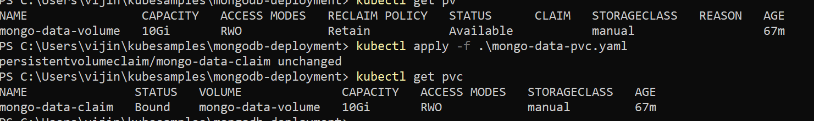
Persistent Volume and Claim
>> kubectl get pv
>> Kubectl get pvc
And status looks like this
Status shows PVC is bound to Volume

Slide 23
Configure a Pod to use the persistent Volume Claim
Create a pod that uses Persistent Volume Claim as a Volume
>> kubectl apply –f app-pod.yaml
>> kubectl get pod app-pod
>> Get a shell to the container running in your Pod:
>> kubectl exec –it app-pod -- /bin/bash
Inside the shell, verify nginx is serving the index.html from the hostPath volume

Slide 24
Run the app
# Be sure to run these 3 commands inside the root shell that comes from
# running "kubectl exec" in the previous step
apt update
apt install curl
curl http://localhost/
You will see
Hello from Kubernetes storage
If you see that message, you have successfully configured a Pod to use storage from a PersistentVolumeClaim.

Slide 25
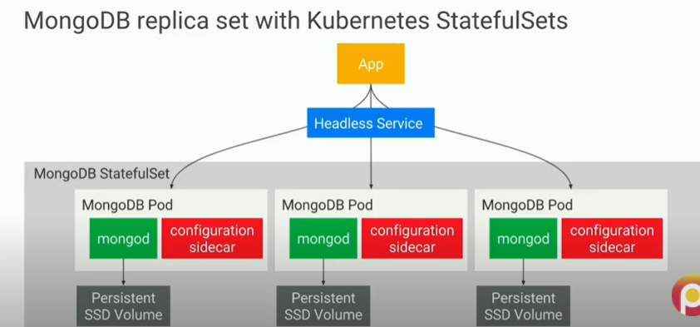
App to Mongodb Replica set

Slide 26
Deploy Mongo DB Statefulset and Headless service in Kubernetes
StatefulSet design applies to all kinds of stateful applications such as MongoDB, Redis Cache, Kafka, and any other database management system that runs under a cluster. They scale horizontally with each pod and maintaining a consistent network and disk identity.
The deployment will follow as creating a Headless Service and StatefulSet with N=3 replicas under a cluster. Headless service does not do Load Balancing for databases but expose the Pods to DNS
>> Kubectl apply –f mongodb-statefulset.yaml

Slide 27
MongoDB Cluster Admin Set up Manually
We will also see how to set up the MongoDB administrator for a container that runs under a cluster.
Setup the ReplicaSet and Administrator
>> Kubectl exec –it mongod-0 –c mongod-container bash
>> hostname -f
>> XXX-mongodb service-cluster-name
To scale up and down use this
>> kubectl scale –replicas=5 statefulset mongod

Slide 28
Set up admin
>> mongo
> rs.initiate({ _id: "MainRepSet", version: 1,
members: [
{ _id: 0, host: "mongod-0.mongodb-headless-service.default.svc.cluster.local:27017" },
{ _id: 1, host: "mongod-1.mongodb-headless-service.default.svc.cluster.local:27017" },
{ _id: 2, host: "mongod-2.mongodb-headless-service.default.svc.cluster.local:27017" } ]});
MainRepSet:PRIMARY> rs.status();

Slide 29
Create the administrator for Mongodb
 | MainRepSet:PRIMARY> db.getSiblingDB("admin").createUser({
 | ... user : "demoadmin",
 | ... pwd : "demopwd123",
 | ... roles: [ { role: "root", db: "admin" } ]
 | ... });
 | Result: Successfully added user: {
 | "user" : "demoadmin",
 | "roles" : [
 | {
 | "role" : "root",
 | "db" : "admin"
 | }
 | ]
 | }

Slide 30
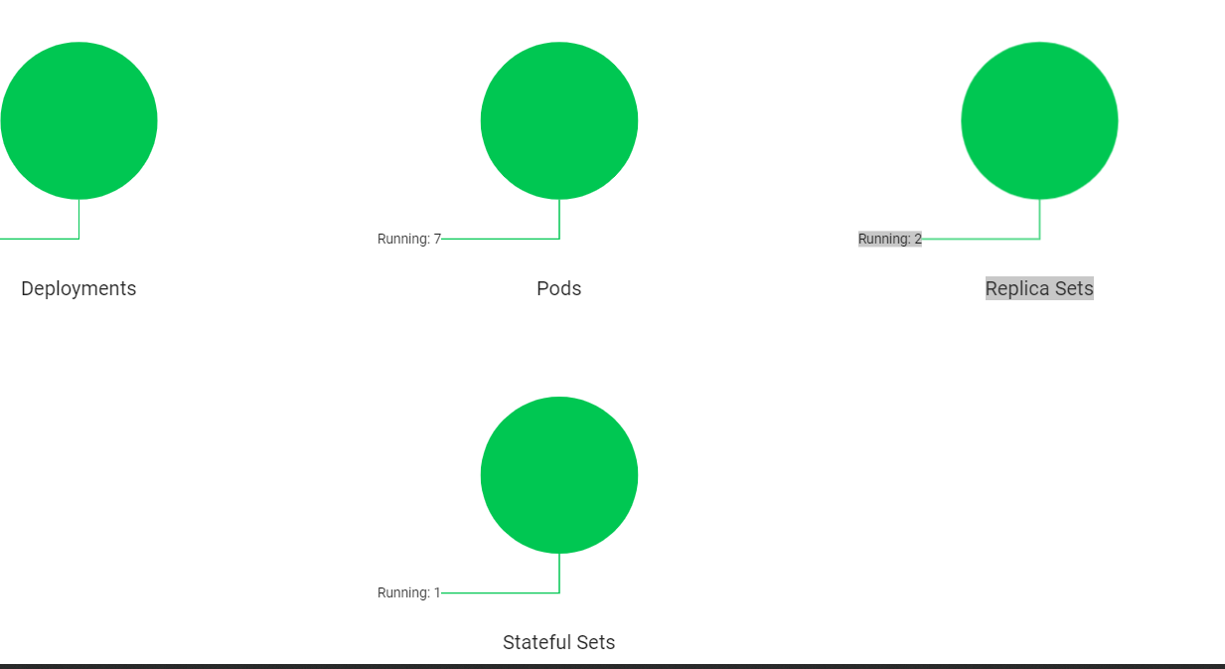
Dashboard status to see Stateful Sets and Mongodb Replica Sets
Verify MongoDB StatefulSet Setup from minikube dashboard
>> kubectl proxy
>> Minikube dashboard

Slide 31
Implement A Web App
>> git clone https://github.com/vnarayanan12/mongodb-deploy-kubernetes.git
>> cd webpp
>> docker build –t webapp:1.0.0 .
>> docker tag webapp:1.0.0 vnarayanan/webapp:1.0.0
>> docker push vnarayanan/webapp:1.0.0
Run web app locally
>> docker network create tasksapp-net
>> docker run --name=mongo --rm -d --network=tasksapp-net mongo
>> docker run –-name=webapp --rm -p 5000:5000 -d –-network=tasksapp-net vnarayanan/webapp:1.0.0

Slide 32
Run webapp
Open http://localhost:5000/ and you will see this message
The next step is to run this containerized app on a container orchestrator - kubernetes.
To deploy our application on a Kubernetes cluster, we will be creating .yaml files for each Kubernetes resource and running a set of kubectl commands.
{ "message": "Welcome to Tasks app! I am running inside 510630d1ef4c pod!" }

Slide 33
Deployment
Taskapp deployment
>> kubectl create –f webapp.yaml
>> kubectl get deployment
Status
NAME READY UP-TO-DATE AVAILABLE AGE
webapp 1/1 1 1 2d23h

Slide 34
Scale Deployment
>> kubectl scale deployment webapp --replicas=3
>> kubectl get pods
Result
NAME READY STATUS RESTARTS AGE
mongod-0 1/1 Running 0 2d23h
mongod-1 1/1 Running 0 2d23h
mongod-2 1/1 Running 0 2d23h
webapp-5f8f9f78b6-bbk87 1/1 Running 0 3m31s
webapp-5f8f9f78b6-wfjsj 1/1 Running 0 2d23h
webapp-5f8f9f78b6-xjm4p 1/1 Running 0 3m31s

Slide 35
Load Balancer service
The LoadBalancer Service enables the pods in a deployment to be accessible from outside the cluster. Here, since we are using a custom Kubernetes cluster, we will be accessing the app from the master node at <service-ip>:<service-port>. The service is also defined in taskapp.yaml.
The advantage of using a Service is that it gives us a single consistent IP to access our app as many pods may come and go in our deployment.

Slide 36
Webapp-svc
>> kubectl get service
Result
NAME TYPE CLUSTER-IP EXTERNAL-IP PORT(S) AGE
kubernetes ClusterIP 10.96.0.1 <none> 443/TCP 3d1h
mongodb-headless-service ClusterIP None <none> 27017/TCP 3d
webapp-svc LoadBalancer 10.105.111.16 <pending> 8080:32416/TCP 2d23h

Slide 37
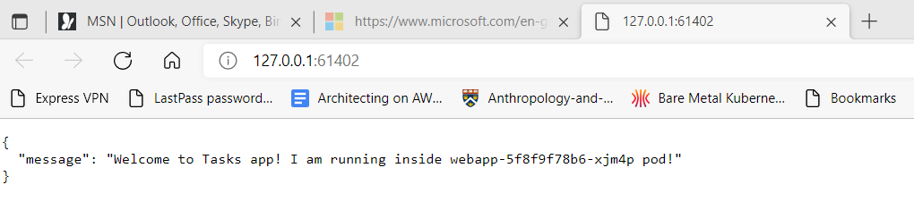
Web URL
Now we should be able to access our Web app through
>> minikube service webapp-svc

Slide 38
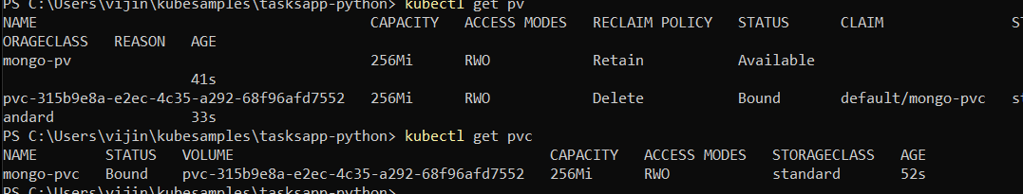
MongoDb persistent volume
Kubectl apply –f mongo-pv.yaml
Kubectl apply –f mongo-pvc.yaml
Status

Slide 39
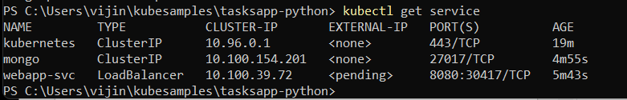
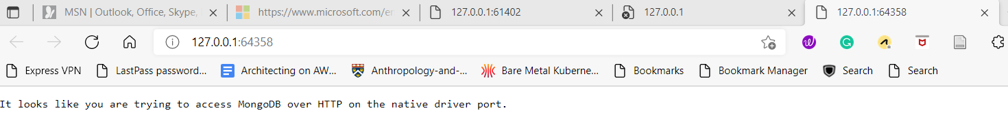
Mongo Deployments
Kubectl apply –f mongo.yaml
Kubectl apply –f mongo-svc.yaml
Kubectl get service
Minikube service mongo
Status

Slide 40
Open Mongodb
>> kubectl get service
>>
you can access through minikube to curl
>> minikube ssh
$$ curl 10.100.154.201:27017 (take the ClusterIP address given in your window and add port number to it)
Result: It looks like you are trying to access MongoDB over HTTP on the native driver port.

Slide 41
Adding a collection to MongoDB
Inside minikube shell:
curl webapp:IP
docker@minikube:~$ curl 10.100.39.72:8080
{
"message": "Welcome to Tasks app! I am running inside webapp-5f8f9f78b6-sxfpx pod!"
}
Create Task collection
$ curl curl 10.100.39.72:8080/tasks { "data": [] }
Add a Task1
$ curl -X POST -d "{\"task\": \"Task 1\"}" http:// 10.100.39.72:8080 /task
{ "message": "Task saved successfully!" }

Slide 42
Display collection
docker@minikube:~$ curl 10.100.39.72:8080/tasks
{
"data": [
{
"id": "620abafa5c737ef68e0f1f57",
"task": "Task 1"
} ]}
Also I restarted minikube and this data was there.

Slide 43
Deploy mongodb-statefulset
>> Kubectl deploy –f mongodb-statefulset.yaml
>> Kubectl get service

