Slide 1
Linear & Binary Search
Tuesday, 2024-05-14

Slide 2

Introductions
Bridger Herman

Slide 3
Roles, Assumptions, and Expectations
Roles:
Me: Guest Lecturer for CS 111
You: Students in CS 111
Assumptions:
We are near the end of the course
You’ve had a chance to solve problems with
Branching, Loops, Functions
Strings, Lists, Recursion
You have not explicitly worked with:
Any search algorithms
Expectations:
There are no “wrong” answers (or questions!)
Be Present*

Slide 4
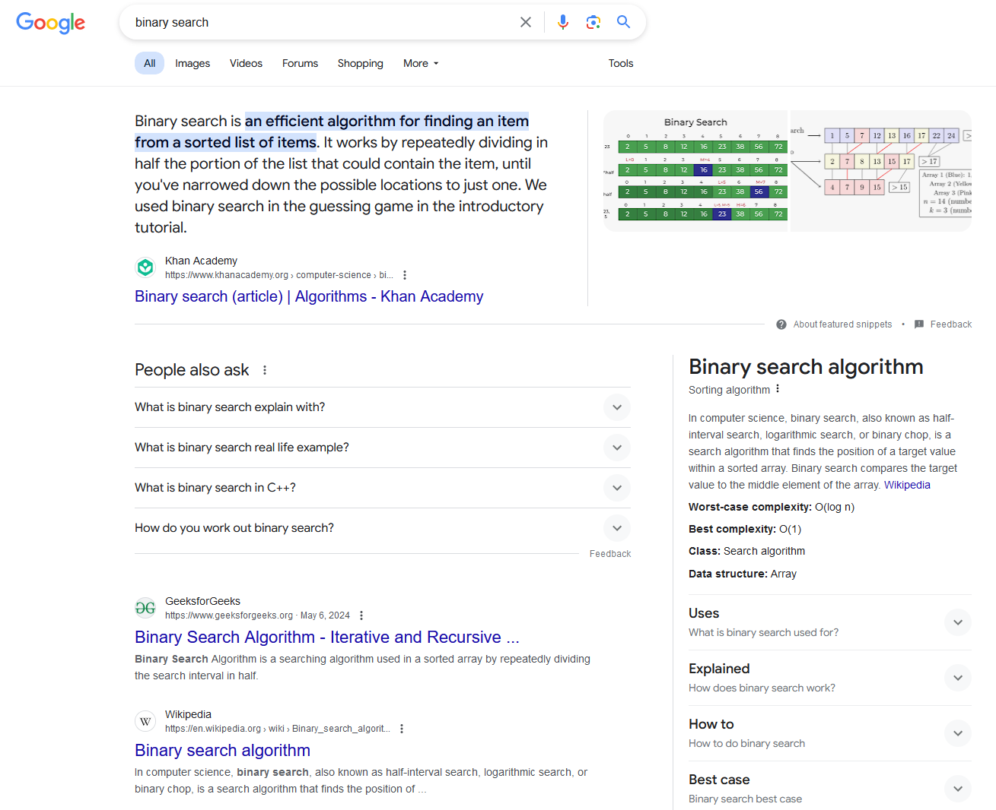
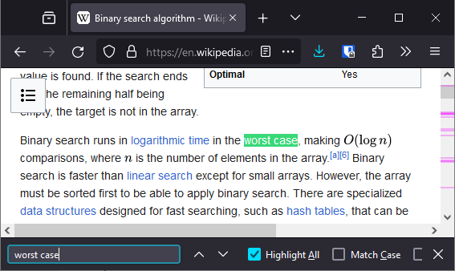
What are search algorithms?
Find something in a large collection of “stuff”
Find text in an article
Finding shortest path,
solving puzzles,
keyboard autocomplete, …

Slide 5
Roadmap
Linear Search (quickly)
Binary Search (the rest)
Exercises & Reflections (async)

Slide 6
Search
21
How would you look for the item 21 in this list?
Index
0
1
2
3
4
5
6
7
1
5
13
17
19
21
27
29
Value

Slide 7
Linear Search
Check one item at a time, see if it’s the same
Repeat until we find the item
Index
0
1
2
3
4
5
6
7
1
5
13
17
19
21
27
29
Value

Slide 8
Linear Search
Check one item at a time, see if it’s the same
Repeat until we find the item
21
Index
0
1
2
3
4
5
6
7
1
5
13
17
19
21
27
29
Value

Slide 9
Linear Search
Check one item at a time, see if it’s the same
Repeat until we find the item
21
Index
0
1
2
3
4
5
6
7
1
5
13
17
19
21
27
29
Value

Slide 10
Linear Search
Check one item at a time, see if it’s the same
Repeat until we find the item
21
Index
0
1
2
3
4
5
6
7
1
5
13
17
19
21
27
29
Value

Slide 11
Linear Search
Check one item at a time, see if it’s the same
Repeat until we find the item
21
Index
0
1
2
3
4
5
6
7
1
5
13
17
19
21
27
29
Value

Slide 12
Linear Search
Check one item at a time, see if it’s the same
Repeat until we find the item
Index
0
1
2
3
4
5
6
7
1
5
13
17
19
21
21
27
29
Value

Slide 13
Linear Search: Code
(you are welcome to follow along and write code, or not – the examples will be posted)

Slide 14
Linear Search: Pitfalls
What if our list of values is REALLY long?
Index
0
1
2
3
4
5
6
7
1
5
13
17
19
21
27
29
Value

Slide 15
Linear Search: Pitfalls
What if our list of values is REALLY long?
Index
0
7,000,000
1
…
29
Value
Worst Case: iterations = number of elements in list.

Slide 16
Binary Search
Repeatedly divide list in half
Is target LESS or GREATER than the middle element
Prereq: List MUST be sorted.

Slide 17
Binary Search
Repeatedly divide list in half
Is target LESS or GREATER than the middle element
Prereq: List MUST be sorted. ✅
21
Index
0
1
2
3
4
5
6
7
1
5
13
17
19
21
27
29
Value

Slide 18
Binary Search
Repeatedly divide list in half
Is target LESS or GREATER than the middle element
Prereq: List MUST be sorted. ✅
21
Index
0
1
2
3
4
5
6
7
1
5
13
17
19
21
27
29
Value
LO
HI

Slide 19
Binary Search
Repeatedly divide list in half
Is target LESS or GREATER than the middle element
Prereq: List MUST be sorted. ✅
21
17 ?? 21
Index
0
1
2
3
4
5
6
7
1
5
13
17
19
21
27
29
Value
LO
MID
HI
(halfway between
HI and LO)

Slide 20
Binary Search
Repeatedly divide list in half
Is target LESS or GREATER than the middle element
Prereq: List MUST be sorted. ✅
21
17 < 21
Index
0
1
2
3
4
5
6
7
1
5
13
17
19
21
27
29
Value
MID
LO
HI

Slide 21
Binary Search
Repeatedly divide list in half
Is target LESS or GREATER than the middle element
Prereq: List MUST be sorted. ✅
21
Index
0
1
2
3
4
5
6
7
1
5
13
17
19
21
27
29
Value
LO
HI

Slide 22
Binary Search
Repeatedly divide list in half
Is target LESS or GREATER than the middle element
Prereq: List MUST be sorted. ✅
21
21 ?? 21
Index
0
1
2
3
4
5
6
7
1
5
13
17
19
21
27
29
Value
LO
MID
HI
(halfway between
HI and LO)

Slide 23
Binary Search
Repeatedly divide list in half
Is target LESS or GREATER than the middle element
Prereq: List MUST be sorted. ✅
21
21 == 21
Index
0
1
2
3
4
5
6
7
1
5
13
17
19
21
27
29
Value
LO
MID
HI
(halfway between
HI and LO)

Slide 24
Binary Search: Algorithm
21
target
LO
HI
while
<=
MID
check target with (element halfway between LO and HI)
If equal, return MID index
If target > MID element, increase LO to MID + 1
Else, decrease HI to MID - 1
17 ?? 21
If not found, return -1
Index
0
1
2
3
4
5
6
7
Value
1
5
13
17
19
21
27
29
LO
MID
HI
(halfway between
HI and LO)

Slide 25
Binary Search: Code
(you are welcome to follow along and write code, or not – the examples will be posted)

Slide 26
Binary Search: Iterative Approach
21
target
LO
HI
while
<=
MID
check target with (element halfway between LO and HI)
If equal, return MID index
If target > MID element, increase LO to MID + 1
Else, decrease HI to MID - 1
17 ?? 21
If not found, return -1
Index
0
1
2
3
4
5
6
7
Value
1
5
13
17
19
21
27
29
LO
MID
HI
(halfway between
HI and LO)

Slide 27
Binary Search: Recursive Approach
21
target
LO
HI
Base Case 1: if
>
: return -1
MID
check target with (element halfway between LO and HI)
Base Case 2: If equal, return MID index
Recursive Step 1: If target > MID element, increase LO to MID + 1
Recursive Step 2: Else, decrease HI to MID - 1
17 ?? 21
Index
0
1
2
3
4
5
6
7
Value
1
5
13
17
19
21
27
29
LO
MID
HI
(halfway between
HI and LO)

Slide 28
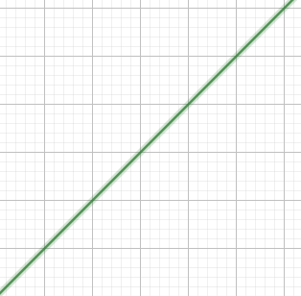
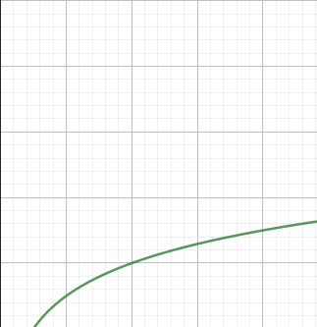
Worst Case Performance: Linear vs. Binary
(assuming n elements in list)
Linear: n iterations
Binary: log(n) iterations
Linear
Binary
iterations
iterations
list size
list size
Example (10,000 element list):
linear search: max 10000 iterations 1.5991158 sec
binary search: max 14 iterations 0.0187128 sec
binary search (recursive): max 14 iterations 0.0263507 sec*
*exact timing may change based on what language you use (i.e., if it supports tail recursion)

Slide 29
Also works with strings!
(and anything else that can be assigned a numeric “key”)

Slide 30

Wrapping Up
Code examples & slides: posted on GitHub
https://github.com/bridger-herman/search-lecture
Exercises & Reflections:
https://forms.gle/vNvfVevihq3AvchS6

