Slide 2
行動系統
3

Slide 3
研讀目標
Q1：什麼是行動系統?
Q2：為何行動系統很重要?
Q3：原生型和網頁型行動應用軟體的比較
Q4：優質行動使用者體驗的特徵是什麼?
Q5：個人行動裝置於工作上的挑戰是什麼?
Notes:
This text takes the position that social media, especially as manifested in the hyper-social organization, is a new business phenomenon.

Slide 4
Q1：什麼是行動系統?
是一種為移動狀態之使用者提供支援的資訊系統
運算裝置
小型
輕量
省電
可連接無線網路
行動系統的要素
移動狀態之使用者
行動裝置
無線連接
雲端基礎資源
Notes:
Users access mobile systems from any place–at home, at work, in the car, on the bus, or the beach–using any smart device, smartphone, tablet, or PC.

Slide 5
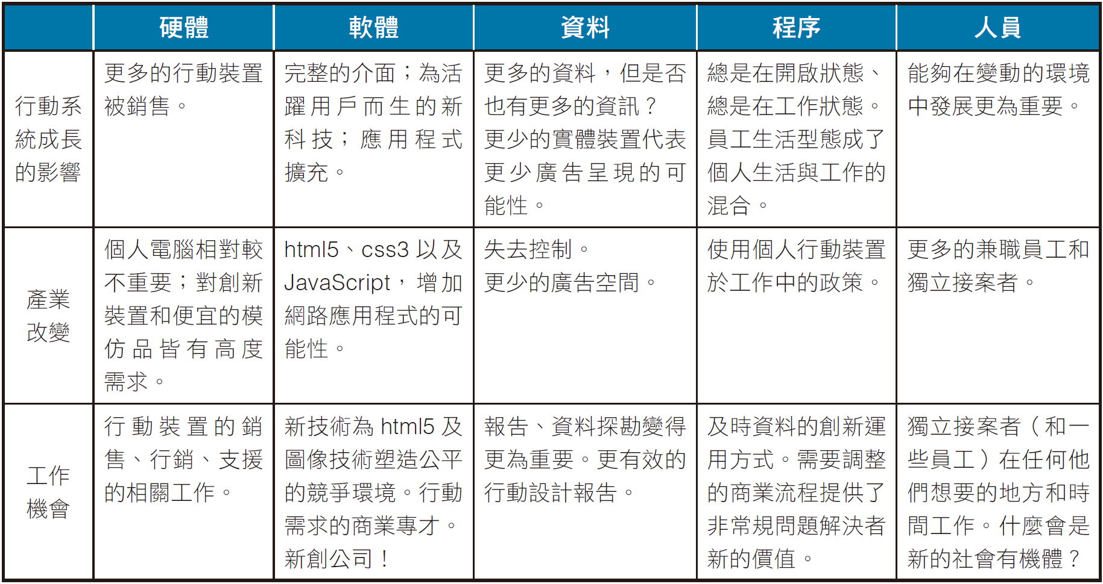
Q2：為何行動系統很重要？
圖CE3-2 行動改變和機會的五個元件
Notes:
2013, there are 6.8 billion wireless subscriptions. One-third of those subscriptions involve smartphones or other mobile devices, meaning there are already 1.9 billion mobile system subscriptions, worldwide.
Mobile systems have major impact on business and society today–an impact forcing industry change while creating new career opportunities for mobile-IS-savvy professionals and large numbers of new, interesting mobile-IS-related jobs.

Slide 6
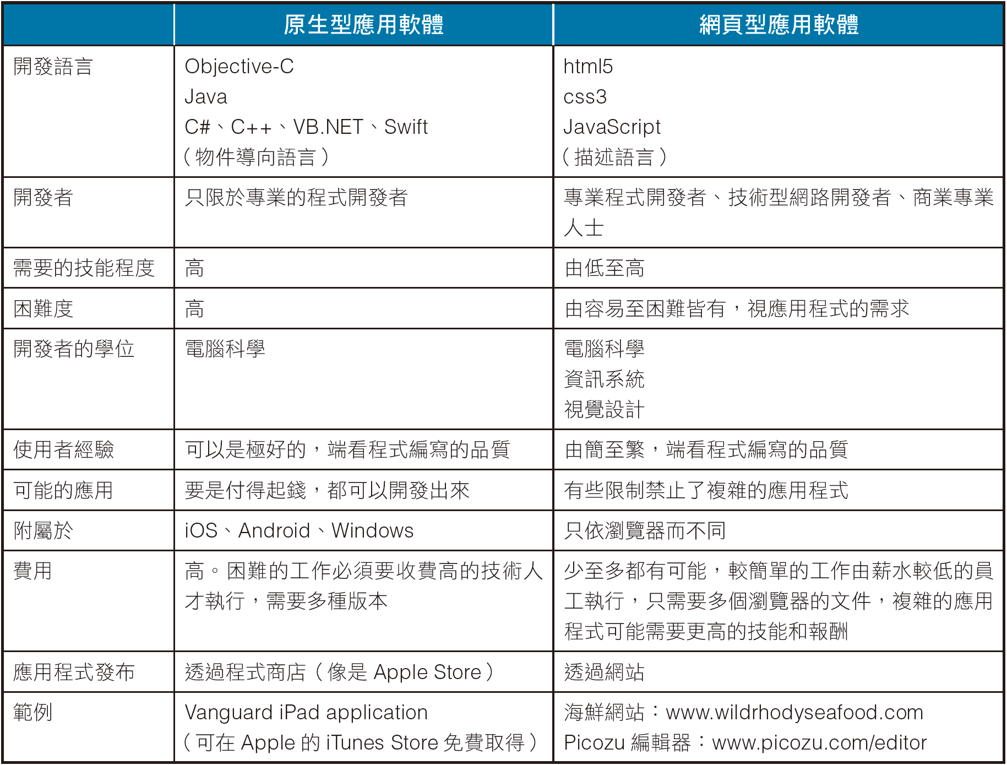
Q3： 原生型和網頁型行動應用軟體的比較
圖CE3-3 原生型及網頁型應用軟體的特性
Notes:
Two primary ways for developing mobile applications: Native and Thin-Client Applications.
Thin-client development languages are HTML5, CSS3, and Javascript. These are not object-oriented languages and hence are much easier to learn to use.
CSS3 is used with HTML5 to specify the appearance of content coded in HTML. Javascript is a scripting programming language that is much easier to learn than object-oriented languages. It is used to provide the underlying logic of the application.

Slide 7
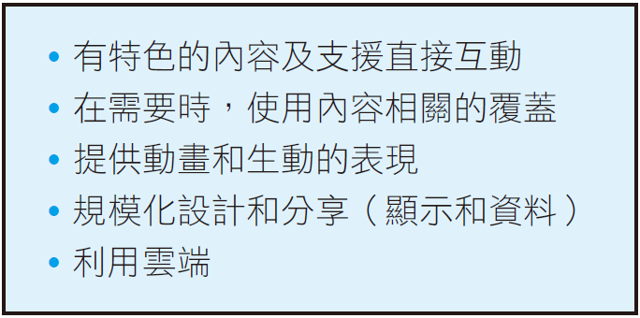
Q4： 優質行動使用者體驗的特徵是什麼？
圖CE3-4 優質的使用者體驗特性
Notes:
Primary emphasis on users’ content, giving such content as much display as possible. Rather than show menus, toolbars, and heavy window borders. Content should be shown cleanly and in center stage.
Context-sensitive chrome, pops up in the display when appropriate.

Slide 8
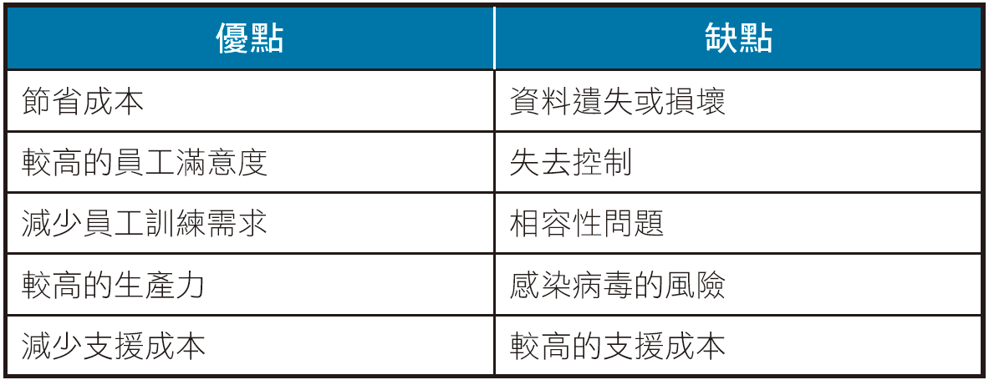
Q5： 個人行動裝置於工作上的挑戰是什麼？
圖CE3-7 員工在工作中使用行動系統的利與弊
Notes:
Organizations have a love/hate relationship with their employees’ use of their own mobile devices at work. They love the cost-saving possibility of having employees buy their own hardware, but hate the increased vulnerability and loss of control.

Slide 9
主動出擊
Q1：什麼是行動系統？
Q2：為何行動系統很重要？
Q3：原生型和網頁型行動應用軟體的比較
Q4：優質行動使用者體驗的特徵是什麼？
Q5：個人行動裝置於工作上的挑戰是什麼？

