Slide 1
Sponges

Slide 2
Antho

Slide 3
Antho (Antho) dichotoma

Slide 4
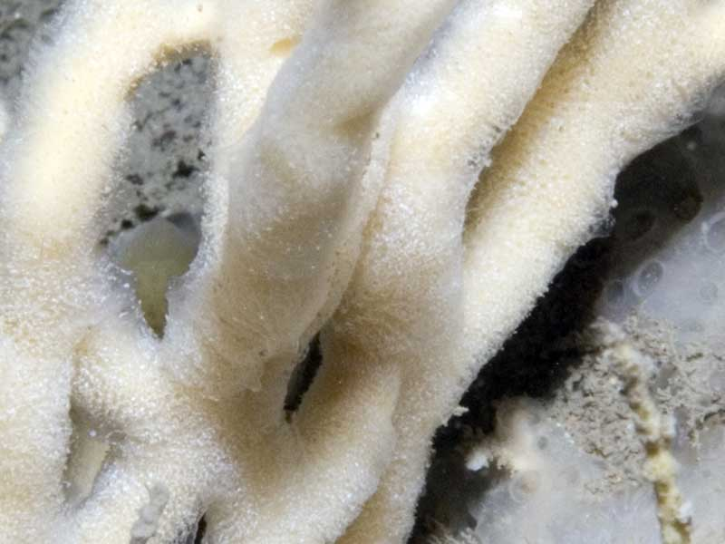
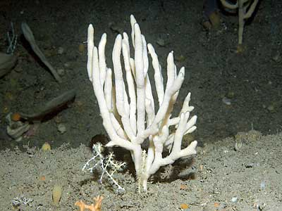
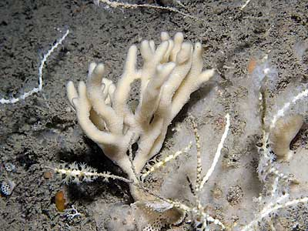
Antho dichotoma
https://www.habitas.org.uk/marinelife/sponge_guide/sponges.asp?item=C8340
Arborescent

Slide 5
Anthoptilum grandiflorum
Seapen??

Slide 6
Aphrocallistes
Genus

Slide 7
Aphrocallistes Beatrix
Species

Slide 8
Aphrocallistes beatrix beatrix
Sub species

Slide 9
Aphrocallistidae
Family

Slide 10
Aplysilla
Most seem encrusting but need to check
genus

Slide 11
Asbestopluma
Genus
Carnivorous sponges

Slide 12
Asconema

Slide 13
Asconema foliatum

Slide 14
Axinella

Slide 15
Axinella infundibuliformis

Slide 16
Axinella polypoides

Slide 17
Axinella rugosa

Slide 18
Axinellida

Slide 19
Axinellidae

Slide 20
Chondrocladia

Slide 21
Chonelasma

Slide 22
Cladorhiza

Slide 23
Craniella

Slide 24
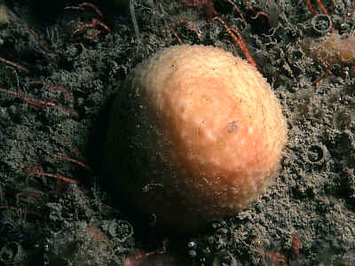
Craniella cranium
Species
Massive
https://www.habitas.org.uk/marinelife/sponge_guide/sponges.asp?item=C1890

Slide 25
Craniella longipilis

Slide 26
Craniella polyura

Slide 27
Craniella zetlandica

Slide 28
Demospongiae

Slide 29
Dendroceratida

Slide 30
Euplectella

Slide 31
Geodia

Slide 32
Geodia atlantica

Slide 33
Geodia barretti

Slide 34
Geodia hentscheli

Slide 35
Geodia macandrewii

Slide 36
Geodia megastrella

Slide 37
Geodia parva

Slide 38
Geodia phlegraei

Slide 39
Geodiidae

Slide 40
Halichondrida

Slide 41
Haliclona

Slide 42
Haliclona urceolus

Slide 43
Haplosclerida

Slide 44
Hexactinellida

Slide 45
Hexadella

Slide 46
Hexadella dedritifera

Slide 47
Hyalonema

Slide 48
Hymedesmia

Slide 49
Lanthellidae

Slide 50
Mycale (mycale) lingua

Slide 51
Mycale (Mycale) lingua

Slide 52
Mycale lingua

Slide 53
Mycalidae

Slide 54
Pachastrellidae

Slide 55
Phakellia

Slide 56
Phakellia bowerbanki

Slide 57
Phakellia robusta

Slide 58
Phakellia ventilabrum

Slide 59
Pheronema

Slide 60
Pheronema carpenteri

Slide 61
Poecilosclerida

Slide 62
Polymastia

Slide 63
Polymastia andrica

Slide 64
Polymastia arctica

Slide 65
Polymastia grimaldii

Slide 66
Polymastia hemisphaerica

Slide 67
Polymastia nivea

Slide 68
Polymastia penicillus

Slide 69
Polymastia thielei

Slide 70
Polymastia uberrima

Slide 71
Polymastiida

Slide 72
Polymastiidae

Slide 73
Porifera

Slide 74
Quasillina brevis

Slide 75
Radiella

Slide 76
Radiella hemisphaerica

Slide 77
Stelletta

Slide 78
Stelletta normani

Slide 79
Stelletta rhaphidiophora

Slide 80
Stelletta tuberosa

Slide 81
Stryphnus

Slide 82
Stryphnus fortis

Slide 83
Stryphnus ponderosus

Slide 84
Stylocordyla

Slide 85
Stylocordyla borealis

Slide 86
Suberites

Slide 87
Suberites ficus

Slide 88
Suberites pagurorum

Slide 89
Tentorium semisuberites

Slide 90
Tethya norvegica

Slide 91
Tethyidae

Slide 92
Tetilla

Slide 93
Thenea

Slide 94
Thenea levis

Slide 95
Thenea muricata

Slide 96
Thenea valdiviae

Slide 97
Theneidae

Slide 98
Umbellula huxleyi

