Slide 1
Microsoft Movie Analysis
Bridget Carson

Slide 2
Summary
Microsoft is looking for actionable insights to enter the movie production industry
Several movie data sets were merged to analyse movie information from 2000-2020
The target variable was worldwide gross revenue
3 recommendations were found –
Adventure or Action genres
Hire key people who have achieved the most success in these genres
Release movies for northern hemisphere Summer (May/June) or for Christmas (Nov/Dec)

Slide 3
Outline
Business Problem
Data
Methods
Results
Conclusions

Slide 4
Business Problem
Microsoft is looking to enter the highly competitive US$7.3 billion movie production industry
Microsoft has no experience in movie production and is looking for actionable insights into what movies to create
This project will provide 3 actionable recommendations for Microsoft for the business venture

Slide 5
Data
Several datasets on past movies were analysed
The target variable is worldwide revenue as for a business venture to succeed, it must be financially viable
The dataset was right skewed, which is a limitation. These ‘outliers’ were kept to include data on the most successful movies

Slide 6
Methods
The datasets were merged to include as many movies as possible which included the required variables
With the final dataset, the data was exploded to find the most successful genres
The dataset was further filtered on these genres to find
The most successful writer and director
Which month to release films

Slide 7
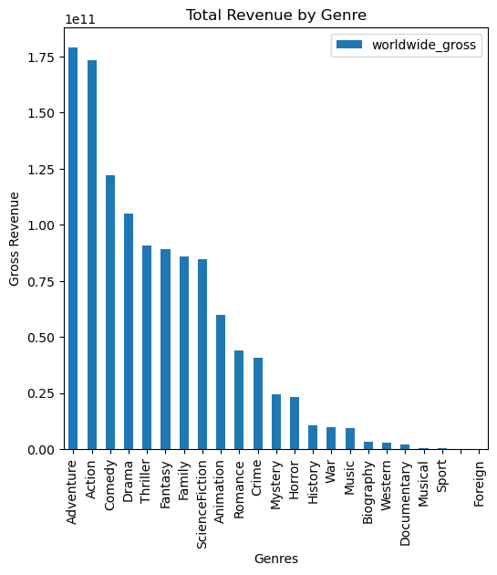
Results
Focus on the highest grossing
genres - Adventure
and Action movies

Slide 8
Results
Due to Microsoft ‘s lack of movie production experience, invest in the most successful key people in Adventure and Action movies -
Nicole Perlman – Writer (Adventure & Action)
Rich Moore – Director (Adventure)
Clint Eastwood – Director (Action)

Slide 9
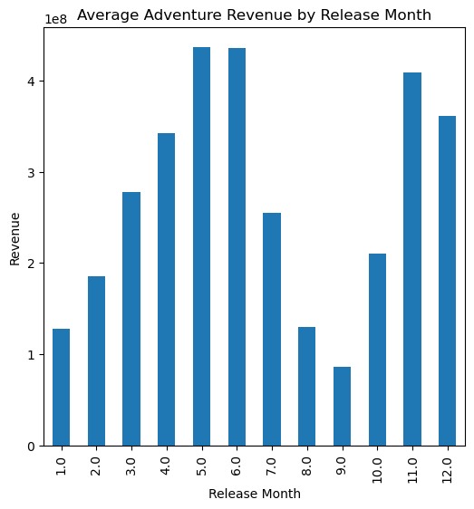
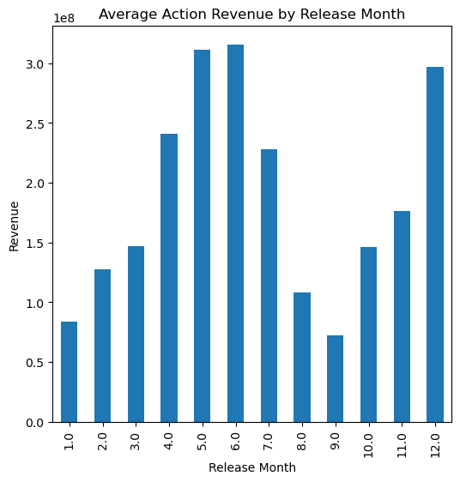
Results
Release movies for summer (May/June) or Christmas (Nov/Dec) times as these are the most successful launch months for Adventure & Action movies

Slide 10
Conclusions
From the available data, it is recommended Microsoft focus on Adventure & Action movies, invest in the most successful people in these genres and release movies for US summer and Christmas
This was a small dataset to provide initial insights for Microsoft to start planning for a movie production business
One risk to consider is some of the most successful movies in recent time are franchises (e.g. Marvel), which Microsoft does not own

