Slide 1
NUMERICAL METHODS ASSIGNMENT
Newton-Raphson Method • Secant Method • 4th-Order Runge-Kutta Method
Flowcharts, pseudocode (for-loop and while-loop), and two worked numerical examples per method

Slide 2
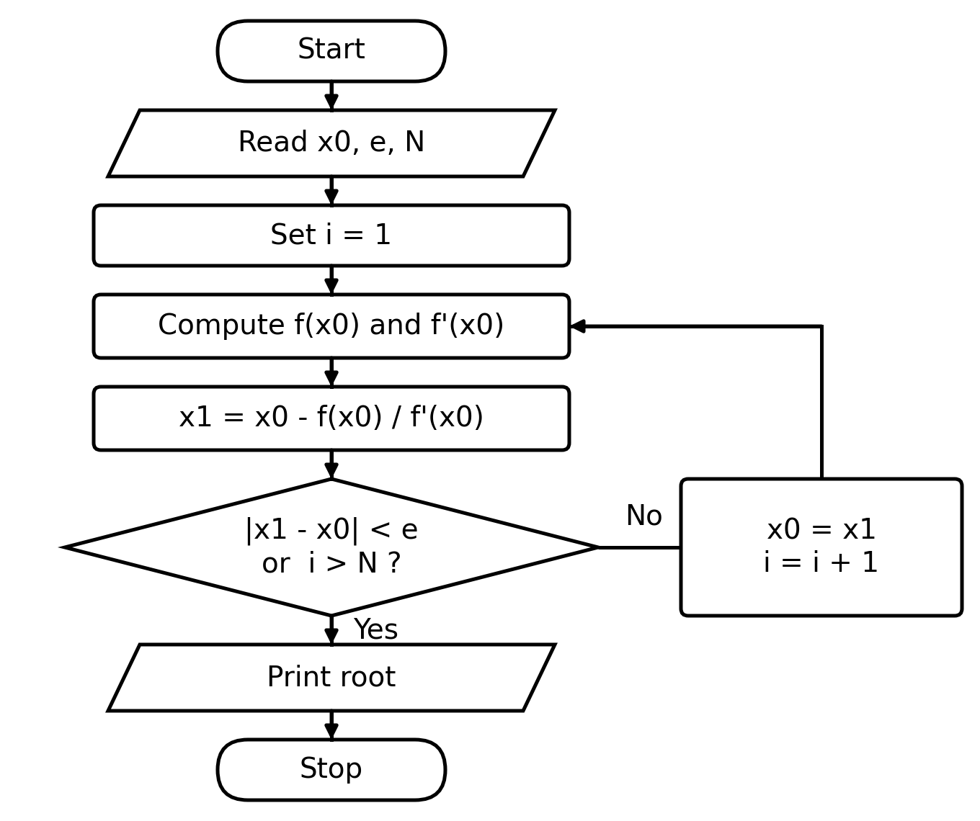
1. Newton-Raphson Method
An open method for finding a root of f(x) = 0.
Iterative formula:
x(i+1) = x(i) - f(x(i)) / f '(x(i))
Repeat until |x(i+1) - x(i)| < e, or i > N.

Slide 3
1. Newton-Raphson Method
Pseudocode
'for' loop version
'while' loop version
Read x0, e, N
for i = 1 to N:
fx = f(x0)
dfx = f'(x0)
x1 = x0 - fx / dfx
if abs(x1 - x0) < e:
break
x0 = x1
Print "Root = ", x1
Read x0, e, N
i = 1
x1 = x0 - f(x0) / f'(x0)
while abs(x1 - x0) >= e
and i <= N:
x0 = x1
x1 = x0 - f(x0) / f'(x0)
i = i + 1
Print "Root = ", x1

Slide 4
1. Newton-Raphson Method
Worked Example 1
Solve f(x) = x^3 - x - 2 = 0, starting from x0 = 1.5, with tolerance e = 1e-5.
i | x(i) | f(x(i)) | f '(x(i)) | x(i+1)
1 | 1.500000 | -0.125000 | 5.750000 | 1.521739
2 | 1.521739 | 0.002137 | 5.947070 | 1.521380
3 | 1.521380 | 0.000001 | 5.943790 | 1.521380
Result: converges after 3 iterations to a root of x ≈ 1.521380.

Slide 5
1. Newton-Raphson Method
Worked Example 2
Solve f(x) = x^2 - 2 = 0 (i.e. compute √2), starting from x0 = 1, with tolerance e = 1e-5.
i | x(i) | f(x(i)) | f '(x(i)) | x(i+1)
1 | 1.000000 | -1.000000 | 2.000000 | 1.500000
2 | 1.500000 | 0.250000 | 3.000000 | 1.416667
3 | 1.416667 | 0.006944 | 2.833333 | 1.414216
4 | 1.414216 | 0.000006 | 2.828431 | 1.414214
5 | 1.414214 | 0.000000 | 2.828427 | 1.414214
Result: converges after 5 iterations to a root of x ≈ 1.414214 (≈ √2).

Slide 6
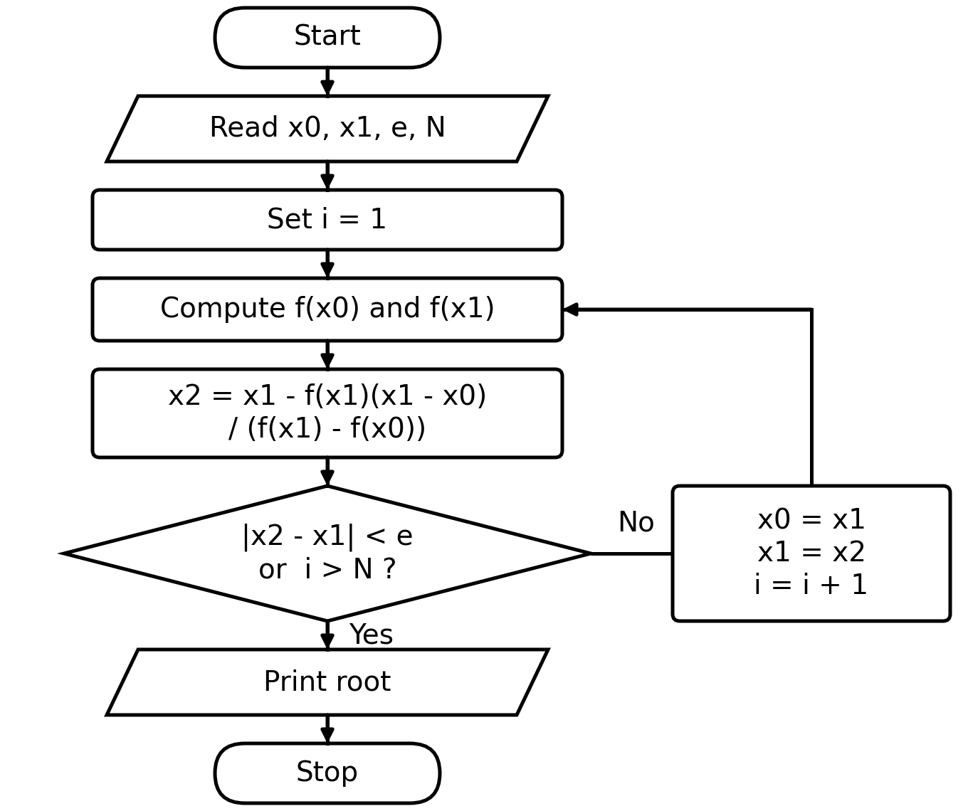
2. Secant Method
Similar to Newton-Raphson, but avoids computing f'(x).
Iterative formula:
x(i+1) = x(i) - f(x(i))·(x(i)-x(i-1))
/ (f(x(i))-f(x(i-1)))
Requires two initial guesses x0 and x1.

Slide 7
2. Secant Method
Pseudocode
'for' loop version
'while' loop version
Read x0, x1, e, N
for i = 1 to N:
x2 = x1 - f(x1)*(x1 - x0)
/ (f(x1) - f(x0))
if abs(x2 - x1) < e:
break
x0 = x1
x1 = x2
Print "Root = ", x2
Read x0, x1, e, N
i = 1
x2 = x1 - f(x1)*(x1 - x0)
/ (f(x1) - f(x0))
while abs(x2 - x1) >= e
and i <= N:
x0 = x1
x1 = x2
x2 = x1 - f(x1)*(x1-x0)
/ (f(x1)-f(x0))
i = i + 1
Print "Root = ", x2

Slide 8
2. Secant Method
Worked Example 1
Solve f(x) = x^3 - x - 2 = 0, starting from x0 = 1, x1 = 2, with tolerance e = 1e-5.
i | x(i-1) | x(i) | f(x(i-1)) | f(x(i)) | x(i+1)
1 | 1.000000 | 2.000000 | -2.000000 | 4.000000 | 1.333333
2 | 2.000000 | 1.333333 | 4.000000 | -0.962963 | 1.462687
3 | 1.333333 | 1.462687 | -0.962963 | -0.333339 | 1.531169
4 | 1.462687 | 1.531169 | -0.333339 | 0.058626 | 1.520926
5 | 1.531169 | 1.520926 | 0.058626 | -0.002693 | 1.521376
6 | 1.520926 | 1.521376 | -0.002693 | -0.000020 | 1.521380
Result: converges after 6 iterations to a root of x ≈ 1.521380.

Slide 9
2. Secant Method
Worked Example 2
Solve f(x) = cos(x) - x = 0, starting from x0 = 0, x1 = 1, with tolerance e = 1e-5.
i | x(i-1) | x(i) | f(x(i-1)) | f(x(i)) | x(i+1)
1 | 0.000000 | 1.000000 | 1.000000 | -0.459698 | 0.685073
2 | 1.000000 | 0.685073 | -0.459698 | 0.089299 | 0.736299
3 | 0.685073 | 0.736299 | 0.089299 | 0.004660 | 0.739119
4 | 0.736299 | 0.739119 | 0.004660 | -0.000057 | 0.739085
5 | 0.739119 | 0.739085 | -0.000057 | 0.000000 | 0.739085
Result: converges after 5 iterations to a root of x ≈ 0.739085 (the Dottie number).

Slide 10
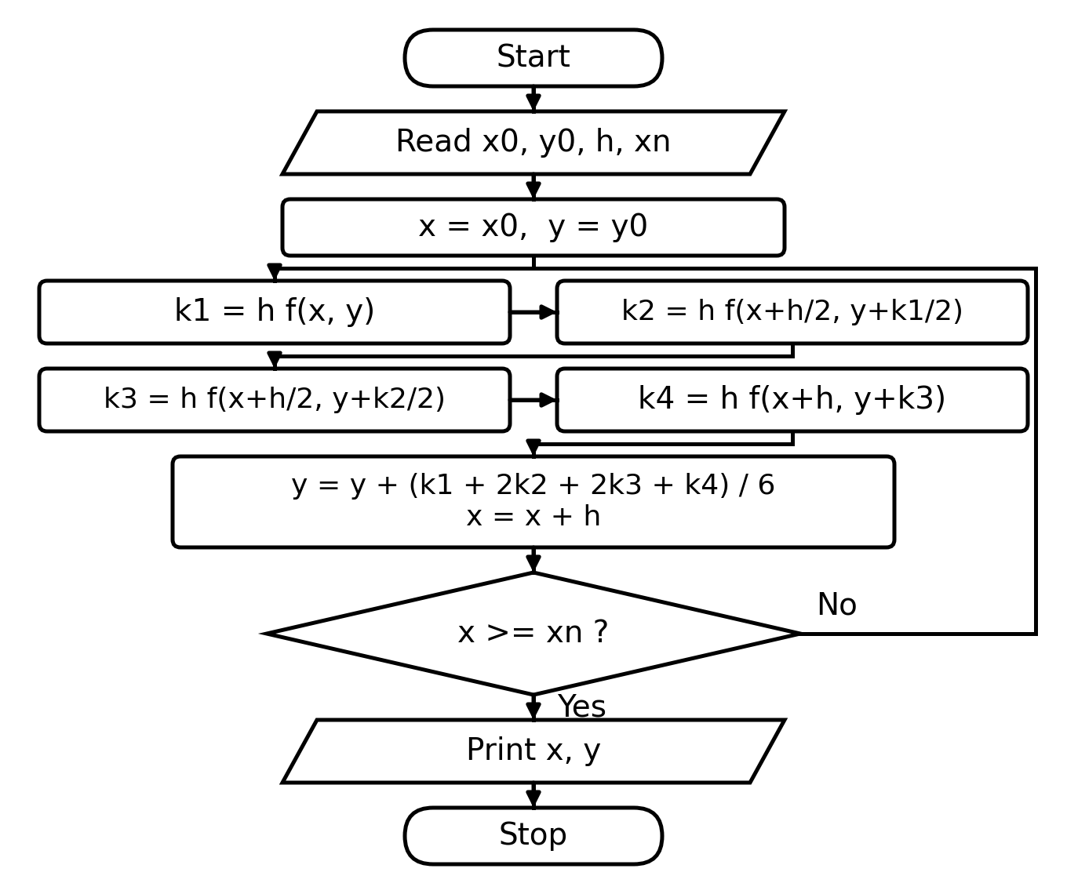
3. 4th-Order Runge-Kutta Method
Solves dy/dx = f(x,y), y(x0) = y0, one step h at a time,
using four slope estimates:
k1 = h f(x, y)
k2 = h f(x+h/2, y+k1/2)
k3 = h f(x+h/2, y+k2/2)
k4 = h f(x+h, y+k3)
y(new) = y + (k1+2k2+2k3+k4)/6

Slide 11
3. 4th-Order Runge-Kutta Method
Pseudocode
'for' loop version
'while' loop version
Read x0, y0, h, xn
n = (xn - x0) / h
x = x0
y = y0
for i = 1 to n:
k1 = h*f(x, y)
k2 = h*f(x+h/2, y+k1/2)
k3 = h*f(x+h/2, y+k2/2)
k4 = h*f(x+h, y+k3)
y = y+(k1+2k2+2k3+k4)/6
x = x + h
Print "y(", x, ") = ", y
Read x0, y0, h, xn
x = x0
y = y0
while x < xn:
k1 = h*f(x, y)
k2 = h*f(x+h/2, y+k1/2)
k3 = h*f(x+h/2, y+k2/2)
k4 = h*f(x+h, y+k3)
y = y+(k1+2k2+2k3+k4)/6
x = x + h
Print "y(", x, ") = ", y

Slide 12
3. 4th-Order Runge-Kutta Method
Worked Example 1
Solve dy/dx = x + y, y(0) = 1, step size h = 0.1. Find y at x = 0.2.
Step | x | y | k1 | k2 | k3 | k4 | y(new)
1 | 0.00 | 1.000000 | 0.100000 | 0.110000 | 0.110500 | 0.121050 | 1.110342
2 | 0.10 | 1.110342 | 0.121034 | 0.132086 | 0.132638 | 0.144298 | 1.242805
Result: y(0.2) ≈ 1.242805.

Slide 13
3. 4th-Order Runge-Kutta Method
Worked Example 2
Solve dy/dx = -2xy, y(0) = 1, step size h = 0.1. Find y at x = 0.2.
Step | x | y | k1 | k2 | k3 | k4 | y(new)
1 | 0.00 | 1.000000 | 0.000000 | -0.010000 | -0.009950 | -0.019801 | 0.990050
2 | 0.10 | 0.990050 | -0.019801 | -0.029404 | -0.029260 | -0.038432 | 0.960789
Result: y(0.2) ≈ 0.960789 (exact solution y = e^(-x^2) gives 0.960789).

