Slide 1
AirBnB Capstone
Can We Predict A Host’s Income?
By Brid McNulty

Slide 2
Goals
Success Metrics
Predict the income of an AirBnB host in London (initially occupancy rate)
Collate a list of features that impact income significantly positively or negatively.
Why?
For potential hosts signing up - expectations
For existing hosts - reaching potential & possible improvements
A model with ‘good’ accuracy on unseen data
A model with ‘good’ precision score - i.e. low false-positive rate.
Manage people’s expectations well!
Notes:
Initially, my plan was to predict occupancy rate of a listing. But after EDA, I realised OR wasn’t the point - the point was how much money can a listing make. Didn’t have income or occ rate variables.. Talk about that later!

Slide 3
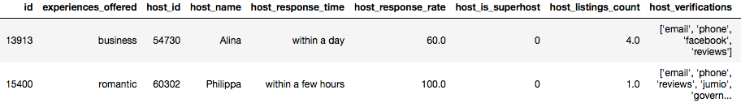
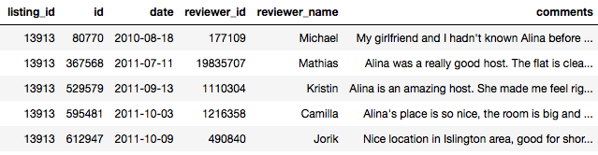
The Data
Sourced from InsideAirBnB as CSV
Listing Data
March 2019 London
83,000 listings, 106 features e.g. host since, bedrooms, number of reviews
Written Reviews
2.5m reviews, 6 features
Notes:
Luckily, had CSV files. Chose recent snapshot of London’s listings March 2019.
Features like: …..

Slide 4
Process
NULLS
CLEANING
FEATURE ENGINEERING
Notes:
Starting off, it was overwhelming - a huge amount of features, had to really go through all of them, understand them, explore. How to best prepare my data.

Slide 5
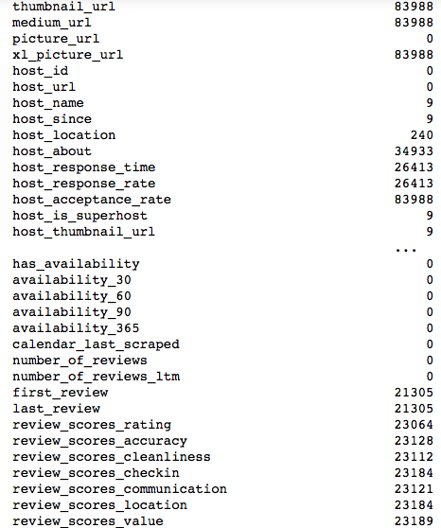
Nulls
Immediately dropped 48 columns either due to mostly nulls, redundancy (country, city), not of interest (host_url)
Dropped null rows when I wanted to keep the feature (host_since)
Dropped null rows where those listings wouldn’t be helpful (e.g. no reviews ever)
Filled nulls with 0 where appropriate (e.g. cleaning_fee)
Notes:
Nulls - handful columns had 90% nulls, some had 25% nulls, some had 0. Grouped together, e.g. written summaries, host about, descriptions, notes nulls over same listings. Reviews too.

Slide 6

Cleaning
I was lucky here!
Not too messy as it was originally scraped well
Price-related fields to floats
%-related fields to floats
Date-based fields to floats
Binarize numerically some fields
One-off drops like Ibiza listing, accommodates 0 listing
Notes:
Cleaning wasn’t too bad - the csv file data had already been somewhat cleaned ready for use. Very helpful was address data - neighbourhood_cleansed feature - cleaned addresses written by hosts (not auto filled from postcode), moved to boroughs.

Slide 7

Feature Engineering
LOTS of it!
Why? A reaction to EDA
Needed more than just bathrooms, bedrooms.
What REALLY differentiates a listing?
Amenities
Tube Proximity
Tourist destinations proximity
Vader Scores for written reviews AND summaries/descriptions
THE TARGET VARIABLE!
Others
Notes:
Key part of my project. As a reaction to my EDA which revolved around modelling existing variables.
Weren’t a lot of correlations in data to targets.
A few others too but didn’t help models so won’t go into that here

Slide 8
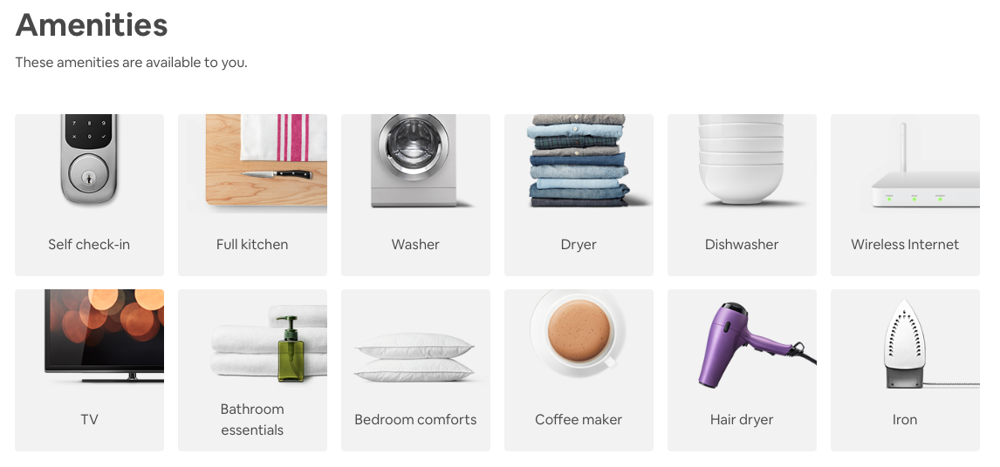
Feature Engineering: Amenities
56 amenities
Total amenities too
Notes:
56+ amenities, formatted in a really messy, difficult to process way. Ended up binarizing each amenities, creating new column for each + number of amenities

Slide 9
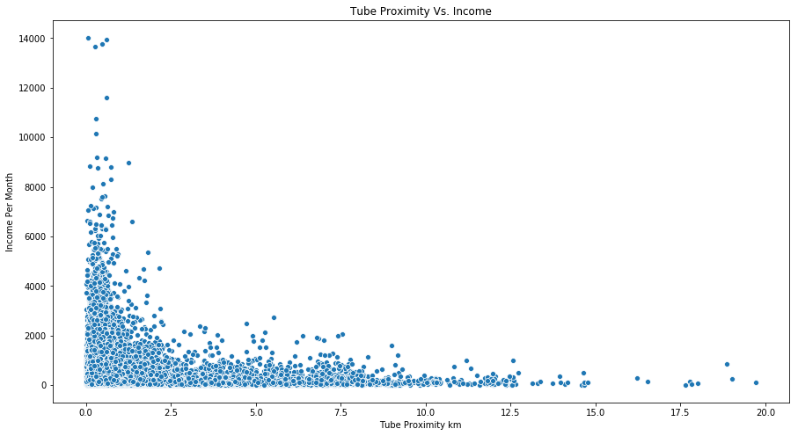
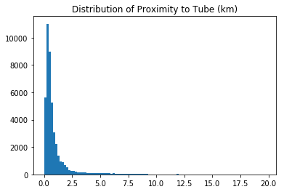
Feature Engineering: Tube Proximity
Boroughs aren’t enough - within each they can vary massively.
What really matters? Convenience!
Included Tube, DLR, Overground - but to an extent!
Tweak or drop distant listings
Notes:
Location is so key - boroughs too broad, not enough info for a model.
What else matters in London accom? Convenience
Note most are very close, especially higher income listings. Some are very far away - turned out they were in areas so far out that the list of overground stations i got from wikipedia didn’t include them. Tweak in future / drop those listings.

Slide 10
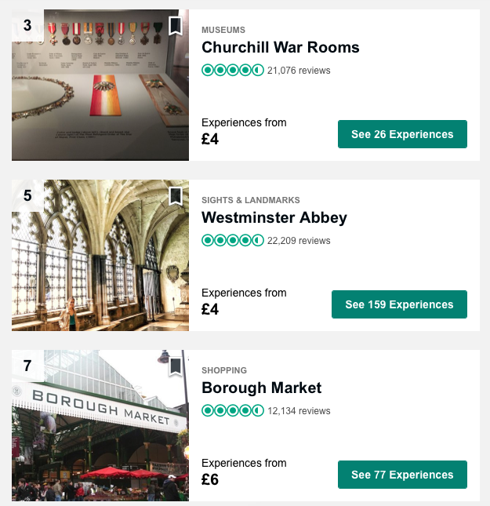
Feature Engineering: Tourist Destinations
Tourists visiting - value added to a listing, and therefore, income possibilities based on proximity to tourist sites
Help model understand why a listing may not seem that great on the surface but earning well
Sourced from TripAdvisor’s Top London Attractions
Bear in mind: Both Tube and tourist proximities use ‘as the crows flies’ distance
Notes:
The idea here is that most of AirBnB's guests are tourists visiting London, so value might be added to a listing based on how close it is to tourist sites. This could help my model understand why a listing that may not seem that great is earning high income - i.e. location and convenience boosts income!

Slide 11
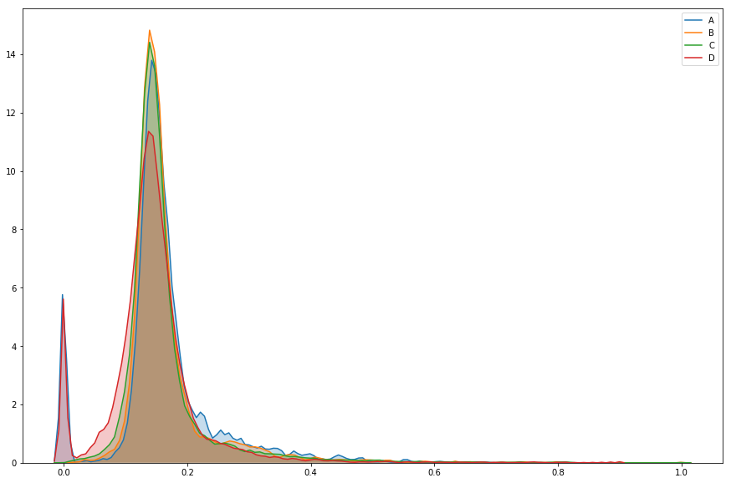
Feature Engineering: Vader Scores On Written Reviews
Histogram of Vader Positive Scores By Income Class
Do positive reviews = more income?
How important are reviews afterall?
A LOT of overlap by income class
Notes:
Pair of strings - had to combine (took a long time actually as 2.5 million). Then sentiment scores on this.
Sentiment analysis to understand the positive, neutral, negative and compound sentiments behind each. I then averaged scores per listing.
Get to income classes later - but this vader pos histogram chart actually showed least overlap of all vader scores.

Slide 12
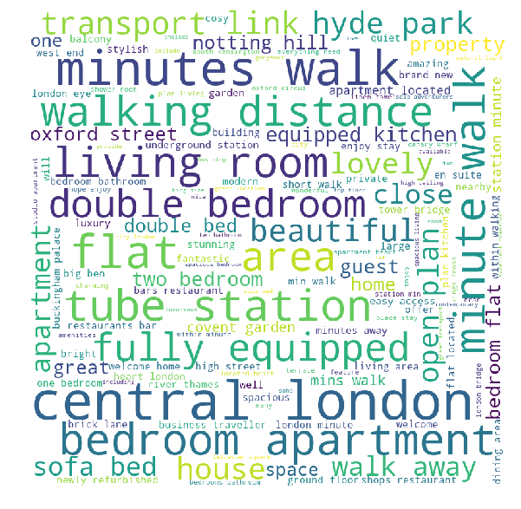
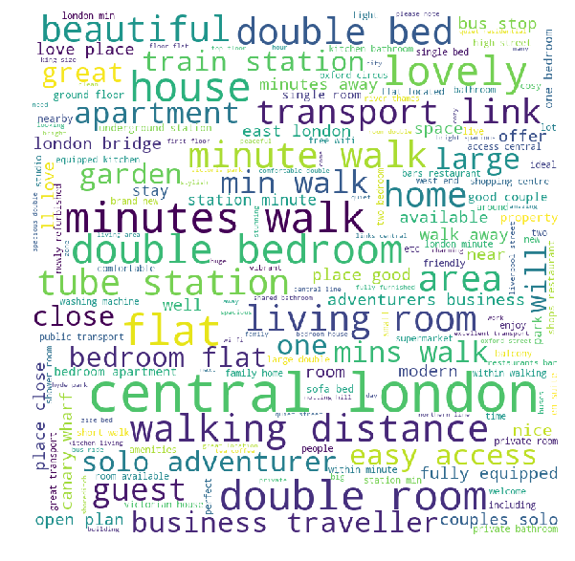
Feature Engineering: Vader Scores On Summary & Description
High-Income Summary Word Cloud
Low-Income Summary Word Cloud
Does the sentiment behind listing descriptions affect income?
Notes:
Pair of strings - had to combine (took a long time actually as 2.5 million). Then sentiment scores on this.
Sentiment analysis to understand the positive, neutral, negative and compound sentiments behind each. I then averaged scores per listing.
Get to income classes later - but this vader pos histogram chart actually showed least overlap of all vader scores.
Would love to have had this for reviews - but took too long

Slide 13
INCOME
(OCCUPANCY RATE x 31 DAYS)*PRICE + (NO. BOOKINGS x CLEANING FEE)
OCCUPANCY RATE
NO. OF BOOKINGS x AVERAGE LENGTH OF STAY 4.6 DAYS
NO. OF BOOKINGS
REVIEWS PER MONTH x 2
=
=
Capped 80%
Or minimum nights if > 4.6 days
=
50% review rate
Notes:
Initially tried using availability_30 existing feature (days in month booked on calendar for next 30 days), looking at last 12 months worth of snapshots, matching with prices at those times, getting income over a year. Used this for quite some time trying to model, and getting terrible scores. Finally, realised it also includes BLOCKED dates on calendar too. Not accurate! Moved to a formula inspired by InsideAirBnB’s site.
Capped OR 80% (a typically good London OR for hotels)
Average length of stay stated by AirBnB specfically for London
Review rate AirBnB says 70%, another site says 30%, took happy middle ground 50%.

Slide 14
Modelling - Feature Selection
Manually
One-by-one added variables to a simple Linear Regression
Lasso
Used Lasso to select key features during modelling
RFE
Recursive Feature Elimination finds the optimum number of features, for which the accuracy is the highest.
Notes:
Major learning point here
Had to exclude formula-based features
Find best set of predictors.
The Recursive Feature Elimination (RFE) method works by recursively removing attributes and building a model on those attributes that remain.
It uses accuracy metric to rank the feature according to their importance.
The RFE method takes the model to be used and the number of required features as input.
It then gives the ranking of all the variables, 1 being most important.
It also gives its support, True being relevant feature and False being irrelevant feature.
152/154 features with LinearRegression 0.39 vs 0.35 score.
Last minute to didn’t follow through on that (also took an entire night to run that code)
Lasso - post modelling, cut out unimportant features

Slide 15
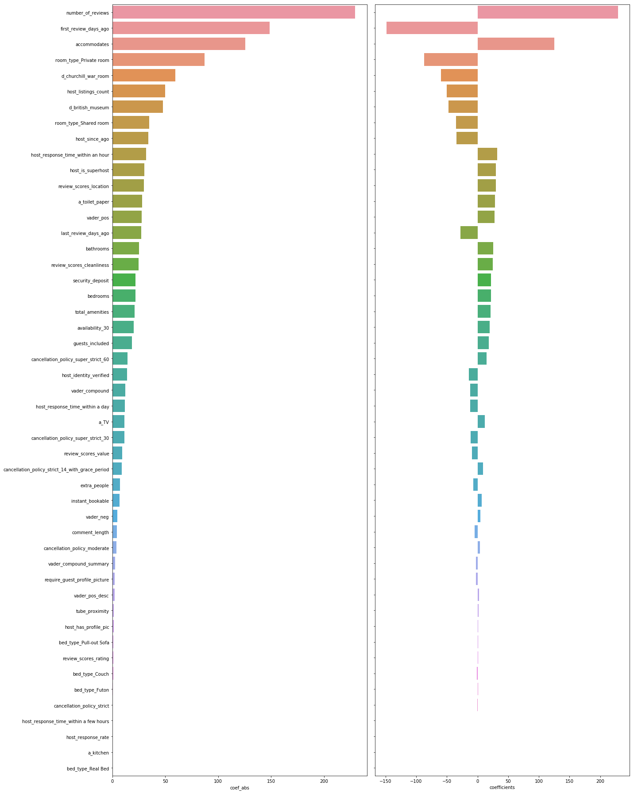
Modelling - Lasso 35%
Number of reviews +£240
First review -£150
Accommodates +£125
Room Type (private) -£80
Distance to Churchill War Rooms -£55
Host Listing Count -£40
Distance to British Museum -£50
Room Type (Shared) -£40
Host since -£40
Host response time (within hour) +£40
Host is superhost +£40
Review scores location +£30
Toilet paper +£25
Vader positive score (reviews) +£25
Last review -£25
Notes:
Good to see lot coeffs and features were engineered - worth it!
Can see some don’t quite make sense - may speak to the accuracy of model
Interestingly, host since, first review, negatively impact income as longer ago. Maybe complacent? Lost novelty?
And host listing count - spread too thin?

Slide 16
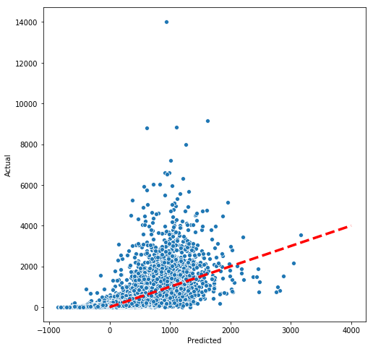
Modelling - Lasso 35%
Number of reviews +£240
First review -£150
Accommodates +£125
Room Type (private) -£80
Distance to Churchill War Rooms -£55
Host Listing Count -£40
Distance to British Museum -£50
Room Type (Shared) -£40
Host since -£40
Host response time (within hour) +£40
Host is superhost +£40
Review scores location +£30
Toilet paper +£25
Vader positive score (reviews) +£25
Last review -£25
Notes:
Negative income predictions - not ideal but can’t cap that- could log transform but less interpretable.
Regression not great at predicting the higher income listings - maybe because few relatively so not much to train on.
More often predicting a lower income than it is (i.e. low false positives in a way).
Not even by a bit - practically not ideal - don’t want to put someone off using airbnb / undervalue the product because doesn’t work well.

Slide 17

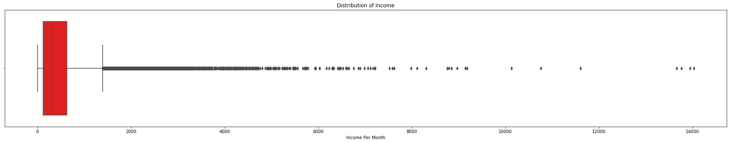
Modelling - CLASSIFICATION
Created 4 income classes (A,B,C,D)
Tried balanced, balanced + log, imbalanced, imbalanced + SMOTE
Most realistic boundaries?
Notes:
This was more out of curiosity - can I get a more accurate model, at the expense of not having coefficients.
Not getting coefficients
Super spread out income, lots outliers at the top. Could omit but I want my model to be able to predict such listings too.

Slide 18
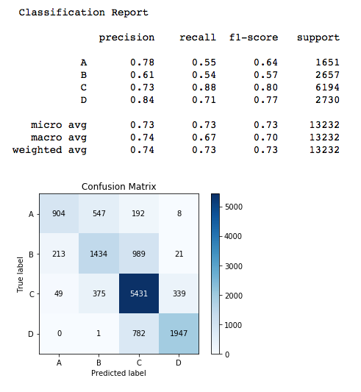
Modelling - SVC 73%

Slide 19
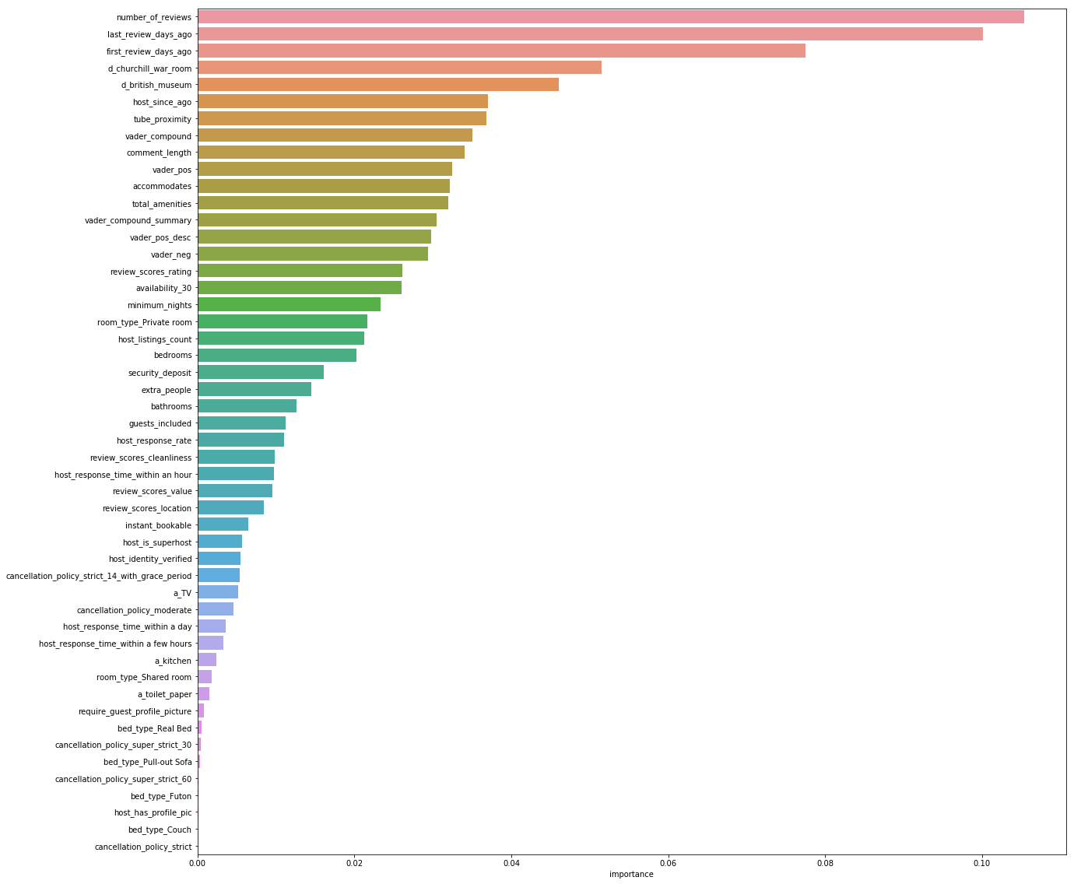
Modelling - RandomForestClassifier 72%
Number of reviews
Last review
First review
Distance to Churchill War Rooms
Distance to British Museum
Host Since
Tube proximity
Vader compound (reviews)
Comment length
Vader positive (reviews)
Accommodates
Total amenities
Vader compound (summary)
Vader positive (description)
Vader negative (reviews)
Lots Vaders!
Notes:
A close second - RFC - possibly more interesting, insightful as see feature importances
Again, lots of feature engineered feats here
Especially vaders - which upon initial EDA looked like they overlapped lots

Slide 20
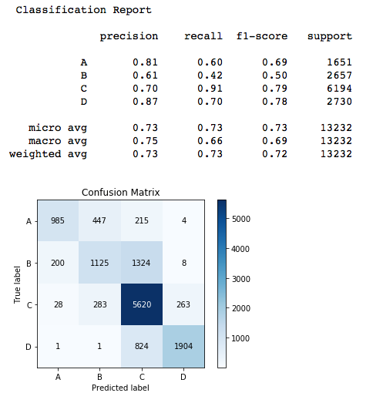
Modelling - RandomForestClassifier
Notes:
Precision better here, but the weighted average F1 slightly better for SVC
Not great at predicting class B. Could tweak boundaries to ‘make more sense’

Slide 21

Risks & Limitations
Target was estimated to begin with
Only used one month worth of information
London is all over the place
Don’t have enough knowledge about occupancy goals / intentions
Notes:
Target estimated - setting things off with lots error already
One month → ignores things like a host taking off market for march but typically good income
London so diverse, difficult for model to understand.
Assumption that hosts have live listings want 100% occ rate and trying to get that. NOT THE CASE:
Some hosts just want a weekend here and there - and get 100% occ + good income on that. An amazing listing, ticks all the boxes for high income but don’t intend on it vs. worse listing thats available all the time and gets more income.

Slide 22
Next Steps
Deployment
Image processing ( composition, colour, brightness etc)
Individual boroughs (next slide)
Or clustering to find out how to segment data to better predict
Panel regression data
Distances calculated via Google maps
Airbnb Plus
PCA - though doesn’t help with finding precise features
More nuanced review analysis
An optimisation model: Find optimal price and occupancy rate to maximise income while minimising fixed and variable costs.
Other cities
App where you can input your features / connect to your AirBnB account and it outputs predicted income. If you’re below the prediction, recommendations given as to which features to focus on, and to what extent would boost income.

Slide 23
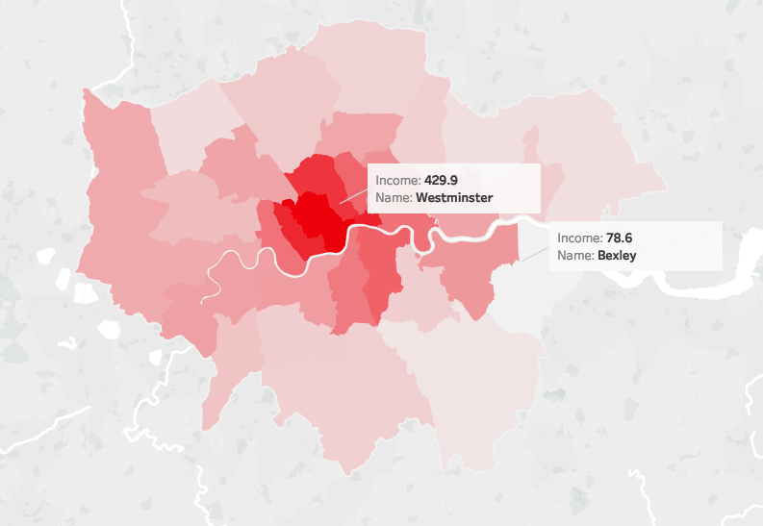
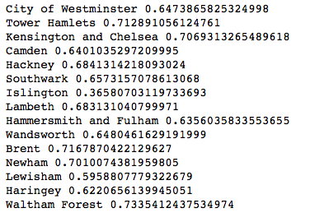
Boroughs
Notes:
Boroughs behave so differently- income, occ rate, price, types of guests (long term, near airport, business, tourist). Worth bundling them / own unique models.

Slide 24
Final Recommendations
Key themes amongst important features across models:
In your control
Amenities provided (tell them you have toilet paper!)
Response rate (within the hour!)
Summary and description language (be mostly positive!)
Accommodates (add a sofa bed!)
Superhost (earn that badge!)
Mostly out of your control:
What others write (you want positive reviews!)
Location, location, location! (Close to tube stations and certain areas of town)

Slide 25
THANK YOU!!!
😄
😄
😄
😄
😄
😄
😄
😄
😄
😄
😄
😄
😄
😄
😄
😄
😄

