Slide 1
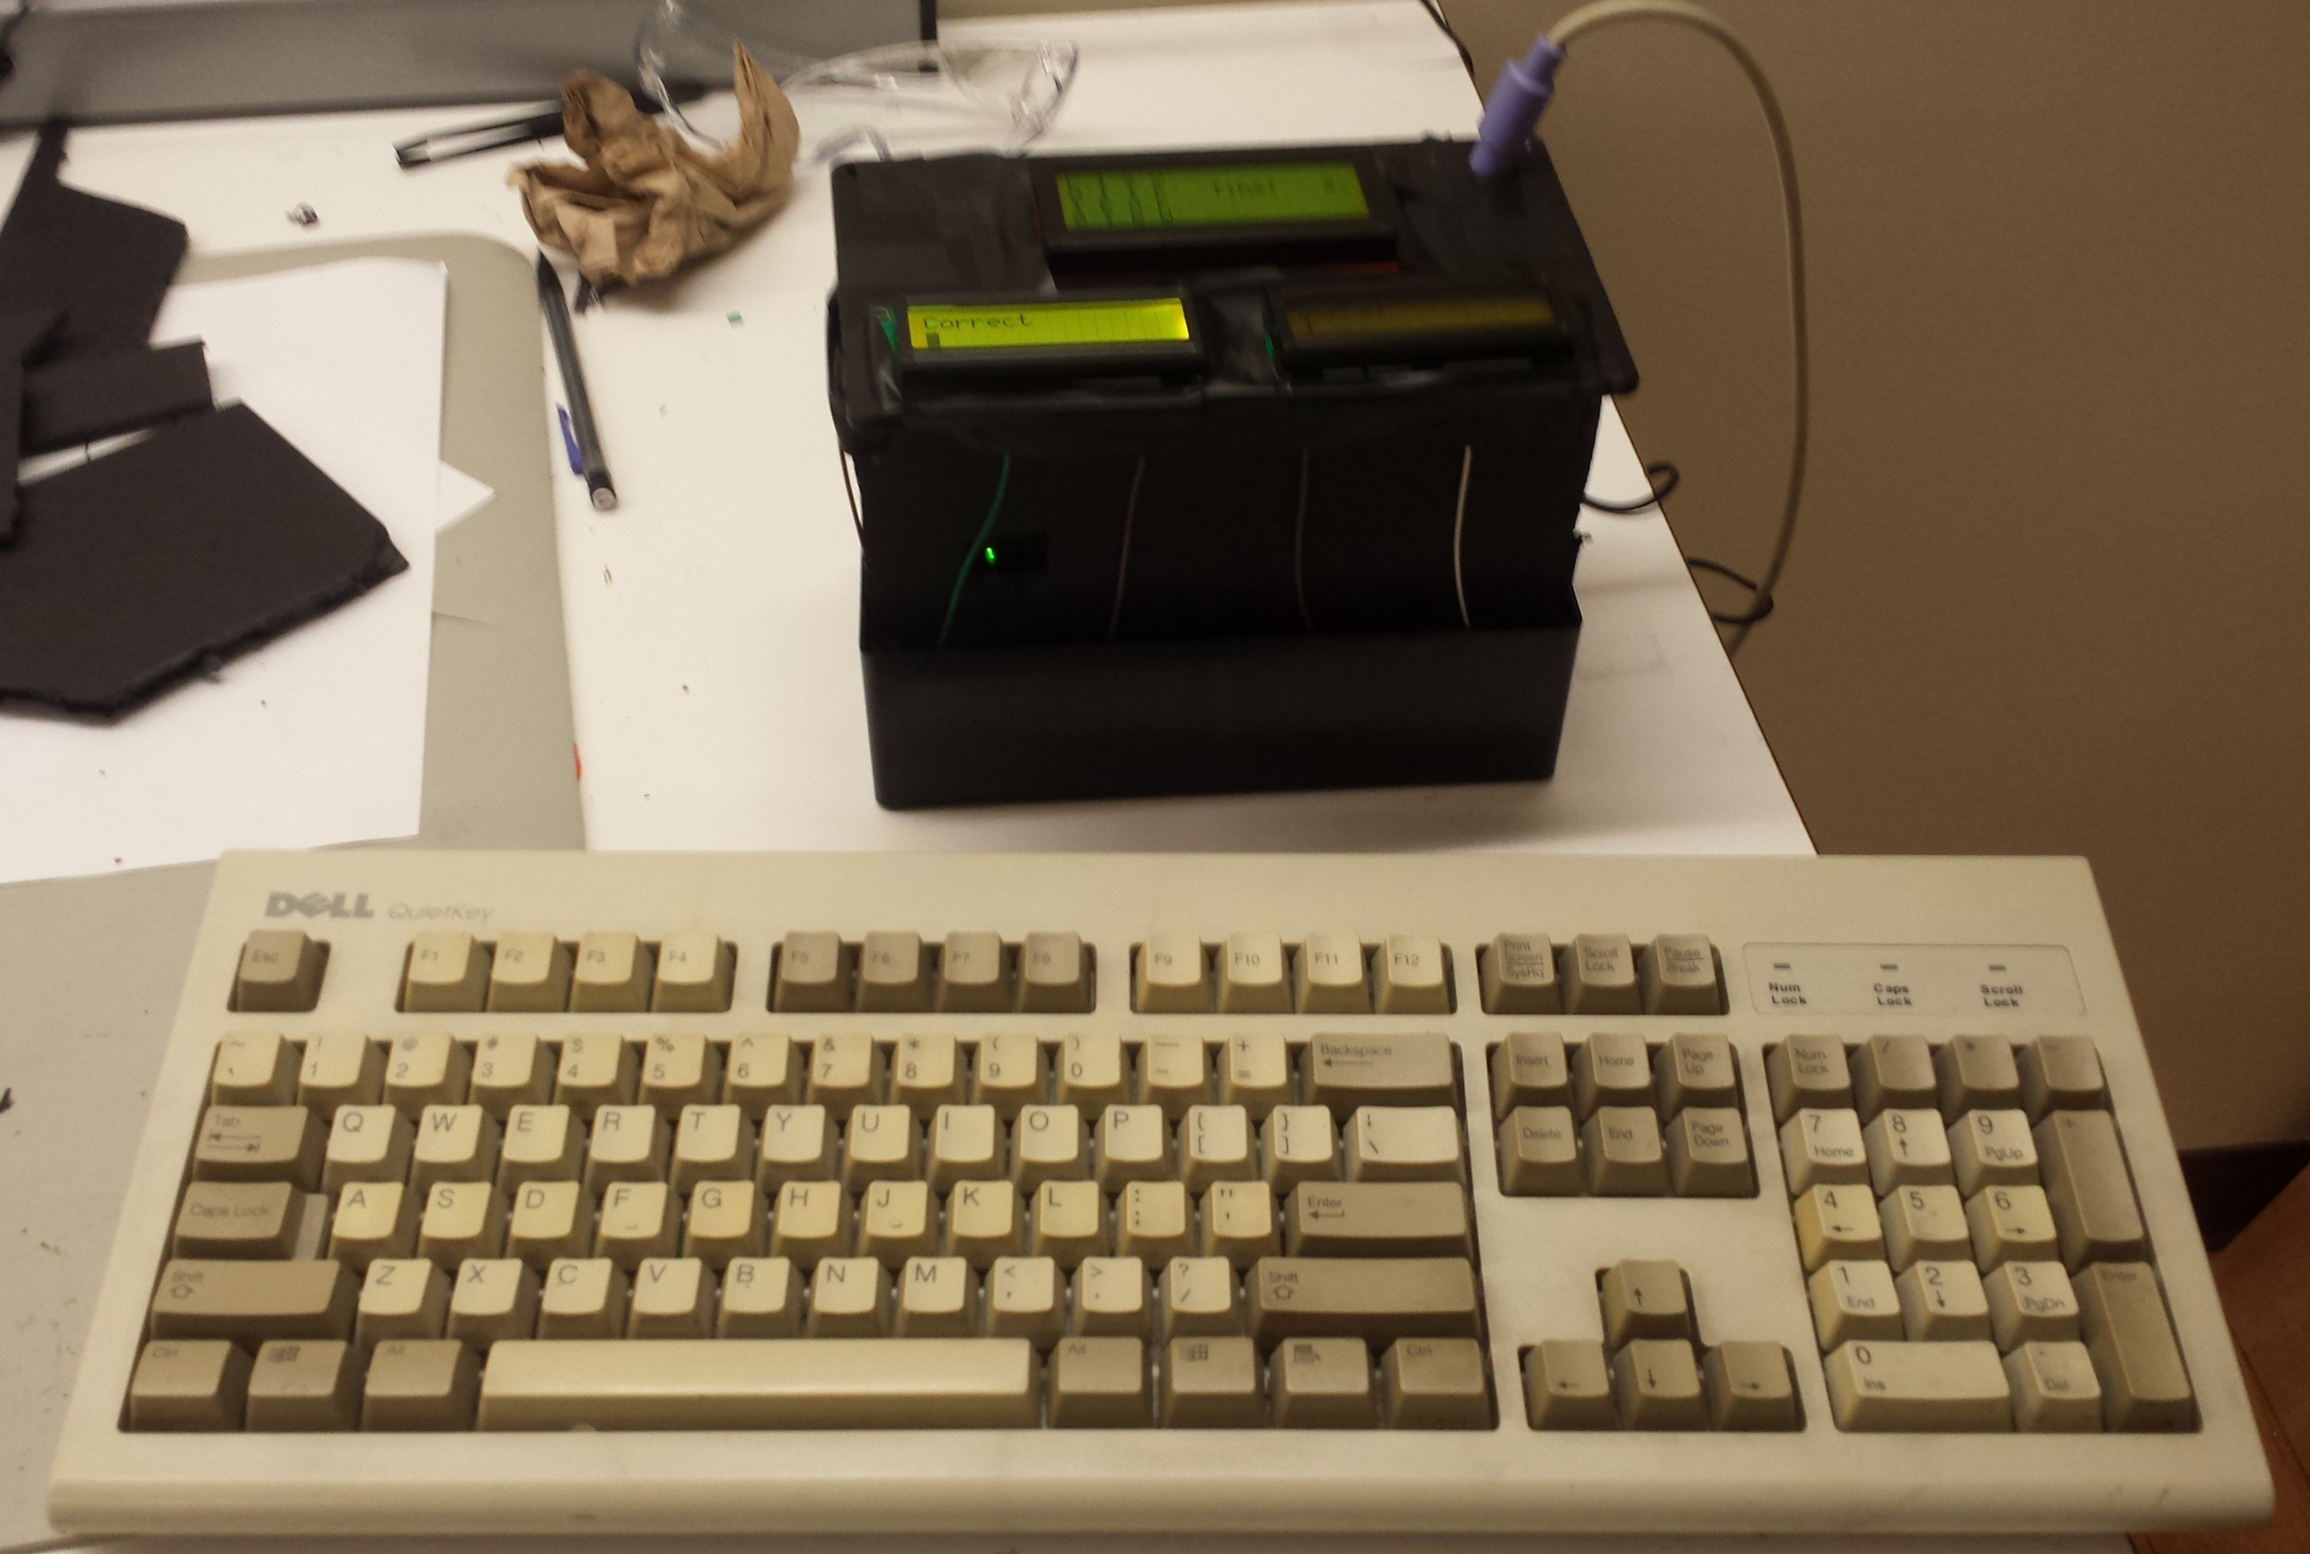

ECE 362 Embedded Microcontroller Mini-Project − Fall 2014
Team 29: ECE362 Digi-Boggle
Components used:
1x 20x4 LCD Display
2X 20x2 LCD Display
2x PS/2 Wired Connector
2x PS/2 Keyboards
1x 74HC74 Flip-flop
1x 74HC04 Inverter
1x W25Q80BV Mb SPI Flash
1x 74LVC245 Logic Level Shifter
Peripherals used:
PWM for gradual LCD backlight brightness increase and “time low” flashing
SPI for interfacing with W25Q80BV Flash chip.
Timer for game countdown and seed randomization for game generation
“Bit-banging” was used in order to interface with the keyboard by triggering interrupts through IRQ/XIRQ
Parallel interface with LCD displays sharing data on individual clocks
Objective:
Implement the word game Boggle by utilizing the MC9S12C32 microcontroller. Users are able to interface with the microcontroller to play the game through the use of a wonderfully “retro” PS/2 keyboard and the words that are found in the randomly generated or user-defined grid are checked for validity and previous usage.
Team Members:
Luke Neuman, Subhav Ramachandran, Brian Rieder
Digijock(ette)-Strength Digital System DesignTM

