Slide 1
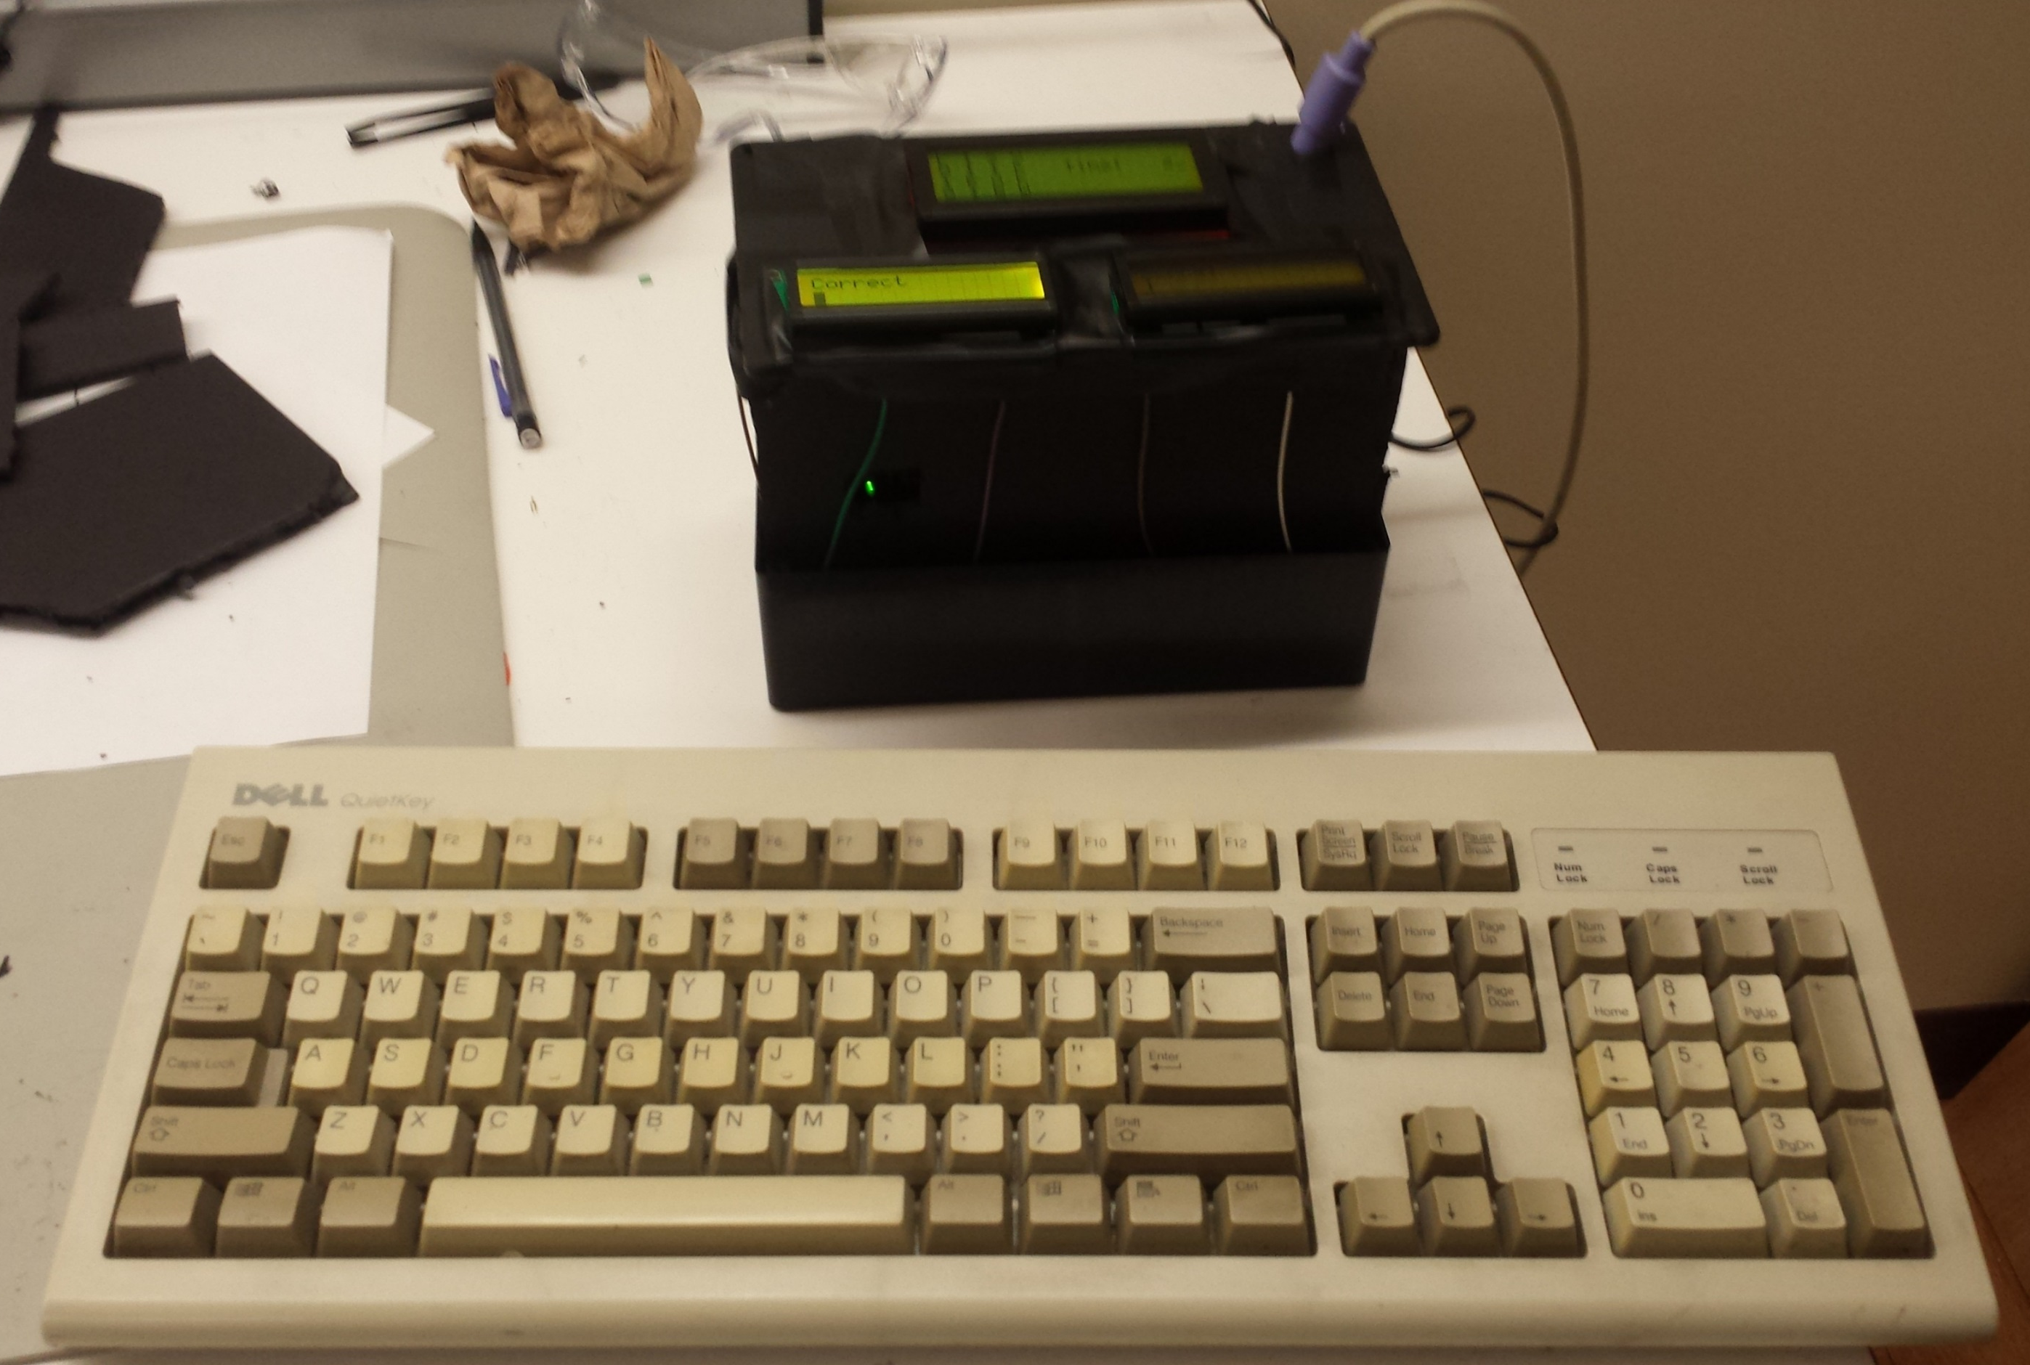
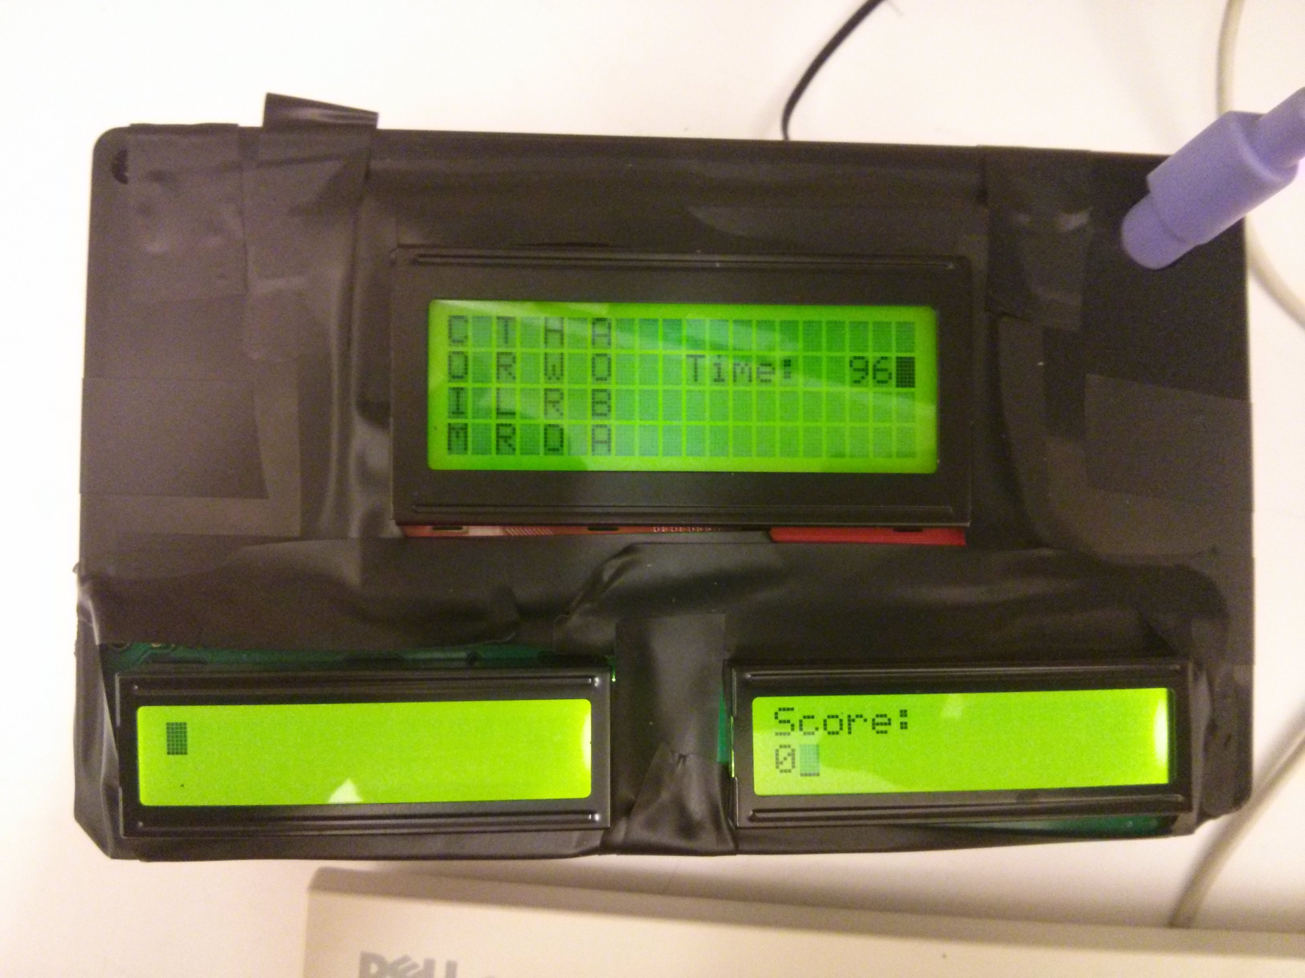

ECE 362 Embedded Microcontroller Mini-Project − Fall 2014
Team 29: ECE362 Digi-Boggle
Objective
Implement the word game Boggle by utilizing the MC9S12C32 microcontroller. Users are able to interface with the microcontroller to play the game through the use of a wonderfully “retro” PS/2 keyboard. Words entered are validated against the randomly generated character grid and a dictionary stored in external flash memory.
Peripherals and Interfacing
PWM for gradual LCD backlight brightness increase and “time low” flashing
SPI for interfacing with W25Q80BV Flash chip.
Timer for game countdown and seed randomization for game generation
“Bit-banging” was used in order to interface with the keyboard by triggering interrupts through IRQ/XIRQ
Parallel interface with LCD displays sharing data on individual clocks
Components
MC9S12C32 micro and docking board
1x 20x4 LCD Display
2X 16x2 LCD Display
2x PS/2 Wired Connector
2x PS/2 Keyboards
1x 74HC74 Flip-flop
1x 74HC04 Inverter
1x W25Q80BV Mb SPI Flash
1x 74LVC245 Logic Level Shifter
3.3 V regulator
Team Members:
Luke Neumann, Subhav Ramachandran, Brian Rieder
Digijock(ette)-Strength Digital System DesignTM
youtube.com/watch?v=F9_-OybG7bw

