Slide 1
A brief introduction to Functional Data Analysis
Gabriel Graciano Herrera
Mentor: Lucia Tabacu

Slide 2
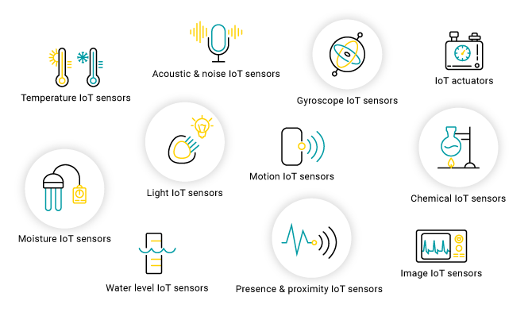
FDA is useful to analyze data from a variety of sensors, medical equipment like electrocardiogram machines, accelerometers, etc, data from climate, weather and financial, among others.

Slide 3
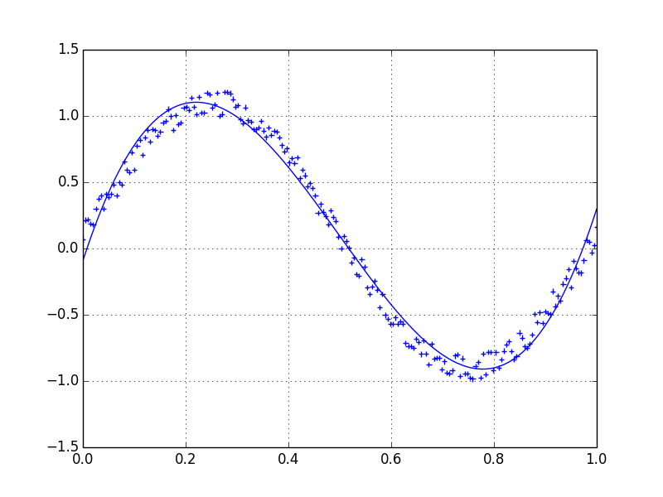
Functional data are the variables or units of interest in a dataset that can view as a smooth curve or function

Slide 4

A more technical definition
Observations on subjects i taht you can imagine as arising from evaluation of a subj-random curve $X_{i}(∙)$ defined on a [a,b] at finite frid of points, $t_{i1},…,t_{im}$. Often such evaluations are contaminated With noise; so we observe $X_{i}\left(t_{ij}\right)+Noise_{ij}$

Slide 5
Type that depends on the data
Type that depends on the observations
Independent replications
Single long record
Input/Output events
Multivariate events
Sparse
Dense

Slide 6
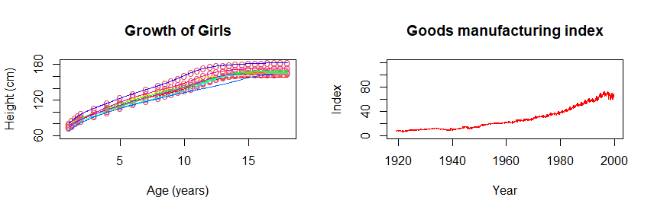
Independent replications
Sparse
Single long record
Dense

Slide 7
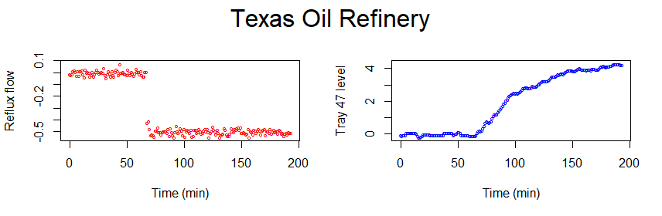
Input and Output event
Dense

Slide 8
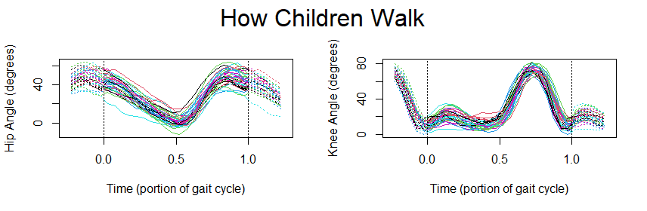
Multivariate Event
Dense

Slide 9
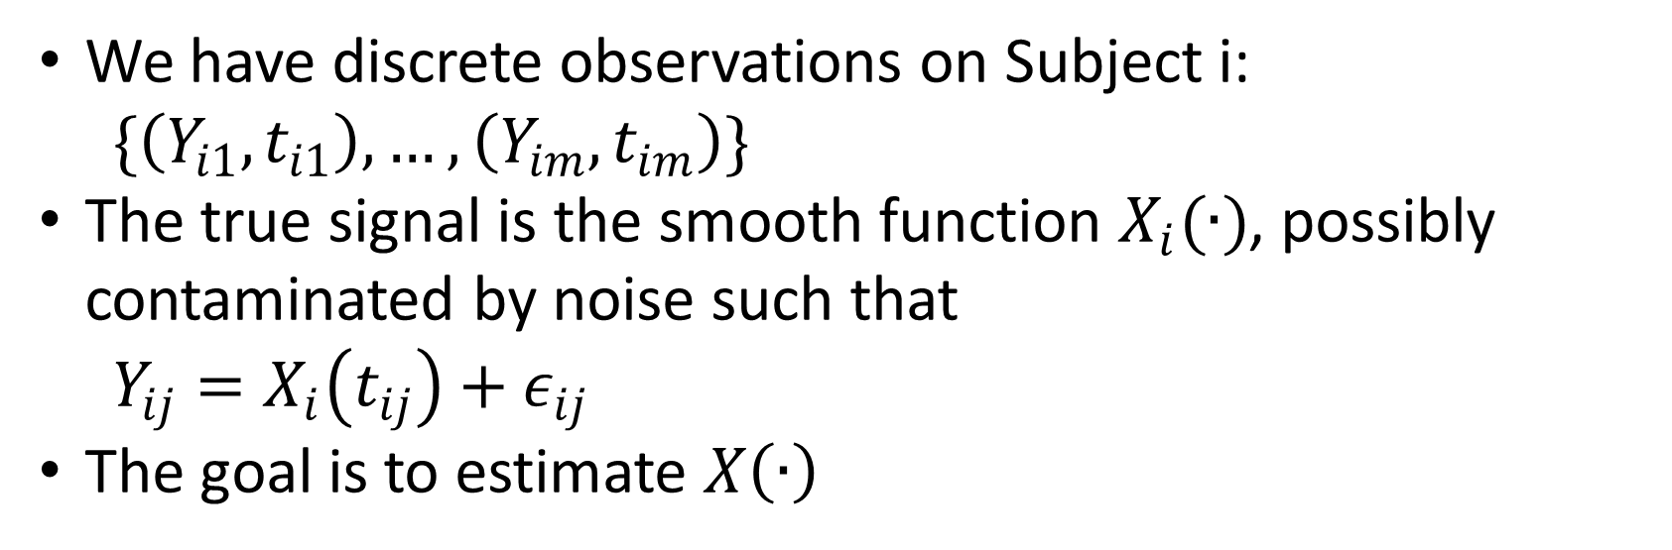
How to build functions
We have discrete observations on Subject i:
$$\{\left(Y_{i1},t_{i1}\right),…,\left(Y_{im},t_{im}\right)\}$$
The true signal is the smooth function $X_{i}(∙)$, possibly contaminated by noise such that
$$Y_{ij}=X_{i}\left(t_{ij}\right)+ε_{ij}$$
The goal is to estimate $X\left(∙\right)$

Slide 10

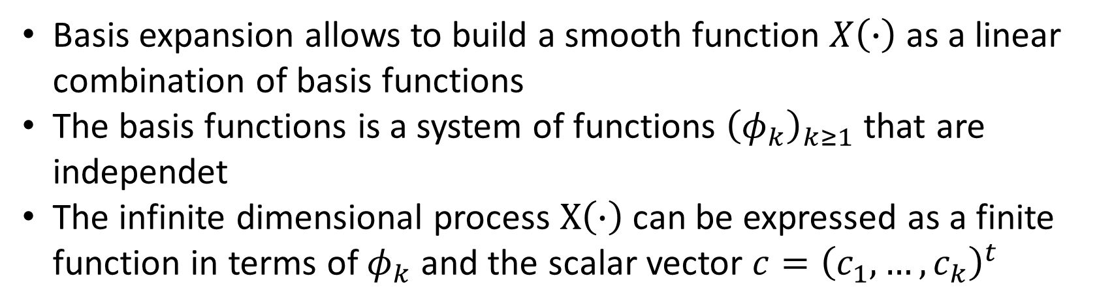
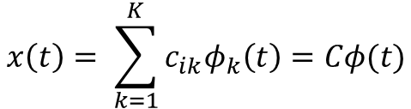
Basis expansion
Basis expansion allows to build a smooth function $X\left(∙\right)$ as a linear combination of basis functions
The basis functions is a system of functions ${\left(φ_{k}\right)}_{k≥1}$ that are independet
The infinite dimensional process $X\left(∙\right)$ can be expressed as a finite function in terms of $φ_{k}$ and the scalar vector $c={\left(c_{1},…, c_{k}\right)}^{t}$
Single Sample
More than one samples
$$x\left(t\right)= \sum_{k=1}^{K}{c_{k}φ_{k}(t)}$$
$$x\left(t\right)= \sum_{k=1}^{K}{c_{ik}φ_{k}\left(t\right)=Cφ(t)}$$

Slide 11
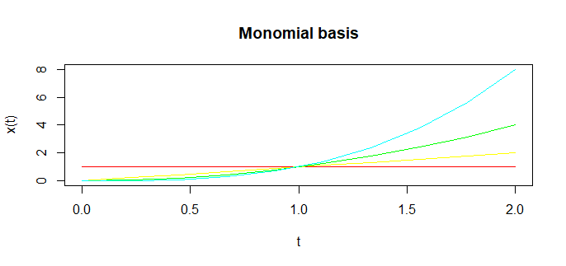

$$φ\left(t\right)=1 \\ φ\left(t\right)=t \\ φ\left(t\right)=t^{2} \\ φ\left(t\right)=t^{3}$$

Slide 12
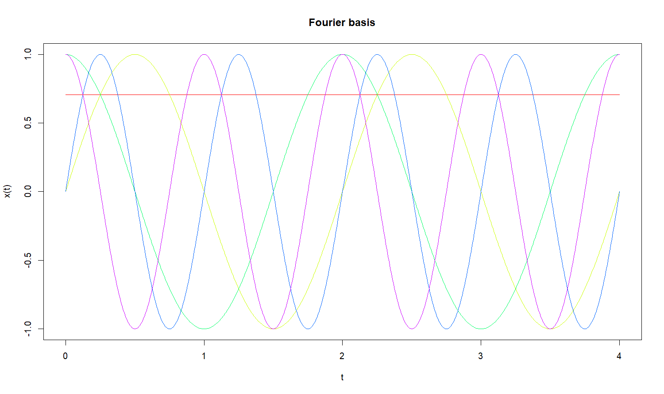

$$φ_{1}=1 \\ φ_{2}=\sin\left(ωt\right) \\ φ_{3}=\cos\left(ωt\right) \\ φ_{4}=\cos\left(2ωt\right) \\ φ_{5}=\cos\left(2ωt\right) \\ . \\ . \\ . \\ φ_{k}=\cos\left(mωt\right)$$ $$K=1+2m \\ T=period \\ ω=\frac{2K}{T}$$
Useful for periodic data

Slide 13
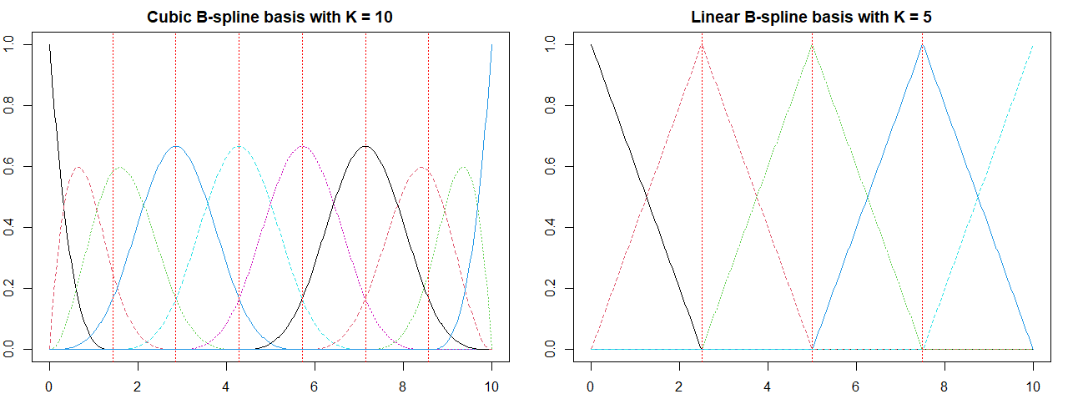
Breakpoints
Knots
Order
Degree
Useful for non-periodic data

Slide 14
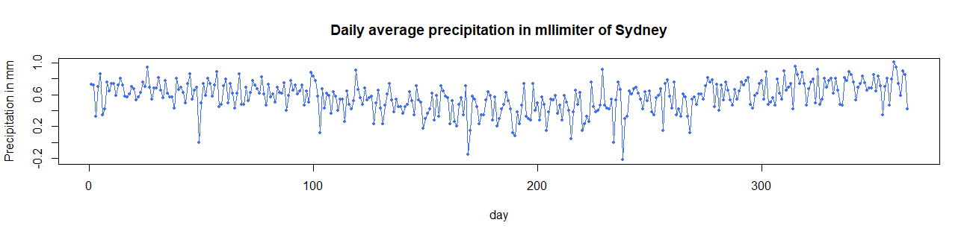
We can see that some points differ significantly from other values, to minimize the difference we can smooth the observed points and build a function that match them. There are multiple approaches to smooth a function, we used the linear regression approach for smoothing.

Slide 15
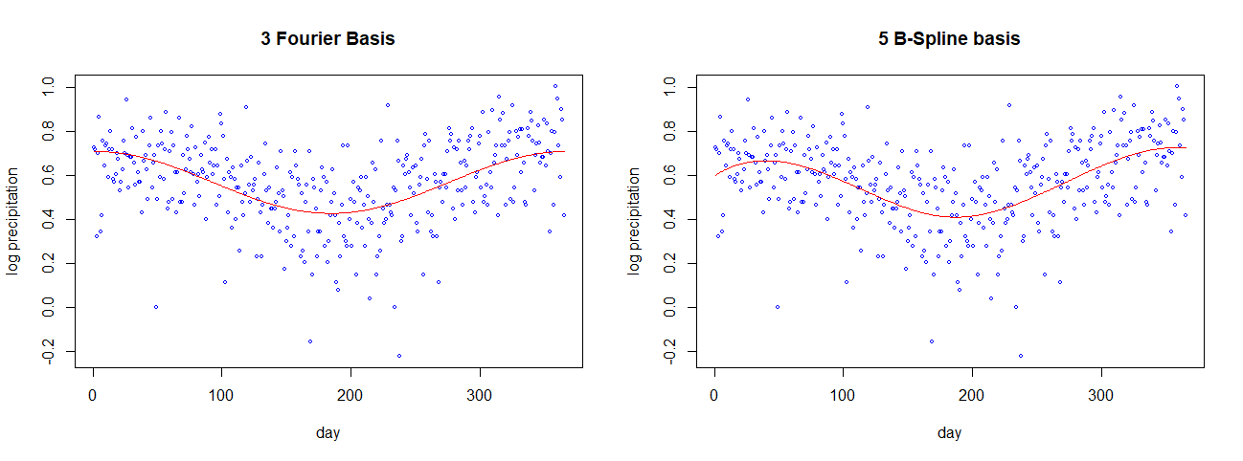
The left and right functions look quite similar, the process of building a function is try and error, often a Fourier basis can match very well a type of data and do a bad job in other, there are not a guide to build functions.

