Slide 1

Week 7: Decisions under uncertainty part 2 + Risk
Instructor: Brielle K Thompson
Course: NAT_R 8001 Decision Analysis for Research and Management of Natural Resources
Notes:
First 30 minutes = intro
Next 60 = slides
Final 30 = activity

Slide 2
Begin with a few final presentations
Jake
Seth
Georgia
Madeline
Emma

Slide 3

Review of last week
Background on types of uncertainties
Linguistic vs Epistemic uncertainties
Learned about how sensitivity analysis, value of information, and adaptive management can be used in decisions where uncertainty may impede management
Sensitivity analysis
Perturbations to understand whether uncertainty is important to resolve
Value of information
Analysis to quantify the improvement of an outcome if uncertainty is resolved
Adaptive management
Formal process of “learning by doing” for repeated decisions

Slide 4
Working with uncertainty
Today:
How do we make decisions under uncertainty & risk?
Three Options:
Make decisions anyway
Risk tools: e.g., Decision Trees, Utility Theory
Conduct research to reduce uncertainty
Value of Information
Learn while managing
Adaptive management
Risk = topic for this week!
last week
Developed by Sarah Converse

Slide 5

Assessing risk
Risk = Chance of an unfavorable outcome
Making a decision under uncertainty involves the decision maker’s risk perception and attitude towards that risk
Perception: a subjective judgment of risk (cognitive)
Attitude: an individual’s tendency to avoid or seek risks (behavioral)
Developed by Sarah Converse

Slide 6

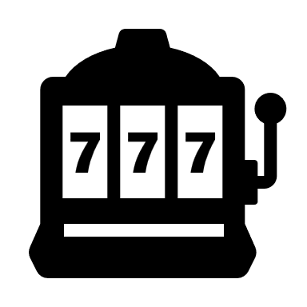

Risk attitude examples
Risk-averse
Buying insurance
You would pay a sure amount to avoid a gamble with an average loss that is smaller than the sure payment. Why do it?
Risk-seeking
Buying a lottery ticket
You would pay a sure amount to enter a gamble with a smaller average return than the sure payment. Why do it?
Risk-neutral
Choosing a standard investment with average returns (e.g., S&P 500)
You would put an investment in something that on average will give you good returns
*risk averse investment = bonds/high-yield savings
*risk seeking investment = individual stocks, crypto
Developed by Sarah Converse

Slide 7



Risk attitude examples
Risk-averse
Accepting a salary instead of commission-based pay
Risk-seeking
Chooses commission-based pay hoping for a big payout despite risk
Risk-neutral:
Indifferent between salary or commission as long as average payout is the same
Developed by Brielle Thompson

Slide 8
Back to decision trees:
A useful tool for dealing with uncertainty
Consequences
Uncertainty
Alternatives
Decision
Developed by Sarah Converse

Slide 9
Decision tree example:
Decision = Whether or not to create a no-habitat buffer around the refuge
Acres of native habitat
Action sacrifices some habitat
70
Species invades?
No
Yes
Action buffers invasion
Act to protect against an invasive species?
Action
20
Habitat not affected
100
No action
No
Species invades?
Yes
Habitat lost by invasion
0
Developed by Sarah Converse

Slide 10
Decision tree example:
Decision = Whether or not to create a no-habitat buffer around the refuge
Acres of native habitat
*Adding probabilities
Action sacrifices some habitat
P = 0.65
70
Species invades?
No
Yes
Action buffers invasion
Act to protect against an invasive species?
Action
P = 0.35
20
Habitat not affected
P = 0.5
100
No action
No
Species invades?
Yes
Habitat lost by invasion
P = 0.5
0
Developed by Sarah Converse

Slide 11
Decision tree example:
Decision = Whether or not to create a no-habitat buffer around the refuge
Acres of native habitat
*Calculating expected value
Expected Value = sum of (outcomes x probabilities)
= 70(0.65) + 20(0.35) = 52.5
Action sacrifices some habitat
P = 0.65
70
Species invades?
No
Yes
Action buffers invasion
Act to protect against an invasive species?
Action
P = 0.35
20
EV = 52.5 ac
Habitat not affected
P = 0.5
100
No action
No
Species invades?
EV = ??
What is the EV?
Yes
Habitat lost by invasion
P = 0.5
0
Developed by Sarah Converse

Slide 12
Decision tree example:
Decision = Whether or not to create a no-habitat buffer around the refuge
Acres of native habitat
*Calculating expected value
Expected Value = sum of (outcomes x probabilities)
= 70(0.65) + 20(0.35) = 52.5
Action sacrifices some habitat
P = 0.65
70
Species invades?
No
Yes
Action buffers invasion
Act to protect against an invasive species?
Action
P = 0.35
20
EV = 52.5 ac
Habitat not affected
P = 0.5
100
No action
No
Species invades?
EV = 50
Yes
Habitat lost by invasion
P = 0.5
0
Developed by Sarah Converse

Slide 13
Activity: Your risk attitude
Consider the following game show with two options:
Take the gamble: Select one of two doors and claim a prize. Behind one door is $1000 and behind the other is $0.
Take the sure thing: Take $500 instead.
Which option would you choose?
Draw a tree to represent your options.
Developed by Sarah Converse

Slide 14
Activity: Your risk attitude
EV = Outcome x Probability
$1000
Win
What would you do if you were:
risk neutral?
risk seeking?
risk averse?
p = 0.5
Select one door
$0
Gamble
Lose
EV = $500
p = 0.5
Choose an option
p = 1
$500
Sure thing
EV = $500
Developed by Sarah Converse, Brielle Thompson
Notes:
If you are risk neutral. You would be indifferent.
If you are risk seeking. You would want to select the door
If you are risk averse. You would want to take the sure thing.

Slide 15
Approaches to risk:
Expected value (EV)
Method = outcomes x probabilities
Solution = maximize EV
Developed by Sarah Converse

Slide 16
Approaches to risk example with EV:
Should you adopt new technology to increase production of fry at a hatchery?
EV = Outcome x Probability
70,000 fry
Win
Does it work?
p = 0.8
Yes
p = 0.2
Lose
EV = 58K
10,000 fry
Add new technology to a hatchery?
No
EV = 40K
40,000 fry
Developed by Sarah Converse
Notes:
Yes or no?

Slide 17
Activity: Risk Discussion
Scenario 1: You can either reintroduce an endangered species now with limited data or wait 3 years for better data but risk habitat degradation
Option A: Reintroduce now
Option B: Wait for data
Scenario 2: You can invest in a new monitoring technology that might double detection rates, but it could fail completely. Or you can continue to use your current monitoring technology which produces worse detection but is consistent
Option A: Invest in new technology
Option B: Use current technology
Scenario 3: You can implement a prescribed burn now to reduce wildfire risk, but weather conditions are marginal and could lead to unintended spread. Waiting for ideal conditions may delay the burn for months.
Option A: Burn now
Option B: Wait
For each scenario would you rather choose option A or B. Why?

Slide 18
Approaches to risk:
Expected value (EV)
Method = outcomes x probabilities
Solution = maximize EV
Expected utility (EU)
Method = Translate outcome onto a scale that incorporates risk attitude
Solution = Maximize EU
Developed by Sarah Converse

Slide 19
Expected utility:
Useful for non-neutral risk attitudes
Convert outcome to a utility score to represent attitude toward risk
e.g., winning $1000 has U=1.0, $500 in pocket has U=0.6
Can be applied to multiple objectives
There are a variety of ways to determine utility
Developed by Sarah Converse

Slide 20
Approaches to risk example:
Should you adopt new technology to increase production of fry at a hatchery?
70,000 fry
U = 1
*Assign highest outcome utility of 1
EU = assign utilities
Win
Does it work?
p = 0.8
Yes
p = 0.2
Lose
*Assign lowest outcome utility of 0
EV = 58K
10,000 fry
U = 0
Add new technology to a hatchery?
No
?????
40K is halfway between 10K and 70K
EV = 40K
40,000 fry
U = ?
Developed by Sarah Converse, Brielle Thompson

Slide 21
Approaches to risk example:
Should you adopt new technology to increase production of fry at a hatchery?
1.00
EU = assign utilities
Utility of 40 K?????
40K is halfway between 10K and 70K
risk neutral
0.75
Assigning EU(40K) = 0.5 makes you risk neutral
Utility
0.50
0.25
0.00
0
20
40
60
80
Hatchery production (1000s)
Developed by Sarah Converse, Brielle Thompson

Slide 22
Approaches to risk example:
Should you adopt new technology to increase production of fry at a hatchery?
1.00
risk averse
EU = assign utilities
Assigning EU(40K) > 0.5 makes you risk averse
(Curve is concave showing diminishing marginal utility)
Utility of 40 K?????
40K is halfway between 10K and 70K
risk neutral
0.75
Utility
0.50
0.25
0.00
0
20
40
60
80
Hatchery production (1000s)
Developed by Sarah Converse, Brielle Thompson

Slide 23

Aside: diminishing utility
Developed by Brielle Thompson

Slide 24
Approaches to risk example:
Should you adopt new technology to increase production of fry at a hatchery?
1.00
risk averse
EU = assign utilities
Utility of 40 K?????
40K is halfway between 10K and 70K
risk neutral
0.75
Utility
0.50
risk seeking
Assigning EU(40K) < 0.5 makes you risk seeking
(Curve is convex showing increasing marginal utility)
0.25
0.00
0
20
40
60
80
Hatchery production (1000s)
Developed by Sarah Converse, Brielle Thompson

Slide 25
Using Gambles to Determine Utility
Probability equivalence:
What probability of getting 70K fry vs 10K fry would you view as equivalent to a sure thing of getting 40K?
That is, at what probability of winning would you be indifferent to the gamble versus the sure thing?
We can show algebraically that this probability is equal to the utility of the sure thing
Developed by Sarah Converse, Brielle Thompson

Slide 26
Probability equivalence:
For a given decision maker, let’s imagine that p would have to be large to make them indifferent, e.g., p = 0.9
70,000 fry
U = 1
Win
Does it work?
p = 0.8
Yes
p = 0.2
Lose
U = 0
EV = 58K
10,000 fry
Add new technology to a hatchery?
No
EV = 40K
40,000 fry
U = 0.9
Developed by Sarah Converse, Brielle Thompson

Slide 27
Probability equivalence:
1.00
risk averse
For a given decision maker, let’s imagine that p would have to be large to make them indifferent, e.g., p = 0.9
risk neutral
0.75
RISK AVERSE
Utility
0.50
risk seeking
0.25
0.00
0
20
40
60
80
Hatchery production (1000s)
Developed by Sarah Converse, Brielle Thompson

Slide 28
Probability equivalence:
For a given decision maker, let’s imagine that p would have to be large to make them indifferent, e.g., p = 0.1
70,000 fry
U = 1
Win
Does it work?
p = 0.8
Yes
p = 0.2
Lose
U = 0
EV = 58K
10,000 fry
Add new technology to a hatchery?
No
EV = 40K
40,000 fry
U = 0.1
Developed by Sarah Converse, Brielle Thompson

Slide 29
Probability equivalence:
1.00
risk averse
For a given decision maker, let’s imagine that p would have to be large to make them indifferent, e.g., p = 0.1
risk neutral
0.75
RISK SEEKING
Utility
0.50
risk seeking
0.25
0.00
0
20
40
60
80
Hatchery production (1000s)
Developed by Sarah Converse, Brielle Thompson

Slide 30
Probability equivalence:
For a given decision maker, let’s imagine that p would have to be large to make them indifferent, e.g., p = 0.5
70,000 fry
U = 1
Win
Does it work?
p = 0.8
Yes
p = 0.2
Lose
U = 0
EV = 58K
10,000 fry
Add new technology to a hatchery?
No
EV = 40K
40,000 fry
U = 0.5
Developed by Sarah Converse, Brielle Thompson

Slide 31
Probability equivalence:
1.00
risk averse
For a given decision maker, let’s imagine that p would have to be large to make them indifferent, e.g., p = 0.5
risk neutral
0.75
RISK NEUTRAL = EV
Utility
0.50
risk seeking
0.25
0.00
0
20
40
60
80
Hatchery production (1000s)
Developed by Sarah Converse, Brielle Thompson

Slide 32
Probability equivalence:
1.00
risk averse
We ask these gambles for more hatchery outcomes to obtain more points on the utility curves!
We can use models to create an equation for utility (Equation that fits the curve!).
risk neutral
0.75
Utility
0.50
risk seeking
0.25
0.00
0
20
40
60
80
Hatchery production (1000s)
Developed by Sarah Converse, Brielle Thompson

Slide 33
If you know the decision maker’s risk attitude:
Assign utility functions:
Example:
Line = equal utility (risk neutral)
Logistic = diminishing marginal utility (risk averse)
Power/Exponential = increasing marginal utility (risk seeking)
Developed by Sarah Converse, Brielle Thompson

Slide 34
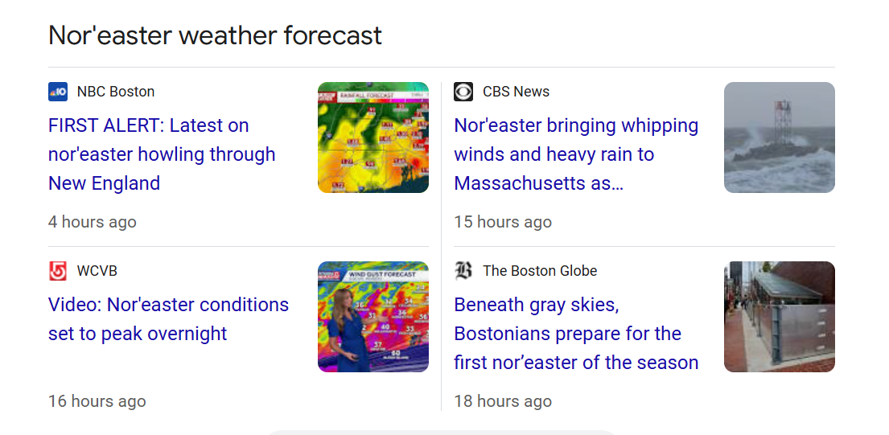
Brielle’s flight risk example:

Slide 35
Brielle’s flight risk example:
Pre-trip decision
Return trip decision
Which return flight should I take?
Do not cancel trip on Friday night
Flight options after hearing about the Nor’easter
Miss best friend’s wedding
Cancel trip on Friday night
U = 0

Slide 36
Brielle’s flight risk example:
Pre-trip decision
Return trip decision
Change flight
(5:30am Monday)
Flight status?
Which return flight should I take?
Do not cancel trip on Friday night
Flight options after hearing about the Nor’easter
Keep flight
(12pm Monday)
Flight status?
Switch to Tuesday (12pm departure)
Miss best friend’s wedding
Cancel trip on Friday night
U = 0
Flight status?

Slide 37
Brielle’s flight risk example:
Pre-trip decision
Return trip decision
Change flight
(5:30am Monday)
Flight status?
p = 0.6
No issues
U = 0.8
Which return flight should I take?
p = 0.35
Delayed & miss connection
Do not cancel trip on Friday night
U = 0.6
p = 0.05
Keep flight
(12pm Monday)
Cancel fly out to Tuesday
U = 0
Flight options after hearing about the Nor’easter
Flight status?
p = 0.2
No issues
U = 1
p = 0.7
Switch to Tuesday (12pm departure)
Delayed & miss connection
U = 0.5
p = 0.1
Miss best friend’s wedding
Cancelled fly out to Tuesday
U = 0
Cancel trip on Friday night
U = 0
Flight status?
p = 0.9
No issues
U = 0
p = 0.1
Delayed & miss connection
U = 0

Slide 38
Brielle’s flight risk example:
Pre-trip decision
Return trip decision
Change flight
(5:30am Monday)
Flight status?
p = 0.6
No issues
U = 0.8
Which return flight should I take?
p = 0.35
Delayed & miss connection
Total U = 0.69
Do not cancel trip on Friday night
U = 0.6
p = 0.05
Keep flight
(12pm Monday)
Cancel fly out to Tuesday
U = 0
Flight options after hearing about the Nor’easter
Flight status?
p = 0.2
No issues
U = 1
p = 0.7
Switch to Tuesday (12pm departure)
Delayed & miss connection
U = 0.5
Total U = 0.55
p = 0.1
Miss best friend’s wedding
Cancelled fly out to Tuesday
U = 0
Cancel trip on Friday night
U = 0
Flight status?
p = 0.9
No issues
U = 0
Total U = 0
p = 0.1
Delayed & miss connection
U = 0

Slide 39
Approaches to risk:
Expected value (EV)
Method = outcomes x probabilities
Solution = maximize EV
Expected utility (EU)
Method = Translate outcome onto a scale that incorporates risk attitude
Solution = Maximize EU
Other approaches
Mini-max: Minimize risk of large losses
Robustness: Focus on attaining a minimum performance requirement over greatest range of uncertainty
Developed by Sarah Converse

Slide 40


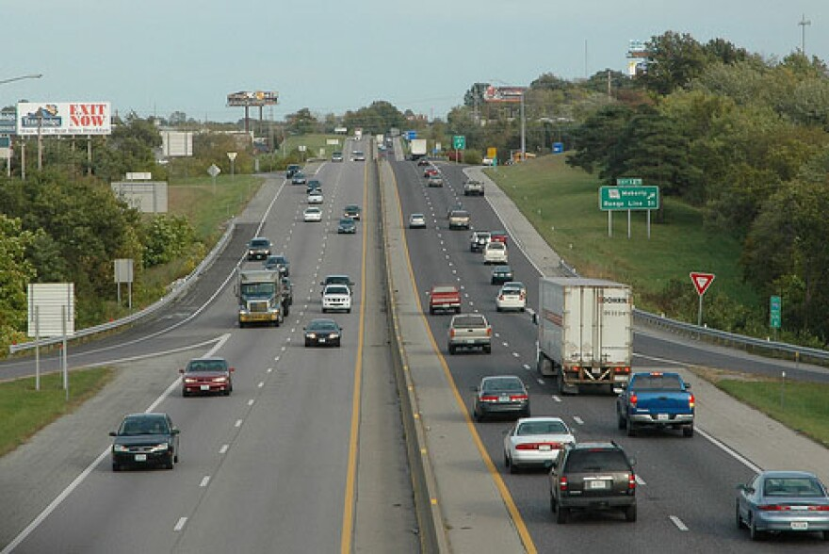

Mini-max
Minimize risk of large losses
Expected value: alternative that is best on average
Mini-max: alternative that minimizes worst possible outcome
Risk-neutral decision maker
Risk-averse decision maker
Decision: route from St. Louis to Columbia
Decision: route from St. Louis to Columbia
Expected value choice: take 70
Mini-max choice: avoid 70
Developed by Brielle Thompson
Notes:
First we have expected value. So that helps identify the alternative that performs best on average which is used for a risk-neutral decision maker.
To understand this criteria lets think about a decision we might be familiar with. Say we want to choose a driving route from st. louis to Columbia. On average taking 70 might be the best route on average. So that would be the expected value choice.
But what if we are risk averse. So our second criteria is called mini-max which selects the alternative that minimizes the wors possible outcome. And using the driving example, that would be choosing a route that avoids 70 –because of the risk for gameday traffic, accidents, or construction.

Slide 41
Mini-max
Minimize risk of large losses
Example: should you adopt new technology to increase production of fry at a hatchery?
70,000 fry
Steps: identify worst outcome for each action and choose the best of the worst
Win
Does it work?
p = 0.8
Yes
p = 0.2
Lose
10,000 fry
best of the worst = 40K so we would NOT add new technology
Add new technology to a hatchery?
No
40,000 fry

Slide 42
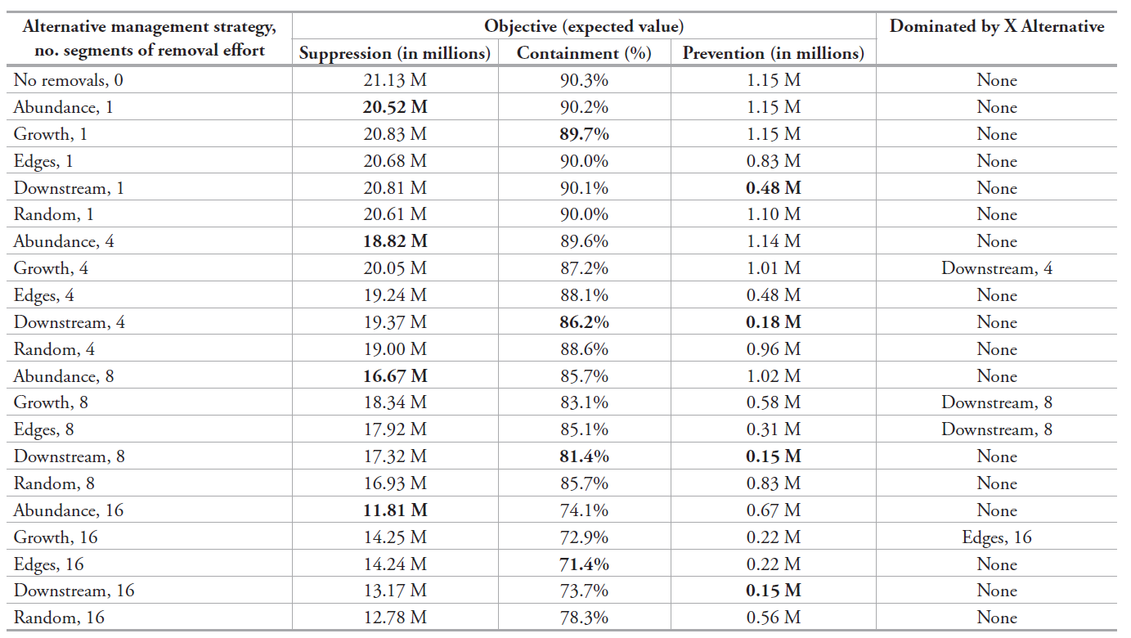
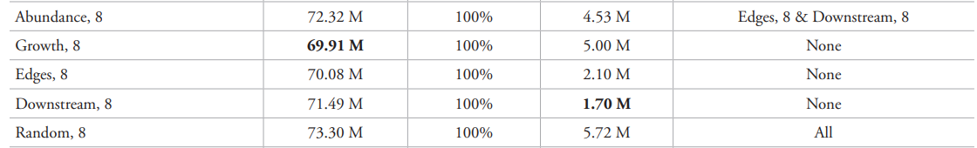
Mini-max vs expected value example #1
Thompson, Olden, & Converse 2024
NeoBiota
Subset of the table: management alternatives to control invasive rusty crayfish
(expected value)
EV
(minimum value)
Mini-max
Developed by Brielle Thompson

Slide 43
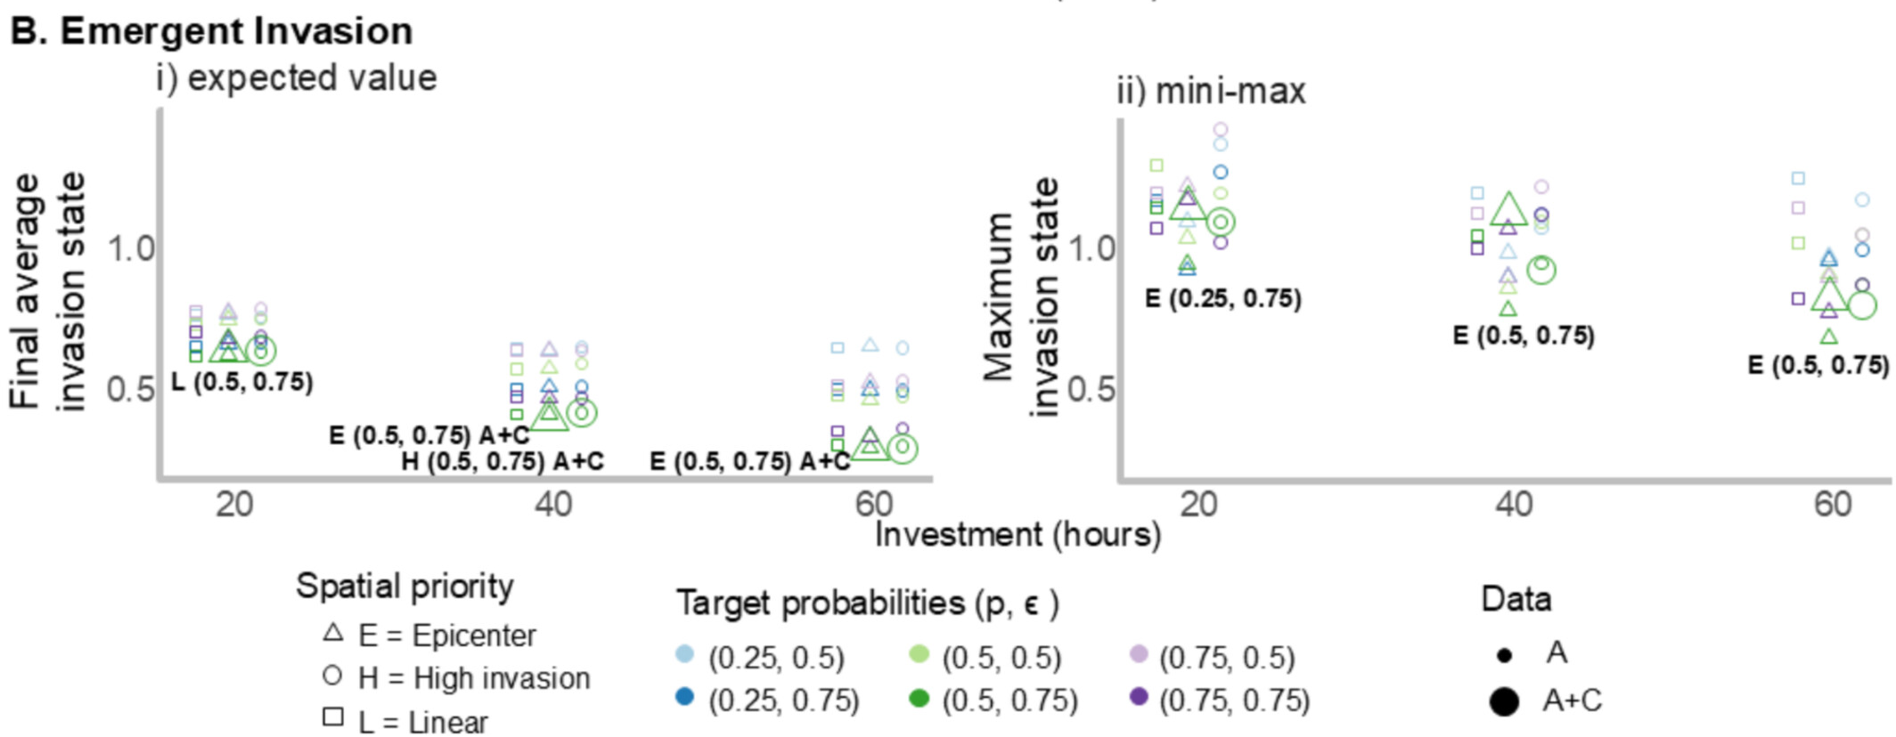
Mini-max vs expected value example #2
Management outcomes for invasive flowering rush
Thompson et al. 2025
Developed by Brielle Thompson

Slide 44
Robustness
Robust-satisficing: focus on attaining a minimum performance requirement over greatest range of uncertainty
“Decision maker defines a minimum level of performance they consider to be satisfactory and chooses the option that ensures at least that level of performance over the greatest range of uncertainty”
*Ben-Haim 2006
Developed by Brielle Thompson, see Runge et al. 2020 Ch 13

Slide 45
Robustness
“Decision maker defines a minimum level of performance they consider to be satisfactory and chooses the option that ensures at least that level of performance over the greatest range of uncertainty”
- Runge et al. 2020 Ch 13
Select B!
Endangered species population
Minimum level of performance
A
B
C
Management alternatives
Developed by Brielle Thompson

Slide 46
Skills Check: Risk attitudes
You are choosing between different invasive carp removal strategies (you want more carp removed)
5,000 removed
Maximum # that could be removed
Yes
p = 0.8
Does it work?
4,000 removed
Minimum # that could be removed
Across removal strategies find each EV & identify:
The strategy for a risk-neutral decision maker (the highest EV)
The strategy for a risk-averse decision maker (best mini-max)
Identify the strategy for a risk-seeker
Strategy A
No
p = 0.2
p = 0.5
15,000 removed
Maximum # that could be removed
Yes
Removal strategy?
Strategy B
Does it work?
3,500 removed
Minimum # that could be removed
No
p = 0.5
Strategy C
Yes
p = 0.2
25,000 removed
Maximum # that could be removed
& Answer the questions:
Which strategy would you choose?
What if this was a decision where we are reintroducing endangered species does this change which strategy you would choose? Would you address risk differently?
Does it work?
p = 1
No
2,000 removed
Minimum # that could be removed
No removal
p = 0.8
0 removed
Developed by Brielle Thompson
Notes:
EV A = 4800
EV B = 8200
EV C = 6600
EV D = 0
B
A
C

Slide 47
Tools to handle identify and deal with uncertainty:
Decision trees
Fault trees
Developed by Brielle Thompson, see Runge et al. 2020 Ch 13

Slide 48
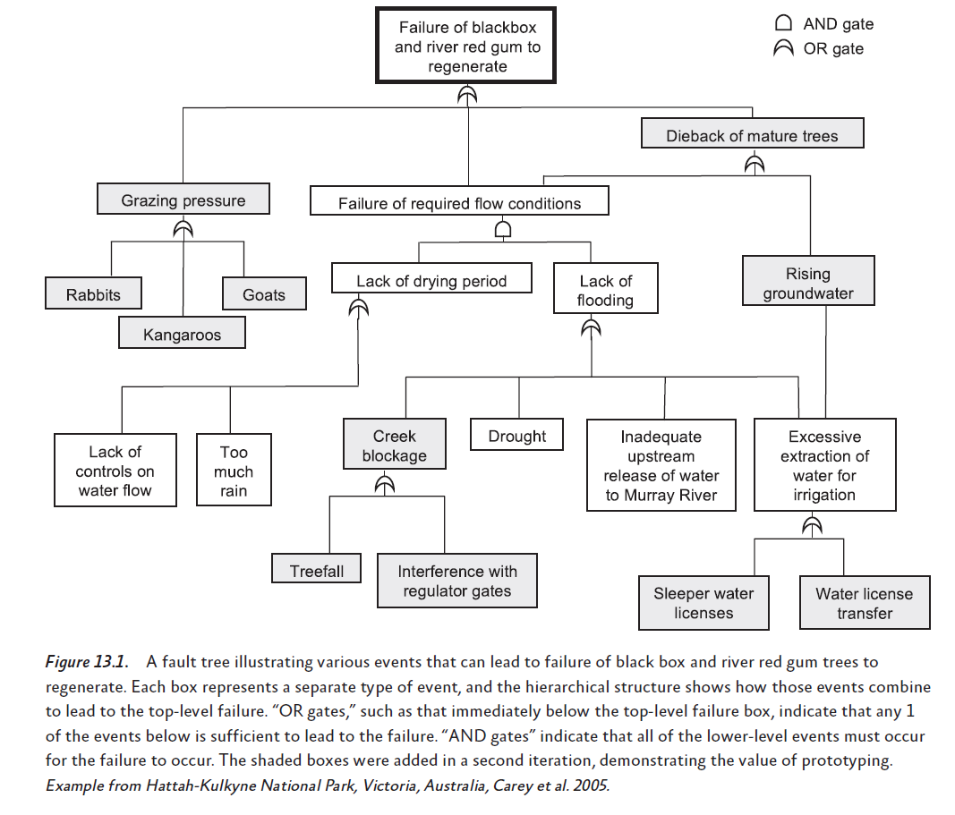
Fault trees
Infrequently used
Runge et al. 2020 Ch 13
Developed by Brielle Thompson, see Runge et al. 2020 Ch 13

Slide 49
Tools to handle identify and deal with uncertainty:
Decision trees
Fault trees
Bayesian belief nets
Developed by Brielle Thompson, see Runge et al. 2020 Ch 13

Slide 50
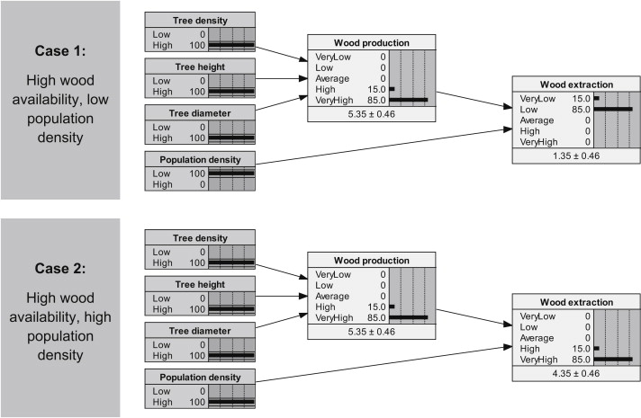
Bayesian Belief Network (BBN) models
Intermediate calculation
Posterior prediction
Parameters
Model that incorporates Bayesian inference to estimate uncertainty in its predictions
Incorporates data, prior distributions, likelihood functions
Landuyt et al. 2013
Developed by Brielle Thompson, see Landuyt et al. 2013

Slide 51
Tools to handle identify and deal with uncertainty:
Decision trees
Fault trees
Bayesian belief nets
Integrated population models
Integrate data streams to better estimate parameter values
Expert judgement methods
Expected value
Expected utility analysis (utilities elicited via gambles)
Maxi-min criterion
Robust satisficing
Last week (Value of information, adaptive management, sensitivity analysis)
Developed by Brielle Thompson, see Runge et al. 2020 Ch 13

Slide 52
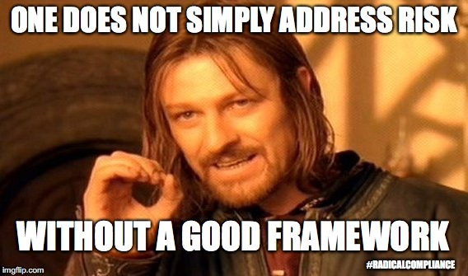
Risk summary
Decisions in the face of uncertainty
Need to consider decision maker’s attitude toward risk
This amounts to valuing outcomes in a way that is not necessarily linear relative to gain or loss
A utility function can be used to capture the decision maker’s risk attitude
Developed by Sarah Converse

Slide 53

Discussion
Why should risk tolerance be understood?
In what ways might a risk-averse decision maker approach a conservation problem differently than a risk-seeking one?

Slide 54

Next week: final class period 2-4pm ABNR 210
Final presentations!
Developed by Brielle Thompson

Slide 55

Extra time activities:

Slide 56

Activity: Risk attitude debate
In the skills check exercise on invasive carp removal strategy B was the best for a risk neutral decision maker, strategy A was the best for a risk-averse decision maker, and strategy C was the best for a risk-seeker.
Let’s have a risk attitude debate!
Group 1 decision maker: Risk-neutral
Group 2 decision maker: Risk-averse
Group 3 decision maker: Risk-seeking
Instructions:
You have 5-10 minutes to produce your arguments
You will have one spokesperson per team for round 1 of arguments
A separate spokesperson will argue for round 2 -rebuttals
Notes:
Objective:
Help students understand how different risk attitudes (neutral, averse, seeking) influence decision-making in conservation scenarios with uncertain outcomes.
Scenario Recap:
Students are choosing between three invasive carp removal strategies:
Strategy A: Best mini-max (risk-averse)
Strategy B: Best expected value (risk-neutral)
Strategy C: Best for risk-seeking (highest potential gain but also highest risk)
Group Setup:
Group 1: Risk-neutral decision makers
Group 2: Risk-averse decision makers
Group 3: Risk-seeking decision makers
Each group will:
Review the strategy outcomes and probabilities
Prepare arguments for why their strategy is best
Consider ecological, social, and policy implications
Instructions:
Prep Time (5–10 minutes):
Each group discusses:
Why their strategy is optimal for their risk attitude
How their approach aligns with conservation goals
What trade-offs they are willing to accept
Round 1 – Initial Arguments:
One spokesperson per group presents their case (2 minutes each)
Focus on logic, ecological outcomes, and alignment with stakeholder values
Round 2 – Rebuttals:
A different spokesperson responds to the other groups
Challenge assumptions, highlight weaknesses, or defend their strategy
Debrief Questions:
How did risk attitude shape each group’s priorities?
Would your group’s choice change if the context involved endangered species?
How might stakeholder values complicate these decisions?
Which strategy would you choose if you were a public agency manager?

Slide 57
Reading discussion (Runge et al. 2020 Ch 13)
How does risk tolerance influence the choice between management actions with uncertain outcomes?
How does expected utility theory help integrate scientific uncertainty with stakeholder values? What challenges might arise when eliciting utility functions from decision makers?
How might cognitive biases affect how decision makers perceive and respond to risk in conservation settings? What strategies can help mitigate these biases?
In what ways can structured decision making tools help clarify value-based disagreements among stakeholders in conservation planning?

