Slide 1

Week 3: Objectives Step of PrOACT
Instructor: Brielle K Thompson
Course: NAT_R 8001 Decision Analysis for Research and Management of Natural Resources
Notes:
First 30 minutes = intro
Next 60 = slides
Final 30 = activity

Slide 2

Review of last week
Discussed the problem framing step of SDM
Elements of problem framing
ID the decision maker(s)
ID other key players
Consider legal and regulatory context
Consider decision structure
Consider the type of analysis required
6. Revise as needed
Learned about the template:
“Decision Maker (D) is trying to do X to achieve Y over time Z and in place W considering B.”

Slide 3
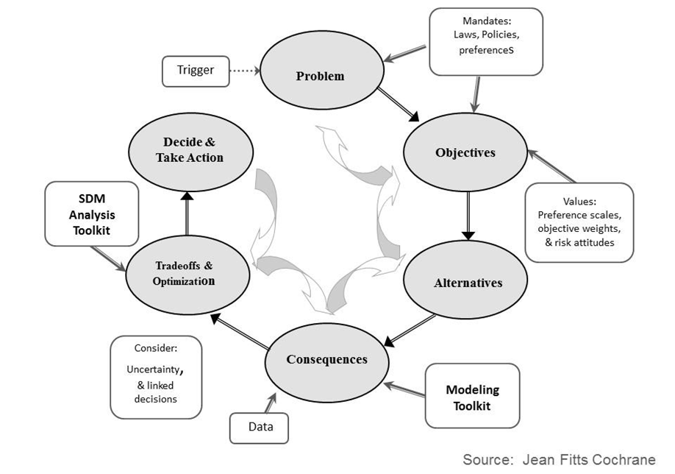
Today:
Learn about the objectives step

Slide 4
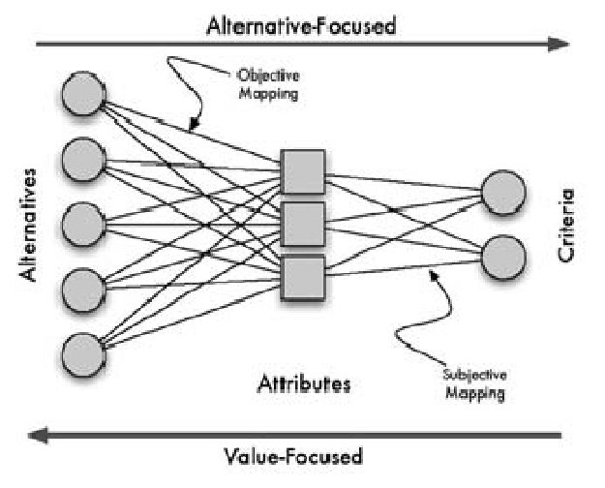
Recall: Values focused vs Alternatives focused thinking:
“Value-focused thinking involves starting at the best and working to make it a reality. Alternative-focused thinking is starting with what is readily available and taking the best of the lot” – Keeny 1992
In other words: value-focused thinking first decides what you want, then you figure out how to get there
Parnell & West 2008
Developed by Brielle Thompson

Slide 5
Recall: Values focused vs Alternatives focused thinking:
What are the risks of Alternative focused thinking?
We tend to limit ourselves to a smaller set of alternatives
We may anchor on the first alternative
We solve the wrong problem
Values are pieces of an objective
Parnell & West 2008
Developed by Brielle Thompson, Alex McInturff, Jean Fitts Cochrane, Angela Matz, Jennifer A. Szymanski, James E. Lyons, Sarah J. Converse, & Michael C. Runge

Slide 6
Management objectives ≠ Research Objectives
Research objectives = “active statement[s] about how the study [or analysis] is going to answer the specific research question[s]” (Farrugia et al., 2010)
Management objectives = “statements of the fundamental interests that could be affected by a decision—the ‘things that matter’ to people” or the things that have intrinsic social and cultural value (Gregory et al., 2012)
Developed by Brielle Thompson, see Aldridge and Colvin 2024

Slide 7
Management objectives ≠ Alternatives
Management actions and monitoring activities are often conflated with management objectives
For example:
Statements such as:
“We wish to better understand habitat effects on bobwhite quail reproduction” ( = research)
“We aim to monitor water quality” (= monitoring)
“We want to develop bass length limit recommendations” (= management action)
These all are not management objectives but describe activities that serve as means of achieving various ends (i.e. management objectives)
See Aldridge and Colvin 2024

Slide 8




Management objectives $≠$ Targets
Target = Desired level of performance towards an objective
Example:
Create 1000 jobs is a target – a specific quantitative level of performance we want to achieve.
Maximize employment is an objective (employment is the thing we want, more is better than less

Slide 9
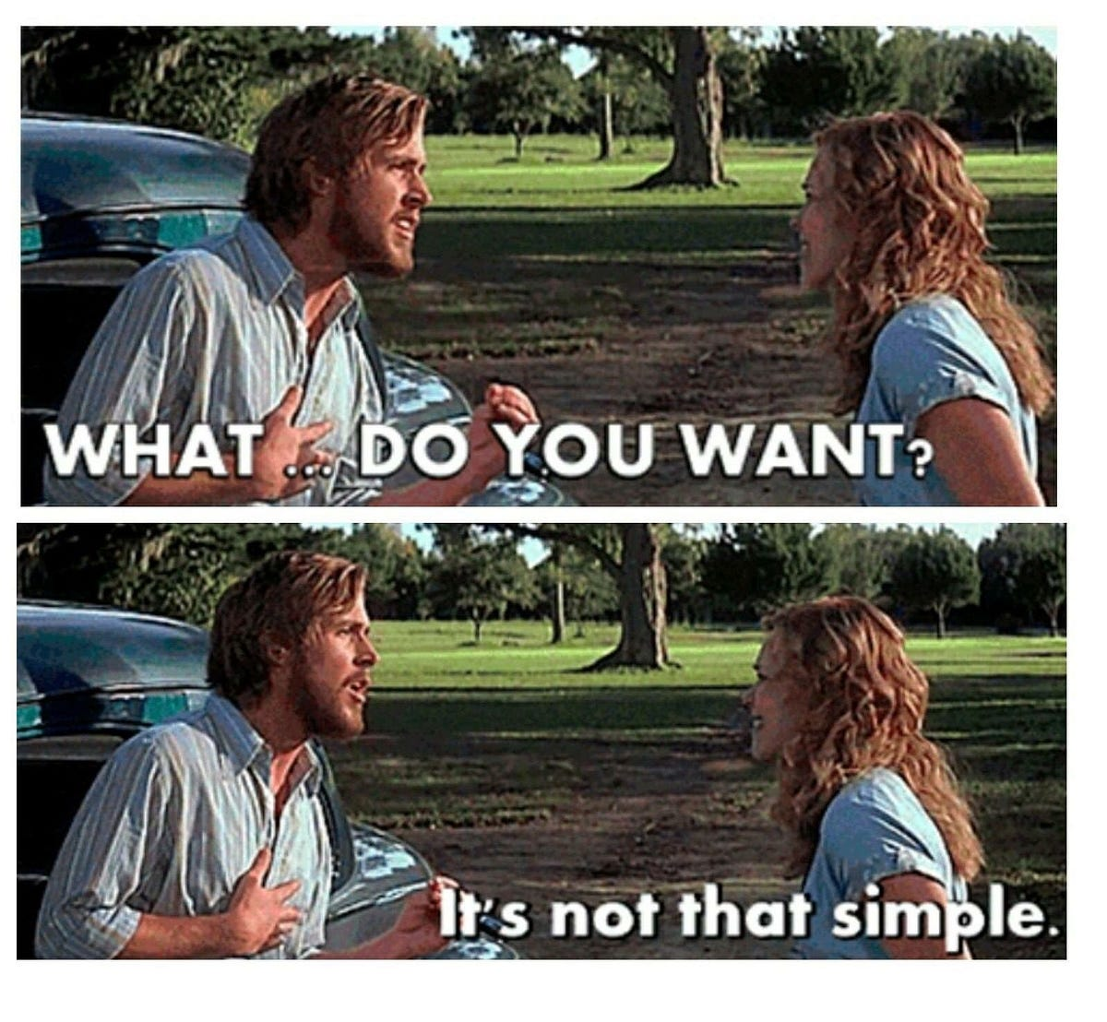

What are objectives in decision analysis?
We make decisions to achieve something
Objectives are what we want to achieve
Concise statements on what matters
Example: I am deciding where to go on vacation.
What objectives are in play for me?
I want to maximize:
Relaxation
Fun
Comfort
I want to minimize:
Cost
Travel time
Medium
Developed by Alex McInturff, Jean Fitts Cochrane, Angela Matz, Jennifer A. Szymanski, James E. Lyons, Sarah J. Converse, & Michael C. Runge

Slide 10
Why are objectives important?
Spending time on this step is important because we will:
Compare alternatives on the right criteria
Develop creative alternatives
Know what we want to make predictions about
Better explain our decisions
Medium
Yogi Berra is reported to have said, “If you don’t know where you’re going, chances are you will end up somewhere else”
Developed by Alex McInturff, Jean Fitts Cochrane, Angela Matz, Jennifer A. Szymanski, James E. Lyons, Sarah J. Converse, & Michael C. Runge

Slide 11
We are surprisingly poor at identifying objectives
1) We often don’t know all our objectives:
Bond et al. (2008) asked MBA students to imagine choosing an MBA program, list their objectives, then check against a master list
4/10 of the final top 10 objectives were absent from the student’s first list
Medium
Developed by Alex McInturff, Jean Fitts Cochrane, Angela Matz, Jennifer A. Szymanski, James E. Lyons, Sarah J. Converse, & Michael C. Runge

Slide 12
We are surprisingly poor at identifying objectives
We often don’t know all our objectives
We confuse ends and means:
Example – when deciding about management of an endangered species:
Is this the objective?
Maximize survival probability of the endangered species
Or is this the objective?
Maximize probability of persistence of the endangered species
Medium
Developed by Alex McInturff, Jean Fitts Cochrane, Angela Matz, Jennifer A. Szymanski, James E. Lyons, Sarah J. Converse, & Michael C. Runge

Slide 13




Pieces of an objective:
Direction
(maximize, minimize)
+
+
Attribute
(the units)
What is desired
e.g.
*Maximize/Minimize may be uncomfortable to state (but its useful for optimization purposes). So, as long as the direction is clear we can use other verbs (e.g., increase, decrease, etc.)
Developed by Brielle K Thompson

Slide 14
1. Articulate goals & concerns 2. Convert goals & concerns to objectives 3. Structure objectives 4. Create measurable attributes for each objective Repeat as needed
Process for identifying objectives:
Big
picture
Specific
Steps
Developed by Alex McInturff, Jean Fitts Cochrane, Angela Matz, Jennifer A. Szymanski, James E. Lyons, Sarah J. Converse, & Michael C. Runge

Slide 15

1. Articulate goals & concerns
Process for identifying objectives:
To help identify the values that should drive the decision, think about:
What do you hope to achieve with this decision?
What concerns will this decision address?
What’s wrong with the current situation?
How can the current situation be improved?
What is the best (and worst) possible outcome from this decision?
If you do make a decision, what do you want to avoid?
If you don’t make a decision, what will happen?
What does this issue look like from other perspectives?
Developed by Alex McInturff, Jean Fitts Cochrane, Angela Matz, Jennifer A. Szymanski, James E. Lyons, Sarah J. Converse, & Michael C. Runge

Slide 16


1. Articulate goals & concerns
Process for identifying objectives:
Think of possible solutions
What do you like and dislike about these solutions?
What constraints and guidelines are restricting your choices?
Make goals and concerns distinct and independent
Developed by Alex McInturff, Jean Fitts Cochrane, Angela Matz, Jennifer A. Szymanski, James E. Lyons, Sarah J. Converse, & Michael C. Runge

Slide 17
1. Articulate goals & concerns 2. Convert goals & concerns to objectives
Process for identifying objectives:
Big
picture
Developed by Alex McInturff, Jean Fitts Cochrane, Angela Matz, Jennifer A. Szymanski, James E. Lyons, Sarah J. Converse, & Michael C. Runge

Slide 18
Activity – convert goals to objectives
Convert concerns to objectives:
Hint: direction + what is desired (don’t worry about units yet!)
Goal or Concern | Hope to Achieve | Potential Objective
It’s hard to catch bluegills any more | Improve fishing
Many loons die ingesting lead tackle | Reduce loon mortality and increase loon populations
Ballast water brings invasive species | Avoid release of invasive species and protect native species
Certain interest groups feel excluded | Organize an inclusive decision process
I won’t have enough money for this | Reduce cost and manage within budget
Developed by Alex McInturff, Jean Fitts Cochrane, Angela Matz, Jennifer A. Szymanski, James E. Lyons, Sarah J. Converse, & Michael C. Runge

Slide 19
Activity – convert goals to objectives
Convert concerns to objectives:
Hint: direction + what is desired (don’t worry about units yet!)
Goal or Concern | Hope to Achieve | Potential Objective
It’s hard to catch bluegills any more | Improve fishing
Many loons die ingesting lead tackle | Reduce loon mortality and increase loon populations
Ballast water brings invasive species | Avoid release of invasive species and protect native species
Certain interest groups feel excluded | Organize an inclusive decision process
I won’t have enough money for this | Reduce cost and manage within budget
Maximize recreational fishing success
Maximize persistence of loon populations
Maximize native invertebrate and fish communities in lakes
Maximize interest group engagement
Minimize cost
Developed by Alex McInturff, Jean Fitts Cochrane, Angela Matz, Jennifer A. Szymanski, James E. Lyons, Sarah J. Converse, & Michael C. Runge

Slide 20

Skills Check Task 1
Lizard example
Consider this decision… (5 min)
You are the manager of a wildlife refuge
Developing a management plan for an endangered lizard.
The species benefits from prescribed fire (though your budget for such activities is limited)
The species is susceptible to road mortality
The Refuge receives substantial visitation by bird watchers, some of whom like to travel by car.
TASK 1: Write a list of objectives
Identify your concerns and translate into objectives:
What are you hoping to accomplish?
What do stakeholders want?
What do you or they want to avoid?
Developed by Alex McInturff, Jean Fitts Cochrane, Angela Matz, Jennifer A. Szymanski, James E. Lyons, Sarah J. Converse, & Michael C. Runge
Notes:
Be sure to take good notes – we will build on this example throughout this module
I’ve already given you some brainstorming tips for creating good objectives.
I’ll hear back from a few of you on how you did in 5 minutes (give a little longer if needed).

Slide 21
1. Articulate goals & concerns
Process for identifying objectives:
Big
picture
2. Convert goals & concerns to objectives
3. Structure objectives:
3a. Classify and distinguish types of objectives
3b. Create an objectives hierarchy
Specific
Steps
Developed by Alex McInturff, Jean Fitts Cochrane, Angela Matz, Jennifer A. Szymanski, James E. Lyons, Sarah J. Converse, & Michael C. Runge

Slide 22
3a. Distinguish types of objectives
Process for identifying objectives:
Fundamental
The basic reason for caring about the decision (essential)
Means
Influence the achievement of fundamental objectives (not necessarily essential)
Process
Concern for how the decision is made rather than what decision is made
Example- maximize public trust
Strategic
Higher level – objectives covering all decisions made by the organization or person or an agency mandate
Developed by Alex McInturff, Jean Fitts Cochrane, Angela Matz, Jennifer A. Szymanski, James E. Lyons, Sarah J. Converse, & Michael C. Runge

Slide 23
3a. Distinguish types of objectives
Process for identifying objectives:
Fundamental Objectives
How do you know what’s fundamental?
Must be controllable – available alternatives could influence the objective
Not too broad or high level to be beyond control with alternatives available for this context
Must be essential – relevant to selection of alternative
Not too narrow and not a means to another objective
Developed by Alex McInturff, Jean Fitts Cochrane, Angela Matz, Jennifer A. Szymanski, James E. Lyons, Sarah J. Converse, & Michael C. Runge
Notes:
These are objectives that are influenced by other decisions the organization is involved in and other organizational objectives including even the mission.
Strategic objectives have some bearing on decisions, but are unlikely to be fully achieved by any one decision
For example from Gregory et al. (2012):
Maximize public trust and consent
Execute organization’s mandate
Comply with international trade rules
If you keep asking why, you always end up at strategic objectives, you get to the mission of the agency, control isn’t necessarily

Slide 24
3a. Distinguish types of objectives
Process for identifying objectives:
Means Objectives
Means objectives point to the actions that you can take to influence what matters
TIP: Distinguish fundamental from means objectives
Fundamental objectives point to what matters
Distinguish fundamental and means objectives to
Correctly weight objectives
Separate means from ends (i.e., improving habitat might not be sufficient to improve species status)
Help develop creative alternatives (focus on the end not the means)
Developed by Alex McInturff, Jean Fitts Cochrane, Angela Matz, Jennifer A. Szymanski, James E. Lyons, Sarah J. Converse, & Michael C. Runge
Notes:
These are objectives that are influenced by other decisions the organization is involved in and other organizational objectives including even the mission.
Strategic objectives have some bearing on decisions, but are unlikely to be fully achieved by any one decision
For example from Gregory et al. (2012):
Maximize public trust and consent
Execute organization’s mandate
Comply with international trade rules
If you keep asking why, you always end up at strategic objectives, you get to the mission of the agency, control isn’t necessarily

Slide 25
3a. Distinguish types of objectives
Process for identifying objectives:
Fundamental
When the answer is: “Just because”/ “Inherent value”
Ask “WHY”
Ask “HOW”
Means
When the answer is: This is how we address our fundamental concern. Or… this is how we measure success
**Often outputs of models**
Developed by Alex McInturff, Jean Fitts Cochrane, Angela Matz, Jennifer A. Szymanski, James E. Lyons, Sarah J. Converse, & Michael C. Runge

Slide 26
3a. Distinguish types of objectives
Activity – fundamental objective
Exercise: Identify the fundamental objective
Concern | Objectives
1. Ballast water brings invasive species | Minimize ballast dumping
 | Minimize invasive species introductions
 | Maximize native species
2. You don’t have enough money for this | Minimize cost
 | Maximize conservation within budget
Developed by Alex McInturff, Jean Fitts Cochrane, Angela Matz, Jennifer A. Szymanski, James E. Lyons, Sarah J. Converse, & Michael C. Runge

Slide 27
3a. Distinguish types of objectives
Activity – fundamental objective
Exercise: Identify the fundamental objective
Concern | Objectives
1. Ballast water brings invasive species | Minimize ballast dumping
 | Minimize invasive species introductions
 | Maximize native species
2. You don’t have enough money for this | Minimize cost
 | Maximize conservation within budget
Do not combine objectives!
Developed by Alex McInturff, Jean Fitts Cochrane, Angela Matz, Jennifer A. Szymanski, James E. Lyons, Sarah J. Converse, & Michael C. Runge

Slide 28
3a. Distinguish types of objectives
Process for identifying objectives:
Process Objectives
“…especially in public decisions made by government, both what is chosen and how the alternative is chosen are important. In other words, the process of decision-making in these situations matters…” Keeney
Process objectives relate to how the decision is made
Example: A decision-making process that declares multi-agency collaboration as an objective.
Developed by Alex McInturff, Jean Fitts Cochrane, Angela Matz, Jennifer A. Szymanski, James E. Lyons, Sarah J. Converse, & Michael C. Runge
Notes:
The process matters…these objectives are about how the decision will be made, not what the solution will be.
Can you think of any mandates that set process objectives?
Often about who is at the table, eg we will include all our indigenous co-management partners in all decisions
Whatever we do, idea is to get agencies to work together on grizzly bears – part of the process needs to be to promote collaboration between agencies

Slide 29
3a. Distinguish types of objectives
Process for identifying objectives:
Strategic Objectives
Strategic objectives = objectives that are concerned with the effects of the decision.
These objectives have some bearing on decisions, but are unlikely to be fully achieved by any one decision
Example: Agency Mission is concerned with the effects of this decision…
On other, linked opportunities
On setting precedents
On larger mission, mandate or image
For example (Gregory et al. 2012):
Maximize public trust and consent
Execute organization’s mandate
Comply with international trade rules
Developed by Alex McInturff, Jean Fitts Cochrane, Angela Matz, Jennifer A. Szymanski, James E. Lyons, Sarah J. Converse, & Michael C. Runge
Notes:
These are objectives that are influenced by other decisions the organization is involved in and other organizational objectives including even the mission.
Strategic objectives have some bearing on decisions, but are unlikely to be fully achieved by any one decision
For example from Gregory et al. (2012):
Maximize public trust and consent
Execute organization’s mandate
Comply with international trade rules
If you keep asking why, you always end up at strategic objectives, you get to the mission of the agency, control isn’t necessarily

Slide 30
3b. Create an objective hierarchy
Maximize Species Persistence
Fundamental
Maximize
Species Abundance
Maximize Species Distribution
Maximize
Genetic Diversity
Means
Sub-means
Maximize Locations
Minimize Allele Losses
Minimize Mortality
Maximize Habitat
Max. Pop. Connectivity
Developed by Alex McInturff, Jean Fitts Cochrane, Angela Matz, Jennifer A. Szymanski, James E. Lyons, Sarah J. Converse, & Michael C. Runge

Slide 31
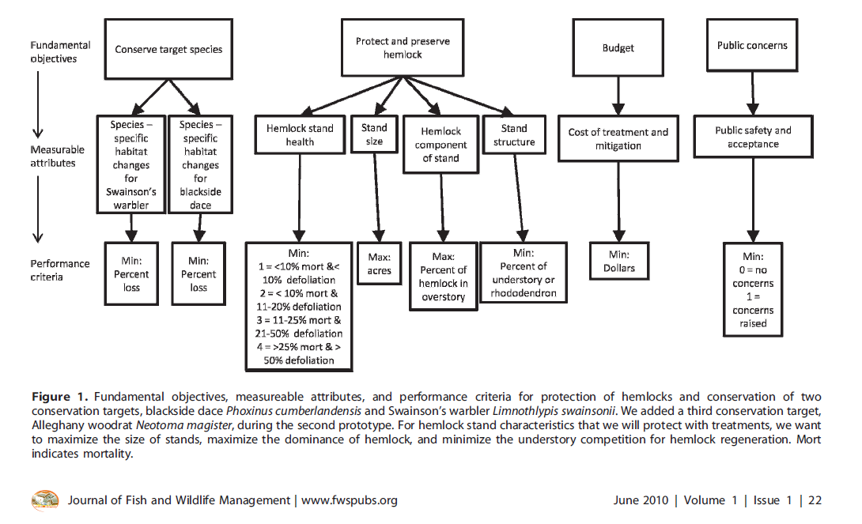
3b. Create an objective hierarchy
Blomquist, S. M., Johnson, T. D., Smith, D. R., Call, G. P., Miller, B. N., Thurman, W. M., ... & Boomer, G. S. (2010). Structured decision-making and rapid prototyping to plan a management response to an invasive species. Journal of Fish and Wildlife Management, 1(1), 19-32.
DIAGRAM FORMAT
Developed by Alex McInturff, Jean Fitts Cochrane, Angela Matz, Jennifer A. Szymanski, James E. Lyons, Sarah J. Converse, & Michael C. Runge

Slide 32
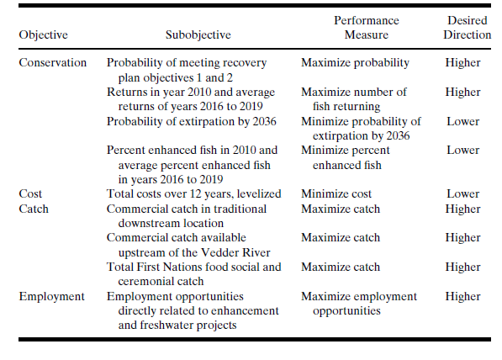
3b. Create an objective hierarchy
Gregory, R., & Long, G. (2009). Using structured decision making to help implement a precautionary approach to endangered species management. Risk Analysis, 29(4), 518-532.
TABLE FORMAT
Developed by Alex McInturff, Jean Fitts Cochrane, Angela Matz, Jennifer A. Szymanski, James E. Lyons, Sarah J. Converse, & Michael C. Runge

Slide 33
3b. Create an objective hierarchy
Desired properties of an objective hierarchy
Complete
Don’t leave out any areas of concern (objectives)
Non-redundant
Redundant objectives can lead to “double-counting”
Concise
Focus on the core issues
Specific
Consequences are clear; measurable attributes can be readily identified
Understandable
Avoid vague and ambiguous terms
Developed by Alex McInturff, Jean Fitts Cochrane, Angela Matz, Jennifer A. Szymanski, James E. Lyons, Sarah J. Converse, & Michael C. Runge

Slide 34
EXAMPLE:
Fundamental objectives
Fundamental objectives
Maximize resources to protect tribal sacred sites and spiritual values
Maximize native species integrity
Maximize recreation
Minimize cost
Means objectives
Minimize taking of life
Maximize HBC population
Min. wilderness days lost
Min. trout removal cost
Max. dam power production
Min. trout population
Max. fish catch
Process objectives
- Be respectful of tribal values and rituals
Strategic objectives
-Operate within the authority, capabilities, and legal responsibility of the Bureau of Reclamation
- Follow ESA compliances
Adapted, modified, and simplified from Runge et al. 2011
Notes:
https://pubs.usgs.gov/of/2011/1012/pdf/ofr20111012.pdf#page=17.21

Slide 35
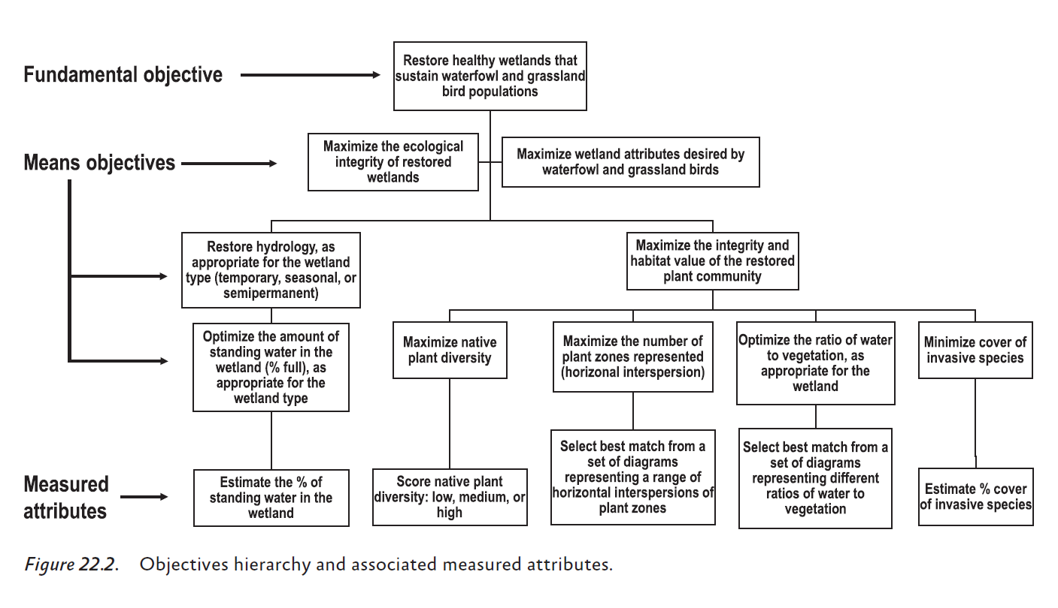
EXAMPLE:
Runge et al. 2020 – Ch 22

Slide 36

Skills Check Task 2
Lizard example
TASK 2: Generate objectives hierarchy
Revisit your earlier potential objectives
Circle your fundamental objectives
Identify fundamental/means/process/strategic objectives
Then draw an objectives hierarchy
Developed by Alex McInturff, Jean Fitts Cochrane, Angela Matz, Jennifer A. Szymanski, James E. Lyons, Sarah J. Converse, & Michael C. Runge
Notes:
Be sure to take good notes – we will build on this example throughout this module
I’ve already given you some brainstorming tips for creating good objectives.
I’ll hear back from a few of you on how you did in 5 minutes (give a little longer if needed).

Slide 37
1. Articulate goals & concerns 2. Convert goals & concerns to objectives 3. Structure objectives 4. Create measurable attributes for each objective Repeat as needed
Process for identifying objectives:
Big
picture
Specific
Steps
Developed by Alex McInturff, Jean Fitts Cochrane, Angela Matz, Jennifer A. Szymanski, James E. Lyons, Sarah J. Converse, & Michael C. Runge

Slide 38

JARGON!!
These terms are interchangeable:
Measurable attributes
Performance measures
Performance criteria
Developed by Alex McInturff, Jean Fitts Cochrane, Angela Matz, Jennifer A. Szymanski, James E. Lyons, Sarah J. Converse, & Michael C. Runge

Slide 39
Recall Pieces of an objective:
Direction
(maximize, minimize)
+
+
Attribute
(the units)
What is desired
e.g.
*Maximize/Minimize may be uncomfortable to state (but its useful for optimization purposes). So, as long as the direction is clear we can use other verbs (e.g., increase, decrease, etc.)
Developed by Brielle K Thompson

Slide 40
4. Create measurable attributes (the units)
Attributes measure performance and is used to:
Predict (in advance of the decision) how a given decision will lead to measurable outcomes
Compare realized objective outcomes to predicted outcomes after decision implementation
Desired characteristics of measurable attributes:
Unambiguous - Clear relationship to fundamental objectives
Direct - Clearly related to the consequences of interest
Comprehensive - Cover full range of possible outcomes
Operational - Suitable information available
Understandable- Readily understood and easily communicated
Developed by Alex McInturff, Jean Fitts Cochrane, Angela Matz, Jennifer A. Szymanski, James E. Lyons, Sarah J. Converse, & Michael C. Runge
Notes:
Proxy scale funny example: Objective = minimize student boredom → proxy = # of yawns

Slide 41


4. Create measurable attributes (the units)
Attributes measure performance and is used to:
Predict (in advance of the decision) how a given decision will lead to measurable outcomes
Compare realized objective outcomes to predicted outcomes after decision implementation
Attribute scales:
1. Natural scale
Objective can be directly measured
Example: $ for cost
2. Constructed scale
Sliding or relative scale requiring interpretation
Example: Likert scale (5 = very satisfied…1 = very unsatisfied) for fisher satisfaction
3. Proxy scale
Natural attribute that is highly correlated with the objective, but does not directly measure
Example: % of natural range preserved for species genetic diversity
Developed by Alex McInturff, Jean Fitts Cochrane, Angela Matz, Jennifer A. Szymanski, James E. Lyons, Sarah J. Converse, & Michael C. Runge
Notes:
Proxy scale funny example: Objective = minimize student boredom → proxy = # of yawns

Slide 42
4. Create measurable attributes (the units)
Constructed attributes – Example 1
Objective: Minimize Wetland Development Impacts:
Development impacts (scale 0-5)
0 No loss of riparian areas and ≥ 300 acres estuary restored
1 No loss of riparian areas and < 300 acres estuary restored
2 No loss of riparian areas and no loss of estuary
3 Loss of < 300 acres riparian area and < 300 acres of estuary
4 Loss of < 300 acres riparian area and ≥ 300 acres of estuary
5 Loss of ≥ 300 acres riparian area and ≥ 300 acres of estuary
Developed by Alex McInturff, Jean Fitts Cochrane, Angela Matz, Jennifer A. Szymanski, James E. Lyons, Sarah J. Converse, & Michael C. Runge
Notes:
Proxy scale funny example: Objective = minimize student boredom → proxy = # of yawns

Slide 43
4. Create measurable attributes (the units)
Constructed attributes – Example 2
Infant APGAR scores :
1. activity and muscle tone
2. pulse (heart rate)
3. grimace response ("reflex irritability")
4. appearance (skin coloration)
respiration (breathing rate and effort)
Each is scored on a scale of 0 to 2.
Scores are added for the total APGAR score; > 7 is a healthy baby
Developed by Alex McInturff, Jean Fitts Cochrane, Angela Matz, Jennifer A. Szymanski, James E. Lyons, Sarah J. Converse, & Michael C. Runge
Notes:
Proxy scale funny example: Objective = minimize student boredom → proxy = # of yawns

Slide 44

4. Create measurable attributes (the units)
Proxy attributes – Example
Minimize student boredom
→ # of yawns
Developed by Alex McInturff, Jean Fitts Cochrane, Angela Matz, Jennifer A. Szymanski, James E. Lyons, Sarah J. Converse, & Michael C. Runge
Notes:
Proxy scale funny example: Objective = minimize student boredom → proxy = # of yawns

Slide 45
4. Create measurable attributes (the units)
Example
Objective | Direction | Attribute
Minimize costs | Minimize (↓)
Maximize occupancy probability | Maximize (↑)
Minimize extinction probability | Minimize (↓)
Maximize hunter satisfaction | Maximize (↑)
M$/yr
Probability (0-1)
Natural
Probability (0-1)
Harvest Success Rate
(# harvested/# permits)
Proxy
Developed by Alex McInturff, Jean Fitts Cochrane, Angela Matz, Jennifer A. Szymanski, James E. Lyons, Sarah J. Converse, & Michael C. Runge

Slide 46
Example - What are the attribute types?
Protect and preserve hemlock
Hemlock stand health
Stand size
Hemlock component of stand
Stand structure
Minimize:
(% of mortality & defoliation)
1 = <10 & <10
2 = <10 & 11-20
3 = 11-25 & 21-50
4 = >25 & >50
Maximize:
Stand acres
Maximize:
% of hemlock overstory
Minimize:
% of understory
Natural
Proxy
Natural
Constructed
Adapted from Blomquist et al. (2010)
Developed by Alex McInturff, Jean Fitts Cochrane, Angela Matz, Jennifer A. Szymanski, James E. Lyons, Sarah J. Converse, & Michael C. Runge

Slide 47
Activity: Brainstorm constructed scale attribute types
For each objective brainstorm a constructed scale attribute:
Group 1: Minimize stakeholder conflict
Group 2: Maximize recreational satisfaction
Group 3: Maximize species persistence
Group 4: Maximize student engagement ☺
What are the limitations of your constructed scale attribute?
Level | Meaning
1 | …
2 | …
3 | …
4 | …
….. | ….

Slide 48
Activity: Brainstorm proxy scale attribute types
Now for these same objectives brainstorm two proxy attributes:
Group 1: Minimize stakeholder conflict
Group 2: Maximize recreational satisfaction
Group 3: Maximize species persistence
Group 4: Maximize student engagement ☺
What are the limitations of your proxy attribute?
What attribute type fits the objectives above better?

Slide 49
EXAMPLE
Runge et al. 2020 – Ch 22

Slide 50
Skills Check Task 3-4
Lizard example
TASK 3: Measurable attributes
Describe measurable attributes for your fundamental objectives and determine attribute type.
TASK 4: Share objectives
Each group will share your objectives (fundamental/means/strategic/process) and your attributes
Developed by Alex McInturff, Jean Fitts Cochrane, Angela Matz, Jennifer A. Szymanski, James E. Lyons, Sarah J. Converse, & Michael C. Runge
Notes:
Be sure to take good notes – we will build on this example throughout this module
I’ve already given you some brainstorming tips for creating good objectives.
I’ll hear back from a few of you on how you did in 5 minutes (give a little longer if needed).

Slide 51
1. Articulate goals & concerns 2. Convert goals & concerns to objectives 3. Structure objectives 4. Create measurable attributes for each objective Repeat as needed
Process for identifying objectives:
Big
picture
Specific
Steps
Developed by Alex McInturff, Jean Fitts Cochrane, Angela Matz, Jennifer A. Szymanski, James E. Lyons, Sarah J. Converse, & Michael C. Runge

Slide 52
Repeat as needed:
You may have to go around the SDM track informally before the objectives are fully understood
Experiment with your objectives in a tentative decision process & ask:
Can these distinguish among alternatives?
Are they really distinct and independent?
Could you be comfortable with a decision reached with these objectives?
Could you explain your choice to others & the public?
If not, what’s missing?
Developed by Alex McInturff, Jean Fitts Cochrane, Angela Matz, Jennifer A. Szymanski, James E. Lyons, Sarah J. Converse, & Michael C. Runge

Slide 53
Activity: think about your decision problem
For your final project presentation, you will provide a slide of your objectives
Can you define some objectives?
Can you distinguish fundamental from means?
Create a hierarchy?
Can you develop measurable attributes?
Feel free to go back to your problem framing step!
Developed by Brielle Thompson

Slide 54

Discussion:
Why do decision makers often struggle to articulate what they want?
Why is it important to identify objectives for management decisions?

Slide 55
Looking ahead:
Next week: A step of PrOACT
Weekly: Work through a step of the PrOACT process/ learn extra tools
Last week of class:
Elevator pitch of your research project in terms of SDM/PrOACT
Note: Abridged PrOACT story slides with a star on the upper right are good examples to use for your presentation
Developed by Brielle Thompson

Slide 56

Extra time activities:

Slide 57
Reading discussion questions (Gregory et al. 2012 Chapter 4)
What distinguishes a well-defined objective from a vague or ineffective one in SDM?
Why is it important to separate means objectives from fundamental objectives?
Why do Gregory et al. caution against setting targets during the objective-setting stage?
What role do process and strategic objectives play in environmental decision-making?
Why is it problematic to use ambiguous terms like “naturalness” or “sustainability” as objectives?
Why do decision makers often struggle to articulate what they want, and how can SDM processes help?

Slide 58
Activity: reverse objective finding
For the following management decisions, identify what the objectives may have been (fundamental, means, process, strategic)
A refuge installed fencing to reduce deer-vehicle collisions
A coastal reserve began using drones to monitor nesting seabirds and detect illegal fishing activity
A lake banned nighttime fishing due to noise complaints from residents
A national forest implemented a series of controlled burns to reduce wildfire risk and promote native plant regeneration
A regional water authority decided to lower reservoir levels during the dry season to support downstream fish spawning
Discussion: Was it difficult to move from alternatives → objectives?

Slide 59
Activity: Fundamental vs Means sorting
In groups identify whether the objective below is Fundamental or Means
Maximize turtle species persistence
Improve habitat quality
Reduce road mortality
Increase stakeholder engagement
Maximize public trust
Enhance monitoring efforts
Minimize cost
Maximize recreational access
Problem:
Native turtles are victims of roadkill at a popular refuge
Concerns:
Native turtles, cost, public trust

Slide 60
Activity: Fundamental vs Means sorting
In groups identify whether the objective below is Fundamental or Means
Improve water quality
Maximize biodiversity
Enhance public education about conservation
Maximize native fish species persistence
Restore native vegetation
Increase stakeholder participation
Problem:
Recreational fishing is harming native fish recovery
Concerns:
Native fish and plants, public involvement

Slide 61
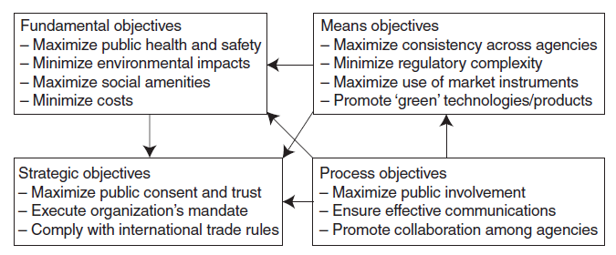
Gregory et al. 2012 Chapter 4

