Slide 1

Week 6: Decisions under uncertainty part 1
Instructor: Brielle K Thompson
Course: NAT_R 8001 Decision Analysis for Research and Management of Natural Resources
Notes:
First 30 minutes = intro
Next 60 = slides
Final 30 = activity

Slide 2

Review of last week
Discussed the Tradeoffs step of SDM
Identified tools to solve multiple objectives:
Simplify the problem (remove dominated alternatives, irrelevant objectives, make even swaps)
Reduce to single objective problem if possible
Negotiate a solution from a set of best compromises
Evaluate trade-offs explicitly
Tools from multi-criteria decision analysis (MCDA): SMART, swing weighting

Slide 3
Quick logistics
No class next week 10/7
Who is presenting 10/14
Final day of class 10/21
Decide how to submit presentations:
Email before class? Flash drive?

Slide 4









Today:
How do we make decisions under uncertainty?
Problem Framing
Decide & Take Action
Articulate Objectives
Specific to Adaptive Management
Monitor
Learn about uncertainty
Methods: adaptive management, decision trees, value of information
Conduct
Tradeoffs & Optimization
Update Models
Develop
Alternatives
Predict Consequences
Figure Adapted from Converse et al. 2013 and Runge 2011

Slide 5
Uncertainty in decision making
Desired outcomes cannot be guaranteed
Decisions under uncertainty should be judged by the quality of decision making, not by the quality of the consequences (Hammond et al. 1999)
Consequence
Uncertainty
Good
Bad
Decision
Good
Bad
Developed by Sarah Converse

Slide 6
Uncertainty in decision making @ all stages
Problem
Objectives
Alternatives
Consequences
Tradeoffs
Clarify ambiguities as much as possible here
Then identify relevant knowledge gaps
At the end, test the sensitivity of your decision to inputs
Developed by Sarah Converse

Slide 7
Types of Uncertainty
Regan HM, M Colyvan, and MA Burgman. 2002. A taxonomy and treatment of uncertainty for ecology and conservation biology. Ecological Applications 12: 618-628.
Linguistic – uncertainty arising from our communication (can be reduced with effort)
Epistemic – uncertainty about how the world works (some types can be reduced with effort)
Developed by Sarah Converse

Slide 8
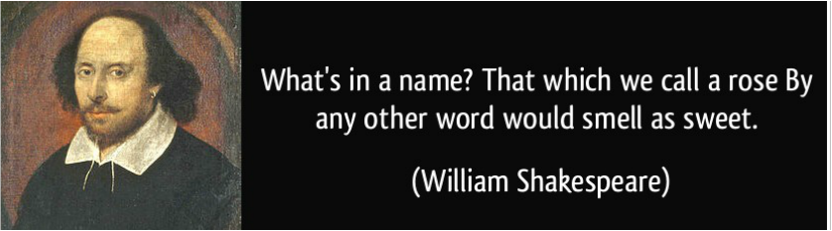
Linguistic uncertainty
Uncertainty arising from our communication (can be reduced with effort)
Arises because of our natural language & our scientific vocabulary, is under specific, ambiguous, vague, context dependent, or exhibits theoretical indeterminacies
Example: consider estimating the number of endangered species in a region. Uncertainty arises because of what constitutes an endangered species. Before we can even attempt to count the number of endangered species, it is necessary to decide what we mean by the term ‘‘endangered species’’
Developed by Brielle Thompson
Notes:
Remember the example from Amanda Knox – see you later the police thought that meant an appointment

Slide 9
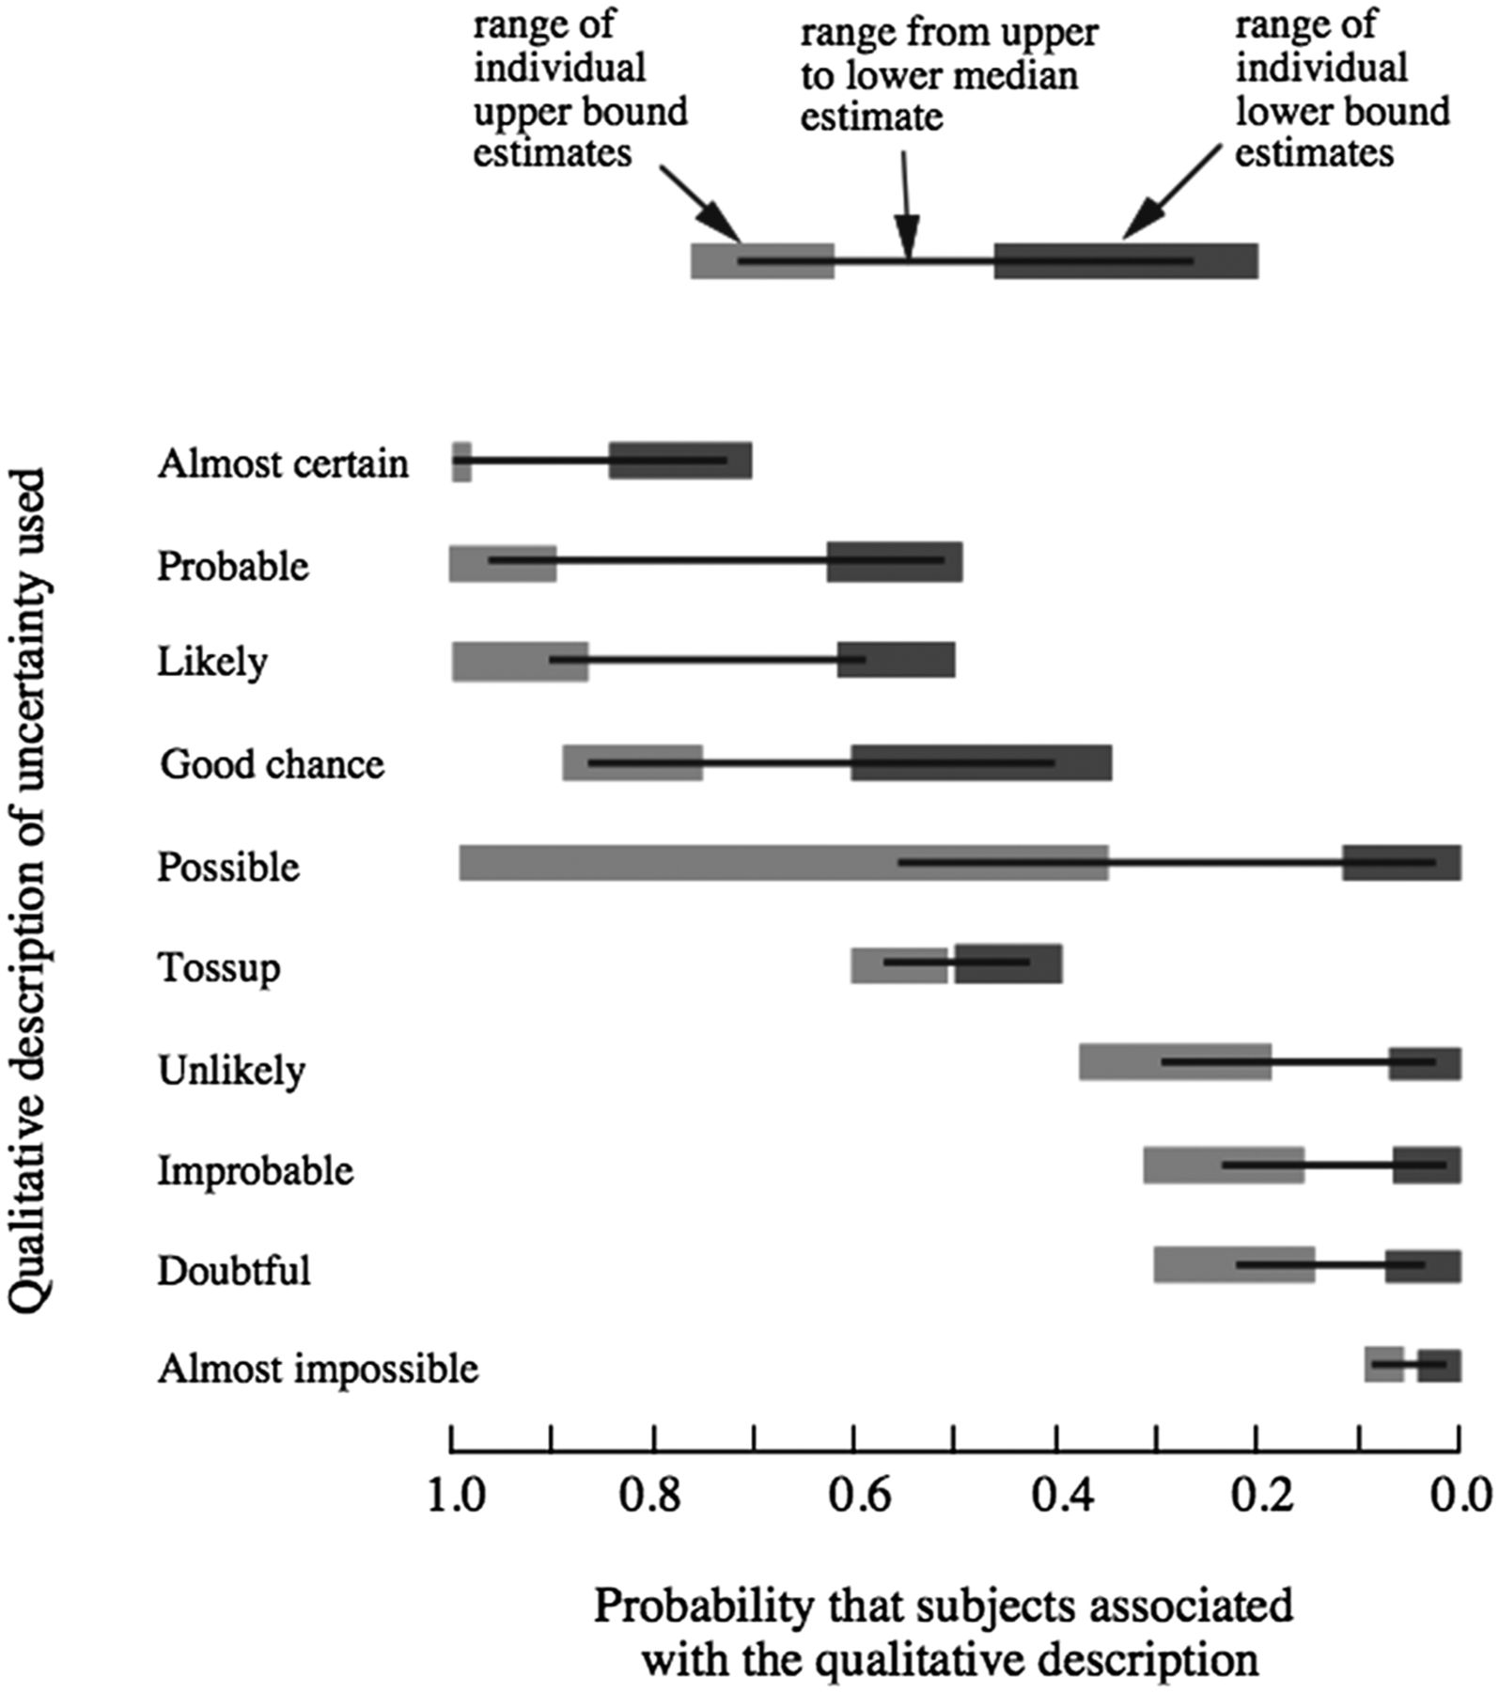
Linguistic uncertainty
Morgan MG. 2014. Use (and abuse) of expert elicitation in support of decision making for public policy. PNAS 111:7176-7184.
Developed by Sarah Converse
Notes:
The range of numerical probabilities that respondents attached to qualitative probability words in the absence of any specific context are shown. Note the very wide ranges of probability that were associated with some of these words. Figure redrawn from Wallsten et al. (30).

Slide 10
Linguistic uncertainty
Morgan MG. 2014. Use (and abuse) of expert elicitation in support of decision making for public policy. PNAS 111:7176-7184.
Developed by Sarah Converse
Notes:
The range of numerical probabilities that respondents attached to qualitative probability words in the absence of any specific context are shown. Note the very wide ranges of probability that were associated with some of these words. Figure redrawn from Wallsten et al. (30).

Slide 11
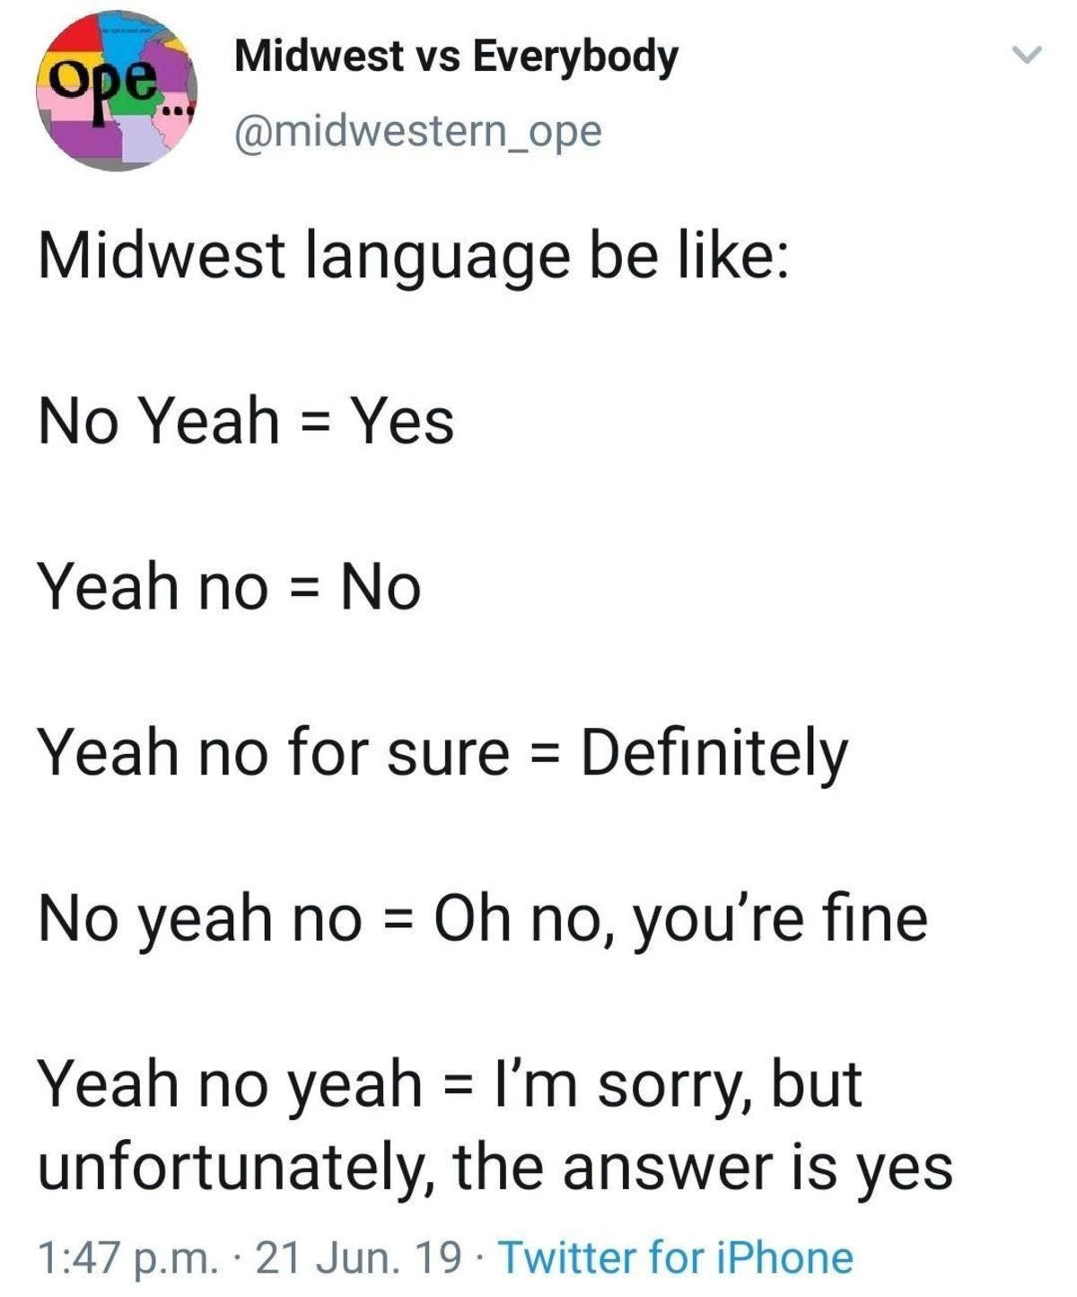
Linguistic uncertainty
Developed by Brielle Thompson
Notes:
The range of numerical probabilities that respondents attached to qualitative probability words in the absence of any specific context are shown. Note the very wide ranges of probability that were associated with some of these words. Figure redrawn from Wallsten et al. (30).

Slide 12
Epistemic uncertainty
Epistemic uncertainty
Measurement error
Systematic error
Natural variation
Inherent randomness
Model uncertainty
Subjective judgement
Uncertainty about how the world works (some types can be reduced with effort)
Random error in equipment or operator
Resolution: apply statistical techniques to repeated measurements
Bias in equipment or operator
Resolution: Recognize bias, double sample
Fluctuations that naturally occur
Resolution: Probability distributions
Unpredictable events, chaotic systems
Resolution: Probability distributions
Error representing systems (mathematically/statistically, e.g., different growth models)
Resolution: model validation, research
How data is interpreted
Resolution: Degrees of belief in form of subjective probability
Aleatoric uncertainty = unpredictable variability (alea = Latin for dice)
Developed by Brielle Thompson
(see Regan et al. 2002)
Notes:
degree of belief about an event in the form of a subjective probability. For instance, an expert might assign a probability of 0.7 to the event ‘‘population size of the species is .500 individuals.’’

Slide 13
Activity: what uncertainty?
Uncertainty | Type
A field technician records fish lengths using a ruler, but the measurements vary slightly due to inconsistent technique
A population model for elk migration fails to account for a newly constructed highway that disrupts movement
A stakeholder group disagrees on what “sustainable harvest” means in a forest management plan
Annual rainfall in a watershed fluctuates unpredictably, affecting streamflow and fish habitat
A researcher estimates the impact of a proposed dam on fish populations based on expert opinion
A sensor used to monitor water temperature consistently reads 1°C too high due to calibration issues
A climate model predicts future temperature changes, but results vary depending on the structure of the model
The number of deer born last year varied due to 1000-year flood that occured
Uncertainty types:
Linguistic uncertainty
Measurement error
Systematic error
Natural variation
Inherent randomness
Model uncertainty
Subjective judgement
Developed by Brielle Thompson
Notes:
2 is systematic error because Systematic error refers to consistent bias introduced by missing or incorrect assumptions, data, or structure in a model or measurement system.
In this case, the model omits a key variable (the highway), which leads to predictable and directional bias in the results—likely underestimating the disruption to elk migration.

Slide 14
Activity: what uncertainty?
Uncertainty | Type
A field technician records fish lengths using a ruler, but the measurements vary slightly due to inconsistent technique | Measurement error
A population model for elk migration fails to account for a newly constructed highway that disrupts movement | Systematic error
A stakeholder group disagrees on what “sustainable harvest” means in a forest management plan | Linguistic uncertainty
Annual rainfall in a watershed fluctuates unpredictably, affecting streamflow and fish habitat | Natural variation
A researcher estimates the impact of a proposed dam on fish populations based on expert opinion | Subjective judgement
A sensor used to monitor water temperature consistently reads 1°C too high due to calibration issues | Systematic error
A climate model predicts future temperature changes, but results vary depending on the structure of the model | Model uncertainty
The number of deer born last year varied due to 1000-year flood that occured | Inherent randomness
Uncertainty types:
Linguistic uncertainty
Measurement error
Systematic error
Natural variation
Inherent randomness
Model uncertainty
Subjective judgement
Developed by Brielle Thompson
Notes:
2 is systematic error because Systematic error refers to consistent bias introduced by missing or incorrect assumptions, data, or structure in a model or measurement system.
In this case, the model omits a key variable (the highway), which leads to predictable and directional bias in the results—likely underestimating the disruption to elk migration.

Slide 15
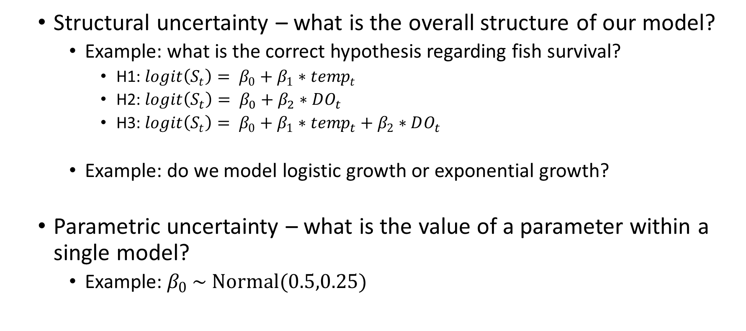
Aside: model uncertainty
Structural uncertainty – what is the overall structure of our model?
Example: what is the correct hypothesis regarding fish survival?
H1: $logit\left(S_{t}\right)= β_{0}+β_{1}∗{temp}_{t}$
H2: $logit\left(S_{t}\right)= β_{0}+β_{2}∗DO_{t}$
H3: $logit\left(S_{t}\right)= β_{0}+β_{1}∗temp_{t}+β_{2}∗DO_{t}$
Example: do we model logistic growth or exponential growth?
Parametric uncertainty – what is the value of a parameter within a single model?
Example: $β_{0} \sim Normal(0.5,0.25)$
Developed by Sarah Converse

Slide 16

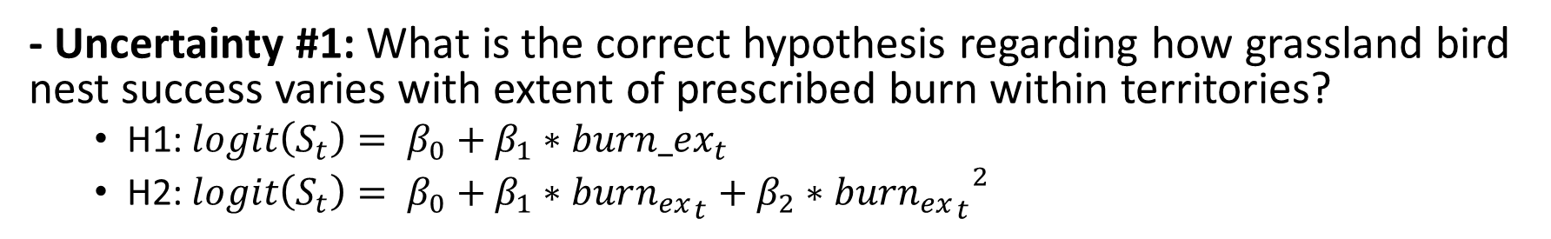
Skills Check Task 1 – Identify uncertainty type
You are a wildlife manager in a refuge who is designing a prescribed burn management plan for a grassland bird
TASK 1#: For the three following uncertainties…
1) Identify the type of uncertainty 2) Suggest a way that it could be resolved
- Uncertainty #1: What is the correct hypothesis regarding how grassland bird nest success varies with extent of prescribed burn within territories?
H1: $logit\left(S_{t}\right)= β_{0}+β_{1}∗{burn_ex}_{t}$
H2: $logit\left(S_{t}\right)= β_{0}+β_{1}∗{burn_{ex}}_{t}+β_{2}∗{{burn_{ex}}_{t}}^{2}$
Uncertainty #2: Expert A believes that a heavy burn would be the best alternative, and Expert B believes a moderate burn would be the best choice
Uncertainty #3: In a nest count survey there is variation in the number of eggs found in a nest

Slide 17

Working with uncertainty
First step is to acknowledge it:
We are surrounded by uncertainty
Simply reducing uncertainty will not guarantee a desired outcome
We often seek information to reduce uncertainty
But we should ask first:
Will that information change our decision and how much will it enhance our performance?
Developed by Sarah Converse

Slide 18
Working with uncertainty
Three Options:
Make decisions anyway
Risk tools: e.g., Decision Trees, Utility Theory
Conduct research to reduce uncertainty
Value of Information
Learn while managing
Adaptive management
Risk = topic for next week!
Topic for today
Developed by Sarah Converse

Slide 19
2. Conducting research to reduce uncertainty
Reducing uncertainty does not guarantee a desired outcome, but it can increase your chances
Decision Tree
Favorable Outcome
Chance Events
Choice A
Unfavorable Outcome
Decision
Choice B
Favorable Outcome
Chance Events
Unfavorable Outcome
Developed by Sarah Converse

Slide 20
When to conduct research
As scientists, we have a strong tendency to:
Want more information before taking action
Recommend postponing a decision until we have more information
Why? What would we do differently based on that information?
We should ask:
Will the information change our decision?
How much will the information improve our performance?
Developed by Sarah Converse

Slide 21

When to conduct research
NOTE:
Information has value to decision makers if, and only if
It influences the selection of management actions
The resulting change in management actions results in improvements in performance on the identified objectives
Developed by Brielle Thompson (See Gregory et al. 2012 Ch 10)

Slide 22
Types of data that might be collected:
Baseline data collection (control data)
Compliance monitoring
Effects monitoring
Capacity building initiatives for agencies/communities
Co-management and trust building initiatives
Research
Development of assessment techniques (new predictive models)
Developed by Brielle Thompson (See Gregory et al. 2012 Ch 10)

Slide 23


Approaches to understand uncertainties
Perform a sensitivity analysis
Conduct a value of information analysis
Developed by Brielle Thompson

Slide 24
Sensitivity analysis
Is the optimal alternative sensitive to uncertainty?
Consider the following example
We are making a decision on whether to repair an impoundment, we evaluated three alternatives against four objectives:
Objectives | Alternatives
 | Status quo | Minor repair | Major repair
Cost ($M) | 0 | 2 | 12
Environmental Benefit (0-10) | 1 | 3 | 10
Disturbance (0-10) | 0 | 1 | 7
Silt Runoff (k ft³) | 5 | 1 | 3
Developed by Sarah Converse

Slide 25
Sensitivity analysis
Let’s say we are uncertain about predicted environmental benefits for Minor Repair – we think they are 3 but they could be as large as 6
Objectives | Alternatives
 | Status quo | Minor repair | Major repair
Cost ($M) | 0 | 2 | 12
Environmental Benefit (0-10) | 1 | 3 | 10
Disturbance (0-10) | 0 | 1 | 7
Silt Runoff (k ft³) | 5 | 1 | 3
Developed by Sarah Converse

Slide 26
Sensitivity analysis
Let’s say we are uncertain about predicted environmental benefits for Minor Repair – we think they are 3 but they could be as large as 6
 | Status Quo | Minor Repair | Major Repair | Weight | Status Quo | Minor Repair | Major Repair
Cost | 0 | 2 | 12 | 0.2 | 1 | 0.83333 | 0
Environ Benefits | 1 | 3 | 10 | 0.6 | 0 | 0.22222 | 1
Disturbance | 0 | 1 | 7 | 0.1 | 0 | 0.85714 | 0
Silt Runoff | 5 | 1 | 3 | 0.1 | 0 | 1 | 0.5
 |  |  |  |  | 0.2 | 0.48571 | 0.65
When value = 3 we would select major repair
Developed by Sarah Converse

Slide 27
Sensitivity analysis
Let’s say we are uncertain about predicted environmental benefits for Minor Repair – we think they are 3 but they could be as large as 6
 | Status Quo | Minor Repair | Major Repair | Weight | Status Quo | Minor Repair | Major Repair
Cost | 0 | 2 | 12 | 0.2 | 1 | 0.83333 | 0
Environ Benefits | 1 | 5 | 10 | 0.6 | 0 | 0.44444 | 1
Disturbance | 0 | 1 | 7 | 0.1 | 0 | 0.85714 | 0
Silt Runoff | 5 | 1 | 3 | 0.1 | 0 | 1 | 0.5
 |  |  |  |  | 0.2 | 0.619044 | 0.65
When value = 5 we would still select major repair
Developed by Sarah Converse

Slide 28
Sensitivity analysis
Let’s say we are uncertain about predicted environmental benefits for Minor Repair – we think they are 3 but they could be as large as 6
 | Status Quo | Minor Repair | Major Repair | Weight | Status Quo | Minor Repair | Major Repair
Cost | 0 | 2 | 12 | 0.2 | 1 | 0.83333 | 0
Environ Benefits | 1 | 6 | 10 | 0.6 | 0 | 0.55556 | 1
Disturbance | 0 | 1 | 7 | 0.1 | 0 | 0.85714 | 0
Silt Runoff | 5 | 1 | 3 | 0.1 | 0 | 1 | 0.5
 |  |  |  |  | 0.2 | 0.68571 | 0.65
When value = 6 we would now select minor repair
Thus, this uncertainty is decision-relevant
Developed by Sarah Converse

Slide 29
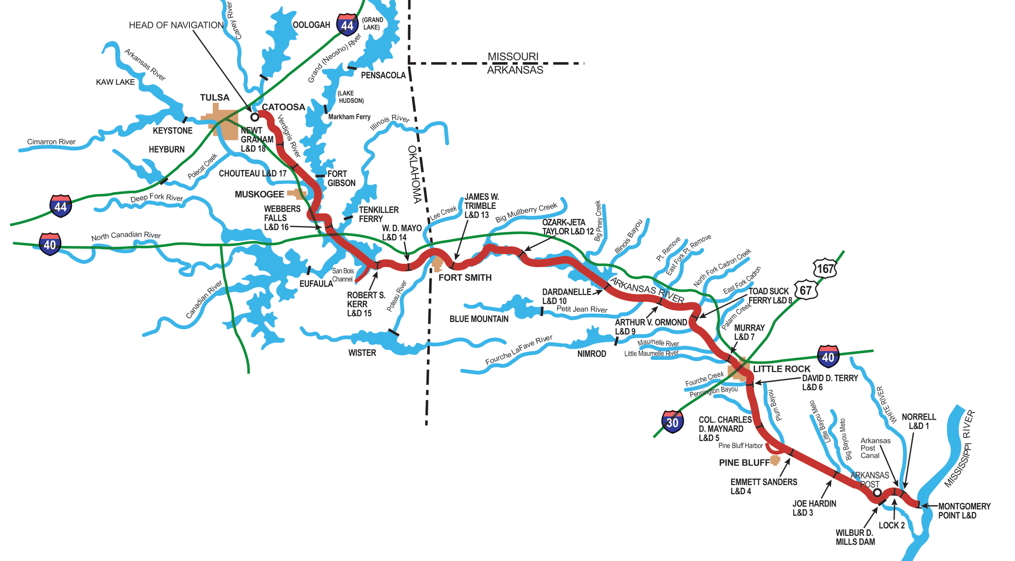
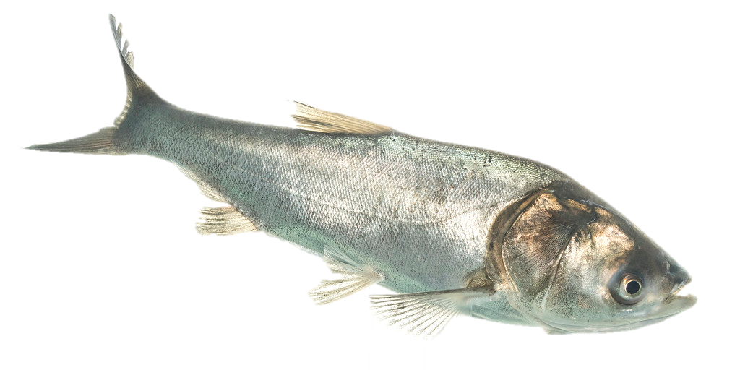
Example: Guiding management decisions of invasive carp in the Lower Mississippi River
Shiny app
Developed by Brielle Thompson

Slide 30
Decision trees:
A useful tool for dealing with uncertainty
Consequences
Uncertainty
Alternatives
Decision
Developed by Sarah Converse

Slide 31

Value of information
If the decision is not sensitive to uncertainty, then there is no decision value in additional information
However, if the decision is sensitive to uncertainty, what is the value of new information?
Value of Information (VoI) offers a suite of tools to quantify the improvement of an outcome if uncertainty is resolved
Developed by Sarah Converse, Brielle Thompson

Slide 32
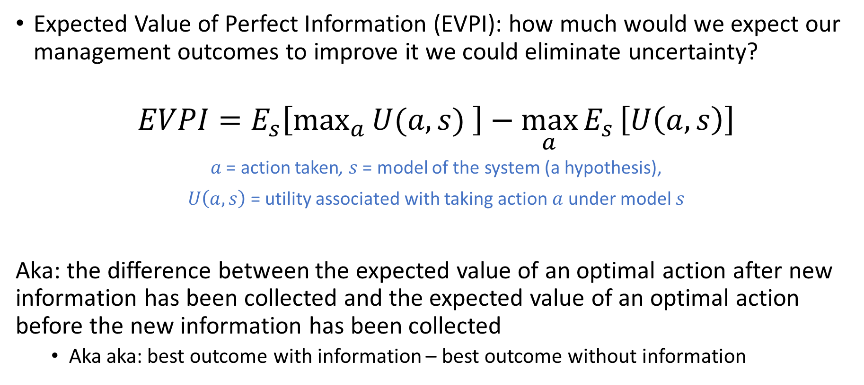
Expected value of perfect information (EVPI)
Expected Value of Perfect Information (EVPI): how much would we expect our management outcomes to improve it we could eliminate uncertainty?
$$EVPI=E_{s}\left[max_{a}{U(a,s) }\right]−\max_{a}{E_{s}}\left[U\left(a,s\right)\right]$$
$a$ = action taken, $s$ = model of the system (a hypothesis),
$U\left(a,s\right)$= utility associated with taking action $a$ under model $s$
Aka: the difference between the expected value of an optimal action after new information has been collected and the expected value of an optimal action before the new information has been collected
Aka aka: best outcome with information – best outcome without information
Runge MC, SJ Converse, and JE Lyons. 2011. Which uncertainty? Using expert elicitation and expected value of information to design an adaptive program. Biological Conservation 144: 1214-1223.
Developed by Sarah Converse

Slide 33
Expected value of perfect information (EVPI)
Example: Hatchery problem – will a new technology improve the hatchery?
Outcomes
How much would you pay to find out which model (hypothesis) is true?
Chance node
70,000 Fry
Does it work?
Yes
No
10,000 Fry
Optimistic (Model 1): Probability that it works = 0.8
Pessimistic (Model 2): Probability that it works = 0.4
Yes
Decision
Add new technology to a hatchery?
40,000 Fry
No
Developed by Sarah Converse

Slide 34
Expected value of perfect information (EVPI)
Work?
0.8
70,000
Y
10,000
Example: Hatchery problem – will a new technology improve the hatchery?
And how much would you pay to find out which model (hypothesis) is true?
Adopt technology?
0.2
Optimistic
Model 1
N
40,000
0.5
Model?
Work?
0.4
Y
70,000
0.5
Adopt technology?
Y
Pessimistic
Model 2
0.6
10,000
N
Research before deciding to adopt tech?
40,000
Optimistic
Model 1
Work?
0.8
70,000
Model
?
N
Y
0.5
10,000
0.2
Adopt technology?
0.5
Pessimistic
Model 2
Work?
0.4
70,000
N
0.6
10,000
Developed by Sarah Converse
Optimistic (Model 1): Probability that it works = 0.8
Pessimistic (Model 2): Probability that it works = 0.4
40,000

Slide 35
Expected value of perfect information (EVPI)
Work?
0.8
70,000
Y
10,000
Example: Hatchery problem – will a new technology improve the hatchery?
And how much would you pay to find out which model (hypothesis) is true?
Adopt technology?
0.2
Optimistic
Model 1
N
40,000
0.5
Model?
Work?
0.4
Y
70,000
0.5
Adopt technology?
Y
Pessimistic
Model 2
0.6
10,000
N
Research before deciding to adopt tech?
40,000
Optimistic
Model 1
Work?
0.8
70,000
Model
?
N
Y
0.5
10,000
0.2
Adopt technology?
0.5
Pessimistic
Model 2
Work?
0.4
70,000
N
0.6
10,000
Developed by Sarah Converse
Optimistic (Model 1): Probability that it works = 0.8
Pessimistic (Model 2): Probability that it works = 0.4
40,000

Slide 36
Expected value of perfect information (EVPI)
EVPI: Hatchery Example
Model | Prior | Adopt the Technology? |  | EV with perfect information
 |  | Yes | No
1 (optimistic) | 0.5 | (0.8)*70+(0.2)*10=58 | 40
2 (pessimistic) | 0.5 | (0.4)*70+(0.6)*10=34
EV with uncertainty
EVPI calculation
1. Calculate EV for each model and alternative
= Probability it works * Frys (in 1000s) + probability it doesn’t work * Frys (in 1000s)
Developed by Sarah Converse

Slide 37
Expected value of perfect information (EVPI)
Work?
0.8
70,000
Y
10,000
Example: Hatchery problem – will a new technology improve the hatchery?
And how much would you pay to find out which model (hypothesis) is true?
Adopt technology?
0.2
Optimistic
Model 1
N
40,000
0.5
Model?
Work?
0.4
Y
70,000
0.5
Adopt technology?
Y
Pessimistic
Model 2
0.6
10,000
N
Research before deciding to adopt tech?
40,000
Optimistic
Model 1
0.8
70,000
Model
?
Work?
N
Y
0.5
10,000
0.2
Adopt technology?
0.5
Pessimistic
Model 2
Work?
0.4
70,000
N
0.6
10,000
Developed by Sarah Converse
Optimistic (Model 1): Probability that it works = 0.8
Pessimistic (Model 2): Probability that it works = 0.4
40,000

Slide 38
Expected value of perfect information (EVPI)
EVPI: Hatchery Example
Model | Prior | Adopt the Technology? |  | EV with perfect information
 |  | Yes | No
1 (optimistic) | 0.5 | (0.8)*70+(0.2)*10=58 | 40
2 (pessimistic) | 0.5
EV with uncertainty
(0.4)*70+(0.6)*10=34 40
EVPI calculation
1. Calculate EV for each model and alternative
= Probability it works * Frys (in 1000s) + probability it doesn’t work * Frys (in 1000s)
Developed by Sarah Converse
Notes:
Ask if they can calculate this bottom one?

Slide 39
Expected value of perfect information (EVPI)
EVPI: Hatchery Example
Model | Prior | Adopt the Technology? |  | EV with perfect information
 |  | Yes | No
1 (optimistic) | 0.5 | (0.8)*70+(0.2)*10=58 | 40 | (0.5)*58
2 (pessimistic) | 0.5 |  |  | (0.5)*40
EV with uncertainty
(0.4)*70+(0.6)*10=34 40
(0.5)*58 + (0.5)*40 = 49
EVPI calculation
Calculate EV for each model and alternative
Calculate EV under certainty
= 49
Developed by Sarah Converse
Notes:
Ask if they can calculate this bottom one?

Slide 40
Expected value of perfect information (EVPI)
EVPI: Hatchery Example
Model | Prior | Adopt the Technology? |  | EV with perfect information
 |  | Yes | No
1 (optimistic) | 0.5 | (0.8)*70+(0.2)*10=58 | 40 | (0.5)*58
2 (pessimistic) | 0.5 |  |  | (0.5)*40
EV with uncertainty
(0.4)*70+(0.6)*10=34 40
(0.5)*58 + (0.5)*34 = 46 40
(0.5)*58 + (0.5)*40 = 49
EVPI calculation
Calculate EV for each model and alternative
Calculate EV under certainty
Calculate EV under uncertainty
= 49
= 46
Developed by Sarah Converse
Notes:
Ask if they can calculate this bottom one?

Slide 41
Expected value of perfect information (EVPI)
EVPI: Hatchery Example
Model | Prior | Adopt the Technology? |  | EV with perfect information
 |  | Yes | No
1 (optimistic) | 0.5 | (0.8)*70+(0.2)*10=58 | 40 | (0.5)*58
2 (pessimistic) | 0.5 |  |  | (0.5)*40
EV with uncertainty
(0.4)*70+(0.6)*10=34 40
(0.5)*58 + (0.5)*34 = 46 40
(0.5)*58 + (0.5)*40 = 49
EVPI calculation
Calculate EV for each model and alternative
Calculate EV under certainty
Calculate EV under uncertainty
Calculate EVPI = EV under certainty – EV under uncertainty
= 49
= 46
= 49 – 46 = 3
Developed by Sarah Converse
Notes:
Ask if they can calculate this bottom one?

Slide 42
Skills Check Task 2 – Calculate EVPI
TASK: Calculate EVPI to determine whether we should undertake research to determine which hypothesis is true?
Notation example:
V(A1|H1) = outcome of A1 given H2 is true
max_{A}V(A|H2) = Maximum outcomes across all alternatives if H2 is true
Hypothesis | Belief |  | Predicted Survival under Alternative and Hypothesis
*See Task 1 uncertainty #1 |  |  | Alternative 1 (A1) – Heavy Burn | Alternative 2 (A2)– Moderate Burn
H1 | 0.4 |  | 0.7 | 0.3
H2 | 0.6 |  | 0.45 | 0.65
1. Calculate EV for each alternative
EV(A1) = Pr(H1)*V(A1|H1)+Pr(H2)*V(A1|H2) = 0.4*0.7 + 0.6*0.45 = 0.55
EV(A2) = Pr(H1)*V(A2|H1)+Pr(H2)*V(A2|H2) = ? [You will answer!]
2. Calculate EV(Uncertainty) = ? [You will answer!] Hint the maximum between EV(A1) and EV(A2)
3. Calculate EV(Certainty) = Pr(H1)*max_{A}V(A|H1)+Pr(H2)*max_{A}V(A|H2) = ? [You will answer!]
4. Calculate EVPI = EV(Certainty) – EV(Uncertainty) = ? [You will answer!]
Developed by Sarah Converse
Notes:
EV(Uncertainty) = max_{A}(EV(A))
EV(A1) = Pr(H1)*V(A1|H1)+Pr(H2)*V(A1|H2) = 0.4*0.7 + 0.6*0.45 = 0.55
EV(A2) = Pr(H1)*V(A2|H1)+Pr(H2)*V(A2|H2) = 0.4*0.3 + 0.6*0.65 = 0.51
EV(Uncertainty) = 0.55
EV(Certainty) = Pr(H1)*max_{A}V(A|H1)+Pr(H2)*max_{A}V(A|H2) = 0.4*0.7 + 0.6*0.65 = 0.67
EVPI = 0.67 – 0.55 = 0.12

Slide 43
Other VOI analysis:
Expected Value of Perfect Information (EVPI): how much would we expect our management outcomes to improve it we could completely eliminate uncertainty?
Expected Value of Partial Perfect Information (EVPXI): how much would we expect our management outcomes to improve if we could completely eliminate one source of uncertainty?
Expected Value of Sample Information (EVSI): how much would we expect our management outcomes to improve if we could get a sample of information?
Qualitative Value of Information (QVoI): a measure of EVPI based on a qualitative analysis
Developed by Sarah Converse

Slide 44
VOI summary:
Reducing uncertainty before taking action is a sequence of decisions with trade-offs and risks
Value of information is useful for evaluating how much management can be improved by reducing uncertainty and gauging how much one should pay for applied research
If you can’t do it quantitatively, think about it conceptually or qualitatively
Developed by Sarah Converse

Slide 45
Working with uncertainty
Three Options:
Make decisions anyway
Risk tools: e.g., Decision Trees, Utility Theory
Conduct research to reduce uncertainty
Value of Information
Learn while managing
Adaptive management
Risk = topic for next week!
Topic for today
Developed by Sarah Converse

Slide 46
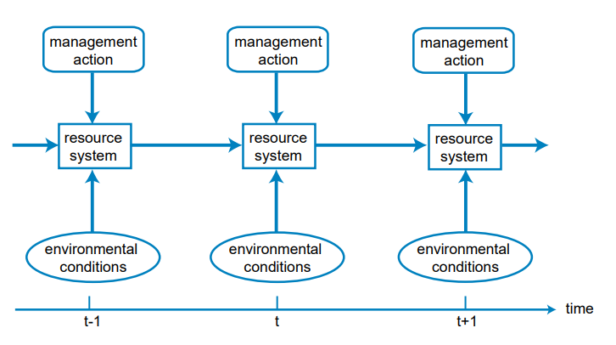
3. Learn while managing
Recurrent Decisions - decisions we make over and over (e.g., annual harvest limits, hatchery releases, translocations, etc.)
Sometimes, if we are making recurrent decisions, we can use the opportunity to learn and adapt
When we use monitoring to reduce our uncertainty and adapt our management over time, we are doing adaptive management
DOI adaptive management guide
Developed by Sarah Converse

Slide 47
When can we use adaptive management?
If we have:
Repeated decisions
Uncertainty that is important to management (EVPI > 0)
The ability to monitor to reduce our uncertainty
Adaptive Management: learning by doing
Management
Assessment
Management
Assessment
Monitor
Monitor
Developed by Sarah Converse, Brielle Thompson

Slide 48
Questions to ask if adaptive management is needed
Do the uncertainties affect the choice of future management actions?
Does the spatial and temporal scale allow for formal and effective monitoring or experimentation?
Given the multiple objectives of stakeholders and potential risks, is experimentation really an option?
Is there sufficient institutional capacity to support an AM program?
Are there alternative ways to reduce the relevant uncertainties?
Do we have the capacity to collect monitoring data?
Developed by Brielle Thompson

Slide 49
The purposes of monitoring in the context of adaptive management are to:
Assess the state of a system
Determine if objectives are being met (evaluate management performance)
Resolve uncertainty about how system works (foster learning)
Lyons JE, MC Runge, HP Laskowski, and WL Kendall. 2008. Monitoring in the context of structured decision-making and adaptive management. Journal of Wildlife Management 172: 1683-1692.
Developed by Sarah Converse

Slide 50
How does it work?
Structure the decision problem
Problem Framing → Objectives → Alternatives
Develop predictive models that include key sources of uncertainty
Distinguish between reducible and irreducible uncertainty
Analyze the expected value of information to determine if the uncertainty is actually worth reducing
Identify a preferred management action, based on
Management objective(s)
Weight of evidence (i.e., relative confidence in each of the alternative models)
Anticipated value of learning
Decision is implemented, the resource evolves to a new state
A monitoring program observes the resource response (new system state)
Model‐specific weights are updated to reflect the new information
Weights increase for those models that more closely matched the observations
Weights decrease for models which showed poorer predictive capacity
Return to step 3
Developed by Runge MC, Nichols JD, Johnson FA, Eaton MJ, Romito AM, Breese G, Cochrane JF, Converse SJ, Eaton MJ, Larson MA, Lyons JE, Smith DR, Isham AF

Slide 51
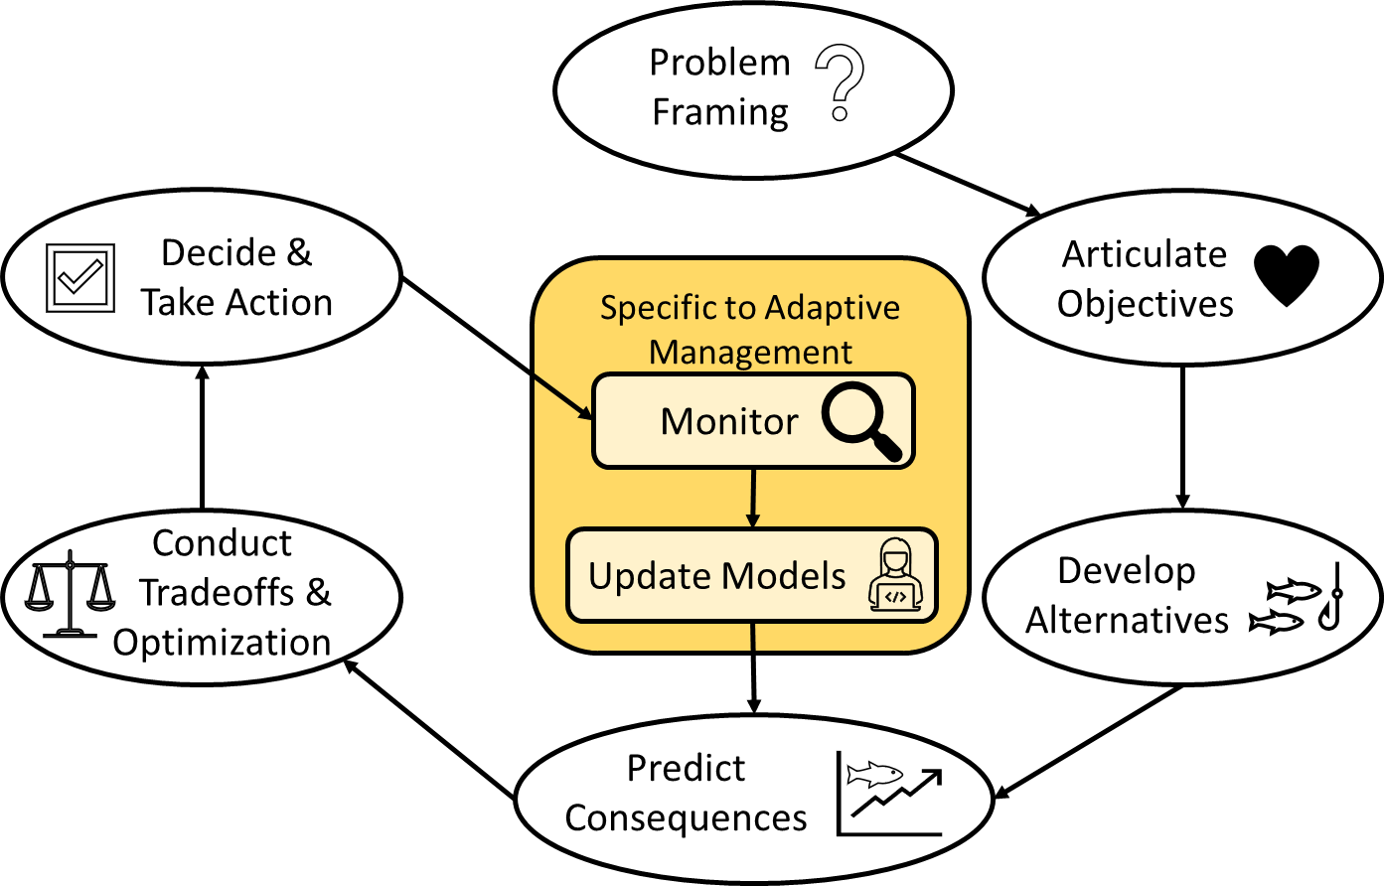
Specific methods used:
Degrees of monitoring:
Monitor single management action
Monitor multiple management ‘experiments’
Degrees of updating models:
Simple as ‘recording new data’
Complex as Bayesian updating
Degrees of predicting consequences:
Expert elicitation
Prediction modeling
Experiments
Management strategy evaluation
Degrees of tradeoff & optimization:
Negotiation
Multi-criteria decision analysis
Value of information
Dynamic programming methods*
*beyond scope of class
Adaptive management loop
Figure Adapted from Converse et al. 2013 and Runge 2011
Developed by Brielle Thompson

Slide 52
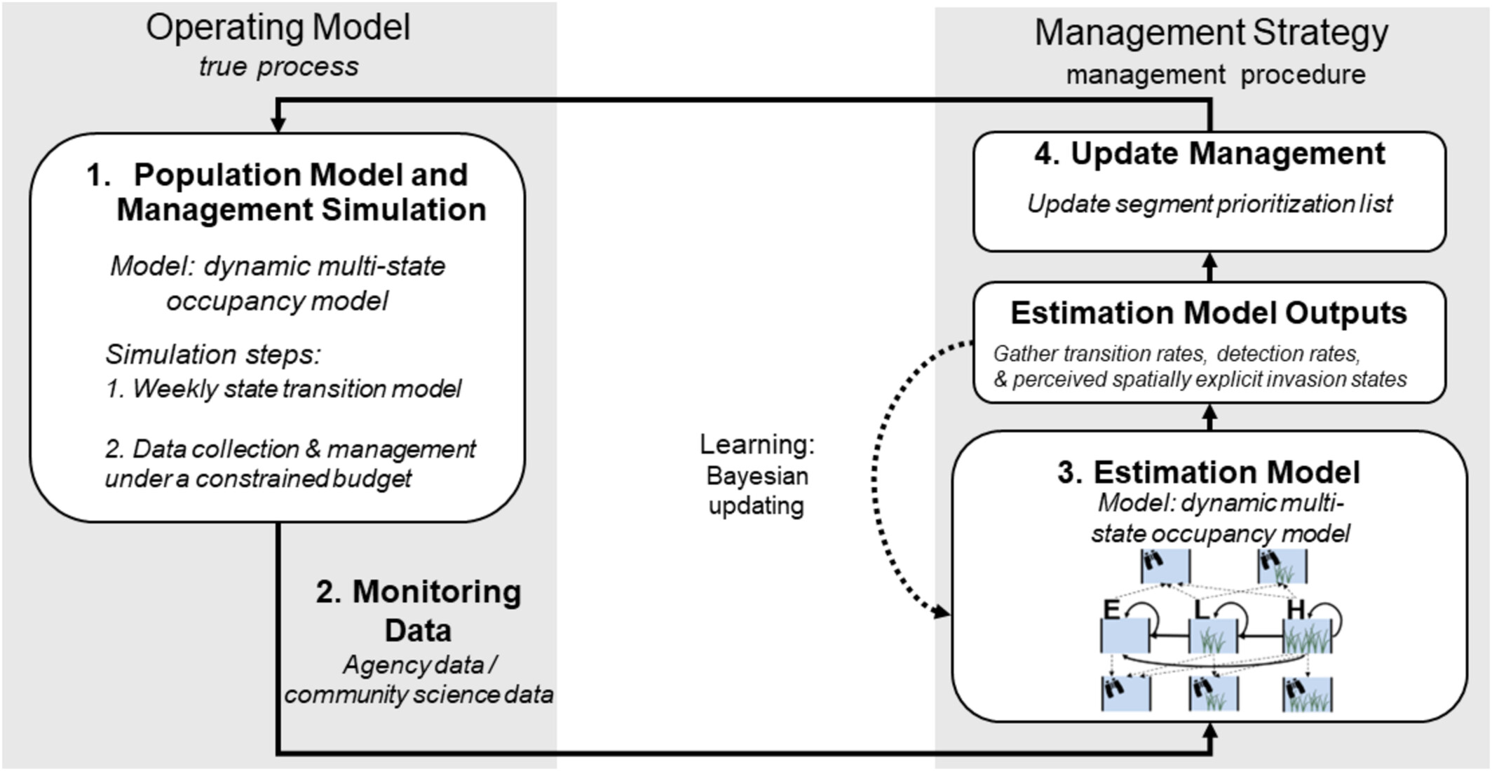
Another useful adaptive management framework:
Management strategy evaluation
Thompson et al. 2025
Developed by Brielle Thompson

Slide 53







How learning can occur over time:
Identify belief of the key parameter of the system
Identify belief of the key parameter of the system
Adapt management
Gather data
Update models
Year 1
Year 2
0.5
0.5
Identify belief of the key parameter of the system
Adapt management
Gather data
Update models
Year 3
…
0.5
Developed by Brielle Thompson

Slide 54
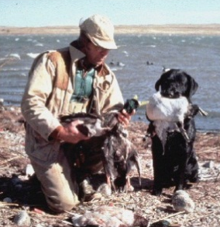
AM example- north American waterfowl harvest
Adaptive Harvest Management
Additive,
Weak DD
0.5
0.5
0.4
Compens.,
Weak DD
0.4
0.3
0.3
Model Weight
Model Weight
0.2
0.2
0.1
Additive,
Strong DD
0.1
Compens.,
Strong DD
0.0
0.0
1995
1995
2000
2000
2005
2005
Year
Developed by Runge MC, Nichols JD, Johnson FA, Eaton MJ, Romito AM, Breese G, Cochrane JF, Converse SJ, Eaton MJ, Larson MA, Lyons JE, Smith DR, Isham AF

Slide 55
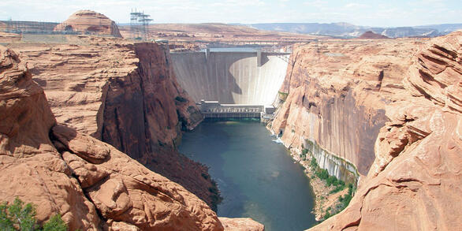
AM example- Glen Canyon Dam
See https://www.usbr.gov/uc/progact/amp/index.html

Slide 56
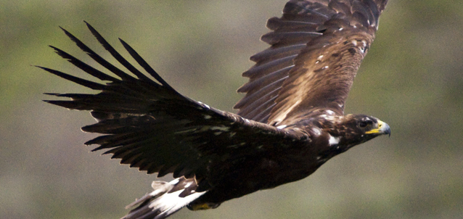
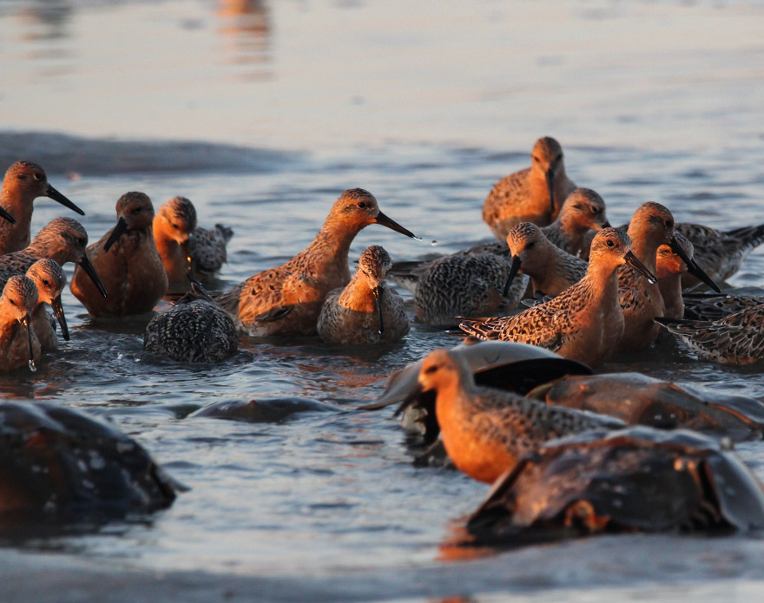
Other AM examples
Red Knots and horseshoe crabs
Golden Eagles in Denali
NPS
3 hypotheses were developed about effects of hiking on site occupancy and nest success
Collected monitoring data each year to update hypothesis to then inform annual decisions about what trails should be restricted
Center for Conservation Biology
Adaptive management program to identify sustainable horseshoe crab harvest strategy that protects red knots and enables learning about how the system functions
Annual Monitoring data informs these decisions
Developed by Brielle Thompson, See Williams and Brown 2014

Slide 57


Adaptive management resources

Slide 58
Impediments to adaptive management:
Confusion with trial and error
It is not a ‘trial and error’ process, but rather emphasizes learning while doing
Institutional resistance to acknowledging uncertainty
Mistake a monitoring plan for being an adaptive management program
Risk aversion → strategies with little or no opportunity for learning
Lack of institutional commitment
Developed by Brielle Thompson, See Williams and Brown 2014

Slide 59
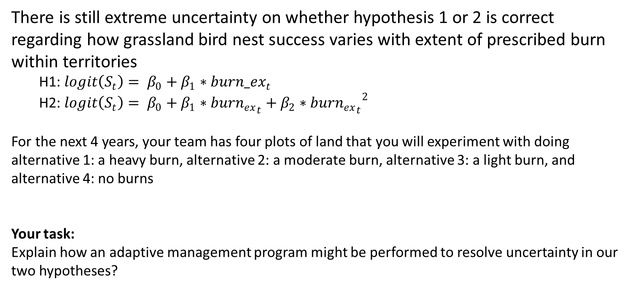
Skills Check #3: Adaptive Management
There is still extreme uncertainty on whether hypothesis 1 or 2 is correct regarding how grassland bird nest success varies with extent of prescribed burn within territories
H1: $logit\left(S_{t}\right)= β_{0}+β_{1}∗{burn_ex}_{t}$
H2: $logit\left(S_{t}\right)= β_{0}+β_{1}∗{burn_{ex}}_{t}+β_{2}∗{{burn_{ex}}_{t}}^{2}$
For the next 4 years, your team has four plots of land that you will experiment with doing alternative 1: a heavy burn, alternative 2: a moderate burn, alternative 3: a light burn, and alternative 4: no burns
Your task:
Explain how an adaptive management program might be performed to resolve uncertainty in our two hypotheses?
Developed by Brielle Thompson

Slide 60
Activity: think about your decision problem
For your final project presentation, you will quickly comment on additional tools that could be used in your problem that are beyond PrOACT
E.g., addressing uncertainty (sensitivity analysis, value of information analysis, and adaptive management)
E.g., for addressing risk (those tools will be talked about next week)
How could you use these tools for your problem?
Feel free to go back to your other PrOACT steps!
Developed by Brielle Thompson

Slide 61
Working with uncertainty
Three Options:
Make decisions anyway
Risk tools: e.g., Decision Trees, Utility Theory
Conduct research to reduce uncertainty
Value of Information
Learn while managing
Adaptive management
Risk = topic for next week!
Topic for today
Developed by Sarah Converse

Slide 62
Looking ahead:
Next week: Additional SDM tools regarding uncertainty and risk & few final presentations
Weekly: Work through a step of the PrOACT process/ learn extra tools
Last week of class:
Elevator pitch of your research project in terms of SDM/PrOACT
Note: Abridged PrOACT story slides with a star on the upper right are good examples to use for your presentation
Developed by Brielle Thompson

Slide 63

Extra time activities:

Slide 64
Reading discussion – Ch 10 Gregory and Long 2012
What role does learning play throughout the SDM process, and why is it considered essential at every stage rather than just at the end?
How does the concept of “value of information” (VOI) help prioritize research and monitoring efforts? What are the limitations of relying solely on VOI calculations?
What are the benefits and challenges of incorporating adaptive management into SDM? How do passive and active adaptive management differ in practice?
The authors argue that learning is a means to an end, not a fundamental objective. Do you agree? Should learning ever be treated as a primary goal in environmental management?

Slide 65
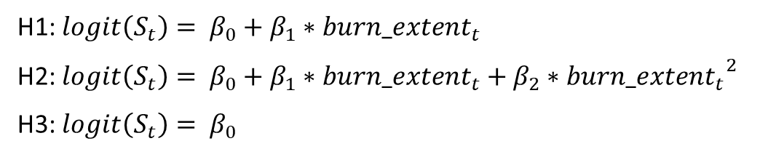
EXPECTED VALUE OF PARTIAL PERFECT INFORMATION (EVPXI)
Expected Value of Partial Perfect Information: how much would we expect our management outcomes to improve if we could completely eliminate one source of uncertainty?
Going back to the bird example: We have a new hypothesis and a new action
Hypothesis | Belief |  | Predicted Outcome under Alternative and Hypothesis
 |  |  | Alternative 1 – Heavy Burn | Alternative 2 – Moderate Burn | Alternative 3 – No Burn
H1 | 0.4 |  | 0.7 | 0.3 | 0.2
H2 | 0.4 |  | 0.45 | 0.65 | 0.4
H3 | 0.2 |  | 0.4 | 0.5 | 0.6
H1: $logit\left(S_{t}\right)= β_{0}+β_{1}∗{burn_extent}_{t}$
H2: $logit\left(S_{t}\right)= β_{0}+β_{1}∗{burn_extent}_{t}+β_{2}∗{{burn_extent}_{t}}^{2}$
H3: $logit\left(S_{t}\right)= β_{0}$
What if I could do an experiment that would either confirm or refute H3?
Let’s call our hypotheses H3 and not-H3
Developed by Sarah Converse

Slide 66
EXPECTED VALUE OF PARTIAL PERFECT INFORMATION (EVPXI)
Expected Value of Partial Perfect Information: how much would we expect our management outcomes to improve if we could completely eliminate one source of uncertainty?
Going back to the bird example: We have a new hypothesis and a new action
Hypothesis | Belief |  | Predicted Outcome under Alternative and Hypothesis
 |  |  | Alternative 1 – Heavy Burn | Alternative 2 – Moderate Burn | Alternative 3 – No Burn
not-H3 | 0.8 |  | 0.575 | 0.475 | 0.3
H3 | 0.2 |  | 0.4 | 0.5 | 0.6
H1 and H2 combine to become not-H3 above ^
= EV(A1|not-H3) = (Pr(H1)*V(A1|H1)+Pr(H2)*V(A1|H2)) / (Pr(H1)+Pr(H2))
= (0.4*0.7+0.4*0.45)/(0.4+0.4) = 0.575
Developed by Sarah Converse

Slide 67
EXPECTED VALUE OF PARTIAL PERFECT INFORMATION (EVPXI)
Expected Value of Partial Perfect Information: how much would we expect our management outcomes to improve if we could completely eliminate one source of uncertainty?
Going back to the bird example: We have a new hypothesis and a new action
Hypothesis | Belief |  | Predicted Outcome under Alternative and Hypothesis
 |  |  | Alternative 1 – Heavy Burn | Alternative 2 – Moderate Burn | Alternative 3 – No Burn
not-H3 | 0.8 |  | 0.575 | 0.475 | 0.3
H3 | 0.2 |  | 0.4 | 0.5 | 0.6
Then just calculate EVPI on the new table ^
EV(Uncertainty) = maxA(EV(A))
• EV(A1) = 0.8*0.575+0.2*0.4 = 0.54
• EV(A2) = 0.8*0.475+0.2*0.5 = 0.48
• EV(A3) = 0.8*0.3+0.2*0.6 = 0.36
*EV(Uncertainty) = 0.54
EV(Certainty) = Pr(not-H3)*maxAV(A|not-H3)+Pr(H3)*maxAV(A|H3) = 0.8*0.575+0.2*0.6 = 0.58
EVPXI(H3) = 0.58 – 0.54 = 0.04
Developed by Sarah Converse

Slide 68
Activity: Calculate EVPXI(H1) and EVPXI(H2)
Hypothesis | Belief |  | Predicted Outcome under Alternative and Hypothesis
 |  |  | Alternative 1 – Heavy Burn | Alternative 2 – Moderate Burn | Alternative 3 – No Burn
H1 | 0.4 |  | 0.7 | 0.3 | 0.2
H2 | 0.4 |  | 0.45 | 0.65 | 0.4
H3 | 0.2 |  | 0.4 | 0.5 | 0.6
Considering EVPXI(H1), EVPXI(H2), and EVPXI(H3), if you could confirm or refute just one hypothesis, which one would you take on?
Developed by Sarah Converse

Slide 69
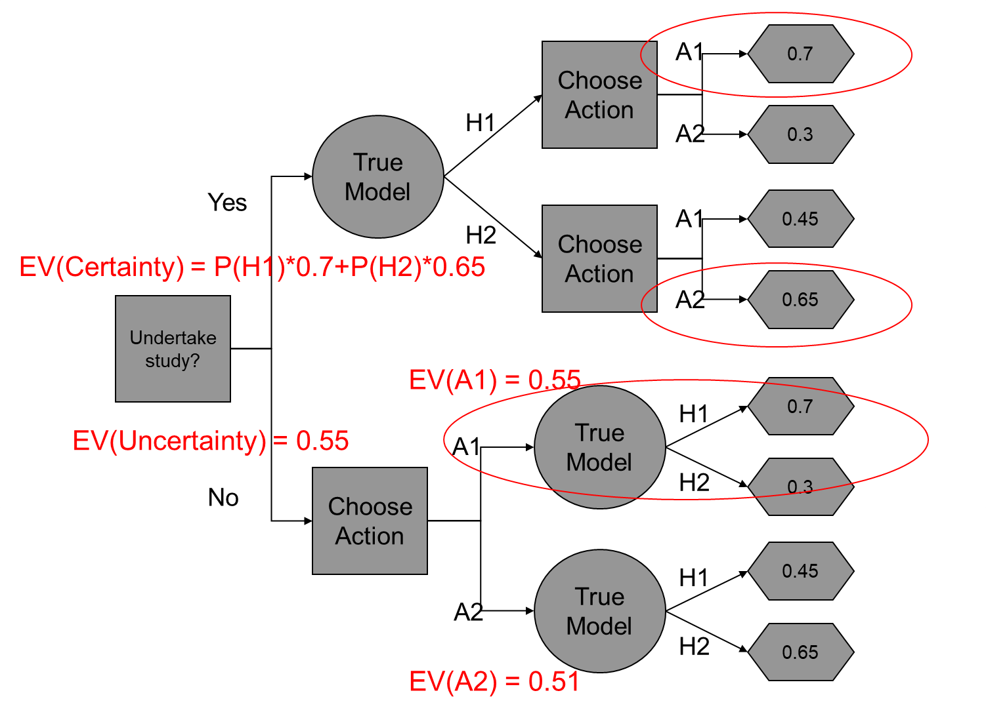
Hints for Skills Check Task 2
Developed by Sarah Converse

Slide 70
Aside: Active vs passive AM
Passive AM involves decision-focused monitoring
New information becomes available through the monitoring of outcomes, the existing data set should be updated and, if appropriate, new hypotheses constructed and new management actions undertaken.
Active AM involves decision-focused experimentation.
The implementation phase incorporates actions intended to deliberately perturb the system
Developed by Brielle Thompson

Slide 71
Aside: Single‐, double‐, and triple‐loop learning
Learning occurs at several levels
Single‐loop: comparing the existing range of our understanding of the system. That is, it asks the question “are we doing things right?”
Double‐loop: describes a re‐examination of the problem framing (values, objectives, alternatives, scale, etc.) following a period of single‐loop learning. That is, it asks the question “are we doing the right things?”
Triple‐loop: examines the role of governance institutions, regulatory frameworks, etc., and questions their efficacy in managing resources. That is, it asks, “who has the right to do it?”
Developed by Runge MC, Nichols JD, Johnson FA, Eaton MJ, Romito AM, Breese G, Cochrane JF, Converse SJ, Eaton MJ, Larson MA, Lyons JE, Smith DR, Isham AF

Slide 72
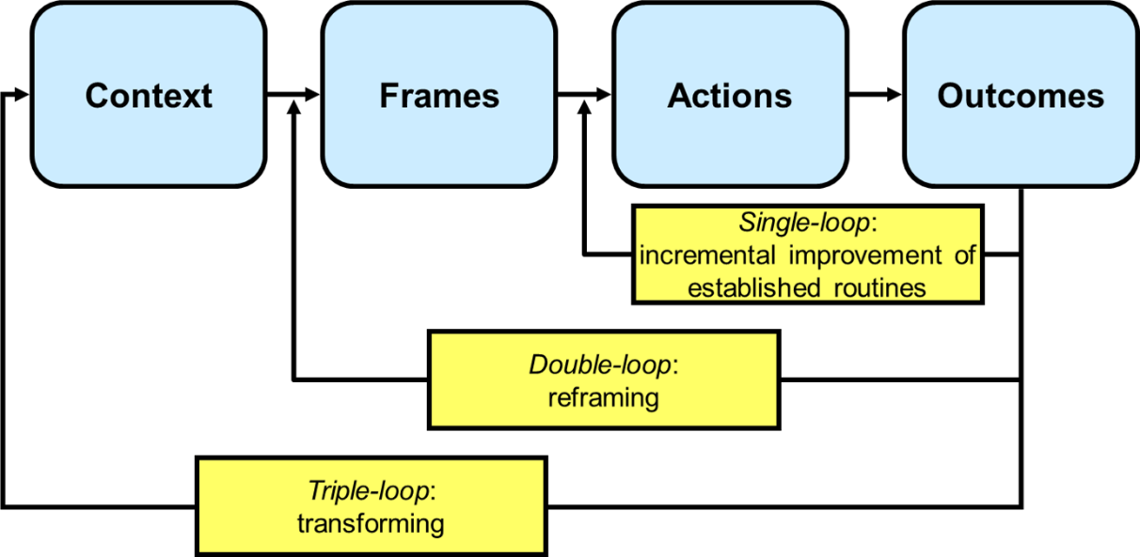
Aside: Single‐, double‐, and triple‐loop learning
Pahl‐Wostl 2009
Developed by Runge MC, Nichols JD, Johnson FA, Eaton MJ, Romito AM, Breese G, Cochrane JF, Converse SJ, Eaton MJ, Larson MA, Lyons JE, Smith DR, Isham AF

Slide 73
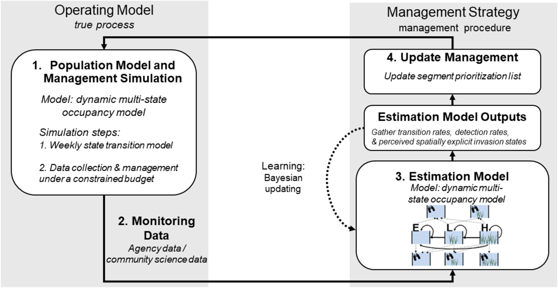
Management Strategy Evaluation
Approach for identifying optimal adaptive management decisions
Two phases:
Operating model
Underlying ecological process
Results in monitoring data
Management strategy
Uses monitoring data to inform estimation model
Estimation model then informs management decision
Use:
Fisheries, invasive species, large predator management
Thompson et al. 2025
Pros: can incorporate complex ecological processes in estimation/simulation models
Cons: Does not inform mathematically optimal decisions (compared to dynamic programming processes)

