Slide 1
Rapid prototype project:
Non-native fish control below glen canyon dam
Adapted, modified, and simplified from Runge et al. 2011

Slide 2
SDM project: Non-native fish control below glen canyon dam
Problem framing statement:
Bureau of reclamation is trying to make decisions regarding invasive trout management to achieve recovery of humpback chub populations over the next 5 years in the Little Colorado River, below the Glen Canyon Dam considering sacred sites and spiritual values of local Native American tribes (e.g., avoid taking of life), humpback chub recovery, trout invasion, recreational values, cost, and local economies.
Adapted, modified, and simplified from Runge et al. 2011

Slide 3
SDM project: Non-native fish control below glen canyon dam
Objectives (objectives hierarchy)
Fundamental objectives
Maximize resources to protect tribal sacred sites and spiritual values
Maximize native species integrity
Maximize recreation
Minimize cost
Means objectives
Min. taking of life
Min. wilderness days lost
Min. trout removal cost
Max. dam power production
Max. HBC population
Min. trout population
Max. fish catch
Process objectives
- Be respectful of tribal values and rituals
Strategic objectives
-Operate within the authority, capabilities, and legal responsibility of the Bureau of Reclamation
- Follow ESA compliances
Adapted, modified, and simplified from Runge et al. 2011
Notes:
https://pubs.usgs.gov/of/2011/1012/pdf/ofr20111012.pdf#page=17.21

Slide 4
SDM project: Non-native fish control below glen canyon dam
Alternatives:
----------------------THEMES-----------------------
a) Trout management | b) HBC habitat | c) Recreation
1. None | 1. None | 1. No changes
2. 25 fish/acre killed | 2. Plant native vegetation | 2. Remove 50 boating days per year
3. 50 fish/acre killed | 3. Build sediment curtain | 3. Close wilderness areas for 1 year
4. 25 fish/acre removed via helicopter |  | 4. Prohibit boating for 1 year
5. 50 fish/acre removed via helicopter
Strategy table:
Strategy | A) Trout management | B) HBC habitat | C) Recreation
A (none) | a1 | b1 | c1
B | a2 | b2, b3 | c2
C | a3 | b2, b3 | c3
D | a4 | b2, b3 | c4
E | a5 | b2 | c3, c4
Adapted, modified, and simplified from Runge et al. 2011

Slide 5
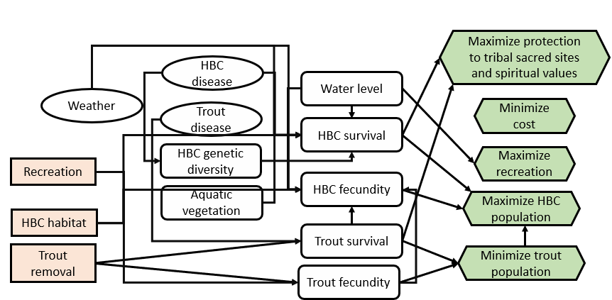
SDM project: Non-native fish control below glen canyon dam
Consequences:
Influence Diagram
Adapted, modified, and simplified from Runge et al. 2011

Slide 6
SDM project: Non-native fish control below glen canyon dam
Consequences:
Simplified consequence table (relative table for illustration)
Objective |  |  |  | Alternative
Objective | Direction | Attribute |  | A | B | C | D | E
Respect Life | Max | [0-10 scale] |  | 6 | 7 | 6 | 9.5 | 9
HBC Recovery | Max | [P(N>6000)] |  | 0.2 | 0.3 | 0.3 | 0.3 | 0.25
Wilderness Disturbance | Min | [User-days] |  | 0 | 30 | 40 | 50 | 60
Cost | Min | [M$/5-yr] |  | 0 | 2.5 | 3 | 4.5 | 2
MODEL:
Expert elicitation
Population model
Expert elicitation/ population model
Adapted, modified, and simplified from Runge et al. 2011

Slide 7
SDM project: Non-native fish control below glen canyon dam
Tradeoffs:
Simplified consequence table (relative table for illustration)
Weights:
Objective |  |  |  | Alternative
Objective | Direction | Attribute |  | A | B | C | D | E
Respect Life | Max | [0-10 scale] |  | 0 | 0.29 | 0 | 0.86 | 1
HBC Recovery | Max | [P(N>6000)] |  | 0 | 1 | 1 | 1 | 0.5
Wilderness Disturbance | Min | [User-days] |  | 1 | 0.5 | 0.33 | 0.17 | 0
Cost | Min | [M$/5-yr] |  | 1 | 0.44 | 0.33 | 0 | 0.56
Weighted outcome: (sum product of weight and outcome) |  |  |  | 0.4 | 0.64 | 0.53 | 0.59 | 0.57
Hypothetical for illustration
0.2
0.4
0.1
0.3
Adapted, modified, and simplified from Runge et al. 2011

Slide 8
SDM project: Non-native fish control below glen canyon dam
Problem
framing
Additional tools:
Adaptive management could be used to learn about the chosen alternative strategy (B) and determine whether the strategy should be updated in the future based on information gathered
Decide & Implement
Articulate
Objectives
Monitor, learn, & update models
Perform
Tradeoffs
Identify
Alternatives
Predict
Consequences
Adapted, modified, and simplified from Runge et al. 2011

