Slide 1

Week 5: Tradeoffs Step of PrOACT
Instructor: Brielle K Thompson
Course: NAT_R 8001 Decision Analysis for Research and Management of Natural Resources
Notes:
First 30 minutes = intro
Next 60 = slides
Final 30 = activity

Slide 2

Review of last week
Discussed the Alternatives and Consequences step of SDM
Identifying Alternatives:
Focus on fundamental objectives & address conflicting objectives
Challenge constraints
Create groups of alternatives (portfolios/strategies)
Revisit objectives
Tips for evaluating consequences:
Build an influence diagram to help create models
Identify model type (population model, economic model, expert elicitation, etc.)
Organize outcomes in a consequence table
Stochastic factor A
Action 1
Intermediate factor A
Objective 1
Action 2
Objective 2
Action 3
Intermediate factor B

Slide 3
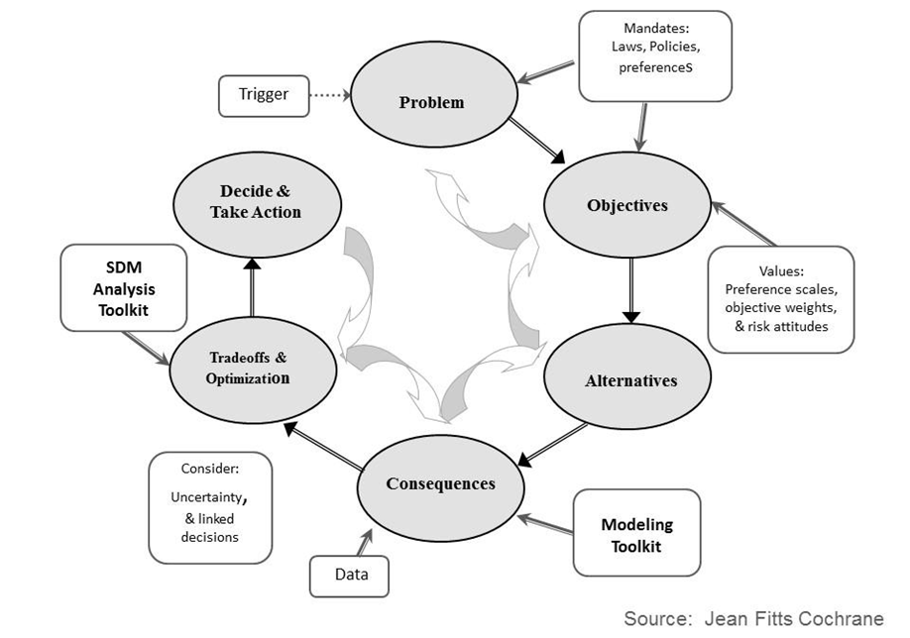
Today:
Learn about the Tradeoffs step

Slide 4
Tradeoffs
“How much you would give up on one objective in order to achieve gains on another objective”
- Gregory et al. 2012
Developed by Justin Gude, Julie Zimmerman, Mitch Eaton, Jean Cochrane, Sarah Converse, Mike Runge

Slide 5
Role of analytical methods in tradeoff analysis
Identify “best” (optimal) solution
Ties together alternatives, objectives, and predicted consequences
How do you integrate all the components?
Easiest with a single objective
Easiest without uncertainty
Solution method depends on the structure of the problem
Developed by Justin Gude, Julie Zimmerman, Mitch Eaton, Jean Cochrane, Sarah Converse, Mike Runge

Slide 6
Analytical approaches
 | Approach
Single Objective | Deterministic optimization
Multiple Objectives | Multiple Attribute Utility Simplification SMART Pareto frontier analysis
 | Negotiate among most efficient alternatives
Increased complexity
Developed by Justin Gude, Julie Zimmerman, Mitch Eaton, Jean Cochrane, Sarah Converse, Mike Runge
Notes:
Optimization= an act, process, or methodology of making something (such as a decision) as effective as possible
We are going to run through a single objective approach quickly, to lay the conceptual framework, then we will talk about decision simplification and SMART analysis.

Slide 7
Single objective approach:
Used when we have a single continuous decision variable (i.e., alternatives)
e.g., harvest rate, amount of herbicide to apply, size of biocontrol release, etc.
Predict outcomes (i.e., objective) are a function of the decision variable
Optimization solution methods:
Graphical
Closed-formed solutions (calculus/differentiation)
Numerical solutions (mathematical search methods)
Constrained optimization (mathematical solution)
Developed by Justin Gude, Julie Zimmerman, Mitch Eaton, Jean Cochrane, Sarah Converse, Mike Runge

Slide 8
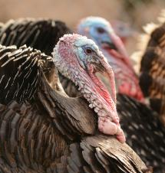
Single objective approach:
Graphical optimization:
250K
Objective: Maximize Sustainable Turkey Harvest
Outcome (Objective)
200K
150K
Sustainable Harvest
100K
Decision Variable (Alternatives)
50K
0.000
0.000
0.050
0.100
0.150
0.200
0.250
Harvest rate
Developed by Justin Gude, Julie Zimmerman, Mitch Eaton, Jean Cochrane, Sarah Converse, Mike Runge

Slide 9
Single objective approach:
Question: Can you think of an example of a single objective problem?
Not very common in natural resource management.
Single objectives are easier to optimize, so we may want to reduce multiple objective problems to make them easier to solve.
Developed by Justin Gude, Julie Zimmerman, Mitch Eaton, Jean Cochrane, Sarah Converse, Mike Runge

Slide 10



Multiple objective tools
Nearly all natural resource management problems are multiple-objective problems
Developed by Justin Gude, Julie Zimmerman, Mitch Eaton, Jean Cochrane, Sarah Converse, Mike Runge

Slide 11
Multiple objective tools
A. Simplify the problem as much as possible
Remove dominated alternatives
Remove irrelevant objectives
Make even swaps
B. Reduce to a single objective if possible
C. Negotiate a solution from a set of best compromises
D. Evaluate trade-offs explicitly
Developed by Justin Gude, Julie Zimmerman, Mitch Eaton, Jean Cochrane, Sarah Converse, Mike Runge

Slide 12
A. Simplify the problem
1. Remove dominated alternatives:
i.e., another alternative performs the same or better on all objectives
Developed by Justin Gude, Julie Zimmerman, Mitch Eaton, Jean Cochrane, Sarah Converse, Mike Runge

Slide 13
A. Simplify the problem (EXAMPLE)
1. Remove dominated alternatives (another alternative performs the same or better on all objectives)
Objectives | Direction | Alternatives
 |  | Status quo | Minor repair | Major repair | Re-build
Cost ($M) | Min
Environmental Benefit (0-10) | Max
Disturbance (0-10) | Min
Silt runoff (k ft³) | Min
Water Retention (MG) | Max
Developed by Justin Gude, Julie Zimmerman, Mitch Eaton, Jean Cochrane, Sarah Converse, Mike Runge

Slide 14
A. Simplify the problem (EXAMPLE)
1. Remove dominated alternatives (another alternative performs the same or better on all objectives)
Objectives | Direction | Alternatives
 |  | Status quo | Minor repair | Major repair | Re-build
Cost ($M) | Min | 0 | 2 | 12 | 20
Environmental Benefit (0-10) | Max | 1 | 3 | 10 | 10
Disturbance (0-10) | Min | 0 | 1 | 7 | 10
Silt runoff (k ft³) | Min | 5 | 1 | 3 | 3
Water Retention (MG) | Max | 41 | 41 | 41 | 39
Developed by Justin Gude, Julie Zimmerman, Mitch Eaton, Jean Cochrane, Sarah Converse, Mike Runge

Slide 15
A. Simplify the problem (EXAMPLE)
1. Remove dominated alternatives (another alternative performs the same or better on all objectives)
Objectives | Direction | Alternatives
 |  | Status quo | Minor repair | Major repair | Re-build
Cost ($M) | Min | 0 | 2 | 12 | 20
Environmental Benefit (0-10) | Max | 1 | 3 | 10 | 10
Disturbance (0-10) | Min | 0 | 1 | 7 | 10
Silt runoff (k ft³) | Min | 5 | 1 | 3 | 3
Water Retention (MG) | Max | 41 | 41 | 41 | 39
Dominated Alternative
Developed by Justin Gude, Julie Zimmerman, Mitch Eaton, Jean Cochrane, Sarah Converse, Mike Runge
Notes:
And which one is it dominated by?

Slide 16
A. Simplify the problem
1. Remove dominated alternatives:
i.e., another alternative performs the same or better on all objectives
2. Remove irrelevant objectives:
i.e., performance measures of that objective does not vary over alternatives
This isn’t to say the objective isn’t important to you, just that it doesn’t help discern among the alternatives currently considered.
Developed by Justin Gude, Julie Zimmerman, Mitch Eaton, Jean Cochrane, Sarah Converse, Mike Runge

Slide 17
A. Simplify the problem (EXAMPLE)
2. Remove irrelevant objective
Objectives | Direction | Alternatives
 |  | Status quo | Minor repair | Major repair | Re-build
Cost ($M) | Min | 0 | 2 | 12 | 20
Environmental Benefit (0-10) | Max | 1 | 3 | 10 | 10
Disturbance (0-10) | Min | 0 | 1 | 7 | 10
Silt runoff (k ft³) | Min | 5 | 1 | 3 | 3
Water Retention (MG) | Max | 41 | 41 | 41 | 39
Dominated Alternative
Developed by Justin Gude, Julie Zimmerman, Mitch Eaton, Jean Cochrane, Sarah Converse, Mike Runge

Slide 18
A. Simplify the problem (EXAMPLE)
2. Remove irrelevant objective
Objectives | Direction | Alternatives
 |  | Status quo | Minor repair | Major repair | Re-build
Cost ($M) | Min | 0 | 2 | 12 | 20
Environmental Benefit (0-10) | Max | 1 | 3 | 10 | 10
Disturbance (0-10) | Min | 0 | 1 | 7 | 10
Silt runoff (k ft³) | Min | 5 | 1 | 3 | 3
Water Retention (MG) | Max | 41 | 41 | 41 | 39
Dominated Alternative
Irrelevant Objective
Developed by Justin Gude, Julie Zimmerman, Mitch Eaton, Jean Cochrane, Sarah Converse, Mike Runge

Slide 19
A. Simplify the problem (EXAMPLE)
Simplified problem:
Objectives | Direction | Alternatives
 |  | Status quo | Minor repair | Major repair
Cost ($M) | Min | 0 | 2 | 12
Environmental Benefit (0-10) | Max | 1 | 3 | 10
Disturbance (0-10) | Min | 0 | 1 | 7
Silt runoff (k ft³) | Min | 5 | 1 | 3
Developed by Justin Gude, Julie Zimmerman, Mitch Eaton, Jean Cochrane, Sarah Converse, Mike Runge

Slide 20
A. Simplify the problem
1. Remove dominated alternatives:
i.e., another alternative performs the same or better on all objectives
2. Remove irrelevant objectives:
i.e., performance measures of that objective does not vary over alternatives
This isn’t to say the objective isn’t important to you, just that it doesn’t help discern among the alternatives currently considered.
3. Make even swaps:
If two objectives are in the same unit, then combine outcomes
Developed by Justin Gude, Julie Zimmerman, Mitch Eaton, Jean Cochrane, Sarah Converse, Mike Runge

Slide 21
A. Simplify the problem (EXAMPLE)
3. Even swaps
Convert silt runoff to cost @ $0.5M / k ft³
Objectives | Direction | Alternatives
 |  | Status quo | Minor repair | Major repair
Cost ($M) | Min | 0 | 2 | 12
Environmental Benefit (0-10) | Max | 1 | 3 | 10
Disturbance (0-10) | Min | 0 | 1 | 7
Silt runoff (k ft³) | Min | 5 | 1 | 3
Developed by Justin Gude, Julie Zimmerman, Mitch Eaton, Jean Cochrane, Sarah Converse, Mike Runge

Slide 22
A. Simplify the problem (EXAMPLE)
3. Even swaps
Convert silt runoff to cost @ $0.5M / k ft³
Objectives | Direction | Alternatives
 |  | Status quo | Minor repair | Major repair
Cost ($M) | Min | 0 | 2 | 12
Environmental Benefit (0-10) | Max | 1 | 3 | 10
Disturbance (0-10) | Min | 0 | 1 | 7
Silt runoff (k ft³) | Min | 5 2.5 M | 1 0.5 M | 3 1.5 M
Developed by Justin Gude, Julie Zimmerman, Mitch Eaton, Jean Cochrane, Sarah Converse, Mike Runge

Slide 23
A. Simplify the problem (EXAMPLE)
3. Even swaps
Convert silt runoff to cost @ $0.5M / k ft³
Objectives | Direction | Alternatives
 |  | Status quo | Minor repair | Major repair
Cost ($M) | Min | 0 + 2.5 | 2 + 0.5 | 12 + 1.5
Environmental Benefit (0-10) | Max | 1 | 3 | 10
Disturbance (0-10) | Min | 0 | 1 | 7
Silt runoff (k ft³) | Min | 5 2.5 M | 1 0.5 M | 3 1.5 M
Developed by Justin Gude, Julie Zimmerman, Mitch Eaton, Jean Cochrane, Sarah Converse, Mike Runge

Slide 24
B. Reduce to a single objective
Tip: Convert all objectives but one to constraints
Example: don’t spend more than $2.5M
Keep disturbance at or below 3
Then take the maximum environmental benefit
Objectives | Direction | Alternatives
 |  | Status quo | Minor repair | Major repair
Cost ($M) | Min | 2.5 | 2.5 | 13.5
Environmental Benefit (0-10) | Max | 1 | 3 | 10
Disturbance (0-10) | Min | 0 | 1 | 7
Developed by Justin Gude, Julie Zimmerman, Mitch Eaton, Jean Cochrane, Sarah Converse, Mike Runge

Slide 25
Activity: Evaluate tradeoffs
Hint: Are there any irrelevant objectives, dominated outcomes, even swaps?
Objective [measurable attribute] {Direction}
 | Alternative | Respect Life | HBC Recovery | Wilderness Disturbance | Cost
 |  | [0-10 scale] | [P(N>6000)] | [User-days] | [M$/5-yr]
 |  | {Max} | {Max} | {Min} | {Min}
A | No action | 6 | 0.2 | 0 | 0
B | Alternative B | 7 | 0.3 | 30 | 2.5
C | Alternative C | 6 | 0.3 | 40 | 3
D | Alternative D | 9.5 | 0.3 | 50 | 4.5
E | Alternative E | 9 | 0.25 | 60 | 2
The consequence table was inspired by Runge et al. 2011 but the values in the table were altered for simplicity
Developed by Mike Runge, Brielle Thompson
Notes:
C is dominated by B. No irrelevant objectives, maybe we can convert wilderness disturbance to $s

Slide 26
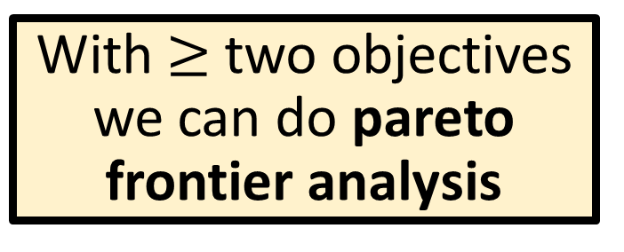
C. Negotiate a solution from a set of best compromises
With $≥$ two objectives we can do pareto frontier analysis
Outcome of alternative
Pareto front
Invasive population
(#)
dominated
Pareto optimal alternative
(non-dominated or ‘efficient’)
outcome on one objective
cannot be improved without a
reduction in another objective
non-dominated
Minimize
Pareto inefficient alternative
(dominated alternative or ‘not efficient’)
Another alternative performs at least as well on all objectives and performs strictly better on at least one
Cost
($)
Minimize
Developed by Brielle Thompson

Slide 27
C. Negotiate a solution from a set of best compromises
Example: Cost vs Population Benefit
Highest Benefit Option
= outcome of each alternative
22
Potential Compromise Options
20
Efficient Frontier
Inefficient Options
(Dominated Alternatives)
Population Benefit
18
16
Lowest Cost Option
14
150000
200000
250000
300000
350000
Developed by Justin Gude, Julie Zimmerman, Mitch Eaton, Jean Cochrane, Sarah Converse, Mike Runge
Cost ($)

Slide 28
C. Negotiate a solution from a set of best compromises
Example: Cost vs Population Benefit
*
Highest Benefit Option
= outcome of each alternative
22
minimum distance
If cost and population benefit are deemed equal, we can find the optimal solution as the minimum distance between the ideal point (*)
20
Population Benefit
Optimal solution
18
16
Lowest Cost Option
14
150000
200000
250000
300000
350000
Developed by Justin Gude, Julie Zimmerman, Mitch Eaton, Jean Cochrane, Sarah Converse, Mike Runge, Brielle K Thompson
Cost ($)

Slide 29
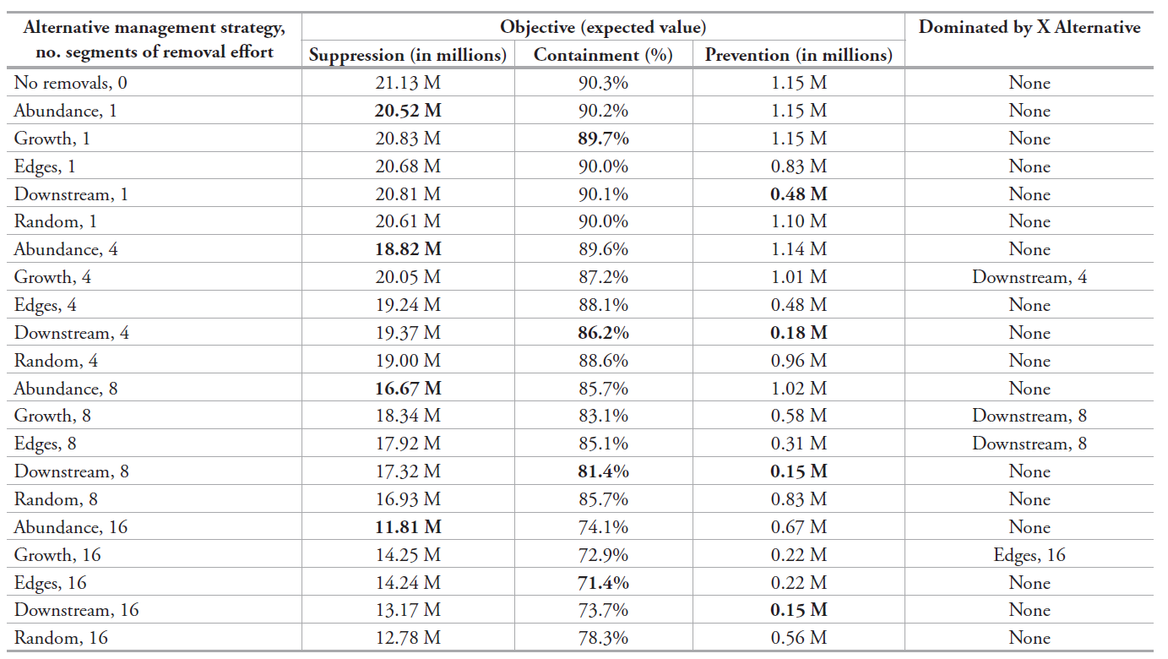
Example: Consequence table + tradeoffs
Thompson, Olden, & Converse 2024
NeoBiota
Developed by Brielle K Thompson

Slide 30
Example: Consequence table + tradeoffs
Thompson, Olden, & Converse 2024
NeoBiota
Subset of the table: management alternatives to control invasive rusty crayfish
4 alternatives to compare
Best in having low
# of crayfish
(suppression objective)
Best alternative in having low % coverage of crayfish & low # of crayfish entering an important area (Containment & Prevention objectives)
“Middle ground outcome”
Means we should not conduct Growth, 8 or Edges, 8
Better than Abundance,8 in Prevention & better than Downstream,8 in Suppression
*But worse than Downstream, 8 in the other 2 objectives
*But worse than Abundance, 8 in the first objective
Developed by Brielle K Thompson

Slide 31
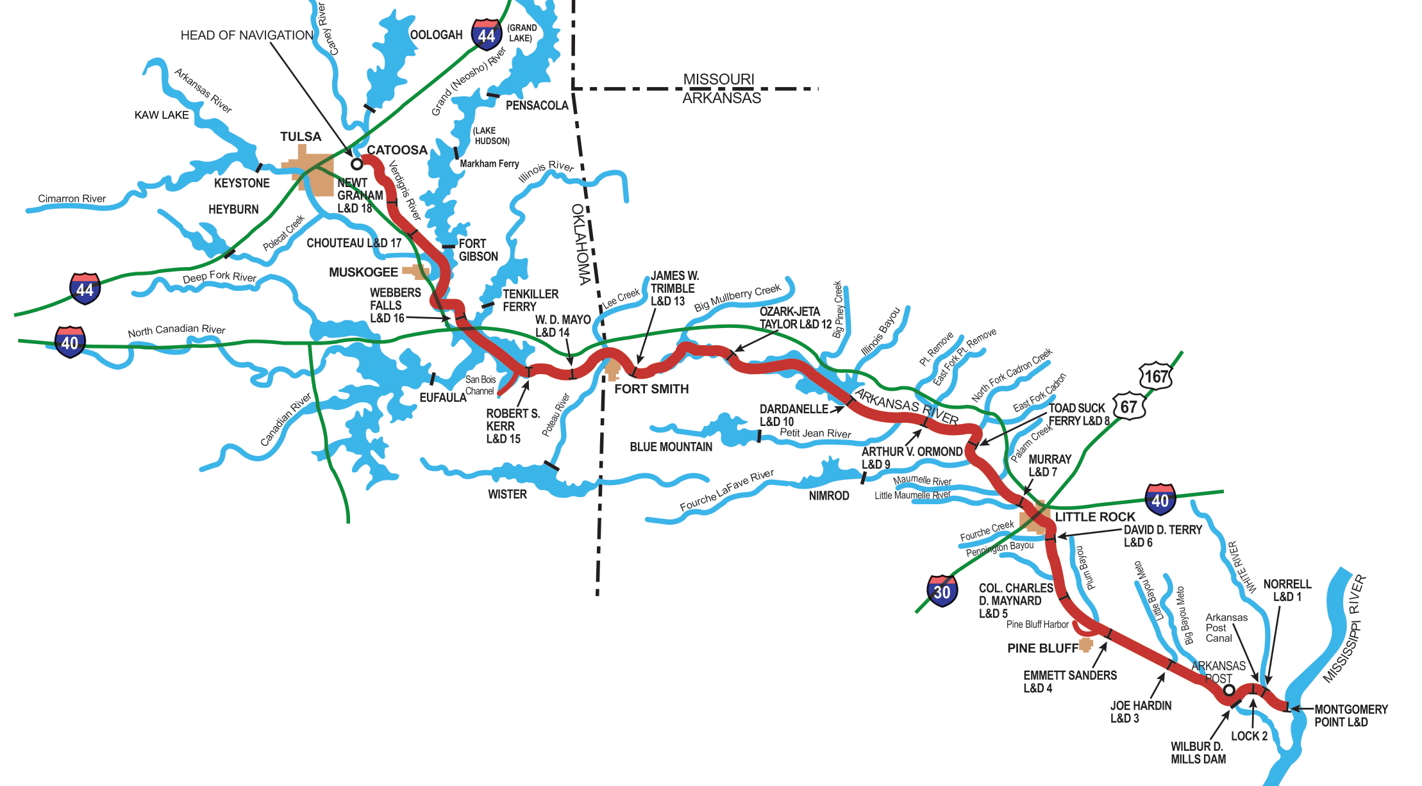
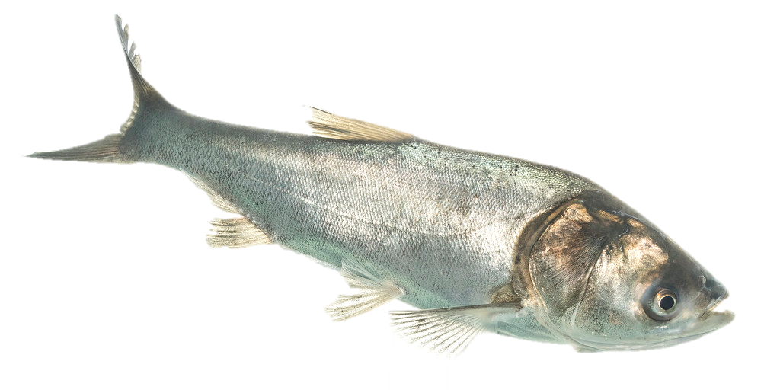
Example: Guiding management decisions of invasive carp in the Lower Mississippi River
Shiny app
Developed by Brielle K Thompson

Slide 32
D. Evaluate trade-offs explicitly
Multicriteria decision analysis:
Offers tools to evaluate multiple objective problems
A variety of tools exist (beyond the scope of this workshop)
Outranking methods
Analytic Hierarchy Process
Multi-attribute value/utility theory
SMART (simple multi-attribute rating technique)
See this week’s reading for more examples
Developed by Justin Gude, Julie Zimmerman, Mitch Eaton, Jean Cochrane, Sarah Converse, Mike Runge

Slide 33
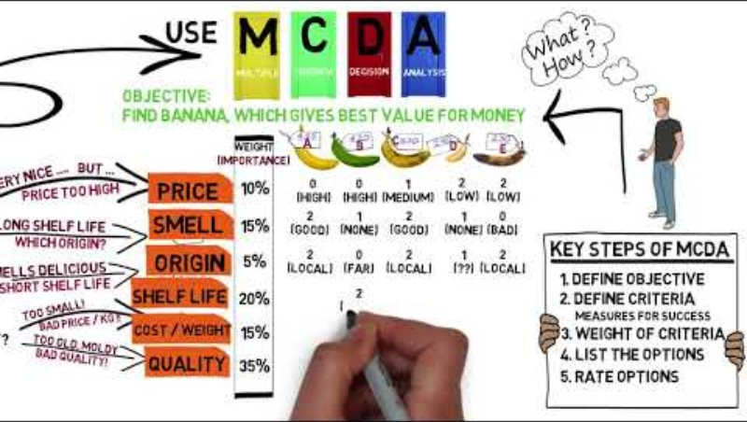
3-minute intro to MCDA

Slide 34
SMART (simple multi-attribute rating technique)
Normalize all attributes to 0-1 scale within each objective
Assign weights to each fundamental objective
Calculate weighted sum of scores for each alternative
Recommend alternative with highest weighted score
Sensitivity analysis! (Is the recommendation sensitive to the weights and predictions?)
For Goal to Maximize the attribute:
(x – minimum)/(maximum-minimum)
For Goal to Minimize the attribute:
1-(x – minimum)/(maximum-minimum)
Developed by Justin Gude, Julie Zimmerman, Mitch Eaton, Jean Cochrane, Sarah Converse, Mike Runge

Slide 35
Activity: SMART Practice
EXCEL LINK
Given our simplified impoundment repair problem (see consequence table), solve it using SMART for two different sets of weights:
Weights for cost/environmental benefit/disturbance are: 0.6, 0.3, 0.1
Weights for cost/environmental benefit/disturbance are: 0.2, 0.6, 0.2
What if my weights are 0.6, 0.3, 0.1, but I am uncertain about the environmental benefit of the minor repair? It could be as small as 1 or as large as 5. Is my decision sensitive to this uncertainty?
Developed by Justin Gude, Julie Zimmerman, Mitch Eaton, Jean Cochrane, Sarah Converse, Mike Runge

Slide 36

Where do objective weights come from?
Represent relative values of a decision maker
Some methods
Direct elicitation- importance weights
Swing weighting
Pairwise weighting (AHP)
Weights are context-dependent
If you change the range of predictions for an attribute, its weight may need to change
Developed by Sarah Converse

Slide 37
Importance weights
These reflect the relative importance of each criterion in a decision-making process and are used in SMART
Example:
 | Weight | Translocations | Habitat Restoration
Maximize Pr (persistence) | 0.9 | 0.5 | 0.9
Minimize cost | 0.1 | $1,000,000 | $100,000,000
This is a common weighting scheme we see from the level of biologists- not as worried about the costs as the biological outcome.
Developed by Sarah Converse

Slide 38
Importance weights
These reflect the relative importance of each criterion in a decision-making process and are used in SMART
Example:
 | Weight | Translocations | Habitat Restoration
Maximize Pr (persistence) | 0.9 | 0.5 | 0.9 0.51
Minimize cost | 0.1 | $1,000,000 | $100,000,000
But what if this is the new outcome? Should we update the weights?
Developed by Sarah Converse

Slide 39
Importance weights
These reflect the relative importance of each criterion in a decision-making process and are used in SMART
Example:
 | Weight | Translocations | Habitat Restoration
Maximize Pr (persistence) | 0.9 | 0 | 1
Minimize cost | 0.1 | 1 | 0
How about now when we standardize outcomes?
We may want a new method to assign weights that considers the absolute range of the predicted values
Developed by Sarah Converse

Slide 40

Swing weighting
Summing normalized scores (i.e., using SMART) with direct importance weights can be misleading.
Swing weights consider the particular values available (range of actual alternatives).
Preferences are context specific, not abstract.
Use the ‘swing’ or range from worst to best values across the alternatives.
Developed by Sarah Converse

Slide 41

Swing weighting – Buying a car example
Displays possible outcomes for each objective
Objective |  |  |  | Range |  | Hypothetical Alternatives (car)
 | Description | Attribute | Goal | Worst | Best | Benchmark | 1 | 2 | 3
A | Life span | years | max | 6 | 12 | 6
B | Price | $(1,000) | min | 24 | 8 | 24
C | Color | natural | max | yellow | red | Yellow
 | Rank | (1 is best; 4 is worst) |  |  |  | 4
 | Score | (100 is best; 0 is worst) |  |  |  | 0
 | Weight | score/(sum of scores) |  |  |  | 0
Developed by Sarah Converse, Brielle Thompson

Slide 42
Swing weighting – Buying a car example
Objective |  |  |  | Range |  | Hypothetical Alternatives (car)
 | Description | Attribute | Goal | Worst | Best | Benchmark | 1 | 2 | 3
A | Life span | years | max | 6 | 12 | 6
B | Price | $(1,000) | min | 24 | 8 | 24
C | Color | natural | max | yellow | red | Yellow
 | Rank | (1 is best; 4 is worst) |  |  |  | 4
 | Score | (100 is best; 0 is worst) |  |  |  | 0
 | Weight | score/(sum of scores) |  |  |  | 0
Write down worst-case alternative
Developed by Sarah Converse, Brielle Thompson

Slide 43
Swing weighting – Buying a car example
Objective |  |  |  | Range |  | Hypothetical Alternatives (car)
 | Description | Attribute | Goal | Worst | Best | Benchmark | 1 | 2 | 3
A | Life span | years | max | 6 | 12 | 6 | 12 | 6 | 6
B | Price | $(1,000) | min | 24 | 8 | 24 | 24 | 8 | 24
C | Color | natural | max | yellow | red | Yellow | Yellow | Yellow | Red
 | Rank | (1 is best; 4 is worst) |  |  |  | 4
 | Score | (100 is best; 0 is worst) |  |  |  | 0
 | Weight | score/(sum of scores) |  |  |  | 0
These alternatives have outcomes that are the worst for each objective except one
Developed by Sarah Converse, Brielle Thompson

Slide 44
Swing weighting – Buying a car example
Objective |  |  |  | Range |  | Hypothetical Alternatives (car)
 | Description | Attribute | Goal | Worst | Best | Benchmark | 1 | 2 | 3
A | Life span | years | max | 6 | 12 | 6 | 12 | 6 | 6
B | Price | $(1,000) | min | 24 | 8 | 24 | 24 | 8 | 24
C | Color | natural | max | yellow | red | Yellow | Yellow | Yellow | Red
 | Rank | (1 is best; 4 is worst) |  |  |  | 4 | 2 | 1 | 3
 | Score | (100 is best; 0 is worst) |  |  |  | 0
 | Weight | score/(sum of scores) |  |  |  | 0
Next, rank each of the 4 alternatives (including worst-case benchmark) from 1 to 4
Developed by Sarah Converse, Brielle Thompson

Slide 45
Swing weighting – Buying a car example
Objective |  |  |  | Range |  | Hypothetical Alternatives (car)
 | Description | Attribute | Goal | Worst | Best | Benchmark | 1 | 2 | 3
A | Life span | years | max | 6 | 12 | 6 | 12 | 6 | 6
B | Price | $(1,000) | min | 24 | 8 | 24 | 24 | 8 | 24
C | Color | natural | max | yellow | red | Yellow | Yellow | Yellow | Red
 | Rank | (1 is best; 4 is worst) |  |  |  | 4 | 2 | 1 | 3
 | Score | (100 is best; 0 is worst) |  |  |  | 0 | 70 | 100 | 5
 | Weight | score/(sum of scores) |  |  |  | 0
Using the ranks, score the alternatives from 0 to 100
(we rank then score for some cognitive help!)
Developed by Sarah Converse, Brielle Thompson

Slide 46
Swing weighting – Buying a car example
Objective |  |  |  | Range |  | Hypothetical Alternatives (car)
 | Description | Attribute | Goal | Worst | Best | Benchmark | 1 | 2 | 3
A | Life span | years | max | 6 | 12 | 6 | 12 | 6 | 6
B | Price | $(1,000) | min | 24 | 8 | 24 | 24 | 8 | 24
C | Color | natural | max | yellow | red | Yellow | Yellow | Yellow | Red
 | Rank | (1 is best; 4 is worst) |  |  |  | 4 | 2 | 1 | 3
 | Score | (100 is best; 0 is worst) |  |  |  | 0 | 70 | 100 | 5
 | Weight | score/(sum of scores) |  |  |  | 0 | 0.40 | 0.57 | 0.03
Calculate your weights!
Developed by Sarah Converse, Brielle Thompson

Slide 47
Swing weighting – Buying a car example
Objective |  |  |  | Range |  | Hypothetical Alternatives (car)
 | Description | Attribute | Goal | Worst | Best | Benchmark | 1 | 2 | 3
A | Life span | years | max | 6 | 12 | 6 | 12 | 6 | 6
B | Price | $(1,000) | min | 24 | 8 | 24 | 24 | 8 | 24
C | Color | natural | max | yellow | red | Yellow | Yellow | Yellow | Red
 | Rank | (1 is best; 4 is worst) |  |  |  | 4 | 2 | 1 | 3
 | Score | (100 is best; 0 is worst) |  |  |  | 0 | 70 | 100 | 5
 | Weight | score/(sum of scores) |  |  |  | 0 | 0.40 | 0.57 | 0.03
These are your weights for objective A,B,C!!!!
Developed by Sarah Converse, Brielle Thompson

Slide 48
Swing weighting activity
SEE EXCEL LINK
Developed by Brielle Thompson

Slide 49
Skills Check
SEE SKILLS CHECK EXCEL LINK

Slide 50
Activity: think about your decision problem
For your final project presentation, you will provide a slide of your Tradeoffs
Some hints:
Review your consequence table from last week (or make one now)
Do you have any irrelevant objectives? Dominated alternatives? Can you make even swaps?
Can you use smart or swing weighting to help make your decision?
Feel free to go back to your problem framing, objectives, alternatives, and consequences steps!
Developed by Brielle Thompson

Slide 51
Looking ahead:
Next week: T step of PrOACT
Weekly: Work through a step of the PrOACT process/ learn extra tools
Last week of class:
Elevator pitch of your research project in terms of SDM/PrOACT
Note: Abridged PrOACT story slides with a star on the upper right are good examples to use for your presentation
Developed by Brielle Thompson

Slide 52

Extra time activities:

Slide 53
Reading discussion: Runge et al. 2020 Chapter 5 (Converse)
Why do you think multi-criteria decision analysis is useful?
Compare the pros/cons of structured discussions over quantitative techniques to examine trade-offs
What are some pitfalls of MCDA?
What happens if we miss an objective?

