Slide 1

Week 5: Tradeoffs Step of PrOACT
Instructor: Brielle K Thompson
Course: NAT_R 8001 Decision Analysis for Research and Management of Natural Resources
Notes:
First 30 minutes = intro
Next 60 = slides
Final 30 = activity

Slide 2
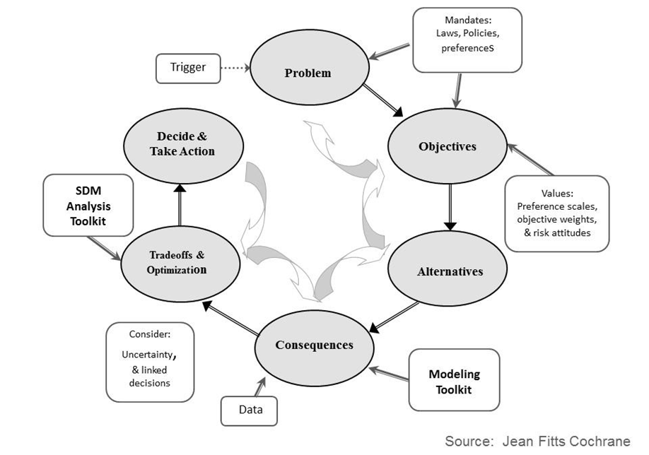

Slide 3
Looking ahead:
Next week: Additional SDM tools
Weekly: Work through a step of the PrOACT process/ learn extra tools
Last week of class:
Elevator pitch of your research project in terms of SDM/PrOACT
Note: Abridged PrOACT story slides with a star on the upper right are good examples to use for your presentation
Developed by Brielle Thompson

Slide 4

Extra time activities:

Slide 5
Reading discussion

