Slide 1

Week 8: Final presentations + closing thoughts
Instructor: Brielle K Thompson
Course: NAT_R 8001 Decision Analysis for Research and Management of Natural Resources
Notes:
First 30 minutes = intro
Next 60 = slides
Final 30 = activity

Slide 2
Finish up with final presentations

Slide 3

Discussion
What did you learn about your project by going through a PrOACT rapid prototype?
How useful was this process?

Slide 4
Closing thoughts – what did you learn?

Slide 5

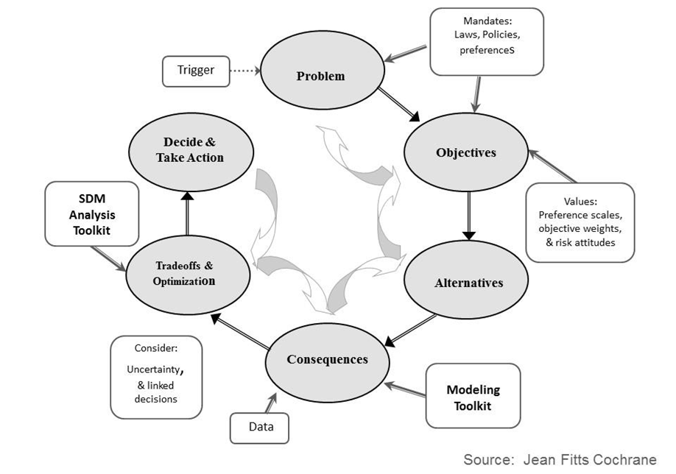

Two key elements of Structured Decision Making
1. Values-focused
Objectives are discussed first
Contrasts with alternative-focused methods
2. Problem decomposition (PrOACT)
Break problem into components, separating science from values
Complete relevant analysis
Recompose the parts to make a decision
Additional considerations: risk, uncertainty, adaptive management
Developed by Ashley Fortune Isham, Jim Lyons, Sarah J Converse, Brielle Thompson

Slide 6
Closing thoughts – what didn’t you learn?

Slide 7


Closing thoughts – what didn’t you learn?
What we didn’t cover:
Variety of quantitative tools
Other types of value of information analysis
Multi-Criteria Decision analysis tools
Bayesian Belief Networks
Adaptive management modeling techniques
Projection modeling
Optimization modeling
Dealing with people
Stakeholder analysis, forming a team
Facilitation
Expert elicitation
Developed by Ashley Fortune Isham, Jim Lyons, Sarah J Converse, Brielle Thompson

Slide 8
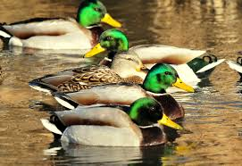
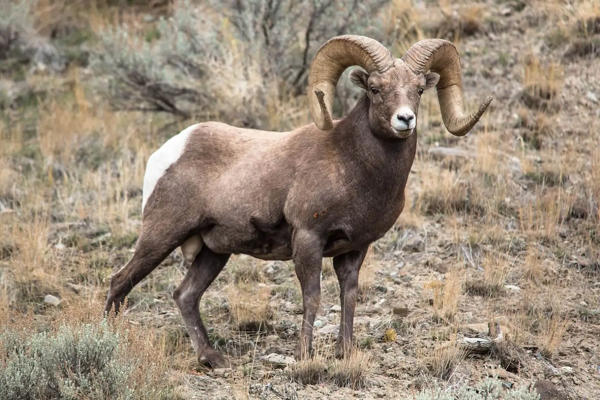
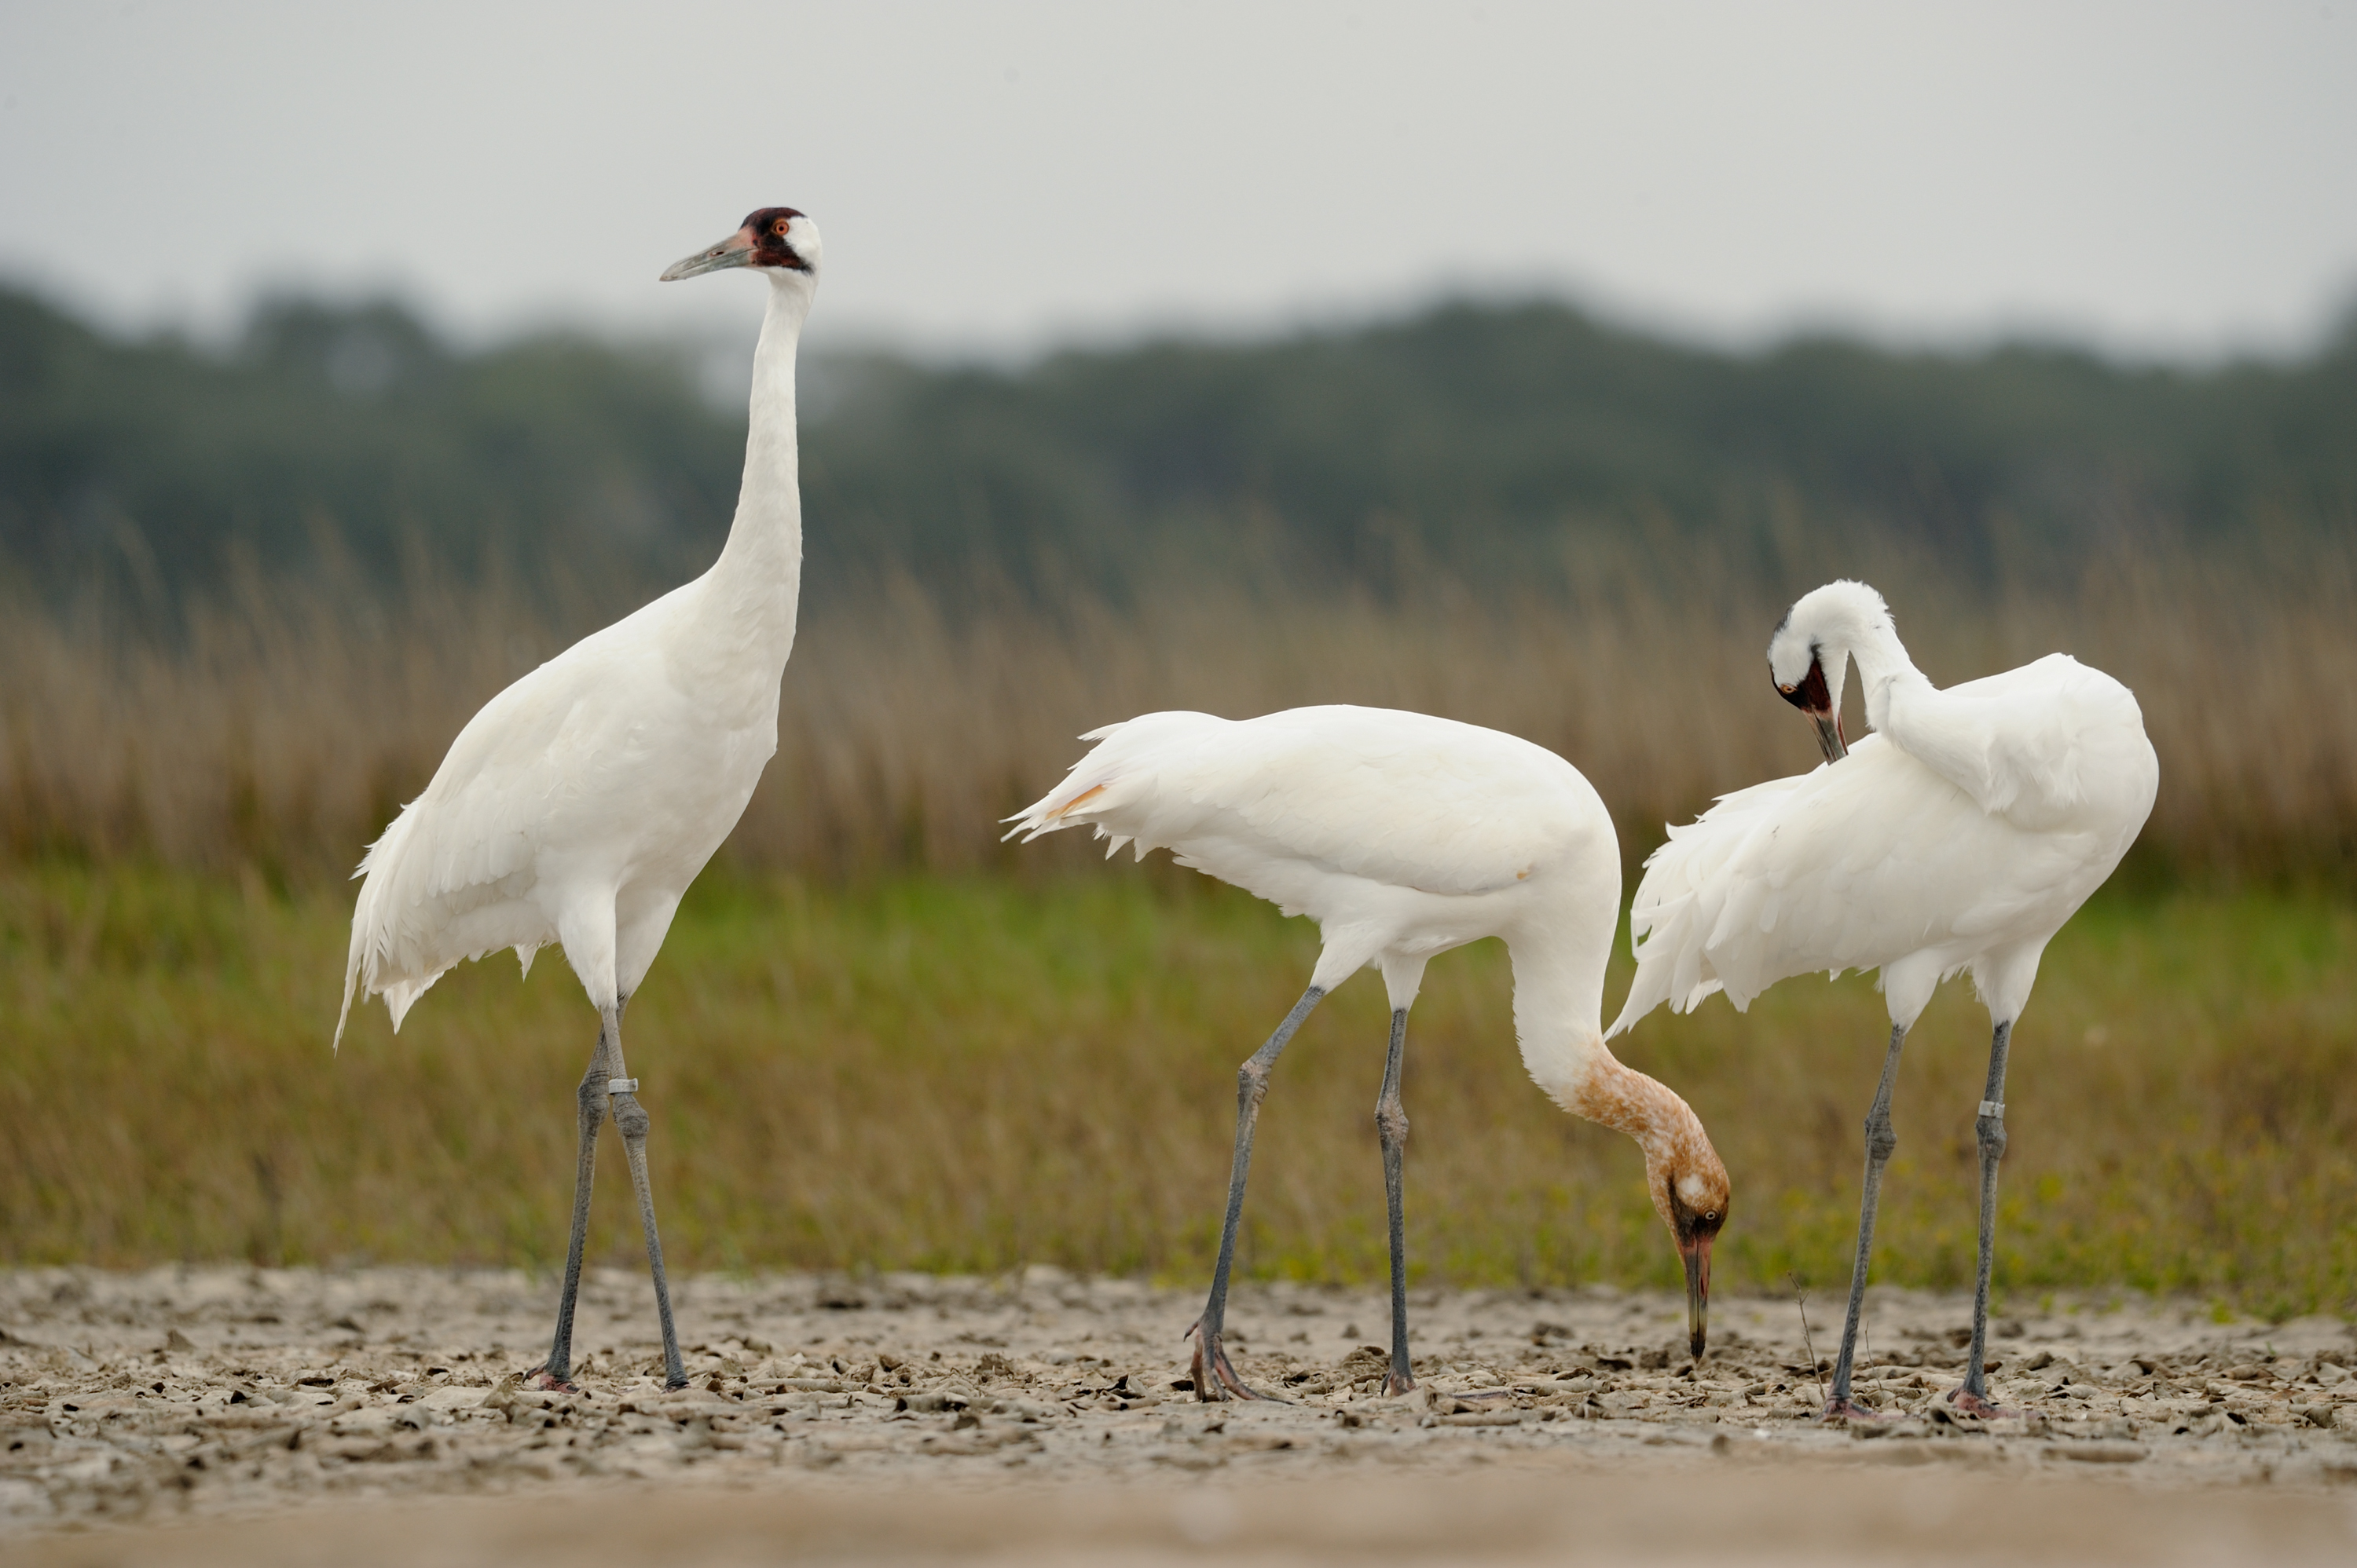
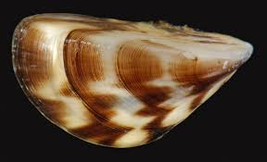
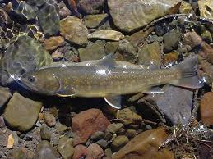
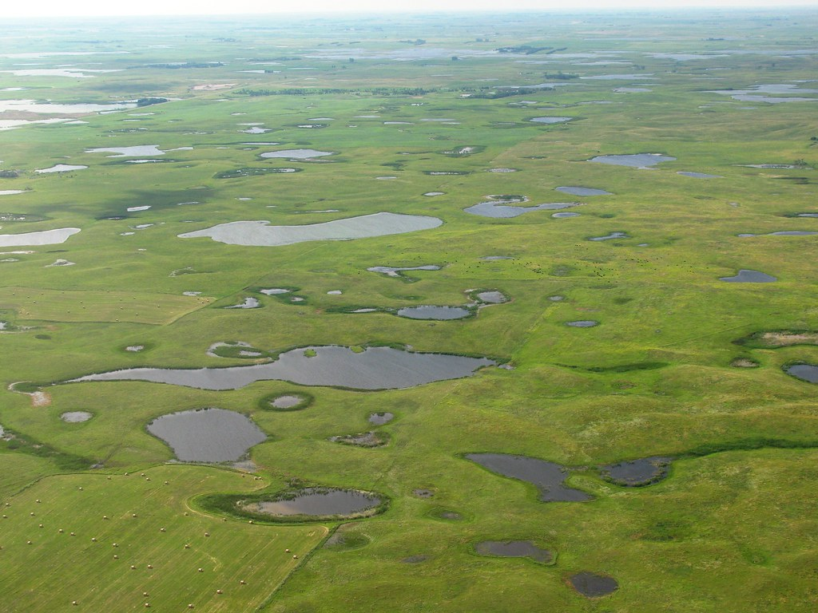
Closing thoughts – What can SDM be used for?
Waterfowl harvests
(Williams and Johnson 1995)
Bighorn Sheep disease mitigation
(Sells et al. 2016)
Across many scales
Routine: one decision maker
Small‐scale: one decision maker or closely collaborating decision makers, few stakeholders
Medium‐scale: multiple collaborative decision makers, many stakeholders
Large‐scale: multiple collaborative decision makers, many stakeholders
Whooping crane management
(Moore et al. 2008)
Dreissenid mussel management
(Sepulveda et al. 2022)
Bull trout reintroduction
(Brignon et al. 2017)
Prairie Pothole wetland management
(Hunt et al. 2020)
Developed by Brielle Thompson, Michael C. Runge

Slide 9






Closing thoughts – What can SDM be used for beyond natural resources?
Buying a car
Choosing a college
Career decisions
Deciding dinner plans
Buying a house
Making travel plans
Developed by Brielle Thompson

Slide 10
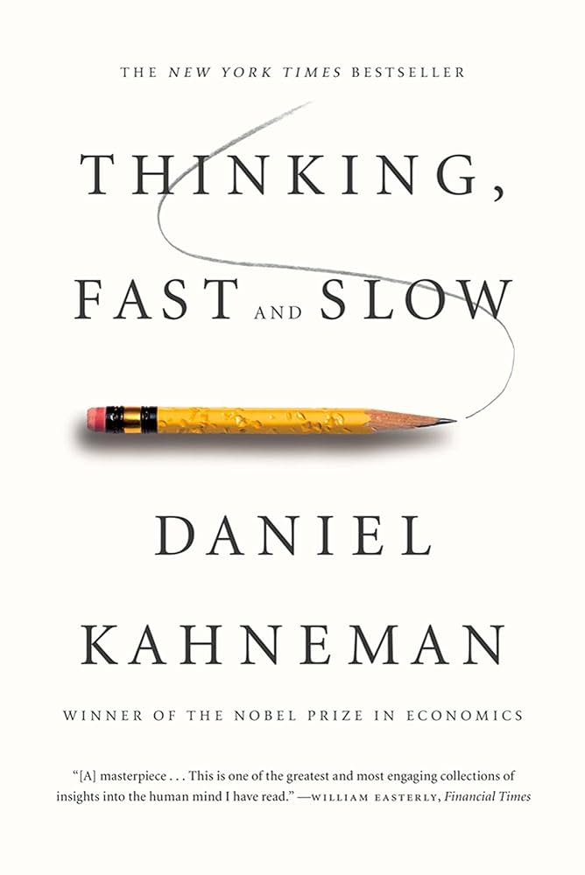
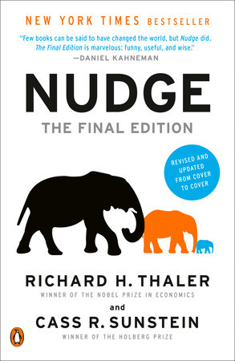
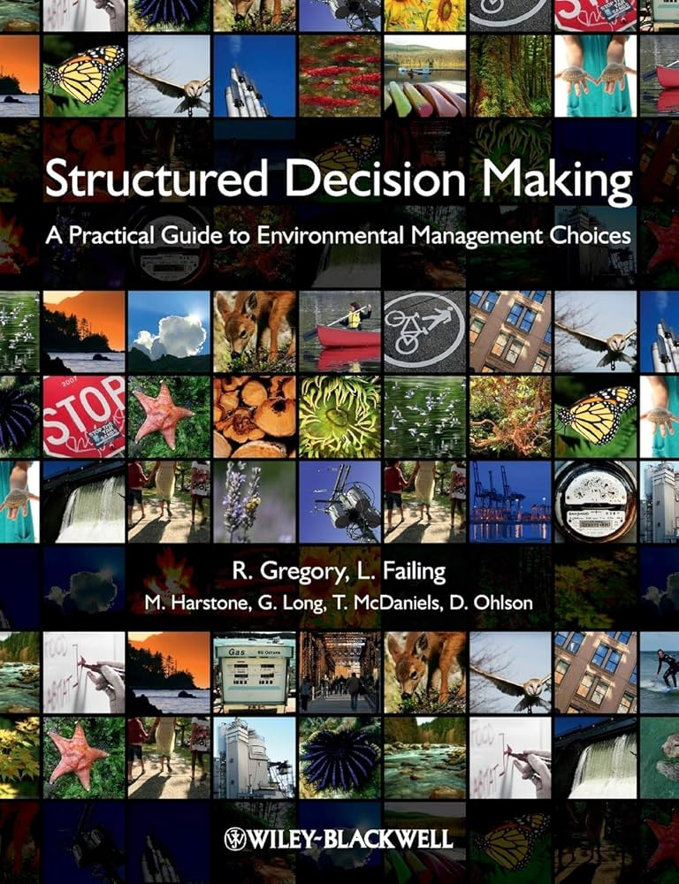
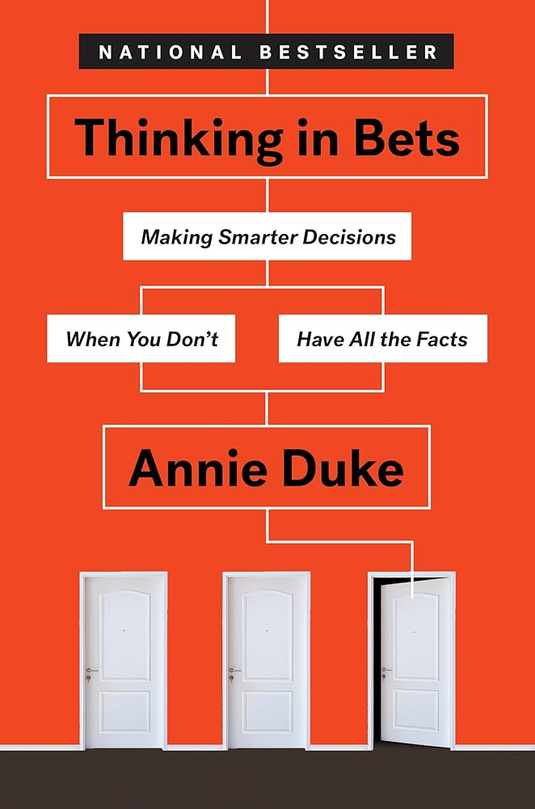

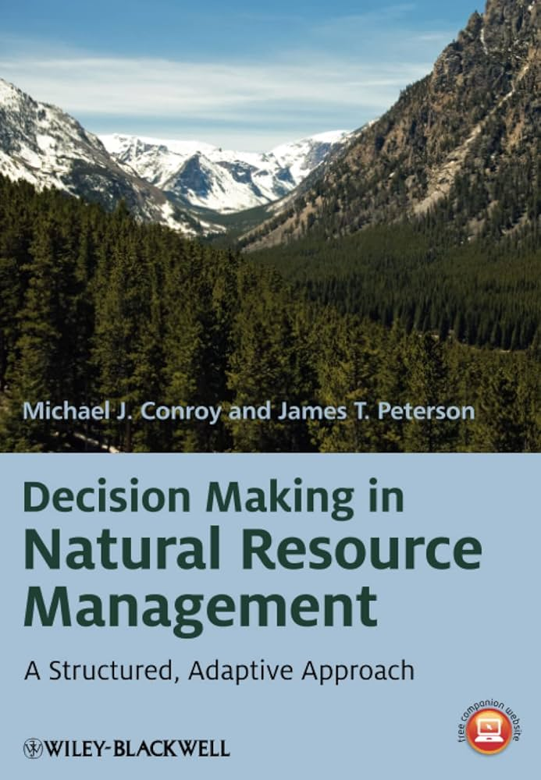
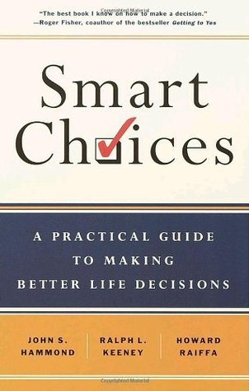

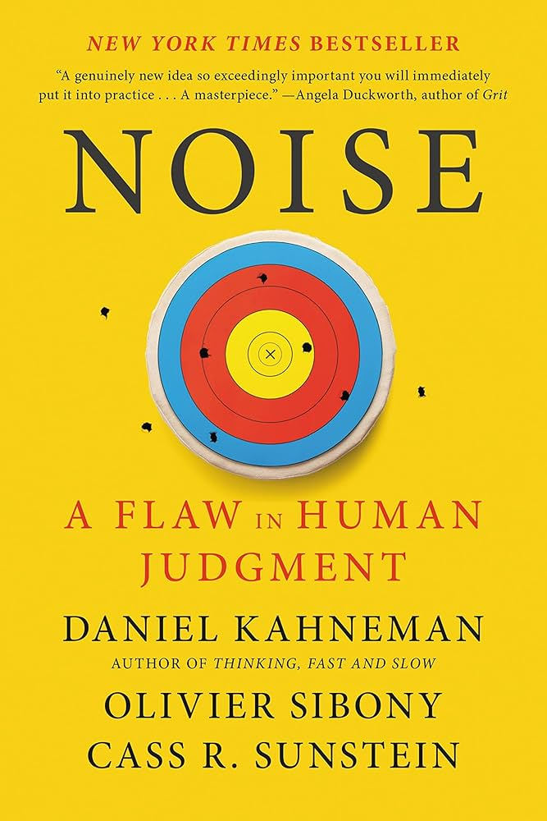
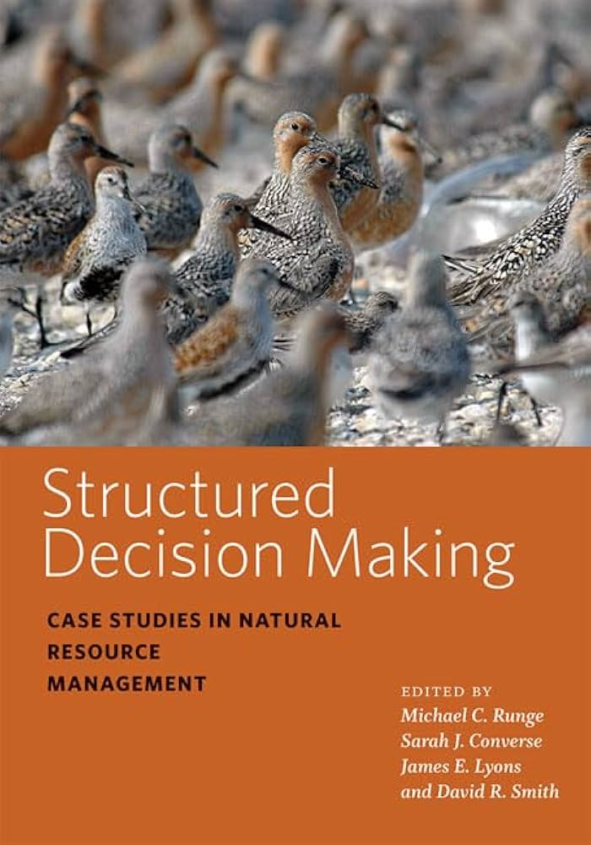

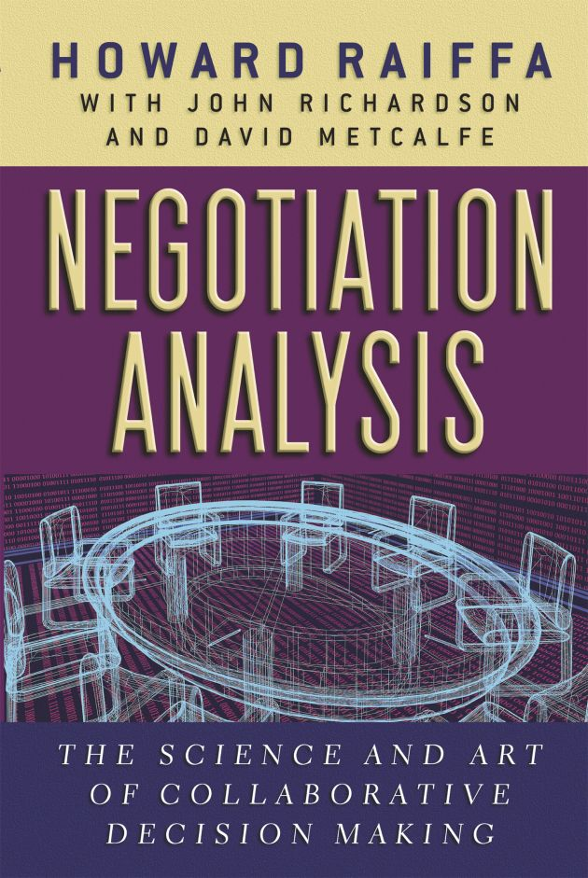
Books to read:
Increasing rigor

