Slide 1
F: TMB and MCMC
Day 3: 11h00-12h00

Slide 2
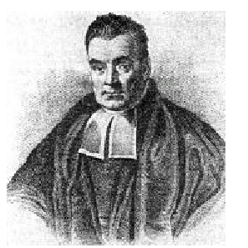
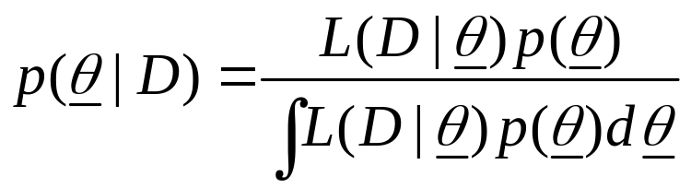

Basics of a Bayesian Assessment
Bayes Theorem:
We need to specify the prior distribution,
, in order to apply Bayes theorem.
The objective is to represent the posterior by means of a (large) number of vectors of parameters.

Slide 3
Objectives for MCMC
MCMC is a way to construct a (joint) Bayesian posterior for the parameters of a population dynamics model.
The basic idea is to set up a (long) “chain” that starts at a pre-specified vector and that then traverses the posterior distribution.
The sample from the posterior distribution is then every n’th element in the chain (ignoring the first “few” elements of the chain).

Slide 4
Overview of the MCMC algorithm
Select an “initial” parameter vector (often the mode of the posterior) and compute its posterior density (the product of the likelihood and the prior).
Generate a “new” parameter vector based on the current one (using a “jump” function) and compute its posterior density.
Replace the current parameter vector by the new parameter vector with probability equal to the ratio of the new to the current posterior density.
Output the current parameter vector.
Repeat steps 2)- 4) many times!
Steps 2-4 are referred to as a cycle.

Slide 5
A Little More Detail
A) Set i to 0.
B) Set y to xi.
C) Apply the “jump function” to y to generate a new vector z (may only differ in one element from y) and compute f(z).
D) If f(z) > f(y), set i=i+1, xi=z, go to B).
E) Generate w~U[0,1]. If w < f(z)/f(y) , set i=i+1, xi=z, go to B).
F) Set i=i+1, xi=y and go to B).

Slide 6
The Jump Function
The “jump” function should be chosen to optimize performance (but is usually selected for computational convenience).
It should be possible to reach all possible parameter vectors “eventually” by applying the “jump” function long enough.
The jump function depends on which MCMC algorithm you select. I have used:
  A naive “Metropolis” algorithm
  The No-Uturn sampler that can be found in the adnuts package. We will discuss this sampler in Lecture G.

Slide 7
Example-I
Compute posterior distributions for the parameters of a logistic regression.
  Formulate the problem as maximum likelihood estimation.
  Select prior distributions.
  Choose a jump function.

Slide 8
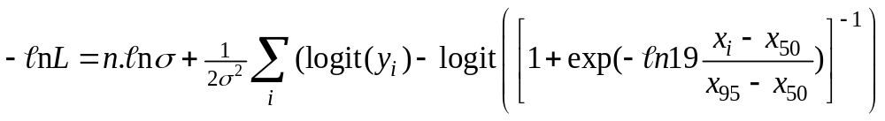
Example-II
The likelihood formulation of the problem.
The prior: uniform on the logarithms of x₅₀, x₉₅ and σ.
The jump function: multivariate normal with mean zero and variance-covariance matrix from a TMB fit.
Hint: You will need the mvtnorm library to run the mcmc function.
The code is in LectF1.R.

Slide 9
Example-III
(R Implementation)
f1 <- function(x)
{
A50 <- exp(x[1])
A95 <- exp(x[2])
Sigma <- exp(x[3])
pred <- MakePred(co$Length,A50,A95)
pred <- log(pred/(1-pred))
SS <- (pred-co$Prob2)^2
SS <- sum(SS)
LogLike <- length(pred)*log(Sigma) + sum(SS)/(2.0*Sigma^2)
return(LogLike)
}
Calculate the
likelihood function
MakePred<-function(Length,A50,A95)
{
pred <- 1/(1+exp(-1*log(19)*(Length-A50)/(A95-A50)))
return(pred)
}
Vector of
predicted values

Slide 10
Example-IV
(R Implementation)
Xcurr <- Xinit
Fcurr <- -1*f1(Xcurr)
Outs <- matrix(0,nrow=(Nsim-Nburn),ncol=(Ndim+1))
Ipnt <- 0; Icnt <- 0
for (Isim in 1:Nsim)
{
Xnext <- rmvnorm(1, Xcurr, cov=cor, sd, rho, Ndim)
Fnext <- -1*f1(Xnext)
Rand1 <- log(runif(1,0,1))
if (Fnext > Fcurr+Rand1)
{Fcurr <- Fnext; Xcurr <- Xnext }
if (Isim %% Nthin == 0)
{
Ipnt <- Ipnt + 1
if (Ipnt > Nburn)
{ Icnt <- Icnt + 1; Outs[Icnt,] <- c(Xcurr,Fcurr); }
}
}
}
DoMCMC<-function(Xinit,Ndim,sd,cor,Nsim=1000,
Nburn=0,Nthin=1)
{
FileN <- "lect18.txt"
TheData<-scan(file=FileN, what=list(Length=0,Prob=0))
co <- NULL
co$Length <- TheData$Length
co$Prob1 <- TheData$Prob
co$Prob2 <- log(TheData$Prob/(1-TheData$Prob))
environment (f1) =environment()

Slide 11
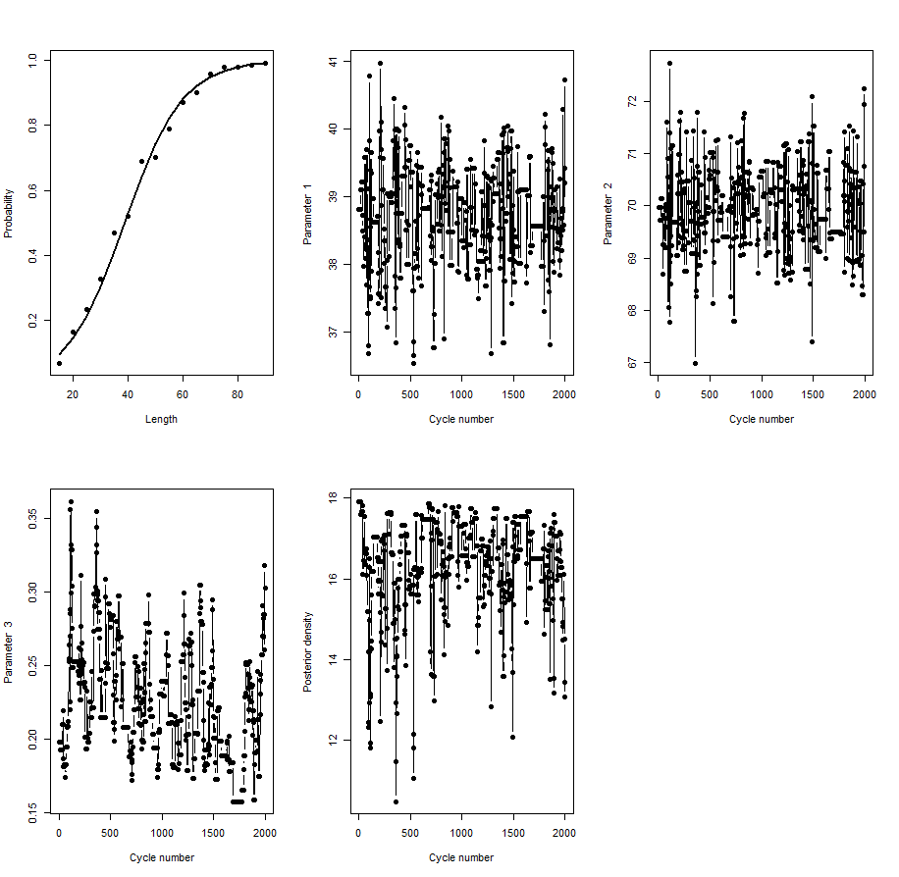
Example-V
(Results-silly jump function)
sd <- c(0.1,0.1,0.1); cor <- matrix(c(1,0,0,0,1,0,0,0,1), ncol=3,nrow=3)

Slide 12
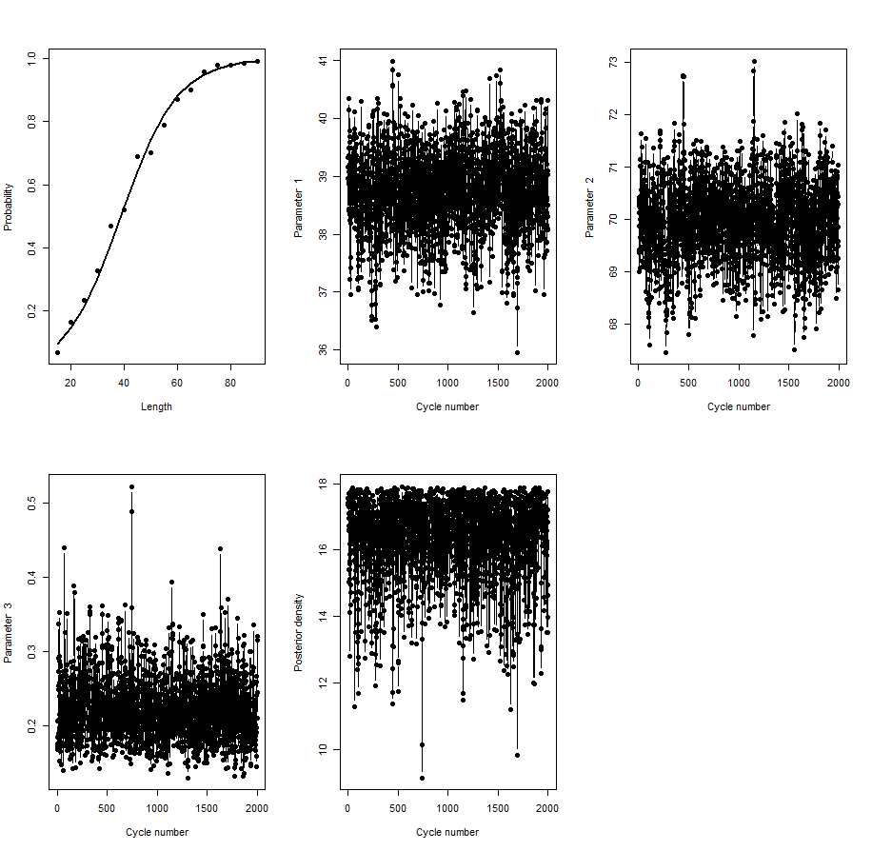
Example-VI
(Results-Informative jump function)
sd <- c(0.015702,0.0093949,0.17678);
cor <- matrix(c(1,0.3769,0,0.3769,1,0,0,0,1),ncol=3,nrow=3)

Slide 13
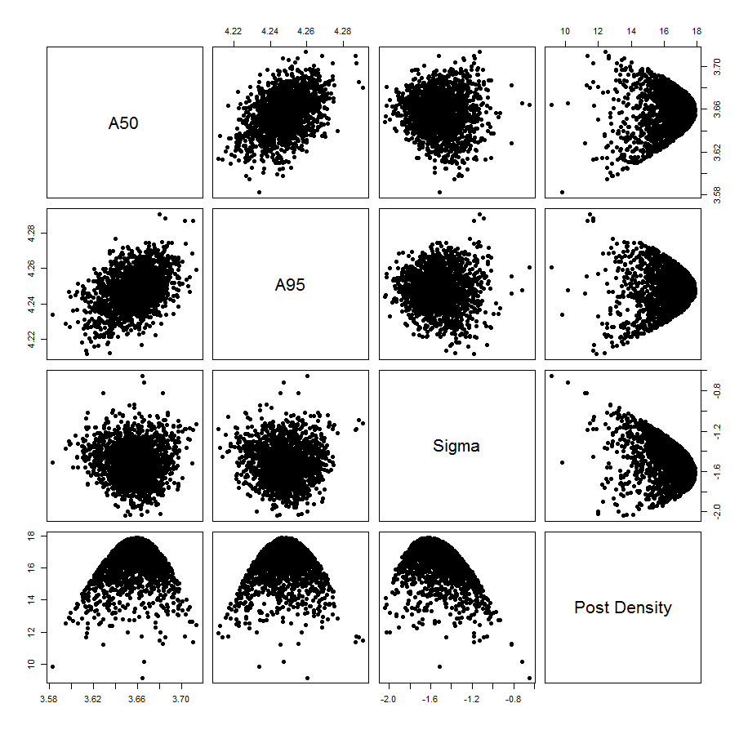
Example-VII
(Results-Posterior correlations)

Slide 14
Example-IX
This problem can be done in one step because one can call TMB functions from R (see LectF2.R).
In general, the steps should be:
Fit the model (maximum likelihood)
Obtain the variance-covariance matrix (hessian=T)
Call MCMC
View MCMC diagnostics.

Slide 15
“Burn in” and “thinning”
The impact of the initial parameter vector and the Markov nature of the algorithm are reduced by having a “burn in” period and by “thinning” the chain.
To get x samples from the posterior:
  Allow for a “burn-in” period (5-50% of the total chain length) to allow the algorithm to “set itself up”. The results of this period are discarded.
  “Thin” the chain by taking every n’th value in the chain.

Slide 16
Tricks of the (MCMC) trade - I
The performance of MCMC deteriorates as the number of parameters increases. Therefore, integrate out any nuisance parameters analytically.
  Examples (Walters and Ludwig, 1994).
    The catchability coefficients;
    The observation error standard deviations.
Walters, C.J. and D. Ludwig. Can. J. Fish. Aquat Sci. 51: 713-722

Slide 17
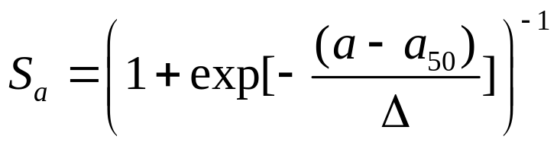
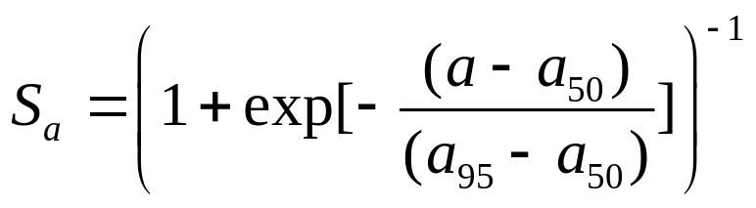
Tricks of the (MCMC) trade - II
The performance of MCMC deteriorates if the parameters are highly correlated (often true for age-structured models).
Use the .COR file to identify highly-correlated parameters (ρ ≥ 0.8).
Re-parameterize the model to reduce correlations:
Use
and not

