Slide 1
E: Variance Estimation
Day 3: 08h30-09h00
Notes:
a

Slide 2
Variance Estimation
There are a variety of ways to compute standard errors and confidence intervals for model parameters and model outputs. This lecture considers two of these:
  asymptotic methods; and
  likelihood profile.

Slide 3
Asymptotic Methods

Slide 4
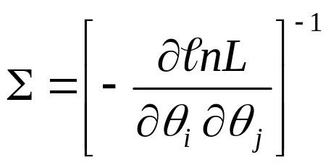
Asymptotic Standard Errors and Correlations-I
TMB automatically calculates asymptotic standard errors and parameter correlations:
The parameter estimates and their asymptotic standard errors can be extracted using the sdreport(model) call.

Slide 5
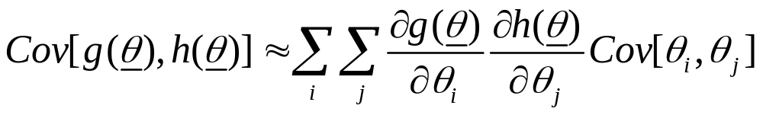
Asymptotic Standard Errors and Correlations-II
The default asymptotic variance-covariance calculations relate to the parameters of the model. However, we often want uncertainty estimates for derived quantities.
The way to do this is via the delta method:

Slide 6
Asymptotic Standard Errors and Correlations-III
To obtain asymptotic variances for derived parameters simply add
ADREPORT(variable)
  to the CPP file.
Note: the results from asymptotic theory are approximations and may be bad approximations.

Slide 7
Asymptotic Standard Errors and Correlations-IV
Hints to speed things up:
  Only calculate the derived variables when they are needed:
  if (Do_sd==1)
  { code; }
  Look at the correlation matrix (which you can get by inverting the Hessian matrix; “hessian=T” in the MakeADFun call). If you see large (>0.80) correlations among the parameters, it may be time to consider reparameterizing the model!

Slide 8
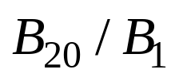
Exercise-I
Use the age-structured model from the last lecture and the dataset LECTE.DAT (a dataset with error) and compute:
  the variance-covariance matrix for the parameters;
  the standard error for the ratio:

Slide 9
Exercise-II
The correlation matrix:
The standard error of :
0.038787
“Large” values
in bold
33 Sel50 1.0000
34 Sel95 0.9663 1.0000
35 logFish 0.6845 0.6354 1.0000
36 logFish 0.7331 0.6794 0.7865 1.0000
37 logFish 0.7521 0.6950 0.7468 0.8133 1.0000
38 logFish 0.7597 0.6992 0.7034 0.7712 0.8081 1.0000
39 logFish 0.7597 0.6949 0.6708 0.7372 0.7792 0.8175 1.0000
40 logFish 0.7643 0.6962 0.6444 0.7057 0.7470 0.7887 0.8250 1.0000

Slide 10
Likelihood profile

Slide 11
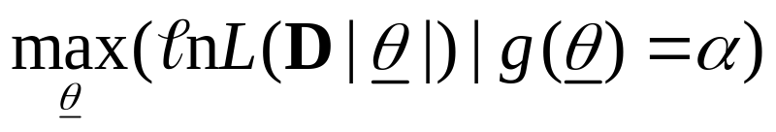
Likelihood profile-I
A likelihood profile is:
  Fit the model to find the ML parameter estimates and find the corresponding negative log-likelihood.
  Select a set of fixed values for the quantity of interest.
  Minimize the negative log-likelihood fixing the quantity to each value in turn.
  Plot the difference between the negative log-likelihood from step 1 and those from step 3

Slide 12


Likelihood profile-II
(Confidence intervals)
An 100-x% confidence interval for p parameters is determined by finding the values for the parameter(s) for which:
is the negative log-likelihood corresponding to the maximum likelihood estimates.

Slide 13
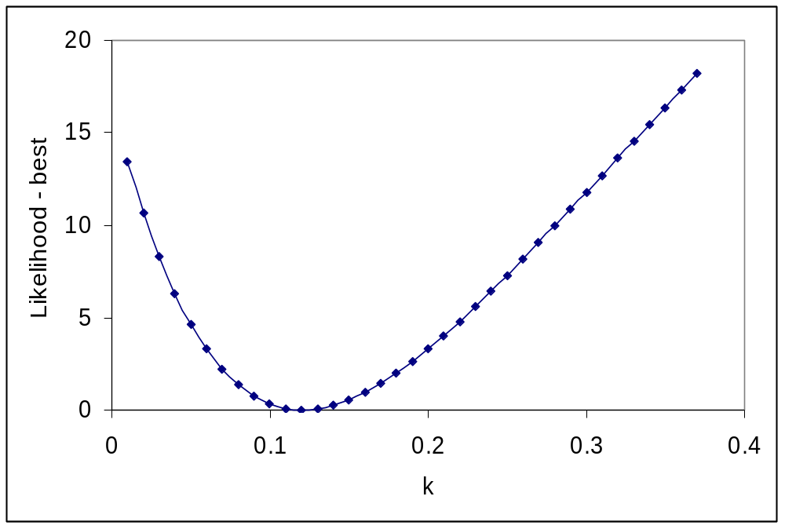
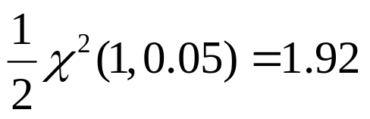
Likelihood profile-III
We can compute confidence intervals from likelihood profiles
Approximate 95% CI

Slide 14
Likelihood Profile-IV
(How to create one)
To obtain a likelihood profile for any parameter (lets say x). Call the function:
You can use the profile to determine confidence intervals for a parameter for which a profile has been determined using:
prof <- tmbprofile(model,“x")
print confint(prof,level=0.8)

Slide 15
Likelihood Profile-V
(Using profiles)
Profiles can be used to evaluate the reliability of asymptotic variance estimates (check for non-symmetric profiles).
Profiles can be used to assess the information content of the data relative to some parameter.
Profiles can be used to assess data conflicts by plotting a the components of the likelihood.

Slide 16
Likelihood Profile-VI
(Constructing likelihood profiles for derived parameters)
Add code that involves the computing the square of the difference between the quantity and a (read-in) target value.
Run the program for many different target values.
Construct a likelihood profile manually.

