Slide 1
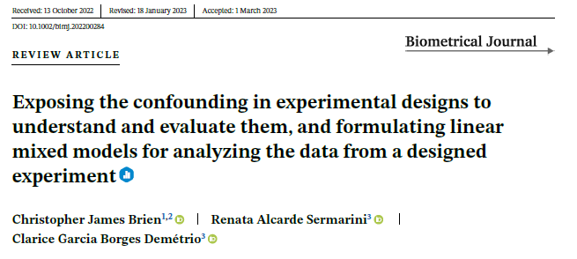



Designing comparative experiments using R
I. Concepts in experimental design
Chris Brien
UniSA STEM, University of South Australia
Australian Plant Phenomics Facility, University of Adelaide.
(https://doi.org/10.1002/bimj.202200284)

Slide 2
Outline
The factor-allocation paradigm for designing experiments.
Experiments on a 5 x 5 grid of plots.
Block-treatment interactions vs inherent random variability.
Insights into experiments involving time.
Examples in the paper that have not been presented.

Slide 3
Jargon alert!
The paper covers many basic principles in the design of comparative experiments.
It involves a lot of terminology,
  with which many statisticians are unfamiliar, and
  that is used precisely (e.g. confounding vs aliasing, term vs source).
  We hope that the effort to understand it will lead to more understanding.
In the online supplementary materials there are:
  A glossary to help with the jargon.
  R scripts for all examples that generate the designs, plot them and produce their anatomies.
  And the underlying theory…

Slide 4
1. The factor-allocation paradigm for designing experiments
Brien & Bailey (2006); Brien & Demétrio (2009).
Anticipated model determined in consultation with the researcher and based on anticipated behaviour in experimental situation.
Shows the confounding and aliasing inherent in the design.
Anticipated
model
Anatomy table under a
homogeneous allocation model
Factor-allocation diagram
Design selection &
construction
Initial
allocation model
Homogeneous allocation
model
Prior
allocation model
Select a design that is optimal for the anticipated model.
Depicts the allocation.
Model derived from the allocation.
  If all randomized, equivalent to a randomization model.
Modified versions of the initial allocation model.
  Homogeneous allocation and anticipated models should have the same terms, possibly simplified.
The design specifies the allocation of a set of factors, the allocated factors, to a second set of factors, the recipient factors.
Allocation is usually by randomization, but not always.

Slide 5
Design optimality for a linear mixed model
Nearly always a design for a comparative experiment that is A-optimal is chosen.
  The definition of A-optimality is that it minimizes the total variance of the predictions or Prediction Error Variance (PEV) (Kiefer, 1959)
  The PEV is the same as the average variance of pairwise differences (AVPD):
    when terms to be optimized (Treatments) are fixed;
However, it is common to seek designs for comparative experiments that are A-optimal for a fixed-model:
  All model terms are assumed fixed, except the residuals.
    Not just the treatments but blocks, row, columns and the like are fixed.
  PEV = AVPD for such designs under a fixed model.

Slide 6
2. Experiments on a 5 x 5 grid of plots
Suppose have 25 plots arranged in a grid of 5 rows × 5 columns.
We want to assign 5 varieties to the 25 plots.
What design to use?
Using the paradigm, we ask the question:
  “what is the anticipated model?”

Slide 7
Case 1: row differences only
Suppose that the researcher says that they are confident that there will be row differences, but column differences are very unlikely.
  That is, the anticipated model is Mean + Varieties + Rows + Rows:Columns (units).
  But, to formulate a model, it is necessary to identify the fixed and random terms?
    Commonly, both Varieties and Rows are fixed; Rows:Columns is random; i.e. a fixed-effects model is assumed.
    The anticipated model becomes Mean + Varieties + Rows | Mean + Rows:Columns
    (fixed terms are left of the ‘|’; the underline indicates an identity term).
    (See the paper for the interpretation of the two Mean terms.)
What is the optimal design for this model?
  It is known that a Randomized Complete Block Design (RCBD) is A-optimal for this model:
  It minimizes the AVPD and so that is the design that will be used.
  Of course, it is not usual to explicitly go through this process to choose a design for a situation as simple as this.
  We argue that it is instructive to realize that choosing an optimal design for a model underscores what we usually do when designing an experiment.

Slide 8
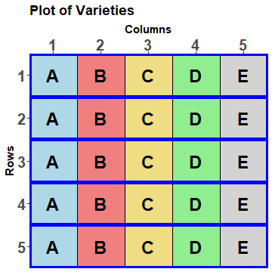
RCBD on a grid of plots
For the example:
  Allocated (treatment) factor is Varieties.
  Recipient (unit) factors are Rows and Columns.
  Each variety is applied once and only once in each row.
  Are Rows and Columns nested or crossed in the model?
    Given that Columns is not in the model, Rows is nested within Columns:
      consistent differences between Columns across Rows are not anticipated;
      instead variable differences within Rows are anticipated.
  Thus, the order of the treatments is randomized within each row.
  A method of achieving this randomization is:
    take a systematic design for the allocated and recipient factors;
    permute the recipient factors.

Slide 9
Randomization by permutation of recipient factors
Permutations for an RCBD with b = 2, k = v = 2.
The allowable permutations are:
  those that permute the blocks as a whole, and
  those that permute the units within a block;
  there are b!(k!)^{b} = 2!(2!)² = 8.
Unit | Blocks | Units | Treatments | Permutation
1 | 1 | 1 | 1 | 4
2 | 1 | 2 | 2 | 3
3 | 2 | 1 | 1 | 1
4 | 2 | 2 | 2 | 2
 |  |  |  |  | Permuted
unit | Blocks | Units | Treatments | Permutation | Blocks | Units
1 | 1 | 1 | 1 | 4 | 2 | 2
2 | 1 | 2 | 2 | 3 | 2 | 1
3 | 2 | 1 | 1 | 1 | 1 | 1
4 | 2 | 2 | 2 | 2 | 1 | 2
Unit | Blocks | Units | Treatments
1 | 1 | 1 | 1
2 | 1 | 2 | 2
3 | 2 | 1 | 1
4 | 2 | 2 | 2
Equivalent to Treatments randomization 1, 2, 2, 1.
  The permuted Blocks and Units and the Treatments are put back into standard order.
designRandomize from dae implements this randomization method.

Slide 10
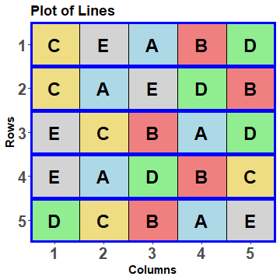
RCBD on a 5 x 5 grid of plots (cont’d)
What is its factor-allocation diagram for the design?
5 Rows
5 Columns in R
5 Varieties
5 treatments
25 units
  Two sets of objects (uncapitalized names) with associated factors (capitalized names):
    Allocated objects: 5 treatments;
    Allocated factor indexes treatments: {Varieties};
    Recipient objects: 25 units;
    Recipient set of factors indexes units: {Rows, Columns}.
  Columns are nested within Rows in the anticipated model and so are permuted within Rows to randomize Varieties.
  This is in spite of the plots being in a grid, for which Rows and Columns are intrinsically crossed.

Slide 11
Factor-allocation diagram for the RCBD (cont’d)
5 Rows
5 Columns in R
5 Varieties
5 treatments
25 units
One allocation (randomization):
  a set of treatments is allocated to a set of units.
The set of factors belonging to a set of objects, i.e. in each panel, forms a tier:
  they have the same status in the allocation (randomization):
    allocated or recipient.
Textbook experiments are two-tiered:
The factor-allocation diagram shows the EU and restrictions on randomization/allocation.
Notes:
Randomization in this case
athletes and test are the EUs; restrictions are to Athletes in Months and Tests in M,A

Slide 12
How to use designRandomize to get a layout for an RCBD on 5 × 5 grid
There are many ways to approach this in R:
  We like to start by creating a systematic data.frame to make the process more transparent.
Order of Rows then Columns in generate means that Columns will move faster than Rows.
fac.gen is convenient because it produces a data.frame containing factors Rows and Columns and another with Varieties; they are combined
Varieties is in a systematic order appropriate for an RCBD, consistent with the Rows-Columns order.
  > b <- 5
  > t <- 5
  > RCBD.sys <- cbind(fac.gen(generate = list(Rows=b, Columns=t)),
  + fac.gen(generate = list(Varieties = LETTERS[1:t]), times = b))
  > RCBD.lay <- designRandomize(allocated = RCBD.sys["Varieties"],
  + recipient = RCBD.sys[c("Rows", "Columns")], + nested.recipients = list(Columns = "Rows"),
  + seed = 1134)
  > RCBD.lay
Note nesting of Columns within Rows,
i.e. randomization involves permutation of Columns within Rows.
nested.recipients controls the randomization.
Notes:
The scripts for these examples are in dae/.tests

Slide 13
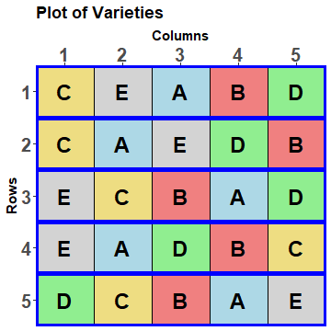
RCBD.lay
Rows Columns Varieties
1 1 1 C
2 1 2 E
3 1 3 A
4 1 4 B
5 1 5 D
6 2 1 C
7 2 2 A
8 2 3 E
9 2 4 D
10 2 5 B
11 3 1 E
12 3 2 C
13 3 3 B
14 3 4 A
15 3 5 D
16 4 1 E
17 4 2 A
18 4 3 D
19 4 4 B
20 4 5 C
21 5 1 D
22 5 2 C
23 5 3 B
24 5 4 A
25 5 5 E
This randomization results from the specified permutations.

Slide 14
The initial allocation-based mixed model
5 Rows
5 Columns in R
5 Varieties
5 treatments
25 units
This model is based on the factor-allocation diagram.
  Take all combinations of the factors within a tier, subject to the restriction that, if a factor is nested within another, then the nesting factor must always be included in terms involving it.
  The allocated (treatment) terms derived from the allocated factors are designated as fixed (to the left of a ‘|’).
  The recipient (unit) terms derived from the recipient factors are designated as random.
Mean + Varieties |
Mean + Rows + Rows:Columns
  Because the allocation involved randomization, this model is equivalent to a randomization model (provided Rows variance is allowed to be negative).
  This model and the anticipated model are different — here Rows is random.
  The Rows terms could be moved to the fixed model to form a homogeneous allocation model, and this might become the prior allocation model.

Slide 15
What do you need?
Anatomy of the design
5 Rows
5 Columns in R
5 Varieties
What is the purpose?
5 treatments
25 units
To evaluate the design by establishing the confounding present in it.
Provides insight into the analysis of the experiments based upon it.
The tiers: the sets of factors in the panels.
  units tier: the recipient factors are {Rows, Columns};
  treatments tier: the allocated factor is {Varieties}.
The relationships between the factors within a tier.
  Columns nested within Rows (given the allocation).
The layout for the experiment, but no response values.
What do you get?
A table showing the confounding relationships between sources.
  Paper includes EMS in the tables, derived using rules in its Appendix.

Slide 16
Terms in models vs sources in anovas/anatomies
A term allows for differences between the levels of a (generalized or joint) factor in a model.
  Mathematically it is of the form Xβ or Zu.
  Its dimension is the number of columns of X or Z.
    For example, factor Rows:Columns represents the difference between the combinations of Rows and Columns.
    It has dimension bt : the Z_{RC} matrix has bt columns. (The associated means projector Z_{RC}(Z^{T}_{RC} Z_{RC})⁻¹ Z^{T}_{RC} has dimension bt.)
For the RCBD with b = 2, k = v = 2.

Slide 17
Terms versus sources (cont’d)
A source represents differences after marginal terms have been eliminated.
Marginality relationships between terms is a property of the column spaces of the incidence matrices for the terms.
  One term is marginal to another if the column space of the first term is a subspace of that of the marginal term.
Where a term is characterized by its mean projection operator (M), a source is characterized by its projection matrix, Q, that is the matrix of the quadratic form for its sum of squares, y^{T}Qy.
  A source’s dimension is the rank of Q.
    The source Columns[Rows] represents Rows:Columns differences, after the marginal Rows term has been eliminated, i.e. differences between Columns within Rows.
    Its dimension is bt – b = (t – 1)b. (cf Rows:Columns term has dimension bt.)
For each term in a model there is a source in the anatomy.

Slide 18
Notation for sources
When all factors and/or variables in a term are crossed,
  They form interactions, in which all are joined together with hashes (#),
  e.g. A#B#C.
Nesting between factors and/or variables in a term leads to nested terms,
  For terms that involve nested factor(s), the rule for determining where factors occur in a source with nesting is:
    those factors in the term that nest other factors in it are placed within the square brackets,
    and joined by ‘:’;
    the rest are put to the left of the square brackets joined by ‘#’.
    e.g. A#B[C:D], where C and D nest one or more of A and B;
    here C:D indicates all observed combinations of C and D.
For the RCBD example:
  For the units terms Rows (5) and Rows:Columns (25), the sources are Rows (4) and Columns[Rows] (20).
  For the Varieties (5) term, Varieties (4) is the source.

Slide 19
Anatomy of the design
5 Rows
5 Columns in R
5 Varieties
5 treatments
25 units
An anatomy is based on the allocation (in a factor-allocation diagram).
  A formula per panel with nesting in panel incorporated.
Shorthand for terms (Wilkinson and Rogers, 1973):
  A/B = A + A:B (‘/’ is called the nesting operator)
  A*B = A + B + A:B (‘*’ is called the crossed operator)
> RCBD.canon <- designAnatomy(formulae = list(units = ~ Rows/Columns,
+ trts = ~ Varieties),
+ grandMean = TRUE, data = RCBD.lay)
The terms for each formula are transformed into sources by designAnatomy.

Slide 20
Anatomy of the design
> RCBD.canon <- designAnatomy(formulae = list(units = ~ Rows/Columns,
+ trts = ~ Varieties),
+ grandMean = TRUE, data = RCBD.lay)
Shows how Varieties is confounded with the units sources?
> summary(RCBD.canon)
Summary table of the decomposition for units & trts
Source.units df1 Source.trts df2 aefficiency eefficiency order
Mean 1 Mean 1 1.0000 1.0000 1
Rows 4
Columns[Rows] 20 Varieties 4 1.0000 1.0000 1
Residual 16
All these are one and so the design is orthogonal.
Varieties is confounded with Columns[Rows] (as expected).
The Residual measures differences between Columns within Rows. (not the interaction of Varieties and Rows).
The overall conclusion:
  Varieties differences have a contribution from variation between Columns within Rows, but not overall Rows differences; the design is orthogonal.

Slide 21
How is it done?
5 Rows
5 Columns in R
5 Varieties
Form source projectors for a tier that are based
on the design matrices for a tier.
  Allocated tier sources: Mean, Varieties with projectors Q₀ and Q_{V}.
  Recipient tier sources: Mean, Rows, Columns[Rows] with projectors P₀, P_{R}, and P_{C[R]}.
    These Ps and Qs separate out the info for the different terms in a tier.
    The product of any pair of Ps or any pair of Qs is zero i.e. for each tier, the source projectors are orthogonal.
Investigate the relationship treatments sources and units sources for all pairs:
  e.g., compare the treatments source projector (Q_{V}) with the units source projectors (P₀, P_{R}, P_{C[R]}) through the nonzero eigenvalues of PQP products, the canonical efficiency factors:
    P₀Q_{V}P₀ and P_{R}Q_{V}P_{R}, both of which have all zero eigenvalues;
    P_{C[R]}Q_{V}P_{C[R]}, which has four nonzero eigenvalues all equal to one, the same as the rank of Q_{V}, so that:
      all four Varieties DF are confounded with Columns[Rows].
5 treatments
25 units
Summarize in an anatomy table:
  Set of Source and DF columns for units and another for treatments.
Source | DF
Mean | 1
Rows | 4
Columns[Rows] | 20
Source | DF
Mean | 1
Varieties | 4
Residual | 16
The advantage of this design is that, because no Varieties information is confounded with Rows, Rows differences will not contribute to the variability of Varieties.
Source | DF
Mean | 1
Varieties | 4

Slide 22
Canonical efficiency (eigenvalue) statistics
For fixed models, maximizing the aefficiency is the same as minimizing the AVPD.
A is the harmonic mean of the efficiency factors.
M is the arithmetic mean of the efficiency factors.
S is the variance of the efficiency factors.
X is the maximum of the efficiency factors.
E is the minimum of the efficiency factors.
Order is the number of unique efficiency factors.
DForthog is the number of efficiency factors equal to one.
All the designs in this talk are orthogonal so that the aefficiency, eefficiency and the order are all 1.
They will be omitted from the anatomies for the remaining designs

Slide 23
How does an anatomy differ from a traditional skeleton-ANOVA?
Anatomy
Skeleton ANOVA
Source | DF | Source | DF
Mean | 1 | Mean | 1
Rows | 4
Columns[Rows] | 20 | Varieties | 4
 |  | Residual | 16
Source | DF
Mean | 1
Rows | 4
Varieties | 4
Residual | 16
The anatomy displays the confounding of Varieties with differences between Columns within Rows.
The Residual is seen to be variation between Columns within Rows.
The two decompositions are equivalent.
The skeleton ANOVA is silent about the confounding, Columns[Rows] not being included.
The Residual is often characterized as the interaction between Rows and Varieties. (more later)

Slide 24
Why anatomy?
Is it not just a skeleton anova table?
  Yes, it is and it is similar to the multistratum skeleton anova tables produced by Genstat (VSN International, 2022), but …
An anova is used to analyse data.
  So, a skeleton anova is showing you how the analysis of some data will look.
These days, I generally don’t do anovas– I mainly do mixed model analyses of data. However, I do produce lots of anatomies.
  Linear mixed models are not capable of portraying the confounding.
An anatomy is the analysis of a design, rather than of data.
  It is relevant no matter what method is to be used in analyzing the data.
  Further, anatomies are based on the allocations for a design.
  They expose the confounding, whereas not all anovas do.
To emphasize these distinctions I refer to the anatomy of a design.

Slide 25
Case 2: Row and Column differences probable
What is the anticipated model?
  Anticipating row and column differences means that we should consider a model that includes Rows and Columns main effects.
  Mean + Varieties | Mean + Rows + Columns + Rows:Columns
    (taking Rows and Columns to be random).
Need a design that is A-optimal for this model.
  The Latin Square Design (LSqD) is such a design.
  It is A-optimal whether Rows or Columns are fixed or random.
  Are Rows and Columns crossed or nested in the model? Why?
  Crossed because expect consistent differences between Rows (across Columns) and between Columns (across Rows) and this has been allowed for in the anticipated model.
  In this case, this is consistent with the intrinsic crossing of Rows and Columns.
  It implies that Rows and Columns should be independently permuted.
For more details see the paper.

Slide 26
Recap of experiment on a 5 x 5 grid of plots
For 25 plots arranged in a grid of 5 rows × 5 columns:
  Rows and Columns are intrinsically crossed.
But just because they are crossed there is no compunction to use a row-column design. The design could be any one of a:
  Completely Randomized (CRD),
  Randomized Complete Block (RCBD), or
  Latin Square Design (LSqD)?
Which depends on whether the researcher anticipates appreciable (i) row and/or (ii) columns differences.
  The researcher’s assessment is encapsulated in the anticipated model.
We have seen how the nesting and crossing relationships between the recipient factors (Rows and Columns) in the anticipated model influences:
  the permutations that are appropriate for randomizing a design,
  Which, in turn, affects the confounding that results from the design.
See paper for why you might not use an LSqD always and just drop nonsignificant Row/Column effects.

Slide 27
3. Block-treatment interaction vs inherent random variability
So far analyses have been presented that assume no block-treatment interaction.
  For example, an RCBD for 5 Blocks, each of 5 plots for 5 Treatments:
Summary table of the decomposition for units & trts
Source.units df1 Source.trts df2
Mean 1 Mean 1
Blocks 4
Plots[Blocks] 20 Treatments 4
Residual 16
  No source for Treatments#Blocks occurs in the table.
  One might ask “Is Blocks#Treatments not the same as the Residual source?”
    Numerically it is the same: Blocks#Treatments has 16 df and it is the same subspace.
    However, the Residual represents the remainder of the Plots[Blocks] source after Blocks has been removed; hence, it represents inherent variability between plots within blocks.
    This is a different source of variability to Blocks#Treatments that derives from the differential response to treatments in different blocks.
  See paper for more.

Slide 28
Adding block-treatment interactions to the anatomy
The homogeneous allocation model with block-treatment interaction is:
  Mean + Treatments | Mean + Blocks + Blocks:Plots + Blocks:Treatments.
  This model gives no indication of the confounding – an anatomy is needed to explore this.
To get the anatomy, add *Blocks to the formula for trts:
> RCBD.canon <- designAnatomy(formulae = list(units = ~ Blocks/Plots,
+ trtblk = ~ Treatments*Blocks),
+ grandMean = TRUE, data = RCBD.lay)
> summary(RCBD.canon)
Note that which factors occur in each formula is related to the division into allocated (treatments) and recipient (factors), rather than into fixed and random.
  The units formula always has just the recipient factors.
  The second formula (trts or trtblk) always has the allocated factors. However, it may also have blocking factors that specify block-treatment interactions and the terms marginal to these interactions.

Slide 29
The anatomy with block-treatment interaction
Summary table of the decomposition for units & trtblk
Source.units df1 Source.trtblk df2
Mean 1 Mean 1
Blocks 4 Blocks 4
Plots[Blocks] 20 Treatments 4
Treatments#Blocks 16
Skeleton ANOVA
Source | DF
Mean | 1
Rows | 4
Treatments | 4
Treatments#Blocks | 16
  Note the exhaustive confounding of Plots[Blocks] by Treatments and Treatments#Blocks
  (there is no Plots[Blocks] Residual).
The anatomy includes sources for plot variability and the interaction:
  It shows that they are inseparable.
  Thus, the homogeneous allocation model is singular.
  To obtain a nonsingular, prior allocation model, one of Blocks:Plots and Treatments:Blocks must be removed from the model.
    Assuming no plot variability is unreasonable.
    So, remove Treatments:Blocks and acknowledge that any interaction will contribute to Blocks:Plots.
The paper discusses designating Blocks, Treats & B:T as fixed or random.

Slide 30
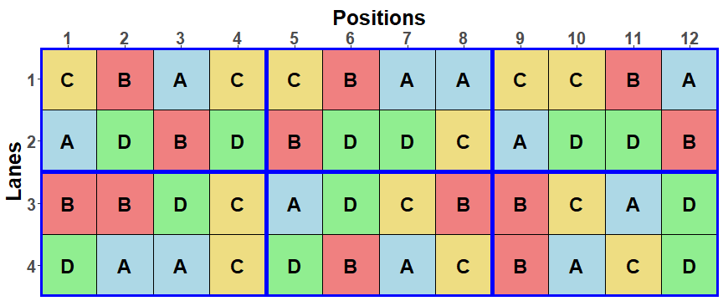
How to allow for block-treatment interaction?
Solution: add replicates within blocks.
Addelman (1969) recommends the Generalized Randomized Block Design (GRBD) for when block-treatment interactions are likely.
  Suppose a greenhouse experiment is to be run to investigate the responses to 4 Zinc levels by plants of a certain medic species and that there are 12 replicates of each level.
  Suppose that a block design is to be used and that block-treatment interactions are anticipated.
  That is, the anticipated model is Mean + Zinc | Mean + Blocks + Blocks:Pots + Blocks:Zinc.
  It is decided to use a GRBD with 6 blocks and 2 replicates per block.
  It is the A-optimal design for the given units structure.

Slide 31
Allocation models and anatomy
6 Blocks
8 Pots in B
4 Zincs
Initial allocation model:
  Mean + Zincs | Mean + Blocks + Blocks:Pots.
Homogeneous allocation model (same as anticipated model):
  Mean + Zincs | Mean + Blocks + Blocks:Pots + Blocks:Zincs.
The anatomy can be obtained using the same designAnatomy call as for an RCBD with a block-treatment interaction.
4 treatments
48 units
Summary table of the decomposition for units & trtblk
Source.units df1 Source.trtblk df2
Mean 1 Mean 1
Blocks 5 Blocks 5
Pots[Blocks] 42 Zincs 3
Blocks#Zincs 15
Residual 24
  For this design, Pots[Blocks] can be separated from Blocks#Zincs.
Because the factor-allocation approach exhibits the confounding, the relationship between these two sources of variation can be seen.

Slide 32
4. Insights into experiments involving time
There are 3 different types of experiments that involve time:
  Split-unit designs in which Time is randomized to either main units or subunits.
  Repeated measurements experiments in which each subject is observed repeatedly:
    Longitudinal experiments in which no factors are allocated to the different times and time differences are of interest.
    Repeated measurements experiments in which factors are allocated to different times for the same subject and time differences are not of intrinsic interest.
What insights into these experiments accrue from using the paradigm?
32

Slide 33
4.1 A greenhouse experiment with a randomized time factor
4 Zinc levels to be investigated for a species medic plants.
The response over 5 weeks is to be measured, the measurements requiring destructive harvesting of the plants.
There are to be 8 replicates.
A total of 160 pots are required and the experimental area is 4 Lanes x 40 Positions:
  Large differences between the weeks are expected and so a split-unit design, with Weeks allocated to main units, seems appropriate.
  Knowledge of the greenhouse suggests:
    a complete block of 2 Lanes x 10 Positions,
    each block being subdivided into 5 main units each of 2 Lanes x 2 Positions.
The factors in the experiment are Blocks, MainUnits, Pots, Zinc, Weeks.
Anticipated model, determined with the researcher:
  Mean + Zinc + Weeks + Zinc:Weeks |
  Mean + Blocks + Blocks:MainUnits + Blocks:MainUnits:Pots.
  Expect the variability of Blocks:MainUnits to be greater than Blocks:MainUnits:Pots.
  Consistent differences between MainUnits in different Lane pairs are considered unlikely.
Notes:
Split-unit = Split-plot

Slide 34
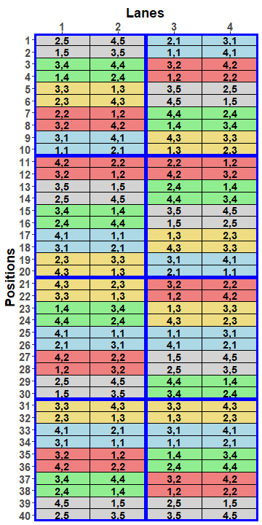
Greenhouse design and its factor-allocation diagram
Given the experimental set-up and the anticipated model, a (standard) split-unit design (SUD) with Weeks allocated to MainUnits will be A-optimal.
The tiers are as given in the following panels with the nesting relationships shown:
allocated
recipient
8 Blocks
5 MainUnits in B
4 Pots in B, M
5 Weeks
4 Zincs
20 treatments
160 units
  Blue lines encompass Blocks; coloured for Weeks.

Slide 35
Allocation models
8 Blocks
5 MainUnits in B
4 Pots in B, M
5 Weeks
4 Zincs
20 treatments
160 units
The initial allocation model is the same as the anticipated model.
    Mean + Zincs + Weeks + Z:W | Mean + Blocks + B:MainUnits + B:M:Pots.
    Because all allocation is by randomization, the initial allocation model is equivalent to a randomization model.
Commonly, the model for an experiment is formed by taking all treatment and blocking factors and form all main effects and interactions involving these factors.
  For this experiment, that would involve taking all combinations of Blocks, Zinc and Weeks.
We derive a homogeneous allocation model that includes all possible block-treatment interactions.
  Mean + Zincs + Weeks + Z:W | Mean + Blocks + B:Z + B:W + B:Z:W + B:MainUnits + B:M:Pots.
  In the traditional approach, the last 2 terms would be omitted.

Slide 36
Using designAnatomy to summarize the confounding
> SUD.BT.canon <- designAnatomy(formulae = list(units = ~ Blocks/MainUnits/Pots,
+ trtblk = ~ Blocks*Zincs*Weeks),
+ grandMean = TRUE, data = SUD.lay)
> summary(SUD.BT.canon , which.criteria = "none")
Two formulae and a data.frame.
Primary division is according to units sources.
Summary table of the decomposition for units & trtblk
Source.units df1 Source.trtblk df2
Mean 1 Mean 1
Blocks 7 Blocks 7
MainUnits[Blocks] 32 Weeks 4
Blocks#Weeks 28
Pots[Blocks:MainUnits] 120 Zincs 3
Blocks#Zincs 21
Zincs#Weeks 12
Blocks#Zincs#Weeks 84
W is confounded with M[B].
Z and Z#W are confounded with P[B:M].
There are no Residual sources: units sources are exhaustively confounded by treat-blocks sources; as a result, M[B] not separable from B#W and P[B:M] not separable from B#Z#W.

Slide 37
4.2 A longitudinal experiment
Longitudinal experiments are an example of experiments in which there is one or more factors of interest that are not allocated.
  In longitudinal experiments, the time factor is not allocated and so is in the recipient set of factors.
  Other common examples of such factors are Sex of animals in animal studies and Tasters in sensory experiments.
Consider the medic experiment that investigated Zinc levels using a GRBD.
  Suppose that the experiment is to be run in a greenhouse that can nondestructively measure responses daily using plant-imaging facilities:
    the plants are to be imaged over 14 days.
  The factor-allocation diagram is:
6 Blocks
8 Pots in B
14 Days
4 Zincs
Days groups the observations and is a blocking factor because it is
not allocated (cf split-unit design where Zinc and Weeks are allocated).
4 treatments
672 units

Slide 38
Models
Anticipated model:
  Extends the GRBD model by adding Days, and its interactions with the GRBD model terms.
  Also anticipated are:
    smooth trends over the Days and random deviations from these trends:
    D = td(D) + dev(D), where td stands for smooth trend and dev for deviations from trend.
    correlations between Days and heterogeneous variances for Days:
    gives the term B:P:sch(D), where sc stands for serial correlation and h for heterogeneous variances.
  Mean + Z + td(D) + Z:td(D) |
  Mean + B + B:P + dev(D) + Z:dev(D) + B:td(D) + B:dev(D) + Z:B + Z:B:D + B:P:sch(D).
Initial allocation model:
  Mean + Z | Mean + B + B:P + D + B:D + B:P:D.
Homogeneous allocation model:
  Swap Days to fixed and add terms for block-treatment interactions, that involve Z with B and D.
  Mean + Z + D + Z:D | Mean + B + B:P + B:D + Z:B + Z:B:D + B:P:D.
  Matches the anticipated model, but without the functions
  (lin, and hence dev, terms can be included in the anatomy via covariates).
Prior allocation model is the same as the anticipated model.
6 Blocks
8 Pots in B
14 Days
4 Zincs
4 treatments
672 units

Slide 39
Using designAnatomy to summarize the confounding
> longi.BZD.canon <- designAnatomy(formulae = list(units = ~ (Blocks/Pots)*Days,
+ trtblk = ~ Blocks*Zincs*Days),
+ grandMean = TRUE, data = longi.lay)
> summary(longi.BZD.canon , which.criteria = "none")
Primary division is according to units sources.
There is no exhaustive confounding.
Summary table of the decomposition for units & trtblk
Source.units df1 Source.trtblk df2
Mean 1 Mean 1
Blocks 5 Blocks 5
Pots[Blocks] 42 Zincs 3
Zincs#Blocks 15
Residual 24
Days 13 Days 13
Blocks#Days 65 Blocks#Days 65
Pots#Days[Blocks] 546 Zincs#Days 39
Zincs#Blocks#Days 195
Residual 312
Same as for the GRBD.
However, D and B#D are units sources.
As for a split-unit design,
(i) there are two Residuals;
(ii) the block-treatment interactions involving Z and D are associated with the second Residual.

Slide 40
5. Examples in the paper that have not been presented
A repeated-measurement experiment with treatments allocated to times that involves:
  Systematic allocation;
  Pseudoreplication;
  An unallocated factor that is of interest.
A balanced incomplete block design for a sensory experiment that involves:
  Nonorthogonality;
  An unallocated factor that is of interest.
  A consolidated, single anatomy showing the dispersal of information across the units sources.
Further, the paper includes rules for obtaining the Expected Mean Squares and gives them for all the examples

Slide 41
dae: Functions useful in designing experiments
Design functions
  designLatinSqrSys: Generate a systematic plan for a Latin square design.
  designRandomize: Takes a systematic design and randomizes it according to the nesting (and crossing) relationships between the recipient (unit) factors for the randomization.
  designGGPlot: A graphical representation of an experimental design based on labels stored in a data.frame using ggplot2.
  designAnatomy: Given the layout for a design, produces a pcanon object containing its anatomy that shows the confounding and aliasing inherent in the design; obtained via the canonical analysis of the designs projectors.
  summary.pcanon: Summarizes the anatomy of a design, being the decomposition of the sample space based on its canonical analysis, as produced by designAnatomy. The table produced includes the degrees of freedom and summary statistics of the canonical efficiency factors.
  efficiencies.pcanon: Extracts the canonical efficiency factors from a pcanon.object produced by designAnatomy.
Factor manipulation functions (4 of 15)
  fac.gen: Generate all combinations of several factors.
  fac.recast: Recasts a factor by modifying the values in the factor vector and/or the levels attribute, possibly combining some levels into a single level.
  fac.combine: Combines several factors into one.
  fac.divide: Divides a factor into several factors.

Slide 42
References
Brien, C. J. (2023). dae: functions useful in the design and ANOVA of experiments. R package version 3.2-17. http://cran.at.r-project.org/package=dae.
Brien, C. J., & Bailey, R. A. (2006). Multiple randomizations (with discussion). Journal of the Royal Statistical Society, Series B (Statistical Methodology), 68, 571-609.
Brien, C. J., & Demétrio, C. G. B. (2009). Formulating Mixed Models for Experiments, Including Longitudinal Experiments. Journal of Agricultural, Biological, and Environmental Statistics, 14, 253-280.
Brien, C. J., Sermarini, R. A., & Demetrio, C. G. B. (2023). Exposing the confounding in experimental designs to understand and evaluate them, and formulating linear mixed models for analyzing the data from a designed experiment. Biometrical Journal, Open access, available in Early View. https://doi.org/10.1002/bimj.202200284.
Kiefer, J. (1959). Optimum Experimental Designs. Journal of the Royal Statistical Society, Series B (Methodological), 21, 272-319.
VSN International. (2022). Genstat 22nd Edition. VSN International. http://www.genstat.co.uk/
Wilkinson, G. N., & Rogers, C. E. (1973). Symbolic description of factorial models for analysis of variance. Journal of the Royal Statistical Society, Series C (Applied Statistics), 22, 392-399.
Thank you for your attention.

