Slide 1
Designing comparative experiments using R
(Chris Brien and Sam Rogers)
III. Multiphase and partially replicated (p-rep) designs

Slide 2
Outline
Multiphase designs.
Partially replicated designs.
Summary.

Slide 3
1. Multiphase designs
Brien (2017) gives a review, including published applications.
Three introductory papers are Brien and Bailey (2006), Brien et al. (2011) and Brien (2019).
“Normal” two-phase experiments (Brien et al., 2011,Section 4) involve a single-randomization in each phase.
  This implies that a design is required for each phase.
  The object of the second phase is to evaluate material produced in the first phase and one or more response variables are measured in the second phase.
  There may also be response variables from the first-phase.
  The phase is the period of time during which a set of units are engaged in producing their outcome: material and/or response variables.
  One phase might overlap another phase.

Slide 4
1.1 A simple two-phase athlete training experiment
Brien, Harch, Correll, Bailey (2011)
Suppose in a simple two-phase athlete training experiment:
  in addition to heart rate taken immediately upon completion of a test,
  the free haemoglobin is to be measured using blood specimens taken from the athletes after each test, which are to be transported to the lab for analysis.
The experiment consists of a test phase and a laboratory phase:
  Test phase: 36 tests involving 3 athletes in each of 4 months; heart rate is measured and a blood specimen taken.
    The unit is a test taken by an athlete.
    The outcomes are the heart rate, a response variable, and a blood sample, material for the second phase.
  Laboratory phase: each month 3 blood samples are taken to the laboratory for analysis.
    The unit is a blood specimen.
    The outcome is the free haemoglobin in the blood specimen, a response variable.
Notes:
Split-unit = Split-plot

Slide 5
First phase: athlete testing
Brien, Harch, Correll, Bailey (2011)
Recall from the standard athlete training experiment in Session 1 that 9 training conditions are to be investigated:
  combinations of 3 surfaces and 3 intensities of training.
In each of the 4 Months of testing:
  3 endurance athletes are recruited.
  Each athlete undergoes 3 tests, separated by 7 days, under 3 different training conditions.
A split-unit design was employed to allocate Intensities and Surfaces.
4 Months
3 Athletes in M
3 Tests in M, A
3 Intensities
3 Surfaces
9 training conditions
36 tests
For the second phase the 36 tests need to be allocated for analysis in the laboratory.
Notes:
Split-unit = Split-plot

Slide 6
Second laboratory phase
A restriction in the second phase:
  The blood specimens from the first phase need to be processed as soon as possible (not held for 4 months).
  Thus, the 9 specimens collected each month are to be processed together.
Suppose that it is decided to process them in a random order,
  That is, it is assumed that there is no systematic trend across the processing of the 9 samples so that a nested second-phase design is required.
4 Months
3 Athletes in M
3 Tests in M, A
4 Batches
9 Locations in B
3 Intensities
3 Surfaces
9 training conditions
36 tests
36 locations

Slide 7
A simple two-phase athlete training experiment (cont’d)
4 Months
3 Athletes in M
3 Tests in M, A
4 Batches
9 Locations in B
3 Intensities
3 Surfaces
9 training conditions
36 tests
36 locations
It is two-phase with three sets of objects:
  training conditions, tests and locations:
    training conditions are allocated in the first-phase and the second-phase i.e. only ever allocated.
    tests are recipients factors in the second phase and are allocated factors in the second phase i.e. different roles in the two phases.
    locations are recipient factors in the second phase i.e. only ever recipient.

Slide 8
A simple two-phase athlete training experiment (cont’d)
4 Months
3 Athletes in M
3 Tests in M, A
4 Batches
9 Locations in B
3 Intensities
3 Surfaces
9 training conditions
36 tests
36 locations
It is described as involving two composed allocations, one of two types of allocations in a chain:
  Training conditions are allocated to tests and tests to locations;
Here, the second phase begins during the first phase.
Have not allowed for an overall, processing-order effect.
  More about that soon.

Slide 9
Randomization in the second phase
Principle 7 (Allocate all and randomize in laboratory) (Brien et al, 2011):
  The laboratory-phase design should always allocate all the first-phase unit factors, as well as any laboratory treatments, to the laboratory units, using randomization wherever possible.
As is the case for any randomization, randomizing the lab phase:
  Guards against unanticipated systematic effects.
  Justifies the form of the variance matrix used for the experiment.
  Required for a valid estimate of error.
Additionally, for a second (lab) phase, randomizing
  compensates for unfortunate randomizations in the first phase.
However, have seen that practical problems can limit randomization.
But, are there other reasons for not randomizing the second phase?
  Does it make it difficult to estimate first-phase phenomena?
  For example, spatial correlation, linear trends, unequal variances?

Slide 10
The design species for a normal two-phase design
4 Months
3 Athletes in M
3 Tests in M, A
4 Batches
9 Locations in B
3 Intensities
3 Surfaces
9 training conditions
36 tests
36 locations
The four design species for allocating sets of objects when there is an allocation in each of the two phases (Brien, 2019):
  First-phase design: allocated and recipient objects from the first phase
    (training conditions and tests);
  Second-phase design: first- and second-phase recipient objects
    (tests and locations);
  Cross-phase design: first-phase allocated objects and second-phase recipient objects
    (training conditions and locations);
  Two-phase or combined design: all three sets of objects.
designTwophaseAnatomies produces the four anatomies for them.

Slide 11
The anatomy for the first phase design (from Session 1)
> split.canon <- designAnatomy(formulae = list(tests = ~Months/Athletes/Tests,
+ cond = ~Intensities*Surfaces),
+ data = split.lay)
> summary(split.canon, which.criteria="none")
Formulae for recipient and allocated.
Layout is in split.lay.
Summary table of the decomposition for tests & cond
Source.tests df1 Source.cond df2
Months 3
Athletes[Months] 8 Intensities 2
Residual 6
Tests[Months:Athletes] 24 Surfaces 2
Intensities#Surfaces 4
Residual 18

Slide 12
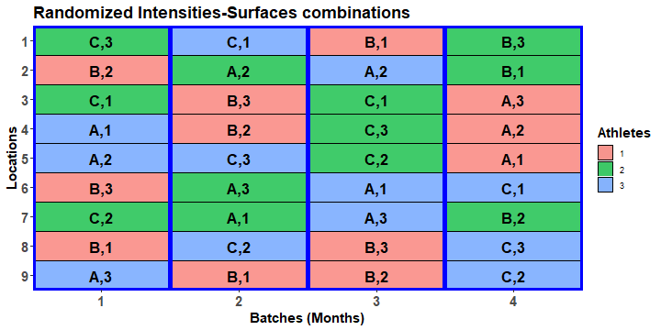
Construct two-phase design
4 Months
3 Athletes in M
3 Tests in M, A
4 Batches
9 Locations in B
3 Intensities
3 Surfaces
9 training conditions
36 tests
36 locations
Have to randomize tests (and training conditions) to locations
> eg1.lay <- designRandomize(allocated = split.lay,
+ recipient = list(Batches = 4, Locations = 9),
+ nested.recipients = list(Locations = "Batches"),
+ except = "Batches",
+ seed = 71230)

Slide 13
Check properties of the multiphase design
> eg1.canon <- designAnatomy(formulae = list(locs = ~ Batches/Locations,
+ test = ~ Months/Athletes/Tests,
+ cond = ~ Intensities*Surfaces),
+ data = eg1.lay)
> summary(eg1.canon, which.criteria=c("aeff", "order"))
Summary table of the decomposition for locs, test & cond
Source.locs df1 Source.test df2 Source.cond df3 aefficiency order
Batches 3 Months 3 1.0000 1
Locations[Batches] 32 Athletes[Months] 8 Intensities 2 1.0000 1
Residual 6 1.0000 1
Tests[Months:Athletes] 24 Surfaces 2 1.0000 1
Intensities#Surfaces 4 1.0000 1
Residual 18 1.0000 1
All sources are orthogonal and all, except Months, are confounded with Locations[Batches].
Note also that there are no residuals for Batches or Locations[Batches].
  They are exhaustively confounded, which will always be the case when the numbers of objects are equal for two consecutive tiers.
Question that remains: what mixed model to fit?
Three formulae reflecting the factor-allocation diagram
(no limit on the number).

Slide 14
Initial allocation model
4 Months
3 Athletes in M
3 Tests in M, A
4 Batches
9 Locations in B
3 Intensities
3 Surfaces
9 training conditions
36 tests
36 locations
Initial allocation model (like the anatomy, reflects the factor allocation diagram):
  Intensities + Surfaces + Intensities:Surfaces |
  Months + Months:Athletes + Months:Athletes:Tests +
  Batches + Batches:Locations.
However, this model will not fit because of confounding between tests and locations.

Slide 15
Prior allocation model
Summary table of the decomposition for locs, test & cond
Source.locs df1 Source.test df2 Source.cond df3 aefficiency order
Batches 3 Months 3 1.0000 1
Locations[Batches] 32 Athletes[Months] 8 Intensities 2 1.0000 1
Residual 6 1.0000 1
Tests[Months:Athletes] 24 Surfaces 2 1.0000 1
Intensities#Surfaces 4 1.0000 1
Residual 18 1.0000 1
Need to remove
  One of Months and Batches, and make the retained term fixed:
  Locations:Batches or both Months:Athletes and Months:Athletes:Tests.
Must retain Months:Athletes, otherwise it would be pooled, either into Months:Athletes:Tests or Batches:Locations.
The prior allocation model is the model for the first phase and is a model of convenience:
  Months + Intensities + Surfaces + Intensities:Surfaces |
  Months:Athletes + Months:Athletes:Tests.
The very important point is that, while they are not in the model, the lab terms contribute to those that are e.g. Months is not just due to Months differences, but is also due to Batches variance.

Slide 16
1.2 Allowing for lab order in the athletic experiment
Brien (2017)
If it is expected that there will be consistent differences between locations across the months, then the initial allocation model would be:
  Intensities + Surfaces + Intensities:Surfaces |
  Months + Months:Athletes + Months:Athletes:Tests +
  Batches + Locations + Batches:Locations.
  That is, Batches and Locations are now crossed (similar to RCBD versus LSD).
  A row-column design is required for the crossed, second phase.
The Locations term has been added.

Slide 17
Design considerations
To produce a good two-phase design, the allocation of the first phase to locations cannot ignore Intensities and Surfaces: a good cross-phase design is needed.
  In the previous design, they could be ignored because everything within Months was being randomized to Locations within Batches.
In addition, the second-phase design cannot be ignored because the split-unit nature of the first-phase design must be taken into account.
  Because of the time constraints Months must be associated with Batches.
  Within a month, assigning Athletes to triples of consecutive Locations is consistent with the use of a split-unit design in the first-phase.
  Tests can then be assigned to the locations within a triple.
Thus the cross-phase design must efficiently assign Intensities to Location triples and Surfaces to the Locations within a triple.
The factor allocation diagram
4 Months
3 Athletes in M
3 Tests in M, A
4 Batches
9 Locations
3 Intensities
3 Surfaces

9 training conditions
36 tests
36 locations

Slide 18
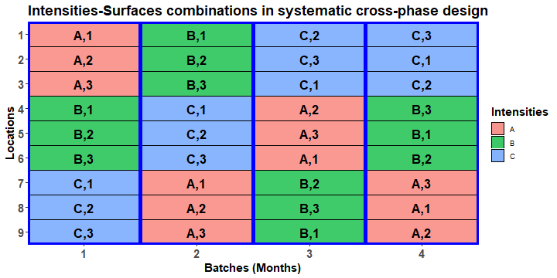
Systematic cross-phase design
A balanced factorial design (Hinkelmann & Kempthorne, 2005, section 12.5).
A 3  4 extended Latin square (LS + column of repeats) is used to allocate Intensities to the triples (colours & letters);
A 3  4 extended Latin square is used for a Locations triple  Batches; the same extended Latin square is used for all 3 triples.
To ensure no repeat Intensities-Surfaces combinations for a Location, the repeated columns for the two ELSs must be associated with different Batches.
The Intensities and Surfaces are arranged in a split-unit pattern.
Notes:
For the triples ELS, the repeat in the fourth row comes from a different Batch-Month

Slide 19
Construct a systematic second-phase design and randomize it
ELSD
> #'## Generate a systematic cross-phase design for Intensities and Surfaces
> eg2.phx.sys <- cbind(fac.gen(list(Batches = 4, Locations = 9)),
+ data.frame(Intensities = factor(rep(c(designLatinSqrSys(3), c(3,2,1)),
+ each = 3), labels = LETTERS[1:3]),
+ Surfaces = factor(c(rep(1:3, times = 3),
+ rep(1:3, times = 3),
+ rep(c(2,3,1), times = 3),
+ rep(c(3,1,2), times = 3)))))
> #'## Generate a systematic two-phase design by bringing in first-phase recipient factors
> eg2.phx.sys$Months <- eg2.phx.sys$Batches
> eg2.sys <- merge(split.lay, eg2.phx.sys) #merge on commmon factors Months, Intensities & Surfaces
> eg2.sys <- with(eg2.sys, eg2.sys[order(Batches,Locations),])
> #'## Allocate the second phase
> eg2.lay <- designRandomize(allocated = eg2.sys[c("Months", "Athletes", "Tests",
+ "Intensities", "Surfaces")],
+ recipient = eg2.sys[c("Batches", "Locations")],
+ except = "Batches",
+ seed = 243526)
An ELSD
Don’t randomize Batches.
Notes:
times = 3 repeats across Locations triples

Slide 20
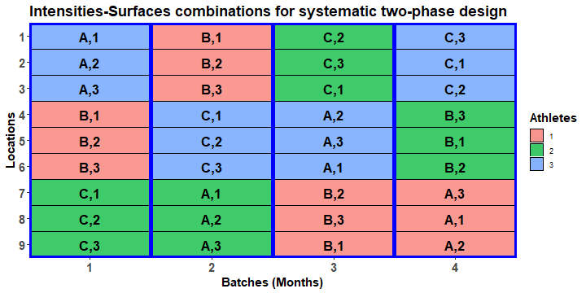
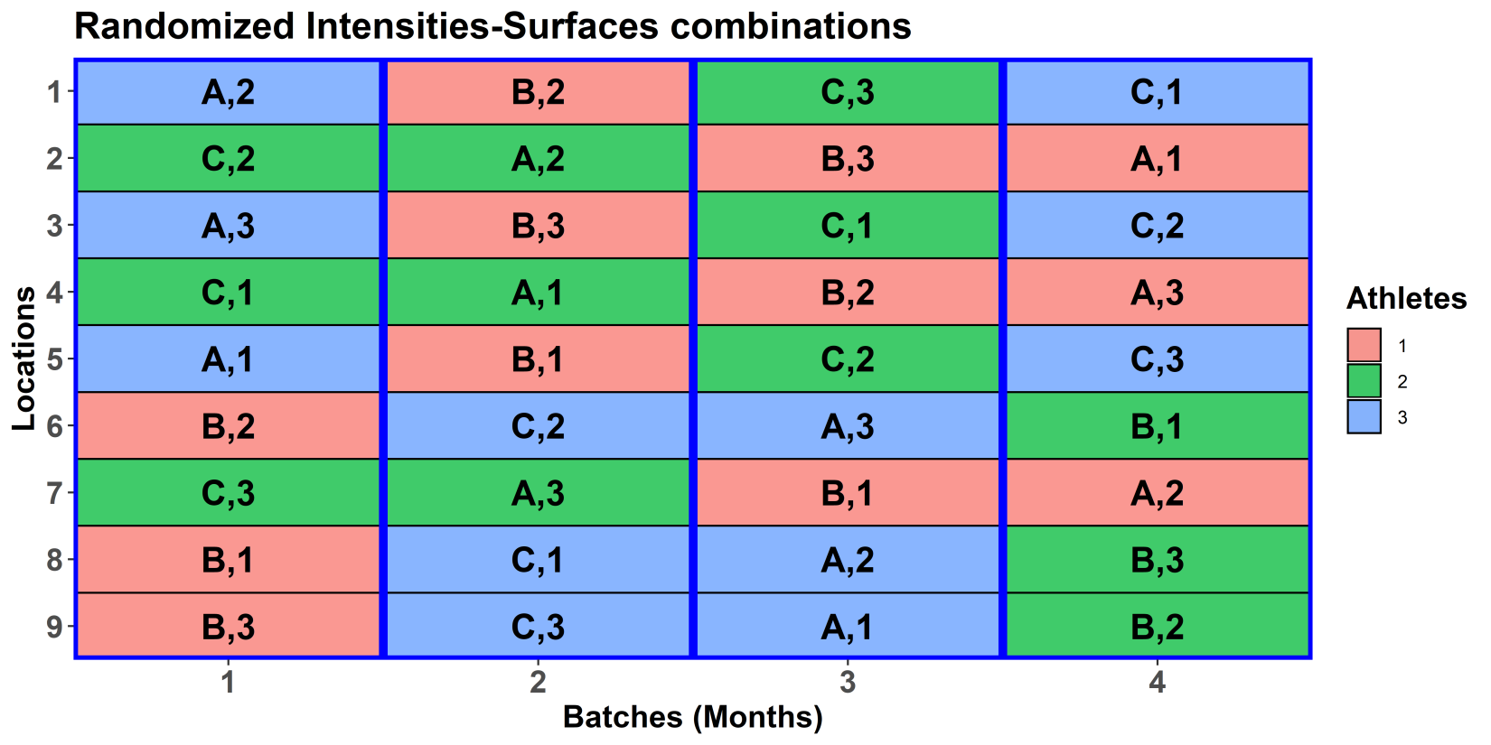
Systematic versus randomized designs
The randomized design is obtained from the systematic design by permuting:
  its rows (Locations),
  but not its columns (Batches).

Slide 21
Anatomy of the two-phase design allowing for lab processing order
Summary table of the decomposition for locs, test & cond (based on adjusted quantities)
Source.locs df1 Source.test df2 Source.cond df3 aefficiency order
Batches 3 Months 3 1.0000 1
Locations 8 Athletes[Months] 2 Intensities 2 0.0625 1
Tests[Months:Athletes] 6 Surfaces 2 0.0625 1
Intensities#Surfaces 4 0.2500 1
Batches#Locations 24 Athletes[Months] 6 Intensities 2 0.9375 1
Residual 4 1.0000 1
Tests[Months:Athletes] 18 Surfaces 2 0.9375 1
Intensities#Surfaces 4 0.7500 1
Residual 12 1.0000 1
The design is not orthogonal
The Residual for Intensities has been reduced from 6 to 4 df.
The design is balanced
Most of the information about Intensities and Surfaces is confounded with Batches#Locations.

Slide 22
Prior allocation model
Summary table of the decomposition for locs, test & cond (based on adjusted quantities)
Source.locs df1 Source.test df2 Source.cond df3 aefficiency order
Batches 3 Months 3 1.0000 1
Locations 8 Athletes[Months] 2 Intensities 2 0.0625 1
Tests[Months:Athletes] 6 Surfaces 2 0.0625 1
Intensities#Surfaces 4 0.2500 1
Batches#Locations 24 Athletes[Months] 6 Intensities 2 0.9375 1
Residual 4 1.0000 1
Tests[Months:Athletes] 18 Surfaces 2 0.9375 1
Intensities#Surfaces 4 0.7500 1
Residual 12 1.0000 1
Same exhaustive confounding issues as for the nested second-phase design.
Must retain Locations and Months:Athletes to prevent undesirable pooling.
One possible prior allocation model is the model for the first phase plus Locations:
  Months + Intensities + Surfaces + Intensities:Surfaces |
  Months:Athletes + Months:Athletes:Tests + Locations.
Again this is a model of convenience and does not portray all the sources of variation affecting the response variables for this experiment

Slide 23
Using od to construct a design
Split-plot designs
  involve a two-step process to optimize:
    optimize the main-unit factors;
    optimize the sub-unit factors, given the main-unit optimization;
  Only optimizes main effects.

Slide 24
Optimizing the main-unit, cross-phase design
> #'## Optimize the main-unit, cross-phase design, based on assigning Intensities to Locations tripletss
> #'### Set up a randomized starting design
> eg2.main.ini <- cbind(fac.gen(list(Batches = 4, Triplets = 3)),
+ fac.gen(list(Intensities = LETTERS[1:3]), times = 4))
> eg2.main.ini <- designRandomize(allocated = eg2.main.ini[c("Intensities")],
+ recipient = eg2.main.ini[c("Batches","Triplets")],
+ nested.recipients = list(Triplets = "Batches"),
+ seed = 61461)
> #'### Use od to optimize the main-unit design
> eg2.main.od <- od(fixed = ~ Batches + Triplets + Intensities,
+ permute = ~ Intensities, swap = ~ Batches,
+ maxit = maxit, search = "tabu",
+ data = eg2.main.ini)
Mon Oct 7 15:00:29 2019
Initial A-value = 0.727273 (3 A-equations; rank C 2)
A-value after tabu loop 1 is 0.533333
A-value after tabu loop 2 is 0.533333
…
A-value after tabu loop 50 is 0.533333
Hash table size 4
Final A-value after 50 tabu iterations: 0.533333
> eg2.main.des <- eg2.main.od$design
Set up an RCBD for Intensities as a starting design.
Use swap to keep the design resolved for Batches.

Slide 25
Optimizing the sub-unit, cross-phase design
> #'## Optimize the sub-unit, cross-phase design, based on assigning Surfaces to Locations within triplets
> #'### Set up a randomized starting design
> eg2.ini <- cbind(fac.gen(list(Surfaces = 3), times = 12),
+ fac.gen(list(Batches = 4, Triplets = 3, Locations = 3)))
> eg2.ini <- designRandomize(allocated = eg2.ini["Surfaces"],
+ recipient = eg2.ini[c("Batches", "Triplets", "Locations")],
+ nested.recipients = list(Locations = c("Batches", "Triplets")),
+ except = c("Batches", "Triplets"),
+ seed = 65435)
> eg2.ini$Locations <- with(eg2.ini, fac.combine(list(Triplets, Locations)))
> eg2.ini <- merge(eg2.ini, eg2.main.des[c("Batches", "Triplets", "Intensities")])
> #'### Use od to optimize the sub-unit design
> eg2.od <- od(fixed = ~ Batches*Triplets + Locations + Surfaces,
+ permute = ~ Surfaces, swap = ~ Batches:Triplets,
+ maxit = maxit, search = search,
+ data = eg2.ini)
Mon Oct 7 15:02:14 2019
Initial A-value = 0.191781 (3 A-equations; rank C 2)
A-value after tabu loop 1 is 0.177778
A-value after tabu loop 2 is 0.177778
…
A-value after tabu loop 50 is 0.177778
Final A-value after 50 iterations: 0.177778
A starting-design design with Surfaces randomized within Batches-Triplets.
Add the main-unit design.
Use swap to only interchange within Batches-Triplets, so keeping main-unit design.

Slide 26
Produce the two-phase design based on the od designs
Combine cross-phase and first-phase designs.
> eg2.des <- eg2.od$design
> split.lay$Batches <- split.lay$Months
> eg2.lay <- merge(eg2.des, split.lay)
> eg2.lay <- with(eg2.lay, eg2.lay[order(Batches, Locations),])
> eg2.lay <- designRandomize(allocated = eg2.lay[c("Months","Athletes","Tests",
+ "Intensities","Surfaces")],
+ recipient = eg2.lay[c("Batches","Locations")],
+ except = "Batches",
+ seed = 87620)
> #'## Check properties of the design
> eg2.canon <- designAnatomy(formulae = list(locs = ~ Batches*Locations,
+ test = ~ Months/Athletes/Tests,
+ cond = ~ Intensities*Surfaces),
+ data = eg2.lay)
Warning messages:
1: In projs.2canon(CombinedSets$Q[[ntiers]], struct[[ktier]]$Q) :
Intensities#Surfaces and Surfaces are partially aliased in Locations&Tests[Months:Athletes]
2: In projs.2canon(CombinedSets$Q[[ntiers]], struct[[ktier]]$Q) :
Intensities#Surfaces and Surfaces are partially aliased in Batches#Locations&Tests[Months:Athletes]
Randomize the first-phase design to the second-phase units.
The interaction and Surfaces main effects are not orthogonal.

Slide 27
Properties of the od-based two-phase design
Summary table of the decomposition for locs, test & cond (based on adjusted quantities)
Source.locs df1 Source.test df2 Source.cond df3 aefficiency order
Batches 3 Months 3 1.0000 1
Locations 8 Athletes[Months] 2 Intensities 2 0.0625 1
Tests[Months:Athletes] 6 Surfaces 2 0.0625 1
Intensities#Surfaces 3 0.1121 3
Residual 1 1.0000 1
Batches#Locations 24 Athletes[Months] 6 Intensities 2 0.9375 1
Residual 4 1.0000 1
Tests[Months:Athletes] 18 Surfaces 2 0.9375 1
Intensities#Surfaces 4 0.6559 4
Residual 12 1.0000 1
Table of (partial) aliasing between sources derived from the same formula
Source df Alias In aefficiency order
Intensities#Surfaces 3 Surfaces Locations&Tests[Months:Athletes] 0.1121 3
Intensities#Surfaces 4 Surfaces Batches#Locations&Tests[Months:Athletes] 0.6559 4
The design is not orthogonal
The design is unbalanced and the interaction efficiency is low
(cf 0.75 for manual construction).

Slide 28
Properties of the four species of od-based designs
Used designTwophaseAnatomies to output the 4 species of designs for a two-phase design.
  The anatomy of the two-phase design has been presented.
  The second-phase anatomy is:
Summary table of the decomposition for locs & test
Source.locs df1 Source.test df2 aefficiency eefficiency order
Batches 3 Months 3 1.0000 1.0000 1
Locations 8 Athletes[Months] 2 1.0000 1.0000 1
Tests[Months:Athletes] 6 1.0000 1.0000 1
Batches#Locations 24 Athletes[Months] 6 1.0000 1.0000 1
Tests[Months:Athletes] 18 1.0000 1.0000 1
  It shows that the allocation of second-phase units (tests) to first-phase units (locations) is orthogonal.
  This is desirable because it means that the variance matrix is relatively straightforward.

Slide 29
2. Partially replicated (p-rep) designs
These designs were introduced by Cullis et al. (2006)
They are a variation of the augmented designs, introduced by Federer in 1956.
An augmented design is one in which a design is used to allocate replicated treatments and these are then augmented with unreplicated treatments.
The particular features of a p-rep design are:
  Both the unreplicated and replicated treatments are new genotypes; in augmented designs, the unreplicated treatments are usually controls or check varieties;
  The p-rep designs are spatially-optimized.

Slide 30
2.1 A field experiment — a single-phase p-rep
(Cullis, Smith & Coombes, 2006)
576 Lines on 60 rows × 12 columns.
Dashed line because Lines are allocated to the plots factors, but not using classic randomization.
576 Lines
2 Blocks
30 WRows in B
12 Columns

ρ
576 lines
720 plots
144 Lines are to be duplicated — p = 0.25.
Local spatial correlation is expected and a spatial design is needed.
The initial allocation model is:
    Lines | Blocks + Blocks:WRows + Columns +
    Blocks:Columns + Blocks:WRows:Columns).
The prior allocation model is:
  Blocks | Lines + Blocks:WRows + Columns +
  Blocks:Columns + units + ar1(Blocks:WRows):ar1(Columns).
Lines and Blocks interchanged between fixed-random model;
Autocorrelation for Rows and Columns is added;
units is added for nugget variance.

Slide 31
A field p-rep — variance parameters
The prior allocation model:
  Blocks | Lines + Blocks:WRows + Columns +
  Blocks:Columns + units + ar1(Blocks:WRows):ar1(Columns).
To search for a spatially-optimized design using od need to specify values for the variance parameters.
The general way to do this is to
  set the residual (or identity) term component to 1: φ_{BRC} = 1;
  Use γ to denote the ratio of each component to the residual: γ_{i} = φ_{i} / φ_{BRC}.
Suppose past experience tells us that the following are reasonable values (Smith et al, 2006, p.405):
  γ_{L} = 1, γ_{BR} = 0.5, γ_{C} = 0.1, γ_{BC} = 0.05, γ_{u} = 0.5, φ_{BRC} = 1, ρ_{BR} = 0.6, ρ_{C} = 0.4.
  The magnitude of φ_{L} equals that of φ_{BRC}; γ_{u} is the nugget variance;
  the ρs are the first-order autocorrelation parameters.

Slide 32
A field p-rep — setting up
> #'## Set up constants
> g <- 576 # no. genotypes
> ndup <- 144 # no. duplicated genotypes
> b <- 2 # no. blocks
> r <- 60 # no. rows
> c <- 12 # no. columns
> n <- r*c # no. Plots
>
> #'## Set up variance parameters
> g.L <- 1
> g.BR <- 0.5
> g.C <- 0.1
> g.BC <- 0.05
> g.u <- 0.5
> g.BRC <- 1.0
> rho.R <- 0.6
> rho.C <- 0.4
> params <- c(g.L, g.BR, g.C, g.BC, g.u, g.BRC, rho.R, rho.C)
> names(params) <- c("g.L", "g.BR", "g.C", "g.BC", "g.u", "g.BRC", "rho.R", "rho.C")
> #'## Set od options
> maxit <- 50
> search <- "tabu+rw"
> od.options(P = 0.10, localSearch = 10000, tabuStop = 100)

Slide 33
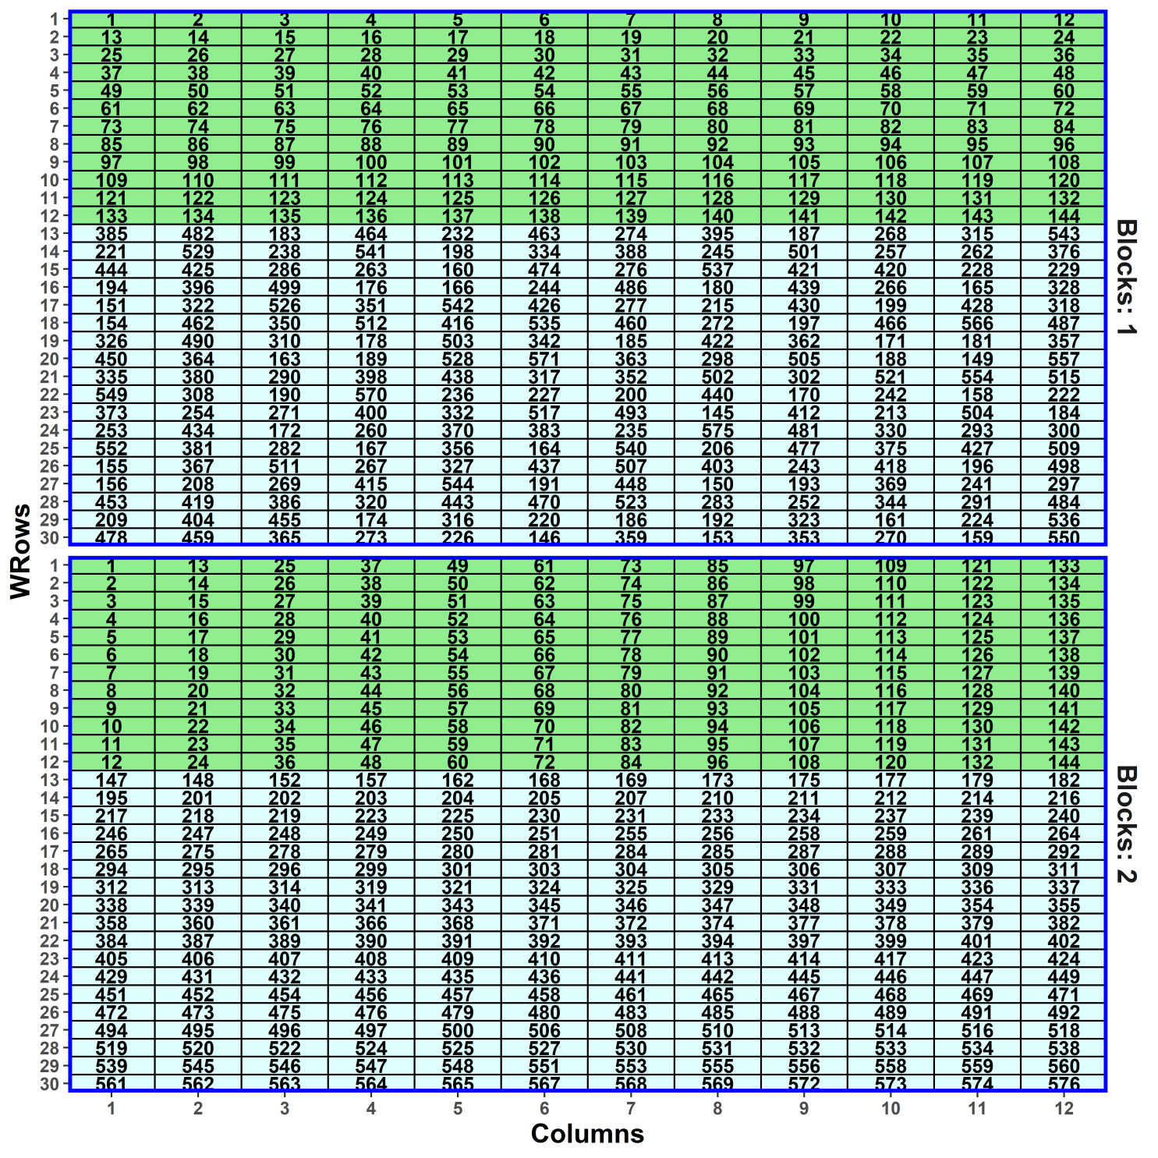
A field p-rep
— initial design
> #'## Generate a simple lattice for Lines 1:144
> #'
> #' 1:144 are replicated twice 145:g are replicated once
> latt.mat <- matrix(1:ndup, nrow = 12, ncol = 12)
> blk1.lines <- sample((ndup+1):g, (g-ndup)/2) #randomly select half undup Lines for Block 1
> blk2.lines <- ((ndup+1):g)[!((ndup+1):g %in% blk1.lines)] #rest in Block 2
> latt.lay <- fac.gen(list(Blocks = 2, WRows = 30, Columns = 12))
> latt.lay <- within(latt.lay,
+ Lines <- factor(c(latt.mat, blk1.lines,
+ t(latt.mat),blk2.lines)))
> #'## Randomize the initial design
> latt.lay <- designRandomize(allocated = latt.lay["Lines"],
+ recipient = latt.lay[c("Blocks", "BRows", "Columns")],
+ nested.recipients = list(BRows = "Blocks"),
+ seed = 64058)
> latt.lay <- within(latt.lay,
+ Rows <- fac.combine(list(Blocks, BRows)))
This is a resolved, augmented design – the replicates of the duplicated Lines are in different blocks and the unduplicated lines are added to the block design.

Slide 34
A field p-rep — setting variance parameters in od
> #'## Use od to generate the p-rep starting with the simple lattice - with units and autocorrelation
> prepuar1.latt.od <- od(fixed = ~ Blocks,
+ random = ~ Lines + Rows + Columns/Blocks + units,
+ residual = ~ ar1(Rows):ar1(Columns),
+ permute = ~ Lines, swap = ~ Blocks,
+ start.values = TRUE,
+ data = latt.lay)
> vp.table <- prepuar1.latt.od$vparameters.table
> vp.table$Value <- params
> vp.table
Component Value
1 Lines 1.00
2 Rows 0.50
3 Columns 0.10
4 Columns:Blocks 0.05
5 units 0.50
6 Rows:Columns!R 1.00
7 Rows:Columns!Rows!cor 0.60
8 Rows:Columns!Columns!cor 0.40
Note Rows used rather than
Blocks:Rows:
ar1 requires a single factor;
the two terms are equivalent as a random term.
swap restricts interchanges to be within Blocks and so ensures that the design remains resolved.

Slide 35
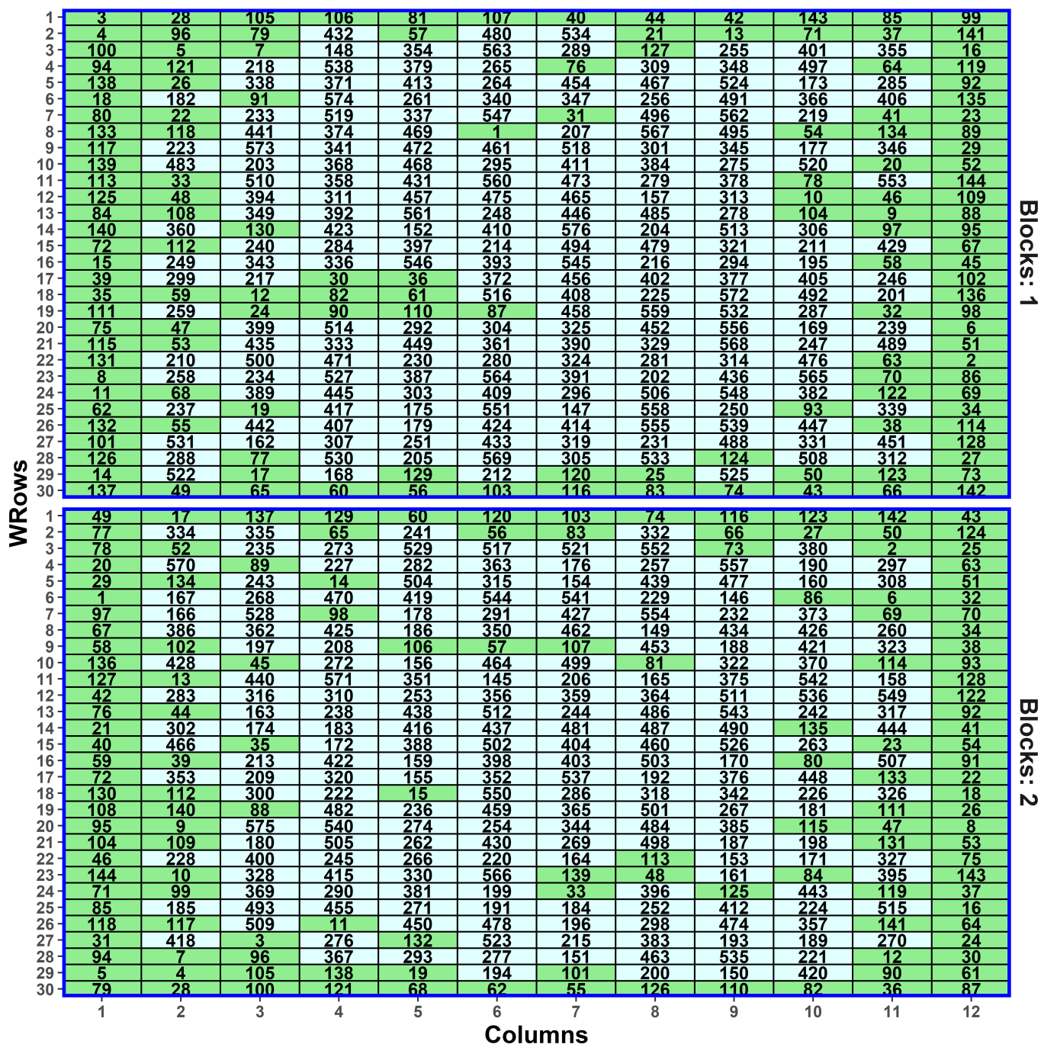
A field p-rep — generating the design
> prepuar1.latt.od <- od(fixed = ~ Blocks,
+ random = ~ Lines + Rows + Columns/Blocks + units,
+ residual = ~ ar1(Rows):ar1(Columns),
+ permute = ~ Lines, swap = ~ Blocks,
+ G.param = vp.table, R.param = vp.table,
+ maxit = maxit, search = search,
+ data =l att.lay)
Fri Sep 6 16:52:46 2019
Initial A-value = 1.026048 (576 A-equations; rank C 576)
A-value after tabu loop 1 is 1.016726
A-value after tabu loop 2 is 1.016552
…
A-value after tabu loop 49 is 1.016174
A-value after tabu loop 50 is 1.016174
Hash table size 2477
Final A-value after 50 iterations: 1.016174
> prepuar1.latt.lay <- prepuar1.latt.od$design
Supplying values of the variances parameters.
Note that all the border plots are duplicated Lines; the same does not occur when an RCBD is used as the starting design (in Prac).

Slide 36
Canonical analysis of the design: investigating its anatomy
Want to look at the relationships of the lines sources to the plots sources.
The plots sources:
  Blocks + Rows[Blocks] + Columns + Blocks#Columns +Rows#Columns[Blocks].
The lines source:
  Lines.
Using dae:
> prepuar1.latt.canon <- designAnatomy(formulae = list(plot = ~ (Blocks + Rows)*Columns,
+ trt = ~ Lines),
+ data = prepuar1.latt.lay)
> summary(prepuar1.latt.canon,
+ which.criteria = c("aeff", "meff", "eeff", "order", "dfor"))
  A is the harmonic mean of the efficiency factors.
  M is the mean of the efficiency factors.
  E is the minimum of the efficiency factors.
  dforth is the number of efficiency factors equal to one.
  Order is the number of unique efficiency factors.

Slide 37
A field p-rep — anatomy
Summary table of the decomposition for plot & trt (based on adjusted quantities)
Source.plot df1
Blocks 1
Rows[Blocks] 58
Columns 11
Blocks#Columns 11
Rows#Columns[Blocks] 638
The design is not orthogonal
Source.trt df2
Lines 1
Lines 58
Lines 11
Lines 11
Lines 575
Residual 63
aefficiency mefficiency eefficiency order dforthog
0.6000 0.6000 0.6000 1 0
0.7849 0.8000 0.4840 58 0
0.7713 0.7818 0.5731 11 0
0.8126 0.8182 0.6727 11 0
0.4135 0.8877 0.0061 82 494
A lot of information about some Lines contrasts in other than Rows#Columns[Blocks] (plots).
Not a unique decomposition, but Rows#Columns[Blocks] decomposition is.
Concentrate on the last Lines source, where all 575 Lines df are partially confounded.
All of the plots sources are orthogonal (no aliasing).
  A is the harmonic mean of the efficiency factors.
  M is the mean of the efficiency factors.
  E is the minimum of the efficiency factors.
  dforth is the number of efficiency factors equal to one.
  Order is the number of unique efficiency factors.

Slide 38
A field p-rep — anatomy
Summary table of the decomposition for plot & trt (based on adjusted quantities)
Source.plot df1 Source.trt df2 aefficiency mefficiency eefficiency order dforthog
Blocks 1 Lines 1 0.6000 0.6000 0.6000 1 0
Rows[Blocks] 58 Lines 58 0.7849 0.8000 0.4840 58 0
Columns 11 Lines 11 0.7713 0.7818 0.5731 11 0
Blocks#Columns 11 Lines 11 0.8126 0.8182 0.6727 11 0
Rows#Columns[Blocks] 638 Lines 575 0.4135 0.8877 0.0061 82 494
Residual 63
Lines efficiencies
≤0.1 | 0.1-0.2 | 0.2-0.3 | 0.3-0.4 | 0.4-0.5 | 0.5-0.6 | … | 1
23 | 21 | 17 | 12 | 7 | 1 |  | 494
  A is the harmonic mean of the efficiency factors.
  M is the mean of the efficiency factors (the sum is the Fisher information for the design and is a component of (M,S optimality).
  dforth is the number of efficiency factors equal to one.
A lot (86%) of orthogonal df in Plots.
But, a lot of efficiencies close to 0 in Plots, which is to be expected for for p-rep designs
— distorts A so M better?

Slide 39
The effect on the anatomy of assuming that Blocks#Columns is zero
Summary table of the decomposition for plot & trt (based on adjusted quantities)
Source.plot df1 Source.trt df2 aefficiency mefficiency eefficiency order dforthog
Blocks 1 Lines 1 0.6000 0.6000 0.6000 1 0
Rows[Blocks] 58 Lines 58 0.7849 0.8000 0.4953 58 0
Columns 11 Lines 11 0.7729 0.7818 0.6024 11 0
Blocks#Rows#Columns 649 Lines 575 0.5168 0.9033 0.0119 71 505
Residual 74
The design is not orthogonal
More lines information in Blocks#Rows#Columns and more Residual df.
Still some information about Lines almost orthogonal to Blocks#Rows#Columns.
AVPD = 1.014φ_{BRC}. (minor change – was 1.016φ_{BRC}.)

Slide 40
Calculating the A-measure (AVPD) using designAmeasures and mat.Vpredicts from dae
The model arguments of the od call
> prepuar1.latt.od<- od(fixed = ~ Blocks,
+ random = ~ Lines + Rows + Columns/Blocks + units,
+ residual = ~ ar1(Rows):ar1(Columns),
+ permute = ~ Lines, …)
Corresponding designAmeasures call
> prepuar1.latt.lay$unit <- factor(1:nrow(prepuar1.latt.lay)) #factor for ASReml units
> (designAmeasures(mat.Vpredicts(target = ~ Lines -1,
+ Gt = 1,
+ fixed = ~ Blocks,
+ random = ~ Rows + Columns/Blocks + unit - 1,
+ G = as.list(params[c("g.BR", "g.C", "g.BC", "g.u")]),
+ R = kronecker(mat.ar1(params["rho.R"], r),
+ mat.ar1(params["rho.C"], c)),
+ design = prepuar1.latt.lay)))[[1]]
[1] 1.016151
To calculate without Columns:Blocks, drop “/Blocks” and “g.BC”.
What happens if ar1 and nugget variance are dropped from od call?
Matches permute.
As in od call, minus Lines.
As in vp.table.
As for residual.

Slide 41
Comparing spatial and nonspatial designs
Design | Nonspatial A | Spatial A | aefficiency | mefficiency | eefficiency | dforthog
Nonspatial | 0.988486 | 1.018665 | 0.5168 | 0.8877 | 0.0264 | 494
Spatial | 0.988857 | 1.016151 | 0.4180 | 0.8877 | 0.0080 | 494
Both designs are equally suitable for nonspatial data.
The difference between the designs for spatial data is very small.
  The only differences are in aefficiency and eefficiency.
  The nonspatial design is slightly better because the range of the efficiency factors is less.

Slide 42
Comparing canonical analysis and A-measures (AVPD)
Canonical analysis
  Shows the anatomy of the design: where the information is in the design and the nonorthogonality that is present.
  Do not need to specify the variance parameter values and not dependent on them.
  Does not account for spatial correlation and nonlinear trends.
  Limited relationship with AVPD
    When target is fixed, variance-components-only model and equally replicated, aefficiency is directly related to AVPD, otherwise it is not.
  Only useful for characterizing a design, rather than searching for an optimal design.
AVPD
  Is a measure of the precision in the experiment that gives equal weight to all contrasts, and is used by od, but is not the same as PEV.
  Need to specify the variance parameter values because depends on them.

Slide 43
2.2 Partially replicated designs in two phases
Smith et al. (2006) give examples of experiments that employ designs in which both phases employ partially replicated designs in both phases:
  They are dubbed p/q-rep designs.
  That is, p% of the lines are replicated in the first phase and q% of the plots with unreplicated lines are replicated in the second phase.
We will produce a design for a an experiment with p = 0.25 and q = 0.10.
  Previous example is a p-rep design for a field experiment, with p = 0.25.
  It will be extended to include a milling phase.

Slide 44
The first phase design— a p-rep field experiment
(Cullis, Smith & Coombes, 2006)
576 Lines on 60 rows × 12 columns.
Dashed line because Lines are allocated to the plots factors, but not using classic randomization.
576 Lines
2 Blocks
30 WRows in B
12 Columns

ρ
576 lines
720 plots
144 Lines are to be duplicated — p = 0.25.
A spatially optimized design was used to allocate lines to plots.
Suppose that samples of grain from the field experiment are to be taken to the laboratory for milling and analysis in the laboratory.
  After the field experiment 370 lines have been identified for processing in the milling phase.

Slide 45
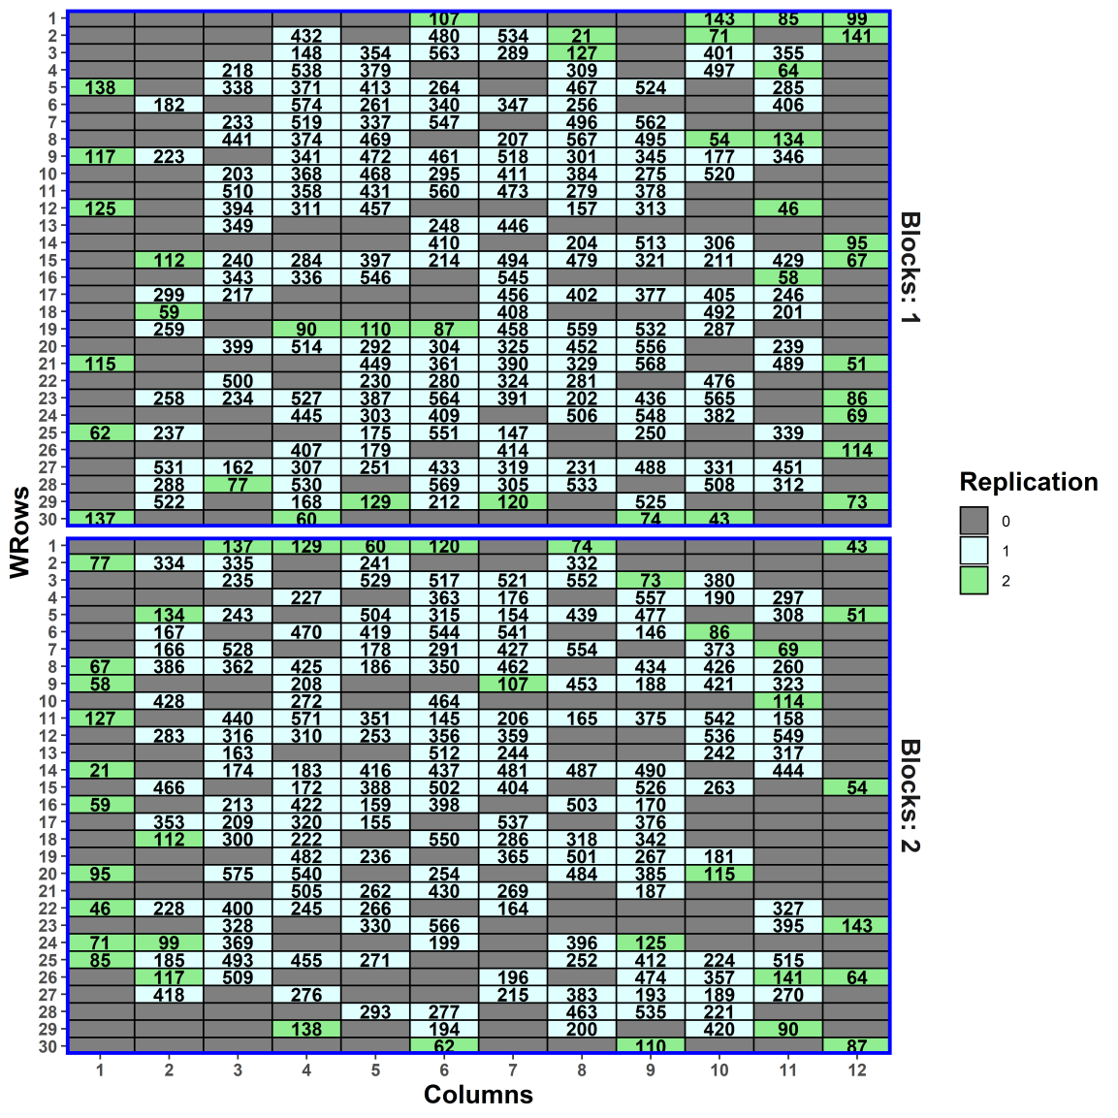
Sampling plots for the milling (second) phase
2 Blocks
30 WRows in B
12 Columns
(Smith, Lim & Cullis, 2006)
576 Lines


ρ
407 Plots
f
1,2 Samples in P
576 lines
720 plots
448 samples
Take 333 unduplicated and 37 duplicated lines on to milling phase
(= 370 lines on 407 plots).
Of the 333 unduplicated Lines, 41 are duplicated (2 samples required) in the milling phase — q = 0.10 (of plots).
What will happen here as compared to previous design?
  Answer: Blocks, Rows and Columns will no longer be orthogonal — unit terms are partially aliased (cf. confounding).
  Also, Lines confounding will change.
Notes:
Hopefully, you are still with me. But take a deep breath as we tackle the p/q-rep two-phase design.
q is the proportion of the 407 plots

Slide 46
First-phase anatomy for the fraction
(without Blocks#Columns)
  > summary(designAnatomy(formulae = list(plot = ~ ((Blocks/WRows)*Cols)/Samp,
  + trt = ~ Lines),
  + keep.order = TRUE, data = layout),
  + which.criteria = c("ae", "me", "ee", "dfor"))
Table of (partial) aliasing between sources derived from the same formula
Source df Alias In aefficiency mefficiency eefficiency dforthog
Cols 11 Blocks plot 0.9992 0.9992 0.9908 10
Cols 11 WRows[Blocks] plot 0.9230 0.9249 0.8374 0
Blocks#Cols 22 WRows[Blocks] plot 0.9210 0.9240 0.8151 0
The terms are fitted in the order Blocks, WRows[Blocks] and Columns (see next slide).
Eleven df for Columns is aliased with Blocks and WRows[Blocks] but 92.3% of the information is retained.
The analysis will depend on whether Columns is fitted first or not, but not greatly given the high aefficiency.

Slide 47
First-phase anatomy for the fraction
Source.plot df1 Source.trt df2 aefficiency mefficiency eefficiency dforthog
Blocks 1 Lines 1 0.8348 0.8348 0.8348 0
WRows[Blocks] 58 Lines 58 0.7742 0.9013 0.0950 26
Cols 11 Lines 11 0.8347 0.8760 0.5187 0
Blocks#Cols 11 Lines 11 0.8231 0.8695 0.4784 0
WRows#Cols[Blocks] 325 Lines 325 0.4602 0.9129 0.0177 288
Samp[Blocks:WRows:Cols] 41
Not unique, but the WRows#Cols[Blocks] strata is.
Of the 369 Lines df, 325 are estimable in WRows#Cols[Blocks], including 288 (78%) only there.
There are 44 Lines df estimable elsewhere, with 26 of these orthogonally confounded with WRows[Blocks].
  Thus for Lines fixed, the design is disconnected for all plot terms fixed except the last two.
  Would be connected if all plots terms (except Blocks) random (needed for od).
The mefficiency for the 369 Lines df in WRows#Cols[Blocks] is 0.8040 (= 0.9129 x 325 / 369).
Samp[Blocks:WRows:Cols] (Error) has full 41 df.

Slide 48
Milling-phase allocation for the p/q-rep design
There are 448 (407 + 41) samples and so 448 time-locations for milling required:
  Take 16 days divide them into 2 intervals.
  Each day there are 28 time-locations for milling.
Samples are assigned to locations using two pseudofactors, S₁ and P₁:
  The 448 samples are assigned to the 2 levels of S₁ so that milling duplicates have different levels and, as far as is possible, so do plots from different blocks;
  The 224 plots in each level of S₁ are assigned to the 224 levels of the pseudofactor P₁ in Rows-Columns order:
    The 224 plots are comprised of those (i) for the 41 lines that are milling-duplicated, (ii) from the same block for the 37 lines that are field duplicated, and (iii) for 183 lines that are from the same block as (ii) or rows nearby.
  S₁ is randomized to Intervals and P₁ is systematically allocated to the Days-Locations combinations, the design being nonorthogonal
576 Lines
12 Columns
30 WRows in B
2 Blocks

8 Days in I
28 Locations
2 Intervals


224 P₁
ρ
407 Plots
f
1,2 Samples in P
2 S₁
576 lines
720 plots
448 samples
448 locations

Slide 49
Check properties of the multiphase design
> layout <- ph2sys.lay
> names(layout)[match(c("Intervals", "Locations", "Columns","Samples"), names(layout))] <-
+ c("Int", "Locn", "Cols","Samp")
> designTwophaseAnatomies(formulae = list(lab = ~ (Int/Days)*Locn,
+ plot = ~ ((Blocks/WRows)*Cols)/Samp,
+ trt = ~ Lines),
+ which.criteria = c("ae", "me", "ee", "dfor"),
+ keep.order = TRUE, data = layout)
Note three formulae supplied.
Have used designTwophaseAnatomies and this will produce the four species of designs for a two-phase design:
  The first-phase design for the fraction is not used for the analysis of first-phase responses (e.g. grain yield).

Slide 50
Anatomy of the second-phase design
Summary table of the decomposition for lab & plot (based on adjusted quantities)
Source.lab df1 Source.plot df2 aefficiency mefficiency eefficiency dforthog
Int 1 Blocks 1 0.6386 0.6386 0.6386 0
Days[Int] 14 Blocks 1 0.2827 0.2827 0.2827 0
WRows[Blocks] 13 0.6963 0.7831 0.2458 0
Locn 27 Blocks 1 0.0061 0.0061 0.0061 0
WRows[Blocks] 26 0.0130 0.0974 0.0023 0
Int#Locn 27 Blocks 1 0.0037 0.0037 0.0037 0
WRows[Blocks] 26 0.0140 0.0903 0.0027 0
Days#Locn[Int] 378 Blocks 1 0.0689 0.0689 0.0689 0
WRows[Blocks] 58 0.2760 0.7074 0.0234 0
Cols 11 0.8298 0.8336 0.7439 0
Blocks#Cols 11 0.8251 0.8304 0.7058 0
WRows#Cols[Blocks] 297 0.4358 0.8991 0.0142 256
A lot of Blocks confounded here.
Blocks#Cols mainly confounded here.
Much of WRows[Blocks] and Cols confounded here.
The estimable df for Wrows#Cols[Blocks] has gone from 638 (first-phase) to 325 (fraction) to 297.

Slide 51
Anatomy of the two-phase design
Source.lab df1 Source.plot df2 Source.trt df3 aefficiency mefficiency eefficiency dforthog
Int 1 Blocks 1 Lines 1 0.6696 0.6696 0.6696 0
Days[Int] 14 Blocks 1 Lines 1 0.6679 0.6679 0.6679 0
WRows[Blocks] 13 Lines 13 0.8261 0.8449 0.5362 0
Locn 27 Blocks 1 Lines 1 0.8062 0.8062 0.8062 0
WRows[Blocks] 26 Lines 26 0.8135 0.8248 0.6160 0
Int#Locn 27 Blocks 1 Lines 1 0.8050 0.8050 0.8050 0
WRows[Blocks] 26 Lines 26 0.8187 0.8279 0.6432 0
Days#Locn[Int] 378 Blocks 1 Lines 1 0.4723 0.4723 0.4723 0
WRows[Blocks] 58 Lines 58 0.7908 0.8443 0.3224 0
Cols 11 Lines 11 0.8309 0.8597 0.5507 0
Blocks#Cols 11 Lines 11 0.8304 0.8587 0.5412 0
WRows#Cols[Blocks] 297 Lines 297 0.2940 0.8207 0.0101 219
Just 297 of the total 369 df for Lines is estimable from Wrows#Cols[Blocks].
In all 66.1 % (0.8207 * 297 / 369) of the Lines information is estimable here.
A lot of Lines information is confounded with the variation from other field and milling phase sources of variation.

Slide 52
Substituting a linear Locations term
> #'## Look at the effect of substituting a linear Columns term for the Column variation term
> ph2sys.lin.canon <- designAnatomy(formulae = list(lab = ~ Int:Days + xLocn +
+ Int:Days:Locn,
+ plot = ~ (Rows*Cols)/Samp,
+ trt = ~ Lines),
+ keep.order = TRUE, data = layout)
> print(summary(ph2sys.lin.canon, which.criteria = c("ae", "me", "ee", "dfor")))
Summary table of the decomposition for lab, plot & trt (based on adjusted quantities)
Source.lab df1 Source.plot df2 Source.trt df3 aefficiency mefficiency eefficiency dforthg
Int:Days 15 Rows 15 Lines 15 0.7852 0.8214 0.4469 0
xLocn 1 Rows 1 Lines 1 0.8095 0.8095 0.8095 0
(Int:Days)#Locn 431 Rows 59 Lines 59 0.7021 0.8452 0.0802 13
Cols 11 Lines 11 0.8257 0.8659 0.5129 0
Rows#Cols 333 Lines 333 0.3245 0.8903 0.0066 283
Samp[Rows:Cols] 28 1.0000 1.0000 1.0000 28
Linear term for Locations.
Pool to simplify the analysis.
Just 333 of the total 638 df for Rows#Cols and of the total 369 df for Lines is estimable here.
Now 80.3% (0.8903 * 333 / 369) of the Lines information is estimable here (cf. 66.1% & 0.8207 with R#C included).
Also 28 of the 41 df for Samples[Rows:Cols] (Error df) is available.

Slide 53
Summary
Here, dividing the factors based on allocation of factors results in three sets of factors: only ever allocated; allocated and recipient; and only ever recipient.
For a two-phase experiment there are four species of design: first-phase; second-phase; cross-phase; two-phase.
The same methods of design selection apply, but need to consider three designs and how they combine.
Again, designRandomize can be used to randomize the experiment and designAnatomy can be used to check the properties of the design, irrespective of the nonorthogonality and the number of tiers e.g. p/q-rep designs.
  can be slow when the number of observations is large (several hundreds).

Slide 54
References
Brien, C. J. (2017). Multiphase experiments in practice: A look back. Australian & New Zealand Journal of Statistics, 59, 327-352.
Brien, C. J. (2019). Multiphase experiments with at least one later laboratory phase. II. Nonorthogonal designs. Australian & New Zealand Journal of Statistics, 61, 234-268.
Brien, C. J., & Bailey, R. A. (2006). Multiple randomizations (with discussion). Journal of the Royal Statistical Society, Series B (Statistical Methodology), 68, 571-609.
Brien, C. J., Harch, B. D., Correll, R. L., & Bailey, R. A. (2011). Multiphase experiments with at least one later laboratory phase. I. Orthogonal designs. Journal of Agricultural, Biological, and Environmental Statistics, 16, 422-450.
Cochran, W. G., & Cox, G. M. (1957). Experimental Designs (2nd ed.). New York: Wiley.
Cullis, B. R., Smith, A. B. & Coombes, N. E. (2006) On the design of early generation variety trials with correlated data. Journal of Agricultural, Biological and Environmental Statistics, 11, 381-393.
Federer, W. T. (1956). Augmented (or hoonuiaku) designs. Hawaiian Planters' Record, 55, 191-208.
Hinkelmann, K., & Kempthorne, O. (2005). Design and analysis of experiments Vol. 2 Advanced experimental design. Hoboken, N.J.: Wiley-Interscience.

