Slide 1


Designing comparative experiments using R III. Miscellaneous topics in experimental design
Chris Brien UniSA STEM, University of South Australia
Australian Plant Phenomics Facility, University of Adelaide.
(Software and materials at http://chris.brien.name/wshop2023/)

Slide 2
Topic 3 outline
Systematic allocation and pseudoreplication.
Block-treatment interaction.
Designing animal grazing experiments.
Summary of confounding and aliasing.
Design for nested-factorial experiments.

Slide 3
Recall the factor-allocation paradigm for designing experiments
(Brien & Demétrio, 2009; Brien, 2017;
Brien, Sermarini & Demétrio, 2023?)
Anticipated model determined in consultation with the researcher.
Anticipated
model
Shows the confounding and aliasing inherent in the design.
Anatomy of
a design
Factor-allocation diagram
Design selection &
construction
Initial
allocation model
Homogeneous allocation
model
Prior
allocation model
Select a design that is optimal for the anticipated model.
Depicts the allocation.
Model derived from the allocation.
Modified versions of the initial allocation model.

Slide 4
1. Systematic allocation and pseudoreplication
It happens that randomization is not always desirable or possible.
A grapevine experiment is to be run in two greenhouses:
One greenhouse is to be kept at ambient temperature and the other is to be cooled;
Of the two greenhouses, one is naturally warmer than the other and so needs to be the warm greenhouse.
So randomization is not desirable.
Within each greenhouse, two salinity treatments (control and saline) are to be applied to 12 varieties.
The combinations of Heat, Salinity and Varieties are to be replicated 6 times.

Slide 5
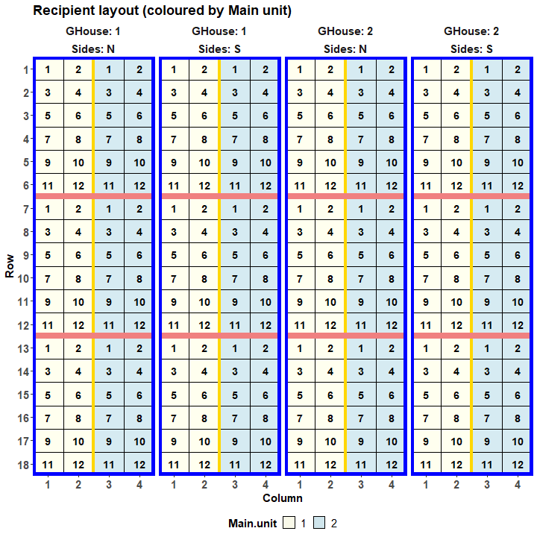
Grapevine design
(Numbers are pots.)
A split-split-unit design is to be used:
Heats are to be allocated to main units (Greenhouses)
Within each greenhouse:
2 Sides (blue rectangles), with 6 subunits per Side (pink and yellow lines separates subunits).
Salinities allocated to subunits;
Varieties to 12 pots (sub-subunits) in each subunit.
Split-split-unit design because:
Large differences between Salinities;
Variety differences are the most important.

Slide 6
Grapevine design
Anticipated model:
Heat * Salinity * Varieties | Ghouses + Ghouses:Sides + Ghouses:Sides:BRows + Ghouses:Sides:BCols + Ghouses:Sides:BRows:BCols + Ghouses:Sides:BRows:BCols:Pots.
Main units
Subunits
Subsubunits
2 Heats
2 Salinities
12 Varieties
2 Greenhouses
2 Sides in G
3 BRows in G, S
2 BCols in G, S
12 Pots in G, S, Br, Bc

To balance Salinity, a 3  2 extended Latin square design, based on 2  2 Latin squares is to be used in each Side.
48 treatments
288 pots

Slide 7
Generating the systematic design in R
2 Heats
2 Salinities
12 Varieties
2 Greenhouses
2 Sides in G
3 BRows in G, S
2 BCols in G, S
12 Pots in G, S, BR, BC

Generate Heat and Varieties in standard order; the 12 works as if a factor with 12 levels occurs in this position.
48 treatments
288 pots
Generate the recipient factors indexing the pots.
> split.sys <- cbind(fac.gen(list(GHouse = 2, Sides = c("N", "S"),
+ BRows = 3, BCols = 2, Pots = 12)),
+ fac.gen(list(Heat = c("Warm", "Cool"), 12, Varieties = 12)),
+ Salinity = factor(rep(c(designLatinSqrSys(2),1,2,
+ designLatinSqrSys(2, start = c(2,1)),2,1),
+ each = 12, times = 2),
+ labels = c("Control", "Na")))
Extra rows.
Salinity has to be assigned using Extended Latin Squares (ELS).
Pair of ELS designs repeated twice, one for each GHouse.
Two Latin squares with different starting rows.

Slide 8
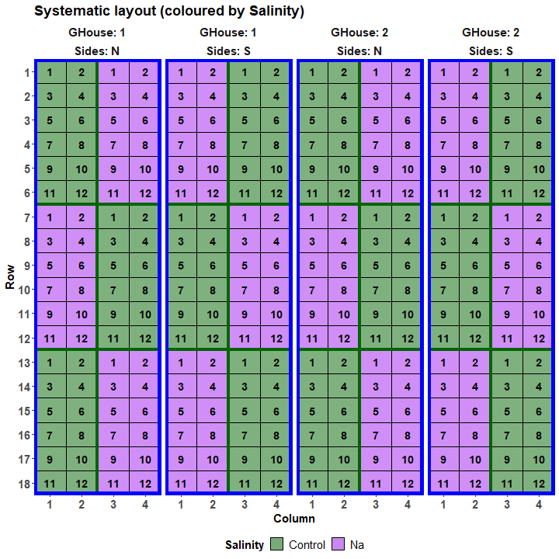
Systematic grapevine design
Numbers are Varieties.
Colours are Salinities.

Slide 9
Randomizing the grapevine design
2 Heats
2 Salinities
12 Varieties
2 Greenhouses
2 Sides in G
3 BRows in G, S
2 BCols in G, S
12 Pots in G, S, BR, BC
Use designRandomize from dae to randomize the systematic layout.
The randomization is determined by the nesting relationships between the recipient factors.

48 treatments
288 pots
> split.lay <- designRandomize(allocated = split.sys[c("Heat", "Salinity", "Varieties")],
+ recipient = split.sys[c("GHouse", "Sides",
+ "BRows", "BCols", "Pots")],
+ nested.recipients = list(Sides = "GHouse",
+ BRows = c("Sides", "GHouse"),
+ BCols = c("Sides", "GHouse"),
+ Pots = c("Sides", "GHouse",
+ "BRows", "BCols")),
+ except = "GHouse",
+ seed = 64131)
The except option allows the generation of a design, in which Heat is systematically allocated, while Salinity and Lines are randomized.
The nested.recipients specifies the nesting shown in the pots panel; factors not nested are assumed to be crossed.

Slide 10
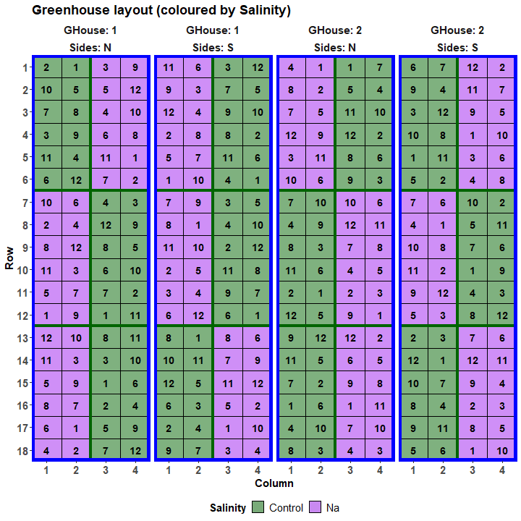
Grapevine design
Warm has been systematically assigned to the first Greenhouse.
Within a Side there are 2 columns (BCols) of main units:
One has 2 subunits with Control and the other 2 with Na.
A complete set of the 12 Varieties is randomized within each subunit.

Slide 11
Properties of the grapevine design
Matches the nested.recipients
> split.canon <- designAnatomy(formulae = list(tests = ~ GHouse/Sides/(BRows*BCols)/Pots,
+ cond = ~ Heat*Salinity*Varieties),
+ data = split.lay)
> summary(split.canon, which.criteria=c("aeff", "order"))
Summary table of the decomposition for tests & cond (based on adjusted quantities)
Source.tests df1 Source.cond df2 aefficiency order
GHouse 1 Heat 1 1.0000 1
Sides[GHouse] 2
BRows[GHouse:Sides] 8
BCols[GHouse:Sides] 4 Salinity 1 0.1111 1
Heat#Salinity 1 0.1111 1
Residual 2
BRows#BCols[GHouse:Sides] 8 Salinity 1 0.8889 1
Heat#Salinity 1 0.8889 1
Residual 6
Pots[GHouse:Sides:BRows:BCols] 264 Varieties 11 1.0000 1
Heat#Varieties 11 1.0000 1
Salinity#Varieties 11 1.0000 1
Heat#Salinity#Varieties 11 1.0000 1
Residual 220
The design is not orthogonal
Heat is inextricably confounded with GHouse, an effect of the pseudoreplication.
Salinity (& Heat#Salinity) are not orthogonal, but most information is confounded with Brows#Bcols[GH:S]. (Design property)
All Varieties effects are orthogonal.
But all orders are one and so it is balanced.

Slide 12
Prior allocation model for the grapevine design
The confounding of Heat and GHouse, is exhaustive in that all GHouse information is mixed up with Heat differences (there is no GHouse Residual).
Summary table of the decomposition for tests & cond (based on adjusted quantities)
Source.tests df1 Source.cond df2 aefficiency order
GHouse 1 Heat 1 1.0000 1
Sides[Ghouse] 2
BRows[GHouse:Sides] 8
BCols[GHouse:Sides] 4 Salinity 1 0.1111 1
Heat#Salinity 1 0.1111 1
Residual 2
BRows#BCols[GHouse:Sides] 8 Salinity 1 0.8889 1
Heat#Salinity 1 0.8889 1
Residual 6
Pots[GHouse:Sides:BRows:BCols] 264 Varieties 11 1.0000 1
Heat#Varieties 11 1.0000 1
Salinity#Varieties 11 1.0000 1
Heat#Salinity#Varieties 11 1.0000 1
Residual 220
The design is not orthogonal
That is Heat and GHouse are inextricably mixed up together so that one cannot say which part of any difference associated with either factor is due one or other of the factors.
As a result, the initial allocation model will not fit.
To have a prior allocation model that will fit, one of GHouse and Heat must be removed.

Slide 13
Prior allocation model for the grapevine design
GHouse is the obvious choice so that Heat and its interactions are retained.
Heat * Salinity * Varieties | Ghouses + Ghouses:Sides + Ghouses:Sides:BRows + Ghouses:Sides:BCols + Ghouses:Sides:Brows:BCols + Ghouses:Sides:Brows:Bcols:Pots.
This model is a ”model of convenience”: it gives a fit. However, it does not contain all the pertinent sources of variation in the experiment.
Summary table of the decomposition for tests & cond (based on adjusted quantities)
Source.tests df1 Source.cond df2 aefficiency order
GHouse:Sides 3 Heat 1 1.0000 1
Residual 2
BRows[GHouse:Sides] 8
BCols[GHouse:Sides] 4 Salinity 1 0.1111 1
Heat#Salinity 1 0.1111 1
Residual 2
BRows#BCols[GHouse:Sides] 8 Salinity 1 0.8889 1
Heat#Salinity 1 0.8889 1
Residual 6
Pots[GHouse:Sides:BRows:BCols] 264 Varieties 11 1.0000 1
Heat#Varieties 11 1.0000 1
Salinity#Varieties 11 1.0000 1
Heat#Salinity#Varieties 11 1.0000 1
Residual 220
The design is not orthogonal
This revised anatomy shows that Sides variability will be used for judging overall Heat differences; this is very likely to be an underestimate of the variability affecting Heat differences.

Slide 14
2. Block-treatment interaction
So far analyses have been presented that assume no block-treatment interaction.
For example, an RCBD for 5 Blocks, each of 5 plots for 5 Treatments:
Summary table of the decomposition for plots & trts
Source.plots df1 Source.trts df2 aefficiency eefficiency order
Blocks 4
Plots[Blocks] 20 Treatments 4 1.0000 1.0000 1
Residual 16
No source for Blocks#Treatments occurs in the table.
One might ask “Is Blocks#Treatments not the same as the Residual source?”
Numerically it is the same: Blocks#Treatments has 16 df and it is the same subspace.
However, the Residual represents the remainder of the Plots[Blocks] source after Treatments has been removed; hence, it represents variability between plots within blocks.
This is a different source of variability to Blocks#Treatments that derives from the differential response to treatments in different blocks.

Slide 15
Adding block-treatment interactions to the anatomy
The homogeneous allocation model with block-treatment interaction is: Treatments | Blocks + Blocks:Plots + Blocks:Treatments.
To get the anatomy, add *Blocks to the formula for trts:
> RCBD.canon <- designAnatomy(formulae = list(plots = ~ Blocks/Plots,
+ lines = ~ Treatments*Blocks),
+ data = RCBD.lay)
> summary(RCBD.canon)

Slide 16
The anatomy with block-treatment interaction
Summary table of the decomposition for plots & trts
Source.plots df1 Source.trts df2 aefficiency eefficiency order
Blocks 4 Blocks 4 1.0000 1.0000 1
Plots[Blocks] 20 Treatments 4 1.0000 1.0000 1
Treatments#Blocks 16 1.0000 1.0000 1
Note the exhaustive confounding of Plots[Blocks] by Treatments and Treatments#Blocks (there is no Plots[Blocks] Residual).
This table includes sources for plot variability and the interaction:
It shows that they are inseparable.
Thus, the homogeneous allocation model is singular.
To obtain a nonsingular, prior allocation model, one of Blocks:Plots and Treatments:Blocks must be removed from the model.
Assuming no plot variability is unreasonable.
So, remove Treatments:Blocks and acknowledge that any interaction will contribute to Blocks:Plots.

Slide 17
How to allow for block-treatment interaction?
Solution: add replicates within blocks.
Addelman (1969) describes the Generalized Randomized Block Design (GRBD) for when block-treatment interactions are likely.
Suppose that the RCBD has 10, rather than 5, plots per block.
The anatomy can be obtained using the same designAnatomy call as for the RCBD.
Summary table of the decomposition for plots & trts
Source.plots df1 Source.trts df2 aefficiency eefficiency order
Blocks 4 Blocks 4 1.0000 1.0000 1
Plots[Blocks] 45 Treatments 4 1.0000 1.0000 1
Treatments#Blocks 16 1.0000 1.0000 1
Residual 25
Now Plots[Blocks] can be separated from Treatments#Blocks.
Because the factor-allocation approach exhibits the confounding, the relationship between these two sources of variation can be seen.

Slide 18
3. Designing animal grazing experiments
Suppose that a grazing experiment is to be run to test the effects of 3 different pasture regimens on the growth of weaner cattle.
A GRBD with 4 blocks, each of 6 plots, is to be used.
Each plot is to have one of 24 weaners assigned to it.
Firstly, this experiment is a single-phase experiment with multiple randomizations (Brien & Demétrio, 1998; Brien & Bailey, 2006, e.g. 3).
It involves the randomizations of i) treatments to plots and ii) plots to animals.
Secondly, it is common in such experiments to divide the animals into weight classes and assign the classes to blocks (e.g. Kaps and Lamberson, 2004):
Rank the animals by initial weight and divide them into the required number of classes. That is, the lightest animals go to the first class and the heaviest to the last class.
Roberts (1975) argues that this can be improved upon.

Slide 19
The factor-allocation approach to an animal experiment in which Blocks are assigned to Classes
For the proposed experiment, the anticipated model is:
Regimens | Blocks + Blocks:Plots + Classes + Classes:Weaners.
The factor-allocation diagram involves three tiers (panels):
4 Blocks
6 Plots in B
4 Classes
6 Weaners in C
3 Regimens
3 treatments
24 plots
24 animals
To obtain the anatomy, supply a formula for each tier.
GRBD.C2B.canon <- designAnatomy(formula = list(anim = ~ Classes/Weaners,
plot = ~ Blocks/Plots,
trt = ~ Regimens),
data = GRBD.B2C.lay)
summary(GRBD.C2B.canon, which.criteria = c("aeff", "order"))

Slide 20
The anatomy
Summary table of the decomposition for anim, plot & trt
Source.anim df1 Source.plot df2 Source.trt df3 aefficiency order
Classes 3 Blocks 3 1.0000 1
Weaners[Classes] 20 Plots[Blocks] 20 Regimens 2 1.0000 1
Residual 18 1.0000 1
The anatomy shows:
Blocks is inextricably confounded with Classes.
Plots[Blocks] is inextricably confounded with Weaners[Classes].
Regimens is confounded with Plots[Blocks] and Weaners[Classes].
In such experiments, it may well be that an interaction between Regimens and Classes is possible, as well as Blocks and Regimens.
Such interactions are also called intertier (between panels) interactions – a more general term for block-treatment interactions.
Notes:
What are the blocks here? Ans. Blocks & Classes

Slide 21
The revised anatomy that includes intertier interactions
Changed trt formula to trt = ~ Regimens*(Classes+Blocks))
Summary table of the decomposition for anim, plot & trt (based on adjusted quantities)
Source.anim df1 Source.plot df2 Source.trt df3 aefficiency order
Classes 3 Blocks 3 Classes 3 1.0000 1
Weaners[Classes] 20 Plots[Blocks] 20 Regimens 2 1.0000 1
Regimens#Classes 6 1.0000 1
Residual 12 1.0000 1
Table of information (partially) aliased with previous sources derived from the same formula
Source df Alias In aefficiency order
Blocks 3 Classes trt 1.0000 1
Blocks 0 ## Aliased trt 1.0000 1
Regimens#Blocks 6 Regimens#Classes trt 1.0000 1
Regimens#Blocks 0 ## Aliased trt 1.0000 1
Aliasing is between sources from the same formula
Can be estimated
Aliased sources omitted from the table.
Blocks from Source.trt is aliased with Classes from Source.trt.
Regimens#Blocks is aliased with Regimens#Classes.

Slide 22
Overcoming the inextricable confounding/aliasing
Roberts (1975) suggested that classes be assigned to animals within treatments.
How does this affect the experimental design?
For the situation under consideration, classes would have to be assigned to the two animals within each combination of Blocks and Regimes.
Consequently, only 2, rather than 4, classes is possible.
However, the basic model remains the same (just the numbers differ):
Regimens | Blocks + Blocks:Plots + Classes + Classes:Weaners.
The factor allocation diagram:
P₁ is a pseudofactor grouping the Plots within a Block that have the same Regimens level.
4 Blocks
6 Plots in B
12 Weaners in C
2 Classes
3 Regimens
3 P₁ in B
2 P₂ in B, P₁
3 treatments
24 plots
24 animals
P₂ is a pseudofactor randomly indexing the plots within a Blocks and Regimens combination .

Slide 23
Overcoming the inextricable confounding/aliasing
Roberts (1975) suggested that classes be assigned to animals within treatments.
How does this affect the experimental design?
For the situation under consideration, classes would have to be assigned to the two animals within each combination of Blocks and Regimes.
Consequently, only 2, rather than 4, classes is possible.
However, the basic model remains the same (just the numbers differ):
Regimens | Blocks + Blocks:Plots + Classes + Classes:Weaners.
The factor allocation diagram:
P₁ is a pseudofactor grouping the plots with the same combination Blocks and Regimens.
3 Regimens
6 Plots in B
4 Blocks
2 P₁ in P₁
2 Classes
12 Weaners in C
12 P₁
3 treatments
24 plots
24 animals
P₂ is a pseudofactor randomly indexing the plots within a Blocks and Regimens combination .

Slide 24
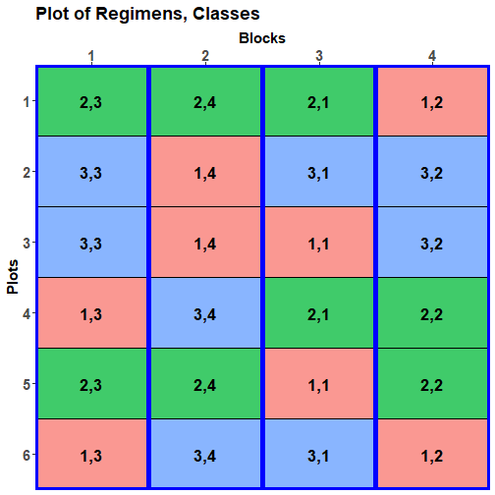

Comparing designs: Classes to Blocks vs to Plots

Slide 25
The anatomy that includes intertier interactions
GRBD.A2P.canon <- designAnatomy(formula = list(
anim = ~ Classes/Weaners,
plot = ~ Blocks/Plots,
trt = ~ Regimens*(Classes+Blocks)),
data = GRBD.A2P.lay)
summary(GRBD.A2P.canon, which.criteria = c("aeff", "order"))
Summary table of the decomposition for anim, plot & trt
Source.anim df1 Source.plot df2 Source.trt df3 aefficiency order
Classes 1 Plots[Blocks] 1 Classes 1 1.0000 1
Weaners[Classes] 22 Blocks 3 Blocks 3 1.0000 1
Plots[Blocks] 19 Regimens 2 1.0000 1
Regimens#Classes 2 1.0000 1
Regimens#Blocks 6 1.0000 1
Residual 9 1.0000 1
There is no inextricable confounding.
Classes and Blocks will not affect Regimens variation.
All intertier interactions are estimable.
Nonsignificant interactions can be omitted.
Assuming no Classes:Blocks terms.

Slide 26
4. Summary of confounding and aliasing
In comparative experiments,
there is always some confounding; and
there may be some aliasing.
All allocation, be it systematic, haphazard, spatial or randomized, results in confounding:
designAnatomy does not distinguish between different types of allocation.
Properly replicated treatments can be systematically allocated.
The danger with systematic replication is that it will be confounded with any systematic trends associated with the factors to which it is allocated.
Pseudoreplication manifests as inextricable confounding.
Numeric covariates introduce partial aliasing (nonorthogonality between allocated terms).
Missing values introduce partial aliasing and confounding.

Slide 27
5. Design for nested-factorial experiments
Groups of similar treatments lead to nested factorials.
One common area is in breeding experiments where lines are naturally grouped (Welham et al., 2015, Sec. 8.4):
A number of crosses with several selections from each cross;
Plants from several countries with multiple provenances from each country (Casuarina experiment).
Several clones from a few mothers.
Several null lines each with a number of transgenic instances.
A second area is where there is a control treatment (Welham et al., 2015, Sec. 8.5) or there is natural set of nested comparisons amongst treatments:
A fundamental grouping is of control and treated.

Slide 28
Several treatments and a control
For example,
The control is a commercial line and the treatments are test lines;
Suppose:
the RCBD on a 5  5 grid has one commercial and 4 test lines;
The difference between the commercial and a test line is the prime comparison.
In this case, a factor comparing commercial and test lines could be included, say Types, and the prior allocation model modified to become:
Types / Lines | Rows + Rows:Columns, where Types has the two levels comm and test.

Slide 29
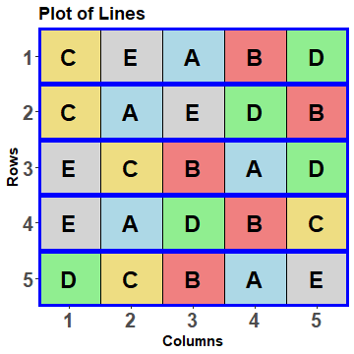
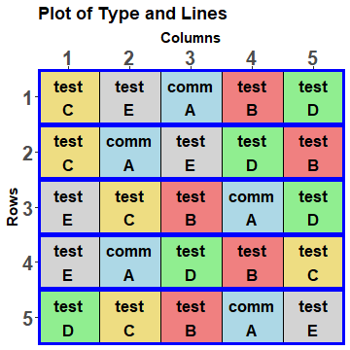
Add the factor Type to an RCBD layout
> RCBD.lay$Types <- fac.uselogical(RCBD.lay$Lines == "A",
+ labels = c("comm", "test"))
This designates level A as the comm(ercial) line and B‒E as the test lines.
So the factor Types divides the levels of Lines into two groups: one consists of A and the other of B‒E.
An implication of this is that Types will be marginal to Lines.

Slide 30
Check the properties of the alternative model
Type nests Lines.
> RCBD.type.canon <- designAnatomy(formulae = list(plots = ~ Rows/Columns,
+ lines = ~ Types / Lines),
+ data = RCBD.lay)
> summary(RCBD.type.canon)
Summary table of the decomposition for plots & lines
Source.plots df1 Source.lines df2 aefficiency eefficiency order
Rows 4
Columns[Rows] 20 Types 1 1.0000 1.0000 1
Lines[Types] 3 1.0000 1.0000 1
Residual 16
Types with 1 df represents the difference between the comm(ercial) mean and the tests mean (Lines B‒E).
Lines[Types] with 3 df represents the differences between Lines within each level of Types. Because there is only one Lines for comm, this represents the differences between the tests means (Lines B‒E).

Slide 31
The potential selected fixed model
The terms considered are Types / Lines = Types + Types:Lines.
If Types:Lines is significant, the selected model becomes Types:Lines = Lines.
There are differences amongst all of the Lines.
If Types:Lines is not significant, the selected model becomes Types.
There is a significant difference between the comm(ercial) lines mean and the mean of the test lines, there not being a significant difference between the test lines.
However, if Types is not significant, then the model can be further reduced to a model involving just the (Grand) Mean.
There is no significant difference between any of the Lines.
In summary, there are three potential fixed models, in order of increasing simplicity:
Lines
Types
Mean

Slide 32
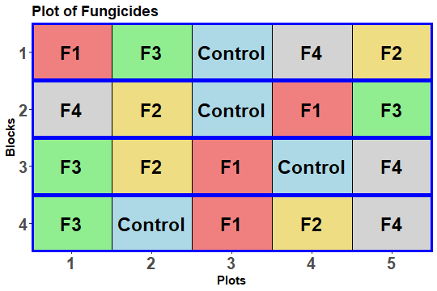
A randomized complete-block with double nesting
A potato field trial to investigate 5 Treatments, each replicated 4 times, is laid out using an RCBD.
The treatments are a Control and 4 Fungicides, labelled F1 to F4;
F1 and F4 use one mode of action, designated a;
F2 and F3 use a second mode of action, designated b.
Set up 4 factors to decompose the 4 df for fungicides into single df sources.
Types: Control vs Fungicide
Modes: a vs b
Modea: F1 vs F4
Modeb: F2 vs F3

Slide 33
Adding nested factors to randomized layout RCBD.lay
Use fac.uselogical to create Types and fac.recast to create Modes.
> RCBD.lay <- within(RCBD.lay,
+ {
+ Types <- fac.uselogical(Fungicides == "Control",
+ labels = c("Control", "Fungicide"))
+ Modes <- fac.recast(Fungicides,
+ newlevels = c("Control", c("a", "b", "b", "a")),
+ levels.order = c("Control", "a", "b"))
+ })

Slide 34
Adding nested factors to randomized layout RCBD.lay
Creates a factor for each level of Modes, using the Fungicides levels for that level of Modes.
Use fac.multinested to create Modea and Modeb.
> RCBD.lay <- with(RCBD.lay, cbind(RCBD.lay,
+ fac.multinested(nesting.fac = Modes,
+ nested.fac = Fungicides,
+ fac.prefix = "Mode")))
> head(RCBD.lay, n = 10) #first two blocks only
Blocks Plots Fungicides Types Modes ModeControl Modea Modeb
1 1 1 F1 Fungicide a rest F1 rest
2 1 2 F3 Fungicide b rest rest F3
3 1 3 Control Control Control Control rest rest
4 1 4 F4 Fungicide a rest F4 rest
5 1 5 F2 Fungicide b rest rest F2
6 2 1 F4 Fungicide a rest F4 rest
7 2 2 F2 Fungicide b rest rest F2
8 2 3 Control Control Control Control rest rest
9 2 4 F1 Fungicide a rest F1 rest
10 2 5 F3 Fungicide b rest rest F3
fac.multinested returns a data.frame.
ModeControl is the same as Types and so is redundant.
Wherever Fungicides has level F1 or F4, Modea has that level; for all other levels of Fungicides, Modea the level rest.
Modeb similarly.

Slide 35
The anatomy for the nested factors
> RCBD.canon <- designAnatomy(formulae = list(plots = ~ Blocks/Plots,
+ trts = ~ Types/Modes/(Modea + Modeb)),
+ data = RCBD.lay)
> summary(RCBD.canon, which.criteria = "aeff")
Summary table of the decomposition for plots & trts
Source.plots df1 Source.trts df2 aefficiency
Blocks 3
Plots[Blocks] 16 Types 1 1.0000
Modes[Types] 1 1.0000
Modea[Types:Modes] 1 1.0000
Modeb[Types:Modes] 1 1.0000
Residual 12
The 2 Mode factors nested within Modes and Modes nested within Types.
The decomposition of the 4 df for Fungicides into single df; they correspond to a set of orthogonal contrasts.

Slide 36
Breeding experiments with naturally grouped lines
Suppose that there are 6 crosses, each with 4 selections, and there are to be 5 replicated plants from each selection.
Two possible designs are:
An RCBD with the 24 selections randomized to each of the 5 blocks;
A split-plot design with the 6 crosses randomized to whole plots and the 4 selections randomized to the 4 subplots within each main plot.
For the split-plot:
You might use the split-plot design if the variability of main plots is greater than that of the subplots and the comparison within a cross are of prime importance;
Then the advantage is that comparisons between selections from the same cross are more precise than they would be for an RCBD;
The disadvantage is that comparisons of selections from different crosses are less precise than they would be for an RCBD.

Slide 37
Split-plot design for breeding experiment
Anticipated model:
Crosses / Selections | Blocks + Blocks:Mainplots + Blocks:Mainplots:Subplots.
allocated
recipient
5 Blocks
6 Mainplots in B
4 Subplots in B, M
6 Crosses
4 Selections
24 lines
120 plots
Generate the recipient factors indexing the plots.
Systematic design:
> split.sys <- cbind(fac.gen(list(Blocks = 5, Mainplots = 6, Subplots = 4)),
+ fac.gen(list(Crosses = 6), each = 4, times = 5),
+ fac.gen(list(Selections = LETTERS[1:24]), times = 5))
Need to generate Crosses and Selections separately.
Different levels for the Selections from different Crosses.

Slide 38
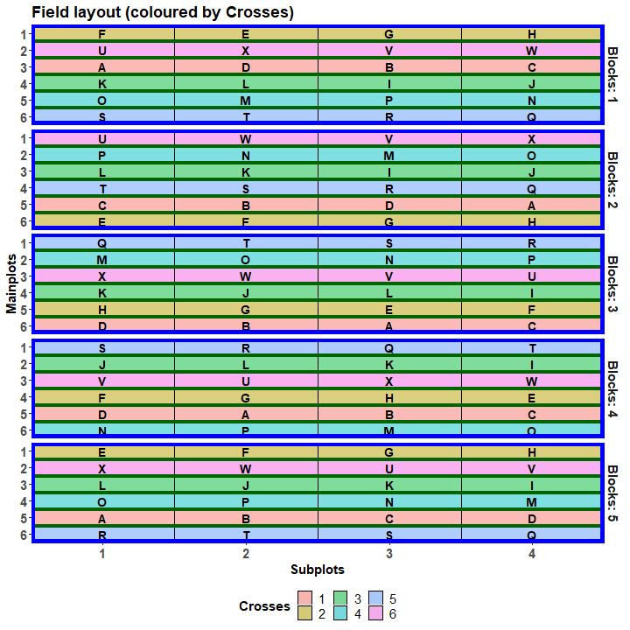
Use designRandomize to get a layout for the nested breeding experiment
Same randomization as for the standard split-unit design.
> split.lay <- designRandomize(allocated = split.sys[c("Crosses", "Selections")],
+ recipient = split.sys[c("Blocks", "Mainplots", "Subplots")],
+ nested.recipients = list(Mainplots = "Blocks",
+ Subplots = c("Blocks", "Mainplots")),
+ seed = 316666)
That there is no Subplots main effect in the anticipated model indicates that column differences are not expected.

Slide 39
Check the properties of the randomized design
> split.canon <- designAnatomy(formulae = list(plots = ~ Blocks/Mainplots/Subplots,
+ lines = ~ Crosses/Selections),
+ data = split.lay)
> summary(split.canon, which.criteria=c("aeff", "order"))
Summary table of the decomposition for plots & lines
Source.plots df1 Source.lines df2 aefficiency order
Blocks 4
Mainplots[Blocks] 25 Crosses 5 1.0000 1
Residual 20
Subplots[Blocks:Mainplots] 90 Selections[Crosses] 18 1.0000 1
Residual 72
Selections nested within Crosses.
Selections within Crosses confounded with Subplots[Blocks:Mainplots]; 18 df, being 3 df for each of 6 Crosses.

Slide 40
An alternative prior allocation model
The initial allocation model might be the same as the anticipated model.
However, this might be modified to yield a prior allocation model with a term for Selections differences for each of the Crosses:
Crosses / (Selections1 + Selections2 + Selections3 + Selections4 + Selections5 + Selections6) | Blocks + Blocks:Mainplots + Blocks:Mainplots:Subplots, where Selectionsi is a factor for the 4 Selections from Crosses i.
The dae function fac.multinested can create the 6 nested factors.

Slide 41
Generating separate factors for each Cross
A factor is created for each level of Crosses, using the levels of Selections for that level of Crosses.
> split.lay <- cbind(split.lay,
+ with(split.lay, fac.multinested(nesting.fac = Crosses,
+ nested.fac = Selections,
+ fac.prefix = "Select")))
> head(split.lay, n = 12)
Blocks Mainplots Subplots Crosses Selections Select1 Select2 Select3 Select4 Select5 Select6
1 1 1 1 2 F rest F rest rest rest rest
2 1 1 2 2 E rest E rest rest rest rest
3 1 1 3 2 G rest G rest rest rest rest
4 1 1 4 2 H rest H rest rest rest rest
5 1 2 1 6 U rest rest rest rest rest U
6 1 2 2 6 X rest rest rest rest rest X
7 1 2 3 6 V rest rest rest rest rest V
8 1 2 4 6 W rest rest rest rest rest W
9 1 3 1 1 A A rest rest rest rest rest
10 1 3 2 1 D D rest rest rest rest rest
11 1 3 3 1 B B rest rest rest rest rest
12 1 3 4 1 C C rest rest rest rest rest
Wherever level 2 of Crosses occurs Select2 has the levels E, F, G and H; for all other levels of Crosses, Select2 has the level rest.

Slide 42
Check the properties for the prior allocation model
> split.multi.canon <- designAnatomy(formulae = list(plots = ~ Blocks/Mainplots/Subplots,
+ lines = ~ Crosses/(Select1 + Select2 +
+ Select3 + Select4 +
+ Select5 + Select6)),
+ data = split.lay)
> summary(split.multi.canon, which.criteria=c("aeff", "order"))
Summary table of the decomposition for plots & lines
Source.plots df1 Source.lines df2 aefficiency order
Blocks 4
Mainplots[Blocks] 25 Crosses 5 1.0000 1
Residual 20
Subplots[Blocks:Mainplots] 90 Select1[Crosses] 3 1.0000 1
Select2[Crosses] 3 1.0000 1
Select3[Crosses] 3 1.0000 1
Select4[Crosses] 3 1.0000 1
Select5[Crosses] 3 1.0000 1
Select6[Crosses] 3 1.0000 1
Residual 72
The 6 Select factors nested within Crosses.
The 6 x 3 df Select[Crosses] sources.

Slide 43
Practical session for Miscellaneous experimental design topics in R
Using dae and od to obtain randomized layouts for orthogonal designs.
An animal feeding experiment.
Grazing experiments.
A detergent experiment.
A Sultana spraying experiment.
A Control treatment for an incomplete-block design.
The Casuarina experiment (continued).
Again, you have only to follow the script that has been given.
There are some questions for you to answer about each design.

Slide 44
References
Addelman, S. (1969). The Generalized Randomized Block Design. The American Statistician, 23(4), 35-36.
Brien, C. J. (2017). Multiphase experiments in practice: A look back. Australian & New Zealand Journal of Statistics, 59, 327-352.
Brien, C. J. & Bailey, R. A. (2006). Multiple randomizations (with discussion). Journal of the Royal Statistical Society, Series B (Statistical Methodology), 68(4), 571-609.
Brien, C. J., & Demetrio, C. G. B. (1998). Using the randomisation in specifying the ANOVA model and table for properly and improperly replicated grazing trials. Australian Journal of Experimental Agriculture, 38(4), 325-334.
Brien, C. J., & Demétrio, C. G. B. (2009). Formulating Mixed Models for Experiments, Including Longitudinal Experiments. Journal of Agricultural, Biological, and Environmental Statistics, 14, 253-280.
Brien, C. J., Sermarini, R. A., & Demetrio, C. G. B. (2023). Exposing the confounding in experimental designs to understand and evaluate them, and formulating linear mixed models for analyzing the data from a designed experiment. Biometrical Journal , https://doi.org/10.1002/bimj.202200284.
Kaps, M., & Lamberson, W. (2004). Biostatistics for animal science. Wallingford, UK: CABI Publishing.
Roberts, E. A. (1975). Accounting for components of error In V. J. Bofinger & J. L. Wheeler (Eds.), Developments in Field Experiment Design and Analysis (pp. 59-71). Slough: Commonwealth Agricultural Bureaux.
Welham, S. J., Gezan, S. A., Clark, S. J., & Mead, A. (2015). Statistical Methods in Biology: Design and Analysis of Experiments and Regression. Boca Raton: Chapman and Hall/CRC.

