Slide 1


Designing comparative experiments using R IV. Multiphase and partially replicated (p-rep) designs
Chris Brien UniSA STEM, University of South Australia
Australian Plant Phenomics Facility, University of Adelaide.
(Software and materials at http://chris.brien.name/wshop2023/)

Slide 2
Topic outline
Multiphase designs.
Partially replicated designs.
Summary.

Slide 3
1. Multiphase designs
Brien (2017) gives a review, including published applications.
Three introductory papers are Brien and Bailey (2006), Brien et al. (2011) and Brien (2019).
“Normal” two-phase experiments (Brien et al., 2011,Section 4) involve a single-randomization in each phase.
This implies that a design is required for each phase.
The object of the second phase is to evaluate material produced in the first phase and one or more response variables are measured in the second phase.
There may also be response variables from the first-phase.
The phase is the period of time during which a set of units are engaged in producing their outcome: material and/or response variables.
One phase might overlap another phase.

Slide 4
1.1 A simple two-phase athlete training experiment
Brien, Harch, Correll, Bailey (2011)
The experiment consists of a test phase and a laboratory phase:
Test phase: 36 tests involving 3 athletes in each of 4 months; heart rate is measured and a blood specimen taken.
The unit is a test taken by an athlete.
The outcomes are the heart rate, a response variable, and a blood sample, material for the second phase.
Laboratory phase: each month 3 blood samples are taken to the laboratory for analysis.
The unit is a blood specimen.
The outcome is the free haemoglobin in the blood specimen, a response variable.
Notes:
Split-unit = Split-plot

Slide 5
Testing Phase: an athlete training experiment
Peeling et al. (2009) ; Brien, Harch, Correll, Bailey (2011)
9 training conditions to be investigated:
combinations of 3 surfaces and 3 intensities of training.
Testing is to be conducted over 4 Months:
In each month, 3 endurance athletes are to be recruited;
Each athlete will undergo 3 tests, separated by 7 days, under 3 different training conditions.
On completion of each test, the athlete’s heart rate is measured and a blood sample is taken.
Anticipated model, determined with the researcher:
Intensities + Surfaces + Intensities:Surfaces | Months + Months:Athletes + Months:Athletes:Tests.
Consistent differences between Athletes across Months is unlikely because different athletes are involved each Month.
Consistent differences between Tests across Athletes are not anticipated.
Notes:
Split-unit = Split-plot

Slide 6
Factor-allocation diagram for the standard athlete training experiment
Given the experimental set-up and the anticipated model, the tiers are as given in the following panels with the nesting relationships shown:
allocated
recipient
4 Months
3 Athletes in M
3 Tests in M, A
3 Intensities
3 Surfaces
9 training conditions
36 tests
Assume the prime interest is in surface differences:
intensities are only included to observe the surfaces over a range of intensities.
Also expect variability of Months:Athletes to be greater than Months:Athletes:Tests
Months:Athletes is marginal to Months:Athletes:Tests.
Use a standard split-unit design.
Assign Surfaces to Tests so that Surfaces has greater precision .

Slide 7
Factor-allocation diagram for the standard athlete training experiment (cont’d)
4 Months
3 Athletes in M
3 Tests in M, A
3 Intensities
3 Surfaces
9 training conditions
36 tests
One allocation (randomization):
a set of training conditions is allocated to a set of tests using a single permutation of the tests.
The recipient tier is {Months, Athletes, Tests};
The allocated tier is {Intensities, Surfaces}.
The initial allocation model is the same as the anticipated model.
Because all allocation is by randomization the initial allocation model is equivalent to a randomization model.
Notes:
Randomization in this case
athletes and test are the EUs; restrictions are to Athletes in Months and Tests in M,A

Slide 8
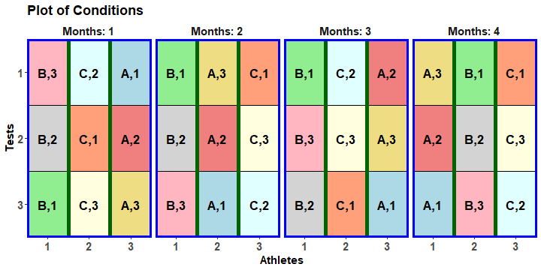
A randomized layout using designRandomize
> split.sys <- cbind(fac.gen(list(Months = 4, Athletes = 3, Tests = 3)),
+ fac.gen(list(Intensities = LETTERS[1:3], Surfaces = 3),
+ times = 4))
> split.lay <- designRandomize(allocated = split.sys[c("Intensities", "Surfaces")],
+ recipient = split.sys[c("Months", "Athletes", "Tests")],
+ nested.recipients = list(Athletes = "Months",
+ Tests = c("Months", "Athletes")),
+ seed = 2598)
split.lay
Notes:
The scripts for these examples are in dae/.tests

Slide 9
Using designAnatomy to summarize the confounding
> split.canon <- designAnatomy(formulae = list(test = ~ Months/Athletes/Tests,
+ cond = ~ Intensities*Surfaces),
+ data = split.lay)
> summary(split.canon, which.criteria="none")
Summary table of the decomposition for tests & cond
Source.test df1 Source.cond df2
Months 3
Athletes[Months] 8 Intensities 2
Residual 6
Tests[Months:Athletes] 24 Surfaces 2
Intensities#Surfaces 4
Residual 18
Intensities is confounded with Athletes[Months].
Surfaces and Intensities#Surfaces is confounded with Tests[Months:Athletes].

Slide 10
Prior allocation model
Summary table of the decomposition for test & cond
Source.test df1 Source.cond df2
Months 3
Athletes[Months] 8 Intensities 2
Residual 6
Tests[Months:Athletes] 24 Surfaces 2
Intensities#Surfaces 4
Residual 18
Probably the same as the initial allocation model, but with Months assumed fixed:
Months + Intensities + Surfaces + Intensities:Surfaces | Months:Athletes + Months:Athletes:Tests

Slide 11
Second laboratory phase
A restriction in the second phase:
The blood specimens from the first phase need to be processed as soon as possible (not held for 4 months).
Thus, the 9 specimens collected each month are to be processed together.
Suppose that it is decided to process them in a random order,
That is, it is assumed that there is no systematic trend across the processing of the 9 samples so that second-phase units are nested.
4 Months
3 Athletes in M
3 Tests in M, A
4 Batches
9 Locations in B
3 Intensities
3 Surfaces
9 training conditions
36 tests
36 locations

Slide 12
A simple two-phase athlete training experiment (cont’d)
4 Months
3 Athletes in M
3 Tests in M, A
4 Batches
9 Locations in B
3 Intensities
3 Surfaces
9 training conditions
36 tests
36 locations
It is two-phase with three sets of objects:
training conditions, tests and locations:
training conditions are allocated in the first-phase and the second-phase i.e. only ever allocated.
tests are recipients factors in the second phase and are allocated factors in the second phase i.e. different roles in the two phases.
locations are recipient factors in the second phase i.e. only ever recipient.

Slide 13
A simple two-phase athlete training experiment (cont’d)
4 Months
3 Athletes in M
3 Tests in M, A
4 Batches
9 Locations in B
3 Intensities
3 Surfaces
9 training conditions
36 tests
36 locations
It is described as involving two composed allocations, one of two types of allocations in a chain:
Training conditions are allocated to tests and tests to locations;
Here, the second phase begins during the first phase.
An overall, processing-order effect has not been allowed for.
More about that soon.

Slide 14
Randomization in the second phase
Principle 7 (Allocate all and randomize in laboratory) (Brien et al, 2011):
The laboratory-phase design should always allocate all the first-phase unit factors, as well as any laboratory treatments, to the laboratory units, using randomization wherever possible.
As is the case for any randomization, randomizing the lab phase:
Guards against unanticipated systematic effects.
Justifies the form of the variance matrix used for the experiment.
Required for a valid estimate of error.
Additionally, for a second (lab) phase, randomizing
compensates for unfortunate randomizations in the first phase.
However, have seen that practical problems can limit randomization.
But, are there other reasons for not randomizing the second phase?
Does it make it difficult to estimate first-phase phenomena?
For example, spatial correlation, linear trends, unequal variances?

Slide 15
The design species for a normal two-phase design
4 Months
3 Athletes in M
3 Tests in M, A
4 Batches
9 Locations in B
3 Intensities
3 Surfaces
9 training conditions
36 tests
36 locations
The four design species for allocating sets of objects when there is an allocation in each of the two phases (Brien, 2019):
First-phase design: allocated and recipient objects from the first phase
(training conditions and tests);
Combined-units design: first- and second-phase recipient objects
(tests and locations);
Cross-phase design: first-phase allocated objects and second-phase recipient objects
(training conditions and locations);
Full two-phase or combined design: all three sets of objects.
designTwophaseAnatomies produces the four anatomies for them.

Slide 16
The anatomy for the first phase design (from Session 1)
> split.canon <- designAnatomy(formulae = list(tests = ~Months/Athletes/Tests,
+ cond = ~Intensities*Surfaces),
+ data = split.lay)
> summary(split.canon, which.criteria="none")
Formulae for recipient and allocated.
Layout is in split.lay.
Summary table of the decomposition for tests & cond
Source.tests df1 Source.cond df2
Months 3
Athletes[Months] 8 Intensities 2
Residual 6
Tests[Months:Athletes] 24 Surfaces 2
Intensities#Surfaces 4
Residual 18

Slide 17
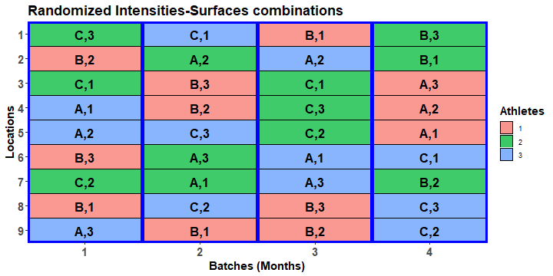
Construct two-phase design
4 Months
3 Athletes in M
3 Tests in M, A
4 Batches
9 Locations in B
3 Intensities
3 Surfaces
9 training conditions
36 tests
36 locations
Have to randomize tests (and training conditions) to locations
> eg1.lay <- designRandomize(allocated = split.lay,
+ recipient = list(Batches = 4, Locations = 9),
+ nested.recipients = list(Locations = "Batches"),
+ except = "Batches",
+ seed = 71230)

Slide 18
Check properties of the multiphase design
> eg1.canon <- designAnatomy(formulae = list(locs = ~ Batches/Locations,
+ test = ~ Months/Athletes/Tests,
+ cond = ~ Intensities*Surfaces),
+ data = eg1.lay)
> summary(eg1.canon, which.criteria=c("aeff", "order"))
Summary table of the decomposition for locs, test & cond
Source.locs df1 Source.test df2 Source.cond df3 aefficiency order
Batches 3 Months 3 1.0000 1
Locations[Batches] 32 Athletes[Months] 8 Intensities 2 1.0000 1
Residual 6 1.0000 1
Tests[Months:Athletes] 24 Surfaces 2 1.0000 1
Intensities#Surfaces 4 1.0000 1
Residual 18 1.0000 1
All sources are orthogonal and all, except Months, are confounded with Locations[Batches].
Note also that there are no residuals for Batches or Locations[Batches].
They are exhaustively confounded, which will always be the case when the numbers of objects are equal for two consecutive tiers.
Question that remains: what mixed model to fit?
Three formulae reflecting the factor-allocation diagram (no limit on the number).

Slide 19
Initial allocation model
4 Months
3 Athletes in M
3 Tests in M, A
4 Batches
9 Locations in B
3 Intensities
3 Surfaces
9 training conditions
36 tests
36 locations
Initial allocation model (like the anatomy, reflects the factor allocation diagram):
Intensities + Surfaces + Intensities:Surfaces | Months + Months:Athletes + Months:Athletes:Tests + Batches + Batches:Locations.
However, this model will not fit because of confounding between tests and locations.

Slide 20
Prior allocation model
Summary table of the decomposition for locs, test & cond
Source.locs df1 Source.test df2 Source.cond df3 aefficiency order
Batches 3 Months 3 1.0000 1
Locations[Batches] 32 Athletes[Months] 8 Intensities 2 1.0000 1
Residual 6 1.0000 1
Tests[Months:Athletes] 24 Surfaces 2 1.0000 1
Intensities#Surfaces 4 1.0000 1
Residual 18 1.0000 1
Need to remove
One of Months and Batches, and make the retained term fixed:
Locations:Batches or both Months:Athletes and Months:Athletes:Tests.
Must retain Months:Athletes, otherwise it would be pooled, either into Months:Athletes:Tests or Batches:Locations.
The prior allocation model is the model for the first phase and is a model of convenience:
Months + Intensities + Surfaces + Intensities:Surfaces | Months:Athletes + Months:Athletes:Tests.
The very important point is that, while they are not in the model, the lab terms contribute to those that are e.g. Months is not just due to Months differences, but is also due to Batches variance.

Slide 21
1.2 Allowing for lab order in the athletic experiment
Brien (2017)
If it is expected that there will be consistent differences between locations across the months, then the initial allocation model would be:
Intensities + Surfaces + Intensities:Surfaces | Months + Months:Athletes + Months:Athletes:Tests + Batches + Locations + Batches:Locations.
That is, Batches and Locations are now crossed (similar to RCBD versus LSD).
A row-column design is required for the crossed, second-phase units.
The Locations term has been added.

Slide 22
Design considerations
To produce a good two-phase design, the allocation of the first phase to locations cannot ignore Intensities and Surfaces: a good cross-phase design is needed.
In the previous design, they could be ignored because everything within Months was being randomized to Locations within Batches.
In addition, the combined-units design cannot be ignored because the split-unit nature of the first-phase design must be taken into account.
Because of the time constraints Months must be associated with Batches.
Within a month, assigning Athletes to triples of consecutive Locations is consistent with the use of a split-unit design in the first-phase.
Tests can then be assigned to the locations within a triple.
Thus, the cross-phase design must efficiently assign Intensities to Location triples and Surfaces to the Locations within a triple.
The factor allocation diagram
4 Months
3 Athletes in M
3 Tests in M, A
4 Batches
9 Locations
3 Intensities
3 Surfaces

9 training conditions
36 tests
36 locations

Slide 23
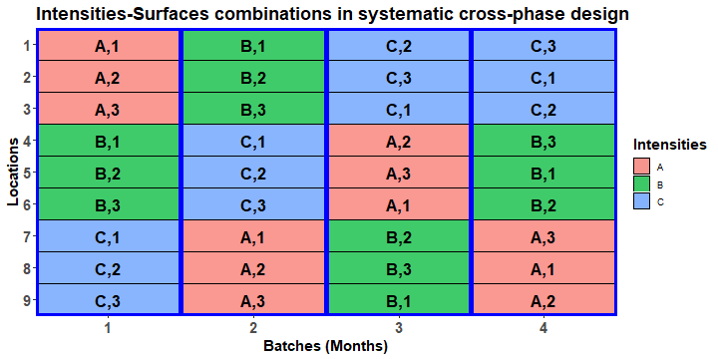
Systematic cross-phase design
A balanced factorial design (Hinkelmann & Kempthorne, 2005, section 12.5).
A 3  4 extended Latin square design (ELSqD = LSqD + column of repeats) is used to allocate Intensities to the triples (colours & letters);
A 3  4 ELqSD is used for a Locations triple  Batches; the same extended Latin square is used for all 3 triples.
To ensure no repeat Intensities-Surfaces combinations for a Location, the repeated columns for the two ELSqDs must be associated with different Batches.
The Intensities and Surfaces are arranged in a split-unit pattern.
Notes:
For the triples ELS, the repeat in the fourth row comes from a different Batch-Month

Slide 24
Construct a systematic two-phase design and randomize it
ELSqD
> #'## Generate a systematic cross-phase design for Intensities and Surfaces
> eg2.phx.sys <- cbind(fac.gen(list(Batches = 4, Locations = 9)),
+ data.frame(Intensities = factor(rep(c(designLatinSqrSys(3), c(3,2,1)),
+ each = 3), labels = LETTERS[1:3]),
+ Surfaces = factor(c(rep(1:3, times = 3),
+ rep(1:3, times = 3),
+ rep(c(2,3,1), times = 3),
+ rep(c(3,1,2), times = 3)))))
> #'## Generate a systematic two-phase design by bringing in first-phase recipient factors
> eg2.phx.sys$Months <- eg2.phx.sys$Batches
> eg2.sys <- merge(split.lay, eg2.phx.sys) #merge on commmon factors Months, Intensities & Surfaces
> eg2.sys <- with(eg2.sys, eg2.sys[order(Batches,Locations),])
> #'## Allocate to the second-phase units
> eg2.lay <- designRandomize(allocated = eg2.sys[c("Months", "Athletes", "Tests",
+ "Intensities", "Surfaces")],
+ recipient = eg2.sys[c("Batches", "Locations")],
+ except = "Batches",
+ seed = 243526)
An ELSqD
Don’t randomize Batches.
Notes:
times = 3 repeats across Locations triples

Slide 25
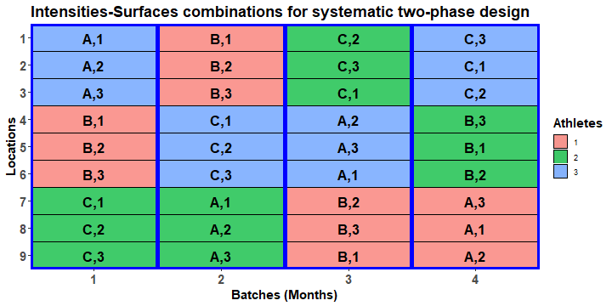
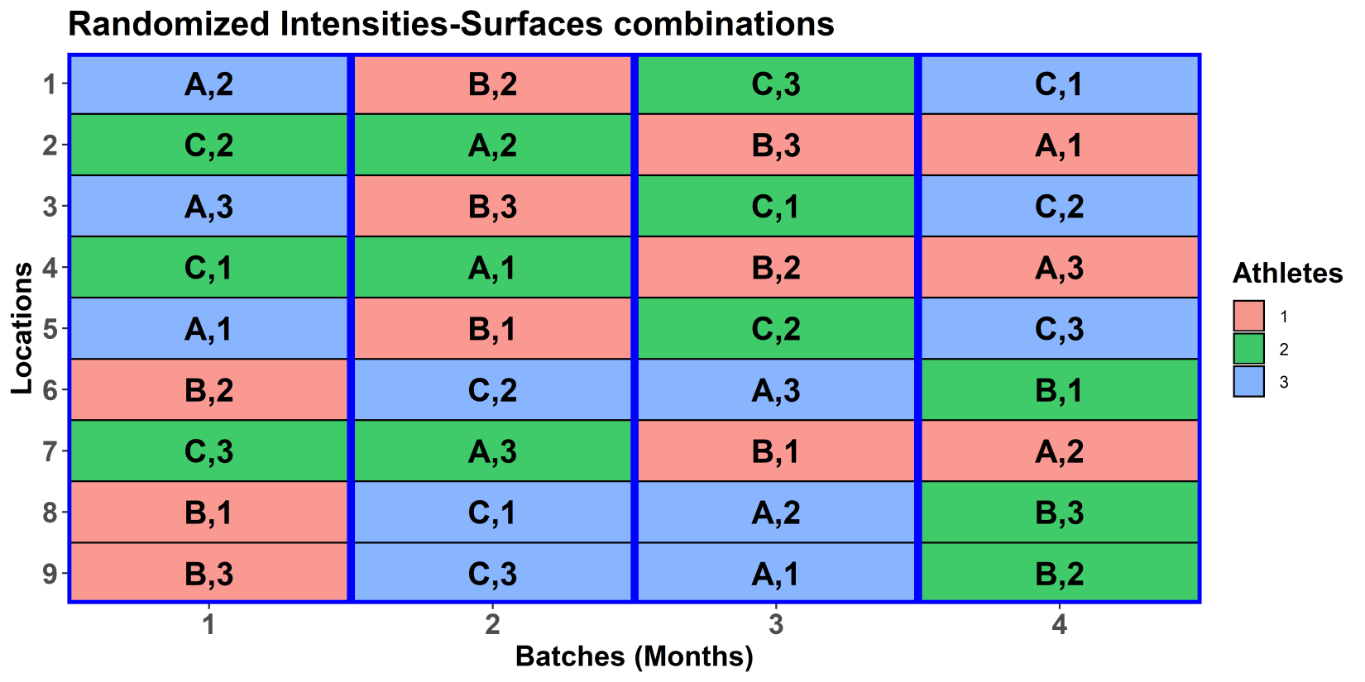
Systematic versus randomized designs
The randomized design is obtained from the systematic design by permuting:
its rows (Locations),
but not its columns (Batches).

Slide 26
Anatomy of the two-phase design allowing for lab processing order
Summary table of the decomposition for locs, test & cond (based on adjusted quantities)
Source.locs df1 Source.test df2 Source.cond df3 aefficiency order
Batches 3 Months 3 1.0000 1
Locations 8 Athletes[Months] 2 Intensities 2 0.0625 1
Tests[Months:Athletes] 6 Surfaces 2 0.0625 1
Intensities#Surfaces 4 0.2500 1
Batches#Locations 24 Athletes[Months] 6 Intensities 2 0.9375 1
Residual 4 1.0000 1
Tests[Months:Athletes] 18 Surfaces 2 0.9375 1
Intensities#Surfaces 4 0.7500 1
Residual 12 1.0000 1
The design is not orthogonal
The Residual for Intensities has been reduced from 6 to 4 df.
The design is balanced
Most of the information about Intensities and Surfaces is confounded with Batches#Locations.

Slide 27
Prior allocation model
Summary table of the decomposition for locs, test & cond (based on adjusted quantities)
Source.locs df1 Source.test df2 Source.cond df3 aefficiency order
Batches 3 Months 3 1.0000 1
Locations 8 Athletes[Months] 2 Intensities 2 0.0625 1
Tests[Months:Athletes] 6 Surfaces 2 0.0625 1
Intensities#Surfaces 4 0.2500 1
Batches#Locations 24 Athletes[Months] 6 Intensities 2 0.9375 1
Residual 4 1.0000 1
Tests[Months:Athletes] 18 Surfaces 2 0.9375 1
Intensities#Surfaces 4 0.7500 1
Residual 12 1.0000 1
Same exhaustive confounding issues as for the design with nested second-phase units.
Must retain Locations and Months:Athletes to prevent undesirable pooling.
One possible prior allocation model is the model for the first phase plus Locations:
Months + Intensities + Surfaces + Intensities:Surfaces | Months:Athletes + Months:Athletes:Tests + Locations.
Again, this is a model of convenience and does not portray all the sources of variation affecting the response variables for this experiment

Slide 28
Using odw to construct a design
Split-plot designs
involve a two-step process to optimize:
optimize the main-unit factors;
optimize the sub-unit factors, given the main-unit optimization;
Only optimizes main effects.

Slide 29
Optimizing the main-unit, cross-phase design
> #'## Optimize the main-unit, cross-phase design, based on assigning Intensities to Locations tripletss
> #'### Set up a randomized starting design
> eg2.main.ini <- cbind(fac.gen(list(Batches = 4, Triplets = 3)),
+ fac.gen(list(Intensities = LETTERS[1:3]), times = 4))
> eg2.main.ini <- designRandomize(allocated = eg2.main.ini[c("Intensities")],
+ recipient = eg2.main.ini[c("Batches","Triplets")],
+ nested.recipients = list(Triplets = "Batches"),
+ seed = 61461)
> #'### Use odw to optimize the main-unit design
> eg2.main.odw <- odw(fixed = ~ Batches + Triplets + Intensities,
+ permute = ~ Intensities, swap = ~ Batches,
+ maxit = maxit, search = "tabu",
+ data = eg2.main.ini)
Thu Jan 26 10:40:56 2023
Initial A-value = 0.727273 (3 A-equations; rank C 2)
Criterion after 1000 initial random iterations: 0.533333
A-value after tabu loop 1 is 0.533333
…
A-value after tabu loop 50 is 0.533333
Hash table size 3
Final criterion after 50 tabu iterations: 0.533333
> eg2.main.des <- eg2.main.odw$design
Set up an RCBD for Intensities as a starting design.
Use swap to keep the design resolved for Batches.

Slide 30
Optimizing the sub-unit, cross-phase design
> #'## Optimize the sub-unit, cross-phase design, based on assigning Surfaces to Locations within triplets
> #'### Set up a randomized starting design
> eg2.ini <- cbind(fac.gen(list(Surfaces = 3), times = 12),
+ fac.gen(list(Batches = 4, Triplets = 3, Locations = 3)))
> eg2.ini <- designRandomize(allocated = eg2.ini["Surfaces"],
+ recipient = eg2.ini[c("Batches", "Triplets", "Locations")],
+ nested.recipients = list(Locations = c("Batches", "Triplets")),
+ except = c("Batches", "Triplets"),
+ seed = 65435)
> eg2.ini$Locations <- with(eg2.ini, fac.combine(list(Triplets, Locations)))
> eg2.ini <- merge(eg2.ini, eg2.main.des[c("Batches", "Triplets", "Intensities")])
> #'### Use odw to optimize the sub-unit design
> eg2.odw <- odw(fixed = ~ Batches*Triplets + Locations + Surfaces,
+ permute = ~ Surfaces, swap = ~ Batches:Triplets,
+ maxit = maxit, search = search,
+ data = eg2.ini)
Thu Jan 26 10:40:57 2023
Initial criterion = 0.191781 (3 A-equations; rank C 2)
Criterion after 1000 initial random iterations: 0.177778A-value after tabu loop 1 is 0.177778
A-value after tabu loop 2 is 0.177778
…
A-value after tabu loop 50 is 0.177778
Hash table size 85
Final criterion after 50 tabu+rw iterations: 0.177778
A starting-design design with Surfaces randomized within Batches-Triplets.
Add the main-unit design.
Use swap to only interchange within Batches-Triplets, so keeping main-unit design.

Slide 31
Produce the two-phase design based on the odw designs
Combine cross-phase and first-phase designs.
> eg2.des <- eg2.odw$design
> split.lay$Batches <- split.lay$Months
> eg2.lay <- merge(eg2.des, split.lay)
> eg2.lay <- with(eg2.lay, eg2.lay[order(Batches, Locations),])
> eg2.lay <- designRandomize(allocated = eg2.lay[c("Months","Athletes","Tests",
+ "Intensities","Surfaces")],
+ recipient = eg2.lay[c("Batches","Locations")],
+ except = "Batches",
+ seed = 87620)
> #'## Check properties of the design
> eg2.canon <- designAnatomy(formulae = list(locs = ~ Batches*Locations,
+ test = ~ Months/Athletes/Tests,
+ cond = ~ Intensities*Surfaces),
+ data = eg2.lay)
Warning messages:
1: In projs.2canon(CombinedSets$Q[[ntiers]], struct[[ktier]]$Q) :
Intensities#Surfaces and Surfaces are partially aliased in Locations&Tests[Months:Athletes]
2: In projs.2canon(CombinedSets$Q[[ntiers]], struct[[ktier]]$Q) :
Intensities#Surfaces and Surfaces are partially aliased in Batches#Locations&Tests[Months:Athletes]
Randomize the first-phase design to the second-phase units.
The interaction and Surfaces main effects are not orthogonal.

Slide 32
Properties of the odw-based two-phase design
Summary table of the decomposition for locs, test & cond (based on adjusted quantities)
Source.locs df1 Source.test df2 Source.cond df3 aefficiency order
Batches 3 Months 3 1.0000 1
Locations 8 Athletes[Months] 2 Intensities 2 0.0625 1
Tests[Months:Athletes] 6 Surfaces 2 0.0625 1
Intensities#Surfaces 3 0.1121 3
Residual 1 1.0000 1
Batches#Locations 24 Athletes[Months] 6 Intensities 2 0.9375 1
Residual 4 1.0000 1
Tests[Months:Athletes] 18 Surfaces 2 0.9375 1
Intensities#Surfaces 4 0.6559 4
Residual 12 1.0000 1
Table of information (partially) aliased with previous sources derived from the same formula
Source df Alias In aefficiency order Intensities#Surfaces 1 Surfaces Locations&Tests[Months:Athletes] 1.0000 1 Intensities#Surfaces 1 Surfaces Batches#Locations&Tests[Months:Athletes] 0.0361 1
The design is not orthogonal
The design is unbalanced and the interaction efficiency is low (cf 0.75 for manual construction).

Slide 33
Properties of the four species of odw-based designs
Used designTwophaseAnatomies to output the 4 species of designs for a two-phase design.
The anatomy of the two-phase design has been presented.
The combined-units anatomy is:
Summary table of the decomposition for locs & test
Source.locs df1 Source.test df2 aefficiency eefficiency order
Batches 3 Months 3 1.0000 1.0000 1
Locations 8 Athletes[Months] 2 1.0000 1.0000 1
Tests[Months:Athletes] 6 1.0000 1.0000 1
Batches#Locations 24 Athletes[Months] 6 1.0000 1.0000 1
Tests[Months:Athletes] 18 1.0000 1.0000 1
It shows that the allocation of second-phase units (tests) to first-phase units (locations) is orthogonal.
This is desirable because it means that the variance matrix is relatively straightforward.

Slide 34
2. Partially replicated (p-rep) designs
These designs were introduced by Cullis et al. (2006)
They are a variation of the augmented designs, introduced by Federer in 1956.
An augmented design is one in which a base design is used to allocate replicated treatments and these are then augmented with unreplicated treatments.
The particular features of a p-rep design are:
Both the unreplicated and replicated treatments are new genotypes; in augmented designs, the unreplicated treatments are usually controls or check varieties;
The p-rep designs are spatially-optimized.
Jarret (2019, IBS-AR talk) stressed that to get a reasonable estimate of σ²:
a good base design should be used;
There should be at least 3 reps of the replicated treatments.

Slide 35
2.1 A field experiment — a single-phase p-rep
(Cullis, Smith & Coombes, 2006)
576 Genotypes on 60 rows × 12 columns.
Dashed line because Genotypes are allocated to the plots factors, but not using classic randomization.
576 Genotypes
2 Blocks
30 WRows in B
12 Columns

ρ
576 genotypes
720 plots
144 Genotypes are to be duplicated — p = 0.25.
Local spatial correlation is expected and a spatial design is needed.
The initial allocation model is:
Genotypes | Blocks + Blocks:WRows + Columns + Blocks:Columns + Blocks:WRows:Columns).
The prior allocation model is:
Blocks | Genotypes + Blocks:WRows + Columns + Blocks:Columns + units + ar1(Blocks:WRows):ar1(Columns).
Genotypes and Blocks interchanged between fixed-random model;
Autocorrelation for Rows and Columns is added;
units is added for nugget variance.

Slide 36
A field p-rep — variance parameters
The prior allocation model:
Blocks | Genotypes + Blocks:WRows + Columns + Blocks:Columns + units + ar1(Blocks:WRows):ar1(Columns).
To search for a spatially-optimized design using odw need to specify values for the variance parameters.
The general way to do this is to
set the residual (or identity) term component to 1: φ_{BRC} = 1;
Use γ to denote the ratio of each component to the residual: γ_{i} = φ_{i} / φ_{BRC}.
Suppose past experience tells us that the following are reasonable values (Smith et al, 2006, p.405):
γ_{G} = 1, γ_{BR} = 0.5, γ_{C} = 0.1, γ_{BC} = 0.05, γ_{u} = 0.5, φ_{BRC} = 1, ρ_{BR} = 0.6, ρ_{C} = 0.4.
The magnitude of φ_{G} equals that of φ_{BRC}; γ_{u} is the nugget variance; the ρs are the first-order autocorrelation parameters.

Slide 37
A field p-rep — setting up
> #'## Set up constants
> g <- 576 # no. genotypes
> ndup <- 144 # no. duplicated genotypes
> b <- 2 # no. blocks
> r <- 60 # no. rows
> c <- 12 # no. columns
> n <- r*c # no. Plots
>
> #'## Set up variance parameters
> g.G <- 1
> g.BR <- 0.5
> g.C <- 0.1
> g.BC <- 0.05
> g.u <- 0.5
> g.BRC <- 1.0
> rho.R <- 0.6
> rho.C <- 0.4
> #'## Set odw options
> maxit <- 50
> search <- "tabu+rw"
> odw.options(P = 0.10, localSearch = 10000, tabuStop = 100)

Slide 38
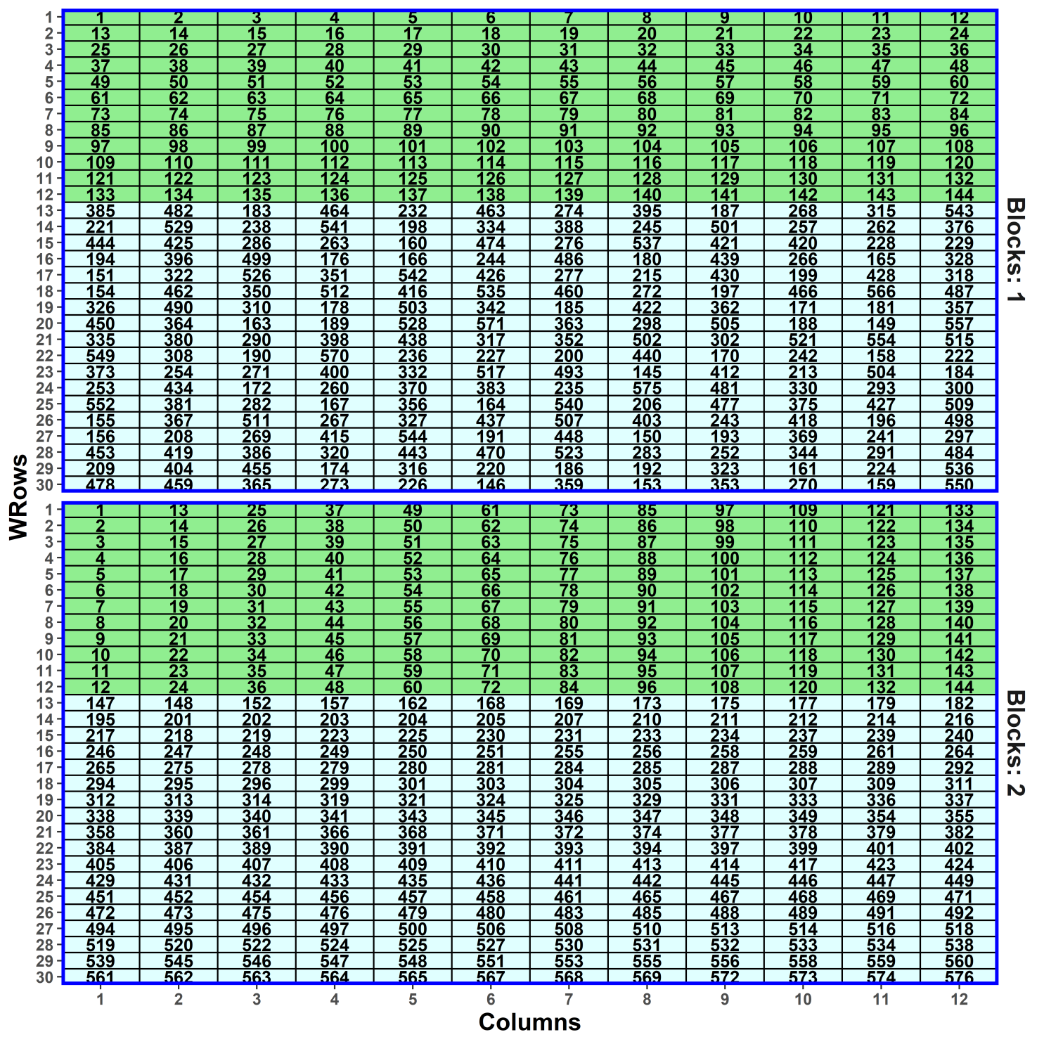
A field p-rep — initial design
> #'## Generate a simple lattice for Genotypes 1:144
> #'
> #' 1:144 are replicated twice and 145:g are replicated once
> latt.mat <- matrix(1:ndup, nrow = 12, ncol = 12)
> blk1.genos <- sample((ndup+1):g, (g-ndup)/2) #randomly select half undup Genotypes for Block 1
> blk2.genos <- ((ndup+1):g)[!((ndup+1):g %in% blk1.genos)] #rest in Block 2
> latt.lay <- fac.gen(list(Blocks = 2, WRows = 30, Columns = 12))
> latt.lay <- within(latt.lay,
+ Genotypes <- factor(c(latt.mat, blk1.genos,
+ t(latt.mat),blk2.genos)))
This is a systematic, resolved, augmented design – the replicates of the duplicated Genotypes are in different blocks and the unduplicated genotypes are added to the block design.

Slide 39
A field p-rep — randomization of the systematic design
Randomize now, according to the augmented design, because an optimized spatial design cannot be randomized.
Avoids remnants of the systematic arrangement in the optimized design.
> #'## Randomize the initial design
> latt.lay <- designRandomize(allocated = latt.lay["Genotypes"],
+ recipient = latt.lay[c("Blocks", "BRows", "Columns")],
+ nested.recipients = list(BRows = "Blocks"),
+ seed = 64058)
> latt.lay <- within(latt.lay,
+ Rows <- fac.combine(list(Blocks, BRows)))

Slide 40
A field p-rep — setting variance parameters in odw
> #'## Use odw to generate the p-rep starting with the simple lattice - with units and autocorrelation
> prepuar1.latt.odw <- odw(fixed = ~ Blocks,
+ random = ~ Genotypes + Rows + Columns/Blocks + units,
+ residual = ~ ar1(Rows):ar1(Columns),
+ permute = ~ Genotypes, swap = ~ Blocks,
+ start.values = TRUE,
+ data = latt.lay)
> vp.table <- prepuar1.latt.odw$vparameters.table
> vp.table$Value[c(1:5, 7:8)] <- c(g.G, g.BR, g.C, g.BC, g.u,
> rho.R, rho.C)
> vp.table
Component Value
1 Genotypes 1.00
2 Rows 0.50
3 Columns 0.10
4 Columns:Blocks 0.05
5 units 1.00
6 Rows:Columns!R 1.00
7 Rows:Columns!Rows!cor 0.60
8 Rows:Columns!Columns!cor 0.40
Note Rows used rather than Blocks:Rows: ar1 requires a single factor; the two terms are equivalent as a random term.
swap restricts interchanges to be within Blocks and so ensures that the design remains resolved.
start.values only are to be produced.

Slide 41
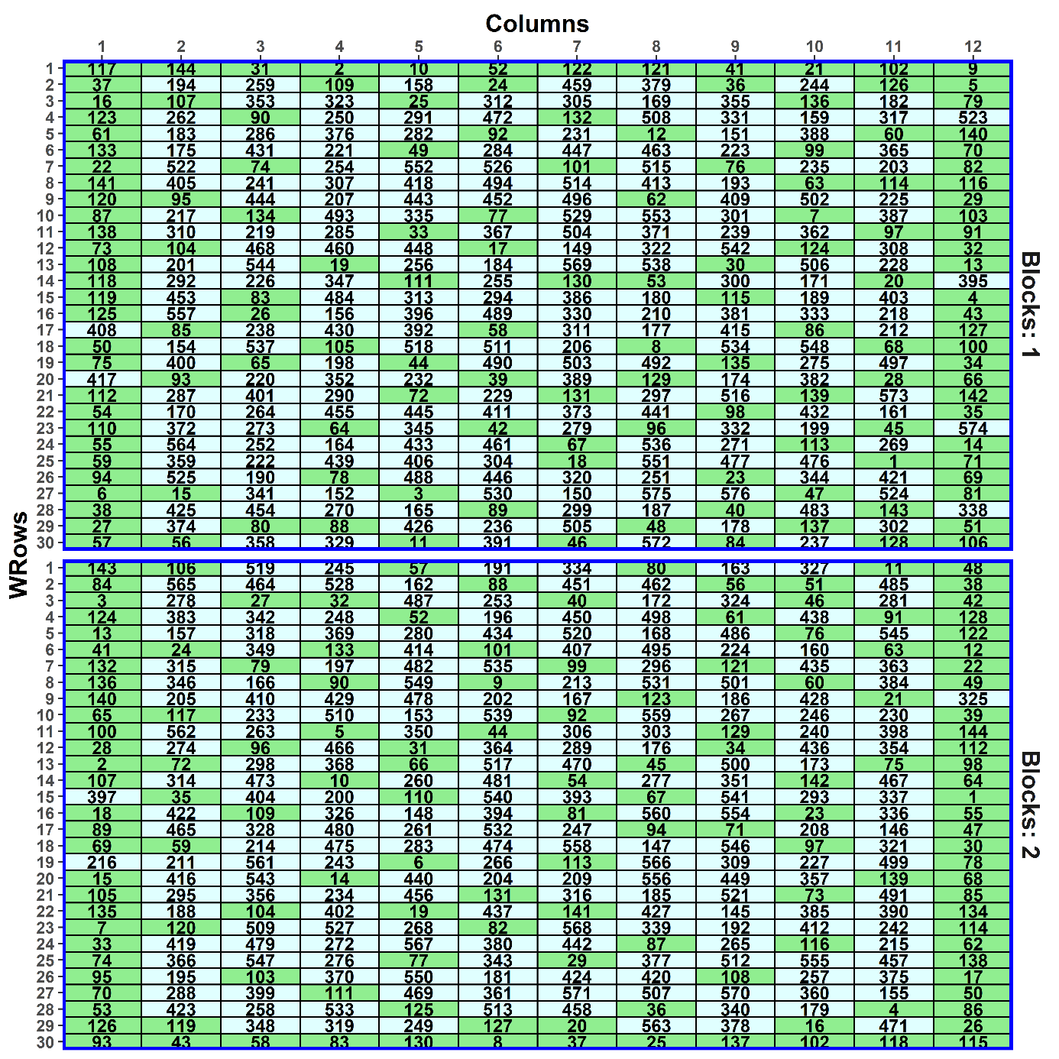
A field p-rep — generating the design
> prepuar1.latt.odw <- odw(fixed = ~ Blocks,
+ random = ~ Genotypes + Rows + Columns/Blocks + units,
+ residual = ~ ar1(Rows):ar1(Columns),
+ permute = ~ Genotypes, swap = ~ Blocks,
+ G.param = vp.table, R.param = vp.table,
+ maxit = maxit, search = search,
+ data = latt.lay)
## Sun Jan 29 17:31:33 2023
## Initial criterion = 1.206828 (576 A-equations; rank C 576)
## Criterion after 1000 initial random iterations: 1.202444
## Criterion after tabu loop 1 is 1.201937
## Criterion after tabu loop 2 is 1.201918
...
## Criterion after tabu loop 10 is 1.201828
> prepuar1.latt.lay <- prepuar1.latt.odw$design
Supplying values of the variances parameters.
Note that nearly all the border plots are duplicated Genotypes; the same does not occur when Genotypes is fixed (in Prac).

Slide 42
Canonical analysis of the design: investigating its anatomy
Want to look at the relationships of the genotypes sources to the plots sources.
The plots sources:
Blocks + Rows[Blocks] + Columns + Blocks#Columns +Rows#Columns[Blocks].
The genotypes source:
Genotypes.
Using dae:
> prepuar1.latt.canon <- designAnatomy(formulae = list(plot = ~ (Blocks + Rows)*Columns,
+ trt = ~ Genotypes),
+ data = prepuar1.latt.lay)
> summary(prepuar1.latt.canon,
+ which.criteria = c("aeff", "meff", "eeff", "order", "dfor"))
A is the harmonic mean of the efficiency factors.
M is the mean of the efficiency factors.
E is the minimum of the efficiency factors.
dforth is the number of efficiency factors equal to one.
Order is the number of unique efficiency factors.

Slide 43
A field p-rep — anatomy
Summary table of the decomposition for plot & trt (based on adjusted quantities)
Source.plot df1
Blocks 1
Rows[Blocks] 58
Columns 11
Blocks#Columns 11
Rows#Columns[Blocks] 638
The design is not orthogonal
Source.trt df2
Genotypes 1
Genotypes 58
Genotypes 11
Genotypes 11
Genotypes 575
Residual 63
aefficiency mefficiency eefficiency order dforthog
0.6000 0.6000 0.6000 1 0
0.7811 0.8000 0.4427 58 0
0.7455 0.7818 0.4400 11 0
0.8040 0.8182 0.6155 11 0
0.4264 0.8877 0.0137 82 494
A lot of information about some Genotypes contrasts in other than Rows#Columns[Blocks] (plots).
Not a unique decomposition, but Rows#Columns[Blocks] decomposition is.
Concentrate on the last Genotypes source, where all 575 Genotypes df are partially confounded.
All of the plots sources are orthogonal (no aliasing).
A is the harmonic mean of the efficiency factors.
M is the mean of the efficiency factors.
E is the minimum of the efficiency factors.
dforth is the number of efficiency factors equal to one.
Order is the number of unique efficiency factors.

Slide 44
A field p-rep — anatomy
Summary table of the decomposition for plot & trt (based on adjusted quantities)
Source.plot df1 Source.trt df2 aefficiency mefficiency eefficiency order dforthog
Blocks 1 Genotypes 1 0.6000 0.6000 0.6000 1 0
Rows[Blocks] 58 Genotypes 58 0.7811 0.8000 0.4427 58 0
Columns 11 Genotypes 11 0.7455 0.7818 0.4400 11 0
Blocks#Columns 11 Genotypes 11 0.8040 0.8182 0.6155 11 0
Rows#Columns[Blocks] 638 Genotypes 575 0.4264 0.8877 0.0137 82 494
Residual 63
Genotypes efficiencies
≤0.1 | 0.1-0.2 | 0.2-0.3 | 0.3-0.4 | 0.4-0.5 | 0.5-0.6 | … | 1
23 | 21 | 20 | 10 | 3 | 4 |  | 494
A is the harmonic mean of the efficiency factors.
M is the mean of the efficiency factors (the sum is the Fisher information for the design and is a component of (M,S optimality).
dforth is the number of efficiency factors equal to one.
A lot (86%) of orthogonal df in Plots.
But, a lot of efficiencies close to 0 in Plots, which is to be expected for for p-rep designs — distorts A so M better?

Slide 45
The effect on the anatomy of assuming that Blocks#Columns is zero
Summary table of the decomposition for plot & trt (based on adjusted quantities)
Source.plot df1 Source.trt df2 aefficiency mefficiency eefficiency order dforthog
Blocks 1 Genotypes 1 0.6000 0.6000 0.6000 1 0
Rows[Blocks] 58 Genotypes 58 0.7811 0.8000 0.4427 58 0
Columns 11 Genotypes 11 0.7455 0.7818 0.4400 11 0
Blocks#Rows#Columns 649 Genotypes 575 0.5080 0.9033 0.0165 71 505
Residual 74
The design is not orthogonal
More genotypes information in Blocks#Rows#Columns and more Residual df.
Still some information about Genotypes almost orthogonal to Blocks#Rows#Columns.
AVPD = 1.200φ_{BRC}. (minor change – was 1.202φ_{BRC}.)

Slide 46
Calculating the A-measure (AVPD) using designAmeasures and mat.Vpredicts from dae
The model arguments of the odw call
> prepuar1.latt.odw <- odw(fixed = ~ Blocks,
+ random = ~ Genotypes + Rows + Columns/Blocks + units,
+ residual = ~ ar1(Rows):ar1(Columns),
+ permute = ~ Genotypes, …)
Corresponding designAmeasures call
> prepuar1.latt.lay$unit <- factor(1:nrow(prepuar1.latt.lay)) #factor for ASReml units
> (designAmeasures(mat.Vpredicts(target = ~ Genotypes - 1,
+ Gt = 1,
+ fixed = ~ Blocks,
+ random = ~ Rows + Columns/Blocks + unit - 1,
+ G = as.list(c(g.BR, g.C, g.BC, g.u)),
+ R = kronecker(mat.ar1(rho.R, r),
+ mat.ar1(rho.C, c)),
+ design = prepuar1.latt.lay)))[[1]]
[1] 1.016151
To calculate without Columns:Blocks, drop “/Blocks” and “g.BC”.
What happens if ar1 and nugget variance are dropped from odw call?
Matches permute.
As in odw call, minus Genotypes.
As in vp.table.
As for residual.

Slide 47
Comparing spatial and nonspatial designs
Design | Nonspatial A | Spatial A | aefficiency | mefficiency | eefficiency | dforthog
Nonspatial | 0.988525 | 1.203164 | 0.5216 | 0.8877 | 0.0327 | 494
Spatial | 0.989128 | 1.201844 | 0.4305 | 0.8877 | 0.0124 | 494
On these values, both designs are equally suitable for nonspatial data.
The difference between the designs for spatial data is very small.
The only differences are in aefficiency and eefficiency.
The nonspatial design is slightly better because the range of the efficiency factors is less.

Slide 48
Comparing canonical analysis and A-measures (AVPD)
Canonical analysis
Shows the anatomy of the design: where the information is in the design and the nonorthogonality that is present.
Do not need to specify the variance parameter values and not dependent on them.
Does not account for spatial correlation and nonlinear trends.
Limited relationship with AVPD
When target is fixed, variance-components-only model and equally replicated, aefficiency is directly related to AVPD, otherwise it is not.
Only useful for characterizing a design, rather than searching for an optimal design.
AVPD
Is a measure of the precision in the experiment that gives equal weight to all contrasts, and is used by odw, but is not the same as PEV.
Need to specify the variance parameter values because depends on them.

Slide 49
2.2 Partially replicated designs in two phases
Smith et al. (2006) give examples of experiments that employ designs in which both phases employ partially replicated designs in both phases:
They are dubbed p/q-rep designs.
That is, p% of the genotypes are replicated in the first phase and q% of the plots with unreplicated genotypes are replicated in the second phase.
We will produce a design for a an experiment with p = 0.25 and q = 0.10.
Previous example is a p-rep design for a field experiment, with p = 0.25.
It will be extended to include a milling phase.

Slide 50
The first phase design— a p-rep field experiment
(Cullis, Smith & Coombes, 2006)
576 Genotypes on 60 rows × 12 columns.
Dashed line because Genotypes are allocated to the plots factors, but not using classic randomization.
576 Genotypes
2 Blocks
30 WRows in B
12 Columns

ρ
576 genotypes
720 plots
144 Genotypes are to be duplicated — p = 0.25.
A spatially optimized design was used to allocate genotypes to plots.
Suppose that samples of grain from the field experiment are to be taken to the laboratory for milling and analysis in the laboratory.
After the field experiment 370 genotypes have been identified for processing in the milling phase.

Slide 51
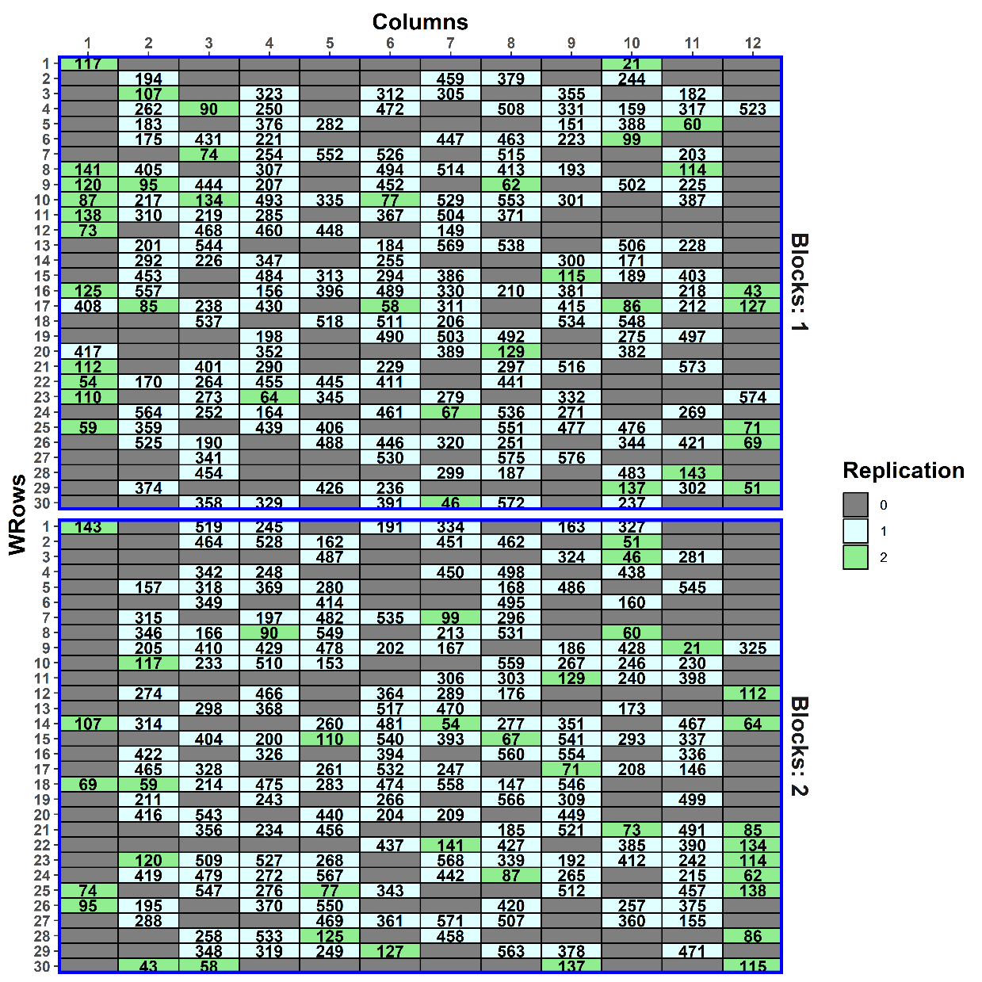
Sampling plots for the milling (second) phase
(Smith, Lim & Cullis, 2006)
576 Genotypes
2 Blocks
30 WRows in B
12 Columns
2 Blocks
203,204 Plots in B

ρ

1,2 Samples in P
f
576 genotypes
720 plots
448 samples
Take 333 unduplicated and 37 duplicated genotypes on to milling phase, half from each block. (= 370 genotypes on 407 plots).
Of the 333 unduplicated Genotypes, 41 are duplicated (2 samples required) in the milling phase — q = 0.10 (of plots).
Half of the milling-phase duplicates from each block.
What will happen here as compared to previous design?
Answer: Blocks, Rows and Columns will no longer be orthogonal — unit terms are partially aliased (cf. confounding).
Also, Genotypes confounding will change.
Notes:
Hopefully, you are still with me. But take a deep breath as we tackle the p/q-rep two-phase design.
q is the proportion of the 407 plots

Slide 52
First-phase anatomy for the fraction
> summary(designAnatomy(formulae = list(plot = ~ ((Blocks/WRows)*Cols)/Samp,
+ trt = ~ Genotypes),
+ keep.order = TRUE, data = layout),
+ which.criteria = c("ae", "me", "ee", "dfor"))
Table of information (partially) aliased with previous sources derived from the same formula
Source df Alias In aefficiency mefficiency eefficiency dforthog
Cols 1 Blocks plot 0.0206 0.0206 0.0206 0
Cols 11 WRows[Blocks] plot 0.0611 0.0743 0.0290 0
Cols 11 ## Information remaining plot 0.9228 0.9240 0.8669 0
Blocks#Cols 22 WRows[Blocks] plot 0.0464 0.0747 0.0109 0
Blocks#Cols 11 ## Information remaining plot 1.0000 1.0000 1.0000 11
The terms are fitted in the order Blocks, WRows[Blocks] and Columns (see next slide).
Eleven df for Columns is aliased with Blocks and WRows[Blocks] but 92.3% of the information is retained.
The analysis will depend on whether Columns is fitted first or not, but not greatly given the high aefficiency.

Slide 53
First-phase anatomy for the fraction
Source.plot df1 Source.trt df2 aefficiency mefficiency eefficiency dforthog
Blocks 1 Genotypes 1 0.8348 0.8348 0.8348 0
WRows[Blocks] 58 Genotypes 58 0.8885 0.9121 0.4403 23
Cols 11 Genotypes 11 0.8417 0.8756 0.5243 0
Blocks#Cols 11 Genotypes 11 0.8628 0.8889 0.5602 0
WRows#Cols[Blocks] 325 Genotypes 325 0.5098 0.9103 0.0225 288
Samp[Blocks:WRows:Cols] 41
Not unique, but the WRows#Cols[Blocks] strata is.
Of the 369 Genotypes df, 325 are estimable in WRows#Cols[Blocks], including 288 (78%) only there.
There are 44 Genotypes df estimable elsewhere, with 23 of these orthogonally confounded with WRows[Blocks].
Thus for Genotypes fixed, the design is disconnected for all plot terms fixed, except the last 2.
Would be connected if all plots terms (except Blocks) random (needed for odw).
The mefficiency for the 369 Genotypes df in WRows#Cols[Blocks] is 0.8017 (= 0.9103 x 325 / 369).
Samp[Blocks:WRows:Cols] (Error) has full 41 df.

Slide 54
Milling-phase allocation for the p/q-rep design
203, 204 Plots in B
2 Blocks
576 Genotypes
12 Columns
30 WRows in B
2 Blocks

1,2 Samples in B,P
8 Days in I
28 Locations
2 Intervals

f
ρ
576 genotypes
720 plots
448 samples
448 locations
There are 448 (407 + 41) samples and so 448 time-locations for milling required:
Take 16 days divide them into 2 intervals.
Each day there are 28 time-locations for milling.
In assigning samples to locations, it is desirable to:
Assign the 2 Blocks to different Intervals, conforming to the “Confound Big with Big” principle of Brien et al. (2011).
Assign the two milling duplicates to different Intervals, to obtain a measure incorporating the broad variability that occurs in the milling phase.
These assignments also have the advantage of making the experiment robust to failures in the experimental procedure.

Slide 55
Milling-phase allocation for the p/q-rep design
For the initial design, samples are assigned to locations using two pseudofactors, R₁ and P₁:
The 448 samples are assigned to the 2 levels of R₁ so that plots for
the plots for the never- and field-replicated genotypes from different blocks have different levels;
the two samples for genotypes that are replicated in the milling phase have different levels.
The 224 plots in each level of R₁ are assigned to the 224 levels of the pseudofactor P₁ in Rows-Columns order:
The 224 plots are comprised of, from the same block, (i) the 37 plots for the field-duplicated genos in it, (ii) 145 (147) for the never-duplicated genos in it, (iii) 21 (20) plots for the milling-duplicated genos.
Initially, R₁ is systematically allocated to Intervals and P₁ is systematically allocated (by Rows) to the Days-Locations combinations.
Then the systematic design is randomized by permuting (i) Intervals, (ii) Locations, and (iii) Days within Intervals , the design being nonorthogonal.

ρ
203, 204 Plots in B
2 Blocks
576 Genotypes
12 Columns
30 WRows in B
2 Blocks

1,2 Samples in B,P

8 Days in I
28 Locations
2 Intervals

f
224 P₁
ρ
ρ
2 R₁
576 genotypes
720 plots
448 samples
448 locations

Slide 56
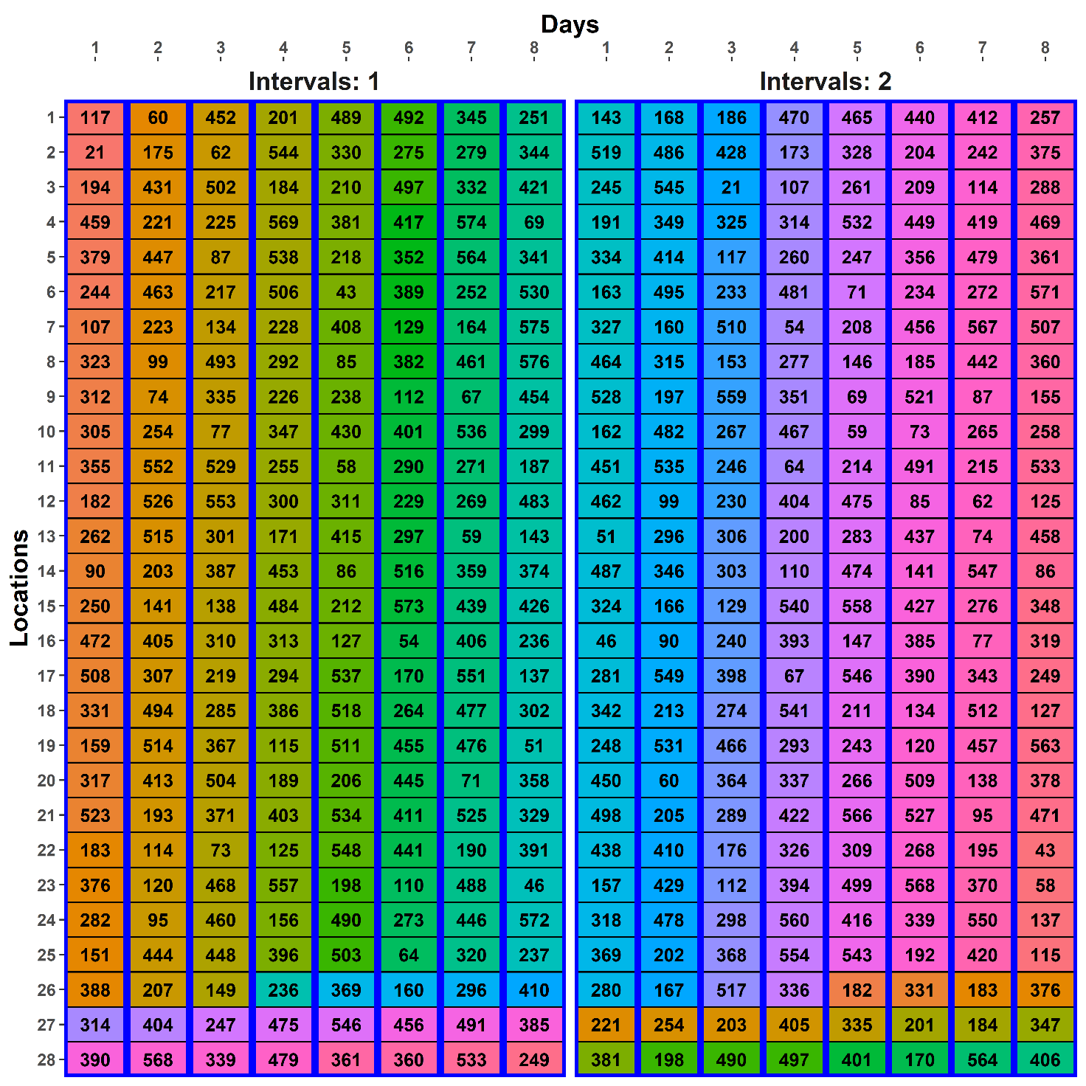
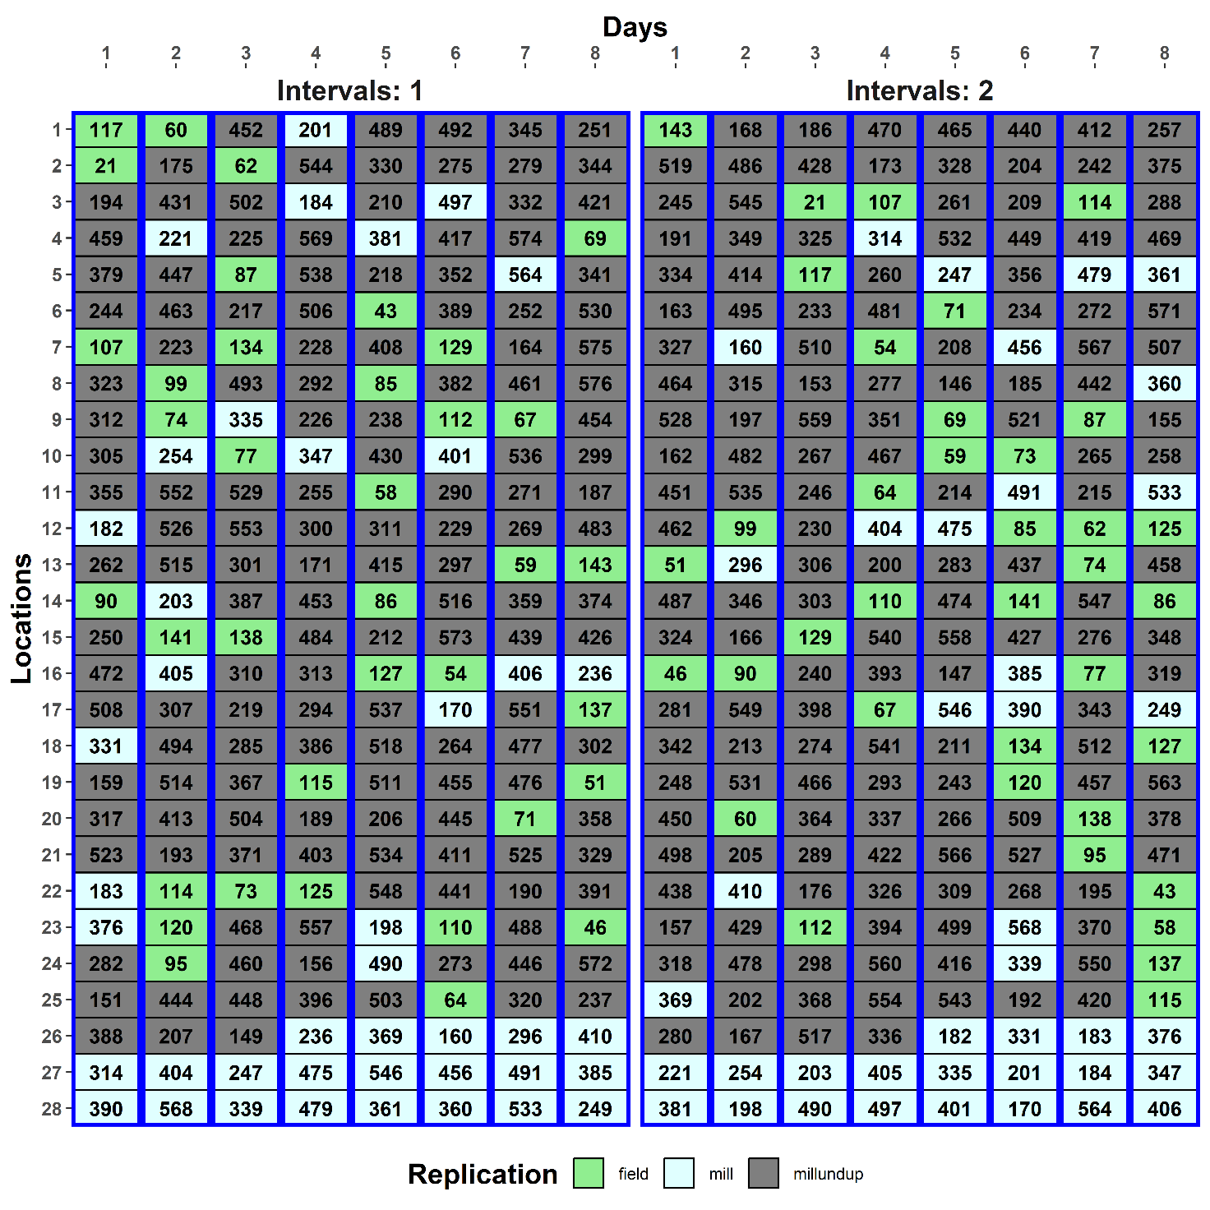
The systematic design

Slide 57
The model for optimizing the two-phase design
203, 204 Plots in B
2 Blocks
12 Columns
30 WRows in B
2 Blocks

1,2 Samples in B,P

8 Days in I
28 Locations
2 Intervals
576 Genotypes

f
224 P₁
ρ
ρ
2 R₁
576 genotypes
720 plots
448 samples
448 locations
The initial allocation model:
Genotypes |
((Blocks / WRows) * Columns) / Samples
+ (Intervals / Days) * Locations
The homogeneous allocation model:
Blocks + Intervals | Genotypes
+ Blocks:WRows + Columns/Blocks + Blocks:Wrows:Columns/Samples
+ Intervals:Days + Locations/Intervals + Intervals:Days:Locations
The prior allocation model:
Blocks + Intervals | Genotypes
+ Rows + Columns/Blocks + ar1(Rows):ar1(Columns)+ Rows:Columns:Samples
+ Intervals:Days + Locations + Intervals:Days:ar1(Locations)
Singularity problems:
Blocks ≡ Intervals
RCS ≡ IDL (both are identity terms with 448 levels)
Delete one of each pair
57

Slide 58
Optimizing the two-phase design using odw
> #'### Optimize for two-phase model, with Rows:Columns:Samples removed because of singularities
> maxit <- 3
> ph2sys.ini$IntDays <- with(ph2sys.ini, fac.combine(list(Intervals, Days)))
> ph2sys.odw.ini <- odw(fixed = ~ Intervals,
+ random = ~ Genotypes + Rows + Columns/Blocks + Rows:Columns +
+ ar1(Rows):ar1(Columns) + Rows:Columns:Samples +
+ Intervals:Days + Locations,
+ residual = ~ IntDays:ar1(Locations),
+ permute = ~ Genotypes | Rows/Columns/Samples + Columns/Blocks,
+ swap = ~ Intervals,
+ start.values = TRUE, data=ph2sys.ini)
> vpc <- ph2sys.odw.ini$vparameters.table

Slide 59
Optimizing the two-phase design using odw (cont’d)
> vpc$Value <- c(g.G*g.BRC, g.BR*g.BRC, g.C*g.BRC, g.BC*g.BRC,
+ g.BRC, rho.R, rho.C, g.BRCS,
+ g.ID, g.L, 1, rho.L)
> (vpc)
Component Value
1 Genotypes 0.500
2 Rows 0.250
3 Columns 0.050
4 Columns:Blocks 0.025
5 Rows:Columns 0.500
6 Rows:Columns!Rows!cor 0.600
7 Rows:Columns!Columns!cor 0.400
8 Rows:Columns:Samples 0.250
9 Intervals:Days 0.800
10 Locations 0.200
11 IntDays:Locations!R 1.000
12 IntDays:Locations!Locations!cor 0.600

Slide 60
Optimizing the two-phase design using odw
> ph2sys.odw <- odw(fixed = ~ Intervals,
+ random = ~ Genotypes + Rows + Columns/Blocks + Rows:Columns +
+ ar1(Rows):ar1(Columns) + Rows:Columns:Samples +
+ Intervals:Days + Locations,
+ residual = ~ IntDays:ar1(Locations),
+ permute = ~ Genotypes | Rows/Columns/Samples + Columns/Blocks,
+ swap = ~ Intervals,
+ G.param = vpc, R.param = vpc,
+ maxit = maxit, search = search, data=ph2sys.ini)
Fri Feb 03 17:27:46 2023
Initial criterion = 0.791760 (370 A-equations; rank C 1187)
Criterion after 1000 initial random iterations: 0.789705
Criterion after tabu loop 1 is 0.787963
Criterion after tabu loop 2 is 0.787223
Criterion after tabu loop 3 is 0.786806
Hash table size 459
Final criterion after 3 tabu+rw iterations: 0.786806
> ph2sys.odw.lay <- ph2sys.odw$design

Slide 61
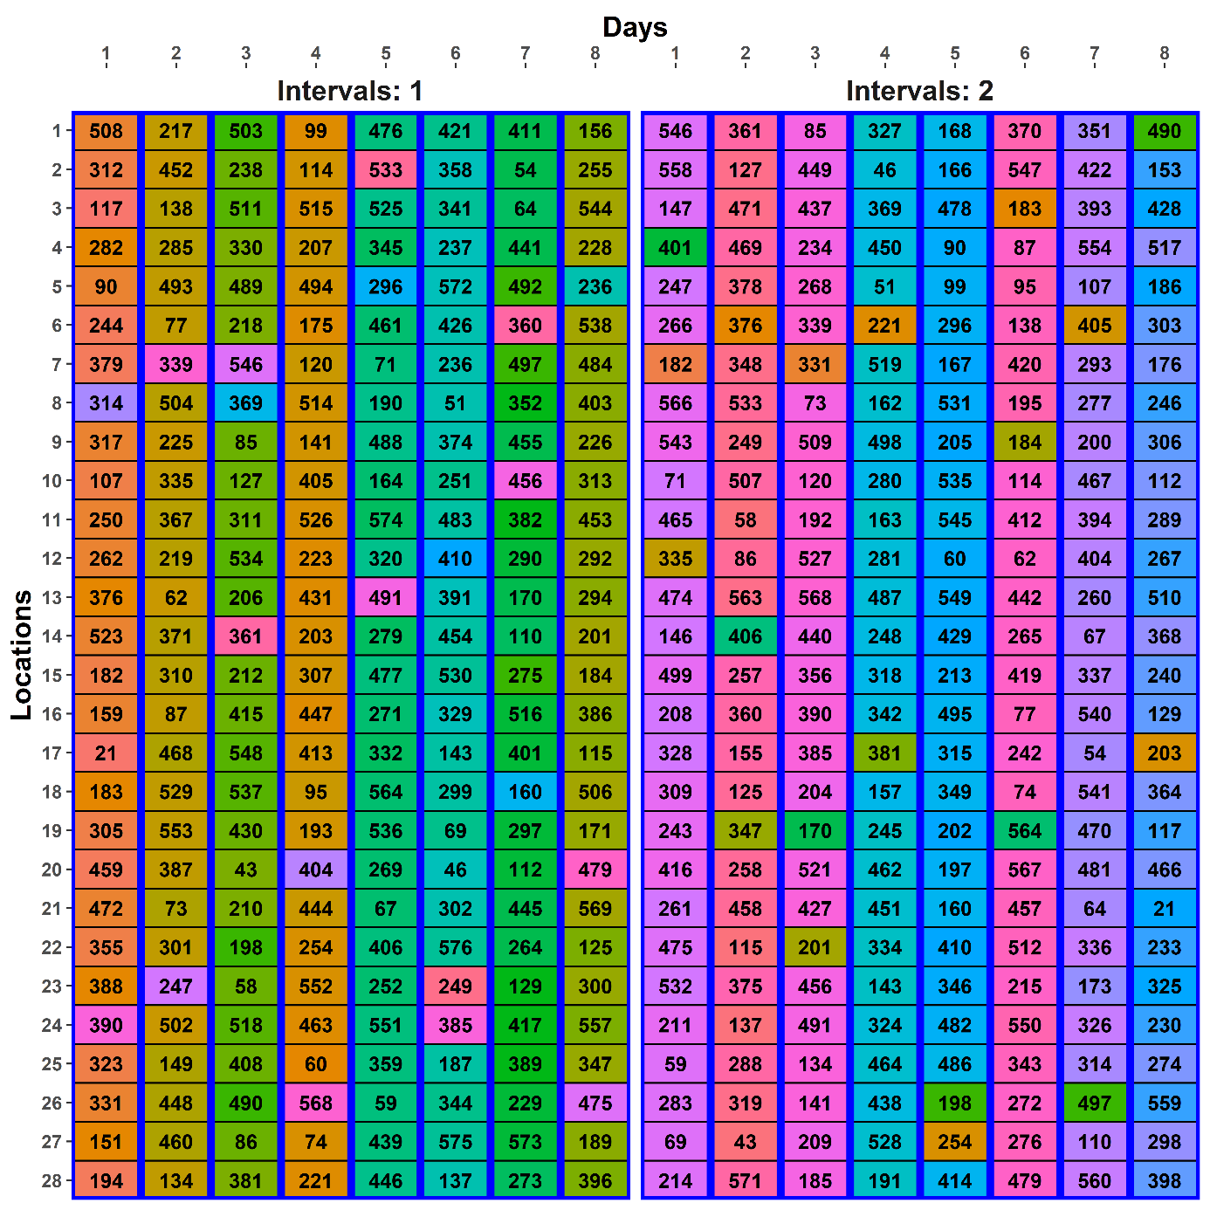
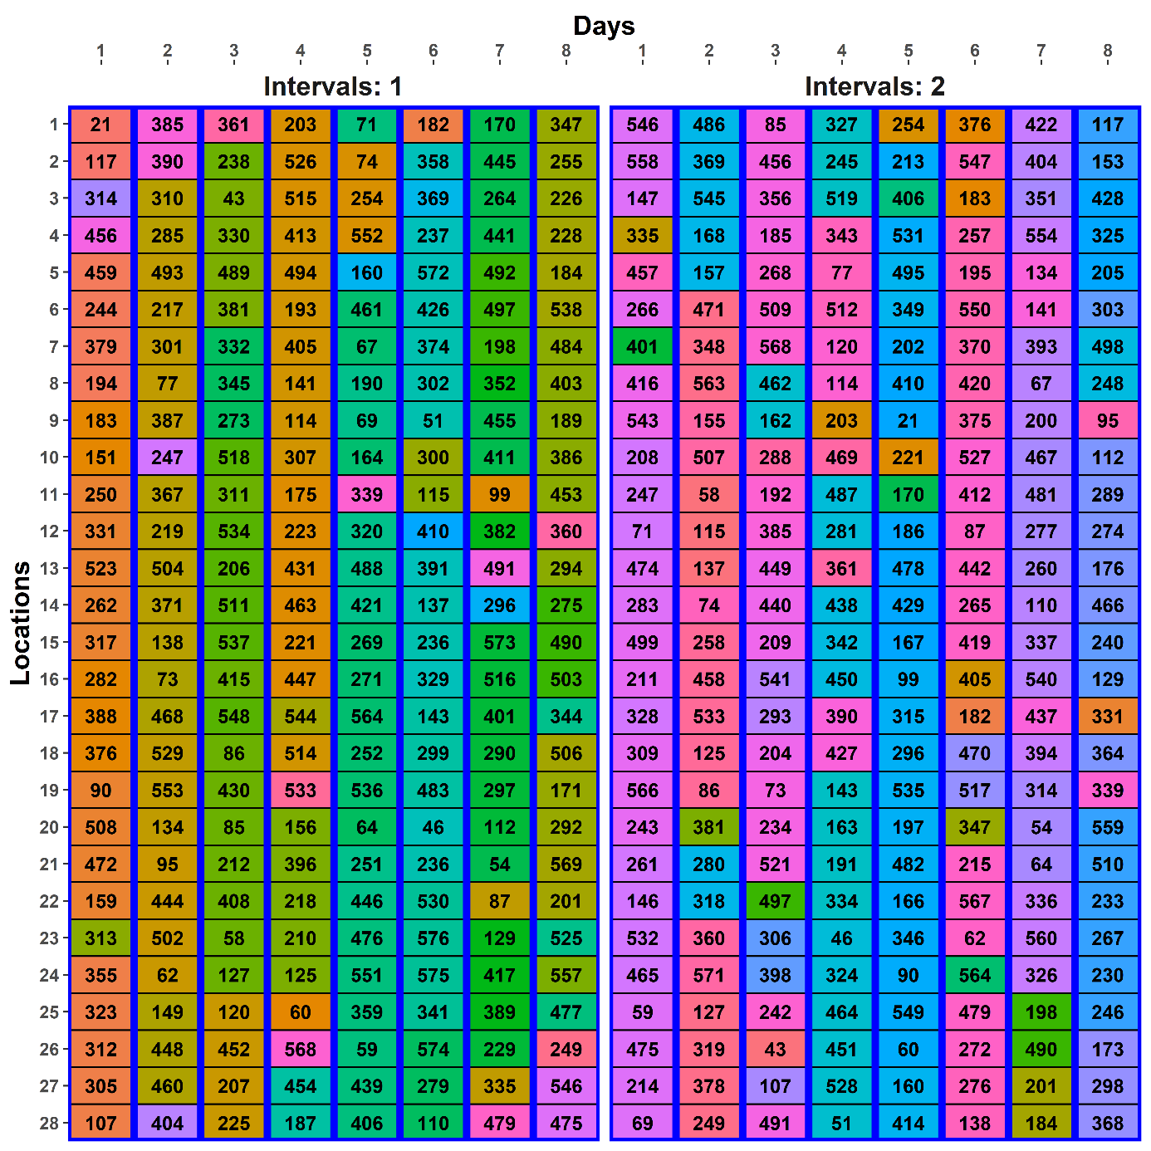
The initial design
A-measure = 0.7918
The optimized design
A-measure = 0.7868

Slide 62
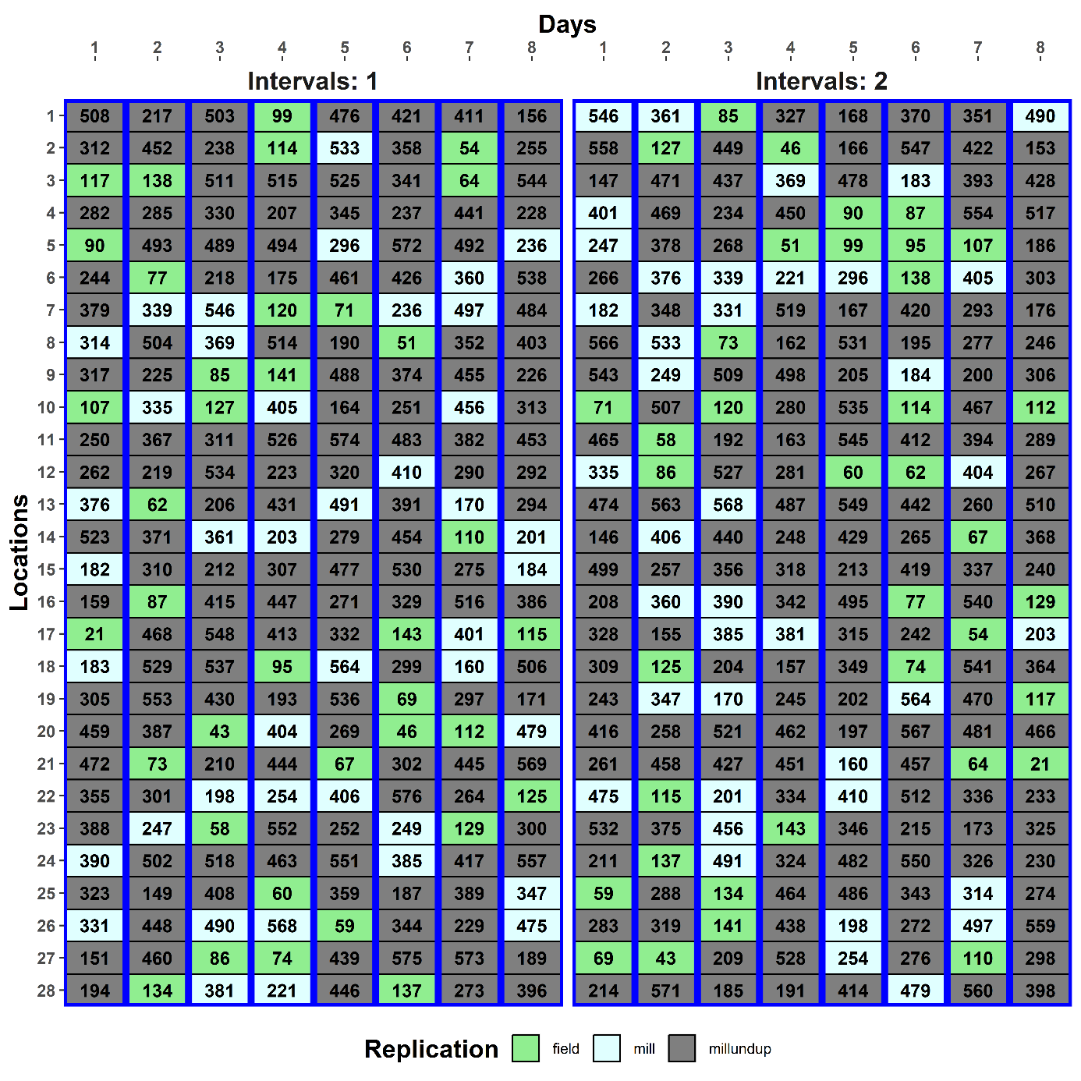
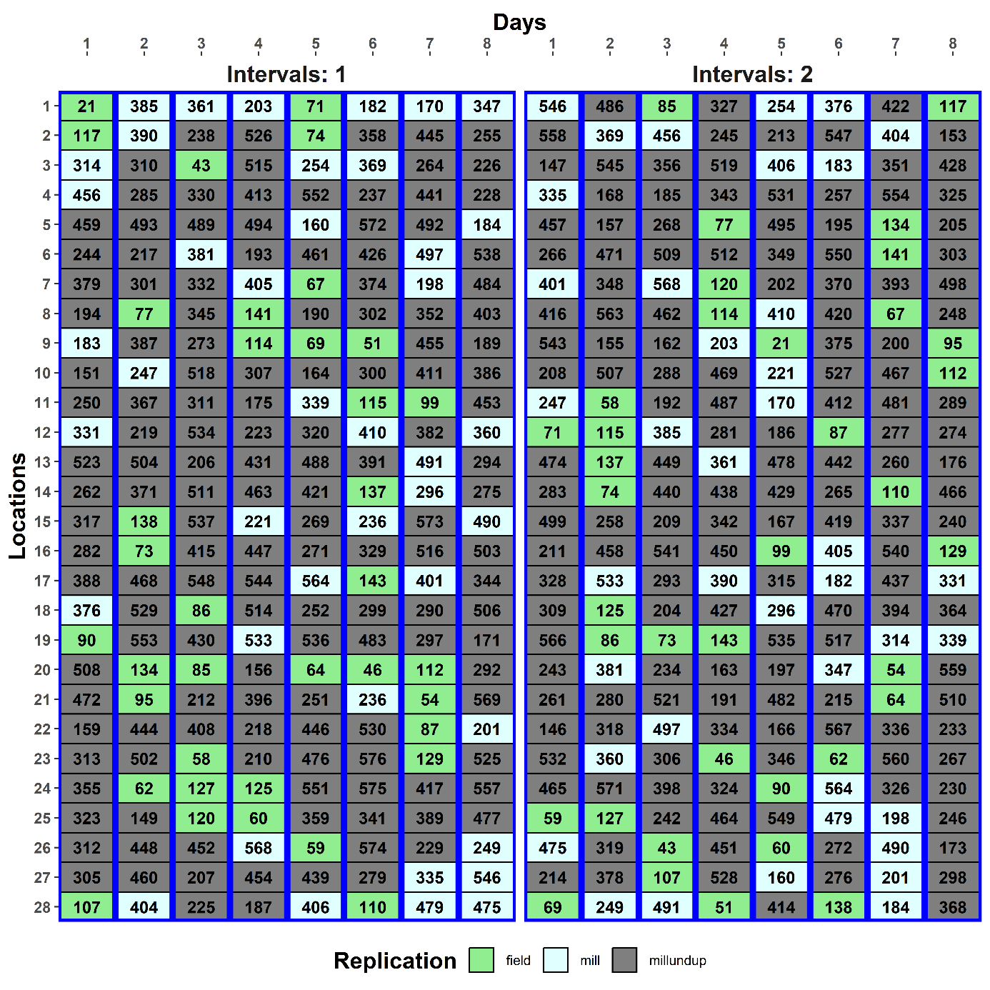
The initial design
The optimized design
Replication |  | Field | Milling | Unduplicated
Interval | 1 | 37 | 42 | 145
 | 2 | 37 | 40 | 147
Notes:
Note that the discrepancy between the two intervals is because there are 41 milling dups and so one of these must have its dups in the same Interval.

Slide 63
Check properties of the multiphase design
> layout <- ph2sys.odw.lay
> names(layout)[match(c("Intervals", "Locations", "Columns","Samples"), names(layout))] <-
+ c("Int", "Locn", "Cols","Samp")
> designTwophaseAnatomies(formulae = list(lab = ~ (Int/Days)*Locn,
+ plot = ~ ((Blocks/WRows)*Cols)/Samp,
+ trt = ~ Genotypes),
+ which.criteria = c("ae", "me", "ee", "dfor"),
+ keep.order = TRUE, data = layout)
Again, have used designTwophaseAnatomies to produce the four species of designs for a two-phase design:
Note three formulae supplied.
The first-phase design for the fraction is not used for the analysis of first-phase responses (e.g. grain yield) in this case.

Slide 64
Anatomy of the combined-units design
Source.lab df1 Source.plot df2 Source.trt df3 aefficiency mefficiency eefficiency dforthog
Int 1 Blocks 1 Genotypes 1 0.6562 0.6562 0.6562 0
Days[Int] 14 Blocks 1 Genotypes 1 0.8004 0.8004 0.8004 0
WRows[Blocks] 13 Genotypes 13 0.8259 0.8303 0.7256 0
Locn 27 Blocks 1 Genotypes 1 0.7723 0.7723 0.7723 0
WRows[Blocks] 26 Genotypes 26 0.8047 0.8213 0.5228 0
Int#Locn 27 Blocks 1 Genotypes 1 0.7463 0.7463 0.7463 0
WRows[Blocks] 26 Genotypes 26 0.8230 0.8355 0.5589 0
Days#Locn[Int] 378 Blocks 1 Genotypes 1 0.6567 0.6567 0.6567 0
WRows[Blocks] 58 Genotypes 58 0.8319 0.8609 0.4499 0
Cols 11 Genotypes 11 0.8271 0.8529 0.5527 0
Blocks#Cols 11 Genotypes 11 0.8495 0.8661 0.6048 0
WRows#Cols[Blocks] 297 Genotypes 297 0.3114 0.8170 0.0123 219
Much of the Blocks confounded here.
Blocks#Cols mainly confounded here.
The estimable df for WRows#Cols[Blocks] has gone from 638 (first-phase) to 325 (fraction) to 297.
Much of WRows[Blocks] and Cols confounded here.

Slide 65
Anatomy of the two-phase design
Source.lab df1 Source.plot df2 aefficiency mefficiency eefficiency dforthog
Int 1 Blocks 1 0.6747 0.6747 0.6747 0
Days[Int] 14 Blocks 1 0.0108 0.0108 0.0108 0
WRows[Blocks] 13 0.6245 0.6532 0.4009 0
Locn 27 Blocks 1 0.0156 0.0156 0.0156 0
WRows[Blocks] 26 0.0363 0.1171 0.0095 0
Int#Locn 27 Blocks 1 0.0217 0.0217 0.0217 0
WRows[Blocks] 26 0.0347 0.1099 0.0087 0
Days#Locn[Int] 378 Blocks 1 0.2771 0.2771 0.2771 0
WRows[Blocks] 58 0.5339 0.7347 0.1217 0
Cols 11 0.7908 0.7989 0.6696 0
Blocks#Cols 11 0.7929 0.8001 0.6678 0
WRows#Cols[Blocks] 297 0.4658 0.8967 0.0187 256
Just 297 of the total 369 df for Genotypes is estimable from WRows#Cols[Blocks].
In all 72.1% (0.8967 * 297 / 369) of the Genotypes information is estimable here.
This compares with 66.0% for the initial design.
cf. 0.7918 and 0.7868 for the A-values.
Differences between initial and optimized design are small.
A lot of Genotypes information is confounded with the variation from other field and milling phase sources of variation.

Slide 66
Substituting a linear Locations term
> #'## Look at the effect of substituting a linear Columns term for the Column variation term
> ph2sys.lin.canon <- designAnatomy(formulae = list(lab = ~ IntDays + xLocn + IntDays:Locn,
+ plot = ~ (Rows*Cols)/Samp,
+ trt = ~ Genotypes),
+ keep.order = TRUE, data = layout)
> print(summary(ph2sys.lin.canon, which.criteria = c("ae", "me", "ee", "dfor")))
Source.lab df1 Source.plot df2 Source.trt df3 aefficiency mefficiency eefficiency dforthog
IntDays 15 Rows 15 Genotypes 15 0.8087 0.8167 0.6353 0
xLocn 1 Rows 1 Genotypes 1 0.8124 0.8124 0.8124 0
IntDays#Locn 431 Rows 59 Genotypes 59 0.8305 0.8640 0.4322 8
Cols 11 Genotypes 11 0.8383 0.8664 0.5509 0
Rows#Cols 336 Genotypes 336 0.3361 0.8793 0.0060 283
Samp[Rows:Cols] 25 1.0000 1.0000 1.0000 25
Linear term for Locations.
Pool to simplify the analysis.
Now 336 of the total 638 df for Rows#Cols and of the total 369 df for Genotypes is estimable here.
Overall, 80.1% (0.8793 * 336 / 369) of the Genotypes information is estimable here (cf. 66.1% & 0.8207 with B#C included).
Also, 25 of the 41 df for Samp[Rows:Cols] is available, although not separately estimable from IntDays#Locn, i.e. there is 25 Error df.

Slide 67
Summary
Here, dividing the factors based on allocation of factors results in three sets of factors: only ever allocated; allocated and recipient; and only ever recipient.
For a two-phase experiment there are four species of design: first-phase; combined-units; cross-phase; two-phase.
The same methods of design selection apply, but need to consider three designs and how they combine.
Again, designRandomize can be used to randomize the experiment and designAnatomy and designTwophaseAnatomies can be used to check the properties of the design, irrespective of the nonorthogonality and the number of tiers e.g. p/q-rep designs.
can be slow when the number of observations is large (several hundreds).

Slide 68
Practical session for Using R for advanced experimental design
Using dae and odw to obtain randomized layouts for multiphase and p-rep designs.
Athletic examples based on Brien et al. (2011).
(McIntyre’s (1955) two-phase example.)
A p-rep design for a field experiment with 576 genotypes.
A p/q-rep design for a field experiment with 576 genotypes.
Again, you have only to follow the script that has been given.
There are some questions for you to answer about each design.

Slide 69
References
Brien, C. J. (2017). Multiphase experiments in practice: A look back. Australian & New Zealand Journal of Statistics, 59, 327-352.
Brien, C. J. (2019). Multiphase experiments with at least one later laboratory phase. II. Nonorthogonal designs. Australian & New Zealand Journal of Statistics, 61, 234-268.
Brien, C. J., & Bailey, R. A. (2006). Multiple randomizations (with discussion). Journal of the Royal Statistical Society, Series B (Statistical Methodology), 68, 571-609.
Brien, C. J., Harch, B. D., Correll, R. L., & Bailey, R. A. (2011). Multiphase experiments with at least one later laboratory phase. I. Orthogonal designs. Journal of Agricultural, Biological, and Environmental Statistics, 16, 422-450.
Cullis, B. R., Smith, A. B. & Coombes, N. E. (2006) On the design of early generation variety trials with correlated data. Journal of Agricultural, Biological and Environmental Statistics, 11, 381-393.
Federer, W. T. (1956). Augmented (or hoonuiaku) designs. Hawaiian Planters' Record, 55, 191-208.
Hinkelmann, K., & Kempthorne, O. (2005). Design and analysis of experiments Vol. 2 Advanced experimental design. Hoboken, N.J.: Wiley-Interscience.
Jarret, R. G. (2019) Designs with many singly-replicated treatments. Contributed talk at Biometrics by the Botanic Gardens, International Biometric Society Australasian Region Conference, Adelaide.

