Slide 1


The design and analysis of a two-phase experiments involving human subjects: a case study
Chris Brien
UniSA STEM, University of South Australia
Australian Plant Phenomics Facility, University of Adelaide.

Slide 2
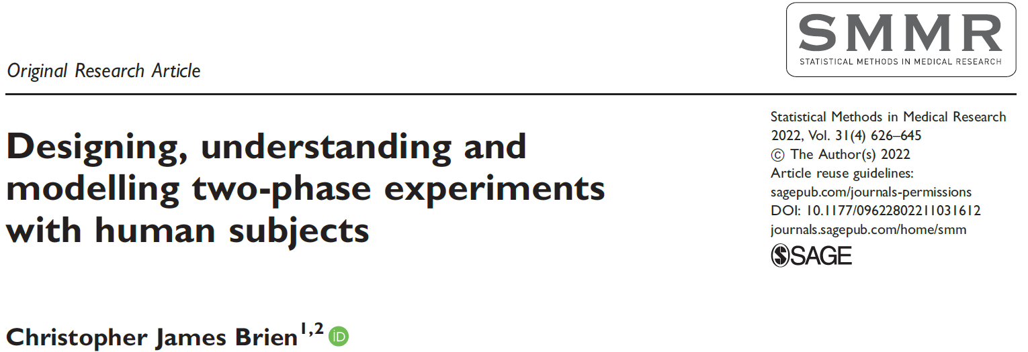
Outline
Two-phase experiments.
A sport science example.
The design for a two-phase pain-rating experiment.
The analysis of the two-phase pain-rating experiment.
Improving the two-phase pain-rating experiment.
Conclusions.

Slide 3
1. Two phase experiments
McIntyre (1955) introduced the term and concept of two-phase experiments.
  A plant experiment with treatments was conducted in a glasshouse.
  Leaf samples from these plants were assayed for TMV in another glasshouse experiment with a different design.
Brien (1983) discussed a general ANOVA approach to their analysis.
  The example was a viticultural field experiment, from which grapes from each plot were made into wine.
  The wine was assessed in a sensory evaluation experiment.
Brien (1992) included two-phase experiments.
Brien and Bailey (2006), in a JRSS read paper, described 6 types of multiple randomizations, providing many examples.
Smith, Lim & Cullis (2006) describe the use of multiphase experiments in plant breeding experiments
Jarrett & Ruggiero (2008) discuss two-phase experiments for microarrays.

Slide 4
Two phase experiments (cont’d)
Walwyn & Roberts (2010) suggested that two-phase experiments may be called for in psychotherapy experiments (citing B&B 2006).
Brien, Harch, Correll & Bailey (2011) suggest that situations in which laboratory analysis follows an initial experiment are likely to require the deployment of two-phase experiments.
  A simple example was an athlete experiment in which track-testing was carried out, after which blood samples had to be taken to the lab for analysis.
Brien (2017) gives a history and a review of the usage of two-phase experiments.
Jarrett, Farewell and Herzberg (2020) identify that an experiment involving pain rating by medical clinicians was a two-phase experiment and discuss its analysis.
Brien (2022) reanalyses the JFW experiment and suggests how the design could be improved upon in future experiments.

Slide 5
Two-phase experiments
The first phase comprises an experiment that employs a design in which factors are allocated to other factors, usually using randomization.
  It will have an outcome that is to be the subject of further experimentation.
  It may also have one or more observed responses as an outcome.
The second phase takes an outcome from the first phase and subjects it further experimentation for which there is allocation of the factors describing the subject from the first-phase.
  There will be at least one observed response from the phase.

Slide 6
2. A sport science example: a standard athlete training example
Peeling et al. (2009) ; Brien, Harch, Correll, Bailey (2011)
9 training conditions to be investigated:
  combinations of 3 surfaces and 3 intensities of training.
Testing is to be conducted over 4 Months:
  In each month, 3 endurance athletes are to be recruited.
  Each athlete will undergo 3 tests, separated by 7 days, under 3 different training conditions.
On completion of each test, the athlete’s heart rate is measured.
4 Months
3 Athletes in M
3 Tests in M, A
3 Intensities
3 Surfaces
9 training conditions
36 tests
Notes:
Split-unit = Split-plot

Slide 7
Factor-allocation for the standard athlete training experiment
4 Months
3 Athletes in M
3 Tests in M, A
3 Intensities
3 Surfaces
9 training conditions
36 tests
Assume the prime interest is in surface differences:
  intensities are only included to observe the surfaces over a range of intensities.
Use a split-unit design.
Training conditions are allocated to tests using a randomized design.
Notes:
Randomization in this case
atheletes and test are the EUs; restrictions are to Athletes in Months and Tests in M,A

Slide 8
The linear mixed model (LMM) for the design
4 Months
3 Athletes in M
3 Tests in M, A
3 Intensities
3 Surfaces
9 training conditions
36 tests
The terms in an LMM are derived from a set of factors in a panel by
  starting with the Mean term;
  then take all possible combinations of the factors in the panel, except that a nested factor must always be accompanied by its nesting factor(s).
Training conditions: Mean, I, S, I:S.
Tests: Mean, M, M:A, M:A:T.
For the LMM, which terms are fixed and which are random?
  Suppose I and S fixed and M, A and T are random.
  Mean + I + S + I:S | Mean + M + M:A + M:A:T.

Slide 9
Understanding a design
What are the properties of a design? What variation affects the treatments?
An anatomy table can be used to answer these questions.
An anatomy table summarizes the confounding in a design.
  Confounding in a design results from the allocations in the design;
  Sources derived from the allocated factors will be confounded with those derived from the recipient factors.
  In the example, it will show how the training conditions terms are mixed up with test terms.
The anatomy is obtained by analyzing a design (not data).
  An eigenanalysis of matrices derived from the indicator matrices (X) for the terms in the model is performed.

Slide 10
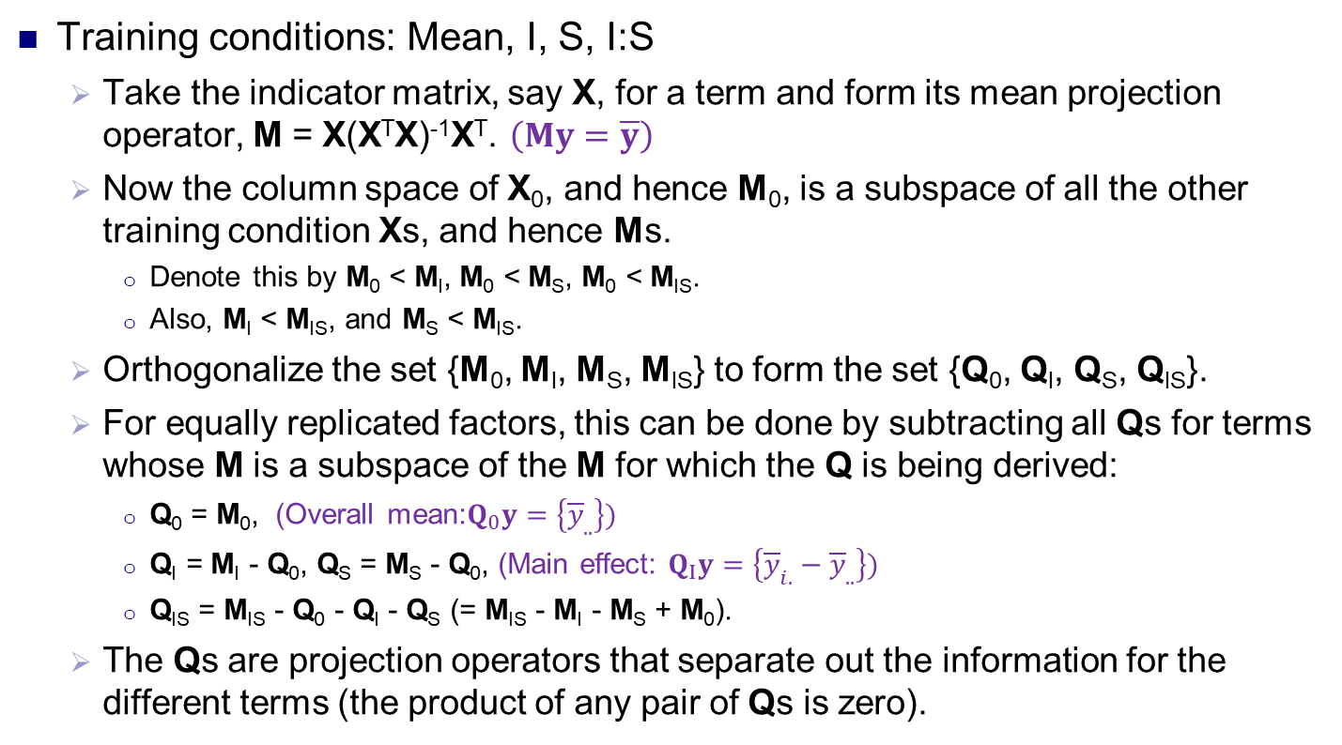
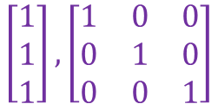
Investigating the confounding in a design
Training conditions: Mean, I, S, I:S
  Take the indicator matrix, say X, for a term and form its mean projection operator, M = X(X^{T}X)⁻¹X^{T}. $\left(My=\overline{y}\right)$
  Now the column space of X₀, and hence M₀, is a subspace of all the other training condition Xs, and hence Ms.
    Denote this by M₀ < M_{I}, M₀ < M_{S}, M₀ < M_{IS}.
    Also, M_{I} < M_{IS}, and M_{S} < M_{IS}.
  Orthogonalize the set {M₀, M_{I}, M_{S}, M_{IS}} to form the set {Q₀, Q_{I}, Q_{S}, Q_{IS}}.
  For equally replicated factors, this can be done by subtracting all Qs for terms whose M is a subspace of the M for which the Q is being derived:
    Q₀ = M₀, (Overall mean:$Q_{0}y=\left\{{\overline{y}}_{..}\right\})$
    Q_{I} = M_{I} - Q₀, Q_{S} = M_{S} - Q₀, (Main effect: $Q_{I}y=\left\{{\overline{y}}_{i.}−{\overline{y}}_{..}\right\})$
    Q_{IS} = M_{IS} - Q₀ - Q_{I} - Q_{S} (= M_{IS} - M_{I} - M_{S} + M₀).
  The Qs are projection operators that separate out the information for the different terms (the product of any pair of Qs is zero).
$$\left[\begin{matrix}1 \\ 1 \\ 1\end{matrix}\right],\left[\begin{matrix}1 & 0 & 0 \\ 0 & 1 & 0 \\ 0 & 0 & 1\end{matrix}\right]$$
(Interaction effects: $Q_{IS}y=\left\{{\overline{y}}_{ij}−{\overline{y}}_{i.}{−\overline{y}}_{.j}+{\overline{y}}_{..}\right\})$

Slide 11
Investigating the confounding in a design
Training conditions: Mean, I, S, I:S
  Have orthogonalized set {Q₀, Q_{I}, Q_{S}, Q_{IS}}.
Tests: Mean, M, M:A, M:A:T
  Similarly, there is the set of mean operators {M₀, M_{M}, M_{MA}, M_{MAT}} and the set of orthogonalized projection operators {P₀, P_{M}, P_{MA}, P_{MAT}}.
To investigate the confounding, perform an eigenanalysis of the PQPs for every pair of P and Q matrices for which PQP is nonzero.
Sumarize in an anatomy table:
  Set of Source and DF columns for training conditions and for tests, plus an expected mean square (EMS) set of columns.

Slide 12
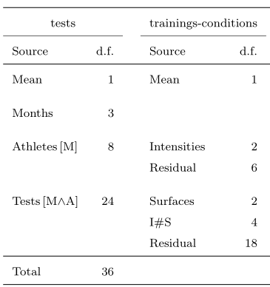
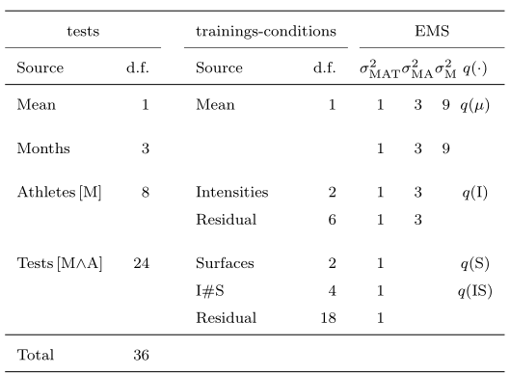
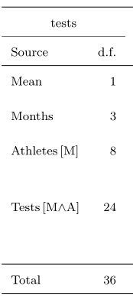
The anatomy of a design
4 Months
3 Athletes in M
3 Tests in M, A
3 Intensities
3 Surfaces
9 training conditions
36 tests
{P₀, P_{M}, P_{MA}, P_{MAT}}
{Q₀, Q_{I}, Q_{S}, Q_{IS}}
  EMS derived from the LMM for the design.
  EMS confirm the effect of the confounding.
    e.g. Intensities subject to MAT and MA variances; Surfaces only subject to MAT variance.
    q(.)-functions are functions of the fixed terms, the same function as the mean square is of the response.
  LMM gives no clues as to the confounding: Mean + I + S + I:S |
  Mean + M + M:A + M:A:T.
While this table can be viewed as a skeleton-ANOVA table, the objective is NOT to formulate an ANOVA to be used in analyzing the data arising from the experiment.
Notes:
List down test sources with df first; add training conditions sources, and Residuals;
E[MSq] show testing and can be used to derive s.e. of mean – standard rules for deriving

Slide 13
Getting the anatomy in R
The R package dae (Brien, 2022), available on CRAN, has the designAnatomy function that produces the anatomy for a design.
#'## Generate a layout for Phase 1 - a split-unit design
ph1.lay <- designRandomize(allocated = fac.gen(list(Intensities = 3, Surfaces = 3),
times = 4),
recipient = list(Months = 4, Athletes = 3, Tests = 3),
nested.recipients = list(Athletes = "Months",
Tests = c("Months", "Athletes")),
seed = 2598)
#'## Check properties of the design
ph1.canon <- designAnatomy(formulae = list(tests = ~Months/Athletes/Tests,
cond = ~Intensities*Surfaces),
data = ph1.lay)
summary(ph1.canon, which.criteria="none")

Slide 14
The anatomy produced by R
> summary(ph1.canon, which.criteria="none")
Summary table of the decomposition for tests & cond
Source.tests df1 Source.cond df2
Mean 1 Mean 1
Months 3
Athletes[Months] 8 Intensities 2
Residual 6
Tests[Months:Athletes] 24 Surfaces 2
Intensities#Surfaces 4
Residual 18

Slide 15
A simple two-phase athlete training experiment
Suppose in the athlete training experiment:
  in addition to heart rate taken immediately upon completion of a test,
  the free haemoglobin is to be measured using blood specimens taken from the athletes after each test, which are to be transported to the lab for analysis.
The experiment is two phase: testing and laboratory phases.
  Testing phase outcomes: heart rate and a blood specimen.
  Laboratory phase outcome: free haemoglobin.
The blood specimens from the first phase need to be processed as soon as possible (not held for 4 months).
4 Months
3 Athletes in M
3 Tests in M, A
4 Batches
9 Locations in B
3 Intensities
3 Surfaces
9 training conditions
36 tests
36 locations
A chain of randomizations is involved.
Have not allowed for an overall, processing-order effect (see Brien, 2017).
Notes:
Note that outcome of a specimen for further analysis is what makes this two-phase.
Locations within the analysis process for a batch

Slide 16
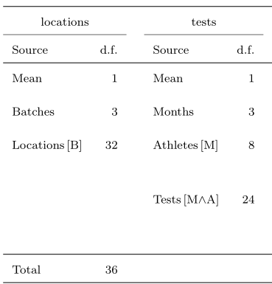
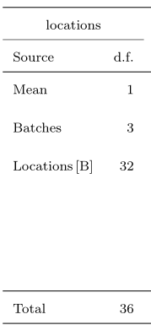
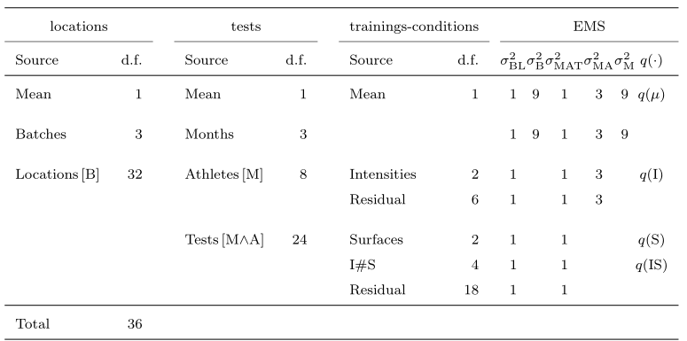
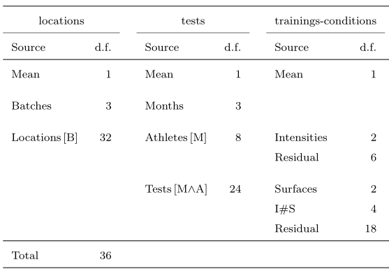
Anatomy of a two-phase athlete training experiment
4 Months
3 Athletes in M
3 Tests in M, A
4 Batches
9 Locations in B
3 Intensities
3 Surfaces
9 training conditions
36 tests
36 locations
Note the chain of confounding Intensities → Athletes[M] → Locations[B]
that often occurs in multiphase experiments.
Also, Surfaces.
Notes:
Dashed line indicates systematic allocation – not randomization

Slide 17
Anatomy (cont’d)
4 Months
3 Athletes in M
3 Tests in M, A
4 Batches
9 Locations in B
3 Intensities
3 Surfaces
9 training conditions
36 tests
36 locations
Note Months exhaustively confounds Batches.
Locations[B]
is exhaustively confounded by Athletes[M] and Tests[MA];
inescapable when the no. of units in the two phases are equal.
Notes:
Dashed line indicates systematic allocation – not randomization

Slide 18
3. The design of a two-phase pain rating experiment (Solomon et al., 1997; Farewell & Herzberg, 2003)
Self-assessment phase:
  8 patients, 4 judged to be expressive and 4 unexpressive.
  Each patient is to undergo a movement on each of 2 occasions.
  Two motions allocated to the occasions: active and passive motion performed without and with assistance.
    For clinical reasons, always active then passive.
  The outcomes are:
    16 videos for 8 patients × 2 Occasions;
    A pain rating by each patient on each occasion.
2 Expressiveness
4 Patients in E
2 Occasions
2 Motions
2 motions
16 videos

Slide 19
Two-phase pain rating experiment (cont’d)
Evaluation phase:
  74 Raters (occupational and physical therapy students) rate pain using the videos from the first phase.
  Half of the raters were randomly chosen to be trained in identifying pain from facial movements, and the other half were untrained.
  Each rater rated the 16 videos, in the same order at 16 viewings.
  The outcome of this phase is the set of 16 differences between patient and rater scores for all raters.
Previously Occasions and Viewings omitted, seen as two sets {2 E, 4 P, 2 M} and {2 T, 37 R}.
2 trainings
2 Trainings
2 Expressiveness
4 Patients in E
2 Occasions
74 Raters
16 Viewings
2 Motions
2 motions
16 videos
1184 episodes

Slide 20
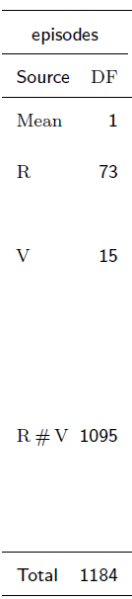
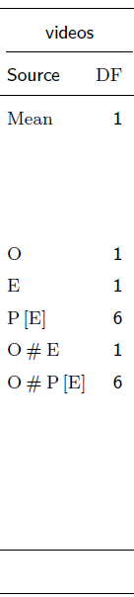
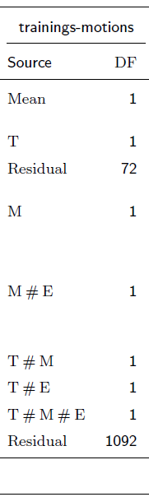
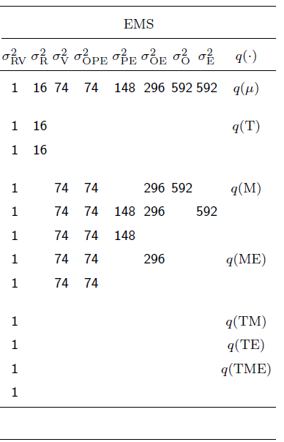
Anatomy of design
74 Raters
16 Viewings
1184 episodes
2 Expressiveness
4 Patients in E
2 Occasions
16 videos
2 Motions
2 motions
2 Trainings
2 trainings
Include interactions for factors of interest, T, M & E.
Without O and V, no confounding exhibited.
Notes:
Ability to test terms and the confounding

Slide 21
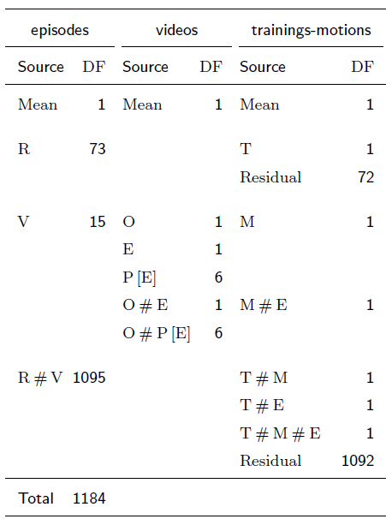
2. Linear mixed model (LMM) analysis
A term for each source.
Suppose any source involving some combo of T, M or E is fixed and the rest are random.
Fixed model:
  Mean + T + M + T:M +
  E + T:E + M:E + T:M:E.
Random model:
  Mean + O + E + O:E + E:P + O:E:P + R + V + R:V.
But model is singular:
  M ≡ O and M:E ≡ O:E.
New random model:
  Mean + E + E:P + O:E:P +
  R + V + R:V.
Dropping O and O#E is not assuming that the terms are zero, but that M and M#E will due to M + O and M:E + O:E.
Tests will be of the combined sources.

Slide 22
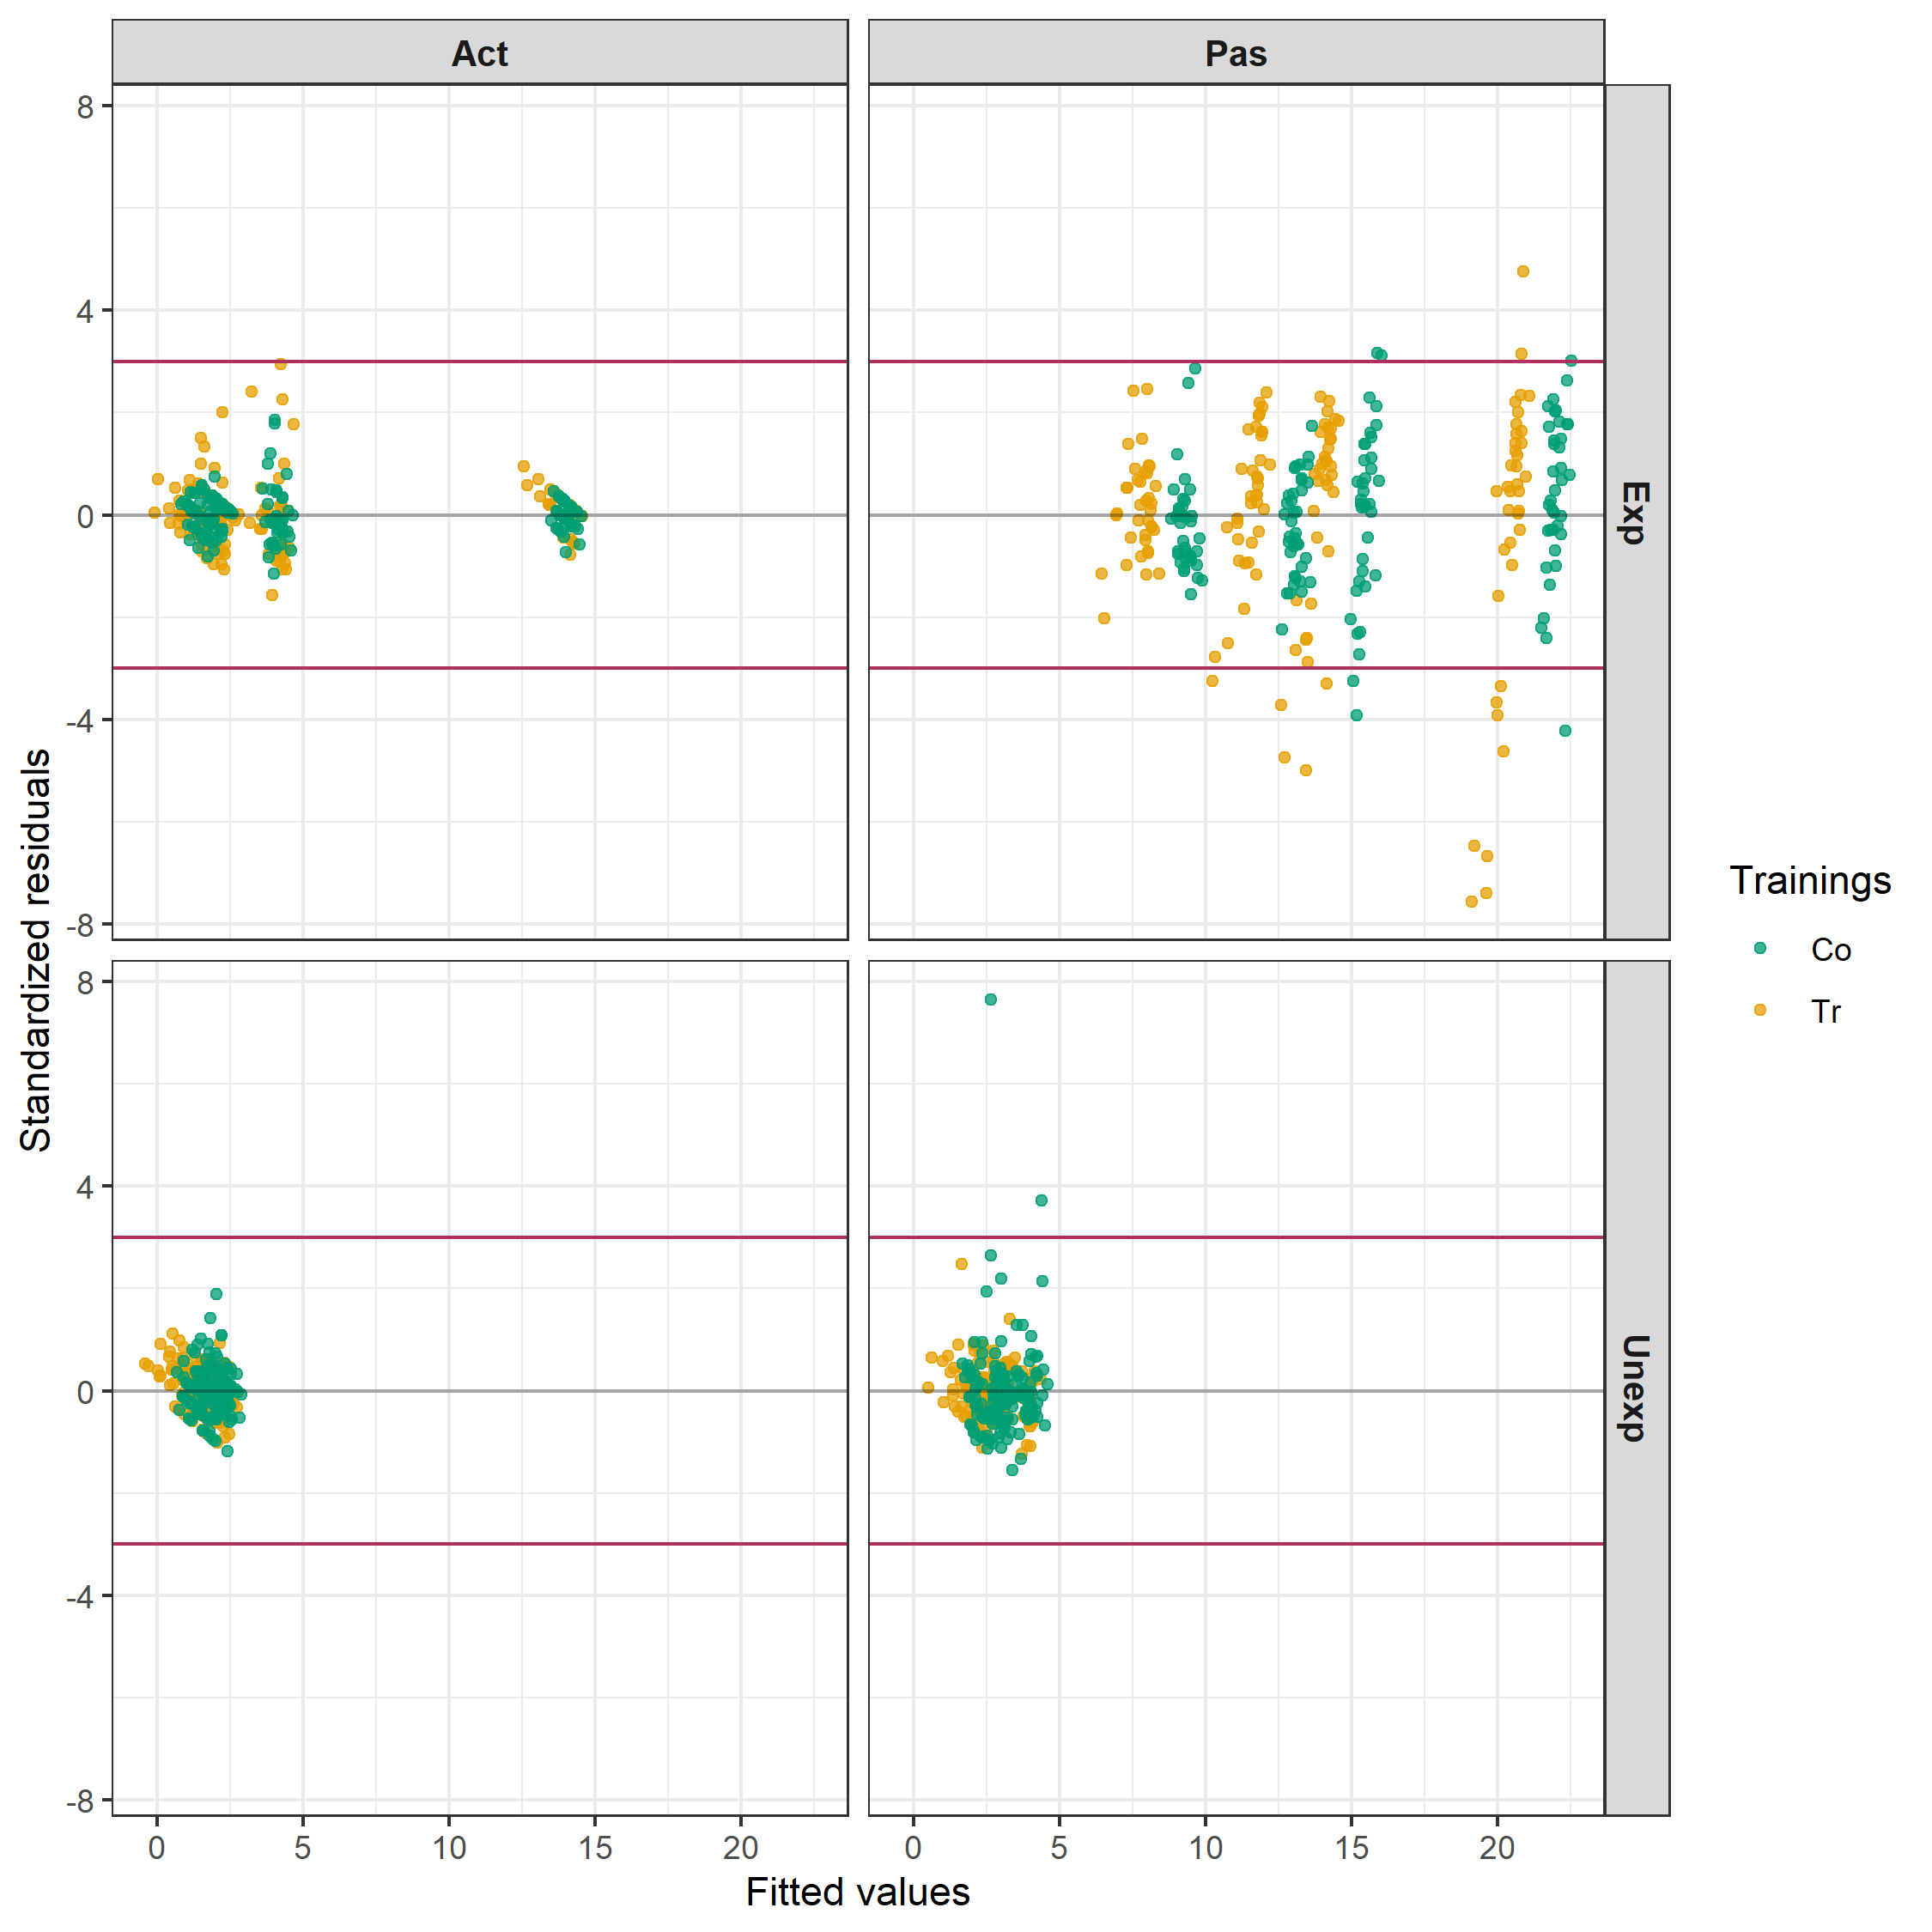
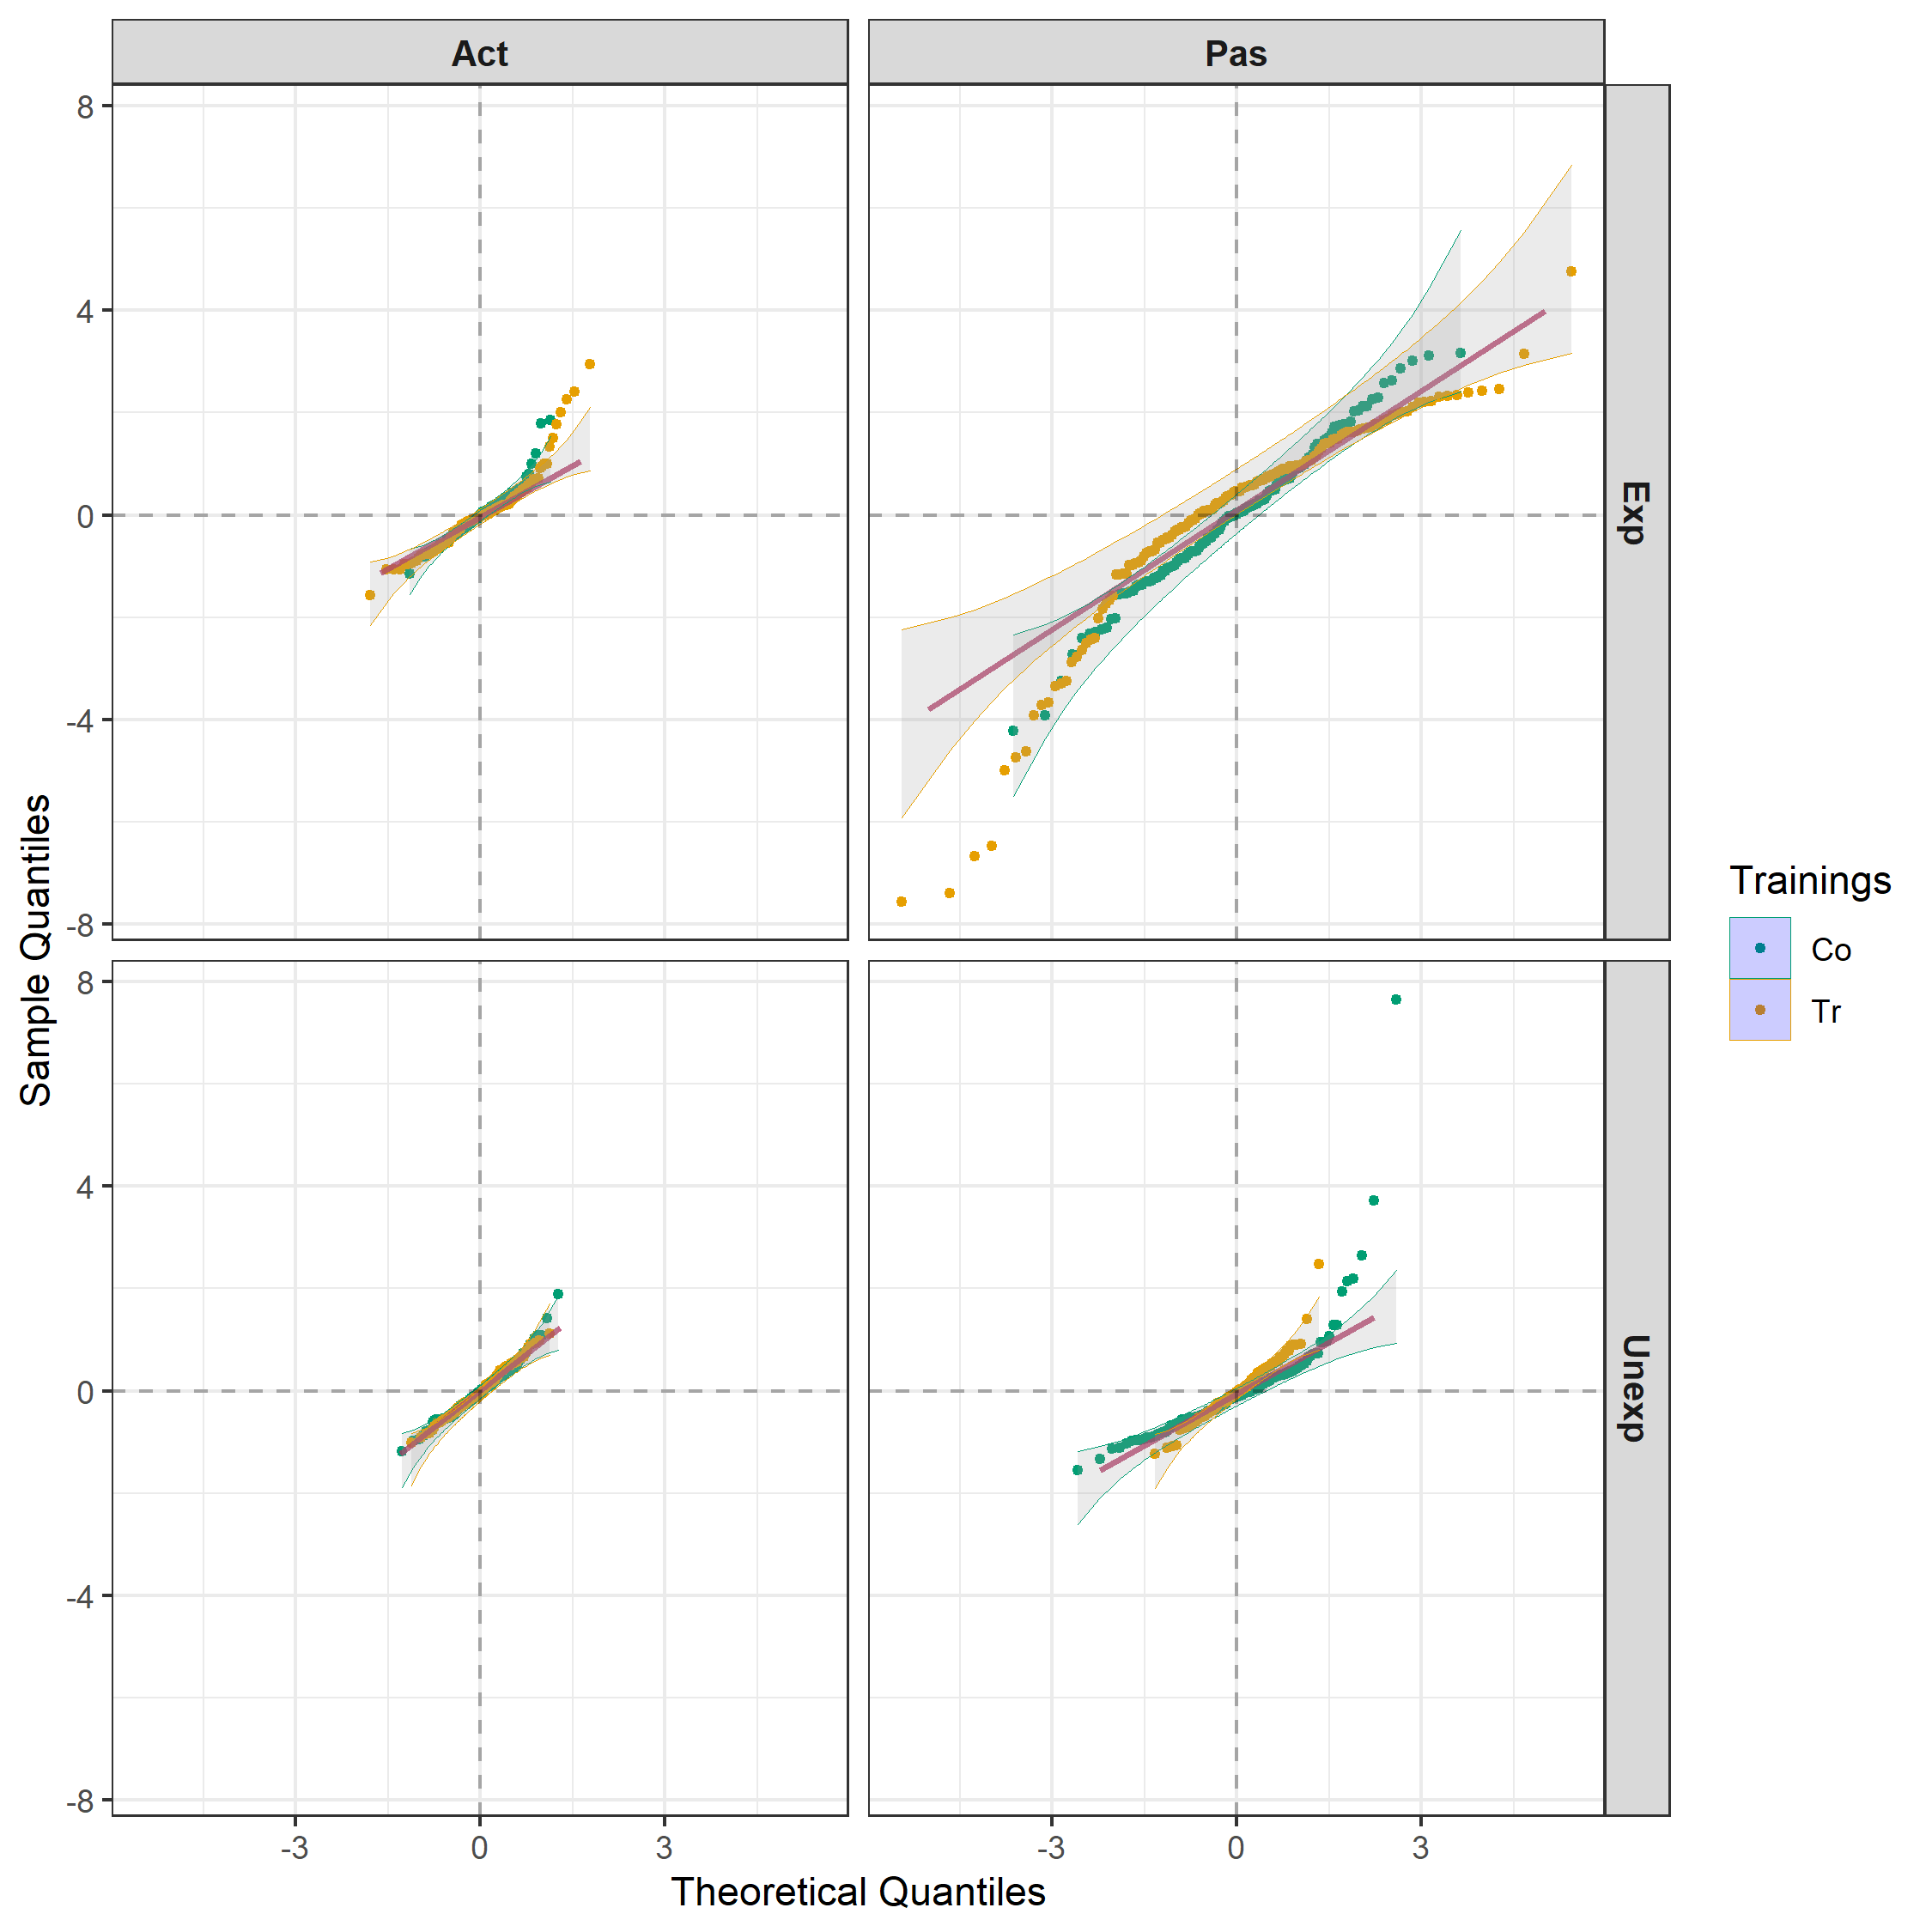
LMM analysis (cont’d)
Mean + T*M*E | Mean + E:P + O:E:P + R + V + R:V
is fitted using asreml (Butler et al., 2020).
Clear evidence of unequal variances and nonnormality.

Slide 23
Intertier (block-treatment) interactions
2 trainings
2 Trainings
2 Expressiveness
4 Patients in E
2 Occasions
74 Raters
16 Viewings
2 Motions
2 motions
16 videos
1184 episodes
The analysis that has been presented assumes no intertier (between panel) interactions, except between the fixed factors T, M and E.
Jarrett, Farewell & Herzberg (2020) showed, using the published data, that further interactions involving the random factors occurred in this case.
There are 6 pairs of panels to consider.
  Cannot include interactions between a factor and the factor to which it is allocated.
  No replication to estimate such interactions e.g. Trainings and Raters, for which there is only one training for each rater.
Random model:
  Mean + E + E:P + O:E:P + R + V + R:V + (T * M):P:E + T:V + R:M + R:O * (E / P)).
Same intertier interactions as J, F & H.

Slide 24
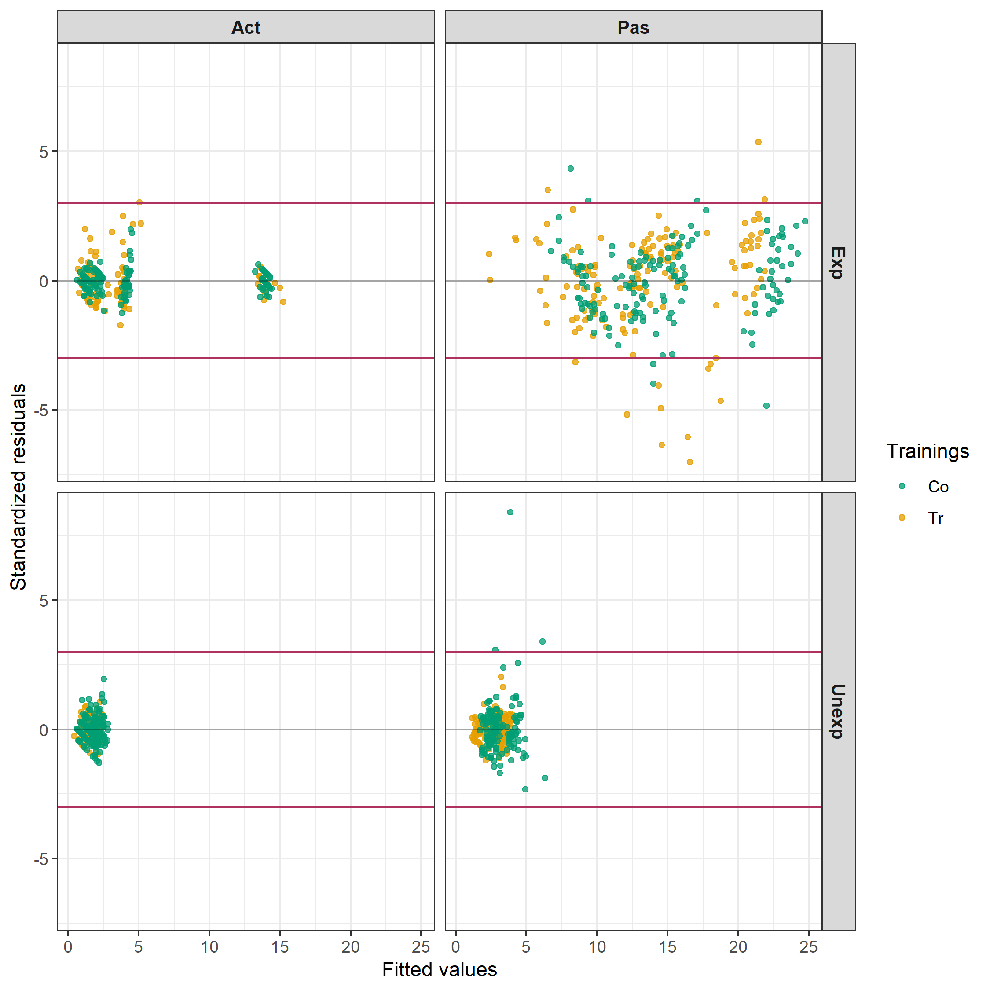
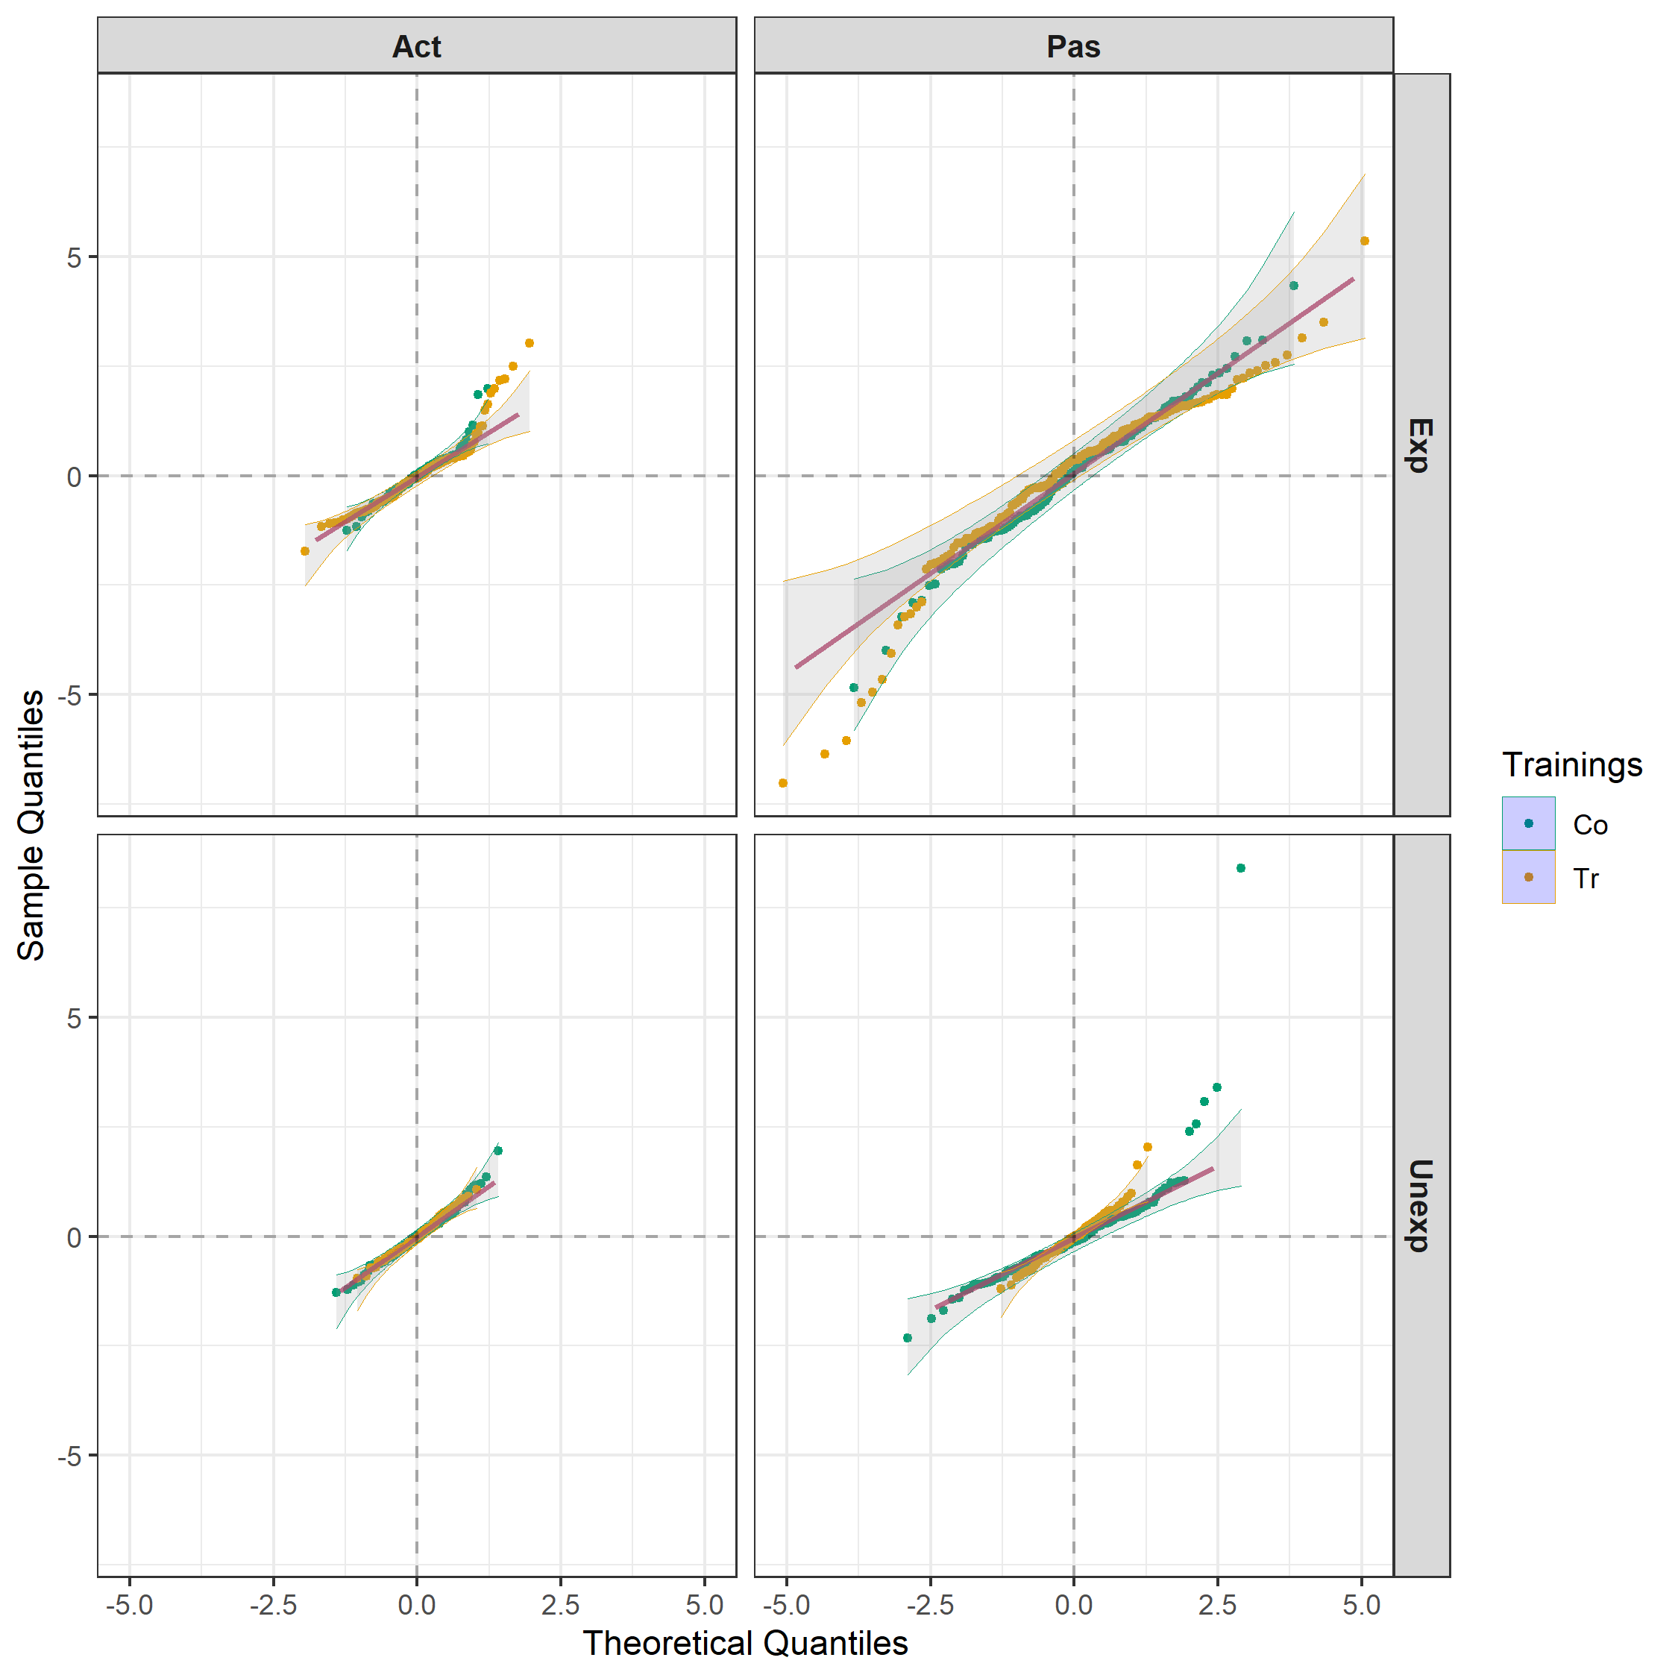
LMM analysis with intertier interaction
Unequal variances and nonnormality remain evident.
Try model that allows for unequal variance between M-E combinations

Slide 25
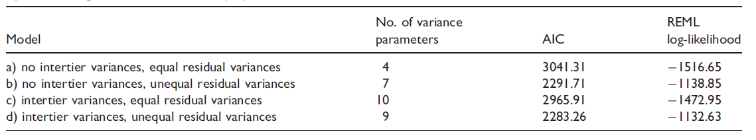
LMM analyses for ± intertier interaction &
± unequal Motion-Expressiveness variances
The combination of the intertier variances and unequal residual variances gives a lower AIC than either model change alone.

Slide 26
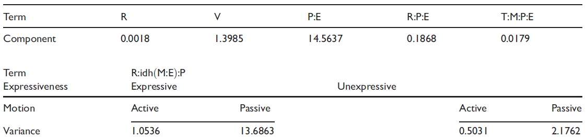
Variance parameters under intertier interaction & unequal Training-Motion variances
(some intertier interactions were zero and so omitted)

Slide 27
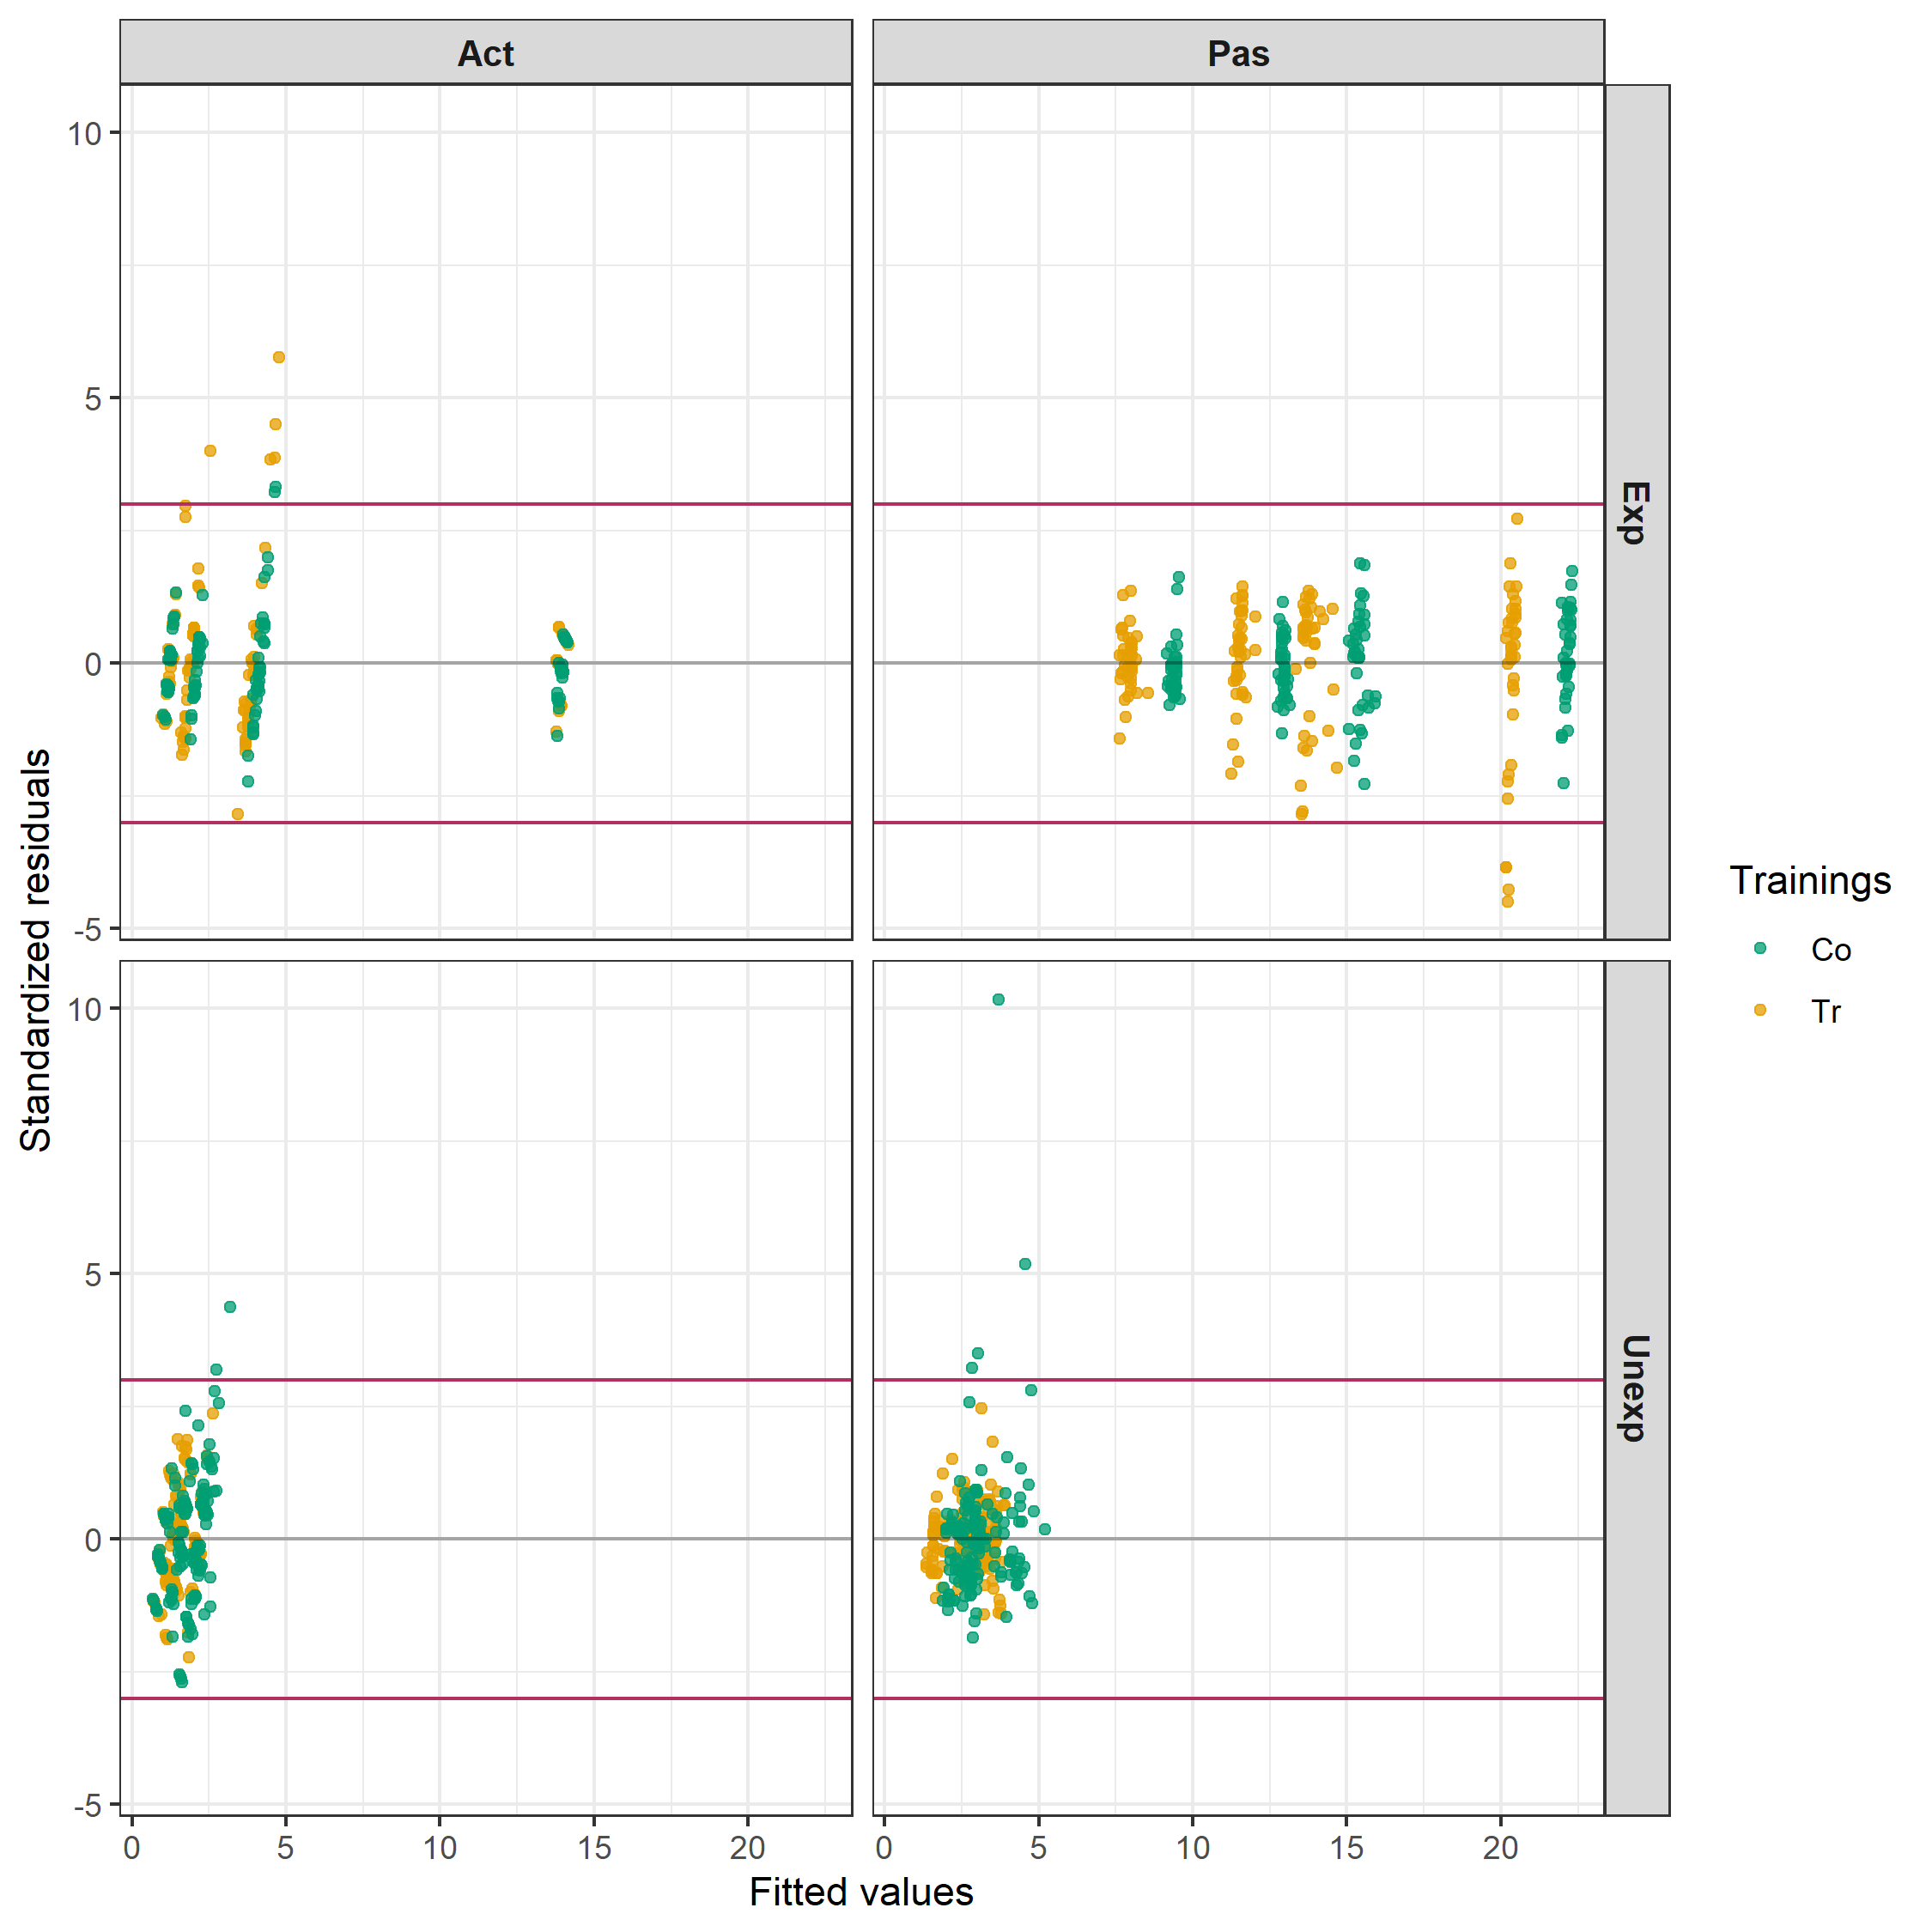
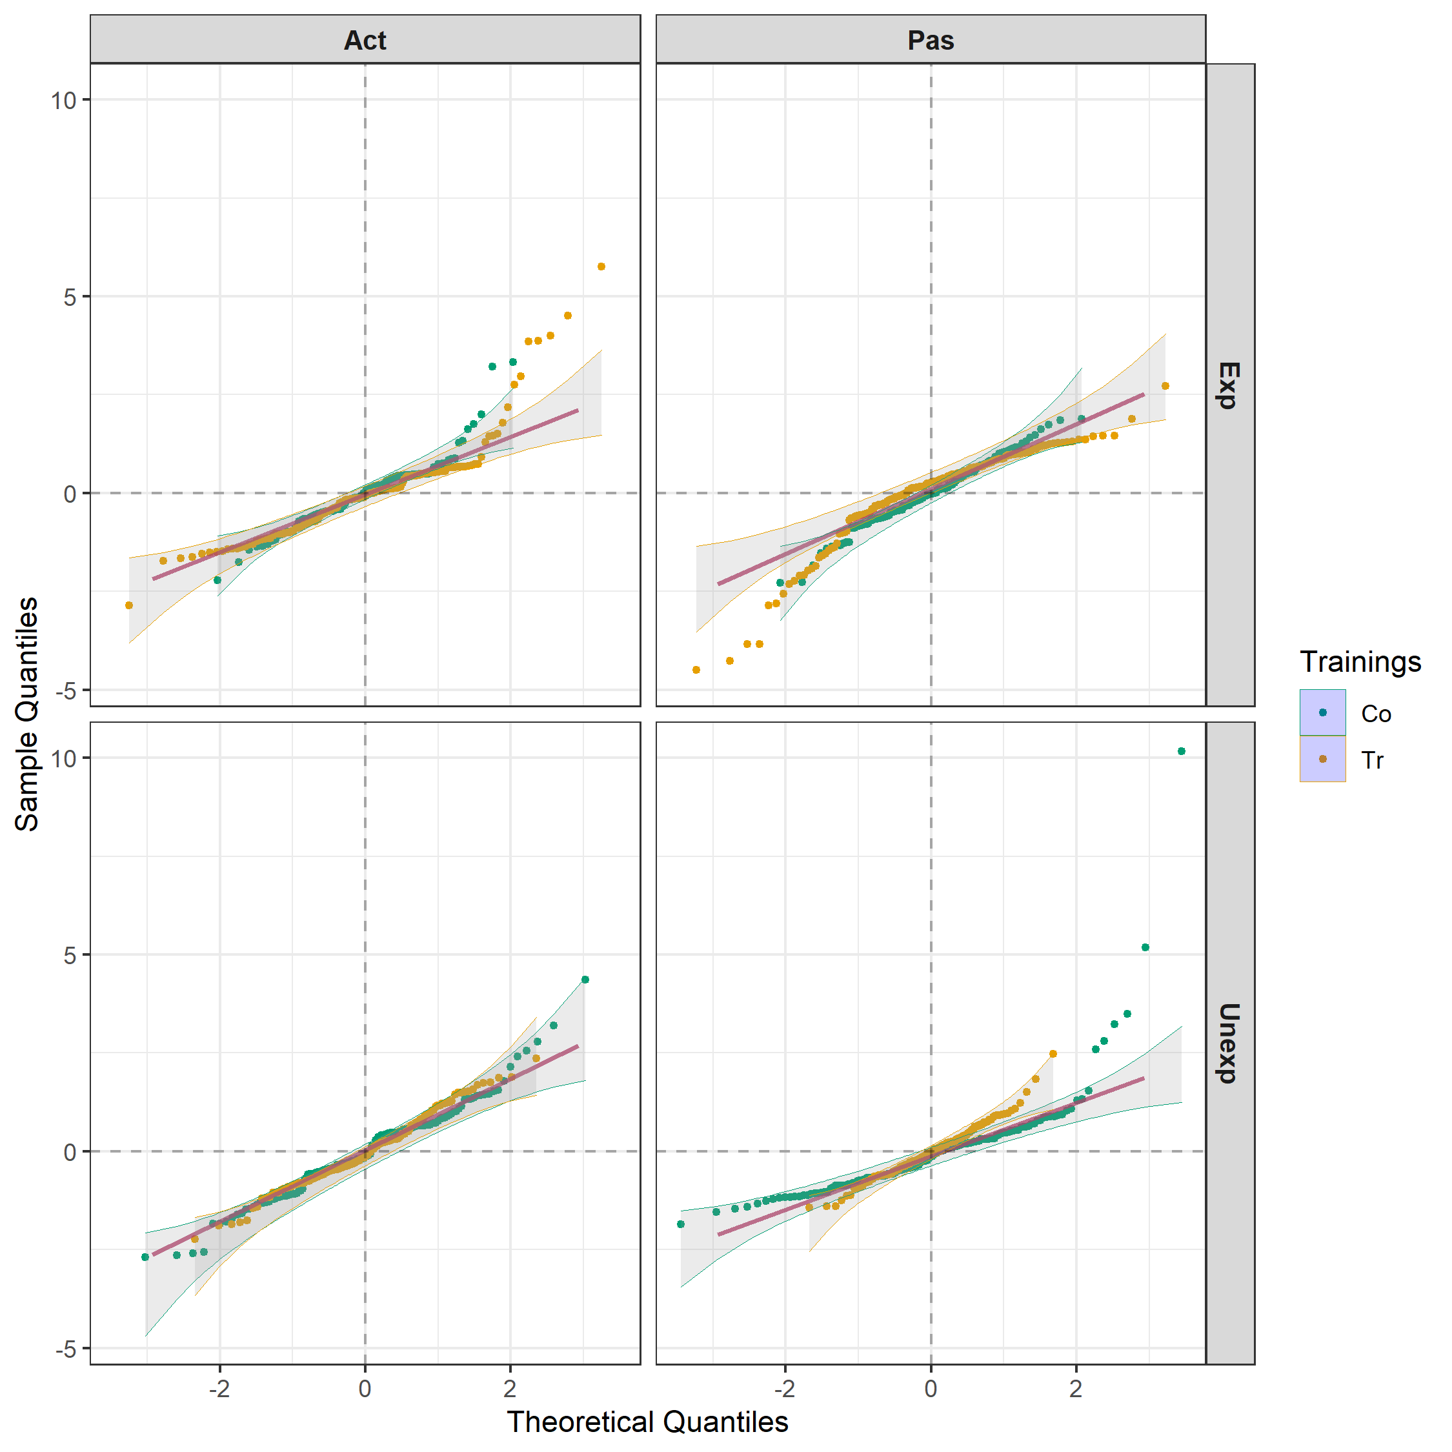
Residuals under intertier interaction & unequal Motion-Expressiveness variances
Evidence of outliers, but approximately homogeneous.

Slide 28
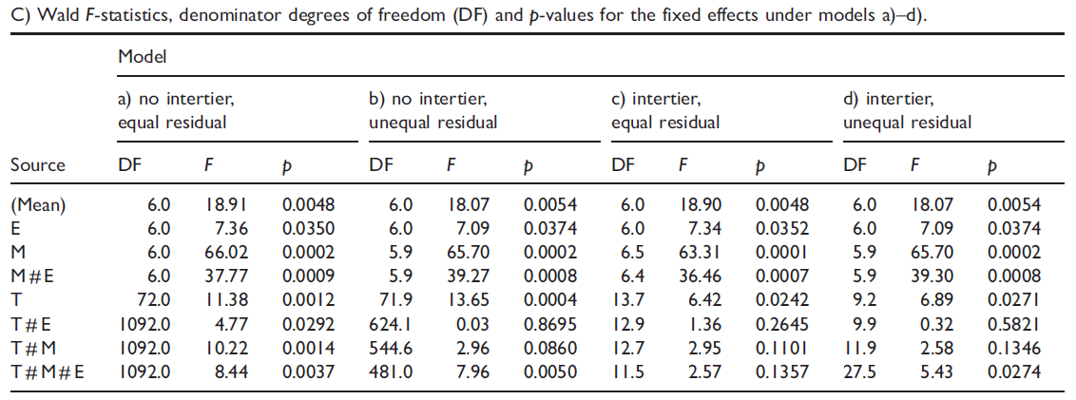
Wald F-tests for the fixed effects under 4 variance models

Slide 29
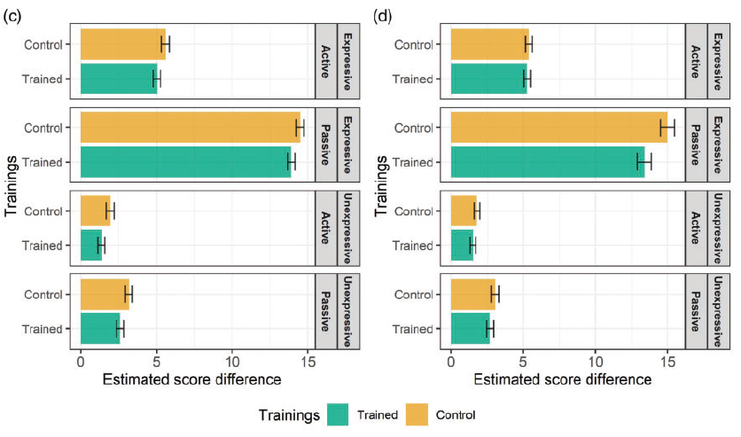
EMM pain rating scores for models c) & d)
Different significances
for the difference between Control and Trained
for Expressive patients doing the Passive.

Slide 30
5. How could the design be improved for this experiment?
Limitations of the design used:
  The Motions are assigned in the same order for the Occasions for all Patients.
  The Videos are viewed in the same order for all Raters.
  The post-hoc power was estimated via simulation to be 0.462 under the model with intertier interactions and unequal variance. Can this be improved?

Slide 31
What to do about the order effects
Motion order
  Probably, not feasible to change.
Video order
  Perhaps a technological limitation at the time, which has now been overcome. Assume that is has.
  The question becomes does the design need to allow for a Viewing order effect.
    There is no evidence available from the original experiment because Videos (O:E[P]) is confounded with Viewings.
    It seems that it is likely to be prudent to allow for it, unless it can be ruled out.

Slide 32
The power problem
The estimated variances show that overall Patient differences are a large source of variability and that Raters are a small variability source.
  Thus, increasing the number of Patients and decreasing the number of Raters will result in more precision for the EMMs for the fixed terms.
Note V = V + O:E[P] – will assume the majority is Viewings.

Slide 33
New design
2 trainings
2 Trainings
64 Raters
16 Viewings
2 P₁
8 Patients in E
2 Expressiveness
2 Occasions
4 P₂ in P₁
2 Motions

2 motions
32 videos
1024 episodes
4 → 8 patients results in 16 → 32 videos.
74 → 64 raters results in 1184 → 1024 episodes.
But 32 videos and 16 viewings → divide the 8 patients within each Expressiveness into 2 groups,
  combine a group from each Expressiveness to form 2 groups of 8 and index by the pseudofactor P₁.
Randomize the 2 P₁ levels in combination with Trainings to the 64 Raters so that there are 16 Raters per combination.
Randomize 4 Patients x 2 Expressiveness x 2 Occasions to 16 Viewings using a row-column design.
  The design is based on four 16 x 16 Latin squares, but is nonorthogonal. Why?

Slide 34
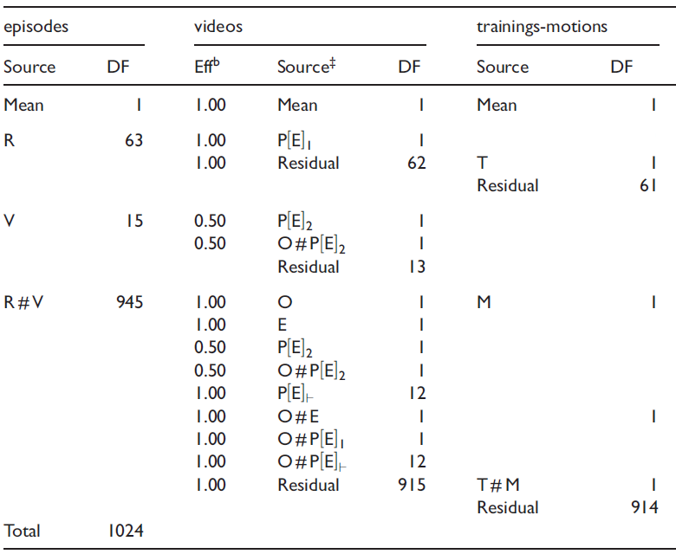
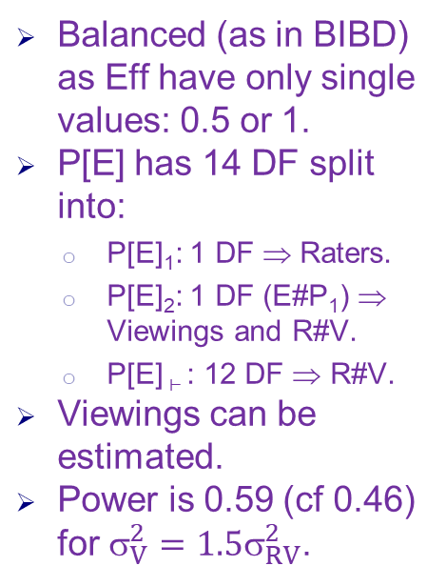
Anatomy of new design (no intertier interactions)
Balanced (as in BIBD) as Eff have only single values: 0.5 or 1.
P[E] has 14 DF split into:
  P[E]₁: 1 DF ⇒ Raters.
  P[E]₂: 1 DF (E#P₁) ⇒ Viewings and R#V.
  P[E] ⊢ : 12 DF ⇒ R#V.
Viewings can be estimated.
Power is 0.59 (cf 0.46) for $_{V}^{2}={1.5}_{RV}^{2}$.
Notes:
The 12 DF is P[E^P_1].
Power assumes most of phi_V + phi_OPE is phi_V – makes a row-column design appropriate.

Slide 35
6. Conclusions
Two-phase experiments involve a design at each phase.
A common type of multiphase experiment is one that has an initial experiment that is followed by a lab phase.
The occurrence of multiphase experiments with human subjects has been largely unrecognized.
Linear mixed models involve terms from both phases
  singularities have to be dealt with.
  Intertier interactions and heterogeneous variances may need to be included.
An anatomy:
  exposes the confounding arising from the allocations used in the design;
  exhibits the singularities in a linear mixed model for a design.
  R package dae can be used to obtain the anatomy.
    Available from CRAN or the repository at http://chris.brien.name/rpackages
Thank you for your attention!

Slide 36
References
Brien, C. J. (1983). Analysis of variance tables based on experimental structure. Biometrics, 39(1), 53-59.
Brien, C. J. (1992). Factorial Linear Model Analysis. (Ph. D. thesis). University of Adelaide, Adelaide, South Australia.
Brien, C. J., & Bailey, R. A. (2006). Multiple randomizations (with discussion). Journal of the Royal Statistical Society, Series B (Statistical Methodology), 68(4), 571-609.
Brien, C. J. (2012). Comments on ‘Therapist variation within randomized trials of psychotherapy: Implications for precision, internal and external validity’. Statistical Methods in Medical Research, 21, 215-216.
Brien, C. J. (2017). Multiphase experiments in practice: A look back. Australian & New Zealand Journal of Statistics. 59(4), 327-352..
Brien, C. J. (2022). Designing, understanding and modelling two-phase experiments with human subjects. Statistical Methods in Medical Research, 31(4), 626-645.
Brien (2022) dae: Functions useful in the design and ANOVA of experiments. Version 3.2-.3. http://cran.r-project.org/package=dae/.
Brien, C.J., Harch, B.D., Correll, R.L. and Bailey, R.A. (2011) Multiphase experiments with at least one later laboratory phase. I. Orthogonal designs. J. Agr. Biol. Env. Stat., 16(3): 422-450.
Butler, D. G., Cullis, B. R., Gilmour, A. R., Gogel, B. J., & Thompson, R. (2020). ASReml-R reference manual. Version 4.1.0.130. Retrieved from http://asreml.org
Farewell, V. T., & Herzberg, A. M. (2003). Plaid designs for the evaluation of training for medical practitioners. Journal of Applied Statistics, 30(9), 957-965.
Jarrett, R. G., Farewell, V. T., & Herzberg, A. M. (2020). Random effects models for complex designs. Statistical Methods in Medical Research, 29(12), 3695-3706.
Jarrett, R. G., & Ruggiero, K. (2008). Design and Analysis of Two-Phase Experiments for Gene Expression Microarrays—Part I. Biometrics, 64(1), 208-216.
McIntyre, G. A. (1955). Design and analysis of two phase experiments. Biometrics, 11(3), 324-334.
Peeling, P., Dawson, B., Goodman, C., Landers, G., Wiegerinck, E. T., Swinkels, D. W., & Trinder, D. (2009). Training Surface and Intensity: Inflammation, Hemolysis, and Hepcidin Expression. Medicine & Science in Sports & Exercise, 41(5), 1138-1145.
Smith, A. B., Lim, P., & Cullis, B. R. (2006). The design and analysis of multi-phase plant breeding experiments. The Journal of Agricultural Science, 144(05), 393-409.
Solomon, P. E., Prkachin, K. M., & Farewell, V. (1997). Enhancing sensitivity to facial expression of pain. Pain, 71(3), 279-284.
Walwyn, R., & Roberts, C. (2010). Therapist variation within randomised trials of psychotherapy: implications for precision, internal and external validity. Statistical Methods in Medical Research, 19(3), 291-315.

