Slide 1
Anatomies of experimental designs: a case study for a p/q-rep multiphase design
Chris Brien
Phenomics and Bioinformatics Research Centre, University of South Australia;
The Plant Accelerator, University of Adelaide
http://chris.brien.name/multitier
Chris.brien@unisa.edu.au
Notes:
Have 15 mins + 2 mins for questions

Slide 2
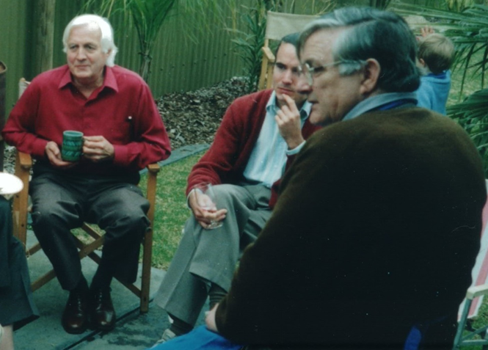
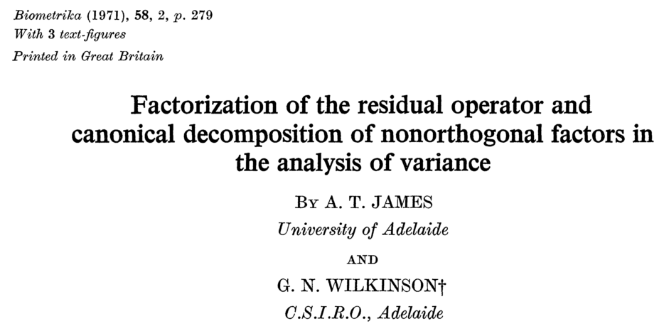
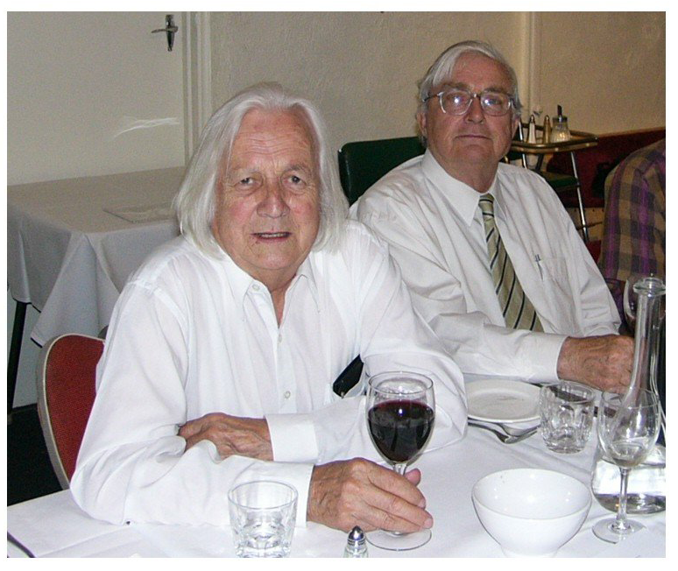
Graham Neil Wilkinson (1927 – 2016)
— talk dedicated to Wilko (and Allan)
The anatomy of an experimental design is derived from its canonical decomposition, in the manner James & Wilkinson (1971) describe.
James & Wilko, Wine bottling, Adelaide, 1991
James & Wilko, 2003
Notes:
According to Graham this paper was written one long weekend over a flagon of red in a beach-house at Aldinga Beach south of Adelaide – might have even been a red that Allan had made himself.
Although Wilko might be rolling over in his grave because I have abandoned his beloved algorithm. Well, we have a lot more computing power so why not just get the projectors and do an eigenanalysis of them?
1971 was an auspicious year in a number of ways: this paper published, Wilko went to Rothamsted and I completed my undergrad degree in Sydney and started work in Adelaide, my first task being to learn GenStat

Slide 3
A question
You are considering a design for an experiment.
It is a block design that is not orthogonal because the no. of units per block is less than the no. of treatments.
You want the design to have most of the treatment information:
  estimated within blocks; or
  confounded with differences between units within blocks.
Is this the case for your design?

Slide 4
An anatomy or canonical analysis of a design
Provides information about the confounding in the experiment:
  In your example, where is the treatment information?
  How much ttreatment information is confounded with each units source/term?
In GenStat 19th edn have the following procedures for producing the anatomy:
  ACANONICAL
  ACDISPLAY
  ACKEEP
Equivalent functionality available in R via the CRAN package dae.

Slide 5
1. A design from Cochran and Cox (1957, p. 379)
 | Blocks
Units | I | II | III | IV | V | VI
1 | 1 | 2 | 3 | 4 | 5 | 6
2 | 4 | 5 | 6 | 1 | 2 | 3
3 | 2 | 3 | 1 | 5 | 6 | 4
4 | 5 | 6 | 4 | 2 | 3 | 1
6 Blocks
4 Units in B
6 Treatments

6 treatments
24 units
26 "Input the design and randomize"
27 UNITS [24]
28 FACTOR [LEVELS=6] Blocks & [LEVELS=4] Units
29 & [LEVELS=6] Treatments; !(1,4,2,5, 2,5,3,6, 3,6,1,4, \
30 4,1,5,2, 5,2,6,3, 6,3,4,1)
31 GENERATE Blocks,Units
32 RANDOMIZE [Blocks/Units] Treatments

Slide 6
Producing its anatomy
6 Blocks
4 Units in B
6 Treatments

6 treatments
24 units
35 ACANONICAL [CRITERIA='aeff', 'xeff', 'eeff','order'] \
36 FORMULAE = !p(!f(Blocks/Units), !f(Treatments))
aefficiency xefficiency eefficiency order
0.2500 0.2500 0.2500 1
0.8824 1.0000 0.7500 2
Source d.f.
Blocks 5
Treatments 2
Residual 3
Blocks.Units 18
Treatments 5
Residual 13
The answer to the question:
  A good amount (88.24%) of the Treatments information is estimated within blocks;
  Some contrasts are completely confounded within blocks (efficiency one);
  Two contrasts have 75% estimated within blocks.
  A is the harmonic mean of the efficiency factors.
  X is the maximum of the efficiency factors.
  E is the minimum of the efficiency factors.
  Order is the number of unique efficiency factors.

Slide 7
What do you need?
What is the purpose?
6 Blocks
4 Units in B
6 Treatments

The evaluation of the design.
Insight into the analysis of the experiments based upon it.
  Are there sources that are completely confounded with each other?
6 treatments
24 units
The tiers: the sets of factors that reflect the allocation.
  the unallocated factors are {Blocks, Units};
  the allocated factor is {Treatments}.
The relationships between the factors within a tier.
  Units within Blocks (given the allocation).
The layout for the experiment.
What don’t you get?
The analysis of the data.
  Use one of ANOVA; AUNBALANCED; AMTIER; REGRESS; REML.
  For REML, the terms in the mixed model are the sources in the anatomy.

Slide 8
How is it done?
Get the Mean projectors (X[X^{T}X]⁻¹X^{T}) for terms in each tier:
  Treatments: M₀, M_{T}.
  Blocks, Block.Units: M₀, M_{B}, M_{BU}.
Orthogonalize summation projectors by differencing:
  Treatments: Q₀ = M₀, Q_{T} = M_{T} ⁻ M₀.
  Blocks, Block.Units: Q₀ = M₀, Q_{B} = M_{B} ⁻ Q₀, Q_{BU} = M_{BU} ⁻ Q₀ ⁻ Q_{B}.
  It can be shown that for each set the projectors are orthogonal.
Now compare Treatments projector (Q_{T}) with Units projectors (Q_{B}, Q_{BU}) by computing the nonzero eigenvalues of
  Q_{B}Q_{T}Q_{B}, which has two nonzerp values, both 0.25
  Q_{BU}Q_{T}Q_{BU}, which has five nonzero values: three are 1 and two are 0.75.
  This information is summarized in the anatomy table.

Slide 9
2. A field experiment — a single phase p-rep
(Cullis, Smith & Coombes, 2006)
576 Lines on 60 rows × 12 columns.
Dashed line because Lines are allocated to the plots factors, but not using classic randomization.
576 Lines
2 Blocks
30 Rows in B
12 Columns

ρ
576 lines
720 plots
144 Lines are to be duplicated — p = 0.25.
Local spatial correlation is expected.
A spatially-optimized design is obtained using od for the following mixed model:
  Blocks | Lines + Blocks.Rows + Columns + Blocks.Columns +
  Blocks.Rows.Columns.
  γ_{L} = 1, γ_{BR} = 0.5, γ_{C} = 0.1, γ_{BC} = 0.05, φ_{BRC} = 1, ρ_{BR} = 0.6, ρ_{BR} = 0.4.
  Average Variance of Pairwise Lines Differences (AVPD) = 0.474 φ_{BRC}.

Slide 10
Canonical analysis of the design: investigating its anatomy
Want to look at the relationships of the lines terms to the plots terms.
The plots terms:
  Blocks + Blocks.Rows + Columns + Blocks.Columns + Blocks.Rows.Columns.
The lines term:
  Lines.
Using GenStat:
  ACANONICAL [CRITERIA='aeff','meff','eeff','dfor','order'] \
  FORMULAE = !p(!f((Blocks/Rows)*Columns), \
  !f(Lines))
+ the factors for a layout
Again form projectors for terms in each formula by differencing

Slide 11
GenStat canonical analysis
aefficiency mefficiency eefficiency dforth order
0.6000 0.6000 0.6000 0 1
0.7907 0.7939 0.7098 0 11
0.7839 0.8000 0.5536 0 58
0.8031 0.8061 0.7184 0 11
0.4412 0.8877 0.0161 494 82
Source d.f.
Blocks 1
Lines 1
Columns 11
Lines 11
Blocks.Rows 58
Lines 58
Blocks.Columns 11
Lines 11
Blocks.Rows.Columns 638
Lines 575
Residual 63
  A is the harmonic mean of the efficiency factors.
  M is the mean of the efficiency factors.
  E is the minimum of the efficiency factors.
  Dforth is the number of efficiency factors equal to one.
  Order is the number of unique efficiency factors.
A lot of information about some Lines contrasts in other than Blocks.Rows.Columns (plots).
Concentrate on the last Lines source

Slide 12
GenStat canonical analysis
aefficiency mefficiency eefficiency dforth order
0.6000 0.6000 0.6000 0 1
0.7907 0.7939 0.7098 0 11
0.7839 0.8000 0.5536 0 58
0.8031 0.8061 0.7184 0 11
0.4412 0.8877 0.0161 494 82
Source d.f.
Blocks 1
Lines 1
Columns 11
Lines 11
Blocks.Rows 58
Lines 58
Blocks.Columns 11
Lines 11
Blocks.Rows.Columns 638
Lines 575
Residual 63
Lines efficiencies
≤0.1 | 0.1-0.2 | 0.2-0.3 | 0.3-0.4 | 0.4-0.5 | 0.5-0.6 | … | 1
23 | 21 | 17 | 12 | 7 | 1 |  | 494
A lot (86%) of orthogonal df in Plots.
But, a lot of efficiencies close to 0 in Plots, which is to be expected for for p-rep designs
— distorts A so M better?

Slide 13
If Blocks.Columns is very unlikely can remove
Source d.f. aefficiency mefficiency eefficiency dforth order
Blocks 1
Lines 1 0.6000 0.6000 0.6000 0 1
Blocks.Rows 58
Lines 58 0.7839 0.8000 0.5536 0 58
Columns 11
Lines 11 0.7907 0.7939 0.7098 0 11
Blocks.Rows.Columns 649
Lines 575 0.5175 0.9031 0.0205 505 71
Residual 74
Canonical analysis:
  More lines information in Blocks.Rows.Columns and more Residual df’
  Still some information about Lines almost orthogonal to Blocks.Rows.Columns.
AVPD = 0.470φ_{BRC}. (minor change – was 0.474φ_{BRC}.)

Slide 14
Advantages and disadvantages
Canonical analysis
  shows the anatomy of the design: where the information is in the design and the nonorthogonality that is present.
  Do not need to specify the variance parameter values and not dependent on them.
  Limited relationship with AVPD
    When variance-components-only model and equally replicated aefficiency is directly related AVPD, otherwise it is a replication-weighted version.
    Not such a problem if only characterizing a design, rather than searching for an optimal design.
AVPD
  Is a measure of the precision in the experiment that gives equal weight to all contrasts, as is likely to be wanted here.
  Need to specify the variance parameter values because dependent on them.

Slide 15
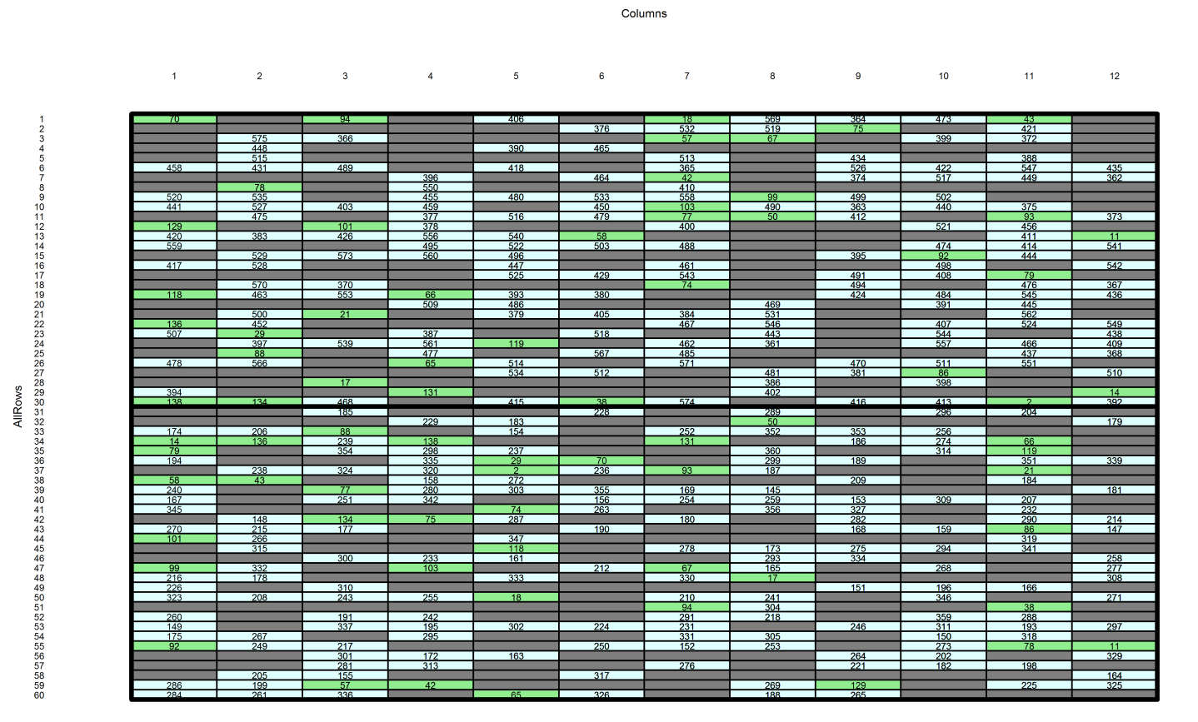
3. Select a fraction of the plots for a milling phase
(Smith, Lim & Cullis, 2006)
Take 333 unduplicated and 37 duplicated lines on to milling phase (= 370 lines).
Of the unduplicated Lines, 41 are duplicated in the milling phase — q = 0.10 (of plots).
576 Lines
2 Blocks
30 Rows in B
12 Columns


ρ
407 Plots
f
1,2 Samples in P
576 lines
720 plots
448 samples
What will happen here as compared to previous design?
  Answer: Blocks, Rows and Columns will no longer be orthogonal — is called partial aliasing.
  Also, Lines confounding will change.
Notes:
Hopefully, you are still with me. But take a deep breath as we tackle the p/q-rep two-phase design.
q is the proportion of the 407 plots

Slide 16
GenStat canonical analysis for fraction
(without Blocks.Columns)
  ACANONICAL [CRITERIA='meff','eeff','dfor','order'] \
  FORMULAE = !p(!f((Blocks/Rows)*Columns), \
  !f(Lines)); \
  ORTHOGONALMETHOD = !t('eigen', 'diff')
Table of efficiency criteria for aliasing between terms within a structure
Source d.f. mefficiency eefficiency dforth order
Columns 11 0.9217 0.8766 0 11
The terms are fitted in the order Blocks, Blocks.Rows and Columns (see next slide).
Eleven df for Columns is aliased with Block and Blocks.Rows but 92.1% of the information is retained.
The analysis will depend on whether Columns is fitted first or not, but not greatly given the high aefficiency.

Slide 17
A GenStat canonical analysis for fraction
(without Blocks.Columns and based on adjusted quantities)
Source d.f. mefficiency eefficiency dforth order all plots
Blocks 1
Lines 1 0.8348 0.8348 0 1 0.6000
Blocks.Rows 58
Lines 58 0.9140 0.5363 22 37 0.8000
Columns 11
Lines 11 0.9139 0.8139 0 11 0.7939
Blocks.Rows.Columns 336
Lines 336 0.9080 0.0078 299 38 0.9031
Blocks.Rows.Columns.Samples 41
Not unique, but the Block.Rows.Colums strata is.
Of the 369 Lines df, 336 are estimable in Blocks.Rows.Columns, including 299 (81%) only there.
There are 33 Lines df estimable elsewhere, with 22 of these orthogonally confounded with Blocks.Rows.
The mefficiency for the 369 Lines df in Blocks.Rows.Columns is 0.8268 (= 0.9080 x 336 / 369).
Blocks.Rows.Columns.Samples has full 41 df.

Slide 18
Milling-phase allocation for the p/q-rep design
There are 448 time-locations for milling required:
  Take 16 days divide them into 2 intervals.
  Each day there are 28 time-locations for milling.
Samples are assigned to locations using two pseudofactors, S₁ and P₁:
  The 448 samples are assigned to the 2 levels of S₁ so that milling duplicates have different levels and, as far as is possible, so do plots from different blocks;
  The 224 plots in each level of S₁ are assigned to the 224 levels of the pseudofactor P₁ in Rows-Columns order:
    The 224 plots are comprised of those (i) for the 41 lines that are milling-duplicated, (ii) from the same block for the 37 lines that are field duplicated, and (iii) for 183 lines that are from the same block as (ii) or rows nearby.
  S₁ is randomized to Intervals and P₁ is systematically allocated to the Days-Locations combinations, the design being nonorthogonal
576 Lines
12 Columns
30 Rows in B
2 Blocks

8 Days in I
28 Locations
2 Intervals


224 P₁
ρ
407 Plots
f
1,2 Samples in P
2 S₁
576 lines
720 plots
448 samples
448 locations

Slide 19
GenStat canonical analysis for the two-phases
576 Lines
12 Columns
30 Rows in B
2 Blocks

8 Days in I
28 Locations
2 Intervals


224 P₁
ρ
407 Plots
f
1,2 Samples in P
2 S₁
576 lines
720 plots
448 samples
448 locations
ACANONICAL [CRITERIA='meff','eeff','dforth','order'] \
FORMULAE = !p(!f((Intervals/Days)*Locations), \
!f(((Blocks/Rows)*Columns)/Samples), \
!f(Lines)); \
ORTHOGONALMETHOD = !t('diff', 'eigen', 'diff')
However, no Blocks.Columns and fit only a trend for Locations (xLocn is a numeric covariate):
ACANONICAL [CRITERIA='meff','eeff','dforth','order'] \
FORMULAE =!p(!f(Intervals/Days + xLocn + Intervals.Days.Locations), \
!f(Blocks/Rows + Columns + Blocks.Rows.Columns/Samples),\
!f(Lines)); \
ORTHOGONALMETHOD = !t('eigen', 'eigen', ‘diff')

Slide 20
GenStat canonical analysis – partial aliasing
(without Blocks.Columns and with Locations trend)
For samples sources, the same as for the single phase design.
Table of efficiency criteria for aliasing between terms within a structure
Source d.f. mefficiency eefficiency dforth order
Columns 11 0.9217 0.8766 0 11

Slide 21
GenStat canonical analysis for two phases
(without Blocks.Columns and based on adjusted quantities)
Source d.f. mefficiency eefficiency dforth order
Intervals 1
Blocks 1 0.6457 0.6457 0 1
Lines 1 0.6518 0.6518 0 1
Intervals.Days 14
Blocks 1 0.2701 0.2701 0 1
Lines 1 0.7003 0.7003 0 1
Blocks.Rows 13 0.7805 0.2645 0 13
Lines 13 0.8356 0.5367 0 13
xLocn 1
Blocks 1 0.0053 0.0053 0 1
Lines 1 0.8150 0.8150 0 1
Intervals.Days.Locations 431
Blocks 1 0.0789 0.0789 0 1
Lines 1 0.7972 0.7972 0 1
Blocks.Rows 58 0.8028 0.0250 42 17
Lines 58 0.8676 0.4501 8 51
Columns 11 0.9664 0.8382 0 11
Lines 11 0.9004 0.7783 0 11
Blocks.Rows.Columns 334 0.9736 0.0797 320 15
Lines 334 0.8831 0.0076 283 52
Blocks.Rows.Columns.Samples 27 1.0000 1.0000 27 1
Blocks is mostly confounded with Intervals.
Most Columns info confounded with I.D.L.
For Lines, only a small reduction in df and efficiency:
  now 0.7994
  (= 0.8831 x 334 / 369);
  was 0.8268 for field phase.
For Samples, df reduced from 41 to 27.

Slide 22
4. An orthogonal field trial
Suppose that 3 Nitrogen levels and 24 Varieties are to be investigated in a field trial.
  A parcel of land is divided into 3 Areas and the Nitrogen levels randomized to the Areas.
  Each area is divided into 72 Plots and the 24 Varieties are randomized to the Plots using an RCBD.
  However, the same randomized layout of the Varieties is used for each Area.
3 N
24 Varieties
3 Areas
3 Blocks
24 Plots in B
72 treatments
216 plots
16 UNITS [216]
17 FACTOR [LEV=3] Areas,Blocks,Nitrogen & [LEV=24] Plots,Varieties
18 GENE Areas,Blocks,Plots & Nitrogen,3,Varieties
19 RANDOMIZE [BLOCK=Areas*(Blocks/Plots)] Nitrogen,Varieties

Slide 23
Anatomy
3 N
24 Varieties
3 Areas
3 Blocks
24 Plots in B
72 treatments
216 plots
ACANONICAL [CRITERIA='aeff','order'] \
FORMUALE = !p(!f(Areas*(Blocks/Plots)), \
!f(Nitrogen*Varieties))
Source d.f. aefficiency order
Areas 2
Nitrogen 2 1.0000 1
Blocks 2
Areas.Blocks 4
Blocks.Plots 69
Varieties 23 1.0000 1
Residual 46
Areas.Blocks.Plots 138
Varieties.Nitrogen 46 1.0000 1
Residual 92
Nitrogen exhaustively confounds Areas (cannot separate Areas & Nitrogen differences).
The Varieties part of the design is appropriate if Blocks.Plots are consistent across Areas.
Can examine Variety differences within Nitrogen levels.

Slide 24
Anatomy if randomize within each Area
3 N
24 Varieties
3 Areas
3 Blocks in A
24 Plots in A, B
72 treatments
216 plots
ACANONICAL [CRITERIA='aeff','order'] \
FORMULAE = !p(!f(Areas/Blocks/Plots), \
!f(Nitrogen*Varieties))
Source d.f. aefficiency order
Areas 2
Nitrogen 2 1.0000 1
Areas.Blocks 6
Areas.Blocks.Plots 207
Varieties 23 1.0000 1
Nitrogen.Varieties 46 1.0000 1
Residual 138
Still Nitrogen exhaustively confounds Areas.
Residuals with 46 and 92 df pooled.
No overall Blocks.Plots effects
Generally the effect of rerandomizing Areas or Sites

Slide 25
Unique numbering of factor levels
Two conventions are used for numbering factor levels:
  within the levels of nested factors.
  a unique level for each physical unit.
For the orthogonal design,
  3 Blocks within Areas and 24 Plots within Blocks
  9 Block and 216 Plot
3 N
24 Varieties
3 Areas
9 Block in A
216 Plot in A, B
For unique numbering, model terms:
  Areas + Block + Plot or
  Areas + Areas.Block + Areas.Block.Plot?
Areas + Areas.Block + Areas.Block.Plot works as before.
If use Areas + Block + Plot, ACANONICAL does not recognize that Block is nested in Areas (at the moment);
  Only nested if factors in one term are a superset of those in another term
  e.g. Areas.Block is nested within Areas.
72 treatments
216 plots

Slide 26
Producing the anatomy when unique numbering
A workaround for Areas + Block + Plot :
  Use ORTHOGONALMETHOD = ‘eigen’ to ensure each term is orthogonalized to previous terms.
ACANONICAL [CRITERIA='aeff','order'] \
FORMULAE =!p(!f(Areas + Block + Plots, \
!f(Nitrogen*Varieties)); \
ORTHOGONALMETHOD = !t('eigen', 'diff')
Source d.f. aefficiency order
Areas 2
Nitrogen 2 1.0000 1
Block 6
Plot 207
Varieties 23 1.0000 1
Nitrogen.Varieties 46 1.0000 1
Residual 138

Slide 27
Conclusion
The anatomy is based on the canonical decomposition (à la J & W);
  It provides an understanding of the confounding in an experiment by quantifying it in terms of canonical efficiency factors.
  It answers the question about how much information for allocated sources is confounded with unallocated sources.
Its role is to investigate the properties of potential designs and to compare alternative designs and analyses.
  How does a design with partial replication compare with one with check lines?
  How do different randomizations affect the properties?
  What is the effect of missing values on the analysis (or observing a fraction in later phases)?
  What will be the effect on the design properties of removing terms from the model for a design?
  What are the properties of a design that someone else produced?

