Slide 1
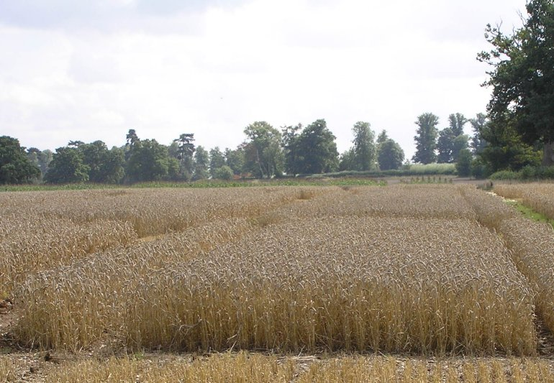
Multiphase experiments in the biological sciences
Chris Brien
Phenomics and Bioinformatics Research Centre, University of South Australia
Joint work with: R.A. Bailey, C.G.B. Demétrio, B.D. Harch and R.L. Correll .
Chris.brien@unisa.edu.au

Slide 2
Multiphase experiments
Multiphase experiments are very common, especially those involving a later laboratory phase (Brien et al, 2011).
A phase is defined to be the period of time during which a set of units are engaged in producing a particular outcome.
  The outcome can be material for processing in the next phase, or values for response variables, or both.
  Only the final phase need have a response variable.
Then, multiphase experiments consist of two or more such phases.
  Generally, the material from one phase is randomized to the next phase and so they involve multiple randomizations (Brien and Bailey, 2006).
Notes:
This is slightly different to the phases in Speed in that it concentrates on the actual physical conduct of the experiment.

Slide 3
a) A standard athlete training example
Peeling et al. (2009)
9 training conditions to be investigated: the combinations of 3 surfaces and 3 intensities of training.
Assume the prime interest is in surface differences
  intensities are only included to observe the surfaces over a range of intensities.
Testing is to be conducted over 4 Months:
  In each month, 3 endurance athletes are to be recruited.
  Each athlete will undergo 3 tests, separated by 7 days, under 3 different training conditions.
On completion of each test, the heart rate of the athlete will be measured.
Randomize 3 intensities to 3 athletes in a month and
3 surfaces to 3 tests in an athlete.
Notes:
Split-unit = Split-plot

Slide 4
Factor-allocation diagram for the standard athlete training experiment
A split-unit (plot) experiment but defined to be one allocation (randomization):
  a set of training conditions to a set of tests.
4 Months
3 Athletes in M
3 Tests in M, A
3 Intensities
3 Surfaces
9 training conditions
36 tests
Notes:
Randomization in this case
atheletes and test are the EUs; restrictions are to Athletes in Months and Tests in M,A

Slide 5
Extending the athlete experiment
Suppose that:
  in addition to heart rate taken immediately upon completion of a test,
  the free haemoglobin is to be measured using blood specimens taken from the athletes after each test, and
  the specimens are transported to the laboratory for analysis.
The experiment is two phase: testing and laboratory phases.
  The outcome of the testing phase is heart rate and a blood specimen.
  The outcome of the laboratory phase is the free haemoglobin.
How to process the specimens from the first phase in the laboratory phase?
Note that specimens will come in monthly and, rather than storing them until the experiment is finished, process those specimens for the month in batch.
Notes:
Note that outcome of a specimen for further analysis is what makes this two-phase

Slide 6
A simple two-phase athlete training experiment (cont’d)
4 Months
3 Athletes in M
3 Tests in M, A
4 Batches
9 Locations in B
3 Intensities
3 Surfaces
9 training conditions
36 tests
36 locations
This aligns lab-phase and first-phase blocking, a natural thing to do.
What are the properties of the design?
  ANOVA is useful for investigating them (Brien & Bailey, 2009, 2010).
How to analyse?
  Formulate linear mixed models for them (Brien & Demétrio, 2009) .
Notes:
Dashed line indicates systematic allocation – not randomization

Slide 7
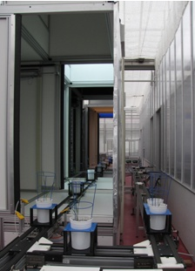
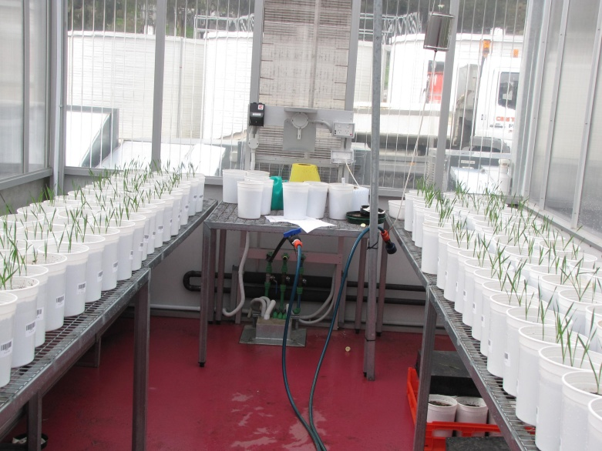
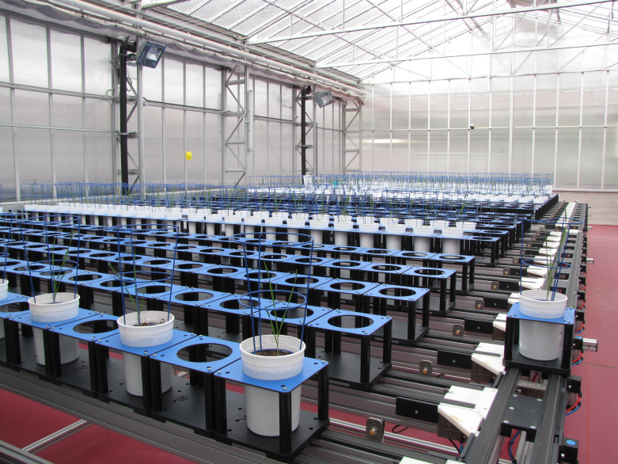
b) Plant accelerator experiments
Greenhouse and Smartroom phases
Smartroom :
  is a high-technology glasshouse, with over 1km of conveyor systems and state-of-the art imaging and robotic equipment;
  allows continuous measurements of the physical attributes (phenotype) of plants automatically and non-destructively.

Slide 8
Plant accelerator questions being investigated
What variation is present in (i) the greenhouse and (ii) the Smartroom?
  Smartroom is large with plants well separated, while greenhouse is small with plants tightly packed.
  Perhaps light and air conditioning trends, not necessarily aligned between greenhouse and Smartroom?
  Is there spatial variation?
Differential layouts:
  In the greenhouse, tables hold 5 x 13 pots;
  In the Smartroom there are 24 Lanes of 24 carts.
  How should this be accounted for in the designs for assigning (i) treatments to greenhouse pots and (ii) greenhouse pots to Smartroom carts?
Should carts change position during their time in the Smartroom?

Slide 9
c) All x-omics are inherently multiphase
One list of phases for a genomics experiment, and their outcomes.
Selection or production of biological material
Sample acquisition & storage
RNA extraction
Labelling
Hybridization, incl. post-washing
Organisms/
Tissues
Samples
Extracts
Aliquots
Scanning
Hybridized arrays
Measure-ments
Arrays
Design
Potentially a designed experiment at every phase — not usually considered.
Array production or purchase
Two-phase design
(McIntyre, 1955; Kerr, 2003):
  1st phase can be an experiment or
  an observational (epidemiological) study;
  2nd phase is a laboratory phase (Brien et al., 2011).
Multiple randomizations (Brien & Bailey, 2006) in a seven-phase process.
Design and analysis?
Notes:
There are several steps in array production, but not discussed here

Slide 10
References
Brien, C.J., and Bailey, R.A. (2006) Multiple randomizations (with discussion). J. Roy. Statist. Soc., Ser. B, 68, 571–609.
Brien, C. J. and R. A. Bailey (2009). Decomposition tables for multitiered experiments. I. A chain of randomizations. The Annals of Statistics, 36 4184–4213.
Brien, C. J. and R. A. Bailey (2010). Decomposition tables for multitiered experiments. II. Two-one randomizations. The Annals of Statistics, 38, 3164 – 3190.
Brien, C.J. and Demétrio, C.G.B. (2009) Formulating mixed models for experiments, including longitudinal experiments. J. Agr. Biol. Env. Stat., 14, 253-80.
Brien, C.J., Harch, B.D., Correll, R.L. and Bailey, R.A. (2011) Multiphase experiments with at least one later laboratory phase. I. Orthogonal designs. J. Agr. Biol. Env. Stat., available online at http://dx.doi.org/10.1007/s13253-011-0060-z.
Kerr, M. K. (2003) Design Considerations for Efficient and Effective Microarray Studies. Biometrics, 59(4), 822-828.
McIntyre, G. A. (1955). Design and analysis of two phase experiments. Biometrics, 11, 324-334.
Peeling, P., B. Dawson, et al. (2009). Training Surface and Intensity: Inflammation, Hemolysis, and Hepcidin Expression. Medicine & Science in Sports & Exercise, 41, 1138-1145.
Web address for Multitiered experiments site:
http://chris.brien.name/multitier

