Slide 1
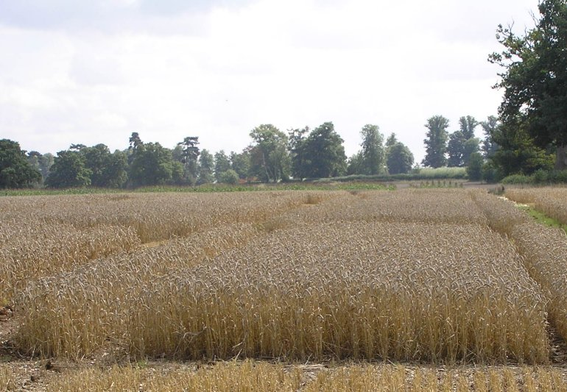
Formulating mixed models for experiments, including longitudinal experiments
[JABES (2009) 14, 253-80]
Chris Brien¹ & Clarice Demétrio²
¹University of South Australia, ²ESALQ, Universidade de São Paulo
Web address for Multitiered experiments site:
http://chris.brien.name/multitier
Chris.brien@unisa.edu.au

Slide 2
Outline
Three-stage method
  A definition of an allocation
  Factor-allocation diagrams & tiers
  Analysis: ANOVA versus mixed models
  Symbolic mixed-model notation
  Why factor-allocation-based models and ANOVA?
A longitudinal Randomized Complete Block Design (RCBD)
Longitudinal factors can be randomized
A three-phase example
Concluding comments

Slide 3
1. Three-stage method
(motivated by Piepho et al., 2004);
extension of Brien and Bailey, 2006, section 7)
I.
Intratier Random and Intratier Fixed models:
Usually models equivalent to a randomization model.
II.
Homogeneous Random and Fixed models:
Terms added to intratier models and others shifted between intratier random and intratier fixed models.
Up to here have ANOVA models
General Random and General Fixed models:
Perhaps reparameterize terms in homogeneous models, particularly if a longitudinal experiment, and omit aliased terms from random model.
III.
May yield a model of convenience, not full mixed model.
Fundamental is experiment description starts with tiers
Notes:
Homogeneous random = ANOVA models

Slide 4
a) A definition of an allocation
An allocation is the assignment of treatments to units and, if randomization, using a permutation of the units:
  treatments are whatever are allocated;
  units are what treatments are allocated to;
  treatments and units called objects, one set being allocated to the other;
  permuting implemented in R function fac.layout from package dae;
  under this definition a split-plot involves a single randomization.
Usually treatments are randomized to units, but can be allocated systematically.
Each set of objects is indexed by a set of factors:
  Unallocated factors (indexing units);
  Allocated factors (indexing treatments).
Allocated factors
Unallocated factors
allocation
Set of treatments
Set of units

Slide 5

b) Factor-allocation diagrams & tiers
(Brien, 1983; Brien & Bailey, 2006, Brien et al., 2011)
RCBD – two-tiered (i.e. two sets of factors)
Here allocation is by randomization
allocated
unallocated
b Blocks
t Runs in B
t treatments
t Treatments
bt runs
A panel for a set of objects shows:
    a list of the factors in a tier; their numbers of levels; their nesting relationships.
So a tier is just a set of factors:
  {Treatments} or {Blocks, Runs}
  But, not just any old set: a) factors that belong to an object and b) a set of factors with the same status in the allocation.
  Textbook experiments are two-tiered, but in practice some experiments are multitiered.
A crucial feature is that diagram automatically shows EU and restrictions on allocation.

Slide 6
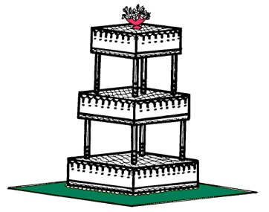
Why have tiers?
Would not be need if all experiments were two-tiered, as only two sets of factors needed.
Various names have been used for the two sets of factors:
  block or unit or unrandomized or unallocated factors;
  treatment or randomized or allocated factors.
One pair of these would be sufficient.
However, some experiments have three or more sets of factors.
As a general name for each set is impracticable, use tiers
as a general term for them.
  i.e. for sets of factors based on the allocation.
Will present an example with 4 tiers
Notes:
Tiers determine intratier models

Slide 7
Single-set description
e.g. Searle, Casella & McCulloch (1992); Littel et al. (2006).
Single set of factors that uniquely indexes observations:
  {Blocks, Treatments}
A subset of the factors from the factor-allocation description:
  {Treatments} and {Blocks, Runs}
What are the EUs in the single-set approach?
  A set of units that are indexed by Blocks x Treatments combinations.
  Of course, Blocks x Treats are not the actual EUs, as Treats not randomized to those combinations.
  They act as a proxy for the unnamed units.
Factor-allocation description (tier-based and so multi-set) has a specific factor for the EUs:
  identity of EUs not obscured;
  runs indexed by Blocks-Runs combinations to which Treats are randomized.

Slide 8
c) Analysis: ANOVA versus mixed models
Given factor-allocation diagram, can derive either the ANOVA table or mixed model for the experiment.
  Describe these as the factor-allocation-based ANOVA and mixed model.
ANOVA best for orthogonal designs, provided the subset of mixed models known as ANOVA models are appropriate.
For more general models probably need to use mixed model software.

Slide 9
d) Symbolic mixed model notation
Generalized factor = term in mixed model:
A∧B is the ab-level factor formed from the combinations of A with a levels and B with b levels.
Symbolic mixed model (Patterson, 1997, SMfPVE)
  Fixed terms | random terms
Factor relationships
  used to get generalized factors from each panel
  A*B factors A and B are crossed;
  A/B factor B is nested within A.

Slide 10
Example
Split-plot with fixed = allocated & random = unallocated
  Varieties*Fertilizers | Blocks/Plots/Subplots
  Varieties + Fertilizers + Varieties∧Fertilizers |
  Blocks + Blocks∧Plots + Blocks∧Plots∧Subplots
Corresponds to the mixed model:
Y = X_{V}θ_{V} + X_{F}θ_{F} + X_{V∧F}θ_{V∧F} + Z_{B}u_{B}+ Z_{B∧P}u_{B∧P}+ Z_{B∧P∧S}u_{B∧P∧S}.
  where the Xs and Zs are indicator variable matrices for the generalized factor (terms in symbolic model) in its subscript, and
  θs and us are fixed and random parameters, respectively, with
This is an ANOVA model, equivalent to the randomization model, and is also written:
Y = X_{V}θ_{V} + X_{F}θ_{F} + X_{V∧F}θ_{V∧F} + Z_{B}u_{B}+ Z_{B∧P}u_{B∧P}+ e.
Notes:
Do not explain mixed model in detail – just that it has an Xtheta for each fixed term and a ZU for each random term.

Slide 11
More general mixed models
Modify intratier models to allow for intertier interactions and other forms of models
Use functions on generalized factors.
For random terms:
  uc(.) some, possibly structured, form of unequal correlation between levels of the generalized factor.
  ar1(.), corb(.), us(.) are examples of specific structures.
  h added to correlation function allows for heterogeneous variances: uch, ar1h, corbh, ush.
For fixed models terms:
  td(.) systematic trend across levels of the generalized factor.
  lin(.), pol(.), spl(.) are examples of specific trend functions.

Slide 12
e) Why factor-allocation-based models and ANOVA?
Common to form models based on the single-set description, sometimes drawing on models for related experiments, and designating each term as fixed or random.
  e.g. Split-plot-in-Time for the longitudinal RCBD
Here derive models from tiers: factors indexing sets of objects.
  Ensures all the terms, taken into account in the allocation, are in the analysis and that the incorporation of any other terms is intentional.
  Also, ANOVA shows the confounding in the experiment.
  When randomization:
    1st step produces mixed model equivalent to the randomization model;
    In the end, say that have randomization-based models & ANOVA in that randomization is used in determining them.
Strongly recommend against using Rule 5 in Piepho et al. (2003), which converts factor-allocation-based to single-set models.

Slide 13
Rule 5
Rule 5 involves substituting allocated for unallocated factors, resulting in a “model of convenience”.
  Mixed model, equivalent to randomization model, for Split-plot:
  V + F + V∧F | B + B∧P + B∧P∧S.
  Rule 5 modifies this to V + F + V∧F | B + B∧V + B∧V∧F.
Of course, latter more economical as P and S no longer needed.
However, latter does not include B∧P or B∧P∧S, whose levels are the EUs.
  Clearly, levels of B∧V and B∧V∧F are not EUs, as treatment factors (V & F) not applied to their levels.
Further, B∧P and B∧V are two different sources of variability:
  inherent variability vs block-treatment interaction.
This "trick" is confusing, false economy and not always possible.
However, need to be careful in SAS:
  Must set the DDFM option of MODEL to KENWARDROGER.

Slide 14
Three-stage method
(motivated by Piepho et al., 2004);
extension of Brien and Bailey, 2006, section 7)
I.
Intratier Random and Intratier Fixed models:
Usually models equivalent to a randomization model.
II.
Homogeneous Random and Fixed models:
Terms added to intratier models and others shifted between intratier random and intratier fixed models.
Up to here have ANOVA models
General Random and General Fixed models:
Perhaps reparameterize terms in homogeneous models, particularly if a longitudinal experiment, and omit aliased terms from random model.
III.
May yield a model of convenience, not full mixed model.
Demonstrate by example
Notes:
Homogeneous random = ANOVA models

Slide 15
2) A longitudinal RCBD
(Piepho et al., 2004, Example 1)
A field experiment comparing 3 different tillage methods
Laid out according to an RCBD with 4 blocks.
On each plot one water collector is installed in each of 4 layers and the amount of nitrogen leaching measured.
Lay 4
Lay 3
Lay 2
4 Blocks
3 Plots in B
4 Lay
Lay 1
3 Tillage
Block 1
Plot 1
Plot 2
Plot 3
3 treatments
Block 2
Plot 1
48 layer-plots
Plot 2
Plot 3
Block 3
Plot 1
Plot 2
Plot 3
Block 4
Plot 1
Plot 2
Plot 3

Slide 16
Specific longitudinal terminology
Longitudinal factors: those a) to which no factors are allocated and b) that index successive observations of some entity.
  Lay
A subject term for a longitudinal factor is a generalized factor whose levels are entities on which the successive observations are taken.
  Blocks∧Plots (1,1; 1,2; 1,3; 2,1; and so on)
Lay 4
Lay 3
Lay 2
Lay 1
4 Blocks
3 Plots in B
4 Lay
Block 1
3 Tillage
Plot 1
Plot 2
Plot 3
Block 2
3 treatments
Plot 1
Plot 2
Plot 3
48 layer-plots
Block 3
Plot 1
Plot 2
Plot 3
Block 4
Plot 1
Plot 2
Plot 3

Slide 17
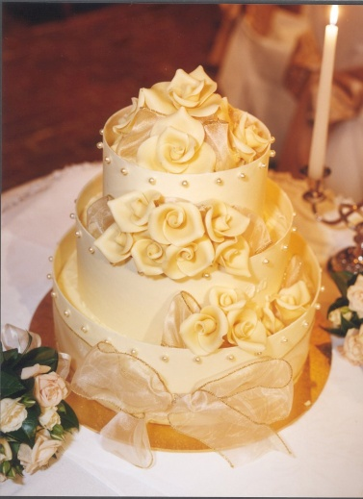
A longitudinal RCBD
— Intratier random and intratier fixed models
4 Blocks
3 Plots in B
4 Lay
3 Tillage
3 treatments
48 layer-plots
I.
Intratier Random and Intratier Fixed models:
The unallocated tier is {Block, Plot, Lay};
The allocated tier is {Tillage}.
The only longitudinal factor is Lay.
Intratier Random: (Block / Plot) * Lay
= Block + Lay + Block∧Lay + Block∧Plot + Block∧Plot∧Lay ;
Intratier Fixed: Tillage.
Have all possible terms given the allocation.

Slide 18
A longitudinal RCBD
— Homogeneous random and fixed models
I.
Intratier Random: (Block / Plot) * Lay
= Block + Lay + Block∧Lay + Block∧Plot + Block∧Plot∧Lay ;
Intratier Fixed: Tillage.
II.
Homogeneous Random and Fixed models:
Terms added to intratier models and others shifted from intratier random to intratier fixed models and vice versa.
Take the fixed factors to be Block, Tillage and Lay and the random factor to be Plot.
Terms involving just Block and Lay that are in the Intratier Random model are shifted to the fixed model.
Lay#Tillage is of interest so that the fixed model should include Tillage∧Lay.
Homogeneous Random:
Block∧Plot + Block∧Plot∧Lay
= (Block∧Plot) / Lay
Fixed: Block + Lay + Block∧Lay + Tillage + Tillage∧Lay
= (Block + Tillage) * Lay

Slide 19
A longitudinal RCBD
— General random and general fixed models
II.
Homogeneous Random:
Block∧Plot + Block∧Plot∧Lay
= (Block∧Plot) / Lay
Fixed: Block + Lay + Block∧Lay + Tillage + Tillage∧Lay
= (Block + Tillage) * Lay
III.
General Random and General Fixed models:
Reparameterize terms in homogeneous models and omit aliased terms from random model.
For longitudinal experiments, form longitudinal error terms:
(subject term) ^ gf(longitudinal factors):
  Allow unequal correlation (uc) between longitudinal factor levels;
  Use gf on longitudinal factor to allow arbitrary uc between these factors.
The subject term for Lay is Block∧Plot;
Expected that there will be unequal correlation between observations with different levels of Lay and same levels of Block∧Plot;
No aliased random terms.
General random: (Block∧Plot) / uc(gf(Lay)) ⇒(Block∧Plot) / uc(Lay)
Trends for Lay are of interest, but not for the qualitative factor Tillage nor for Block.
Mixed model:
(Block + Tilllage) * td(Lay) | (Block∧Plot) / uc(Lay)
General fixed: (Block + Tilllage) * td(Lay)

Slide 20
A longitudinal RCBD versus a Split-plot
Often a "Split-plot-in-Time“ analysis advocated
  Random: Block / Plot / Subplot;
  Fixed: Tillage * Lay.
4 Blocks
3 Plots in B
4 Subplots in B, P
3 Tillage
4 Lay
But, what are Subplots?
Well, Plots are divided into Layers
6 treatments
24 units
4 Blocks
3 Plots in B
4 Lay in B, P
But, Lay crossed with Blocks and Plots.
3 Tillage
3 treatments
This difference leads to different models.
24 units
4 Blocks
3 Plots in B
4 Lay
3 Tillage
3 treatments
24 units
Mixed models:
Split-plot: Tilllage * td(Lay) | Block / Plot / Subplot
Longitudinal: (Block + Tilllage) * td(Lay) | (Block∧Plot) / uc(Lay)

Slide 21
3) Longitudinal factors can be randomized
Example 5 (Piepho, 2005; Brien & Demétrio, 2009)
  An RCBD is laid out for a fixed factor Tillage.
  As in Example 1, on each plot, one random soil column is sampled and stratified according to 4 soil layers.
  The measurements are repeated on three dates, with a new soil sample taken on each plot.
4 Blocks
3 Plots in B
3 Samples in B, P
4 Lay
3 Tillage
3 Date
9 treatments
144 layer-samples
  Date is a longitudinal factor in that it indexes successive measurements made on Plots — and it is randomized.
  Lay is also a longitudinal factor, indexing successive measurements made on Plots and on Samples.

Slide 22
Randomized longitudinal factor
— Intratier random and intratier fixed models
4 Blocks
3 Plots in B
3 Samples in B, P
4 Lay
3 Tillage
3 Date
9 treatments
144 layer-samples
I.
Intratier Random and Intratier Fixed models:
The unallocated tier is {Block, Plot, Samples Lay};
The allocated tier is {Tillage, Date}.
The longitudinal factors are Date and Lay.
Intratier Random: (Block / Plot / Sample) * Lay
= Block + Lay + Block∧Lay + Block∧Plot + Block∧Plot∧Lay + Block∧Plot∧Sample + Block∧Plot ∧Sample∧Lay;
Intratier Fixed: Tillage * Date = Tillage + Date + Tillage∧Date.
Have all possible terms given the allocation.

Slide 23
Randomized longitudinal factor
— Homogeneous random and fixed models
I.
Intratier Random: (Block / Plot / Sample) * Lay
= Block + Lay + Block∧Lay + Block∧Plot + Block∧Plot∧Lay + Block∧Plot∧Sample + Block∧Plot ∧Sample∧Lay;
Intratier Fixed: Tillage * Date = Tillage + Date + Tillage∧Date.
II.
Homogeneous Random and Fixed models:
Terms added to intratier models and others shifted from intratier random to intratier fixed models and vice versa.
Take the fixed factors to be Block, Tillage, Date and Lay and the random factors to be Plot and Sample.
Terms involving just Block and Lay that are in the intratier random model are shifted to the fixed model.
Interactions of Lay with Tillage and Date are of interest so that the fixed model should include terms from Tillage * Date * Lay.
Homogeneous Random:
Block∧Plot + Block∧Plot∧Lay + Block∧Plot∧Sample + Block∧Plot∧Sample∧Lay
= (Block∧Plot) / Lay + (Block∧Plot∧Sample) / Lay
Fixed: Block + Lay + Block∧Lay + Tillage + Date + Tillage∧Date + Tillage∧Lay + Date∧Lay + Tillage∧Date∧Lay
= (Block + Tillage * Date) * Lay

Slide 24
Randomized longitudinal factor
— General random and general fixed models
II.
Homogeneous Random:
Block∧Plot + Block∧Plot∧Lay + Block∧Plot∧Sample + Block∧Plot∧Sample∧Lay
= (Block∧Plot) / Lay + (Block∧Plot∧Sample) / Lay
Fixed: Block + Lay + Block∧Lay + Tillage + Date + Tillage∧Date + Tillage∧Lay + Date∧Lay + Tillage∧Date∧Lay
= (Block + Tillage * Date) * Lay
III.
General Random and General Fixed models:
Reparameterize terms in homogeneous models and omit aliased terms from random model.
For longitudinal experiments, form longitudinal error terms:
(subject term) ^ gf(longitudinal factors):
  Allow unequal correlation (uc) between longitudinal factor levels;
  Use gf on longitudinal factor to allow arbitrary uc between these factors.
The subject terms are Block∧Plot for Lay and Date and Block∧Plot∧Sample for Lay;
Longitudinal error terms are Block∧Plot∧gf(Date*Lay) and Block∧Plot∧Sample∧gf(Lay);
No aliased random terms.
General random: (Block∧Plot) / uc(gf(Date*Lay) )+ (Block∧Plot∧Sample) / uc(gf(Lay)) ⇒(Block∧Plot) / uc(Date∧Lay) + (Block∧Plot∧Sample)∧uc(Lay)
Trends for Date and Lay.
General fixed: = (Block + Tillage * td(Date)) * td(Lay)

Slide 25
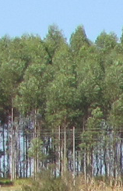
4) A three-phase example
(Pereira, 1969)
Experiment to investigate differences between pulps
produced from different Eucalypt trees.
Chip phase:
  3 lots of 5 trees from each of 4 areas were processed into wood chips.
  Each area differed in i) kinds of trees (2 species) and ii) age (5 and 7 years).
  For each of 12 lots, chips from 5 trees were combined and 4 batches selected.
Pulp phase:
  Batches were cooked to produce pulp & 6 samples obtained from each cooking.
Measurement phase:
  Each batch processed in one of 48 runs of a laboratory refiner with its 6 samples randomly placed on 6 positions in a pan in the refiner.
  For each run, 6 times of refinement (30, 60, 90, 120, 150 and 180 minutes)
  were randomized to the 6 positions in the pan.
  After allotted time, a sample taken from a pan and its degree of refinement measured.
2 Kinds
2 Ages
3 Lots in K, A
4 Batches in K, A, L
6 Times
6 times
6 Samples in C
48 Cookings
6 Positions in R
48 Runs
48 batches
288 samples
288 positions

Slide 26
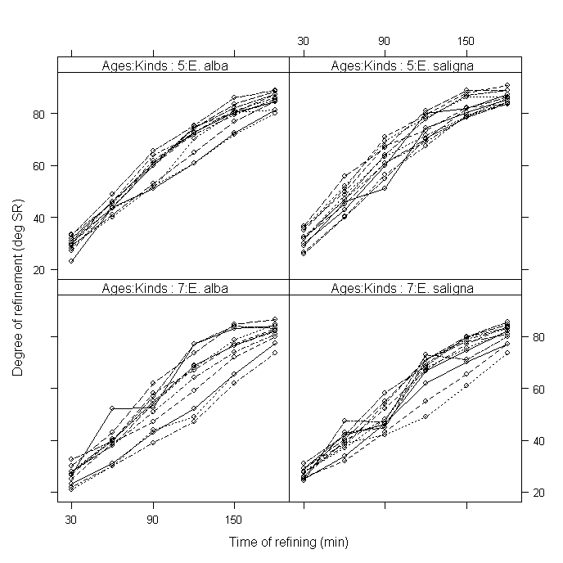
Profile plot of data
Shows: a) curvature in the trend over time; b) some trend variability;
c) variance heterogeneity, in particular between the Ages
Notes:
Trend variability indicates need for random trend terms.

Slide 27
Formulated and fitted mixed models
(details in Brien & Demétrio, 2009.)
Using 3-stage process, following model of convenience (terms omitted – no Rule 5) is formulated from the 4 tiers:
General random: Runs / Positions + (Kinds∧Ages∧Lots) / uc(Times) + (Kinds∧Ages∧Lots∧Batches) / uc(Times);
General fixed: Kinds * Ages * td(Times)
This model:
  Does not contain Cooking or Samples because of aliasing.
  Has variance components for Runs, Positions, Lots, Batches.
  Allows for some form of unequal correlation between Times.
  Includes trends over Times.
The full fitted model, obtained using ASReml-R (Butler et al., 2009), has:
  For variance,
    unstructured, heterogeneous covariance between Times arising from Runs, Batches and the re-included Cookings, this covariance differing for Ages and
    a component for Lots variability.
  For time, trend whose intercepts and curvature (characterized by cubic smoothing splines (Verbyla, 1999) differ for Ages and whose slopes differ for Kinds.
Notes:
The General random model allows var. comps for Runs, Position, Lots and Batches.
It allows for unequal covariance between Times arising from Lots and from Batches.
No components for Runs or Batches and Positions/Samples (the later is nugget variance); no unequal correlation between Times arising from Lots.
General fixed allows for trends over time (that varies with Kinds and Ages)

Slide 28
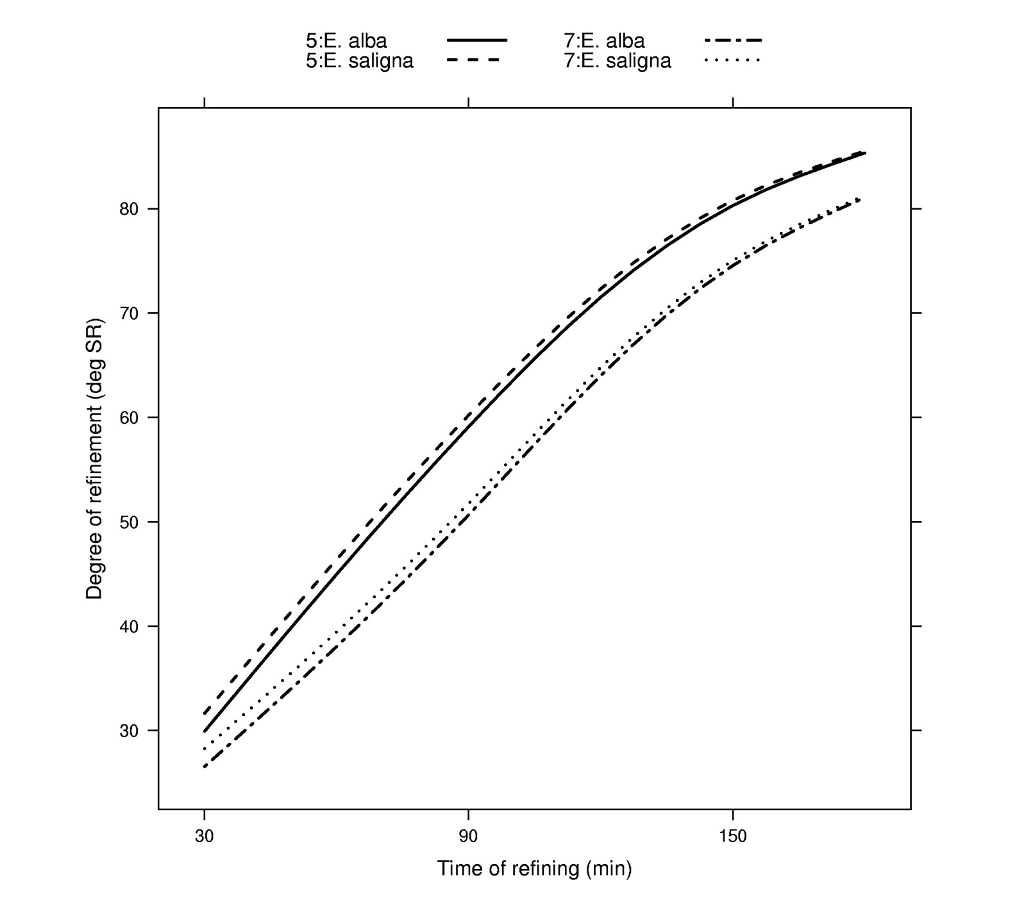
Predicted degree of refinement
Same Age (differ in slope)
Different Age (differ in intercept and curvature)

Slide 29
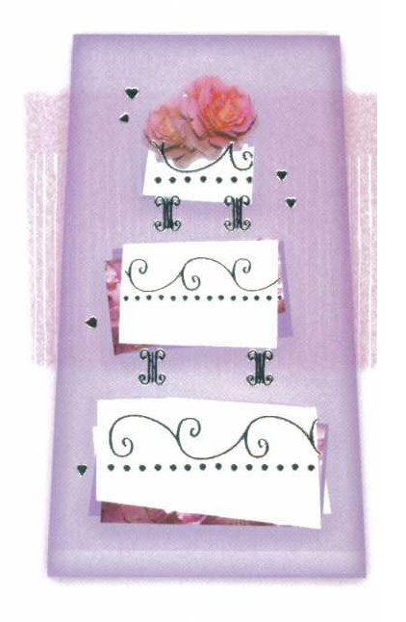
5) Concluding comments
Formulate a factor-allocation-based mixed model:
  to ensure that all terms appropriate, given the allocation,
  are included;
  and, when randomization only employed, to make explicit where model deviates from a randomization model.
Based on dividing the factors in an experiment into tiers.
To obtain fit, a model of convenience is often used:
  When aliased random sources, terms for all but one are omitted to obtain fit;
    But re-included in fitted model if retained term is in fitted model.
All 11 examples from Piepho et al. (2004) are in Brien and Demétrio (2009), including:
  An experiment with systematically applied treatments and another with crop rotations, both of which are not longitudinal.

Slide 30
References
Brien, C.J., and Bailey, R.A. (2006) Multiple randomizations (with discussion). J. Roy. Statist. Soc., Ser. B, 68, 571–609.
Brien, C.J., Harch, B.D., Correll, R.L. and Bailey, R.A. (2011) Multiphase experiments with laboratory phases subsequent to the initial phase. I. Orthogonal designs. Journal of Agricultural, Biological and Environmental Statistics, 16, 422–450.
Brien, C.J. and Demétrio, C.G.B. (2009) Formulating mixed models for experiments, including longitudinal experiments. J. Agr. Biol. Env. Stat., 14, 253-80.
Butler, D., Cullis, B.R., Gilmour, A.R. and Gogel, B.J. (2009) Analysis of mixed models for S language environments: ASReml-R reference manual. DPI Publications, Brisbane.
Littel, R., Milliken, G., Stroup, W., Wolfinger, R. and Schabenberger, O. (2006) SAS for Mixed Models. 2nd edn. SAS Press, Cary.
Pereira, R.A.G. (1969) Estudo Comparativo das Propriedades Físico-Mecânicas da Celulose Sulfato de Madeira de Eucalyptus saligna Smith, Eucalyptus alba Reinw e Eucalyptus grandis Hill ex Maiden. Escola Superior de Agricultura `Luiz de Queiroz', University of São Paulo, Piracicaba, Brasil.
Patterson, H. D. (1997) Analyses of Series of Variety Trials. in Statistical Methods for Plant Variety Evaluation, eds. R. A. Kempton and P. N. Fox, London: Chapman & Hall, pp. 139–161.
Piepho, H.P., Büchse, A. and Emrich, K. (2003) A hitchhiker's guide to mixed models for randomized experiments. Journal of Agronomy and Crop Science, 189, 310–322.
Piepho, H.P., Büchse, A. and Richter, C. (2004) A mixed modelling approach for randomized experiments with repeated measures. Journal of Agronomy and Crop Science, 190, 230–247.
Verbyla, A.P., Cullis, B.R., Kenward, M.G. and Welham, S.J. (1999) The analysis of designed experiments and longitudinal data by using smoothing splines (with discussion). Applied Statistics, 48, 269–311.

