Slide 1
Mixed modelling: things to worry about
Chris Brien
Phenomics and Bioinformatics Research Centre, University of South Australia;
The Plant Accelerator, University of Adelaide

Slide 2
1. Once upon a time ANOVA was king
In my early career mixed models were fitted using ANOVA.
  Only variance components models possible.
Maximal expectation and variation models were fitted.
  As a result, in orthogonal experiments at least, estimates of variance terms are obtained that are uncontaminated with possible expectation effects.
Model selection focused on the expectation model and did not entail model refits.
Then in September 1999 life got complicated:
  I went to Ari Verbyla’s Mixed Models for Practitioners course based on ASREML in S-Plus.

Slide 3
2. NSW-school strategy — forward selection or build it up
In Gilmour et al. (1997, p.289-90):
  ‘We include design effects only if there is evidence to suggest they are needed’.
  ‘The general superiority of the AR1 x AR1 model over the IB model justifies its use as an initial model for spatial analysis. We have found that assuming independence of plot errors for an initial model can be misleading in the subsequent identification of the variance model for plot errors. Use of the ARl x AR1 model as an initial model allows for a more accurate assessment of the presence of global and extraneous variation or outliers.’
Stefanova et al. (2009) describe this as:
  ‘a sequential approach to modeling beginning with a tentative, yet plausible spatial model and revising this model using graphical and formal diagnostics.’
Stringer et al. (2011) follows this approach too.

Slide 4
NSW-school strategy
For an experiment on a grid of plots in Rows and Columns, start with:
  ANOVA model with just blocks as baseline model and then AR1 x AR1 and no Rows or Columns, or
  AR1 x AR1 and no Rows or Columns.
This is followed by diagnostic checking (plots of row and column eBLUPS and variograms) to identify further terms required.
One reason for this type of approach is that complex variance models can be difficult to fit and starting values from simpler models are needed to achieve a fit.
It is contrary to the ANOVA approach:
  Start with var[Y] = Blocks + Rows + Columns.

Slide 5
3. Randomization-based mixed models — backward selection or pull it down
Brien and Bailey (2006) and Brien and Demétrio (2009) give a three-stage procedure:
  Derive randomization-equivalent model.
  Modify model by adding/deleting factorial terms and swapping factorial terms between fixed and random.
  Reparameterize terms to allow for trends and more complex variance models.
Smith et al. (2005), Stringer et al (2012) and de Faveri et al. (2015) all start with what they call randomization-based mixed models.
  These are what I am calling randomization-equivalent models.
Cullis (2015, pers. comm.) says:
  These days, because design is explicitly model-based, start with a model for which the design was generated  design-based mixed models.

Slide 6
4. A recommended approach in the psychological literature
Fit only an unstructured variance matrix (Barr et al., 2013):
  The argument is that all other models are submodels and so you have them covered.
  Will not:
    Falsely remove variance components and so have anti-conservative tests of fixed effects.
    Increase fixed effect Type I error rate by testing with variance structures that do incorporate appropriate correlations.
  A problem is that the fit may not converge.
    Barr et al. (2013) state that this is the only circumstance in which the model can be reduced.
Matuschek et al. (2015) show that this approach results in a loss in power.
  They advocate data-driven model selection, using backward selection, to both control Type I error rate and to increase power.

Slide 7
5. Some philosophical issues
What model selection should be done?
  Do you drop nonsignificant treatment factor interactions or variance terms (Blocks, Mainplots) so that Residual degrees of freedom are increased?
  These are termed sometimes-pool, as opposed to never-pool, strategies.
Randomization arguments are used against pooling.
In any case, Janky (2000) shows there are size problems and gains in power are minimal.
However, even if model selection is not to be used to choose which terms, it may well be employed to decide between different parameterizations of the same terms.
  Smith et al. (2005): It is important to note that, in the spirit of a randomization-based analysis, terms in the mixed model that are associated with the block structure are maintained irrespective of their level of significance. In contrast, model-based terms and covariance structures are only included if found to be statistically significant.

Slide 8
What significance level?
For model selection, ‘it is important to resist the reflex of choosing a_{LRT} = 0.05’ (Matuschek et al., 2015).
In this context, Matuschek et al. (2015) argue:
  ‘a_{LRT} cannot be interpreted as the “expected model-selection Type I error rate”’;
  It is “the relative weight of model complexity and goodness-of-fit”.
    a_{LRT} = 0 implies infinite penalty on model complexity — minimal model best.
    a_{LRT} = 1 implies infinite penalty on goodness-of-fit — maximal model is best.
    So a_{LRT} = 0.05 puts a strong penalty on model complexity.
    Apparently, in comparing two nested models, AIC is equivalent to a_{LRT} = 0.157.
    They use a_{LRT} = 0.20, which will choose a more complex model more frequently than AIC.
  Interesting that a = 0.25 has been recommended for sometimes-pooling to guard against contaminating variance estimates by accepting H₀ too readily.

Slide 9
6. Plant Accelerator experiment:
Exp278 — 200 Chick pea RILs
Chris designed and Jules and Chris have been discussing the genetic analysis
Two Smarthouses, each with a grid 20 Lanes x 22 Positions.
Split-plot design:
  Main plots of two neighbouring carts/plants to which Lines assigned:
    A blocked, row-column design of 40 Lanes × 11 MainPosns;
    Blocks are zones of 4 Lanes in two Smarthouses;
    All RILs occur once in each Smarthouse;
    The two parents each occur 20 times in each Smarthouse.
  Subplots are carts/plants:
    Two Conditions (salt or not) are randomized to the subplots in each main plot.
2 Smarthouses
5 Zones in S
4 Lanes in S,Z
11 MainPosns
2 Subplots in S,Z,L,M
202 Lines
2 Conditions

404 treatments
880 carts

Slide 10
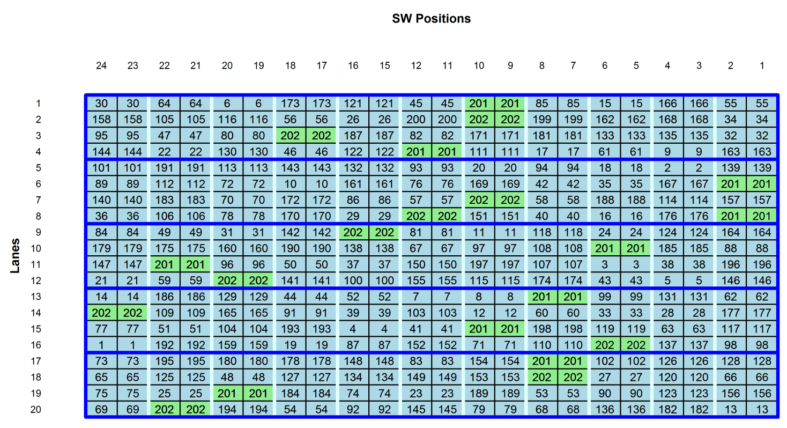
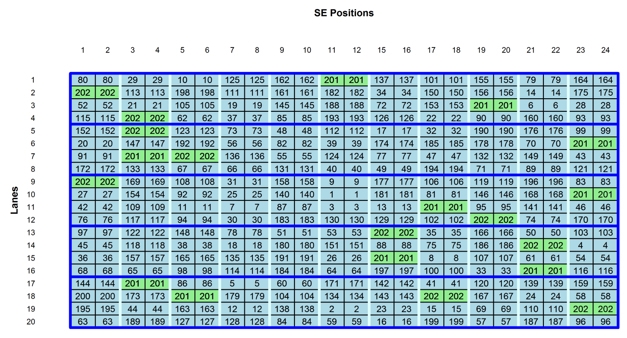
Exp278 — 200 Chick pea RILs: layout
Randomization for the design generated:
  Between whole Smarthouses; Zones within S; Lanes within Z within S;
  Between complete MainPosns across S (MainPosns are pairs of Positions);
  Between subplots within a main plot.
However, do not anticipate (i) same MainPosns differences in the Smarthouses and (ii) differences between Lanes within S, Z, so rerandomize Lines:
  11 MainPosns in S ; 4 Lanes in S, Z, M.

Slide 11
Model proposed for this experiment
Given the design set up, experience and desire for Lines random:
  E[Y] = Smarthouse/spl(xMainPosition) + Parents * Condition;
  var[Y] = Lines/Condition +
  Smarthouse:Zones/Mainplots +
  idh(Condition):Smarthouse:Zones:Mainplots.
However, this is rather simple model for the genetic variance in the Lines.
  It allows for variation between Lines and a homogeneous random component that allows for Conditions to vary from the overall Line effect.
A more sophisticated model allows for the variation in the Lines to differ between Conditions and for there to be a covariance between the effects of the Lines for the different conditions.
  E[Y] = Smarthouse/spl(xMainPosition) + Parents * Condition;
  var[Y] = us(Condition):Lines
  Smarthouse:Zones/Mainplots +
  idh(Condition):Smarthouse:Zones:Mainplots.

Slide 12
Models for main plot + genetic variation
Data are ordered as:
  2 Smarthouses then 220 Mainplots then 2 Carts in standard order.
Each of these has an equal-genetic-variance version:

Slide 13
Which genetic model to start with?
Start simple and build up or start complex and work down?
  Starting simple might be safest to avoid overfitting and convergence problems.
Suppose:
  Start with genetic covariance zero to make sure have some genetic variance before attempting to fit genetic covariance,
  But allow for different genetic variances because this is often the case.

Slide 14
Fitted model for no genetic covariance
> nocov.asr <- asreml(fixed = Plant.height..cm. ~ Smarthouse/xMainPosn + Parent*TRT,
+ random = ~ at(TRT):Lines + SHZone/Mainplot + spl(xMainPosn):Smarthouse,
+ rcov = ~ at(TRT):SHZone:Mainplot, data = dat, maxiter = 20)
LogLikelihood Converged
Change(%)
at(TRT, Control):Lines!Lines.var 1.68
at(TRT, Salt):Lines!Lines.var 1.38
Warning message:
In asreml.call(data, asr.inter, asr.struc, asr.glm, asr.predict$predict, :
At least one parameter changed by more than 1% on the last iteration
> nocov.asr <- update(nocov.asr)
LogLikelihood Converged
> summary(nocov.asr)$varcomp[,c(1:3,5)]
gamma component std.error constraint
SHZone!SHZone.var 0.1928430 0.1928430 1.3690702 Positive
spl(xMainPosn):Smarthouse!Smarthouse.var 0.8052793 0.8052793 0.9577375 Positive
at(TRT, Control):Lines!Lines.var 1.3348083 1.3348083 4.2862000 Positive
at(TRT, Salt):Lines!Lines.var 1.3625158 1.3625158 3.7891765 Positive
SHZone:Mainplot!SHZone.var 100.3557508 100.3557508 7.8323270 Positive
TRT_Control!variance 30.0172022 30.0172022 6.5683450 Positive
TRT_Salt!variance 14.6758565 14.6758565 5.8041638 Positive
!!!

Slide 15
Fitted model for unstructured genetic variance
> us.asr <- asreml(fixed = Plant.height..cm. ~ Smarthouse/xMainPosn + Parent*TRT,
+ random = ~ us(TRT):Lines + SHZone/Mainplot + spl(xMainPosn):Smarthouse,
+ rcov = ~ at(TRT):SHZone:Mainplot, data = dat, maxiter = 20)
US variance structures were modified in 20 instances to make them positive definite
LogLikelihood not converged
> us.asr <- update(us.asr)
US variance structures were modified in 19 instances to make them positive definite
LogLikelihood not converged
> us.asr <- update(us.asr)
US variance structures were modified in 3 instances to make them positive definite
LogLikelihood Converged
> summary(us.asr)$varcomp[,c(1:3,5)]
gamma component std.error constraint
SHZone!SHZone.var 2.55111685 2.55111685 1.57793311 Positive
spl(xMainPosn):Smarthouse!Smarthouse.var 0.02718461 0.02718461 0.09293905 Positive
TRT:Lines!TRT.Control:Control 115.43695760 115.43695760 13.13905693 ?
TRT:Lines!TRT.Salt:Control 108.52336843 108.52336843 11.73949083 ?
TRT:Lines!TRT.Salt:Salt 102.69408970 102.69408970 11.63218780 ?
SHZone:Mainplot!SHZone.var 3.73391281 3.73391281 1.76600252 Positive
TRT_Control!variance 24.98765659 24.98765659 2.84188174 Positive
TRT_Salt!variance 20.81586143 20.81586143 2.54385435 Positive
Looks like equal variance and r = 1  Line component only — no interaction.

Slide 16
Fitted model for Line variance component only and unequal s²
> sL.asr <- asreml(fixed = Plant.height..cm. ~ Smarthouse/xMainPosn + Parent*TRT,
+ random = ~ Lines + SHZone/Mainplot + spl(xMainPosn):Smarthouse,
+ rcov = ~ at(TRT):SHZone:Mainplot, data = dat, maxiter = 20)
LogLikelihood Converged
> summary(sL.asr)$varcomp[,c(1:3,5)]
gamma component std.error constraint
SHZone!SHZone.var 2.625765e+00 2.625765e+00 1.618298 Positive
spl(xMainPosn):Smarthouse!Smarthouse.var 2.829043e-07 2.829043e-07 NA Boundary
Lines!Lines.var 1.095509e+02 1.095509e+02 11.804690 Positive
SHZone:Mainplot!SHZone.var 3.753450e+00 3.753450e+00 1.656179 Positive
TRT_Control!variance 2.642699e+01 2.642699e+01 2.482468 Positive
TRT_Salt!variance 2.029288e+01 2.029288e+01 2.196520 Positive
> summary(sL.asr)$varcomp[,c(1:3,5)]
gamma component std.error constraint
SHZone!SHZone.var 2.625765 2.625765 1.618297 Positive
Lines!Lines.var 109.550897 109.550897 11.804688 Positive
SHZone:Mainplot!SHZone.var 3.753450 3.753450 1.656179 Positive
TRT_Control!variance 26.426987 26.426987 2.482468 Positive
TRT_Salt!variance 20.292882 20.292882 2.196520 Positive
Have not dropped MainPosn — still have a linear term.
Should the Mainplot term be tested?

Slide 17
Is there a design problem for some models?
Principle: There is not a design problem if, for each model, its variance parameters are correctly estimated by fitting the model, or one within which it is nested, to data sets simulated from the model .
  Have found that for the proposed genetic models, the parameters in the each model can be successfully estimated from simulated data  the design can estimate these genetic models.
On the other hand, not all models will necessarily fit a particular data set; i.e. the data may not support one or more models.
  A common case is a boundary variance component for a data set.
  Another example is the fitting of a nugget variance (measurement error).
    Nugget variance can only be estimated if the data displays spatial dependence (e.g. ar1).
    If error variance is independent then nugget and residual variances are aliased.
    The disturbing thing here, and in the example, is that estimates do not go to zero.
  In the example, the model that describes the data (perfect genetic variance), variance parameters of the zero-genetic-covariance model are effectively aliased.

Slide 18
Model for s² + main plot + unstructured genetic variation
For two levels of all factors:
  2 Smarthouses then 2 Mainplots then 2 Carts in standard order;
  2 Lines * 2 Conditions randomized.
Line 2 2 1 1 1 1 2 2
Condition 2 1 2 1 2 1 1 2

Slide 19
Variance matrix for data described by model with Line component only
Try to fit zero genetic covariance:
Fitting following block to diagonal blocks above.
Zero genetic covariance is unable to be fitted when data conform to Line component only.

Slide 20
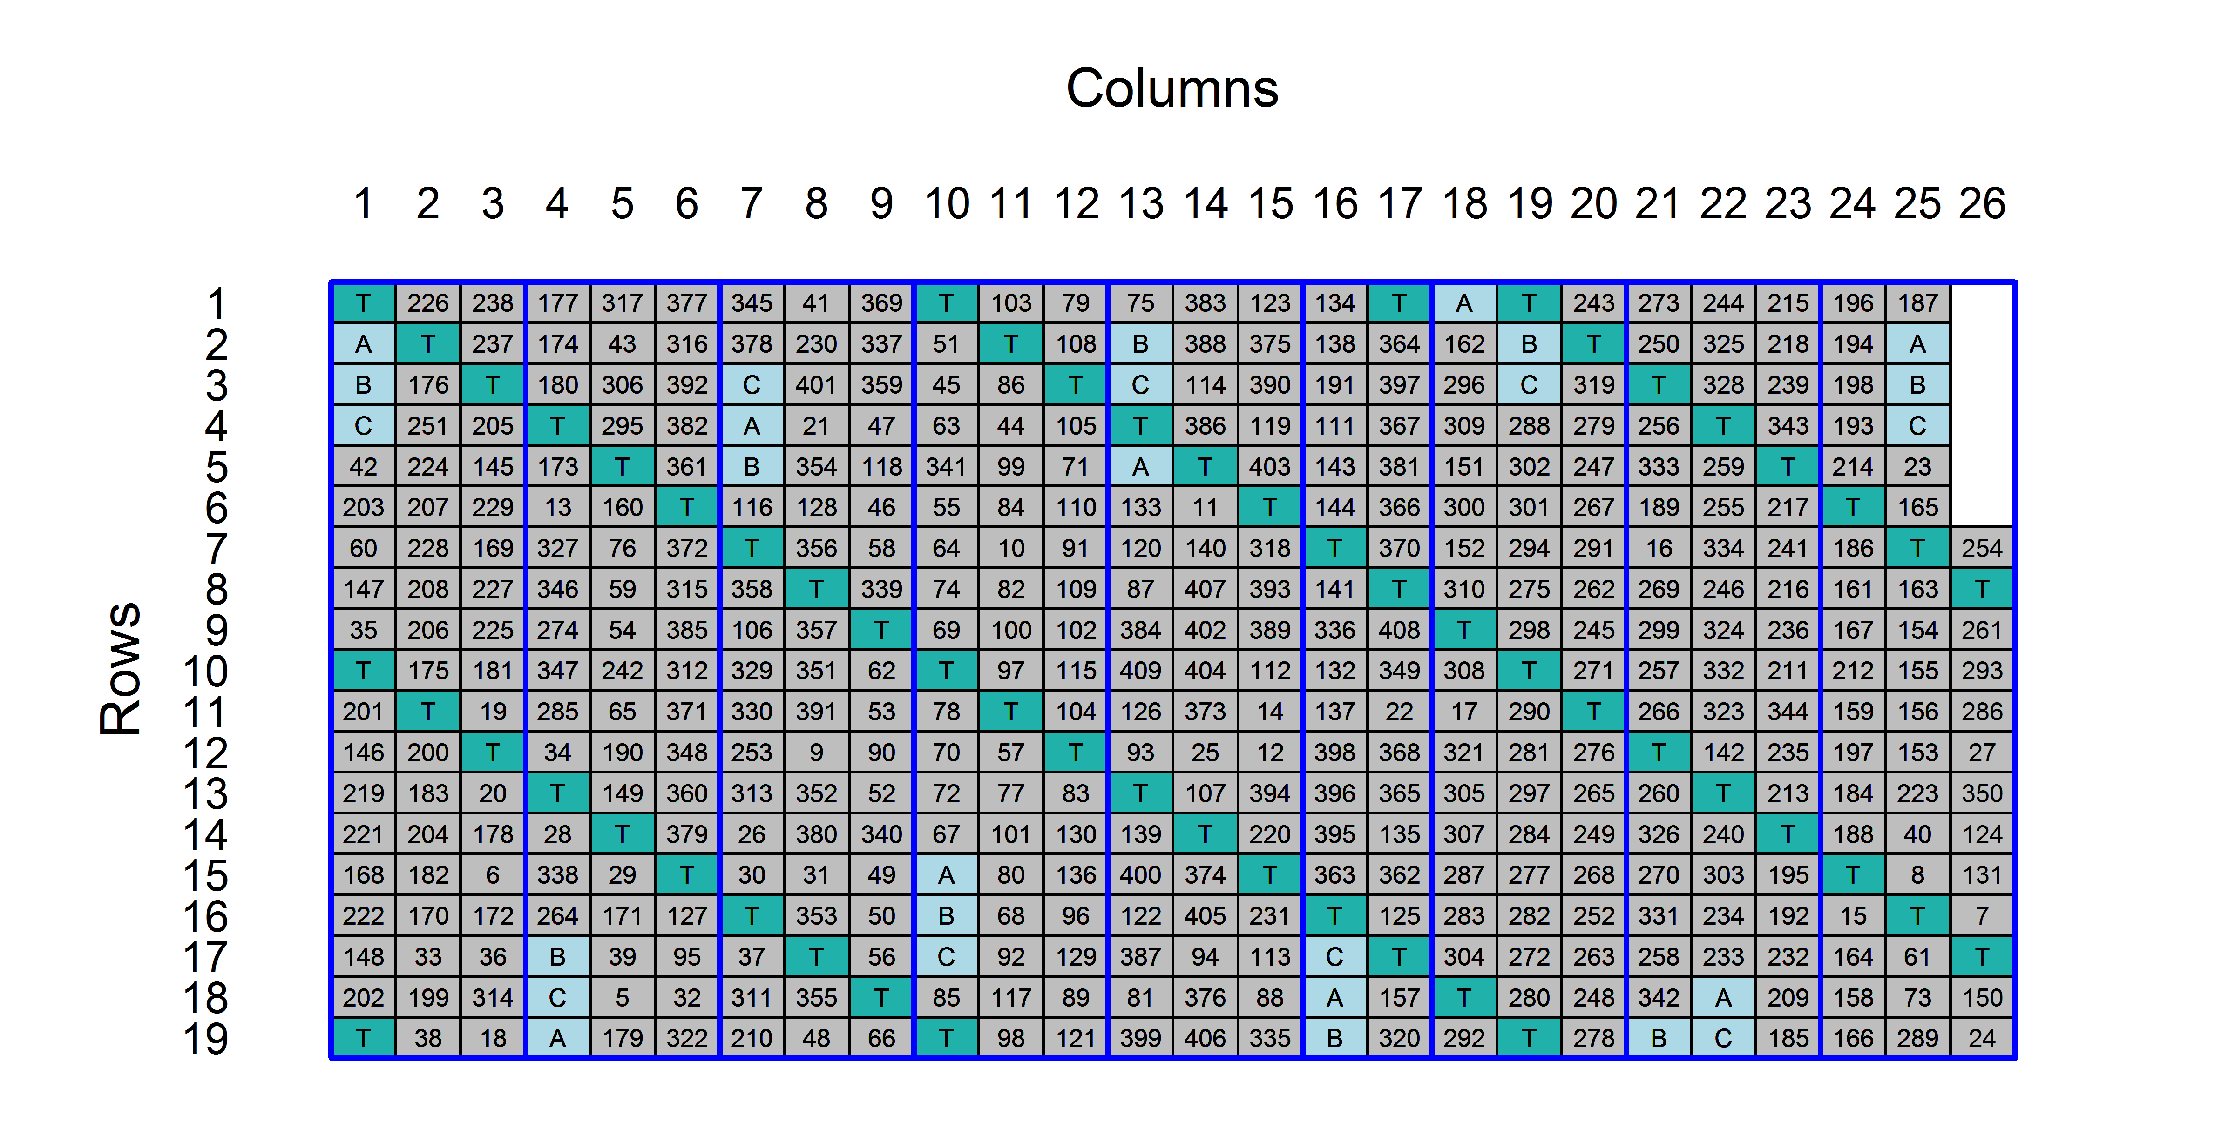
7. Brazilian sugar cane experiment
Joint work with Alessandra dos Santos
A systematic arrangement.
  Not claiming this is a good design, but it is what the company used.

Slide 21
What starting model here?
Old NSW-school approach used by Stringer et al. (2011) in analyzing sugar-cane experiments:
  fixed = Type/Check,
  random = Type/NewClones,
  rcov = ar1(Columns):ar1(Rows).
  Do diagnostic checking to see if need (i) fixed and/or random Columns and Rows terms and (ii) different plot variation model.
  In this experiment, known that there is a group (9) of 3 lower-yielding columns:
    fixed = Group9 + Type/Check.
Model | Fixed | Random | Residual | Comparison | p-value
0 | Group9 + Type/Check | NewClones | id(Column):id(Row)
1 |  |  | ar1(Column):ar1(Row) | 1 vs 0 | 0.114

Slide 22
Include Rows and Columns in the starting model
Model | Fixed | Random | Residual | Comparison | p-value
0 | Group9 + Type/Check | NewClones | id(Column):id(Row)
2 |  | Columns + Rows + NewClones | id(Column):id(Row) | 2 vs 0 | < 0.001
3 |  |  | ar1(Column):ar1(Row) | 3 vs 2 | 0.334
4 |  |  | id(Column):corb(Row, k = 3) | 4 vs 2 | 0.041
5 |  |  | id(Column):corb(Row, k = 4) | 5 vs 4 | 0.036
6 |  |  | id(Column):corb(Row, k = 5) | 6 vs 5 | 0.878
Test for spatial correlation depends on whether Rows and Columns included: without p < 0.20, r_{c} = 0.127, r_{r} = -0.007; with p > 0.20, r_{c} = 0.073, r_{r} = -0.077
Nonsignificant ar1 does not mean that there is no spatial correlation.
  r_{r1} = -0.012 (se 0.082), r_{r2} = 0.151 (se 0.082), r_{r3} = 0.165 (se 0.075), r_{r4} = 0.172 (se 0.078).
I suggest that the problem here is that ar1(Row) is ill-fitting.
I am advocating the use of corb to check on the form of the spatial correlation.

Slide 23
8. Considerations in mixed modelling
Models that are too complex for the data may not converge.
But, be wary of constraints in models (zero variance parameters, ar?):
  Fitting ‘less-constrained’ (more complex) models, even if they are not a good fit, can be useful in diagnosing model-specification problems.
  Allowing negative estimates for variance components can relieve convergence problems, as can making the corresponding terms fixed (less constrained).
  Make random terms with few degrees of freedom fixed — as random terms, the precision of the estimated variance component will be low.
  Generally, converting troublesome random terms to fixed, can be revealing.
Models where the order of the fit has to determined (FA, corb), often have to be fitted starting with a low order and then the estimates from them used as initial values as the order is increased successively by one.
Best if can start with the ‘unknown’, correct model for the data; otherwise, a plausible model that experience shows is likely to fit and avoids constraints.
Diagnostic checking remains relevant.
What model selection is to be done and what will be the significance level?

Slide 24
References
Barr, D. J., Levy, R., Scheepers, C., Tily, H. J. (2013) Random effects structure for confirmatory hypothesis testing: Keep it maximal. J. Memory Lang., 68, 255-278.
Brien, C. J. and R. A. Bailey (2006) Multiple randomizations (with discussion). J. Roy. Stat. Soc., Ser. B (Stat. Methodol.), 68, 571–609.
Brien, C. J. and C. G. B. Demétrio (2009) Formulating mixed models for experiments, including longitudinal experiments. J. Agric. Biol. Environ. Stat., 14, 253–280.
de Faveri, J., A. P. Verbyla, W. S. Pitchford, S. Venkatanagappa, and B. R. Cullis (2015) Statistical methods for analysis of multi-harvest data from perennial pasture variety selection trials. Crop Past. Sci., 66, 947–962.
Gilmour, A. R., B. R. Cullis, and A. P. Verbyla (1997) Accounting for natural and extraneous variation in the analysis of field experiments. J. Agric. Biol. Environ. Stat., 2, 269–293.
Janky, D. G. (2000) Sometimes pooling for analysis of variance hypothesis tests: A review and study of a split-plot model. Amer. Statist., 54, 269–279.
Matuschek, H., R. Kliegl, S. Vasishth, H. Baayen, and D. M. Bates (2015) Balancing type I error and power in linear mixed models. arXiv preprint, arXiv:1511.01864v1, 1–14.
Smith, A. B., B. R. Cullis, and R. Thompson (2005) The analysis of crop cultivar breeding and evaluation trials: an overview of current mixed model approaches. J. Agric. Sci., 143, 449–462.
Smith, A. B., P. Lim, and B. R. Cullis (2006) The design and analysis of multi-phase plant breeding experiments. J. Agric. Sci., 144, 393–409.
Stefanova, K. T., A. B. Smith, and B. R. Cullis (2009) Enhanced diagnostics for the spatial analysis of field trials. J. Agric. Biol. Environ. Stat., 14, 392–410.
Stringer, J., B. R. Cullis, and R. Thompson (2011) Joint modeling of spatial variability and within-row interplot competition to increase the efficiency of plant improvement. J. Agric. Biol. Environ. Stat., 16, 269–281.
Stringer, J. K., A. B. Smith, and B. R. Cullis (2012) Spatial analysis of Agric. field experiments. design and analysis of experiments. In K. Hinkelmann (Ed.), Design and analysis of experiments Volume 3. Special Designs and Applications. pp. 109–136. Hoboken, N.J: Wiley-Interscience.
Verbyla, A. P., B. R. Cullis, M. G. Kenward, and S. J. Welham (1999) The analysis of designed experiments and longitudinal data by using smoothing splines (with discussion). J. Roy. Stat. Soc., Ser. C (Appl. Stat.), 48, 269–311.

Slide 25
Plausible model?
This is a sugar cane experiment.
  Stringer et al. (2011) show that need:
    sar2 (constrained ar3) to model competition at the plot level, and
    a genetic-level competition model.
  fixed = Group9 + Type/Check,
  random = Type:NewClones + N(Type:NewClones)
  + Columns + Rows + ar1(Columns):sar2(Rows).
Our experience is that, in Brazilian experiments:
  No genetic-level competition;
  Plot level competition not always modelled by sar2;
  So could start with:
    fixed = Group9 + Type/Check,
    random = Type:NewClones + Columns + Rows + ar1(Columns):corb(Rows, k=3).

Slide 26
9. Start with a plausible model
Best if you could fit the model that best describes the data.
  It can be that fitting models that are either too simple or too complex is problematic.
In reality, a mixture of forward and backward selection, perhaps with restrictions.
  You will definitely want to test the initial model against simpler models and possibly against more complex models.
  Some terms may not be tested at all.
There is no panacea.

Slide 27
Outline
The mixed model.
Once upon a time ANOVA was king.
NSW-school strategy ― forward selection.
Randomization-based mixed models ― backward selection.
A recommended approach in the psychological literature.
Plant Accelerator experiment: Exp278 — 200 Chick pea RILs.
Brazilian sugar cane experiment.
Considerations in choosing the initial model.
Start with a plausible model.

Slide 28
1. The mixed model
The conditional form of the mixed model that we fit is:
  Y = Xt + ZU + E,
  where E[Y | U] = Xt + ZU, Cov[U] = G and Cov[Y | U] = R.
The corresponding marginal form is:
  E[Y] = Xt and Cov[Y] = ZGZ’ + R = (S_{i} Z_{i}G_{i}Z’_{i}) + R.
We will refer to E[Y] as the expectation model, ZGZ’ as the random model and R as the residual model.
In general, each R and G_{i} each could be unstructured.
In a variance components model, R = s²I and

Slide 29
Three alternative models for spatial dependence
Model for R expressed as direct or Kronecker products of a matrix for Rows with another for Columns.

