Slide 1
The R-package asremlPlus:
I. Mixed model selection;
II. Prediction production & presentation
Chris Brien
Australian Centre for Plant Functional Genomics, University of Adelaide.
School of Information Technology and Mathematical Sciences, University of South Australia

Slide 2
Outline
A three-factor generalized RCBD on ladybirds.
Principles and practices that grew alongside anova.
Using asremlPlus for reml mixed modelling.
  Model selection;
  A wheat experiment
  Prediction production and presentation;
  The Ladybird experiment,
  A Brachypodium experiment,
  A longitudinal experiment.
Conclusions.

Slide 3
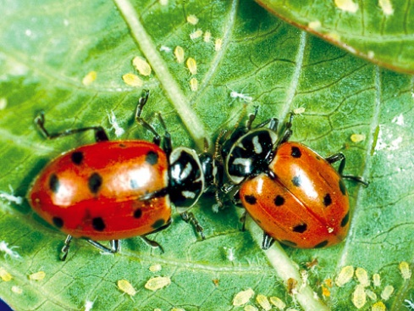
1. Three-factor generalized randomized complete-block experiment on ladybirds (Welham et al. (2015) Example 8.2)
Will ladybirds transfer fungus to aphids on plants?
2 runs of 36 containers with a plant and aphids.
12 treatments: Host plant (beans, trefoil), infected Cadavers (5, 10, 20), Ladybird (−, +).
2 Host
3 Cadavers
2 Ladybird
2 Run
36 Plant in R
12 treatments
72 plants
Analyse the logit of the proportion of live aphids that were infected.

Slide 4
The anova
Ladybird.aov <- aov(logitP ~ Host*Cadavers*Ladybird + Error(Run/Plant),
data=Ladybird.dat)
summary(Ladybird.aov)
Error: Run
Df Sum Sq Mean Sq F value Pr(>F)
Residuals 1 0.06766 0.06766
Error: Run:Plant
Df Sum Sq Mean Sq F value Pr(>F)
Host 1 13.599 13.599 59.172 1.82e-10
Cadavers 2 17.027 8.514 37.044 3.78e-11
Ladybird 1 11.091 11.091 48.257 3.33e-09
Host:Cadavers 2 0.308 0.154 0.670 0.5158
Host:Ladybird 1 0.228 0.228 0.992 0.3234
Cadavers:Ladybird 2 1.735 0.867 3.774 0.0287
Host:Cadavers:Ladybird 2 0.200 0.100 0.435 0.6493
Residuals 59 13.560 0.230
  Analysis achieved with a single fit of the maximal model.
  However, could do a second analysis removing the ns terms that would pool these terms with the Residual.
  The Run:Plant Residual MSq (0.230) in this anova is a pure estimate of error, being derived from replicates only.
  The estimate of the
  Run variance component is negative:
  (0.06766 – 0.230) / 36.
  Only significant interaction is C:L & Host is significant.
  Tables of means for C:L and Host examined.

Slide 5

2. Principles and practices that grew alongside anova
Historical perspective:
  Fisher (1918) introduces anova as a way of
  organizing the calculations.
  Eisenhart (1947) describes fixed, random & mixed models in anova.
  Patterson and Thompson (1971) formalize REML estimation.
  Software for mixed modelling not widely available until 1990s (Littel, 2002).
  Anova dominant in the 20th Century for analysing experiments.
An analyst would run an anova and determine significant treatment effects for each response.
  Usually single fit of the maximal model.

Slide 6
The principles
Include all unit (recipient) terms as random terms; hypothesis tests for them are not valid.
  Justified by the randomization argument for a valid estimate of error and that there is no randomization test available.
  Dropping terms leads to problematic pooling terms (Janky, 2000).
Test treatment (allocated) terms by testing their sources, but never remove them from the analysis.
  Ensures a pure estimate of error, in case a Type II error occurs.
Use hypothesis tests to select a marginality-compliant model (Nelder, 1977) and base conclusions on corresponding tables of means.
  If A#B is significant, there is no need to test the marginal terms (Grand mean), A and B: the fitted model is E[Y] = A:B (ab parameters).
  If A#B is not significant (ns), E[Y] = A + B and conclusions should be based on A and B means (increased precision because more obs^{n} per mean).
Notes:
A:B standards for a separate parameter for each combination of the levels of A and B

Slide 7
Difficulties with principles in mixed modelling
Include all unit (recipient) terms as random terms ; hypothesis tests for them are not valid.
  Because of constraints imposed, random unit variance components that are negative are, in effect, omitted because they are estimated as zero.
Test treatment (allocated) terms by testing their sources, but never remove them from the analysis.
  From a modelling perspective, it is natural to remove nonsignificant terms.
Use hypothesis tests to select a marginality-compliant model (Nelder, 1977) and base conclusions on corresponding tables of means.
  Researchers want predictions for all factor combinations. To get these when an additive model is selected, must ns interaction terms be omitted?
    When E[Y] = A + B (A#B is ns), how to get estimates for all combinations A & B without removing A#B?

Slide 8
Terminology: Term versus source
A term represents the differences between the levels of a (generalized or joint) factor in a model.
  Mathematically it is of the form Xβ or Zu.
  Its dimension is the number of columns of X or Z.
    For example, for fixed factor A with a levels and B with b levels, the X matrix for the term A:B has ab columns i.e. there are ab parameters for A:B in the model.
A source represents a difference between a pair of models
  Mathematically it can be characterized by the projection matrix, Q, the matrix of the quadratic form for the source’s SS, y^{T}Qy.
  Its dimension is the rank of Q, which equals the difference in the ranks of the models.
    The interaction A#B represents the difference between the models E[Y] = A:B and E[Y] = A + B:
    Its dimension is ab – (a + b – 1) = (a – 1)(b – 1).

Slide 9
3. Using asremlPlus for reml mixed modelling.
asremlPlus: Augments asreml-R in fitting mixed models and packages generally in exploring prediction differences.
Two main areas of application:
  Model selection;
  Prediction production and presentation.
Predictions functionality does not require asreml-R.

Slide 10
I. Model selection
While do not remove terms for allocated and recipient terms, do
  test and remove post-hoc covariates;
  test and change the parameterization of random terms
  (e.g. ar1 versus id).
Functions written to solve two problems:
  Painful to determine the model differences between two calls to asreml.
  When multiple responses are to to be analysed in batch mode:
    You want to run similar analyses on them,
    But the fitted models may differ.
  Was not an issue last century (anova had simple one-fit models).
  But, how to automate this process for mixed models?

Slide 11
I.1 Some functions for model selection
Object manipulation functions
  as.asrtests: forms an asrtests object.
Model testing functions
  testranfix.asrtests: tests for a single fixed or random term in a model.
  testresidual.asrtests: fits a new residual formula and tests whether the change is significant.
  testswapran.asrtests: tests the difference between the current random model and one in which some terms have been added and others dropped.
  chooseModel.asrtests: determines the set of significant terms taking into account the marginality (or hierarchy) relations.
All functions are S3 methods for asrtests objects
  Can omit .asrtests; first argument must be an asrtests object.

Slide 12
An asrtests object
A list consisting of the following components:
  asreml.obj: an object produced from an asreml call;
  wald.tab: a data.frame that contains the Wald tests for a set of fixed terms;
  test.summary: a data.frame that contains a history of the tests performed by a sequence of model testing and modification functions.

Slide 13
Some functions for model selection (cont^{d})
Model modification functions
  rmboundary.asrtests: removes boundary or singular variance components.
  changeTerms.asrtests: adds and drops the specified sets of terms from one or both of the fixed or random model and/or replaces the residual (rcov) model with a new model (no testing performed).
  setvarianceterms.call: allows the setting of bounds and initial values for terms.
Model diagnostics and simulation functions
  variofaces.asreml: plots empirical variogram faces, including envelopes.

Slide 14
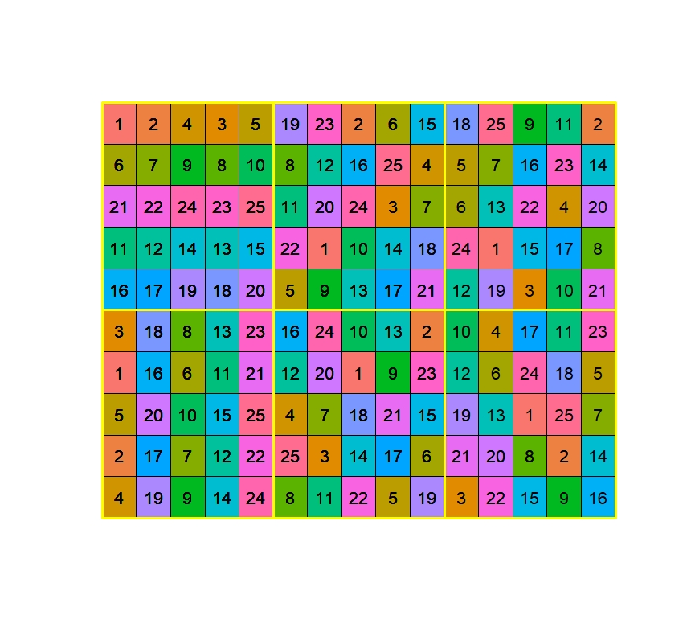
I.2 The wheat experiment (Gilmour et al., 1995)
Investigates 25 varieties of wheat.
A balanced lattice square on a 10  15 grid.
Six reps, each 5 rows  5 columns
It is an example given in the asreml
and asremlPlus manuals, and
the Wheat vignette:
vignette(package = 'asremlPlus').
Factor-allocation diagram
6 Reps
5 Rows in r
5 Columns in r
25 Varieties

25 varieties
150 plots
r = Reps

Slide 15
Paradigm for formulating mixed models
(Brien, 2017; based on Brien & Bailey, 2006, Brien & Demétrio, 2009, Brien et al., 2011)
Initial allocation model
Homogeneous allocation model
Prior allocation model
Factor-allocation diagram
Anatomy of a design
The prior allocation model is a maximal model.
Why allocation?
The initial allocation model reflects the allocations made in the design:
  If all allocations are randomized, it is the randomization model.
The homogeneous allocation model comes from interchanging terms in the initial allocation model between the fixed and random components.
The prior allocation model reparameterizes terms in the homogeneous allocation model e.g. trend terms and residual correlation.
  It is the model formed prior to the analysis and contains terms for all the sources anticipated to occur in the experiment and is a starting model.
Notes:
Allocation versus randomization

Slide 16
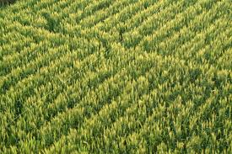
The wheat experiment — models
Allocated  fixed;
Recipient  random.
Take all combinations of the factors within a panel, subject to the restriction that a nested factor cannot occur without its nesting factor.
allocated
recipient
6 Reps
5 Rows in r
5 Columns in r
25 Varieties

25 varieties
150 plots
Initial allocation model:
  Varieties | Reps + Reps:Rows + Reps:Columns + Reps:Rows:Columns.
Homogeneous allocation model:
  Might make Reps fixed.
Prior allocation model:
    Want to add ar1 on Rows and Columns, but on 10 Rows x 15 Columns,
    not on 6 Reps x 5 Rows x 5 Columns (Reps:Rows:Columns).
    Note that Reps are in a 2 x 3 grid; introduce 2 S(uper)Rows x 3 S(uper)Columns.
  An identity (or residual) term
  – it uniquely indexes the units.
A randomization model

Slide 17
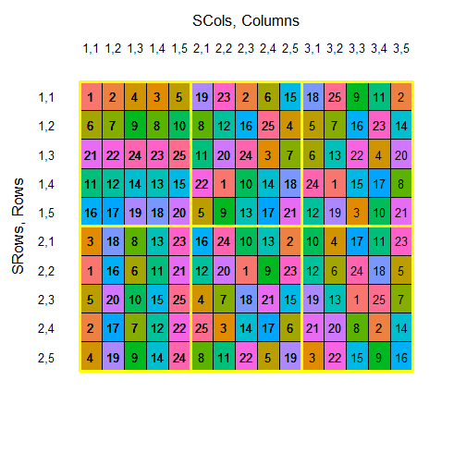
Revised wheat design
This view of the design has the following
factor-allocation diagram.
2 SuperRows
3 SuperColumns
5 Rows in Sr, Sc
5 Columns in Sr, Sc
25 Varieties

25 varieties
150 plots
The initial allocation model becomes (SRows:SColumns = Reps):
  Varieties | SRows + SColumns + SRows:SColumns +
  SRows:SColumns:Rows + SRows:SColumns:Columns +
  SRows:SColumns:Rows:Columns.
  No term for differences between whole rows and whole columns, because not randomized by them.
    If had, then structure (SRows/Rows) * (SColumns/Columns), not (SRows*SColumns) / (Rows*Columns).

Slide 18
The wheat experiment - properties
> Wheat.canon <- designAnatomy(formulae = list(units = ~ (SRows:SColumns)/(Rows*Columns),
+ trt = ~ Variety),
+ data = Wheat.dat)
> summary(Wheat.canon, which.criteria = c("aeff", "order"))
Summary table of the decomposition for units & trt (based on adjusted quantities)
Source.units df1 Source.trt df2 aefficiency order
SRows:SColumns 5
Rows[SRows:SColumns] 24 Variety 24 0.1667 1
Columns[SRows:SColumns] 24 Variety 24 0.1667 1
Rows#Columns[SRows:SColumns] 96 Variety 24 0.6667 1
Residual 72
The design is not orthogonal
Based on initial or homogeneous allocation model, with SRows*SColumns combined.
However, Gilmour et al. (1995) and Butler et al. (2018) have ignored Reps.
What happens?
> Wheat.RC.canon <- designAnatomy(formulae = list(units = ~ Row*Column, trt = ~ Variety),
+ data = Wheat.dat)
> summary(Wheat.RC.canon)
Summary table of the decomposition for units & trt (based on adjusted quantities) Source.units df1 Source.trt df2 aefficiency eefficiency order
Row 9 Variety 8 0.1667 0.1667 1
Residual 1
Column 14 Variety 12 0.1667 0.1667 1
Residual 2
Row#Column 126 Variety 24 0.8452 0.6732 18
Residual 102
The design is not orthogonal
Row = SRows:Rows;
Column = SColumns:Columns.
Not randomization-based:
  Ignores variation allowed for in the design by restricting randomization;
  Pushed down into other terms:
  Reps in all unit terms; some of all Rep terms in Row#Col Residual.
  More Variety information confounded with Row#Col.
Notes:
Inflated estimate of Residual

Slide 19
The wheat experiment – models (revised)
allocated
recipient
2 SuperRows
3 SuperColumns
5 Rows in Sr, Sc
5 Columns in Sr, Sc
25 Varieties

25 varieties
150 plots
Initial allocation model:
  Varieties | SRows*SColumns + SRows:SColumns:Rows + SRows:SColumns:Columns + SRows:SColumns:Rows:Columns).
Homogeneous allocation model:
  Might make SRows*SColumns fixed.
Prior allocation model:
    Varieties | Srows*SColumns + SRows:SColumns:Rows + SRows:SColumns:Columns + units + ar1(SRows:Rows):ar1(SColumns:Columns).
The maximal starting model
A randomization model
nugget variance
ar1(Row):ar1(Column) for asreml-R

Slide 20
I.2 The wheat experiment (Gilmour et al., 1995)
An analysis that investigates spatial correlation.
  Fits the prior allocation model, but with the addition of a post-hoc covariate.
library(asreml)
library(asremlPlus)
library(dae)
data(Wheat.dat)
#'### Add 5-level Rows and Columns (vs 10-level Row and 15-level Column)
recipients <- fac.gen(list(SRows = 2, Rows = 5, SColumns = 3, Columns =5))
Wheat.dat <- cbind(recipients, Wheat.dat)
#’## Fit initial model
current.asr <- asreml(yield ~ WithinColPairs + Variety,
random = ~ (SRows:SColumns)/(Rows + Columns) + units,
residual = ~ ar1(Row):ar1(Column),
data=Wheat.dat)
Warning message:
In asreml(yield ~ WithinColPairs + Variety, random = ~Rep/(Row + :
Some components changed by more than 1% on the last iteration.
  The post-hoc covariate, units and ar1(Row):ar1(Column)will be subject to model selection.
Probably a bound term

Slide 21
Initialize a sequence of model testing
> #’## Load current fit into an asrtests object
> current.asrt <- as.asrtests(current.asr, NULL, NULL)
Calculating denominator DF
> #’## Check for and remove any boundary terms
current.asrt <- rmboundary(current.asrt)
Notes:
  as.asrtests forms the list object with components and contents:
    asreml.obj: containing current.asr;
    wald.tab: a pseudoanova table calculated by as.asrtests.
    test.summary: data.frame for the testing history (initialized with no entries).
  rmboundary rather than rmboundary.asrtests.
  current.asrt is used recursively:
    current.asrt is passed to rmboundary and returned with modified components:
    an asreml.obj in which boundary terms have been removed from the model;
    test.summary with a message and a new wald.tab.

Slide 22
The asrtests object
> summary(current.asrt$asreml.obj)$varcomp
component std.error z.ratio bound %ch
SRows:SColumns:Rows 4.293282e+03 3.199458e+03 1.3418779 P 0.0
SRows:SColumns:Columns 1.575689e+02 1.480357e+03 0.1064398 P 0.7
units 5.742689e+03 1.652457e+03 3.4752438 P 0.0
Row:Column!R 4.706787e+04 2.515832e+04 1.8708669 P 0.0
Row:Column!Row!cor 7.920301e-01 1.014691e-01 7.8056280 U 0.0
Row:Column!Column!cor 8.799559e-01 7.370402e-02 11.9390486 U 0.0
> print(current.asrt, which = "testsummary")
Sequence of model terms whose status in the model has been investigated
terms DF denDF p action
1 SRows:SColumns 1 NA NA Boundary
However, all components are bound to be positive.
  if you do not set the negative variance component estimate to zero, but allow it to remain negative, you get better control over Type I error and, for cases of negative wholeplot error variance estimates, greater power.
  Therefore, allowing negative components is the recommended procedure. (Littel et al, 2006)
The three variance components will be unbound, so that they will be estimated in a manner analogous to anova.

Slide 23
Unconstrained variance components
> #'## Unbind variance components and reload into an asrtests object
> current.asr <- setvarianceterms(current.asr$call,
+ terms = c("SRows:SColumns", "SRows:SColumns:Rows",
+ "SRows:SColumns:Columns"),
+ bounds = "U", update = FALSE)
Model fitted using the gamma parameterization.
Warning message:
In asreml(fixed = yield ~ WithinColPairs + Variety, random = ~(SRows:SColumns)/(Rows + :
Some components changed by more than 1% on the last iteration.
> current.asrt <- as.asrtests(current.asr, NULL, NULL)
Calculating denominator DF
> current.asrt <- rmboundary(current.asrt)
> summary(current.asrt$asreml.obj)$varcomp
component std.error z.ratio bound %ch
SRows:SColumns -2462.3785854 1.191435e+03 -2.066734 U 0.2
SRows:SColumns:Rows 5012.4021412 3.396848e+03 1.475604 U 0.1
SRows:SColumns:Columns 920.5936387 1.704008e+03 0.540252 U 1.1
units 5964.9099372 1.608792e+03 3.707695 P 0.1
Row:Column!R 46690.4620339 2.731906e+04 1.709080 P 0.0
Row:Column!Row!cor 0.8152180 9.988929e-02 8.161216 U 0.1
Row:Column!Column!cor 0.8857252 7.487875e-02 11.828793 U 0.0

Slide 24
The asrtests object (cont^{d})
> print(current.asrt, which = "testsummary")
Sequence of model terms whose status in the model has been investigated
[1] terms DF denDF p action
<0 rows> (or 0-length row.names)
> print(current.asrt, which = "pseudoanova")
Pseudo-anova table for fixed terms
Wald tests for fixed effects.
Response: yield
Df denDF F.inc Pr
(Intercept) 1 1.7 153.400 0.011498
WithinColPairs 1 15.6 2.543 0.130840
Variety 24 76.1 10.110 0.000000
  No change of model since this current.asrt initiated.

Slide 25
Test a fixed term and drop if n.s.
#’## Test term for within Column pairs (a post hoc covariate)
current.asrt <- testranfix(current.asrt, term = "WithinColPairs",
+ drop.fix.ns=TRUE)
Calculating denominator DF
Calculating denominator DF
Warning messages:
In asreml(fixed = yield ~ Variety, random = ~ Rep/(Row + Column) + :
Some components changed by more than 1% on the last iteration.
It is clear that withinColPairs is being tested?
current.asr <- asreml(yield ~ WithinColPairs + Variety,
random = ~ SRows:SColumns /(Rows + Columns) + units,
residual = ~ ar1(Rows):ar1(Columns),
data=Wheat.dat)
current.asr <- asreml(yield ~ Variety,
random = ~ SRows:SColumns /(Rows + Columns) + units,
residual = ~ ar1(Row):ar1(Column),
data=Wheat.dat)
  If WithinColPairs is ns then the model for the asreml.obj in current.ast post-execution will not contain WithinColPairs.
What are the differences between these two?
Are you sure?

Slide 26
Testing random and residual terms
  Default is to drop ns random terms.
#’## Test nugget term
> current.asrt <- testranfix(current.asrt, "units", positive=TRUE)
Warning message:
In asreml(fixed = yield ~ Variety, random = ~(SRows:SColumns)/(Rows + :
Some components changed by more than 1% on the last iteration.
# Test Row autocorrelation
> current.asrt <- testresidual(current.asrt, "~ Row:ar1(Column)",
+ label="Row autocorrelation",
+ simpler=TRUE)
Warning message:
In asreml(fixed = yield ~ Variety, random = ~(SRows:SColumns)/(Rows + :
Some components changed by more than 1% on the last iteration.
  The residual model in the resulting current.asrt depends on the result of the test and the convergence.

Slide 27
Testing residual terms (cont^{d})
#’## Test Column autocorrelation(depends whether Row autocorrelation retained)
> (p <- getTestPvalue(current.asrt, label = "Row autocorrelation"))
[1] 4.676813e-06
{ if (p <= 0.05)
+ current.asrt <- testresidual(current.asrt, "~ ar1(Row):Column",
+ label="Col autocorrelation",
+ simpler=TRUE, update=FALSE)
+ else
+ current.asrt <- testresidual(current.asrt, "~ Row:Column",
+ label="Col autocorrelation",
+ simpler=TRUE, update=FALSE)
+ }

Slide 28
The model selection results
> print(current.asrt, which = "test")
Sequence of model terms whose status in the model has been investigated
terms DF denDF p action
1 WithinColPairs 1 15.6 0.1308 Dropped
2 units 1 NA 0.0006 Retained
3 Row autocorrelation 1 NA 0.0000 Unswapped - new unconverged
4 Col autocorrelation 2 NA 0.0000 Unswapped
> summary(current.asrt$asreml.obj)$varcomp
component std.error z.ratio bound %ch
SRows:SColumns -2392.1643976 1.194200e+03 -2.0031528 U 0.4
SRows:SColumns:Rows 5035.7265975 3.405769e+03 1.4785872 U 0.3
SRows:SColumns:Columns 762.1738643 1.612310e+03 0.4727218 U 1.3
units 5933.5126841 1.610749e+03 3.6836971 P 0.1
Row:Column!R 45973.2573642 2.635502e+04 1.7443833 P 0.0
Row:Column!Row!cor 0.8101706 9.994728e-02 8.1059792 U 0.1
Row:Column!Column!cor 0.8846993 7.502816e-02 11.7915640 U 0.0
  Can see that no changes made to variance terms.
  The asreml.obj in current.asrt contains the selected model.

Slide 29
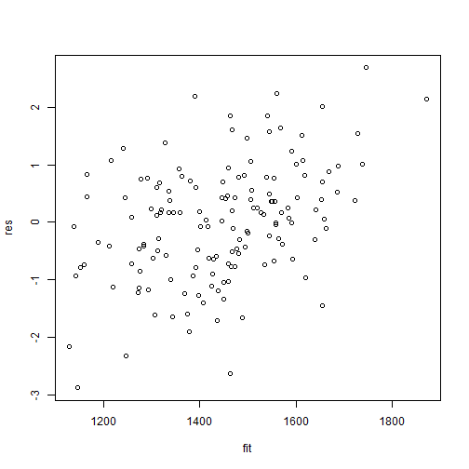
Diagnostic checking
> #'## Get current fitted asreml object and update to include standardized residuals
> current.asr <- current.asrt$asreml.obj
> current.asr <- update(current.asr, aom=TRUE)
> Wheat.dat$res <- residuals(current.asr, type = "stdCond")
> Wheat.dat$fit <- fitted(current.asr)
>
> #'## Do residuals-versus-fitted values plot
> #+ "ResFit"
> with(Wheat.dat, plot(fit, res))
  Need to specify type argument

Slide 30
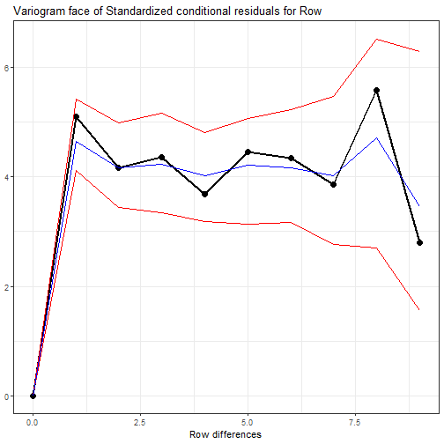
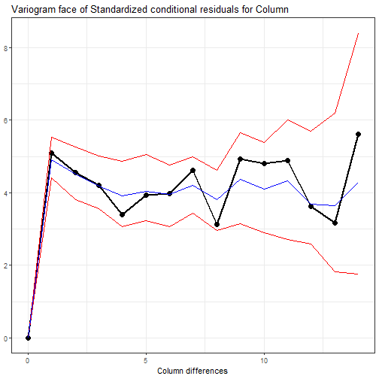
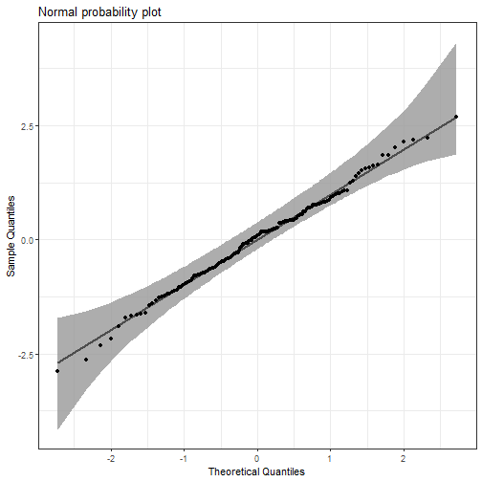
Diagnostic checking (cont^{d})
> #'## Plot variofaces
> #+ "VarioF"
> with(Wheat.dat, variofaces(current.asr, V=NULL, units="addtores",
+ maxiter=50, update = FALSE))
> #'## Plot normal quantile plot
> #+ "Nplot"
> ggplot(data = Wheat.dat, mapping = aes(sample = res)) +
+ stat_qq_band(bandType = "ts") + stat_qq_line() + stat_qq_point() +
+ labs(x = "Theoretical Quantiles", y = "Sample Quantiles",
+ title = "Normal probability plot") +
+ theme(plot.title = element_text(size = 12, face = "bold")) + theme_bw()
  Stefanova et al. (2009)
  update = FALSE needed for convergence
  Uses qqplotr package

Slide 31
Variety predictions — call
> #'## Get Variety predictions and all pairwise prediction differences and p-values
> Var.diffs <- predictPlus(asreml.obj=current.asr,
+ classify = "Variety",
+ error.intervals="halfLeast",
+ wald.tab=current.asrt$wald.tab,
+ sortFactor = "Variety",
+ tables = "predictions")
The basic predictPlus arguments are an asreml object and a classify.
Want to plot half Least Significant differences (Snee, 1981).
Also, sort the Variety predictions into increasing order.
predictPlus returns an alldiffs object (described later).

Slide 32
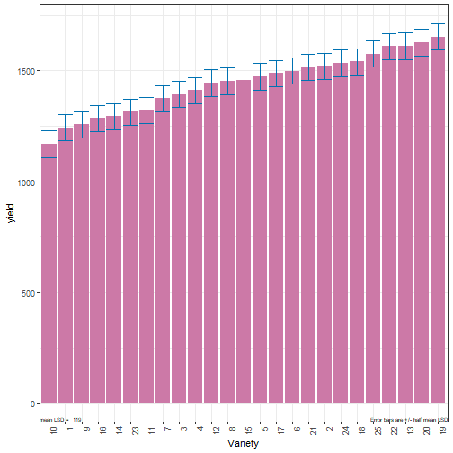
Variety predictions — sorted table
#### Predictions for yield from Variety
Variety predicted.value standard.error upper.halfLeastSignificant.limit
10 10 1168.980 120.4925 1228.306
1 1 1242.751 119.8263 1302.077
9 9 1257.141 119.9866 1316.467
16 16 1285.719 119.9558 1345.045
14 14 1293.530 119.9385 1352.856.
.
.
lower.halfLeastSignificant.limit est.status
10 1109.654 Estimable
1 1183.425 Estimable
9 1197.815 Estimable
16 1226.393 Estimable
14 1234.204 Estimable.
.
.
.
> plotPredictions(Var.diffs$predictions,
+ classify = "Variety",
+ y = "predicted.value",
+ error.intervals = "half")

Slide 33
I.3 Multiple responses
Here is a set of 23 responses to be analyzed:
> responses
[1] "Area.smooth.28" "Area.smooth.35" "Area.smooth.40"
[4] "Area.smooth.50" "Area.smooth.60" "Area.smooth.70"
[7] "Area.smooth.AGR.28to35" "Area.smooth.AGR.35to40" "Area.smooth.AGR.40to50"
[10] "Area.smooth.AGR.50to60" "Area.smooth.AGR.60to70" "Area.smooth.RGR.28to35"
[13] "Area.smooth.RGR.35to40" "Area.smooth.RGR.40to50" "Area.smooth.RGR.50to60"
[16] "Area.smooth.RGR.60to70" "Hue.smooth.28" "Hue.smooth.35"
[19] "Hue.smooth.40" "Hue.smooth.50" "Hue.smooth.60"
[22] "Hue.smooth.70" "Senescence.70"
I usually make a function, say fitModel, that does the analyses and saves the results.

Slide 34
Function for fitting the model to a response
# fitModel <- function(kresp) {
mod.ch <- paste(kresp, "~", "WithinColPairs + Variety")
# Set up fixed model and fit initial model
cat("\n\n#### ",mod.ch,"\n\n")
current.asr <- do.call(asreml,
args=list(fixed = as.formula(mod.ch),
random = ~ (SRows:SColumns)/(Row + Column) + units,
residual = ~ ar1(Row):ar1(Column),
data=Wheat.dat))
# Load current fit into an asrtests object
# Check for and remove any boundary terms
# Check term for within Column pairs (a post hoc covariate)
# Test nugget term
# Test Row autocorrelation
# Test Column autocorrelation
# Get current fitted asreml object
# Do residuals-versus-fitted values plot
# Plot variofaces and normal probability plot
# Get Variety predictions and plot
# save model results
save <- list()
save[["asreml.obj"]] <- current.asrt[["asreml.obj"]]
save[["tests"]] <- current.asrt[["test.summary"]]
save[["wald.tab"]] <- current.asrt$wald.tab
save[["diffs"]] <- Var.diffs
invisible(save)
}
  This needed to vary the response being fitted.
#'## Fit the models
responses <- c("yield", "GWt1000",
"TillLength")
saves <- list()
for (resp in responses)
saves[[resp]] <- fitModel(resp)
saves
yield
asreml.obj
tests
wald.tab
diffs
GWt1000
asreml.obj
tests
wald.tab
diffs
TillLength
asreml.obj
  For each response is saved the 4 objects, with a potentially different model fitted for each.
tests
wald.tab
diffs

Slide 35
II. Prediction production and presentation
Use hypothesis tests to select a marginality-compliant model (Nelder, 1977) and base conclusions on corresponding tables of means.
  Researchers want predictions for all factor combinations.
  But these should conform to chosen model.
Functions written to:
  Select marginality-compliant models.
  Produce, plot and explore predictions.

Slide 36
II.1 Some functions for prediction production and presentation
Model selection function
  chooseModel.asrtests: selects the significant (fixed) terms in model, given the marginality relations between the terms.
Prediction production function
  predictPlus.asreml: enhances predict from asreml, including linear.transformation of the predictions and error.intervals of various types (se, CI, 0.5LSD).
Prediction plotting functions
  plotPredictions.alldiffs: uses ggplot2 to plot predictions.
  predictPresent.asrtests: combines predictPlus and plotPredictions.
  plotPvalues.alldiffs: plots the approximate p-values for all pairwise prediction differences.
All functions are S3 methods
  Can omit the class after the `. `, the first argument must be of the appropriate class.

Slide 37

II.2 Recall the Ladybird example
Will ladybirds transfer fungus to aphids on plants?
2 runs of 36 containers with a plant and aphids.
12 treatments: Host plant (beans, trefoil),
infected Cadavers (5, 10, 20), Ladybird (−, +).
2 Host
3 Cadavers
2 Ladybird
2 Run
36 Plant in R
12 treatments
72 plants
The initial allocation model is:
  Host * Cadavers * Ladybirds | Run + Run:Plant
This will also be the prior allocation model.
As all allocation is by randomization, the model is the same as the randomization model for the experiment.
  An identity (or residual) term – it uniquely indexes the units.

Slide 38
The Ladybird anova
Ladybird.aov <- aov(logitP ~ Host*Cadavers*Ladybird + Error(Run/Plant),
data=Ladybird.dat)
summary(Ladybird.aov)
Error: Run
Df Sum Sq Mean Sq F value Pr(>F)
Residuals 1 0.06766 0.06766
Error: Run:Plant
Df Sum Sq Mean Sq F value Pr(>F)
Host 1 13.599 13.599 59.172 1.82e-10
Cadavers 2 17.027 8.514 37.044 3.78e-11
Ladybird 1 11.091 11.091 48.257 3.33e-09
Host:Cadavers 2 0.308 0.154 0.670 0.5158
Host:Ladybird 1 0.228 0.228 0.992 0.3234
Cadavers:Ladybird 2 1.735 0.867 3.774 0.0287
Host:Cadavers:Ladybird 2 0.200 0.100 0.435 0.6493
Residuals 59 13.560 0.230
  Analysis achieved with a single fit.
  The Run:Plant Residual MSq (0.230) in this anova is a pure estimate of error, being derived from replicates only.
  Only significant interaction is C:L & Host is significant.
  Tables of means for C:L and Host examined.

Slide 39
REML mixed modelling using the randomization-based model
m <- asreml(logitP ~ Host*Cadavers*Ladybird,
random = ~ Run,
residual = ~ Run:Plant,
data = Ladybird.dat)
Warning in asreml(logitP ~ Host * Cadavers * Ladybird, random = ~Run, residual = ~Run:Plant, : Some components changed by more than 1% on the last iteration.
summary(m)$varcomp #shows bound Run component
component std.error z.ratio bound %ch
Run 2.298309e-08 0.01638903 1.402346e-06 B 93.7
Run:Plant!R 2.271216e-01 0.04156985 5.463612e+00 P 0.0
m <- setvarianceterms(m$call, terms = "Run", bounds = "U")
summary(m)$varcomp #shows negative Run component
component std.error z.ratio bound %ch
Run -0.004504789 0.002896281 -1.555370 U 0.1
Run:Plant!R 0.229834648 0.042316936 5.431269 P 0.0
  Must be unconstrained to be equivalent to a randomization model.
  Biased estimate (Littel et al., 2006).
  Variance component estimates equal anova estimates.

Slide 40
The fixed effects analysis
Set up an asrtests object and print out wald.tab (with denominator df calculated using Kenward-Rogers by default).
> current.asrt <- as.asrtests(m)
Calculating denominator DF
> print(current.asrt, which = "pseudoanova",
+ colourise = TRUE)
#### Pseudo-anova table for fixed terms
Wald tests for fixed effects.
Response: logitP
Df denDF F.inc Pr
(Intercept) 1 1 1550.00 0.01617
Host 1 59 59.17 0.00000
Cadavers 2 59 37.04 0.00000
Ladybird 1 59 48.26 0.00000
Host:Cadavers 2 59 0.67 0.51581
Host:Ladybird 1 59 0.99 0.32342
Cadavers:Ladybird 2 59 3.77 0.02868
Host:Cadavers:Ladybird 2 59 0.44 0.64932A
  Same as the anova.

Slide 41
Use chooseModel to select a marginality-compliant fixed model
Based on the marginality relationships between terms.
Marginality is a property of the column spaces of the incidence matrices for the terms.
  One term is marginal to another if the column space of the first term is a subspace of the term to which it is marginal.
  This property is independent of the replications of the levels of the factors that make up the term.
  For example, the term for A is marginal to A:B irrespective of the number of values for each combination of the levels of A and B.
  When nesting is explicit, because nested factors are numbered within the nesting factors (e.g. Run & Plant), then a term is marginal to another if its factors are a subset of those in the marginal term.

Slide 42
The marginality matrix
> Ladybird.pstr <- pstructure(formula = ~ Host*Cadavers*Ladybird,
+ data = Ladybird.dat)
> HCL.marg <- marginality(Ladybird.pstr)
> print(HCL.marg)
Host Cadavers Host:Cadavers Ladybird Host:Ladybird Cadavers:Ladybird
Host 1 0 1 0 1 0
Cadavers 0 1 1 0 0 1
Host:Cadavers 0 0 1 0 0 0
Ladybird 0 0 0 1 1 1
Host:Ladybird 0 0 0 0 1 0
Cadavers:Ladybird 0 0 0 0 0 1
Host:Cadavers:Ladybird 0 0 0 0 0 0
Host:Cadavers:Ladybird
Host 1
Cadavers 1
Host:Cadavers 1
Ladybird 1
Host:Ladybird 1
Cadavers:Ladybird 1
Host:Cadavers:Ladybird 1
pstructure is a dae function for forming the projection matrices for a formula, a side effect of which is to produce the marginality matrix.

Slide 43
Choose the model
> sigmod <- chooseModel(current.asrt, terms.marginality = HCL.marg)
Calculating denominator DF
Calculating denominator DF
Calculating denominator DF
Calculating denominator DF
Calculating denominator DF
sigmod is a list with two components: asrtests.obj and sig.terms.
> print(sigmod$sig.terms)
[[1]]
[1] "Cadavers:Ladybird"
[[2]]
[1] "Host"
> current.asrt <- sigmod$asrtests.obj
> print(current.asrt, which = "test")
Sequence of model terms whose status in the model has been investigated
terms DF denDF p action
1 Host:Cadavers:Ladybird 2 59 6.493237e-01 Nonsignificant
2 Cadavers:Ladybird 2 59 2.868479e-02 Significant
3 Host:Ladybird 1 59 3.234182e-01 Nonsignificant
4 Host:Cadavers 2 59 5.158105e-01 Nonsignificant
5 Host 1 59 1.816387e-10 Significant

Slide 44
Obtaining the predictions
Want the predictions for Host:Cadavers:Ladybird that conforms to the selected model.
  Such predictions are called estimated or population marginal means.
  Could get the predictions using predictPlus.asreml and then plot them using plotPredictions.data.frame.
  Get predictions and plot in one step with predictPresent.asreml.
Both predictPlus and predictPresent have a linear.transformation argument that can be a formula or a matrix of contrasts.
  For a formula, the projection of the predicted values onto the formula subspace is produced.
Both produce an alldiffs object.

Slide 45
An alldiffs object
A list consisting of the following components:
  predictions: the predictions, their standard errors and error intervals;
  vcov: the variance matrix of the predictions;
  differences: all pairwise differences between the predictions,
  p.differences: p-values for all pairwise differences between the predictions;
  sed: the standard errors of all pairwise differences between the predictions;
  LSD: the mean, minimum and maximum LSDs.
All components (except LSD) in standard order and labelled for the classify: "Host:Cadavers:Ladybird"

Slide 46
Using predictPresent
(and plotPvalues)
same as classify.
> > diffs <- predictPresent(current.asrt$asreml.obj,
+ terms = "Host:Ladybird:Cadavers",
+ linear.transformation = ~Cadavers:Ladybird + Host,
+ wald.tab = current.asrt$wald.tab,
+ error.intervals = "halfLeast",
+ meanLSD.type = "factor.combination", LSDby = "Host",
+ tables = "none",
+ ggplotFuncs = list(facet_grid(Ladybird ~ Host,
+ labeller = labeller(Host = prependerHost,
+ Ladybird = prependerLBird))))
> plotPvalues(diffs$Host.Ladybird.Cadavers, factors.per.grid = 1, show.sig = TRUE)
LSD varies with Host comparison, so use within Host LSD.
Extra ggplot predefinded functions to beautify the plots.
> prependerHost <- function(string, prefix = "Host: ") paste0(prefix, string)
> prependerHost <- as_labeller(prependerHost)
> prependerLBird <- function(string, prefix = "Ladybird: ") paste0(prefix, string) > prependerLBird <- as_labeller(prependerLBird)

Slide 47
The diffs object for Ladybirds
> str(diffs)
List of 7
$ predictions :'data.frame': 12 obs. of 8 variables:
..$ Host : Factor w/ 2 levels "bean","trefoil": 1 1 1 1 1 1 2 2 2 2 ...
..$ Ladybird : Factor w/ 2 levels "-","+": 1 1 1 2 2 2 1 1 1 2 ...
..$ Cadavers : Factor w/ 3 levels "5","10","20": 1 2 3 1 2 3 1 2 3 1 ...
..$ predicted.value : num [1:12] -1.604 -1.145 -0.745 -1.02 -0.598 ...
..$ standard.error : num [1:12] 0.142 0.142 0.142 0.142 0.142 ...
..$ upper.halfLeastSignificant.limit: num [1:12] -1.408 -0.95 -0.549 -0.824 -0.403 ...
..$ lower.halfLeastSignificant.limit: num [1:12] -1.8 -1.341 -0.941 -1.215 -0.794 ...
..$ est.status : chr [1:12] "Estimable" "Estimable" "Estimable" "Estimable" ...
..- attr(*, "meanLSD")= num [1:2] 0.392 0.392
$ vcov : NULL
$ differences : num [1:12, 1:12] 0 0.458 0.859 0.584 1.005 ...
..- attr(*, "dimnames")=List of 2
.. ..$ : chr [1:12] "bean,-,5" "bean,-,10" "bean,-,20" "bean,+,5" ...
.. ..$ : chr [1:12] "bean,-,5" "bean,-,10" "bean,-,20" "bean,+,5" ...
$ p.differences : num [1:12, 1:12] NA 2.26e-02 4.78e-05 4.12e-03 3.30e-06 ...
..- attr(*, "dimnames")=List of 2
.. ..$ : chr [1:12] "bean,-,5" "bean,-,10" "bean,-,20" "bean,+,5" ...
.. ..$ : chr [1:12] "bean,-,5" "bean,-,10" "bean,-,20" "bean,+,5" ...

Slide 48
The diffs object for Ladybirds
$ sed : num [1:12, 1:12] NA 0.196 0.196 0.196 0.196 ...
..- attr(*, "dimnames")=List of 2
.. ..$ : chr [1:12] "bean,-,5" "bean,-,10" "bean,-,20" "bean,+,5" ...
.. ..$ : chr [1:12] "bean,-,5" "bean,-,10" "bean,-,20" "bean,+,5" ...
$ LSD :'data.frame': 2 obs. of 3 variables:
..$ minLSD : num [1:2] 0.392 0.392
..$ meanLSD: num [1:2] 0.392 0.392
..$ maxLSD : num [1:2] 0.392 0.392
$ backtransforms: NULL
- attr(*, "response")= chr "logitP“
- attr(*, "response.title")= chr "logitP transform(s)“
- attr(*, "term")= chr "Host:Ladybird:Cadavers“
- attr(*, "classify")= chr "Host:Ladybird:Cadavers“
- attr(*, "tdf")= num 59
- attr(*, "class")= chr "alldiffs“
- attr(*, "meanLSD.type")= chr "factor.combinations“
- attr(*, "LSDby")= chr "Host"

Slide 49
The diffs object for Ladybirds
> diffs$Host.Ladybird.Cadavers$differences
bean,-,5 bean,-,10 bean,-,20 bean,+,5 bean,+,10 bean,+,20 . . .
bean,-,5 0.00000000 -0.4584030 -0.8590241 -0.5842863 -1.0054898 -2.0825042 . . .
bean,-,10 0.45840297 0.0000000 -0.4006211 -0.1258833 -0.5470869 -1.6241012
bean,-,20 0.85902408 0.4006211 0.0000000 0.2747378 -0.1464657 -1.2234801
bean,+,5 0.58428627 0.1258833 -0.2747378 0.0000000 -0.4212036 -1.4982179
bean,+,10 1.00548982 0.5470869 0.1464657 0.4212036 0.0000000 -1.0770144
bean,+,20 2.08250420 1.6241012 1.2234801 1.4982179 1.0770144 0.0000000
trefoil,-,5 -0.86920012 -1.3276031 -1.7282242 -1.4534864 -1.8746899 -2.9517043
trefoil,-,10 -0.41079715 -0.8692001 -1.2698212 -0.9950834 -1.4162870 -2.4933014
trefoil,-,20 -0.01017604 -0.4685790 -0.8692001 -0.5944623 -1.0156659 -2.0926802
trefoil,+,5 -0.28491385 -0.7433168 -1.1439379 -0.8692001 -1.2904037 -2.3674180
trefoil,+,10 0.13628970 -0.3221133 -0.7227344 -0.4479966 -0.8692001 -1.9462145
trefoil,+,20 1.21330408 0.7549011 0.3542800 0.6290178 0.2078143 -0.8692001 . . .

Slide 50
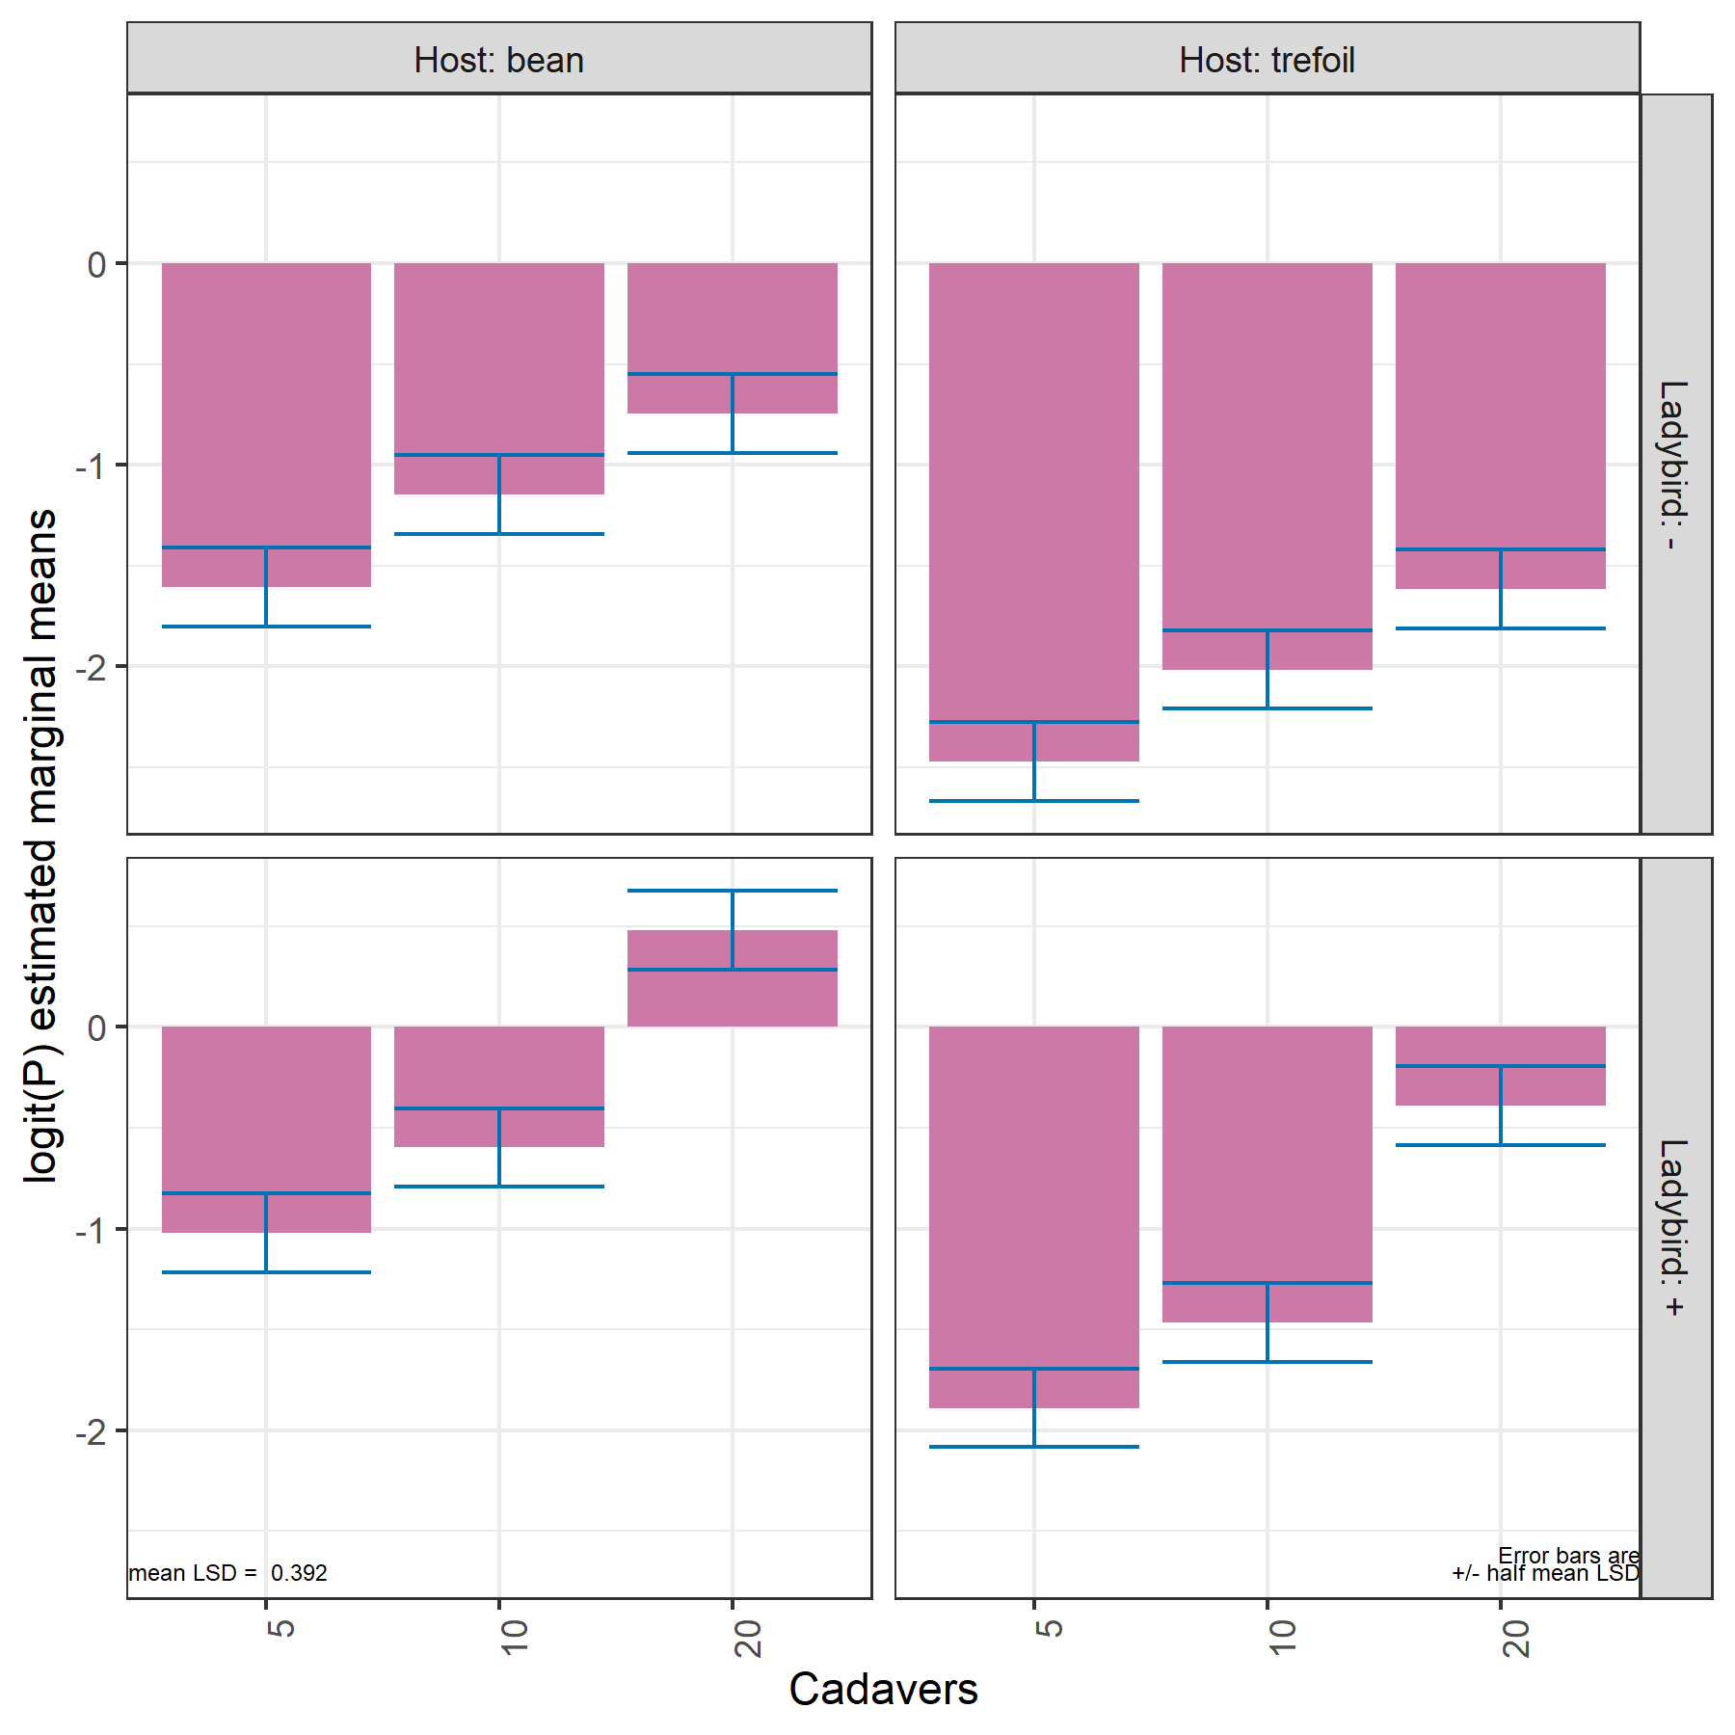
Predictions
Predictions for all combinations of the levels of Host, Ladybird and Cadavers.
But, same pattern in predictions for both Hosts within each Ladybird level (row of the plot).
Error bars are ± 0.5 LSD (5%) (Snee, 1981):
  When overlap within a Host, prediction differences are ns;
  LSD = 0.392; based on 12 values.
  If drop ns terms, same predictions, but s² = 0.223 and LSD = 0.386.
  For a mean based on 6 values,
  LSD = 0.554.
Notes:
LSD (5%) = 2.000 sqrt(2 * 0.230 /6) = 0.554

Slide 51
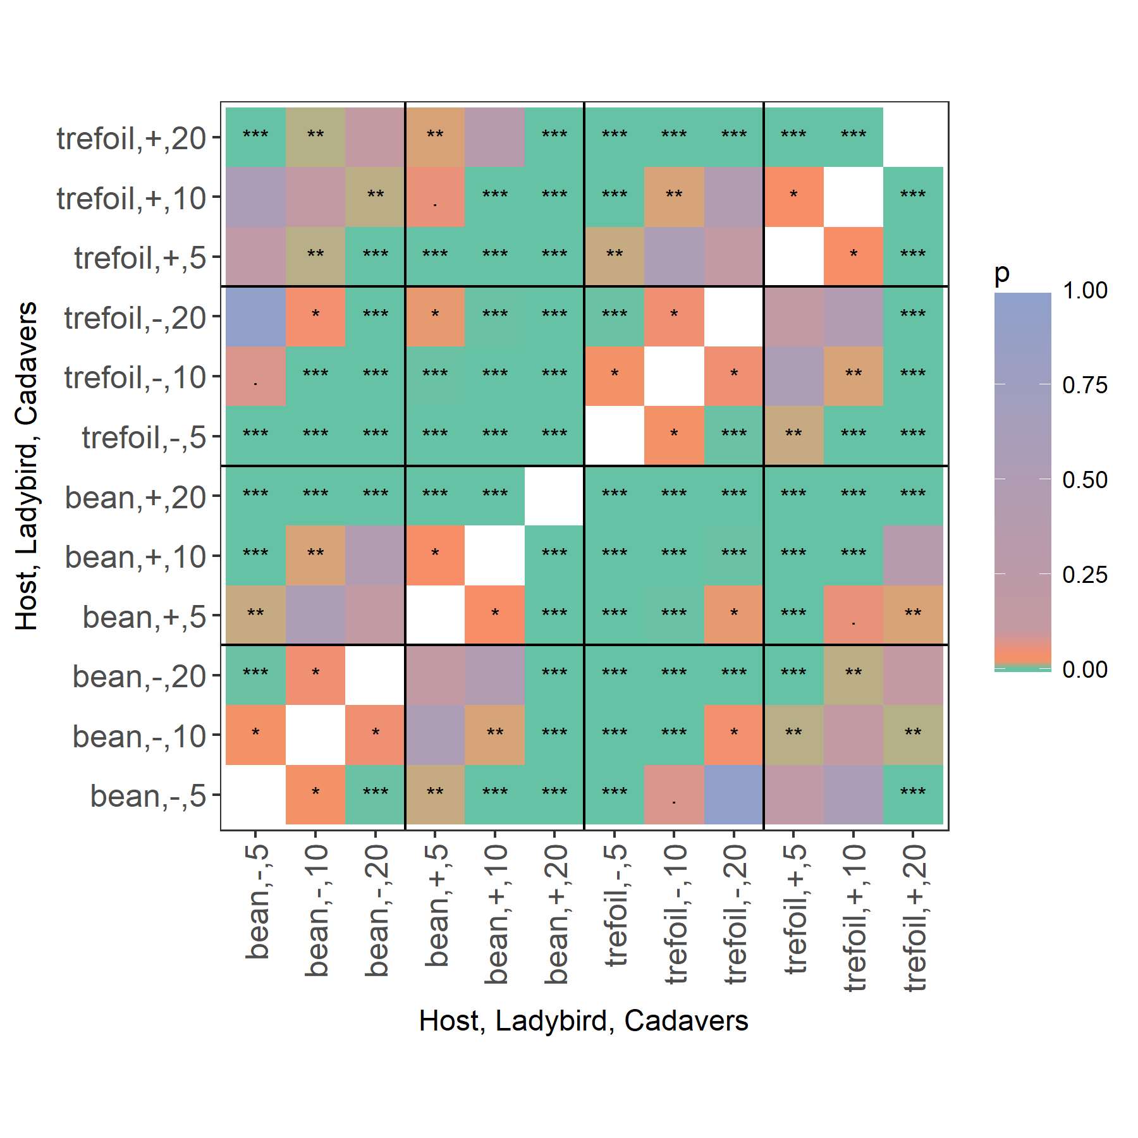
Heat map of p-values for pairwise differences
Based on exact t-tests, so equivalent to LSDs.
The differences within a panel are down the antidiagonal.
All differences within a panel are significant.
Note that the top and the bottom two antidiagonal grid pairs are the same.

Slide 52
II.3 Functions producing alldiffs objects
  as.alldiffs: forms an alldiffs object from supplied objects.
  allDifferences.data.frame: Using supplied predictions, seds and/or variance matrix of predictions, computes the components of an alldiffs object.
  predictPlus.asreml: Computes predictions and the components of an alldiffs object.
  predictPresent.asreml: Computes predictions and the components of an alldiffs object for each of one or more terms and plots or tables them.

Slide 53
The alldiffs methods
  facCombine.alldiffs: combines several factors into one factor in the components of an alldiffs object.
  linTransform.alldiffs: calculates a linear transformation of the predictions stored in an alldiffs object.
  plotPvalues.alldiffs: plots the approximate p-values for all pairwise prediction differences.
  recalcLSD.alldiffs: adds or recalculates the LSD component of an alldiffs object.
  redoErrorIntervals.alldiffs: adds or replaces the error intervals stored in the prediction component of an alldiffs object.
  reorderClassify.alldiffs: reorders the components in an alldiffs object according to a new classify.
  sort.alldiffs: sorts the components of an alldiffs object according to the predicted values associated with a factor.
  subset.alldiffs: subsets the components in an alldiffs object according to the the supplied condition.
Do not need asreml for these functions.

Slide 54
II.4 Presenting predictions obtained with lmerTest and emmeans
> #'# Script using lmerTest and asremlPlus to analyse the Ladybird example
> library(lmerTest)
> library(emmeans)
> library(asremlPlus)
> data("Ladybird.dat")
>
> #'# Use lmerTest and emmmeans to get predictions and associated statistics
> m1.lmer <- lmerTest::lmer(logitP ~ Host*Cadavers*Ladybird + (1|Run), + data=Ladybird.dat)
singular fit
> HCL.emm <- emmeans::emmeans(m1.lmer, specs = ~ Host:Cadavers:Ladybird)
> HCL.preds <- summary(HCL.emm)
> den.df <- min(HCL.preds$df)
> HCL.vcov <- vcov(HCL.emm)
> HCL.sed <- NULL
lmerTest does the analysis
emmeans (estimated marginal means) gets the predictions and associated statistics

Slide 55
Converting summary_emm object to a predictions.frame
> HCL.preds <- summary(HCL.emm)
> ## Modify HCL.preds to be compatible with a predictions.frame
> names(HCL.preds)
[1] "Host" "Cadavers" "Ladybird" "emmean" "SE" "df" "lower.CL" "upper.CL"
> HCL.preds <- as.predictions.frame(HCL.preds, predictions = "emmean",
+ se = "SE", interval.type = "CI",
+ interval.names = c("lower.CL", "upper.CL"))
> names(HCL.preds)
[1] "Host" "Cadavers" "Ladybird" "predicted.value"
[5] "standard.error" "df" "lower.Confidence.limit" "upper.Confidence.limit"
[9] "est.status"
The columns in HCL.preds are now compatible with functions that require a predictions.frame.
  In particular, allDifferences.data.frame can be used, together with the variance matrix extracted from the emmGrid object to form an alldiffs object.
Note that the order of the factors is not the same as used in the predictions produced using asreml-R:
  In the emmGrid object the order was Host, Ladybird, Cadavers;
  Reorder by giving the desired order of the factors in the classify supplied to allDifferences.

Slide 56
Presenting predictions obtained with lmerTest and emmeans
> #'# Form an alldiffs object with predictions obtained with lmerTest
> HCL.diffs <- allDifferences(predictions = HCL.preds, classify = "Host:Ladybird:Cadavers",
+ sed = HCL.sed, vcov = HCL.vcov, tdf = den.df)
> #'### Transform and plot the predictions
> diffs <- linTransform(HCL.diffs, linear.transformation = ~Cadavers:Ladybird + Host,
+ error.intervals = "halfLeast",
+ meanLSD.type = "factor.combination", LSDby = "Host",
+ tables = "none")
> prependerHost <- function(string, prefix = "Host: ") paste0(prefix, string)
> prependerHost <- as_labeller(prependerHost)
> prependerLBird <- function(string, prefix = "Ladybird: ") paste0(prefix, string)
> prependerLBird <- as_labeller(prependerLBird)
> plotPredictions(diffs$predictions, y ="predicted.value",
+ y.title = "logit(P)",
+ classify = "Host:Ladybird:Cadavers",
+ error.intervals = "halfLeast",
+ meanLSD.type = "factor.combination", LSDby = "Host",
+ ggplotFuncs = list(facet_grid(Ladybird ~ Host,
+ labeller = labeller(Host = prependerHost,
+ Ladybird = prependerLBird))))
> plotPvalues(diffs, factors.per.grid = 1, show.sig = TRUE)

Slide 57
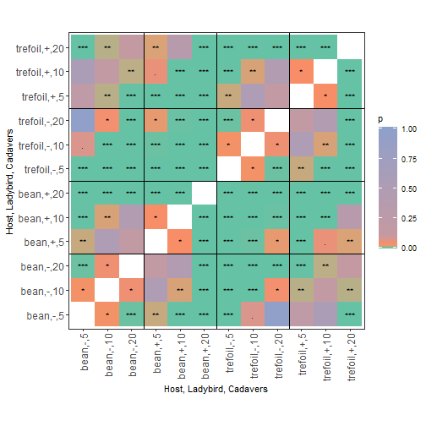
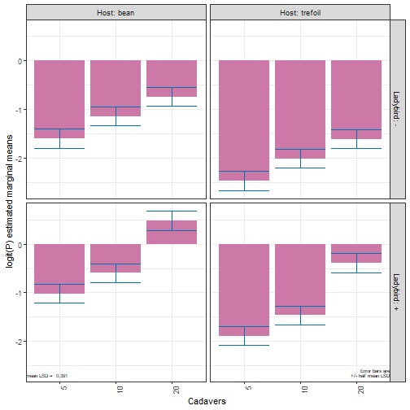
Plots from emmGrid

Slide 58
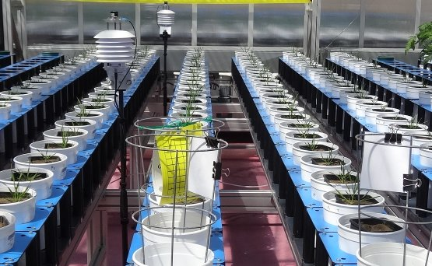
II.5 Brachypodium experiment
The treatments were:
  2 Genotypes x 3 N:P levels x
  2 Salt levels x 2 AMF levels:
  12 treatments
Treatments allocated to 144 carts in 6 Rows x 24 Positions:
  A resolved row-column design used.
Many response variables obtained, including Total P.
Also measured was the % Colonisation by the AMF, used as a covariate (per.col) in the model, rather than the two-level AMF factor, because colonization is quite variable.

Slide 59
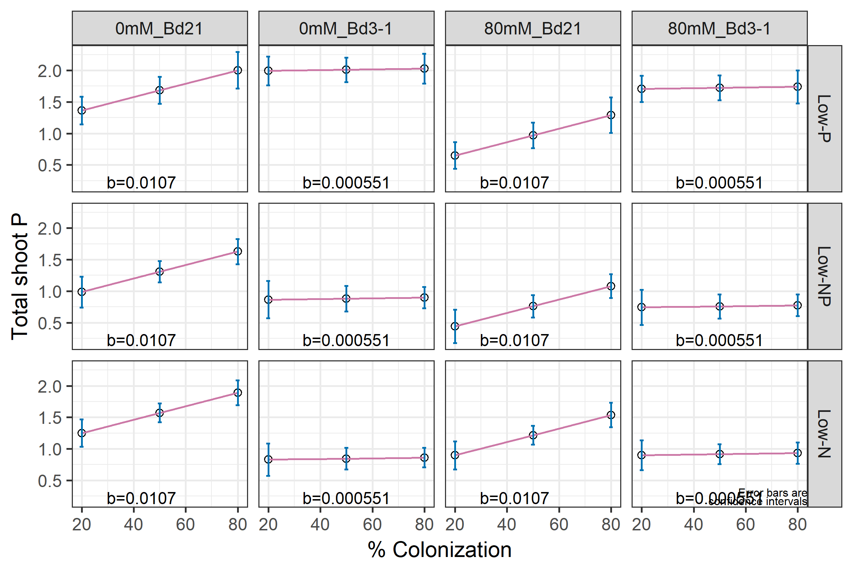
Predictions for quantitative covariate
Get predictions with predictPlus and combine Salt and Genotypes with facCombine .
plotPredictions(data = diffs$predictions,
classify = "Salt_Genotype:NP:per.col",
y = "predicted.value", x.num = "per.col",
y.title = attr(diffs, which = "response.title"),
titles = "% Colonization",
ggplotFuncs = list(geom_text(data = b,
mapping = aes(x = x, y = y, label=lab),
hjust= -0.5, vjust=-0.3, size = 3)))
x.num specifies the quantitative covariate
geom_text adds the slopes based on b, a data.frame with x, y, and lab;
lab is a character constructed from coefficients extracted from the asreml object (method not shown).

Slide 60
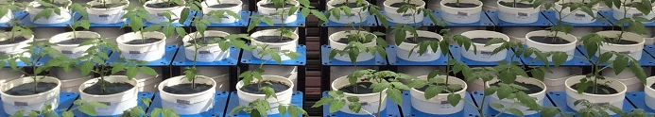
II.6 A longitudinal example
A tomato experiment in a
high-throughput phenotyping facility.
A randomized complete-block with 4 blocks of 8 treatments
  Treatments are 4 Zn levels x 2 AMF (Arubuscular Mycorrhiza Fungi).
A complex longitudinal analysis (Brien & Demétrio, 2009):
  Includes random variation in the curved trend per plant, modelled using splines.
  Autocorrelation between days.
  Differential curved trends between the treatments (restricted the number of knots to 10 to increase smoothness).
Want to get predictions over time and growth rates.
  Growth rates obtained by a matrix linear transformation of predictions

Slide 61
Getting the predictions using predictPlus
> #'## Obtain the predictions for the longitudinal response
> DAPs <- 17:51 # DAP = Days after planting
> xDays <- DAPs - mean(DAPs)
> diffs <- predictPlus(save10[["Area"]]$asreml.obj, classify = "Zn:AMF:xDays",
+ x.num = "xDays", levels = list(xDays = xDays),
+ error.intervals = "halfLeast", meanLSD.type = "factor",
+ LSDby = "xDays",
+ wald.tab = save10[["Area"]]$wald.tab,
+ tables = "none", Vmatrix = TRUE)
Spline: design points closer than 0.0034 have been merged.
Spline: design points closer than 0.0034 have been merged.

Slide 62
Plotting the predictions using ggplot
> labelAMF <- as_labeller(function(lev) paste(lev, "AMF"))
> plt <- ggplot(diffs$predictions,
+ aes_string(x = "xDays+34", y = "predicted.value",
+ group = "Zn", colour = "Zn")) +
+ geom_line() + geom_point() +
+ geom_ribbon(aes_string(ymin = "lower.halfLeastSignificant.limit",
+ ymax = "upper.halfLeastSignificant.limit",
+ colour = "Zn", fill = "Zn"), alpha = 0.1) +
+ facet_wrap("AMF", labeller = labeller(AMF = labelAMF), ncol = 2) +
+ labs(x = "DAP", y = "Predicted PSA (kpixels)", colour = "Zn (mg/kg)") +
+ theme_bw() +
+ theme(legend.position = "bottom") +
+ guides(fill = "none")
> print(plt)
Specify data & variables
Plot predictions & intervals
Beautify the plot

Slide 63
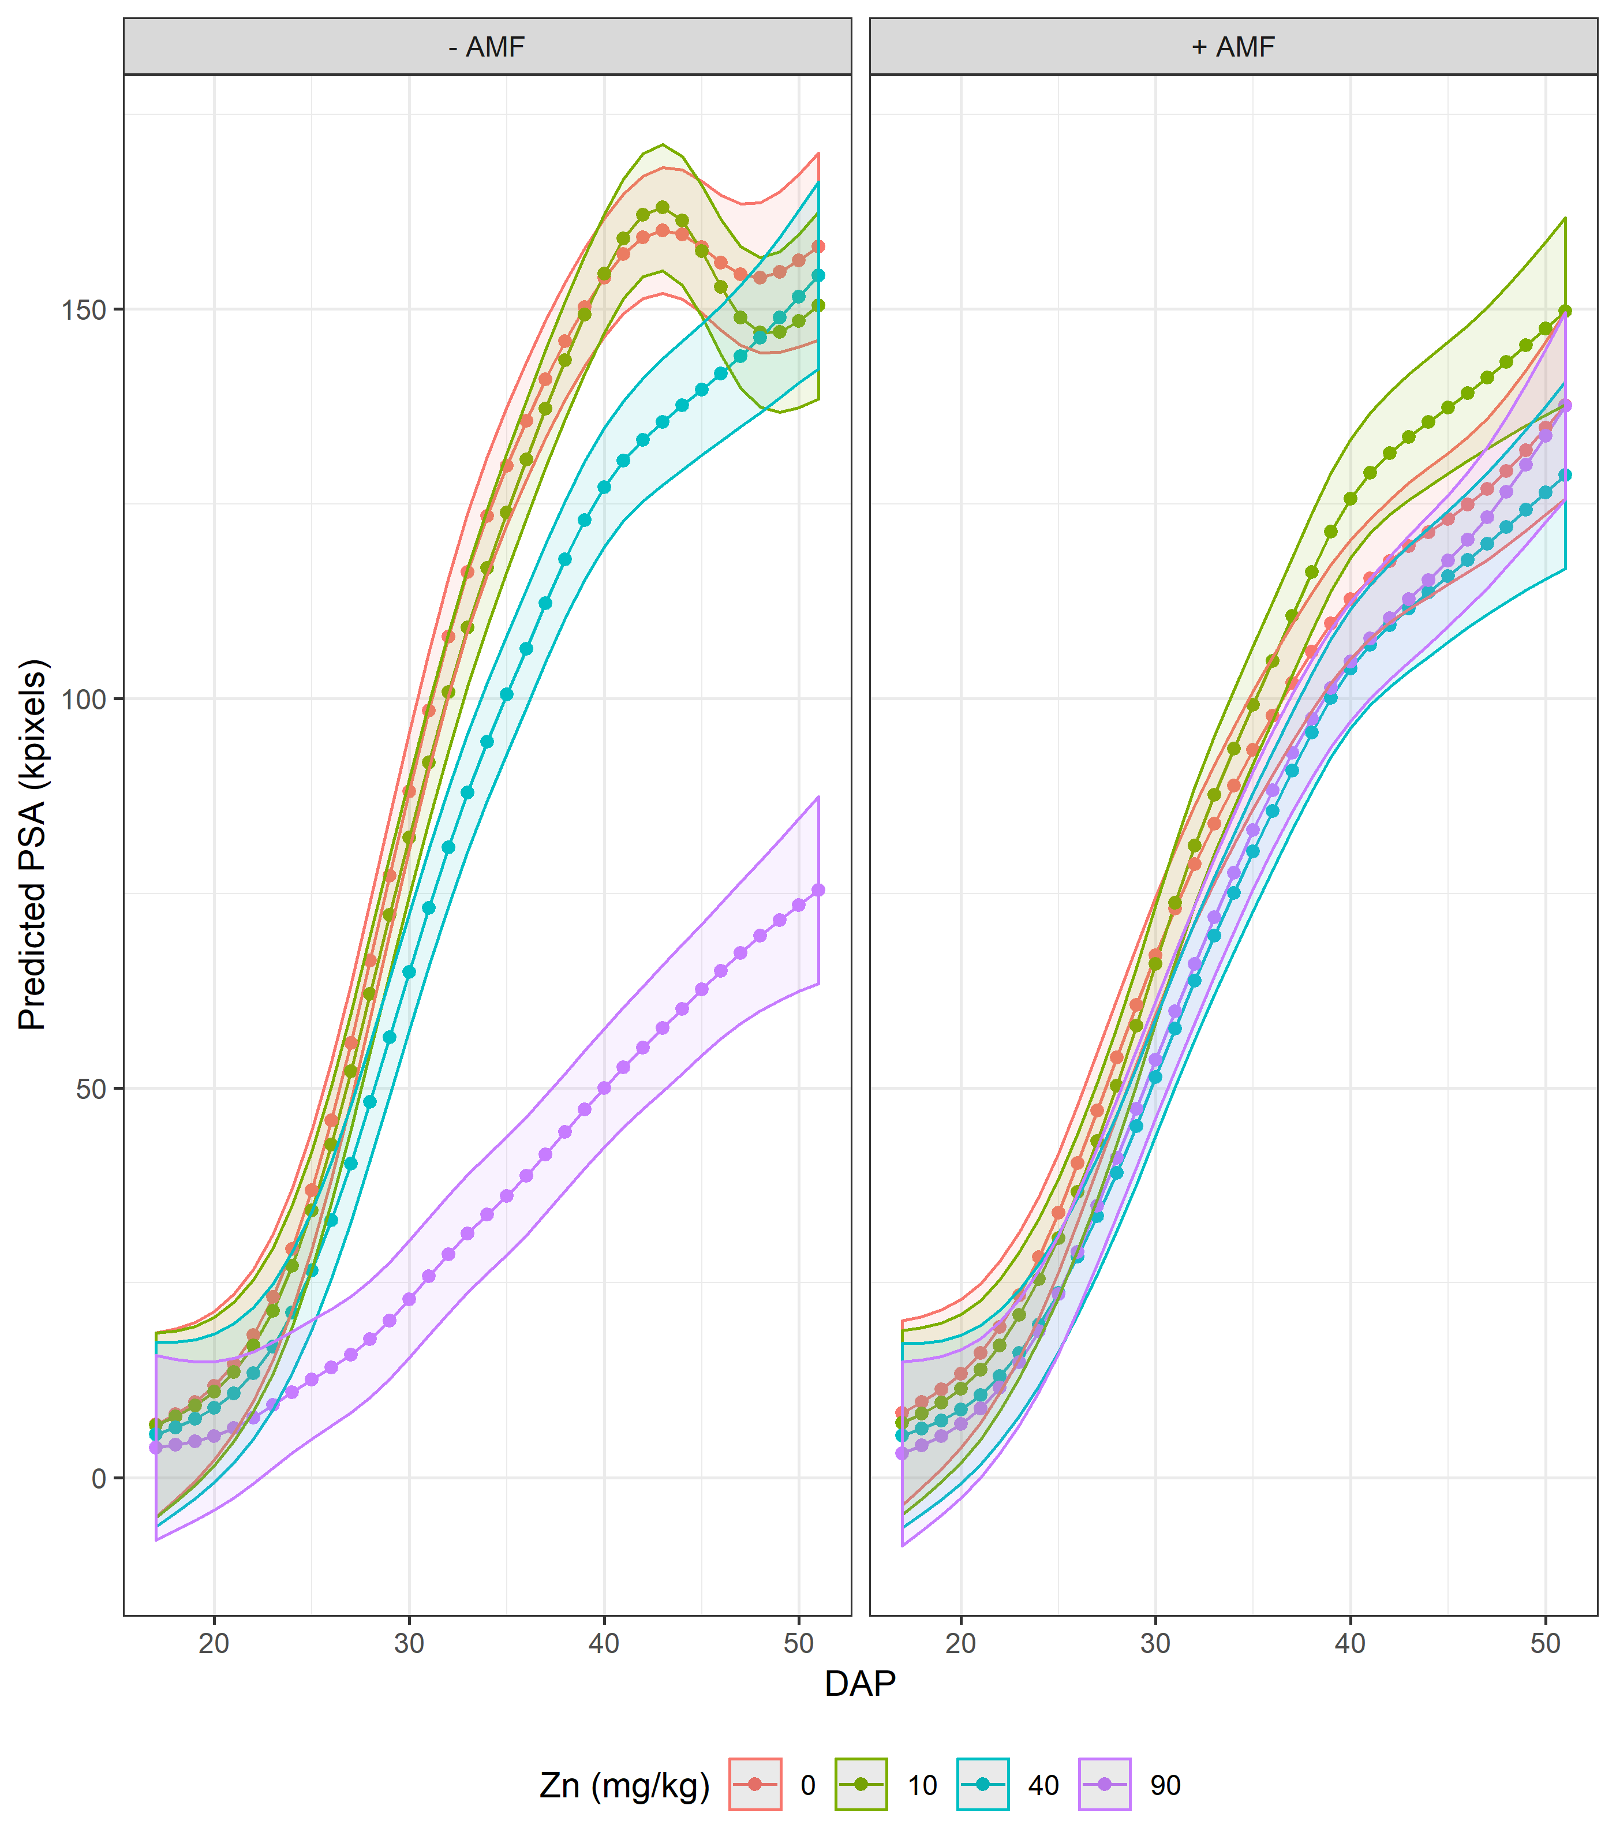
PSA plot
The error bars are
± 0.5 LSD(5%).

Slide 64
Predicted Projected Shoot Area (PSA)
Absolute growth rates (AGR) are obtained by taking:
  predicted PSA for a day - predicted PSA for the previous day.
This is equivalent to taking a linear transformation of the predictions using the following (t - 1) x t first difference matrix
linTransform.alldiffs function will do this, producing a new alldiffs.obj.

Slide 65
Getting the growth rates
> #'#'## Set up the first difference matrix to calculate GR contrasts
> (nDAPs = length(DAPs))
[1] 35
> (ntrt <- nrow(diffs$predictions) / nDAPs)
[1] 8
> con.GR <- mat.banded(c(-1,1), nrow = (nDAPs - 1), ncol = nDAPs)
> con.GR[lower.tri(con.GR)] <- 0 #remove subdiagonal band
> con.GR <- kronecker(diag(1, nrow = ntrt), con.GR)
> #'## Calculate the Absolute Growth Rate (AGR) using linTransform
> diffs.GR <- linTransform(diffs,
+ linear.transformation = con.GR,
+ tables = "none")
> head(diffs.GR$predictions)
Combination predicted.value standard.error upper.Confidence.limit lower.Confidence.limit
1 1 1.354922 0.8683788 3.150022 -0.440177
2 2 1.594811 0.8458880 3.343417 -0.153796
3 3 2.074588 0.8069951 3.742795 0.406380
A block-diagonal matrix, each block of which is a first-difference matrix
Combination instead of factors and Cis need revising

Slide 66
Restructuring the GR predictions
> #'### Reinstate factors
> diffs.GR$predictions <- cbind(fac.gen(list(Zn = levels(diffs$predictions$Zn),
+ AMF = levels(diffs$predictions$AMF),
+ xDays = xDays[-1])),
+ diffs.GR$predictions[-1])
> diffs.GR$predictions$xDays <- as.numfac(diffs.GR$predictions$xDays)
> diffs.GR <- renewClassify(diffs.GR, newclassify = "Zn:AMF:xDays")
>
> #'### Calculate halfLSD intervals
> diffs.GR <- redoErrorIntervals(diffs.GR, error.intervals = "halfLeast",
+ meanLSD.type = "factor", LSDby = "xDays")
> head(diffs.GR$predictions)
#### Predictions
Zn AMF xDays predicted.value standard.error upper.halfLeastSignificant.limit
1 0 - -16 1.354922 0.8683788 2.649348
0 - -15 1.594811 0.8458880 2.855738
lower.halfLeastSignificant.limit est.status
1 0.060497 Estimable
2 0.333883 Estimable

Slide 67
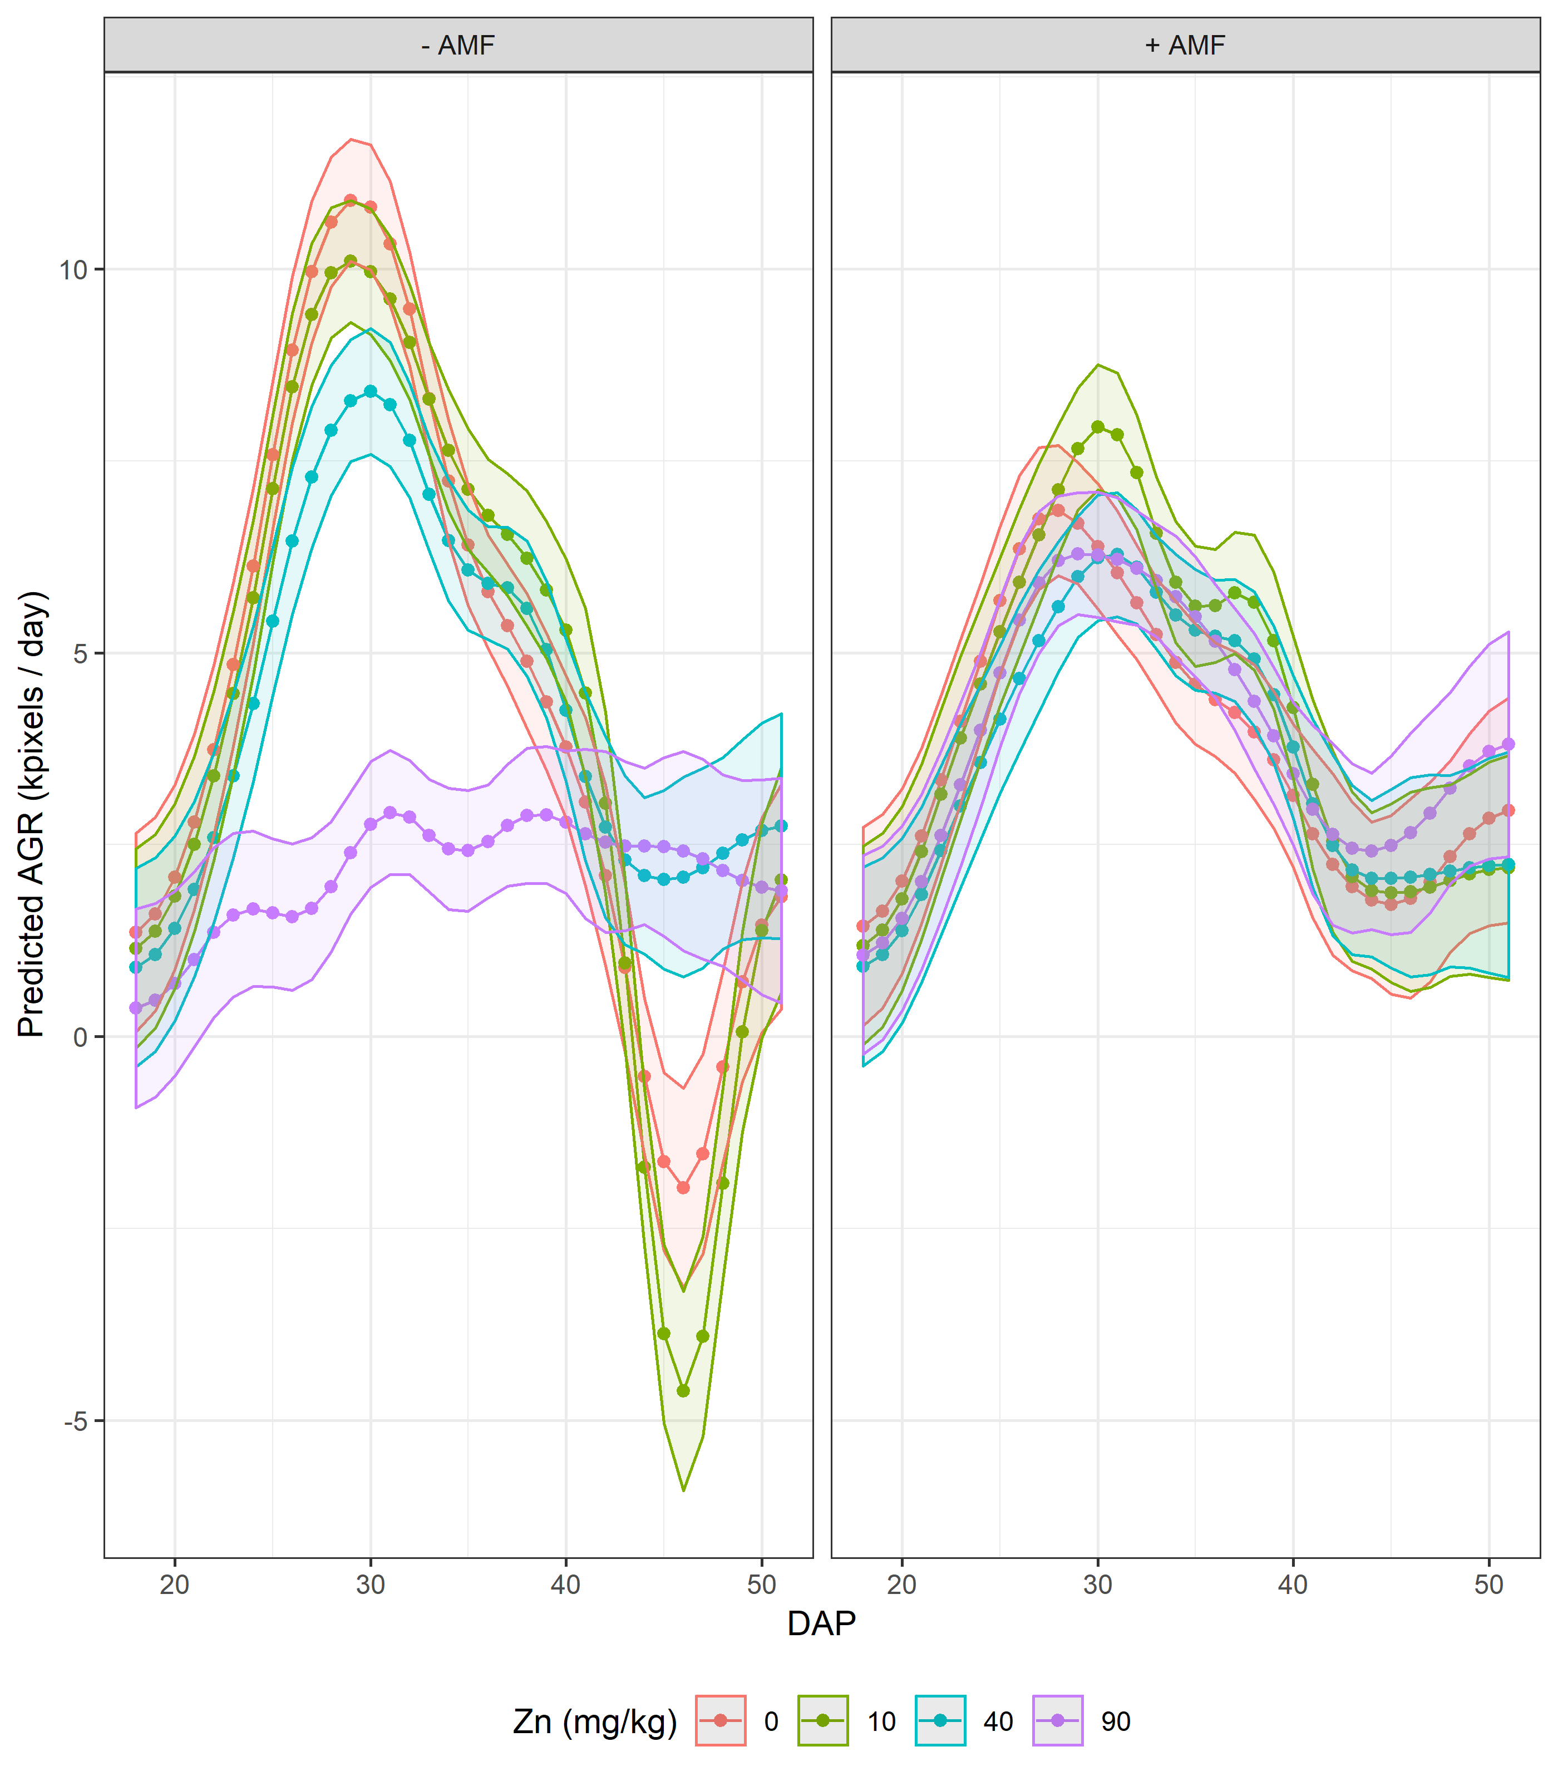
PSA AGR
The error bars are
± 0.5 LSD(5%).

Slide 68
4. Conclusions
R package asremlPlus
  Enables bulk, one-pass, automated analysis of multiple response data.
  Assists in fulfilling the principles that originate from anova when doing reml mixed modelling. In particular,
    can produce predictions for all combinations of the treatment factors , yet conform to the selected model and
    so have smaller standard errors for the estimated differences, because they are based on lower order terms.
    tricky for quantitative variables with predictions for several values of each (not implemented as yet).
  Has prediction production and presentation functions that facilitate examination of pairwise differences.
  Available on CRAN and from my R repository (http://chris.brien.name/rpackages).
  Compatible with asreml-R versions 3 and 4.1.
  The Wheat.dat and Ladybird.dat data sets are available with asremlPlus, as are vignettes describing the analyses presented.
  Slides: http://chris.brien.name/multitier, then Research > Slides for talks.

Slide 69
References
Brien, C. J. (2017). Multiphase experiments in practice: A look back. Australian & New Zealand Journal of Statistics, 59, 327-352.
Brien, C. J. (2019) asremlPlus: augments ASReml-R in fitting mixed models and packages generally in exploring predictions. R package version 4.1-26. http://chris.brien.name/rpackages or http://cran.at.r-project.org/package=asremlPlus.
Brien, C.J., and Bailey, R.A. (2006) Multiple randomizations (with discussion). J. Roy. Statist. Soc., Ser. B, 68, 571–609.
Brien, C.J. and Demétrio, C.G.B. (2009) Formulating mixed models for experiments, including longitudinal experiments. Journal of Agricultural, Biological and Environmental Statistics, 14, 253–80.
Brien, C.J., Harch, B.D., Correll, R.L. and Bailey, R.A. (2011) Multiphase experiments with laboratory phases subsequent to the initial phase. I. Orthogonal designs. Journal of Agricultural, Biological and Environmental Statistics, 16, 422–450.
Butler, D. G., Cullis, B. R., Gilmour, A. R., Gogel, B. J., & Thompson, R. (2018). ASReml-R reference manual. (Version 4). Hemel Hempstead: VSN International Ltd. URL http://asreml.org
Gilmour, A. R., Thompson, R., & Cullis, B. R. (1995). Average Information REML: An Efficient Algorithm for Variance Parameter Estimation in Linear Mixed Models. Biometrics, 51, 1440-1450.
Janky, D. G. (2000). Sometimes pooling for analysis of variance hypothesis tests: A review and study of a split-plot model. The American Statistician, 54, 269-279.
Littell, R. C. (2002). Analysis of unbalanced mixed model data: A case study comparison of ANOVA versus REML/GLS. Journal of Agricultural, Biological, and Environmental Statistics, 7, 472-490.
Littell, R. C., Milliken, G. A., Stroup, W. W., Wolfinger, R. D., & Schabenberger, O. (2006). SAS for Mixed Models (2nd ed.). Cary, N.C.: SAS Press.
Nelder, J. A. (1977). A reformulation of linear models (with discussion). Journal of the Royal Statistical Society, Series A (General), 140, 48-77.
Patterson, H. D., & Thompson, R. (1971). Recovery of inter-block information when block sizes are unequal. Biometrika, 58, 545-554.
Snee, R. D. (1981). Graphical Display and Assessment of Means. Biometrics, 37, 835-836.
Stefanova, K. T., Smith, A. B., & Cullis, B. R. (2009). Enhanced Diagnostics for the Spatial Analysis of Field Trials. Journal of Agricultural, Biological, and Environmental Statistics, 14(4), 392-410.
Welham, S. J., Gezan, S. A., Clark, S. J., & Mead, A. (2014). Statistical Methods in Biology: Design and Analysis of Experiments and Regression. Boca Raton: Chapman and Hall/CRC.

