Slide 1
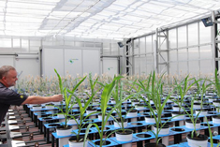
Accounting for variation in designing greenhouse experiments
Chris Brien¹, Bettina Berger², Huwaida Rabie¹, Mark Tester²
¹Phenomics & Bioinformatics Research Centre, University of South Australia; ²Australian Centre for Plant Functional Genomics, Adelaide.

Slide 2
Outline
The issues.
The experiment.
Results
Conclusions.

Slide 3
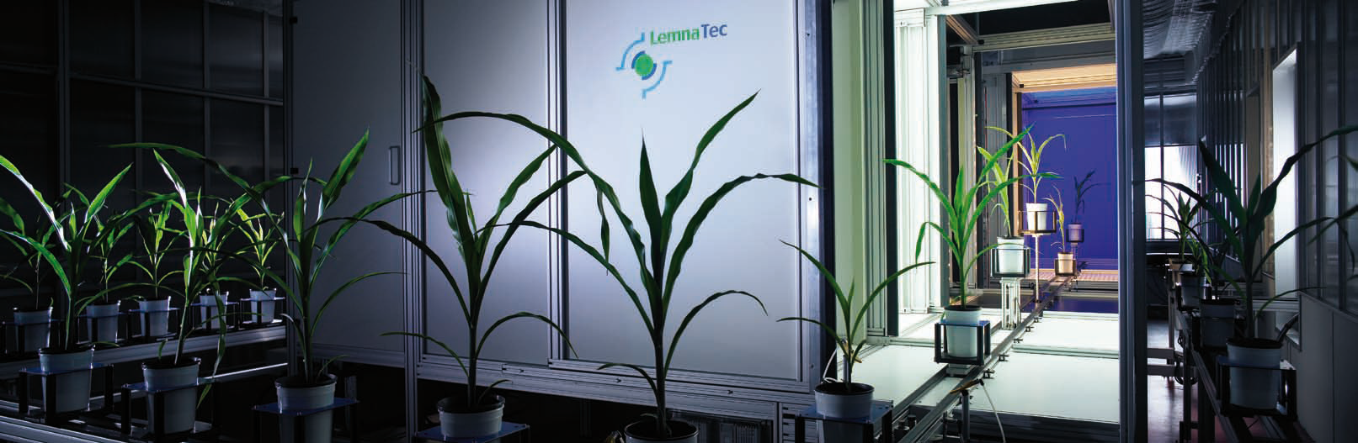
1. The issues
The Plant accelerator ®
  Latest technology in high throughput plant imaging
  Plants are first grown in a Greenhouse then moved to the imaging room (Smarthouse)
  Automatic, non-destructive, repeated measurements of the physical attributes (phenotype) of plants in Smarthouse.
Notes:
$40 million

Slide 4
Issues in designing PA experiments
At least two phases: Greenhouse and Smarthouse phases.
  Should one worry about design at all?
    Perhaps better to rearrange location of plants during the experiment to average out microclimate effects.
  Even if design Smarthouse phase, do we need to worry about design in the Greenhouse phase?
If do use designs, what design to use in a phase?
  What N-S or E-W trends should be accounted for?
  Is there spatial correlation?
Does movement in PA have a thigmomorphogenic effect?
Ran a two-phase wheat experiment in PA.

Slide 5
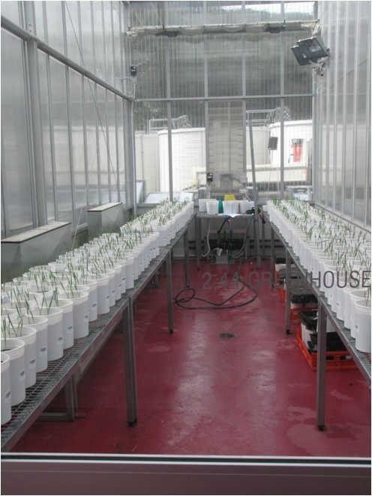
2. The experiment: Greenhouse phase
East
North
South
  2 Sides
  2 Blocks
  3 Rows in S
  24 Columns in B
Air con
288 pots
The 2 Sides by 2 Blocks correspond to 4 Locations in the Greenhouse.
Western door

Slide 6
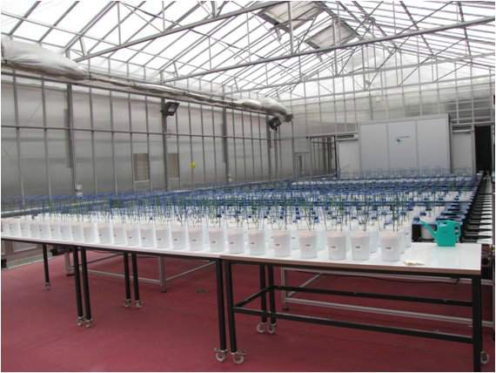
Smarthouse phase: allocation of pots to carts
East
North
North
Zone 4
Zone 3
South
West
Air con
Zone 4
Zone 3
Zone 2
Zone 1
Zone 2
Zone 1
South
Greenhouse
Smarthouse
  2 Sides
  2 Blocks
  3 Rows in S
  24 Columns in B
  4 Zones
  3 Lanes in Z
  24 Positions
Solid lines indicate randomization while dashed lines indicate systematic assignment.
288 pots
288 carts

Slide 7
Smarthouse tactics
Four tactics, each of 3 rows of 24 carts, were applied in the Smarthouse:
  Bench: Plants placed on benches at the end of the conveyer system and not moved;
  Same lane: always return to the same position after watering or imaging;
  Half lane: After watering or imaging, move pots forward half a lane, which will result in pots changing sides from East to West and vice-a-versa with each move;
  Next lane: After watering or imaging, move the whole lane forward to the next lane in the Smarthouse.
Greenhouse
Smarthouse
  2 Sides
  2 Blocks
  3 Rows in S
  24 Columns in B
  4 Zones
  3 Lanes in Z
  24 Positions
  4 Tactics
4 treatments
288 pots
288 carts

Slide 8
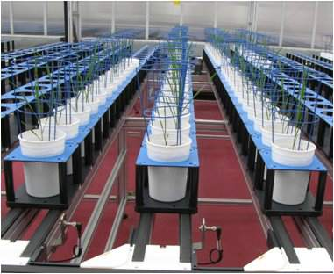
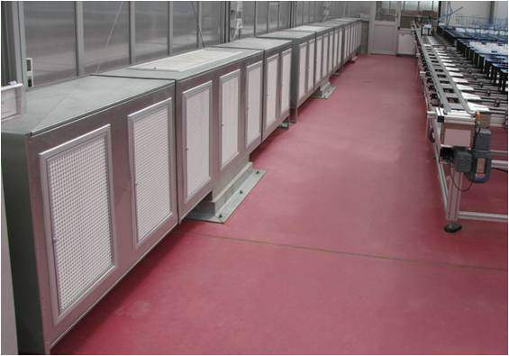
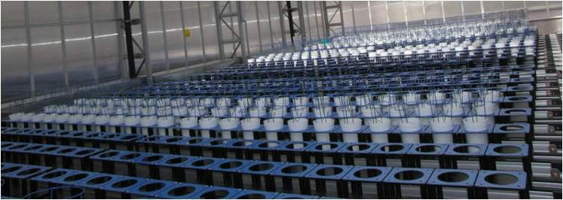
Smarthouse phase
East
North
Imaging
West
Zone 3 – Half lane
Air con
Next
Half
West
Same
Air con
Bench
South
Zone 4 – Next lane
North

Slide 9
3. Results: data obtained
Fresh weight at the end of the trial
Total area (pixels) on Mon, Wed & Fri from day 21 to day 51.
Height (cm) on day 51, from which derived a Density index ( = Total area / height)
Focus on Total area measurements for Days 21 and Day 51.
  Day 21 represents the effect of the Greenhouse.
  Day 51 represents the combined effect of the Greenhouse and Smarthouse.

Slide 10
Results of mixed model analyses
Similar models for Day 21 and Day 51.
Differences in means and variances between the Tactics.
  However, no differences between bench and same lane for any responses (including density index).
No evidence of spatial correlation.
No differences between the three Lanes within each Tactic.
Trends over Columns in the greenhouse and Positions in the Smarthouse that differ between Tactics.

Slide 11
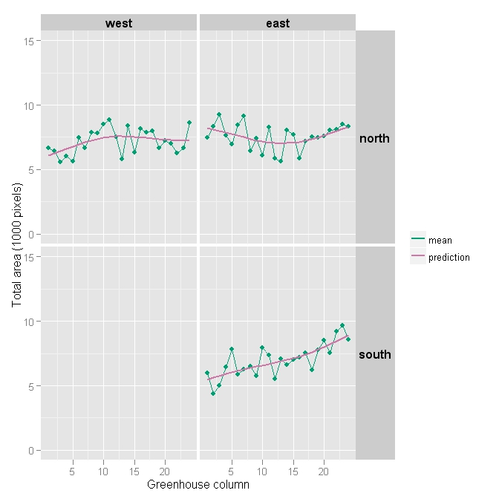
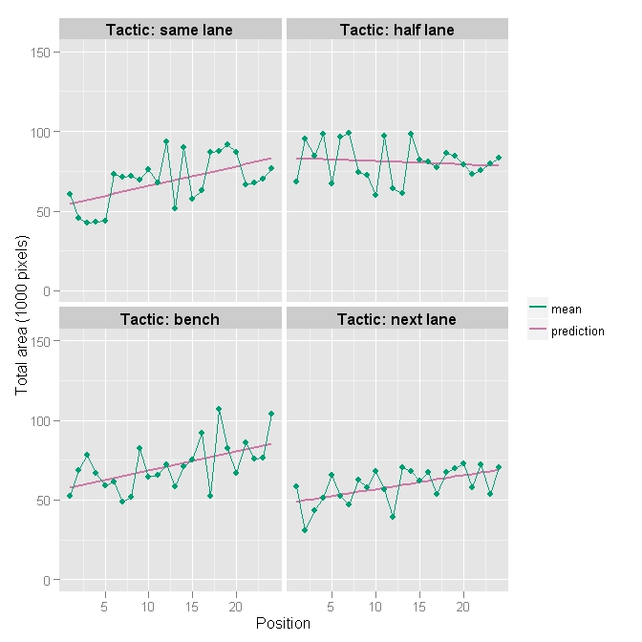
Column/Position trends in Total area
Day 21
Day 51
In Greenhouse, total area increases in the eastern end, especially in the south (light?).
Increasing slope for all on Day 51, except for half-lane.

Slide 12
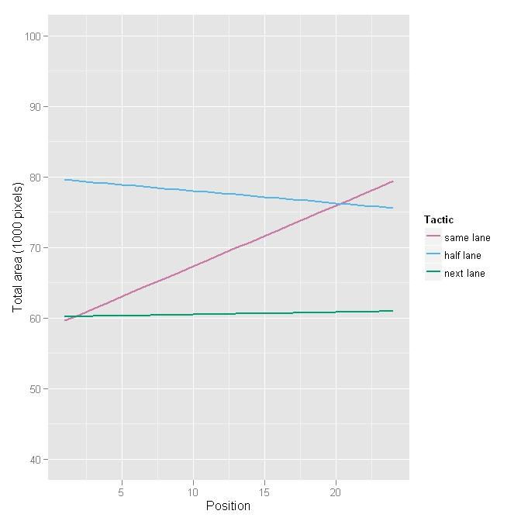
Position trends for Day 51 adjusted for Day 21
Day 51
For same lane (and probably bench) there is a trend in the Smarthouse that increases from West to East (air in W).
The Position trend in next lane parallels Column trend in Day 21 total areas — greenhouse or Smarthouse?
For half lane, no Smarthouse Position trend — little Column trend in north-east and no Smarthouse contribution.

Slide 13
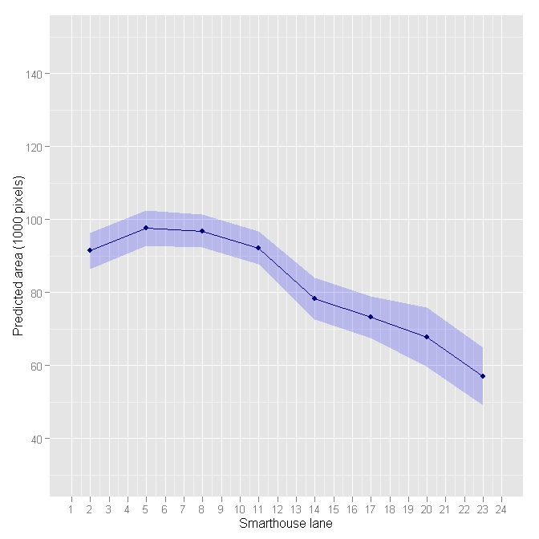
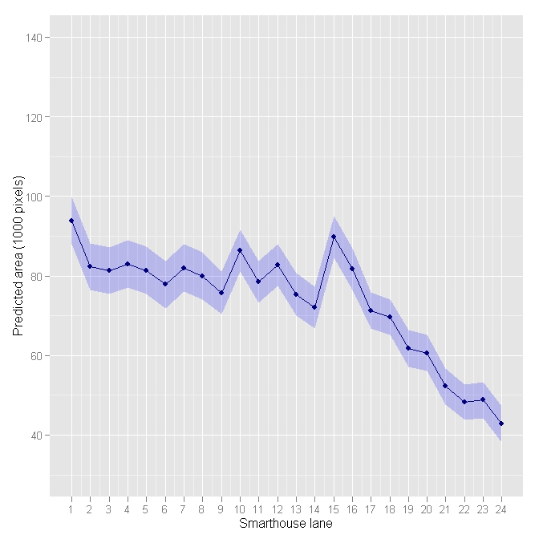
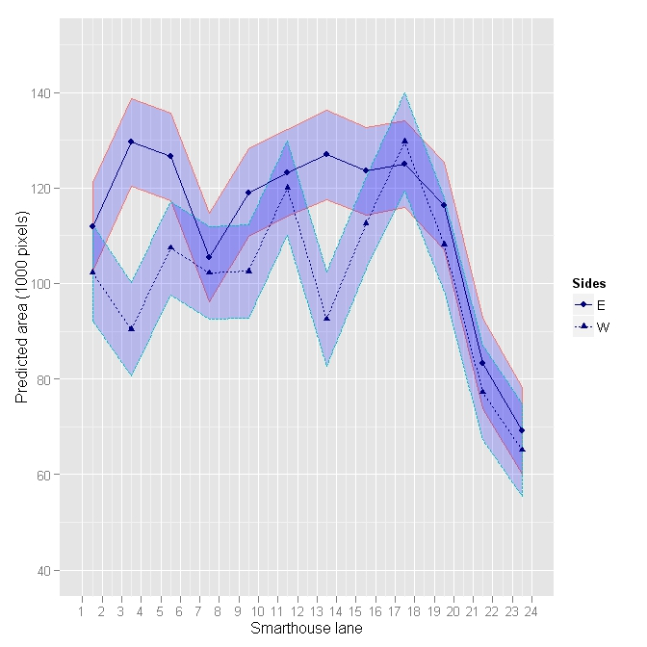
Lane trend
Jo Tillbrooks’ 2011 experiments – fill Smarthouse
Ribbons are CIs
Plants in Lanes towards north grow less
  no. lanes with lower area depends on time of the year.
Seems about 4 lanes are homogeneous.
It would appear that the lower total area for next-lane tactic is due to shading in the northern zone.
Notes:
Experiments are in May, July, September

Slide 14
Relocation during the PA experiment
In half-lane tactic:
  Plants spend half time in eastern half and western half;
  Plants not equal in exposure to trend: when carts 13–24 moved to positions 1–12, relative east west positions maintained.
  Result is unable to detect trend, but greater plant variability (30% less precision)
In next-lane tactic:
  Plants spend equal amount of time in shaded lanes;
  5 or less days difference in entry and exit of 1st and 3rd lanes.
  No difference between lanes of next-lane tactic supports uniform exposure of plants to lane trend.
Notes:
Experiments are in May, July, September

Slide 15
Uniformity trials to compare designs
Each tactic, 3 Lanes × 24 Positions, is essentially a uniformity trial (all Gladius, all treated equally).
Perfect for comparing different designs to deal with position trends:
  Superimpose treatments (lines) on a zone using different designs;
  Analyse the total area according to the design;
  Compute the relative efficiencies (%) of designs:
    A design has more efficiency if it has smaller s.e.d.s and so better able to detect treatment (line) differences;
  Repeat for a random sample of possible randomizations of the designs.

Slide 16
Equally-replicated lines
Consider the following designs & analyses with 36 (24) lines:
  A CRD, without and with adjustment for Position trend;
  An RCBD with two 3 × 12 (three 3 ×8 & 1 × 24) blocks, without and with adjustment for Position trend;
  (Nearly) Trend-free designs for CRD & RCBD;
  Resolved IBDs with blocks 3 × 1, 1 × 4 & 3 × 6
  (3 × 1, 1 × 4 & 3 ×4);
  Resolved row-col designs with two 3 × 12 (three 3 ×8) rectangles.
3
2
1
 | 1 | 2 | 3 | 4 | 5 | 6 | 7 | 8 | 9 | 10 | 11 | 12 | 13 | 14 | 15 | 16 | 17 | 18 | 19 | 20 | 21 | 22 | 23 | 24
3
2
1
 | 1 | 2 | 3 | 4 | 5 | 6 | 7 | 8 | 9 | 10 | 11 | 12 | 13 | 14 | 15 | 16 | 17 | 18 | 19 | 20 | 21 | 22 | 23 | 24
3
2
1
 | 1 | 2 | 3 | 4 | 5 | 6 | 7 | 8 | 9 | 10 | 11 | 12 | 13 | 14 | 15 | 16 | 17 | 18 | 19 | 20 | 21 | 22 | 23 | 24
3
2
1
 | 1 | 2 | 3 | 4 | 5 | 6 | 7 | 8 | 9 | 10 | 11 | 12 | 13 | 14 | 15 | 16 | 17 | 18 | 19 | 20 | 21 | 22 | 23 | 24

Slide 17
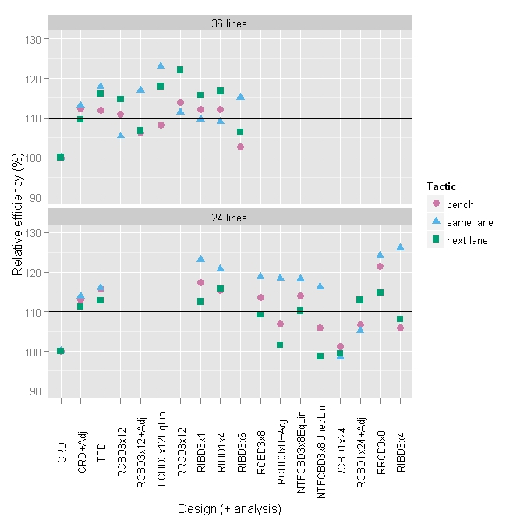
Equally-replicated lines
Look for designs which give > 10% increase for all tactics.
  For 36 lines: small blocks, CRD + Adj, or TFD;
  but, TFCBD3×12EqLin best for same & next.
  For 24 lines: small blocks, CRD + Adj, RCBD 3×8 (≈ RRCD 3×8); TF or NTF no advantage.

Slide 18
Partially-replicated lines, with 2 conditions (an initial investigation)
A split-plot design for 72 carts with:
  6 (or 8) duplicated lines, 20 (or 16) unreplicated lines and 2 control lines replicated twice;
  Lines applied to 36 main plots, of 2 consecutive carts in the same lane, using an augmented block design;
  2 conditions randomized to the 2 subplots (carts) of a main plot.
Again, looked at designs with varying block sizes.
3
2
1
 | 1 | 2 | 3 | 4 | 5 | 6 | 7 | 8 | 9 | 10 | 11 | 12 | 13 | 14 | 15 | 16 | 17 | 18 | 19 | 20 | 21 | 22 | 23 | 24
3
2
1
 | 1 | 2 | 3 | 4 | 5 | 6 | 7 | 8 | 9 | 10 | 11 | 12 | 13 | 14 | 15 | 16 | 17 | 18 | 19 | 20 | 21 | 22 | 23 | 24
3
2
1
 | 1 | 2 | 3 | 4 | 5 | 6 | 7 | 8 | 9 | 10 | 11 | 12 | 13 | 14 | 15 | 16 | 17 | 18 | 19 | 20 | 21 | 22 | 23 | 24
3
2
1
 | 1 | 2 | 3 | 4 | 5 | 6 | 7 | 8 | 9 | 10 | 11 | 12 | 13 | 14 | 15 | 16 | 17 | 18 | 19 | 20 | 21 | 22 | 23 | 24

Slide 19
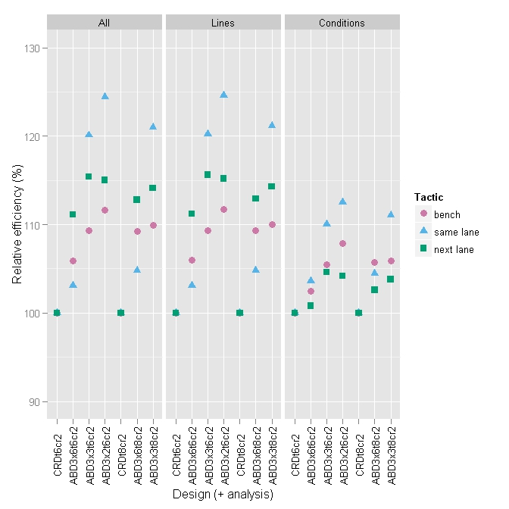
Partially-replicated lines, with two conditions
t6
t8
t6
t8
Look for designs which give > 10% increase for all tactics.
  Line comparisons: best is main plots (2 carts) of
  3×3 (= 3 Lanes ×6 Positions) for t6 & t8, and 3×2 (= 3 Lanes ×4 Positions) for t6.
  Conditions comparisons: little affected (as assigned to carts), but same designs best.

Slide 20
4. Conclusions:
No evidence of a thigmomorphogenic effect of movement in the Smarthouse. (Bench & Same Lane tactics do not differ.)
Not much Greenhouse column trend, except in south-east.
There are substantial lane and, to a lesser extent, position trends in the Smarthouse.
Rearranging carts only minimizes plant variability where plants’ exposure to microclimates is equalized.
Designed experiments and statistical analysis can more easily and reliably achieve same as rearranging carts.
Designs in the Smarthouse should be block or trend-free designs, not row-and-column designs, nor spatial designs.
  The blocks in such design should be no larger than 4 Lanes by 8 Positions.
Best to align Greenhouse and Smarthouse features,
e.g. blocks and trends, so both dealt with simultaneously.

