Slide 1
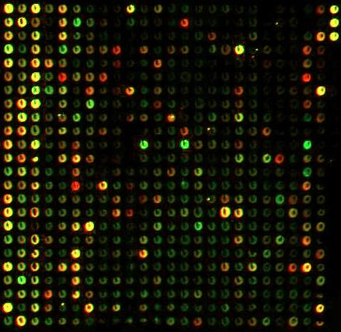
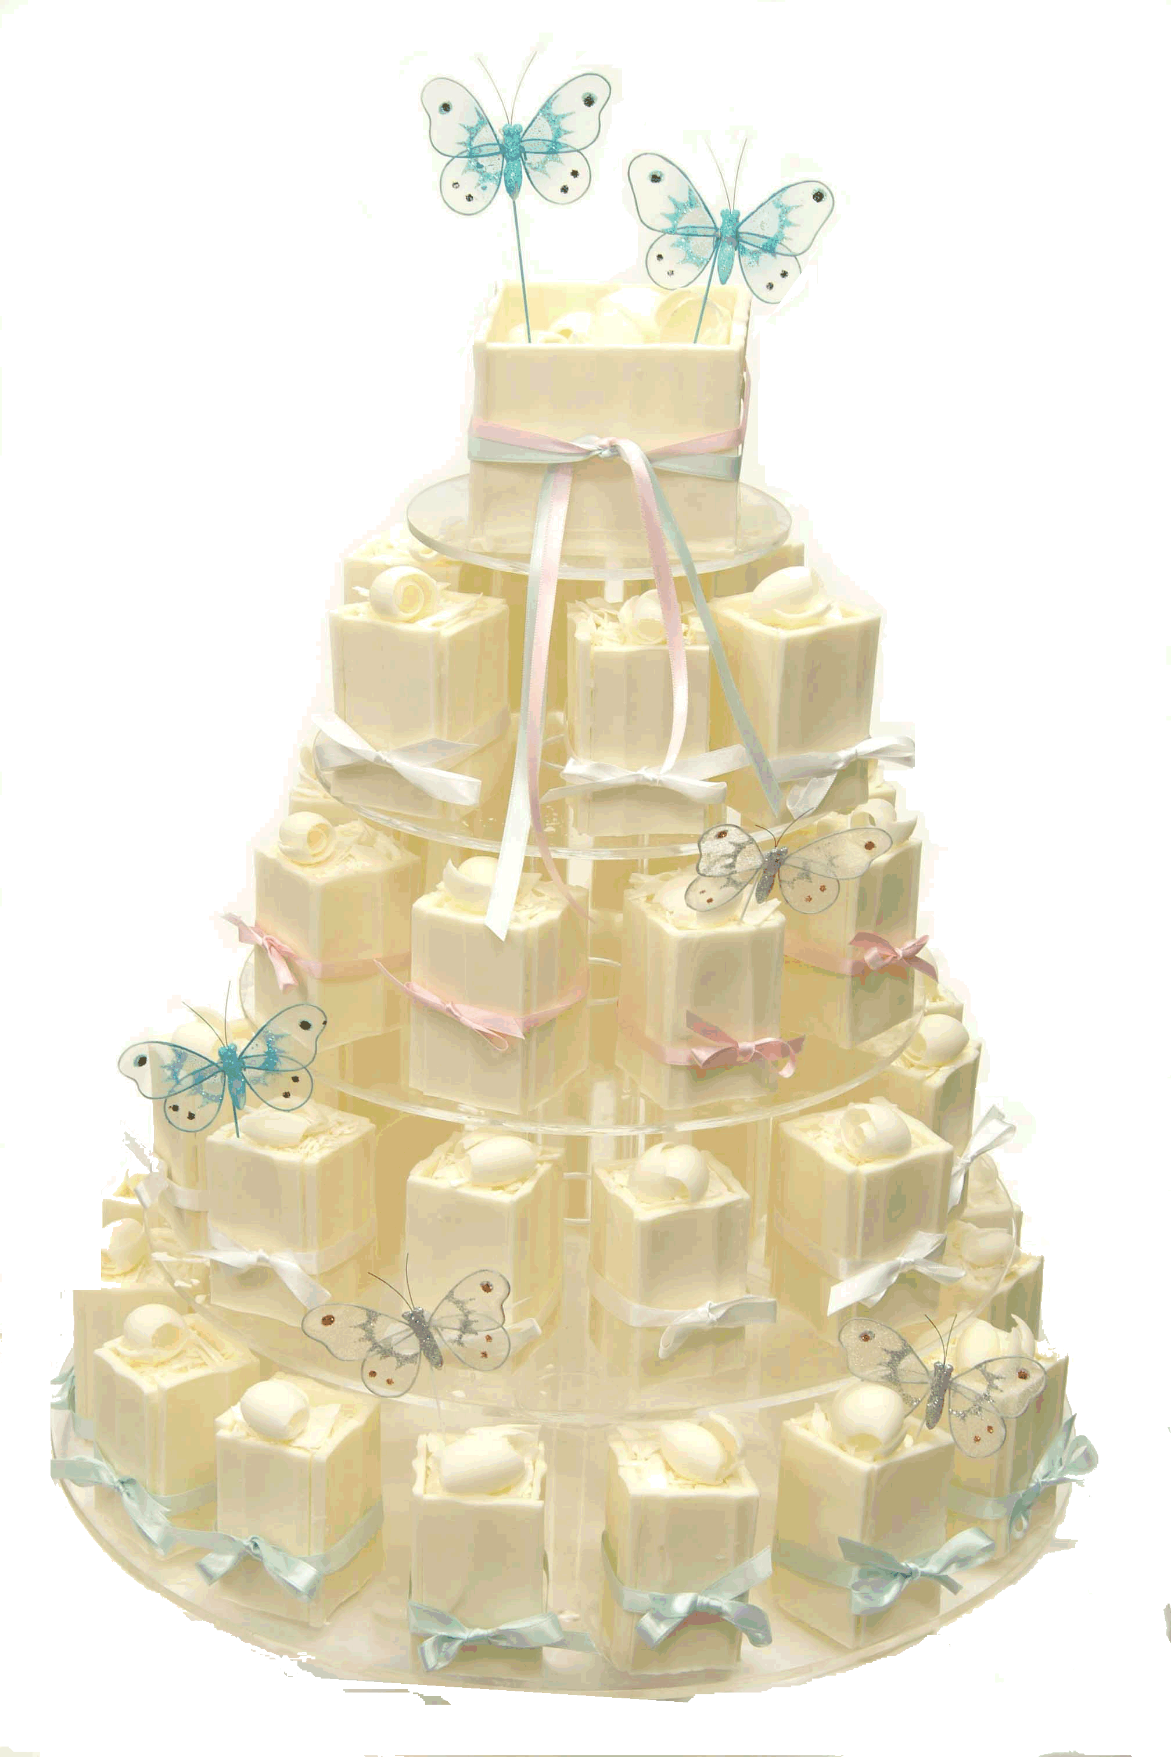
Tiers in gene-expression microarray experiments
Chris Brien
School of Mathematics and Statistics
University of South Australia
chris.brien@unisa.edu.au

Slide 2
Outline
Introduction
Observational studies with technical versus biological replication
Material from a split-plot experiment
(Balanced incomplete block design in the both phases)
Summary

Slide 3
1. Introduction a) A definition of a randomization
Define a randomization to be the random assignment of one set of objects to another, using a permutation of the latter.
Generally each set of objects is indexed by a set of:
  Unrandomized factors (indexing units);
  Randomized factors (indexing treatments).
Randomized
factors
Unrandomized
factors
randomized
Set of treatment objects
Set of unit objects

Slide 4
Using a permutation of units to achieve the randomization
Randomized
factors
Unrandomized
factors
randomized
Set of treatment objects
Set of unit objects
Write down a list of
  the units;
  the levels of the unrandomized factors in standard order;
  the randomized factors in systematic order according to the design being used;
Identify all possible permutations of the levels combinations of the unrandomized factors allowable for the design;
Select a permutation and apply it to the levels combinations of the unrandomized factors.
Sort the levels of all factors so that unrandomized factors are in standard order.

Slide 5
A randomization
randomized
unrandomized
b Blocks
t Plots in B
t treatments
t Treatments
bt units
Systematic design:
  one treatment on each plot in each block.
Randomization:
  permute blocks;
  permute plots in each block independently.
  Gives levels combinations of all factors that will occur in experiment.
Final sort
Unit | Blocks | Plots | Treatments
1 | 1 | 1 | 1
2 | 1 | 2 | 2
3 | 2 | 1 | 1
4 | 2 | 2 | 2
Unit | Blocks | Plots | Treatments
1 | 2 | 2 | 1
2 | 2 | 1 | 2
3 | 1 | 1 | 1
4 | 1 | 2 | 2
Unit | Blocks | Plots | Treatments
1 | 1 | 1 | 1
2 | 1 | 2 | 2
3 | 2 | 1 | 2
4 | 2 | 2 | 1

Slide 6

Randomization diagrams & tiers
(Brien, 1983; Brien & Bailey, 2006)
RCBD – two-tiered
randomized
unrandomized
b Blocks
t Runs in B
t treatments
t Treatments
bt units
A panel for a set of objects shows a factor poset:
    a list of factors in a tier; their numbers of levels; their nesting relationships.
So a tier is just a set of factors:
  {Treatments} or {Blocks, Runs}
  But, not just any old set: a set of factors with the same status in the randomization.
  Textbook experiments are two-tiered, but in practice some experiments are multitiered.
Shows EU and restrictions placed on randomization.

Slide 7
b) Mixed model notation
Terms in the mixed model correspond to generalized factors. (Brien & Bailey, 2006, Brien & Demétrio, 2009)
Generalized factor
  A∧B is the ab-level factor formed from the combinations of A with a levels and B with b levels.
Symbolic mixed model (Patterson, 1997, SMfPVE)
  Fixed terms | random terms
  (A + B + A∧B | Blocks + Blocks∧Runs)
Corresponds to the mixed model:
Y = X_{A}θ_{A} + X_{B}θ_{B} + X_{A∧B}θ_{A∧B} + Z_{b}u_{b}+ Z_{b∧R}u_{b∧R}.
  where the Xs and Zs are indicator variable matrices for the generalized factor (terms in symbolic model) in its subscript, and
  θs and us are fixed and random parameters, respectively, with
This is an ANOVA model, equivalent to the randomization model, and is also written:
Y = X_{V}θ_{V} + X_{F}θ_{F} + X_{V∧F}θ_{V∧F} + Z_{B}u_{B}+ e.
Notes:
Do not explain mixed model in detail – just that it has an Xtheta for each fixed term and a ZU for each random term.

Slide 8
Assessing a design
A general set of rules using tiers and Hasse diagrams (and pseudofactors) in which:
Formulate the mixed model
  full model based on the randomization
Get the decomposition/ANOVA table
  showing confounding for the design
Derive the E[MSq] and use to
  obtain variance of treatment mean differences
  Identify model of convenience (for fitting)

Slide 9
2. Observational studies with technical versus biological replication
Two types of replication:
  technical replication – replicates from the same extraction of mRNA:
    either spot-to-spot or array-to-array replication;
    call them Fractions
  biological replication – replicates from different extractions:
    e.g. different samples from a) the same cell line or tissue, or b) from different tissues or plants.
    call them Samples, Plants, Individuals and so on.
Compare just technical with biological replication

Slide 10
a) Observational study with just technical replication
Tissue from a naturally diseased and a normal organism.
A sample of mRNA is obtained from each.
8 arrays spotted with fractions (tech. reps) from both samples using a quadruple dye-swap design (Kerr, 2003):
Systematic layout
Array | Dye R | Dye G
1 | Diseased1 | Normal1
2 | Diseased2 | Normal2
3 | Diseased3 | Normal3
4 | Diseased4 | Normal4
5 | Normal5 | Diseased5
6 | Normal6 | Diseased6
7 | Normal7 | Diseased7
8 | Normal8 | Diseased8
D1
N1
D2
N2
D3
N3
D4
N4
D5
N5
D6
N6
D7
N7
D8
N8
Randomization
  Seldom mentioned (Kerr, 2003).
  Have 16 fractions to be randomized to 8 arrays (using permutations).
  Permute Arrays (rows) and Dye (cols) separately, but would always put the first fraction from each condition on the same array.
Notes:
Perhaps randomization of fractions not possible and fractions taken as needed and so nature does the randomization.
Have to randomize/assign 16 fractions to 8 arrays so need to pair up fractions to do this.

Slide 11
Randomization (continued)
To deal with this using permutations, randomly assign the fractions in each condition to an 8 level pseudofactor F₁.
  It indicates the fractions that are to be assigned to the same array.
Array | Dye R | Dye G
1 | 6,Diseased2 | 6,Normal3
2 | 3,Normal5 | 3,Diseased1
3 | 1,Normal2 | 1,Diseased4
4 | 7,Diseased3 | 7,Normal1
5 | 5,Diseased6 | 5,Normal6
6 | 4,Normal4 | 4,Diseased5
7 | 8,Diseased7 | 8,Normal8
8 | 2,Normal7 | 2,Diseased8
Array | Dye R | Dye G
1 | 3,Diseased1 | 7,Normal1
2 | 6,Diseased2 | 1,Normal2
3 | 7,Diseased3 | 6,Normal3
4 | 1,Diseased4 | 4,Normal4
5 | 3,Normal5 | 4,Diseased5
6 | 5,Normal6 | 5,Diseased6
7 | 2,Normal7 | 8,Diseased7
8 | 8,Normal8 | 2,Diseased8
Array | Dye R (2) | Dye G (1)
1 (3) | 1,Diseased4 | 1,Normal2
2 (8) | 2,Diseased8 | 2,Normal7
3 (2) | 3,Diseased1 | 3,Normal5
4 (6) | 4,Diseased5 | 4,Normal4
5 (5) | 5,Normal6 | 5,Diseased6
6 (1) | 6,Normal3 | 6,Diseased2
7 (4) | 7,Normal1 | 7,Diseased3
8 (7) | 8,Normal8 | 8,Diseased7
Next re-order according to F₁ within Conditions.
Finally randomize by permuting Arrays and Dyes independently.
  Result is Arrays have Diseased and Normal, but with various fractions.
Notes:
Perhaps randomization of fractions not possible and fractions taken as needed and so nature does the randomization.
Have to randomize/assign 16 fractions to 8 arrays so need to pair up fractions to do this.
Note that could get away with not using F_1 if just randomized fractions in traditional way. However, will need pseudofactor for the analysis (do not make this point in talk)

Slide 12
Observational study (cont'd)
Randomization diagram for original factors: two-tiered.
2 Dyes
8 Arrays
2 Conditions
8 Fractions in C

⊥
8 F₁
16 fractions
16 array-dyes
One might not randomize Fractions if confident “nature will do the randomization”. Even so, different Fractions are assigned.
Hasse diagrams: show nesting/marginality relations between generalized factors from each tier.
U 1
U 1
Conditions 2
Arrays 8
Dyes 2
Conditions∧Fractions 16
Arrays∧Dyes 16
Mixed model
  C + D | A + A∧D + C∧F
Notes:
Randomization diagram: the Fractions are randomized to Arrays using F_1 and Conditions to the Dyes-Arrays combinations using an orthogonal design (the latter indicated by a perp).
To get Hasse diagrams consider all combinations of factors allowable given the nesting -> terms in the LHS of Hasse diagram.
To get mixed model consider which terms are fixed and which are random.

Slide 13
Observational study (cont'd)
Hasse diagrams with sources
U 1
1 M
U 1
1 M
Arrays 8
7 A
Dyes 2
1 D
Conditions 2
1 C
Arrays∧Dyes 16
7 A#D
Conditions∧Fractions 16
14 F[C]
Decomposition table
(summarizes properties)
F[C] split over all 3 arrays-dyes sources
Rather than ignoring Fractions, use pseudofactors to split it and retain it as a source of variation.
U 1
1 M
1 C
7 F₁
Conditions 2
F₁ 8
F₂ 2
1 F₂
Conditions∧Fractions 16
6 F[C]
Notes:
There is a rule for getting the sources from the terms

Slide 14
Observational material (cont'd)
ANOVA table
Mixed model
  C + D | A + A∧D + C∧F
  No need to consider pseudofactors in computation of E[MSq]
    a substantial simplification
Hasse diagrams for E[MSq]
  Use standard rules for each tier (Lohr, 1995)
Arrays
A
Dyes
D
Arrays∧Dyes
A#D
Conditions
C
Conditions∧Fractions
F[C]
Notes:
To get mixed model consider all combinations of factors allowable given the nesting -> terms in the LHS of Hasse diagram
There is a rule for getting the sources from the terms
To get E[MSq], put variance or fixed component with subscripts being the first letter of the factors in the generalized factor (fixed component is the noncentrality parameter for the chi-square and is a quadratic function in the expectation)
RHS elements are the contributions of the sources to the E[MSq]

Slide 15
Observational study (cont'd)
ANOVA table
Similar, but single undifferentiated error source and no confounding;
Alerted to Fractions as a variability source.
Mixed model
  C + D | A + A∧D + C∧F
  C∧F and A∧D inseparable – drop one to get fit
  C + D | A + A∧D – mixed model of convenience
Variance of diff between condition means
easily obtained:
  κ = E[MSq] for Conditions ignoring q(),
  r = repl^{n} of a condition mean.
Notes:
To get E[MSq], put variance or fixed component with subscripts being the first letter of the factors in the generalized factor (fixed component is the noncentrality parameter for the chi-square and is a quadratic function in the expectation)
RHS elements are the contributions of the sources to the E[MSq]

Slide 16
b) Observational material with biological reps
Tissue obtained from 4 naturally diseased individuals and 4 others that are not.
A sample of mRNA is obtained from each.
Eight arrays spotted with extracts from each individual using a quadruple dye-swap design:
D1
N1
Systematic layout (Kerr, 2003, Fig. 1c; Jarrett & Ruggiero, 2008, Table 5a):
  Need two fractions from each individual,
  so each has both dyes.
D2
N2
D3
N3
D4
N4
Array | Dye R | Dye G
1 | Diseased, 1a | Normal, 1b
2 | Normal, 1a | Diseased, 1b
3 | Diseased, 2a | Normal, 2b
4 | Normal, 2a | Diseased, 2b
5 | Diseased, 3a | Normal, 3b
6 | Normal, 3a | Diseased, 3b
7 | Diseased, 4a | Normal, 4b
8 | Normal, 4a | Diseased, 4b
Individuals: 1-4;
Fractions: a,b.

Slide 17
Traditional approach
Array | Dye R | Dye G
1 (1) | Diseased, 1a | Normal, 1b
2 (3) | Diseased, 2a | Normal, 2b
3 (8) | Normal, 4a | Diseased, 4b
4 (5) | Diseased, 3a | Normal, 3b
5 (6) | Normal, 3a | Diseased, 3b
6 (4) | Normal, 2a | Diseased, 2b
7 (2) | Normal, 1a | Diseased, 1b
8 (7) | Diseased, 4a | Normal, 4b
Set
1
2
4
3
3
2
1
4
Assume randomize Arrays and Dyes.
Systematic pairing of individuals and allocation of fractions.
ANOVA table (Jarrett & Ruggiero, 2008).
  Set up a grouping factor, Sets say, on Arrays that identifies those with the same Individuals.
  Ignore Fractions.
Mixed model (Kerr, 2003; Jarrett & Ruggiero, 2008):
  C + D | A + A∧D + C∧I;
  Does not correspond to the sources in the ANOVA.

Slide 18
Permutations
Randomly assign individuals within conditions to 4-level pseudofactor I₁.
Fractions within individuals randomized to 2-level pseudofactor F₁.
  The combinations of the two pseudofactors (I₁, F₁) indicate the fractions that are to be assigned to the same array.
Array | Dye R | Dye G
1 | 3,2 Diseased, 1a
2 |  | 3,1 Diseased, 1b
3 | 2,1 Diseased, 2a
4 |  | 2,2 Diseased, 2b
5 | 1,2 Diseased, 3a
6 |  | 1,1 Diseased, 3b
7 | 4,1 Diseased, 4a
8 |  | 4,2 Diseased, 4b
Array | Dye R | Dye G
1 |  | 4,2 Normal, 1b
2 | 4,1 Normal, 1a
3 |  | 1,1 Normal, 2b
4 | 1,2 Normal, 2a
5 |  | 2,1 Normal, 3b
6 | 2,2 Normal, 3a
7 |  | 3,1 Normal, 4b
8 | 3,2 Normal, 4a
Array | Dye R | Dye G
1 | 1,1 Diseased, 3b | 1,1 Normal, 2b
2 | 1,2 Normal, 2a | 1,2 Diseased, 3a
3 | 2,1 Diseased, 2a | 2,1 Normal, 3b
4 | 2,2 Normal, 3a | 2,2 Diseased, 2b
5 | 3,1 Diseased, 1b | 3,1 Normal, 4b
6 | 3,2 Normal, 4a | 3,2 Diseased, 1a
7 | 4,1 Diseased, 4a | 4,1 Normal, 1a
8 | 4,2 Normal, 1b | 4,2 Diseased, 4b
  Sort into standard order for pseudofactors, bearing in mind assignment of Conditions to Dyes.
  Randomly pairs up individuals and randomizes them and fractions.

Slide 19
Permutations
Finally permute Arrays and Dye.
Randomized layout
Array | Dye R (1) | Dye G (2)
1 (1) | 1,1 Diseased, 3b | 1,1 Normal, 2b
2 (7) | 1,2 Normal, 2a | 1,2 Diseased, 3a
3 (2) | 2,1 Diseased, 2a | 2,1 Normal, 3b
4 (6) | 2,2 Normal, 3a | 2,2 Diseased, 2b
5 (4) | 3,1 Diseased, 1b | 3,1 Normal, 4b
6 (5) | 3,2 Normal, 4a | 3,2 Diseased, 1a
7 (8) | 4,1 Diseased, 4a | 4,1 Normal, 1a
8 (3) | 4,2 Normal, 1b | 4,2 Diseased, 4b
Array | Dye R | Dye G
1 | 1,1 Diseased, 3b | 1,1 Normal, 2b
2 | 2,1 Diseased, 2a | 2,1 Normal, 3b
3 | 4,2 Normal, 1b | 4,2 Diseased, 4b
4 | 3,1 Diseased, 1b | 3,1 Normal, 4b
5 | 3,2 Normal, 4a | 3,2 Diseased, 1a
6 | 2,2 Normal, 3a | 2,2 Diseased, 2b
7 | 1,2 Normal, 2a | 1,2 Diseased, 3a
8 | 4,1 Diseased, 4a | 4,1 Normal, 1a
Randomization
2 Dyes
8 Arrays
Again, one might not randomize Individuals and Fractions if confident “nature will do the randomization”.
2 Conditions
4 Individuals in C
2 Fractions in C, I

4 I₁
⊥
2 F₁
16 fractions
16 array-dyes

Slide 20
Using tiers
2 Conditions
4 Individuals in C
2 Fractions in C, I
2 Dyes
8 Arrays

4 I₁
⊥
Terms and sources in the analysis, given nesting (and crossing):
2 F₁
16 fractions
16 array-dyes
U
M
Decomposition table
Arrays
A
Dyes
D
Arrays∧Dyes
A#D
Conditions
C
C∧Individuals
I[C]
C∧I∧Fractions
F[I∧C]
Mixed model
  C + D | A + A∧D + C∧I + C∧I∧F
Displays confounding
Both I[C] and F[I∧C] are split across the arrays sources.
For this, rather than including artificial new grouping factors (like Sets) in ANOVA, use pseudofactors to retain identity of sources of variation
Notes:
F2 groups the fractions that received the same dye

Slide 21
Adding E[Msq]
Contributions for fractions only
Conditions
C
Mixed model
  C + D | A + A∧D + C∧I + C∧I∧F
C∧ Individuals
I[C]
ANOVA table
C∧I∧Fractions
F[I∧C]
C∧I∧F and A∧D inseparable – drop one to fit
Mixed model of convenience (given ANOVA)
  C + D | A + A∧D + C∧I
  same as traditional model, to which this ANOVA corresponds.
Notes:
Arrays-dyes contributions the same as for a)

Slide 22
Comparison for observed material
Without biological replicates
Both are two-tiered, because only randomization in array-phase.
When no bio-reps, little difference between two ANOVAs
With bio-reps, artificial sources in traditional ANOVA.
With biological replicates

Slide 23
Comparison for observed material
Without biological replicates
With bio-reps, include source for Individuals in Var.
Less df for testing conditions with bio-reps.
  Increase by using 8 individuals from each Condition.
  Will not be able to separate AD, CIF and CI variability, but retain in model
With biological replicates
  Var becomes:
Notes:
8 individuals means a different individual for each colour – counterintuitive?
This will give a smaller variance of the treatment mean differences, because var(C means) must involve CI variability and it will be more precisely estimated (6 df instead of 3 df) and make less of a contribution because coefficient of CI component in E[MSq] will be 1 instead of 2. However, will not be able to separate Fractions and Individuals variability.

Slide 24
Two-phase, but single randomization
They are two-phase, in the general sense that there will be:
  a material production phase and a microarray phase.
However, they only involve a single randomization:
  because the material production phase is an observational study;
  only the microarray phase involves randomization, of fractions to array-dye combinations.
‘Normal’ two-phase experiments, as introduced by McIntyre (1955), involve a randomized design in each phase:
  so two randomizations.
The number of randomizations determines the number of tiers:
  One randomization  two-tiered
  More than one randomization  multitiered

Slide 25
3. Material from a split-plot experiment
Milliken et al. (2007,SAGMB) discuss the design of microarray experiments applied to a pre-existing split-plot experiment:
  i.e. a two-phase experiment (McIntyre, 1955).
First, a split-plot experiment on grasses in which:
  An RCBD with 6 Blocks is used to assign the 2-level factor Precip to the main plots;
  Each main-plot is split into 2 subplots to which the 2-level factor Temp is randomized.
6 Blocks
2 MainPlots in B
2 Subplot in B, M
2 Precip
2 Temp
4 treatments
24 subplots
Even though two factors are randomized, regard this as a single randomization of treatments to subplots.
  (because can be done with one permutation of the subplots factors.)

Slide 26
Split-plot analysis
6 Blocks
2 MainPlots in B
2 Subplot in B, M
2 Precip
2 Temp
4 treatments
24 subplots
Using tiers

Slide 27
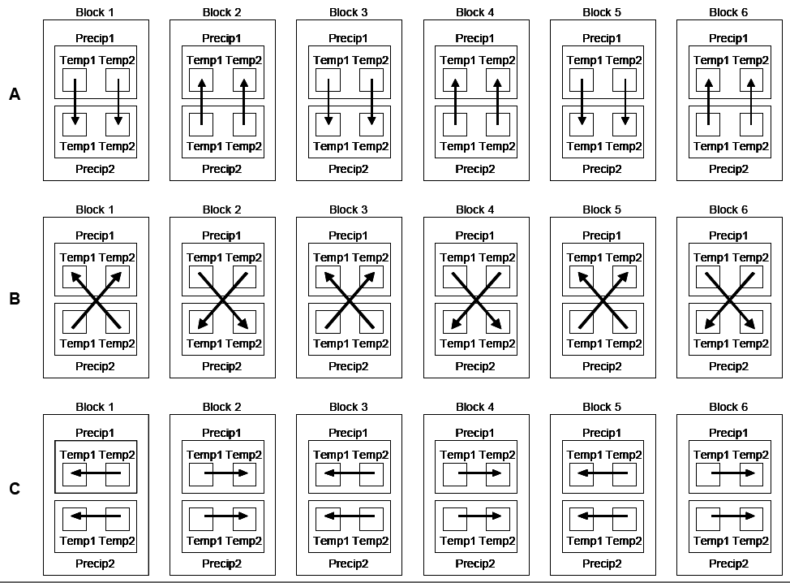
Milliken et al.'s (2007) designs
Each arrow represents an array, with 2 arrays per block.
Two Blktypes depending on dye assignment: 1,3,5 and 2,4,6.
same T, diff P
diff T,
diff P
diff T, same P

Slide 28
Milliken et al. (2007) Plan B
Microarray randomization (Milliken et al. (2007) not explicit).
◻
2 Precip
2 Temp
2 MainPlots in B
6 Blocks
2 Subplot in B, M
2 M₁
12 Array
2 Dyes

⊥
2 S₁
4 treatments
◻
24 subplots
24 array-dyes
M₁ (= P) is 1 (2) for main plots that got level 1 (2) of Precip.
Similarly for S₁ (= T) for Subplot.
Combinations of (P, M₁) & (T, S₁) assigned to A∧D using Plan B, although no Array blocks (A and D permuted).
  Using pseudofactors retains sources from split-plot experiment
Randomized-inclusive randomizations (3 tiers) (B & B, 2006)
Mixed model: P + T + P∧T + D | B + B∧M + B∧M∧S + A + A∧D;
  However, Milliken et al. (2007) include intertier (block-treatment) interactions of D with P and T.
  P*T*D | B + B∧M + B∧M∧S + A + A∧D.
Notes:
Randomize Precip,M1 and Temp,S1 to Arrays^Dyes

Slide 29
Decomposition table for
Plan B
◻
2 Precip
2 Temp
2 MainPlots in B
6 Blocks
2 Subplot in B, M
2 M₁
12 Array
2 Dyes

⊥
2 S₁
4 treatments
◻
24 subplots
24 array-dyes
array-dyes tier
Source | df
Array | 11
Dye | 1
A#D | 11
subplots tier
Source | df
Blocks | 5
SubPlots[B∧M]_{A} | 6
MainPlots[B]_{D} | 1
MainPlots[B] | 5
SubPlots[B∧M] | 6
treatments tier
Source | df
P#D | 1
Residual | 4
P#T | 1
T#D | 1
Residual | 4
Precip | 1
Residual | 4
Temp | 1
P#T#D | 1
Residual | 4
Sources for arrays-dyes standard.
However, Subplots[B∧M] and MainPlots[B] are split across array-dyes sources.
  set up 2-level pseudofactors M_{D} and S_{A} to split the sources
The treatments tier sources are confounded as shown.
  P#T, and other two-factor interactions, confounded with Arrays.
  P and T confounded with less variable A#D
Notes:
M_1 does not represent Precip differences, but Main plot differences associated with Precip diffs.

Slide 30
Comparison with Milliken et al.'s ANOVA
array-dyes tier |  | subplots tier |  | treatments tier
Source | df | Source | df | Source | df | Milliken et al.'s sources
Array | 11 | Blocks | 5 | P#D | 1 | Blktype (= P#D)
 |  |  |  | Residual | 4 | Block[Blktype]
 |  | SubPlots[B∧M]_{A} | 6 | P#T | 1 | P#T
 |  |  |  | T#D | 1 | T#D
 |  |  |  | Residual | 4 | ArrayPairs#Block[Blktype]
Dye | 1 | MainPlots[B]_{D} | 1 |  | 1 | Dye
A#D | 11 | MainPlots[B] | 5 | Precip | 1 | Precip
 |  |  |  | Residual | 4 | P#Block[Blktype]
 |  | SubPlots[B∧M] | 6 | Temp | 1 | Temp
 |  |  |  | P#T#D | 1 | Temp#Blktype
 |  |  |  | Residual | 4 | Residual
Equivalent ANOVAs, but labels differ – they use artificial grouping factors like Blktype and ArrayPairs, not pseudofactors.
Their labels do not show confounding and hence sources of variation obscured (e.g. P#T) – but their E[MQs] show it.
Their labels unrelated to terms in model; rationale for decompos^{n} unclear.
Notes:
Blk(blktype) is blocks within blktype and blktype is the two kind of block (1,3,5 vs 2,4,6)
Blktype is equal to trt1*color

Slide 31
Adding E[MSq] for Plan B
array-dyes tier |  | subplots tier |  | treatments tier
Source | df | Source | df | Source | df | E[MSq]
Array | 11 | Blocks | 5 | P#D | 1
 |  |  |  | Residual | 4
 |  | SubPlots[B∧M]_{A} | 6 | P#T | 1
 |  |  |  | T#D | 1
 |  |  |  | Residual | 4
Dye | 1 | MainPlots[B]_{D} | 1
A#D | 11 | MainPlots[B] | 5 | Precip | 1
 |  |  |  | Residual | 4
 |  | SubPlots[B∧M] | 6 | Temp | 1
 |  |  |  | P#T#D | 1
 |  |  |  | Residual | 4
E[MSq] synthesized using standard rules as for earlier example.
  Milliken et al. (2007) use ad hoc procedure that takes 4 journal pages.
Mixed model of convenience (drop B∧M∧S or A∧D to get fit):
  P*T*D | B + B∧M + A + A∧D;
  Equivalent to Milliken et al. (2007).

Slide 32
Variance of mean differences
array-dyes tier |  | subplots tier |  | treatments tier
Source | df | Source | df | Source | df | E[MSq]
Array | 11 | Blocks | 5 | P#D | 1
 |  |  |  | Residual | 4
 |  | SubPlots[B∧M]_{A} | 6 | P#T | 1
 |  |  |  | T#D | 1
 |  |  |  | Residual | 4
Dye | 1 | MainPlots[B]_{D} | 1
A#D | 11 | MainPlots[B] | 5 | Precip | 1
 |  |  |  | Residual | 4
 |  | SubPlots[B∧M] | 6 | Temp | 1
 |  |  |  | P#T#D | 1
 |  |  |  | Residual | 4
Again, variance of mean differences based on E[Msq].
For example, for Precip mean differences:

Slide 33
4. Balanced design in the both phases
Jarrett & Ruggiero (2008) give an experiment with 1st phase involving 7 treatments assigned to 21 plants using a BIBD with b = 7, k = 3 intrablock efficiency 7/9.
Systematic layout
 | Block
Plant | 1 | 2 | 3 | 4 | 5 | 6 | 7
1 | A | B | C | D | E | F | G
2 | B | C | D | E | F | G | A
3 | D | E | F | G | A | B | C
In 2nd phase design, 2 samples (fractions) are taken from each plant and assigned to arrays using a BIBD in which arrays are formed into 7 Sets of 3 Arrays.
  Sets only necessary if they are a separate source of variability, triples being more homogeneous than all 21 arrays.
  Jarrett & Ruggiero do not include a Sets component in mixed model so omit.

Slide 34
Jarrett & Ruggiero (2008) BIBD (cont'd)
1st phase involving BIBD for 7 treatments in blocks of 3 plants (intrablock efficiency 7/9).
 | Block
Plant | 1 | 2 | 3 | 4 | 5 | 6 | 7
1 | A | B | C | D | E | F | G
2 | B | C | D | E | F | G | A
3 | D | E | F | G | A | B | C
2nd phase reformulated as two samples (fractions) taken from each plant and plants assigned to arrays using 2 x 3 Youden squares with intrablock efficiency ¾.
Systematic layout
 | Array | 1 | 2 | 3 | 4 | 5 | 6 | … | 19 | 20 | 21
Dye | Block |  | 1 |  |  | 2 |  | … |  | 7
Green |  | 1_{a} | 2_{a} | 3_{a} | 1_{a} | 2_{a} | 3_{a} |  | 1_{a} | 2_{a} | 3_{a}
Red |  | 2_{b} | 3_{b} | 1_{b} | 2_{b} | 3_{b} | 1_{b} |  | 2_{b} | 3_{b} | 1_{b}
Plants in B: 1-3;
Samples: a,b.

Slide 35
Jarrett & Ruggiero (2008) BIBD (cont'd)
Randomization: composed (3 tiers)
7 Treatments
7 Blocks
3 Plants in B
2 Samples in B, P
21 Arrays
2 Dyes


2 S₁
7 treatments
42 samples
42 array-dyes
  An open circle indicates the use of a nonorthogonal design.
  S₁ groups Samples that receive the same Dye.
  Here randomize across all arrays, as no Sets
Mixed model:
    T + D | A/D + B/P/S

Slide 36
Jarrett & Ruggiero (2008) BIBD (cont'd)
ANOVA table
This ANOVA displays confounding & allows an assessment of design.
  Efficiency factors are products of those from component designs
  (1 x 2/9, ¼ x 7/9, ¾ x 7/9).
  E[MSq]s can still be derived using Hasse diagrams.
  Not all random lines correspond to an
  eigenspace of V and so are not strata.
  For intrablock Treatment differences:

Slide 37
Jarrett & Ruggiero (2008) BIBD (cont'd)
ANOVA table
Likely to prefer:
  Combined estimates of Treatments and of the Plants[B] component;
  Combined Treatments test of hypothesis.
Mixed model of convenience:
    Needed because AD and BPS are inseparable;
    T + D | A/D + B/P (same as Jarrett & Ruggiero, 2008).
Working on expressions for variance of combined estimates.

Slide 38
5. Summary
Microarray designs for observational material are two-tiered and those for experimental material are multitiered.
Tiers and randomization diagrams lead to explicit consideration of randomization for array design – important but often overlooked.
A general, non-algebraic method for synthesizing the decomposition table, mixed model and variances of mean differences.
Using pseudofactors:
  retains all sources of variation;
  avoids substitution of artificial grouping factors for real sources of variations, so direct relationship between ANOVA sources and model terms.
Mixed models likely to be preferred for analyzing nonorthogonal designs.
Web address for link to Multitiered experiments site:
http://chris.brien.name/multitier

Slide 39
References
Brien, C. J. (1983). Analysis of variance tables based on experimental structure. Biometrics, 39, 53-59.
Brien, C.J., and Bailey, R.A. (2006) Multiple randomizations (with discussion). J. Roy. Statist. Soc., Ser. B, 68, 571–609.
Brien, C.J. and Demétrio, C.G.B. (2009) Formulating mixed models for experiments, including longitudinal experiments. J. Agr. Biol. Env. Stat., 14, 253-80.
Jarrett, R. G. and K. Ruggiero (2008). Design and Analysis of Two-Phase Experiments for Gene Expression Microarrays—Part I. Biometrics, 64, 208—216.
Kerr, M. K. (2003) Design Considerations for Efficient and Effective Microarray Studies. Biometrics, 59, 822-828.
McIntyre, G. A. (1955). Design and analysis of two phase experiments. Biometrics, 11, 324-334.
Milliken, G. A., K. A. Garrett, et al. (2007) Experimental Design for Two-Color Microarrays Applied in a Pre-Existing Split-Plot Experiment. Stat. Appl. in Genet. and Mol. Biol., 6(1), Article 20.
Patterson, H. D. (1997) Analyses of Series of Variety Trials. in Statistical Methods for Plant Variety Evaluation, eds. R. A. Kempton and P. N. Fox, London: Chapman & Hall, pp. 139–161.

