Slide 1
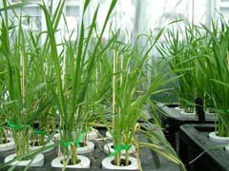
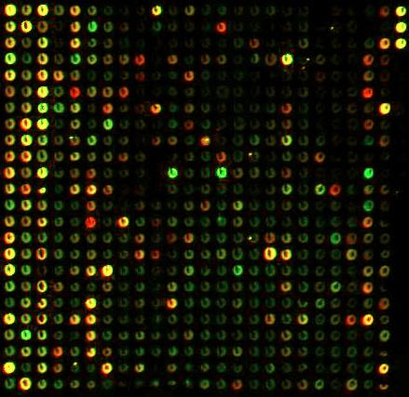
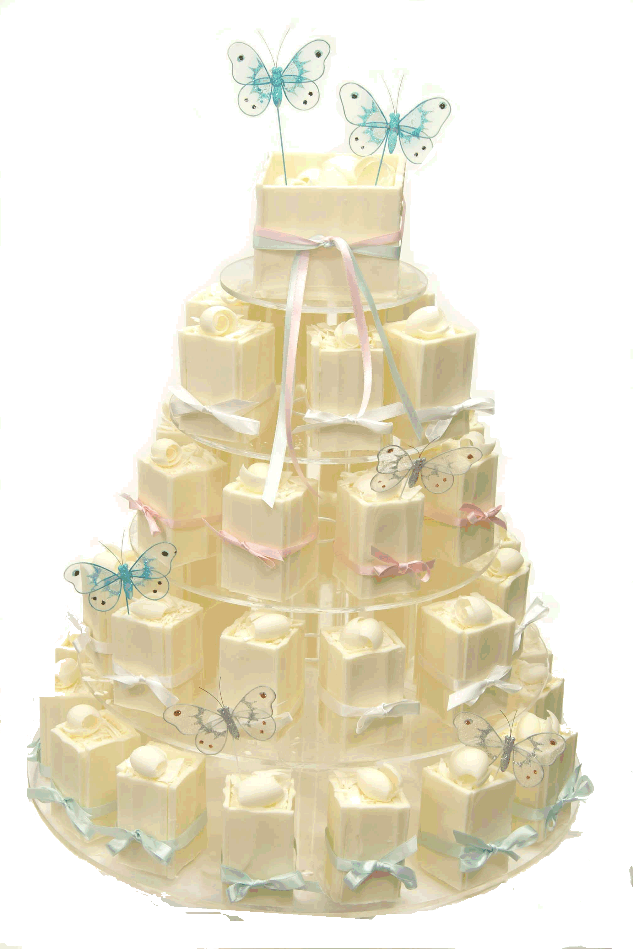
Factor-allocation in gene-expression microarray experiments
Chris Brien
Phenomics and Bioinformatics Research Centre
University of South Australia
chris.brien@unisa.edu.au

Slide 2
Outline
Establishing the analysis for a design
Analysis based on factor-allocation description
Analysis based on single-factor description
Microarray experiment (second phase)
Conclusions

Slide 3
1. Establishing the analysis for an design
The aim is to:
Formulate the mixed model:
Get the skeleton ANOVA table:
Derive the E[MSq] and use to obtain variance of treatment mean differences.

Slide 4
2. Analysis based on factor-allocation description
Milliken et al. (2007,SAGMB) discuss the design of microarray experiments applied to a pre-existing split-plot experiment:
  i.e. a two-phase experiment (McIntyre, 1955).
First phase is a split-plot experiment on grasses in which:
  An RCBD with 6 Blocks is used to assign the 2-level factor Precip to the main plots;
  Each main-plot is split into 2 subplots to which the 2-level factor Temp is randomized.
Investigate analysis of a first-phase response, such as grass production
Notes:
Factor-allocation description of this phase first

Slide 5

2a. Factor-allocation description
(Brien, 1983; Brien & Bailey, 2006; Brien et al., 2011)
Use factor-allocation diagrams:
allocated
unallocated
6 Blocks
2 MainPlots in B
2 Subplots in B, M
4 treatments
2 Precip
2 Temp
24 subplots
Two panels, each with:
    a list of factors; their numbers of levels; their nesting relationships.
A set of factors is called a tier:
  {Precip, Temp} or {Blocks, MainPlots, Subplots};
  The factors in a set have the same status in the allocation, usually a randomization;
  Textbook experiments are two-tiered, others are not.

Slide 6
2b. Mixed model
(Brien & Bailey, 2006; Brien & Demétrio, 2009)
6 Blocks
2 MainPlots in B
2 Subplots in B, M
4 treatments
2 Precip
2 Temp
24 subplots
Terms in mixed model correspond to generalized factors:
  A∧B is the ab-level factor formed from the combinations of A with a levels and B with b levels.
Display in Hasse diagrams that show hierarchy of terms from each tier.
U 1
U 1
Blocks 6
Precip 2
Temp 2
Blocks∧MainPlots 12
Precip∧Temp 4
Blocks∧MainPlots∧Subplots 24
Mixed model
  P + T + P∧T | B + B∧M + B∧M∧S
Y = X_{P}θ_{P} + X_{T}θ_{T} + X_{P∧T}θ_{P∧T} + Z_{B}u_{B}
+ Z_{B∧M}u_{B∧M}+ Z_{B∧M∧S}u_{B∧M∧S}.
Notes:
To get Hasse diagrams consider all combinations of factors allowable given the nesting -> terms in the LHS of Hasse diagram.
To get mixed model consider which terms are fixed and which are random.
Model can be viewed as an approximation to a randomization model

Slide 7
2c. ANOVA sources
U 1
1 M
Add sources to Hasse diagrams
Blocks 6
5 B
Blocks∧MainPlots 12
6 M[B]
U 1
1 M
Blocks∧MainPlots∧Subplots 24
12 S[B∧M]
Precip 2
1 P
Temp 2
1 T
2d. ANOVA table
(summarizes properties)
Precip∧Temp 4
1 P#T
Notes:
There is a rule for getting the sources from the terms

Slide 8
2e. E[Msq]
Add E[MSq] to ANOVA table, tier by tier
  Use Hasse diagrams and standard rules (Lohr, 1995; Brien et al., 2011).
Variance of diff between means from effects confounded with a single source easily obtained:
  2 κ / r, κ = E[MSq] for source for means ignoring q(), r = repl^{n} of a mean.
For example, variance of diff between Precip means:
Precip-Temp mean differences use extended rules.
Notes:
To get E[MSq], put variance or fixed component with subscripts being the first letter of the factors in the generalized factor (fixed component is the noncentrality parameter for the chi-square and is a quadratic function in the expectation)
RHS elements are the contributions of the sources to the E[MSq]

Slide 9
3) Analysis based on single-set description
e.g. Searle, Casella & McCulloch (1992); Littel et al. (2006).
Single set of factors that uniquely indexes observations:
  {Blocks, Precip, Temp} (MainPlots and Subplots omitted).
What are the EUs in the single-set approach?
  A set of units that are indexed by Blocks-Precip combinations and another set by the Blocks-Precip-Temp combinations.
  Of course, Blocks-Precip-(Temp) are not actual EUs, as Precip (Temp) are not randomized to those combinations.
  They act as a proxy for the unnamed EUs.
Factor allocation clearly shows the EUs are MainPlots in B and Subplots in B, M
6 Blocks
2 MainPlots in B
2 Subplots in B, M
4 treatments
2 Precip
2 Temp
24 subplots
Notes:
B^M is mainplot variability and B^P is the interaction of P and B.

Slide 10
Mixed model and ANOVA table
Mixed model: P + T + P∧T | B + B∧P + B∧P∧T.
  Previous model: P + T + P∧T | B + B∧M + B∧M∧S.
  Former model more economical as M and S not needed.
  However, B∧M and B∧P are different sources of variability: inherent variability vs block-treatment interaction.
  An important difference is that in factor-allocation, initially at least, factors from different sets are taken to be independent.
Same decomposition and E[MSq], but the single-set ANOVA does not display confounding and the identification of sources is blurred.
Notes:
To get E[MSq], put variance or fixed component with subscripts being the first letter of the factors in the generalized factor (fixed component is the noncentrality parameter for the chi-square and is a quadratic function in the expectation)
RHS elements are the contributions of the sources to the E[MSq]

Slide 11
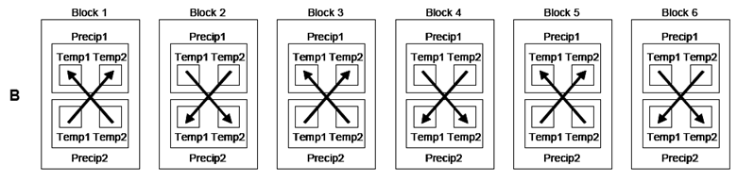
4. Microarray experiment: second phase
For this phase, Milliken et al. (2007) gave three designs that differ in the way P and T assigned to an array:
  Same T, different P;
  Different T and P;
  Different T, same P.
Each arrow represents an array, with 2 arrays per block (Red at the head).
Two Blktypes depending on dye assignment: 1,3,5 and 2,4,6.

Slide 12
Randomization for Plan B
Milliken et al. (2007) not explicit.
2 Precip
2 Temp
2 MainPlots in B
6 Blocks
2 Subplots in B, M
12 Array
2 Dyes
■

⊥
4 treatments
24 subplots
24 array-dyes
Wish to retain MainPlots and Subplots in the allocation and analysis to have a complete factor-allocation description.
  Cannot just assign them ignoring treatments.
  Need to assign combinations of the factors from both first-phase tiers and so these form a pseudotier which in indicated by the dashed oval.
Three-tiered.

Slide 13
Microarray phase randomization
Randomized layout for first-phase:
 | B | M | S |  | P | T |  | B | M | S |  | P | T
Green | 1 | 1 | 1 |  | 2 | 2 |  | 4 | 1 | 1 |  | 1 | 1
Green | 1 | 1 | 2 |  | 2 | 1 |  | 4 | 1 | 2 |  | 1 | 2
Red | 1 | 2 | 1 |  | 1 | 2 |  | 4 | 2 | 1 |  | 2 | 1
Red | 1 | 2 | 2 |  | 1 | 1 |  | 4 | 2 | 2 |  | 2 | 2
 | 2 | 1 | 1 |  | 2 | 1 |  | 5 | 1 | 1 |  | 2 | 2
 | 2 | 1 | 2 |  | 2 | 2 |  | 5 | 1 | 2 |  | 2 | 1
 | 2 | 2 | 1 |  | 1 | 2 |  | 5 | 2 | 1 |  | 1 | 2
 | 2 | 2 | 2 |  | 1 | 1 |  | 5 | 2 | 2 |  | 1 | 1
 | 3 | 1 | 1 |  | 2 | 2 |  | 6 | 1 | 1 |  | 1 | 2
 | 3 | 1 | 2 |  | 2 | 1 |  | 6 | 1 | 2 |  | 1 | 1
 | 3 | 2 | 1 |  | 1 | 1 |  | 6 | 2 | 1 |  | 2 | 2
 | 3 | 2 | 2 |  | 1 | 2 |  | 6 | 2 | 2 |  | 2 | 1
Notes:
Look at Block 1: MainPlot 2 got P 1 and Mainplot 1 got P 2; in both Mainplots, Subplot 1 got T2 and Subplot 2 got T 1.
So, in Block 1, M_1 has relabelled mainplots 2 and 1 to become 1 and 2.
In each Mainplot in Block 1, S_1 has swapped the S labels.
Now M_1,S_1 equal to 1,1 and 2,2 go on the same array; similarly for other pair of subplots

Slide 14
Microarray phase randomization (cont’d)
Assignment to array-dyes
 | DyeR |  |  |  |  |  |  |  | DyeG
Array | B | M | S |  | P | T |  | Array | B | M | S |  | P | T
1 | 1 | 2 | 2 |  | 1 | 1 |  | 1 | 1 | 1 | 1 |  | 2 | 2
2 | 1 | 2 | 1 |  | 1 | 2 |  | 2 | 1 | 1 | 2 |  | 2 | 1
3 | 2 | 1 | 2 |  | 2 | 2 |  | 3 | 2 | 2 | 2 |  | 1 | 1
4 | 2 | 1 | 1 |  | 2 | 1 |  | 4 | 2 | 2 | 1 |  | 1 | 2
5 | 3 | 2 | 1 |  | 1 | 1 |  | 5 | 3 | 1 | 1 |  | 2 | 2
6 | 3 | 2 | 2 |  | 1 | 2 |  | 6 | 3 | 1 | 2 |  | 2 | 1
7 | 4 | 2 | 2 |  | 2 | 2 |  | 7 | 4 | 1 | 1 |  | 1 | 1
8 | 4 | 2 | 1 |  | 2 | 1 |  | 8 | 4 | 1 | 2 |  | 1 | 2
9 | 5 | 2 | 2 |  | 1 | 1 |  | 9 | 5 | 1 | 1 |  | 2 | 2
10 | 5 | 2 | 1 |  | 1 | 2 |  | 10 | 5 | 1 | 2 |  | 2 | 1
11 | 6 | 2 | 1 |  | 2 | 2 |  | 11 | 6 | 1 | 2 |  | 1 | 1
12 | 6 | 2 | 2 |  | 2 | 1 |  | 12 | 6 | 1 | 1 |  | 1 | 2
To do the randomization, permute Arrays and Dye separately (as for a row-column design), and then re-order.

Slide 15
Microarray phase randomization (cont’d)
Randomized layout:
 | DyeR |  |  |  |  |  |  |  | DyeG
Array | B | M | S |  | P | T |  | Array | B | M | S |  | P | T
1 | 4 | 2 | 1 |  | 2 | 1 |  | 1 | 4 | 1 | 2 |  | 1 | 2
2 | 3 | 1 | 1 |  | 2 | 1 |  | 2 | 3 | 2 | 2 |  | 1 | 1
3 | 6 | 2 | 1 |  | 2 | 2 |  | 3 | 6 | 1 | 2 |  | 1 | 1
4 | 1 | 1 | 1 |  | 2 | 2 |  | 4 | 1 | 2 | 2 |  | 1 | 1
5 | 2 | 2 | 2 |  | 1 | 2 |  | 5 | 2 | 1 | 1 |  | 2 | 2
6 | 5 | 1 | 2 |  | 2 | 1 |  | 6 | 5 | 2 | 1 |  | 1 | 2
7 | 1 | 1 | 2 |  | 2 | 1 |  | 7 | 1 | 2 | 1 |  | 1 | 2
8 | 3 | 1 | 2 |  | 2 | 2 |  | 8 | 3 | 2 | 1 |  | 1 | 2
9 | 5 | 1 | 1 |  | 2 | 2 |  | 9 | 5 | 2 | 2 |  | 1 | 1
10 | 6 | 2 | 2 |  | 2 | 1 |  | 10 | 6 | 1 | 1 |  | 1 | 2
11 | 2 | 2 | 1 |  | 1 | 1 |  | 11 | 2 | 1 | 2 |  | 2 | 1
12 | 4 | 2 | 2 |  | 2 | 2 |  | 12 | 4 | 1 | 1 |  | 1 | 1
Notes:
Perhaps randomization of fractions not possible and fractions taken as needed and so nature does the randomization.
Have to randomize/assign 16 fractions to 8 arrays so need to pair up fractions to do this.

Slide 16
Mixed model for Plan B
2 Precip
2 Temp
2 MainPlots in B
6 Blocks
2 Subplots in B, M
12 Array
2 Dyes
■

⊥
4 treatments
24 subplots
24 array-dyes
Mixed model based on generalized factors from each panel:
P + T + P∧T + D | B + B∧M + B∧M∧S + A + A∧D;
  However, Milliken et al. (2007) include intertier (block-treatment) interactions of D with P and T.
  P*T*D | B + B∧M + B∧M∧S + A + A∧D.

Slide 17
ANOVA for Plan B
If examine the design, see that a MainPlots[Blocks] contrast confounded with Dyes
  use two-level pseudofactors M_{D} to capture it.
Also some Subplots[Blocks∧MainPlots] contrasts confounded with Arrays:
  Use S_{A} for Subplots on the same array to capture it.
 | DyeR |  |  |  |  |  |  |  |  |  |  | DyeG
Array | B | M | S |  | M_{D} | S_{A} |  | P | T |  | Array | B | M | S |  | M_{D} | S_{A} |  | P | T
1 | 4 | 2 | 1 |  | 1 | 2 |  | 2 | 1 |  | 1 | 4 | 1 | 2 |  | 2 | 2 |  | 1 | 2
2 | 3 | 1 | 1 |  | 1 | 1 |  | 2 | 1 |  | 2 | 3 | 2 | 2 |  | 2 | 1 |  | 1 | 1
3 | 6 | 2 | 1 |  | 1 | 2 |  | 2 | 2 |  | 3 | 6 | 1 | 2 |  | 2 | 2 |  | 1 | 1
4 | 1 | 1 | 1 |  | 1 | 1 |  | 2 | 2 |  | 4 | 1 | 2 | 2 |  | 2 | 1 |  | 1 | 1
5 | 2 | 2 | 2 |  | 1 | 1 |  | 1 | 2 |  | 5 | 2 | 1 | 1 |  | 2 | 1 |  | 2 | 2
6 | 5 | 1 | 2 |  | 1 | 2 |  | 2 | 1 |  | 6 | 5 | 2 | 1 |  | 2 | 2 |  | 1 | 2
7 | 1 | 1 | 2 |  | 1 | 2 |  | 2 | 1 |  | 7 | 1 | 2 | 1 |  | 2 | 2 |  | 1 | 2
8 | 3 | 1 | 2 |  | 1 | 2 |  | 2 | 2 |  | 8 | 3 | 2 | 1 |  | 2 | 2 |  | 1 | 2
9 | 5 | 1 | 1 |  | 1 | 1 |  | 2 | 2 |  | 9 | 5 | 2 | 2 |  | 2 | 1 |  | 1 | 1
10 | 6 | 2 | 2 |  | 1 | 1 |  | 2 | 1 |  | 10 | 6 | 1 | 1 |  | 2 | 1 |  | 1 | 2
11 | 2 | 2 | 1 |  | 1 | 2 |  | 1 | 1 |  | 11 | 2 | 1 | 2 |  | 2 | 2 |  | 2 | 1
12 | 4 | 2 | 2 |  | 1 | 1 |  | 2 | 2 |  | 12 | 4 | 1 | 1 |  | 2 | 1 |  | 1 | 1
 | DyeR |  |  |  |  |  |  |  |  |  |  | DyeG
Array | B | M | S |  | M_{D} | S_{A} |  | P | T |  | Array | B | M | S |  | M_{D} | S_{A} |  | P | T
1 | 4 | 2 | 1 |  | 1 | 2 |  | 2 | 1 |  | 1 | 4 | 1 | 2 |  | 2 | 2 |  | 1 | 2
2 | 3 | 1 | 1 |  | 1 | 1 |  | 2 | 1 |  | 2 | 3 | 2 | 2 |  | 2 | 1 |  | 1 | 1
3 | 6 | 2 | 1 |  | 1 | 2 |  | 2 | 2 |  | 3 | 6 | 1 | 2 |  | 2 | 2 |  | 1 | 1
4 | 1 | 1 | 1 |  | 1 | 1 |  | 2 | 2 |  | 4 | 1 | 2 | 2 |  | 2 | 1 |  | 1 | 1
5 | 2 | 2 | 2 |  | 1 | 1 |  | 1 | 2 |  | 5 | 2 | 1 | 1 |  | 2 | 1 |  | 2 | 2
6 | 5 | 1 | 2 |  | 1 | 2 |  | 2 | 1 |  | 6 | 5 | 2 | 1 |  | 2 | 2 |  | 1 | 2
7 | 1 | 1 | 2 |  | 1 | 2 |  | 2 | 1 |  | 7 | 1 | 2 | 1 |  | 2 | 2 |  | 1 | 2
8 | 3 | 1 | 2 |  | 1 | 2 |  | 2 | 2 |  | 8 | 3 | 2 | 1 |  | 2 | 2 |  | 1 | 2
9 | 5 | 1 | 1 |  | 1 | 1 |  | 2 | 2 |  | 9 | 5 | 2 | 2 |  | 2 | 1 |  | 1 | 1
10 | 6 | 2 | 2 |  | 1 | 1 |  | 2 | 1 |  | 10 | 6 | 1 | 1 |  | 2 | 1 |  | 1 | 2
11 | 2 | 2 | 1 |  | 1 | 2 |  | 1 | 1 |  | 11 | 2 | 1 | 2 |  | 2 | 2 |  | 2 | 1
12 | 4 | 2 | 2 |  | 1 | 1 |  | 2 | 2 |  | 12 | 4 | 1 | 1 |  | 2 | 1 |  | 1 | 1
Notes:
The pseudofactors equal Dyes and Arrays, respectively.

Slide 18
ANOVA table for
Plan B
2 Precip
2 Temp
2 MainPlots in B
6 Blocks
2 Subplots in B, M
12 Array
2 Dyes
■

⊥
4 treatments
24 subplots
24 array-dyes
array-dyes tier
Source | df
Array | 11
Dye | 1
A#D | 11
subplots tier
Source | df
Blocks | 5
SubPlots[B∧M]_{A} | 6
MainPlots[B]_{D} | 1
MainPlots[B] | 5
SubPlots[B∧M] | 6
treatments tier
Source | df
P#D | 1
Residual | 4
P#T | 1
T#D | 1
Residual | 4
Precip | 1
Residual | 4
Temp | 1
P#T#D | 1
Residual | 4
Sources for arrays-dyes straightforward.
Sources for subplots as before but split across array-dyes sources using the pseudofactors M_{D} and S_{A}.
The treatments tier sources are confounded as shown.
  P#T, and other two-factor interactions, confounded with Arrays.
  P and T confounded with less variable A#D
Notes:
1 df for S_A in each Block
Need to extend Hasse diagrams to include M_{D} and S_{A} to get df.

Slide 19
Comparison with single-set-description ANOVA
array-dyes tier |  | subplots tier |  | treatments tier |  | single-set-description sources
Source | df | Source | df | Source | df | (Milliken et al., 2007)
Array | 11 | Blocks | 5 | P#D | 1 | Blktype (= P#D)
 |  |  |  | Residual | 4 | Block[Blktype]
 |  | SubPlots[B∧M]_{A} | 6 | P#T | 1 | P#T
 |  |  |  | T#D | 1 | T#D
 |  |  |  | Residual | 4 | ArrayPairs#Block[Blktype]
Dye | 1 | MainPlots[B]_{D} | 1 |  | 1 | Dye
A#D | 11 | MainPlots[B] | 5 | Precip | 1 | Precip
 |  |  |  | Residual | 4 | P#Block[Blktype]
 |  | SubPlots[B∧M] | 6 | Temp | 1 | Temp
 |  |  |  | P#T#D | 1 | Temp#Blktype
 |  |  |  | Residual | 4 | Residual
Instead of pseudofactors, use grouping factors (Blktype & ArrayPairs) that are unconnected to terms in the model; all factors crossed or nested.
Equivalent ANOVAs, but labels differ – rationale for single-set decomposition is unclear and its table does not show confounding; Thus, sources of variation obscured (e.g. P#T), although their E[MQs] show it.
Notes:
Blk(blktype) is blocks within blktype and blktype is the two kinds of block (1,3,5 vs 2,4,6)
Blktype is equal to trt1*color

Slide 20
Adding E[MSq] for Plan B
array-dyes tier |  | subplots tier |  | treatments tier
Source | df | Source | df | Source | df | E[MSq]
Array | 11 | Blocks | 5 | P#D | 1
 |  |  |  | Residual | 4
 |  | SubPlots[B∧M]_{A} | 6 | P#T | 1
 |  |  |  | T#D | 1
 |  |  |  | Residual | 4
Dye | 1 | MainPlots[B]_{D} | 1
A#D | 11 | MainPlots[B] | 5 | Precip | 1
 |  |  |  | Residual | 4
 |  | SubPlots[B∧M] | 6 | Temp | 1
 |  |  |  | P#T#D | 1
 |  |  |  | Residual | 4
E[MSq] synthesized using standard rules as for first phase.
  Milliken et al. (2007) use ad hoc procedure that takes 4 journal pages.
Mixed model of convenience (drop B∧M∧S or A∧D to get fit):
  P*T*D | B + B∧M + A + A∧D (no pseudofactors);
  Equivalent to Milliken et al. (2007).

Slide 21
Variance of mean differences
array-dyes tier |  | subplots tier |  | treatments tier
Source | df | Source | df | Source | df | E[MSq]
Array | 11 | Blocks | 5 | P#D | 1
 |  |  |  | Residual | 4
 |  | SubPlots[B∧M]_{A} | 6 | P#T | 1
 |  |  |  | T#D | 1
 |  |  |  | Residual | 4
Dye | 1 | MainPlots[B]_{D} | 1
A#D | 11 | MainPlots[B] | 5 | Precip | 1
 |  |  |  | Residual | 4
 |  | SubPlots[B∧M] | 6 | Temp | 1
 |  |  |  | P#T#D | 1
 |  |  |  | Residual | 4
Now, for Precip mean differences:

Slide 22
5. Conclusions
Microarray designs are two-phase.
Single-set description can be confusing and so false economy.
Factor-allocation diagrams lead to explicit consideration of randomization for array design – important but often overlooked.
A general, non-algebraic method for synthesizing the skeleton ANOVA table, mixed model and variances of mean differences is available for orthogonal designs.
When allocation is randomized, mixed models are randomization-based (Brien & Bailey, 2006; Brien & Demétrio, 2009).
Using pseudofactors where necessary:
  retains all sources of variation;
  avoids substitution of artificial grouping factors for real sources of variations so that sources in decomposition and terms in model directly related.

Slide 23
References
Brien, C. J. (1983). Analysis of variance tables based on experimental structure. Biometrics, 39, 53-59.
Brien, C.J., and Bailey, R.A. (2006) Multiple randomizations (with discussion). J. Roy. Statist. Soc., Ser. B, 68, 571–609.
Brien, C.J. and Demétrio, C.G.B. (2009) Formulating mixed models for experiments, including longitudinal experiments. J. Agr. Biol. Env. Stat., 14, 253-80.
Brien, C.J., Harch, B.D., Correll, R.L. and Bailey, R.A. (2011) Multiphase experiments with at least one later laboratory phase. I. Orthogonal designs. accepted for J. Agr. Biol. Env. Stat.
Lohr, S. L. (1995). Hasse diagrams in statistical consulting and teaching. The American Statistician, 49(4), 376-381.
McIntyre, G. A. (1955). Design and analysis of two phase experiments. Biometrics, 11, 324-334.
Milliken, G. A., K. A. Garrett, et al. (2007) Experimental Design for Two-Color Microarrays Applied in a Pre-Existing Split-Plot Experiment. Stat. Appl. in Genet. and Mol. Biol., 6(1), Article 20.
Web address for Multitiered experiments site:
http://chris.brien.name/multitier

