Slide 1
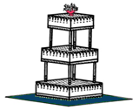

Multitiered experiments: Tiers in the design and analysis of experiments
Chris Brien
School of Mathematics and Statistics
University of South Australia
chris.brien@unisa.edu.au

Slide 2
Multitiered experiments course outline
Introduction and two-tiered experiments
Multiple randomizations
Randomization-based analysis of experiments
Notes:
It has been suggested that St Bride’s Church off Fleet Street inspired the tiered wedding cake

Slide 3

I. Introduction & two-tiered experiments
Multitiered experiments: what are they?
Two-tiered experiments
  Notation
  The design question
Summary
Notes:
It has been suggested that St Bride’s Church off Fleet Street inspired the tiered wedding cake

Slide 4
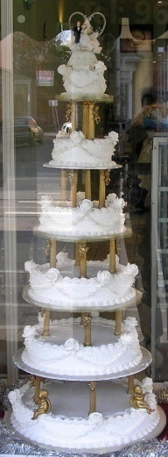
1. Multitiered experiments: what are they?
Experiments involving multiple randomizations
Include:
  two-phase experiments (sensory experiments in 1970s but McIntyre, 1955);
  superimposed experiments;
  some plant and animal experiments;
  human interaction experiments;
  multistage reprocessing experiments.
Not new designs but a particular class of (complex) experiments.
How many randomizations in a design:
  One in an RCBD?
  Two in a split-plot design?
  Two in a two-phase experiment?
Depends on how randomization is defined

Slide 5
A definition of a randomization
Define a randomization to be the random assignment of one set of objects to another using a permutation of the latter.
Generally each set of objects is indexed by a set of factors
  Unrandomized factors (indexing units)
  Randomized factors (indexing treatments)
A permutation of units used to randomize
Randomized
factors
Unrandomized
factors
randomized
Set Γ of objects
(treatments)
Set Ω of objects
(units)

Slide 6
How is such a randomization achieved?
Randomized
factors
Unrandomized
factors
randomized
Set Γ of objects
(treatments)
Set Ω of objects
(units)
Write down an unrandomized list of a) the set Ω; b) the levels of the unrandomized factors in standard order; c) the randomized factors in systematic order according to the design being used;
Identify all possible permutations of the levels combinations of factors indexing Ω allowable for the design;
Select a permutation and apply it to the levels combinations of factors indexing Ω.
Now have levels combinations of all factors that will occur in experiment.

Slide 7
A randomization
randomized
unrandomized
b Blocks
t Plots in B
t treatments
t Treatments
bt units
Systematic design:
  one treatment on each plot in each block
Randomization:
  permute blocks
  permute plots in each block independently
Unit | Blocks | Plots | Treatments
1 | 1 | 1 | 1
2 | 1 | 2 | 2
3 | 2 | 1 | 1
4 | 2 | 2 | 2

Slide 8
A randomization
randomized
unrandomized
b Blocks
t Plots in B
t treatments
t Treatments
bt units
Systematic design:
  one treatment on each plot in each block
Randomization:
  permute blocks
  permute plots in each block independently
Unit | Blocks | Plots | Treatments
1 | 2 | 2 | 1
2 | 2 | 1 | 2
3 | 1 | 1 | 1
4 | 1 | 2 | 2

Slide 9
A randomization
randomized
unrandomized
b Blocks
t Plots in B
t treatments
t Treatments
bt units
Systematic design:
  one treatment on each plot in each block
Randomization:
  permute blocks
  permute plots in each block independently
Unit | Blocks | Plots | Treatments
1 | 1 | 1 | 1
2 | 1 | 2 | 2
3 | 2 | 1 | 2
4 | 2 | 2 | 1

Slide 10
A randomization
randomized
unrandomized
b Blocks
t Plots in B
t treatments
t Treatments
bt units
Systematic design:
  one treatment on each plot in each block
Randomization:
  permute blocks
  permute plots in each block independently
The arrow from the randomized tier to the unrandomized tier indicates both
  a systematic design (with extra explanation if necessary)
  the randomization: permute the (names of the) objects in the unrandomized set by a permutation chosen at random from among all those that preserve the relevant structure.

Slide 11

Randomization diagrams (Brien & Bailey, 2006)
Example 1: RCBD in first phase of a sensory experiment (Brien, 1983)
randomized
unrandomized
b Blocks
t Plots in B
t treatments
t Treatments
bt units
A panel for a set of objects shows a factor poset:
    a list of factors in a tier,
    their numbers of levels,
    their nesting relationships.
So a tier is just a set of factors:
  {Treatments} or {Blocks, Plots}
  But, not just any old set: a set of factors with the same status in the randomization.
  Factors in different tiers have the levels combinations of them that are observed determined by a randomization.
  Not true for any factors in the same tier.
Shows EU and restrictions placed on randomization.

Slide 12
Standard textbook examples
RCBD
randomized
unrandomized
b Blocks
t Plots in B
t treatments
t Treatments
bt units
Most textbook examples involve two tiers only and tier is unnecessary.
Could have factor sets:
    Topographical and treatment (Fisher, 1935)
    Block and treatment (Nelder, 1965a, b)
    Plots/Units and treatments (Wilks & Kempthorne, 1956; Bailey, 1981)
    Unrandomized and randomized (Brien, 1983)

Slide 13
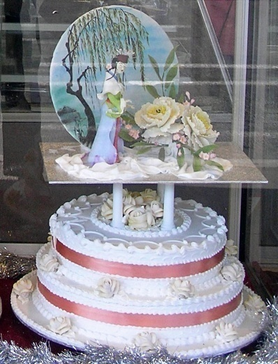
Randomization for a standard split-plot experiment
An experiment about cooking cakes in an oven
Main plots
  4 Baking conditions randomized to 4 Intervals in each of 3 Days using RCBD.
Subplots
  In an Interval, an oven with 3 Shelves used to bake 3 different Recipes together.
  Recipes order on Shelves randomized in each Interval.
4 Bake
3 Recipes
3 Days
4 Intervals in D
3 Shelves in D, I
12 treatments
36 cakes
Notes:
Portuguese for cooking a cake is cozendo um bolo ao forno; for baking is cozendo ao forno; for shelf is bandeja

Slide 14
Sense in which one randomization
4 Bake
3 Recipes
3 Days
4 Intervals in D
3 Shelves in D, I
12 treatments
36 cakes
Two randomizations in that two factors are randomized to two experimental units:
  Bake to Intervals in Days
  Recipes to Shelves in Days and Intervals
But, as randomization has been defined, one randomization:
  can achieve by applying one of the allowable permutations of cakes.
  Two set of objects with tiers
  factors associated by randomization in different tiers.
Presume cakes measured (physical?) immediately:
  A complete experiment
Notes:
Factors associated by randomization in different tiers

Slide 15
Extend to second phase
Suppose 36 cakes to be evaluated in a sensory phase.
Sensory phase:
  5 Judges are to be given a piece of cake to assess.
  Sensory phase divided into 3 Occasions at which 12 cakes, all produced on the same day, are assessed one at a time by the 5 judges.
  Order of presentation randomized for each judge on each occasion.
4 Bake
3 Recipes
3 Days
4 Intervals in D
3 Shelves in D, I
5 Pieces in D, I, P
3 Occasions
12 Tests in O, J
5 Judges
12 treatments
180 pieces
180 tests
Three sets of objects
Two randomizations whose effects cannot be achieved with one
Notes:
Factors associated by randomization in different tiers

Slide 16
Fundamental difference between split-plot and two-phase experiments
4 Bake
3 Recipes
3 Days
4 Intervals in D
3 Shelves in D, I
5 Pieces in D, I, P
3 Occasions
12 Tests in O, J
5 Judges
12 treatments
180 pieces
180 tests
Split-plots involve independent randomizations (Koch, Elashoff & Amara, 1988, Encyclopaedia of Statistics) to two different experimental units from the same set of objects.
  reducible to a single randomization (permutation)
Two-phase experiments involve two randomizations each to a different set of objects.
  not reducible to a single randomization.
Sets of objects and tiers basic to identifying multiple randomizations.
Notes:
Tendency to regard complex experiments, i.e. multiple-error experiments, as split-plot experiments. Also seem to involve multiple randomizations.
Need to establish that multitiered experiments are fundamentally different to split-plot experiments

Slide 17
2. Two-tiered experiments
Tiers can be useful in
  the design of experiments
  the analysis of experiments
especially multitiered experiments
Establish concepts in using tiers in familiar context of textbook experiments
  one way of approaching design and analysis of experiments
  same as Nelder (1965a, b) for two-tiered experiments

Slide 18
2(i) Notation
Factor relationship operators:
  A*B factors A and B are crossed
  A/B factor B is nested within A
Generalized factor
A∧B is the ab-level factor formed from the combinations of A with a levels and B with b levels
Sources in Decomposition/ANOVA table
  A#B a source for the interaction of A and B
  B[A] a source for the effects of B nested within A
  A / B / C = A + A∧B + A∧B∧C ⇒ A + B[A] + C[A∧B]
  Rule: factors, and only those factors, that nest any of the factors in the generalized factor must be in the square braces

Slide 19
A poultry-feeding experiment
(Brien & Bailey, 2006, Example 2)
4 Quantities
2 Sources
4 Rooms
8 Cages in R

8 treatments
32 cages
The generalized factor Q∧S has 8 levels.
R∧C = generalized factor whose levels are the 32 combinations of the levels of Rooms and Cages.
“Cages is nested in R” means that R∧C is a meaningful factor but C is not.

Slide 20
A greenhouse split-split plot experiment
(R. Mead,1990, p.382; Brien & Bailey, 2006, Fig. 4)
4 Blocks
2 Compartments in B
2 Troughs in B, C
2 Halves in B, C, T
2 Air Temperatures
2 Soil Temperatures
4 treatments
32 units
Two arrows but a single randomization

Slide 21
2(ii) The design question using tiers
Two sets of objects, one to be randomized to the other.
For example:
  A set of plots to which a set of treatments are to be randomized;
  i.e. objects are plots and treatments.
Suppose
  plots in a rectangular array indexed by Rows and Columns;
  treatments indexed by a single factor A;
  treatments are assigned to plots using an RCBD with Rows as the blocks.
Tier 2
Tier 1
b Rows
a A
a Columns in R
a treatments
ab plots
What are the properties of the design?

Slide 22
Deriving the sources
Objects: plots and treatments
Tiers: F_{plots} = {Rows, Columns}, F_{treatments} = {A}
Factor posets (based on nesting for design and intrinsic):
b Rows
●
a A
b Rows
a A
a Columns in R
a Columns
a treatments
ab plots
Structure formulae
  b Rows / a Columns
  a A
Generalized factors and Sources
(expand formulae or derive factor combinations complying with nesting & construct Hasse diagrams based on marginality of gen. factors)
Notes:
Generalized factors specify a basis for the permutation algebra

Slide 23
Decomposition (skeleton ANOVA) table
Summarizes properties of design:
  confounding and apportionment of variability
  useful at design stage irrespective of whether analysis by ANOVA or mixed model estimation (more later)
Have from each panel:
This table
  exhibits confounding resulting from randomizations, with multiple sources for contrasts: A is confounded with Columns[Rows]
  shows us that Columns[Rows], but not Rows, variability affects A differences and that the df of the relevant Residual is (a – 1)(b - 1) df.
Why is this a nice design?
  Because it is orthogonal with Rows differences eliminated.

Slide 24
White's (1975) three experiments
A cluster-randomized clinical trial
2 Therapies
10 Doctors
6 Patients in D
2 therapies
60 patients
A car-wash emporium
2 Types
5 Wash-units in T
60 Cars
10 wash-units
60 cars
An animal experiment
2 Drugs
10 Days
60 Animals
2 drugs
10 days
60 animals
What are the tiers?
All could be analyzed using a nested ANOVA (2 A / 5 B / 6 C), but different confounding (or different EUs).
  different decomposition tables e.g clinical trial

Slide 25
The properties of a design
How do we determine the properties of design in general?
What happens if not orthogonal?
Nelder, James-Wilkinson, Brien-Bailey answer by examining the relationship between the structures (orthogonal decompositions) associated with the two sets of objects.
The factor poset, specifying the nesting (and crossing) relations between factors in a set, for each tier gives rise to a Poset structure:
  The orthogonal decomposition for the set all generalized factors that comply with the nesting of the factors in the factor poset. It is specified by a set of orthogonal projectors.

Slide 26
A randomization: its elements
Randomized
factors
Unrandomized
factors
randomized
treatments
plots
Sets of objects | Γ (treatments) |  | Ω (plots)
Tiers: sets of factors | F_{Γ} (Randomized) |  | F_{Ω} (Unrandomized)
Vector spaces | V_{Γ} ≤ V_{Ω} |  | V_{Ω} = R^{n}
Orthogonal decompositions (structures) | R, a set of Rs |  | U, a set of Us
Start with U and further decompose according to R.

Slide 27
An orthogonal decomposition
U is a set of orthogonal idempotents, U₁,…,U_{u}, that decomposes V_{Ω} into a set of mutually orthogonal subspaces. The idempotents are:
  Symmetric: U' = U
  Idempotent: U² = U
  Mutually orthogonal: U_{i}U_{j} = 0, i≠j
  Sum to I: Σ U = I
Similarly R is a set of orthogonal idempotents, R₁,…,R_{r}, that decomposes V_{Γ} into a set of mutually orthogonal subspaces, except:
  Sum to I_{R}, the identity for V_{Γ} in V_{Ω} (i.e. RI_{R} = I_{R}R = R)

Slide 28
How are U and R determined?
Permutations that conform to the relations for the factor poset mathematically determine the idempotents.
Alternatively can think of these idempotents as the orthogonal projectors on the orthogonal subspaces corresponding to the terms in a randomization-equivalent mixed model (for a randomization involving two factor posets)
  The form of the mixed model is Y = Xθ + Zu with
    all random terms (Z_{j}u_{j}) from unrandomized, generalized factors
    all fixed terms (X_{i}θ_{i}) from just randomized, generalized factors.
  Need the idempotents that project onto the orthogonal subspaces corresponding to fitting either the fixed or random terms.
  Define summation or relationship matrices S = XX' (or ZZ') .
  Those for a tier determine a relationship algebra (James, 1957) whose idempotents are those required.
It is possible to specify structure without a factor poset.

Slide 29
Idempotents for the RCBD
Generalized factors and Sources
Sets of idempotents (structures)
  U = {U_{Mean}, U_{Rows}, U_{Columns[Rows]}}
  R = {R_{Mean}, R_{A}}
Idempotents U and R, for each source, are a linear function of mean operators M:
Expressions for Us and Rs in terms of Ms using Hasse diagrams
Notes:
Generalized factors specify a basis for the permutation algebra

Slide 30
A pair of orthogonal decompositions
Two orthogonal decompositions U and R.
The design is orthogonal if each subspace in R is contained in just one subspace in U.
That is, for each R ∈ R:
  there is just one U_{i} ∈ U such that U_{i}R = RU_{i} = R;
  for all other U_{j} ∈ U, U_{j}R = RU_{j} = 0.
For our example, have
  U = {U_{Mean}, U_{Rows}, U_{Columns[Rows]}};
  R = {R_{Mean}, R_{A}}.
So ignoring Mean sources, can show:
  U_{Rows} R_{A} = 0 ⇒ Rows and A are orthogonal;
  and U_{Columns[Rows]} R_{A} = R_{A}
  ⇒ A is totally confounded with Columns[Rows].

Slide 31
Decomposition: U  R
U = {U_{Mean}, U_{Rows},
U_{Columns[Rows]}}

R = {R_{Mean}, R_{A}}
Im(U_{Mean})
Im(R_{Mean})
Im(I)
= R^{n}
Im(U_{Rows})
Im(U_{Rows})
U pertaining to R_{A}
Im(U_{Columns[Rows]})
Im(U_{Columns[Rows]}  R_{A}) = Im(R_{A})
Consider each U with each R
  Mean is trivial
  only need to consider R_{A}.
Im(U_{Columns[Rows]}  R)
= Im(U_{Columns[Rows]} − R_{A})
U orthogonal to R
U  R is
{U_{Mean,} U_{Rows,} U_{Columns[Rows]}  R_{A,} U_{Columns[Rows]}  R}
or {U_{Mean,} U_{Rows,} R_{A,} (U_{Columns[Rows]} − R_{A})} .

Slide 32
Properties of design summarized in decomposition table
U  R consists of 3 orthogonal subspaces (+ Mean)
A further decomposes Columns[Rows] because A randomized to columns within rows
Residual formed by difference
If Q is an idempotent, then y'Qy is the SSq

Slide 33
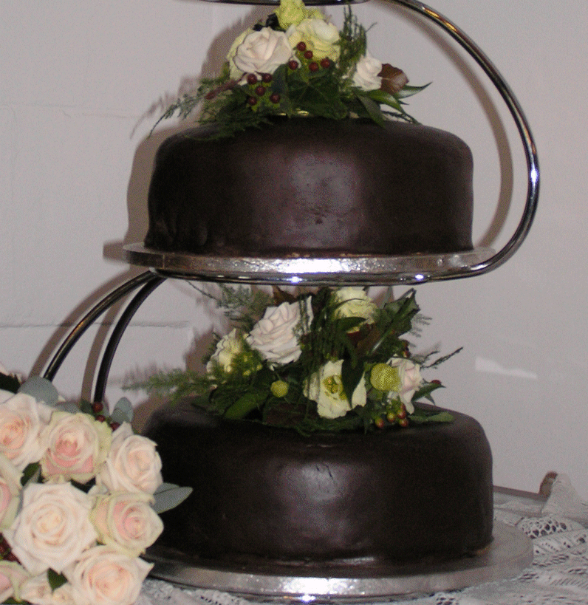
Summary (so far)
Two sets of objects, one randomized to other
A tier is a set of factors indexing a set of objects,
and hence determined by randomization
Factor relationships within tiers determine generalized factors and sources for each tier
One idempotent for each generalized factor/source
Relationships between two sets of idempotents determine decomposition table
Tiers are fundamental
But so far just Nelder
  unrandomized tier = block factors
  randomized tier = treatment factors
If only two sets of factors then do not need tiers, although I prefer unrandomized/randomized over block/treatment
  Reflects key distinction and so less liable to misinterpretation.
  Too many alternative meanings(nuisance/interest, random/fixed). Are Plots and Sex block factors?
Notes:
Can have randomized nuisance factors e.g. Seedlings and Batches (of wine)
Sex is often unrandomized, but of interest.
Plots do not group anything and so do not correspond to blocks.

Slide 34
What are properties of a standard split-plot experiment?
An experiment about cooking cakes in an oven
Main plots
  4 Baking conditions randomized to 4 Intervals in each of 3 Days using RCBD.
Subplots
  In an Interval, an oven with 3 Shelves used to bake 3 different Recipes together.
  Recipes order on Shelves randomized in each Interval.
What are:
  Sets of objects
  Tiers
  Factor posets and structure formulae
  Generalized factors
  Sources
  Sets of idempotents
  Idempotent relationships
  Decomposition table
Notes:
Portuguese for cooking a cake is cozendo um bolo ao forno; for baking is cozendo ao forno; for shelf is bandeja

Slide 35
Structure-balanced experiments
So orthogonal experiments are nice:
  for every RR, UR = RU = R for one UU
What other experiments are nice?
  Balanced experiments
Brien and Bailey (2008), following Nelder, call an experiment structure-balanced if, for all the matrices in structures U and R, the following relations between the idempotents are met:
  RUR = l_{UR}R for all RR, UU
  (0≤l_{UR}≤1 is called a canonical efficiency factor and is the nonzero eigenvalue of both RUR and URU.)
  R₁UR₂ = 0 for all UU and R₁ ≠ R₂
  (implies that when orthogonal R₁, R₂ projected into Im(U) they remain orthogonal and so a unique analysis.)
  Properties, w.r.t. efficiency, summarized in the U × R efficiency matrix Λ_{UR}.
Notes:
A broader class of experiments

Slide 36
Relationship to reduced normal equations
In block designs the canonical efficiency factors are the eigenvalues of r^{−δ}A = A*,
  where A is the information matrix from the reduced normal equations and r^{δ} is the diagonal matrix of replications of the treatments.
From James and Wilkinson (1971, Th. 3), in general, the eigenvalues of an RUR and its corresponding A* are equal.
That is, for a block design,
  The eigenvalues of R_{T}U_{P[B]}R_{T} and A* are the same.
  Can be shown that, for a block design,
  R_{T}U_{P[B]}R_{T} = Xr^{−(δ/2)}A*r^{−(δ/2)} X'
    R_{T} is the orthogonal projector for treatments;
    R_{P[B]} is the orthogonal projector for plots within blocks;
    X is the design matrix for treatments.
For a balanced design, the single eigenvalue is l_{UR}.

Slide 37
The decomposition
Now define the idempotents that further refine U according to R.
  Note that R₁UR₂ = 0 for R₁ ≠ R₂ implies UR₁ and UR₂ are orthogonal.
  So UR₁, UR₂, … UR_{m}, UR decompose U orthogonally.
Then the complete decomposition is given by
i.e. all bits of Im(U) with a bit of Im(R) in it and all bits of Im(U) without any Im(R) in it.

Slide 38
A BIBD ─ v = 6, b =15, k = 4, E = 0.9
Each pair of treatments occurs together in exactly 6 blocks
Sets of idempotents:
  U = {U_{Mean}, U_{Blocks}, U_{Plots[Blocks]}} and R = {R_{Mean}, R_{Treats}}
Relationships between sets:
  R_{Treats} U_{Blocks} R_{Treats} = 1/10 R_{Treats}
  R_{Treats} U_{Plots[Blocks]} R_{Treats} = 9/10 R_{treats}
The efficiency matrix:
The decomposition consists of 4 (+ Mean) elements:
  U  R = {U_{Mean,} U_{B} R_{T,} U_{B}  R, U_{P[B]}  R_{T,} U_{P[B]}  R}

Slide 39
Decomposition table for the BIBD
Treatments partially confounded with both Blocks and Plot[Blocks] in proportion to efficiency factors:
— reflects R_{Treats} U_{Blocks} R_{Treats} = 1/10 R_{Treats} and
R_{Treats} U_{Plots[Blocks]} R_{Treats} = 9/10 R_{treats}
This is a unique decomposition.
  cf. Unadj Blocks + Adj Treats
  vs Unadj Treats + Adj Blocks

Slide 40
Software for decomposition (skeleton ANOVA) tables
Useful to obtain for checking design.
Several packages allow derivation of tables of the form described.
  Use model formulae based on crossing and nesting.
  Genstat (Payne et al., 2008) with blockstructure and treatmentstructure.
    e.g. BIBD:
    block Blocks/Plots
    treat Treatments
    anova
  R (R Core Development Team, 2008) and S-Plus (Insightful corporation, 2007) in aov function:
    Y ~ randomized formula
    + Error(unrandomized formula)
    e.g. BIBD: Y ~ Treatments + Error(Blocks/Plots)
    Y can be randomly-generated data

Slide 41
Expected mean squares
Often not crucial as clear what variability is affecting which sources
If required, can use Hasse diagrams to assist in getting them.
  Replace nos of levels with variance components premultiplied by replications of generalized factors or quadratic forms in the expectation.
  Derive contributions for sources by adding variance components and their multipliers for generalized factors to which the source is marginal
Add contributions to ANOVA table, multiplying by efficiencies.
Notes:
Generalized factors specify a basis for the permutation algebra

Slide 42
Expected mean squares for RCBD
Hasse diagrams (omitting Universe) are as follows:
Rows
R
A
●
A
Rows∧Columns
C[R]
Skeleton ANOVA table
plots tier |  | treatments tier
source | df | source | df
Mean | 1 | Mean | 1
Rows | b – 1
Columns[R] | b(a – 1) | A | a – 1
 |  | Residual | (a – 1)(b – 1)
E[MSq]
As was clear from the decomposition table, the Residual for Columns[Rows] provides the error for A.

Slide 43
3. Summary
A randomization consists of two sets of objects,
one randomized to other.
A tier is a set of factors indexing a set of objects,
and hence determined by randomization:
  unrandomized tier = block factors;
  randomized tier = treatment factors.
Factor relationships within tiers determine generalized factors and sources for each tier.
One idempotent for each generalized factor/source.
Relationships between two sets of idempotents determine decomposition table that displays the confounding.
Hasse diagrams useful for deriving degrees of freedom, idempotents in terms of mean operators and E[MSq]s.
Multitiered experiments involve multiple randomizations.
Need a tiered-based approach to sort out confounding in multitiered experiments.

