Slide 1
Randomizing and checking standard and multiphase designs using the R package dae
Chris Brien
Phenomics and Bioinformatics Research Centre, University of South Australia;
The Plant Accelerator, University of Adelaide
http://chris.brien.name/multitier
Chris.brien@unisa.edu.au
Notes:
Have 15 mins + 2 mins for questions

Slide 2
Outline
Randomizing and analyzing a design.
dae: What is it?
A standard athlete training example.
A simple two-phase athlete training example.
A plant accelerator experiment.
Summary.

Slide 3
1. Randomizing and analyzing a design
Want to randomize a set of factors to a second set of (units) factors.
  A set of units factors can only lead to a poset unit structure when it is based on all combinations of the units factors:
    such that the included combinations are subject to the rule that a combination with nested factors must include all their nesting factors. (e.g. if Plots is nested in Blocks then we have Blocks and Blocks:Plots and not Plots)
    for each legal combination of factors, their levels must be equally replicated (Blocks:Plots combinations must be equally replicated).
  Given a systematic design for the allocation of factors to such a set of units factors, the randomization can be done by permuting the unit factors according to the nesting and crossing relationships between the unit factors.
Even if data will not be analysed using ANOVA, it is insightful to obtain the skeleton ANOVA for proposed designs during the planning stages:
  It gives an ‘anatomy’ of a design, showing the confounding in it (Brien et al., 2015).
  Can check the properties of the design and check for mistakes in constructing it.
  It can be done for any design via its canonical analysis (eigenanalysis) using the theory of James and Wilkinson (1971).
The R package dae includes functions that implement these procedures.

Slide 4
2. dae: What is it?
dae: a package available on CRAN
Functions useful in the design and anova of experiments (62 functions):
  Data,
  Factor manipulation functions,
  Design functions,
  ANOVA functions,
  Matrix functions,
  Projector and canonical efficiency functions, and
  Miscellaneous functions.

Slide 5
dae functions in this talk
fac.gen: Generate all combinations of several factors.
fac.layout: generate a randomized layout for an experiment by permuting the unrandomized factors.
projs.canon: A canonical analysis of the relationships between two or more sets of projectors:
  produces a list of class pcanon.
summary.pcanon: A summary of the results of the canonical analysis of the relationships between two or more sets of projectors stored in a list of class pcanon.

Slide 6
3. A standard athlete training example
(Peeling et al., 2009;
Brien et al., 2011)
4 Months
3 Athletes in M
3 Tests in M, A
3 Intensities
3 Surfaces
9 training conditions
36 tests
9 training conditions to be investigated
  Assume the prime interest is in surface differences
Testing is to be conducted over 4 Months:
  In each month, 3 endurance athletes are to be recruited.
  Each athlete will undergo 3 tests, separated by 7 days, under 3 different training conditions.
On completion of each test, the heart rate of the athlete is measured.
Randomize intensities to athletes and surfaces to tests.
A split-unit design.
Notes:
Split-unit = Split-plot
Intensities are only included to observe the surfaces over a range of intensities.

Slide 7
Factor-allocation description for standard designs
(Nelder, 1965; Brien, 1983; Brien & Bailey, 2006; Brien et al., 2011)
Represent the allocation using factor-allocation diagrams that have a panel for each set of objects with:
    a list of the factors; their numbers of levels; their nesting relationships.
Standard designs involve a single allocation in which a set of treatments is assigned to a set of units:
  treatments are whatever are allocated;
  units are what treatments are allocated to;
  treatments and units each referred to as a set of objects;
Treatments allocated to units by randomization or, more generally, using a spatial design or systematically or ???
Each set of objects is indexed by a set of factors:
  Unit or unallocated factors (indexing units);
  Treatment or allocated factors (indexing treatments).
Notes:
Extension of approach in Brien (1983) and Brien and Bailey (2006)

Slide 8
Factor-allocation diagram for the standard athlete training experiment
4 Months
3 Athletes in M
3 Tests in M, A
3 Intensities
3 Surfaces
9 training conditions
36 tests
One allocation (randomization):
  a set of training conditions to a set of tests.
The set of factors belonging to a set of objects, i.e. in each panel, forms a tier:
  they have the same status in the allocation (randomization):
  {Intensities, Surfaces} or {Months, Athletes, Tests}
  Textbook experiments are two-tiered.
Shows EU and restrictions on randomization/allocation.
Notes:
Randomization in this case
atheletes and test are the EUs; restrictions are to Athletes in Months and Tests in M,A

Slide 9
Use of fac.layout to get a randomized layout
  eg1.lay <-
  fac.layout(unrandomized = list(Months = 4, Athletes = 3, Tests = 3),
  nested.factors = list(Athletes = "Months",
  Tests = c("Months", "Athletes")),
  randomized = fac.gen(list(Intensities = 3, Surfaces = 3),
  times = 4),
  seed = 2598, unit.permutation=FALSE)
  eg1.lay
  Order of Months then Athletes then Tests in unrandomized means that Tests will change faster than Athletes which will change faster than Months.
  Note nesting of Athletes and Tests.
  Order of levels in randomized has to be consistent with unrandomized.
  Supplied to randomized is Intensities and Surface in the systematic order appropriate for an split-unit design.
Notes:
The scripts for these examples are in dae/.tests

Slide 10
eg1.lay (first two months)
Months Athletes Tests Intensities Surfaces
1 1 1 1 2 3
2 1 1 2 2 2
3 1 1 3 2 1
4 1 2 1 3 2
5 1 2 2 3 1
6 1 2 3 3 3
7 1 3 1 1 1
8 1 3 2 1 2
9 1 3 3 1 3
10 2 1 1 2 1
11 2 1 2 2 2
12 2 1 3 2 3
13 2 2 1 1 3
14 2 2 2 1 2
15 2 2 3 1 1
16 2 3 1 3 1
17 2 3 2 3 3
18 2 3 3 3 2
Intensities line up with Athletes and Surfaces with Tests, in a random order.

Slide 11
Check properties using projs.canon
> eg1.canon <- projs.canon(formulae = list(tests = ~Months/Athletes/Tests,
+ cond = ~Intensities*Surfaces),
+ data = eg1.lay)
> summary(eg1.canon, which.criteria="none")
Two formulae with nesting and crossing corresponding to the randomization and a data.frame.
Summary table of the decomposition (based on adjusted quantities)
Source1 df1 Source2 df2
Months 3
Months:Athletes 8 Intensities 2
Residual 6
Months:Athletes:Tests 24 Surfaces 2
Intensities:Surfaces 4
Residual 18
The anatomy:
  Primary division according to tests;
  Intensities confounded with Athletes[Months];
  Surfaces and Surfaces#Intensities confounded with Tests[Months, Athletes].

Slide 12
4. A simple two-phase athlete training experiment
Suppose in the athlete training experiment:
  in addition to heart rate taken immediately upon completion of a test,
  the free haemoglobin is to be measured using blood specimens taken from the athletes after each test, and
  the specimens are transported to the laboratory for analysis and processed shortly after arrival (before those for next month are available).
The experiment is two phase: testing and laboratory phases.
  The outcome of the testing phase is heart rate and a blood specimen.
  The outcome of the laboratory phase is the free haemoglobin.
How to process the specimens from the first phase in the laboratory phase?
  Simplest is to randomize the order of processing within each monthly batch.
Notes:
Note that outcome of a specimen for further analysis is what makes this two-phase

Slide 13
A simple two-phase athlete training experiment (cont’d)
4 Months
3 Athletes in M
3 Tests in M, A
4 Batches
9 Locations in B
3 Intensities
3 Surfaces
9 training conditions
36 tests
36 locations
Two composed randomizations and a systematic allocation
eg2.lay <- fac.layout(unrandomized = list(Batches = 4, Locations = 9),
nested.factors = list(Locations = "Batches"),
randomized = eg1.lay,
except = "Batches",
seed = 71230, unit.permutation=FALSE)
eg2.lay
Use except to allocate Months to Batches systematically
Notes:
Dashed line indicates systematic allocation – not randomization

Slide 14
A simple two-phase athlete training experiment: layout for first batch
4 Months
3 Athletes in M
3 Tests in M, A
4 Batches
9 Locations in B
3 Intensities
3 Surfaces
9 training conditions
36 tests
36 locations
Batches Locations Months Athletes Tests Intensities Surfaces
1 1 1 1 2 3 3 3
2 1 2 1 1 2 2 2
3 1 3 1 2 2 3 1
4 1 4 1 3 1 1 1
5 1 5 1 3 2 1 2
6 1 6 1 1 1 2 3
7 1 7 1 2 1 3 2
8 1 8 1 1 3 2 1
9 1 9 1 3 3 1 3
Notes:
Dashed line indicates systematic allocation – not randomization

Slide 15
A simple two-phase athlete training experiment (cont’d)
eg2.canon <- projs.canon(formulae = list(locs = ~Batches/Locations,
+ tests = ~Months/Athletes/Tests,
+ cond = ~Intensities*Surfaces),
+ data = eg2.lay)
> summary(eg2.canon, which.criteria="none")
Three formulae and a data.frame.
Summary table of the decomposition (based on adjusted quantities)
Source1 df1 Source2 df2 Source3 df3
Batches 3 Months 3
Batches:Locations 32 Months:Athletes 8 Intensities 2
Residual 6
Months:Athletes:Tests 24 Surfaces 2
Intensities:Surfaces 4
Residual 18
No. tests = no. locations = 36 and so tests sources exhaust the locations source.
Cannot separately estimate locations and tests variability, but can estimate their sum.
Months confounded with Batches (i.e. Big with Big).

Slide 16
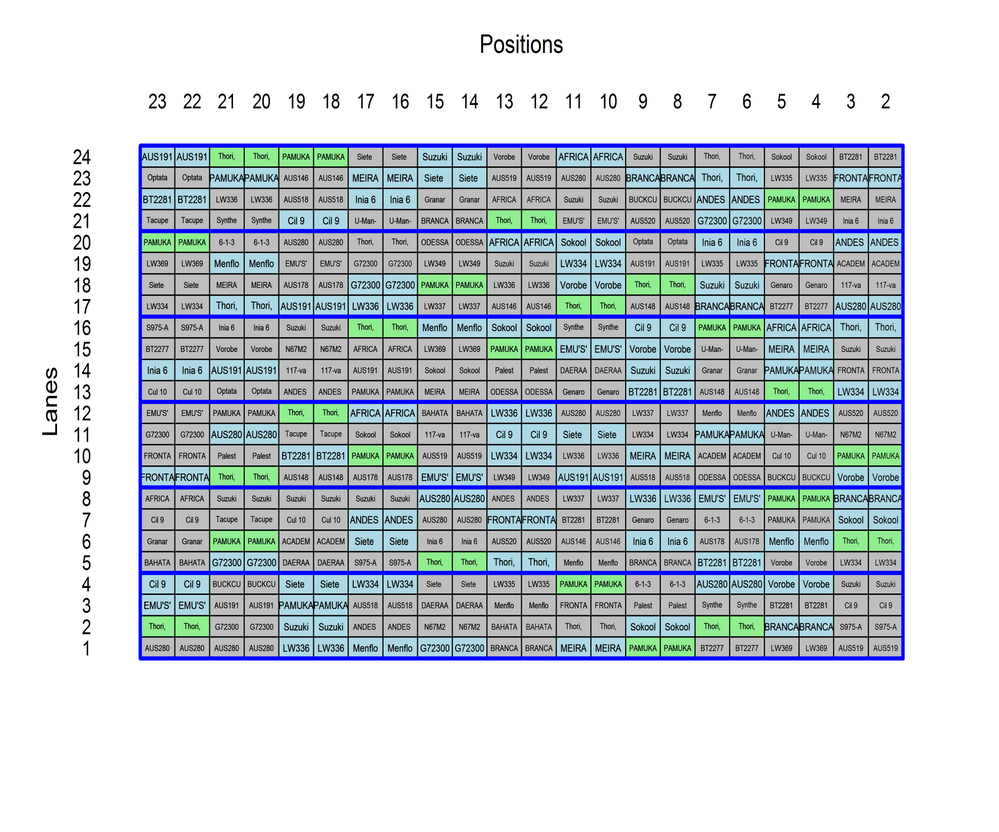
5. Plant Accelerator
Split plot design
75 lines assigned to
main plots (2 carts)
using a blocked,
row-column design:
  6 zones (blocks) of
  4 Lanes;
  21 NAM lines (blue) on
  4 main plots;
  52 NAM lines (grey) on
  3 main plots;
  Scout & Gladius (green)
  on 12 mainplots.
2 Conditions randomized to pairs of carts.

Slide 17
An anatomy of the Plant Accelerator experiment
> Exp249.xMain.canon <- projs.canon(list(cart=~ Zones/Mainplots/Carts,
+ treat=~ xMainPosn + (Parent + Lines.nos)*Conditions),
+ data = Exp249.lay)
Includes a term (xMainPosn) for trends across Mainplot Positions.
Lines split into Parents and offspring.
> summary(Exp249.xMain.canon, which=c("aeff", "eeff", "order"))
Summary table of the decomposition (based on adjusted quantities)
Source1 df1 Source2 df2 aefficiency eefficiency order dforthog
Zones 5 Lines.nos 5 0.1499 0.1441 5 0
Zones:Mainplots 258 xMainPosn 1 1.0000 1.0000 1 1
Parent 2 0.9999 0.9999 2 1
Lines.nos 72 0.9838 0.7606 7 66
Residual 183
Zones:Mainplots:Carts 264 Conditions 1 1.0000 1.0000 1 1
Parent:Conditions 2 1.0000 1.0000 1 2
Lines.nos:Conditions 72 1.0000 1.0000 1 72
Residual 189
An average of 98% of Line.nos differences confounded with Main plots, but some contrasts are as low as 77%.
All Conditions differences are associated with carts.

Slide 18
6. Summary
fac.layout randomizes experiments where the unrandomized factors lead to a poset unit structure.
projs.canon can be used to obtain an anatomy of any design, irrespective of the nonorthogonality and the number of tiers.
  slow when the number of observations is large (several hundreds).

