Slide 1



Designing comparative experiments using R
Topic II. Nonorthogonal experimental design & analysis
Chris Brien^{1,2}, Renata Sermarini³ & Clarice Demétrio³
¹ Australian Plant Phenomics Facility, University of Adelaide.
² UniSA STEM, University of South Australia.
³ESALQ, Universidade de São Paulo
(Software and materials at http://chris.brien.name/curso2024/)

Slide 2
Topic II. Outline
Designing nonorthogonal experiments and the alphabet of efficiency measures.
Using the concepts for balanced designs.
Using the concepts for unbalanced designs.
  A partially balanced incomplete-block design
  A wheat experiment from Gilmour et al. (1995)
  A plant accelerator design
Summary of constructing nonorthogonal designs.
What happens when there are missing data.

Slide 3
Recall the factor-allocation paradigm for designing experiments
(Brien & Demétrio, 2009; Brien, 2017;
Brien, Sermarini & Demétrio, 2023)
Anticipated model determined in consultation with the researcher.
Anticipated
model
Anatomy table under a
homogeneous allocation model
Shows the confounding and aliasing inherent in the design.
Factor-allocation diagram
Design selection &
construction
Initial
allocation model
Homogeneous allocation
model
Prior
allocation model
Select a design that is optimal for the anticipated model.
Depicts the allocation.
Model derived from the allocation.
Modified versions of the initial allocation model.

Slide 4
1. Designing nonorthogonal experiments
For nonorthogonal experiments, getting the initial systematic design is generally more difficult than for orthogonal experiments.
  Cannot just deploy a standard known design;
  Will demonstrate several approaches.
Our dae friends, designRandomize and designAnatomy, play the same role as for orthogonal experiments.
(designRandomize is not used for spatial designs.)
How do we know that the design that we have is good?
  Design optimality is the answer.
  There is A-, D-, C-, E-, G-, M- and S-optimality. Which one?

Slide 5
Design optimality
For comparative experiments, A-optimality is the favoured optimality criterion.
  The definition of A-optimality is that it minimizes the total variance of the predictions or Prediction Error Variance (PEV) (Kiefer, 1959)
  The PEV is the same as the average variance of pairwise differences (AVPD):
    when terms to be optimized (e.g. Treatments) are fixed;
    not when the terms to be optimized are random;
    whether or not the random errors are assumed iid or correlated.
Often suggested that minimum AVPD be used for comparative experiments.
  So, they will be A-optimal if the terms to be optimized are fixed;
  But what if the terms to be optimized are random?
    Is AVPD appropriate for random factors?
    Given the effects are random, conducting inference on a pair of differences is not meaningful.
    So PEV seems a reasonable measure, but it is not the same as AVPD; nonetheless, AVPD is used.
As previously mentioned, often fixed-model A-optimal designs are sought for comparative experiments:
  All model terms are assumed fixed, except the random errors for each observation.
Some designs are optimal under both fixed and random units terms:
  orthogonal, balanced (incomplete-) block, (most generalized) Youden square and the lattice square designs are A-optimal under fixed and mixed models.

Slide 6
2. Using the concepts for balanced designs
Brien, Sermarini and Demétrio (2023, Section 5)
Suppose have 20 plots arranged in a grid of 4 rows × 5 columns.
We want to assign 5 lines to the 20 plots.
Again, what design to use?
  Completely Randomized CRD,
  Randomized Complete or Incomplete Block (RCBD or IBD), or
  Youden Square Design (YSD) (an LSqD is impossible)?
Already know that, irrespective of the design:
  the unit factors are Rows, Columns and the treatment factor is Lines.
Suppose that Row and Column differences are probable.
What is the anticipated model?
  Mean + Lines | Mean + Rows + Columns + Rows:Columns — same as for an LSqD

Slide 7
2(a) Row and Column differences likely in 4 x 5 grid
Need a design that allows for Row and Column main effects.
    Are Rows and Columns crossed or nested? Why?
    Crossed because expect consistent differences between Rows and between Columns.
YSD is a design that is optimal for this model:
  Construct by taking a Latin square and omitting a row.
Use of designRandomize (and designLatinSqrSys) to get a design:
  b <- 4
  t <- 5
  > #'## Construct a systematic layout and obtain the randomized layout
  > YSD.sys <- cbind(fac.gen(list(Rows=b, Columns=t)),
  + Lines = factor(designLatinSqrSys(t)[1:(b*t)], labels = LETTERS[1:t]))
  > YSD.lay <- designRandomize(allocated = YSD.sys["Lines"],
  + recipient = YSD.sys[c("Rows", "Columns")],
  + seed = 95332)
  > #'## Output the layout
  > YSD.lay
Generate Latin square, but take only first 20 of 25 values (4 rows x 5 columns).
Extract column subsets of data.frames.
Notes:
The scripts for these examples are in dae/.tests

Slide 8
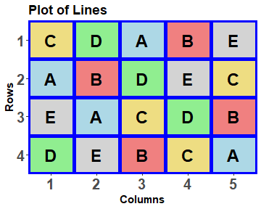
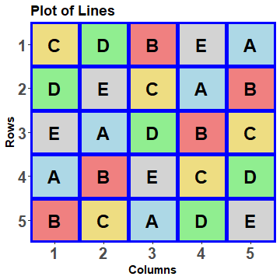
YSD.lay
Rows Columns Lines
1 1 1 C
2 1 2 D
3 1 3 A
4 1 4 B
5 1 5 E
6 2 1 A
7 2 2 B
8 2 3 D
9 2 4 E
10 2 5 C
11 3 1 E
12 3 2 A
13 3 3 C
14 3 4 D
15 3 5 B
16 4 1 D
17 4 2 E
18 4 3 B
19 4 4 C
20 4 5 A

Slide 9
The initial allocation-based mixed model
The factor allocation diagram is:
4 Rows
5 Columns
5 Lines

5 treatments
20 units
From the factor allocation diagram, the initial allocation model is:
Mean + Lines |
Mean + Rows + Columns + Rows:Columns
  This model and the anticipated model are the same.

Slide 10
Working out the confounding
4 Rows
5 Columns
5 Lines

5 treatments
20 units
What are the recipient (unit) sources?
  Mean, Rows, Columns & Rows#Columns
Lines will be confounded with which
recipient (unit) sources?
  With Columns & Rows#Columns (cf. LSqD).
Can determine this by investigating the relationships between two sets of projectors, those for lines and those for plots:
  one source projector for each term in the initial allocation model;
  {Q_{L}} and {P_{R}, P_{C}, P_{R#C}}.
Require the sets of eigenvalues of PQ_{L}P for all 3 Ps.
They are calculated and statistical summaries of them are tabulated by designAnatomy.

Slide 11
Check properties using designAnatomy
> YSD.canon <- designAnatomy(formulae = list(units = ~ Rows*Columns,
+ trts = ~ Lines),
+ grandMean = TRUE, data = YSD.lay)
> summary(YSD.canon)
Summary table of the decomposition for units & trts (based on adjusted quantities)
Source.units df1 Source.trts df2 aefficiency eefficiency order
Mean 1 Mean 1 1.0000 1.0000 1
Rows 3
Columns 4 Lines 4 0.0625 0.0625 1
Rows#Columns 12 Lines 4 0.9375 0.9375 1
Residual 8
The design is not orthogonal
For the first time,
Lines occurs twice in an analysis;
neither the aefficiency nor the eefficiency are 1;
Lines is partially confounded with two sources.
but the order is one and so the design is balanced

Slide 12
The design’s properties
Summary table of the decomposition for units & trts (based on adjusted quantities)
Source.units df1 Source.trts df2 aefficiency eefficiency order
Mean 1 Mean 1 1.0000 1.0000 1
Rows 3
Columns 4 Lines 4 0.0625 0.0625 1
Rows#Columns 12 Lines 4 0.9375 0.9375 1
Residual 8
The design is not orthogonal
Thus there are 4 nonzero eigenvalues for P_{C}Q_{L}P_{C} and for P_{RC}Q_{L}P_{RC}:
  For P_{C}Q_{L}P_{C}, all are 0.0625 (1/16);
  For P_{RC}Q_{L}P_{RC}, all are 0.9375 (15/16);
  Being 1st-order balanced, the efficiencies sum to 1.
15/16 of the information for Lines is confounded with Rows#Columns.
  Generally, prefer the intrablock or intrarow-intracolumn efficiency to be greater than, say, 0.75.
All 4 df for Lines are confounded with both Columns and Rows#Columns;
None are confounded with Rows.

Slide 13
To combine or not combine information?
Lines, being confounded with Columns and with Rows#Columns, there are available two estimates of the Lines effects:
  It is expected that those estimated from Columns differences would have greater variability than those estimated from Rows#Columns. Why?
Should these two sets of estimates be combined?
  In this case, not a lot would be lost by relying on the intrarow-intracolumn estimates: actually, only 1/16 of the information.
  The advantage is that the more variable inter-column estimates do not contaminate the less variable intrarow-intracolumn estimates.
In the context of mixed modelling,
  The combined estimates are produced when Columns is random.
  The intrarow-intracolumn estimates are produced when Columns is fixed.
  That is, in deciding whether Columns is fixed or random, consider whether intrablock or combined estimates of Lines are required.
Notes:
Columns > Rows#Columns because Row#Columns measures plot differences, but Columns differs because of the different plots and because of any differences between the Columns. So provided the Columns are different then Columns will be more variable than the plots.

Slide 14
What if you don’t know what design to use here?
Look up Cochran and Cox (1957) [C&C] – but they are called incomplete Latin squares, or use agricolae (De Mendiburu, 2021).
  However, you have to know what design is optimal.
Use computer searching: CycDesigN, SAS or odw.
  The standalone software package CycDesigN searches for a design that minimizes the AVPD for a fixed-model and so produces fixed-model A-optimal designs;
  The R package odw can search for mixed-model designs using either the AVPD or the PEV criterion and so can produce A-optimal designs;
    If the terms being optimized (treatments) are fixed, both CycDesigN and odw produce A-optimal because the AVPD equals the PEV.
    If the terms being optimized (treatments) are random and the PEV criterion is specified, odw produces A-optimal designs.
    Otherwise, designs may not be A-optimal.
  SAS searches for a D-optimal design.
    Minimizes the volume of the confidence ellipsoid of estimates (not necessarily A-optimal).
    The product of the reciprocals of the efficiency factors is minimized.
    D-optimal designs are used when response curve parameters are to be estimated.

Slide 15
Using odw to obtain an optimal design
The odw function has the following arguments:
  fixed, random and residual are formulae for specifying the mixed model.
  permute is a formula with a single term that is to be optimized by swapping values for the term between rows of its design matrix.
  criterion specifies which of avalue or pev to use to compute the criterion.
  swap is a formula for specifying a term for restricting the permutes to be within its levels.
  search specifies a search strategy: random, tabu (records rejected designs), randomwalk (as for random, but accepts a non-improving design with proability P) and tabu+rw (combined).
  maxit gives the number of tabu loops or random interchanges.
  start.values allows one to specify the values of variance parameters, without beginning a search.
  data is a data.frame containing an initial design (obligatory as used to resolve terms in formulae).

Slide 16
Using odw to obtain an optimal 4 x 5 grid design
> #'### Initialize with a randomized RCBD layout
> R4C5.ini <- cbind(fac.gen(list(Rows=b, Columns=t)),
+ Lines = factor(rep(1:t, times = b), labels = LETTERS[1:t]))
> R4C5.ini <- designRandomize(allocated = R4C5.ini["Lines"],
+ recipient = R4C5.ini[c("Rows", "Columns")],
+ nested.recipients = list(Columns = "Rows"),
+ seed = 7851)
> #'### Get the odw design
> R4C5.odw <- odw(fixed = ~ Rows + Columns + Lines,
+ permute = ~ Lines,
+ search = "tabu", maxit = 25,
+ data = R4C5.ini)
Initial criterion = 0.733333 (5 A-equations; rank C 4)
Criterion after 1000 initial random iterations: 0.533333
Criterion after tabu loop 1 is 0.533333
Criterion after tabu loop 2 is 0.533333
Criterion after tabu loop 3 is 0.533333
...
Criterion after tabu loop 25 is 0.533333
Hash table size 11
Final criterion after 25 tabu iterations: 0.533333
All effects are assumed fixed, except Row:Columns, the identity term.
  the residual argument can be used to specify this term, but odw includes an identity term by default.
> R4C5.lay <- R4C5.odw$design
> #'### Independently calculate the A-measure
> (designAmeasures(mat.Vpredicts(target = ~ Lines -1,
+ fixed = ~ Rows + Columns,
+ design = R4C5.lay)))
all
all 0.5333333
The AVPD for the row-column design (0.53) is much less than that for the RCBD (0.73).

Slide 17
The odw design
> #'### Randomize design according to the units structure
> R4C5.lay <- designRandomize(allocated = R4C5.lay["Lines"],
+ recipient = R4C5.lay[c("Rows", "Columns")],
+ seed = 65460)
This randomization ensures a valid randomization.
  That is, a single randomization that is randomly selected from all possible randomizations.
> #'### Calculate the A-measure of the randomized design
> (designAmeasures(mat.Vpredicts(target = ~ Lines -1,
+ fixed = ~ Rows + Columns,
+ design = R4C5.lay)))
all
all 0.5333333
No change in the AVPD.

Slide 18
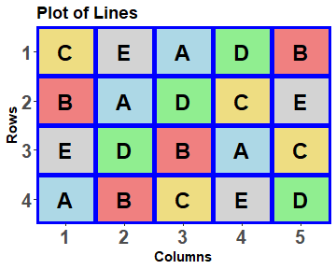
The anatomy of the odw design
> #'### Check properties of the odw layout
> R4C5.canon <- designAnatomy(formulae = list(units = ~ Rows*Columns,
+ trts = ~ Lines),
+ grandMean = TRUE, data = R4C5.lay)
> summary(R4C5.canon)
Summary table of the decomposition for units & trts (based on adjusted quantities)
Source.units df1 Source.trts df2 aefficiency eefficiency order
Mean 1 Mean 1 1.0000 1.0000 1
Rows 3
Columns 4 Lines 4 0.0625 0.0625 1
Rows#Columns 12 Lines 4 0.9375 0.9375 1
Residual 8
The design is not orthogonal
Same as the Youden square anatomy.
Each treatment occurs in 4 out of 5 columns and so the design is a YSD.

Slide 19
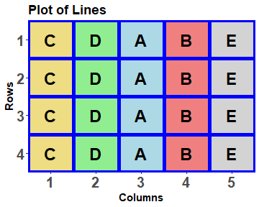
Can choose the wrong starting design
> #'## Try a starting design in which row-column randomization is used on a systematic design
> R4C5.ini <- designRandomize(allocated = data.frame(Lines =
+ factor(rep(1:t, times = b),
+ labels = LETTERS[1:t])),
+ recipient = list(Rows=b, Columns=t),
+ seed = 95332)
> #'### Get the odw design
> R4C5.odw <- odw(fixed = ~ Rows + Columns + Lines,
+ permute = ~ Lines,
+ search = "tabu", maxit = 25,
+ data = R4C5.ini)
Design is disconnected of order 4 (eps = 1.05367e-08)
Error in odw(fixed = ~Rows + Columns + Lines,
permute = ~Lines, search = "tabu", :
Disconnected design of order 4
At least some DF for the fixed permute term are confounded with other fixed terms:
  All DF Lines with Columns here;
Solution:
  Choose a connected design (full Lines df at least partially confounded with Rows#Columns.
  Or, use a mixed model (not here).

Slide 20
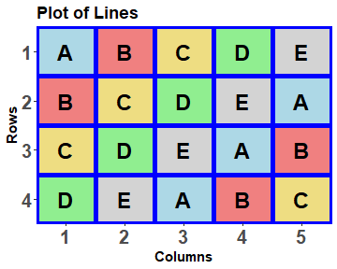
Optimal systematic design in, optimal systematic design out
YSD.sys <- cbind(fac.gen(list(Rows=b, Columns=t)),
Lines = factor(designLatinSqrSys(t)[1:(b*t)], labels = LETTERS[1:t]))
R4C5.sys.odw <- odw(fixed = ~ Rows + Columns + Lines,
permute = ~ Lines,
search = "tabu", maxit = 25,
data = YSD.sys)
> cell.colours <- c("lightblue","lightcoral","lightgoldenrod","lightgreen","lightgrey“)
> designGGPlot(R4C5.sys.odw$design, labels = "Lines", colour.values = cell.colours[1:t],
+ axis.text.size = 20, label.size = 8,
+ blockdefinition = cbind(1,1))
Take home message:
odw produces an optimal design, not a randomized design.

Slide 21
Some points to remember in using odw
The treatment terms cannot be totally confounded with a fixed unit term:
  e.g. Lines confounded with fixed Columns.
  Safest to randomize the systematic design according to a related design.
    e.g. for a block design, randomize as for an RCBD.
odw does not necessarily produce a properly randomized design:
  That is, one randomly selected from all possible valid randomizations;
  Proof: supply a systematic optimal design: odw will return it unmodified;
  Can use designRandomize after odw when independent errors are assumed; otherwise before odw.
The computed A-value (AVPD) can be checked, or the value under an alternative model calculated, with designAmeasures(mat.Vpredicts(…)).
  mat.Vpredicts calculates the predictions variance matrix and designAmeasures calculates the AVPD from the matrix.

Slide 22
3. Using the concepts for unbalanced designs
3(a) A partially balanced incomplete-block design (PBIBD) from C&C (p.379)
This design is suitable for a situation in which:
  the number of treatments is 6,
  each treatment is to be replicated 4 times,
  the anticipated model is Mean + Treatments | Mean +Blocks + Blocks:Units,
  the number of units per block restricted to 4.
 | Blocks
Units | I | II | III | IV | V | VI
1 | 1 | 2 | 3 | 4 | 5 | 6
2 | 4 | 5 | 6 | 1 | 2 | 3
3 | 2 | 3 | 1 | 5 | 6 | 4
4 | 5 | 6 | 4 | 2 | 3 | 1
6 Blocks
4 Units in B
6 Treatments

6 treatments
24 units

Slide 23
PBIBD randomized layout
> #'## Input the systematic design
> b <- 6
> k <- 4
> t <- 6
> PBIBD2.sys <- cbind(fac.gen(list(Blocks = b, Units = k)),
+ Treatments = factor(c(1,4,2,5,
+ 2,5,3,6,
+ 3,6,1,4,
+ 4,1,5,2,
+ 5,2,6,3,
+ 6,3,4,1)))
> #'## Randomize the systematic design
> PBIBD2.lay <- designRandomize(allocated = PBIBD2.sys["Treatments"],
+ recipient = PBIBD2.sys[c("Blocks", "Units")],
+ nested.recipients = list(Units = "Blocks"),
+ seed = 98177)
Treatments must be in the correct order given the order of Blocks and Units

Slide 24
PBIBD properties
>#'## Compute the anatomy
> PBIBD2.canon <- designAnatomy(formulae = list(units = ~ Blocks/Units,
+ trts = ~ Treatments),
+ grandMean = TRUE, data = PBIBD2.lay)
> summary(PBIBD2.canon, which.criteria = c('aeff', 'xeff', 'eeff','order', 'dforth'))
Summary table of the decomposition for unit & trt (based on adjusted quantities)
Source.units df1 Source.trts df2 aefficiency xefficiency eefficiency order dforthog
Mean 1 Mean 1 1.0000 1.0000 1.0000 1 1
Blocks 5 Treatments 2 0.2500 0.2500 0.2500 1 0
Residual 3
Units[Blocks] 18 Treatments 5 0.8824 1.0000 0.7500 2 3
Residual 13
The design is not orthogonal
What are the eigenvalues for P_{U[B]}Q_{L}P_{U[B]}?
  Three are one and two are 0.75 for a harmonic mean of 0.8824.
That 88% of Lines information confounded with Units[Blocks] is good.

Slide 25
PBIBD with unique Units levels
AUnits = All Units
> PBIBD2.lay$AUnits <- with(PBIBD2.lay, fac.combine(list(Blocks,Units)))
> levels(PBIBD2.lay$AUnits)
[1] "1" "2" "3" "4" "5" "6" "7" "8" "9" "10" "11" "12" "13" "14" "15" "16" "17" "18"
[19] "19" "20" "21" "22" "23" "24"
> #'### Blocks + AUnits
> PBIBD2U.canon <- designAnatomy(formulae = list(units = ~ Blocks + AUnits,
+ trts = ~ Treatments),
+ grandMean = TRUE, data = PBIBD2.lay)
> summary(PBIBD2U.canon, which.criteria = c('aeff', 'xeff', 'eeff','order', 'dforth'))
Summary table of the decomposition for unit & trt (based on adjusted quantities)
Source.units df1 Source.trts df2 aefficiency xefficiency eefficiency order dforthog
Mean 1 Mean 1 1.0000 1.0000 1.0000 1 1
Blocks 5 Treatments 2 0.2500 0.2500 0.2500 1 0
Residual 3
AUnits[Blocks] 18 Treatments 5 0.8824 1.0000 0.7500 2 3
Residual 13
The design is not orthogonal
> #'### Blocks/AUnits
> PBIBD2U.canon <- designAnatomy(formulae = list(units = ~ Blocks/AUnits,
+ trts = ~ Treatments),
+ data = PBIBD2.lay)
Produces exactly the same anatomy.

Slide 26
Using odw to get an A-optimal design
Randomize as an RCBD.
> #'### Initialize with a randomized layout
> PBIBD.ini <- cbind(fac.gen(list(Blocks=b, Units=k)),
+ Treatments = factor(rep(1:t, times = b*k/t), labels = LETTERS[1:t]))
> PBIBD.ini <- designRandomize(allocated = PBIBD.ini["Treatments"],
+ recipient = PBIBD.ini[c("Blocks", "Units")],
+ nested.recipients = list(Units = "Blocks"),
+ seed = 4794)
> #'### Get the odw design
> PBIBD.odw <- odw(fixed = ~ Blocks + Treatments,
+ permute = ~ Treatments,
+ search = "tabu", maxit = 25,
+ data = PBIBD.ini)
Initial criterion = 0.566667 (6 A-equations; rank C 5)
Criterion after 1000 initial random iterations: 0.559487
Criterion after tabu loop 1 is 0.559487
Criterion after tabu loop 2 is 0.559487
...
Criterion after tabu loop 25 is 0.559487
Hash table size 3
Final criterion after 25 tabu iterations: 0.559487
> (designAmeasures(
+ mat.Vpredicts(target = ~ Treatments -1,
+ fixed = ~ Blocks,
+ design = PBIBD2.lay)))
all
all 0.5666667
AVPD for C&C design.

Slide 27
Randomize the PBIBD design from odw
> PBIBD.lay <- PBIBD.odw$design
> #'## Randomize the odw design
> PBIBD.lay <- designRandomize(allocated = PBIBD.lay["Treatments"],
+ recipient = PBIBD.lay[c("Blocks", "Units")],
+ nested.recipients = list(Units = "Blocks"),
+ seed = 13332)
Notes:
No. of SEDs = k(k-1) where k is the order

Slide 28
PBIBD odw design properties
> #'### Check properties of the odw layout
> PBIBD.canon <- designAnatomy(formulae = list(units = ~ Blocks/Units,
+ trts = ~ Treatments),
+ grandMean = TRUE, data = PBIBD.lay)
> summary(PBIBD.canon, which.criteria = c('aeff', 'xeff', 'eeff','order', 'dforth'))
Summary table of the decomposition for plots & trts (based on adjusted quantities)
Source.units df1 Source.trts df2 aefficiency xefficiency eefficiency order dforthog
Mean 1 Mean 1 1.0000 1.0000 1.0000 1 1
Blocks 5 Treatments 4 0.0937 0.1875 0.0625 2 0
Residual 1
Units[Blocks] 18 Treatments 5 0.8937 1.0000 0.8125 3 1
Residual 13
The design is not orthogonal
This shows that, in contrast to a BIBD, a PBIBD of order 2 is not necessarily A-optimal.
Which one to use?
  The PBIBD2 will have only 2 SEM values and so 3 SEDs.
  The odw design would have 6 SEDs, but they would cover a narrower range.
More than A-value to consider.
The odw design is (nearer) A-optimal, with
  a higher A-efficiency than the PBIBD2 (0.8937 versus 0.8824),
  three rather than two different efficiency factors,
  the range of the efficiency value is less
  (min of 0.75 versus 0.8125).
Notes:
No. of SEDs = k(k-1) where k is the order

Slide 29
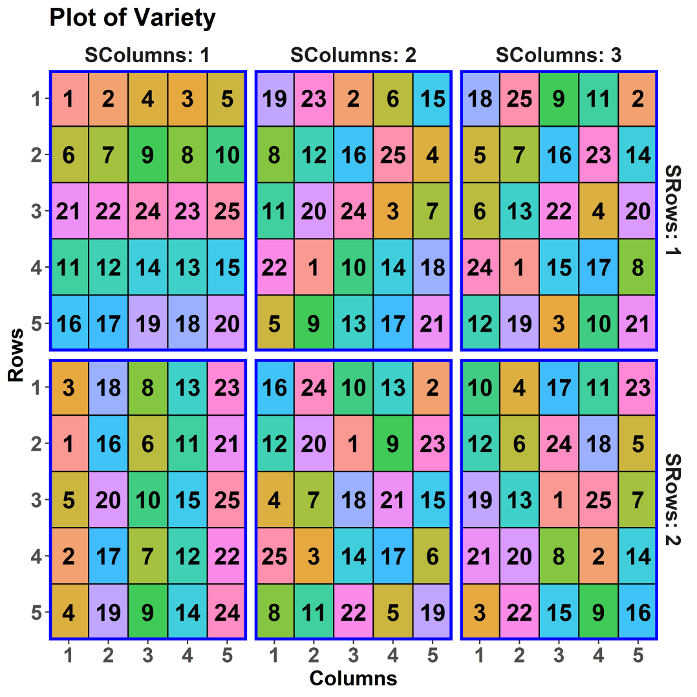
3(b) A wheat experiment (Gilmour et al., 1995)
Investigates 25 varieties of wheat.
A balanced lattice square on a 10  15 grid from C&C.
Six reps, each 5 rows  5 columns
It is an example in the asreml manual,
and the asremlPlus manual and
the Wheat vignette:
vignette(package = 'asremlPlus').
Factor-allocation diagram
2 SuperRows
3 SuperColumns
5 Rows in Sr, Sc
5 Columns in Sr, Sc
25 Varieties

25 treatments
150 units
Sr = SuperRows, Sc = SuperColumns
How is this design to be randomized?
Notes:
WheatTalkDesign.r

Slide 30
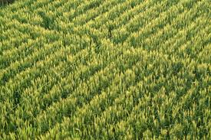
The wheat experiment — models
allocated
recipient
Allocated  fixed;
Recipient  random.
Take all combinations of the factors within a panel, subject to the restriction that a nested factor cannot occur without its nesting factor.
2 SuperRows
3 SuperColumns
5 Rows in Sr, Sc
5 Columns in Sr, Sc
25 Varieties

25 treatments
150 units
Initial allocation model:
  Mean + Varieties | Mean + SRows + SColumns + SRows:SColumns +
  SRows:SColumns:Rows + SRows:SColumns:Columns +
  SRows:SColumns:Rows:Columns.
The balanced lattice square is A-optimal for this model.
No term for differences between whole rows and whole columns, because not randomized by permuting them.
    If had, then structure (SRows/Rows) * (SColumns/Columns), not (SRows*SColumns) / (Rows*Columns).
A randomization model
  An identity term
  – it uniquely indexes the units.

Slide 31
The wheat experiment – models (revised)
allocated
recipient
2 SuperRows
3 SuperColumns
5 Rows in Sr, Sc
5 Columns in Sr, Sc
25 Varieties

25 treatments
150 units
Initial allocation model:
  Mean + Varieties | Mean + SRows*SColumns + SRows:SColumns:Rows + SRows:SColumns:Columns + SRows:SColumns:Rows:Columns.
Homogeneous allocation model:
  Might make SRows*SColumns fixed.
Prior allocation model:
    Mean + Varieties | Mean + SRows*SColumns + SRows:SColumns:Rows + SRows:SColumns:Columns + units + ar1(SRows:Rows):ar1(SColumns:Columns).
The prior allocation model is not a randomization model, but a randomization-based model.
spatial correlation between individuals
nugget variance

Slide 32
The wheat experiment - properties
Based on initial or homogeneous allocation model, with SRows*SColumns combined.
> Wheat.canon <- designAnatomy(formulae = list(units = ~ (SRows:SColumns)/(Rows*Columns),
+ trts = ~ Variety),
+ data = Wheat.dat)
> summary(Wheat.canon, which.criteria = c("aeff", "order"))
Summary table of the decomposition for units & trt (based on adjusted quantities)
Source.units df1 Source.trts df2 aefficiency order
SRows:SColumns 5
Rows[SRows:SColumns] 24 Variety 24 0.1667 1
Columns[SRows:SColumns] 24 Variety 24 0.1667 1
Rows#Columns[SRows:SColumns] 96 Variety 24 0.6667 1
Residual 72
The design is not orthogonal
However, Gilmour et al. (1995) and Butler et al. (2020) have ignored SRows:SColumns (Reps).
What happens?
> Wheat.RC.canon <- designAnatomy(formulae = list(units = ~ ARows*AColumns,
+ trts = ~ Variety),
+ data = Wheat.dat)
> summary(Wheat.RC.canon)
Summary table of the decomposition for units & trt (based on adjusted quantities) Source.units df1 Source.trts df2 aefficiency eefficiency order
ARows 9 Variety 8 0.1667 0.1667 1
Residual 1
AColumns 14 Variety 12 0.1667 0.1667 1
Residual 2
ARows#AColumns 126 Variety 24 0.8452 0.6732 18
Residual 102
The design is not orthogonal
ARow = SRows:Rows; (A = All)
AColumn = SColumns:Columns.
Not randomization-based:
  Pushes down the 53 DF of the
  first 3 sources from the lattice:
    into all units sources;
    some in ARow#ACol Residual.
  More Variety information confounded with Row#Col, but ...
Notes:
Inflated estimate of Residual

Slide 33
A-optimality of the design
The resolved design has the advantage that
  SRows*SColumns (Replicate) differences do not contribute to the variability of the Varieties.
  It is the A-optimal resolved design.
  It is balanced (only one SED value).
It is not the A-optimal row-column design, i.e. under the model:
  Mean + ARows + AColumns + Varieties | Mean + Rows:Columns.
Nor is it A-optimal for the prior allocation model with :
  Mean + Varieties | Mean + SRows*SColumns + SRows:SColumns:Rows + SRows:SColumns:Columns + units + ar1(SRows:Rows):ar1(SColumns:Columns).
For these alternative models, use odw to search for (near) A-optimal designs.
For the design that allows for ar1, the design cannot be randomized post-search;
  I recommend randomizing pre-search to avoid remnant systematic patterns in the final design.

Slide 34
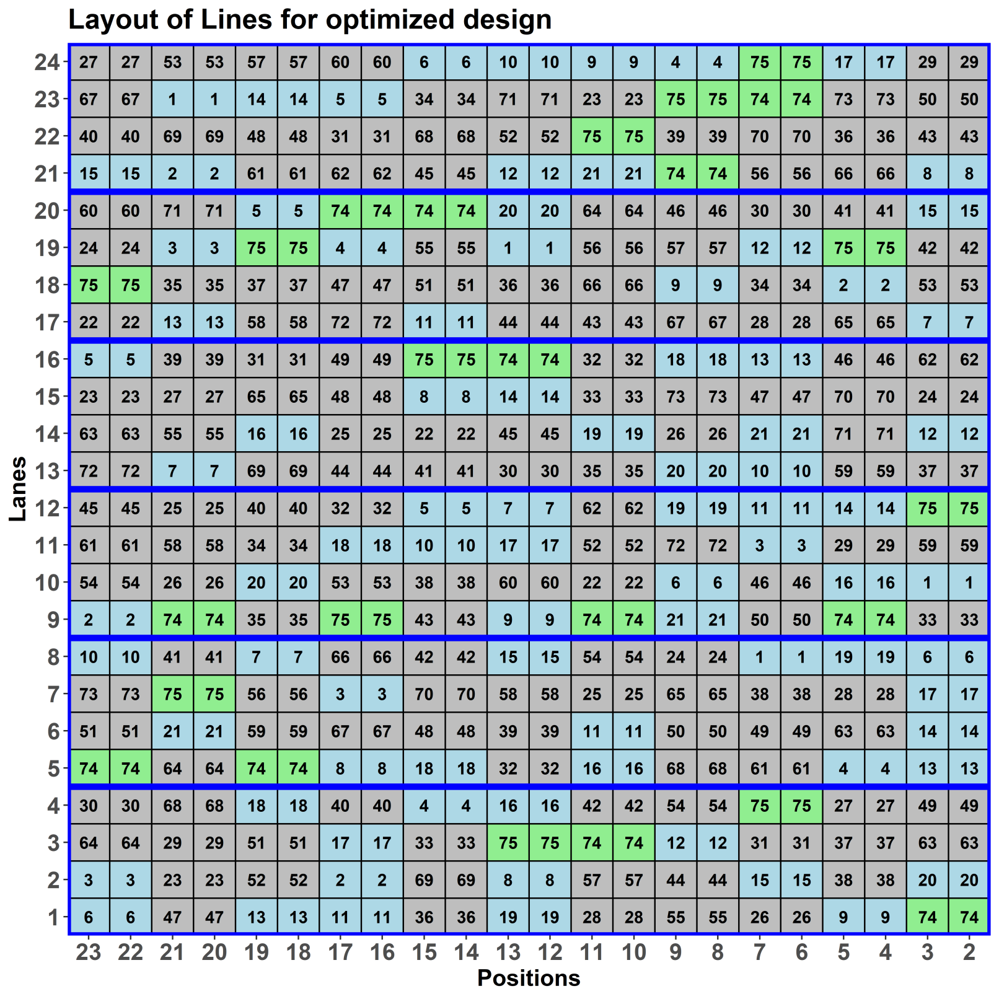
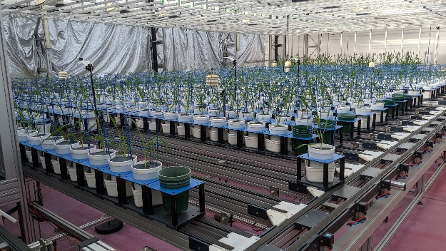
3(c) A Plant Accelerator (PA) design
Split-unit design from odw.
75 lines assigned to
main units (2 carts) using
a blocked, row-column
design:
  6 blocks of
  4 Lanes x 11 MainPositions;
  21 lines (blue) on
  4 main units each;
  52 lines (grey) on
  3 main units each;
  Scout & Gladius (green)
  on 12 main units each.
2 Conditions randomized
to pairs of carts (not shown).

Slide 35

The anticipated model
Zones-MainPositions cell
Mean + Zones + Lines +
Conditions + Lines:Conditions |
Mean + MainPositions +
Zones:MainPositions +
Zones:MainPositions:Rows +
Zones:MainPositions:Rows:Carts.
  Zones are the blocks of 4 Lanes;
  MainPositions are the columns of pairs of carts;
  Rows are the 4 lanes within a Zone;
  Zones:MainPositions:Rows are the main units.
  Carts are the pairs of Carts within a Zones:MainPositions:Rows combination; they are the sub-units.

Slide 36
Check properties of the PA design
> PA.canon <- designAnatomy(formulae = list(units = ~ (Zones*MainPositions)/Rows/Carts,
+ trts = ~ Lines * Conditions),
+ grandMean = TRUE, data = PA.lay)
> summary(PA.canon, which=c("aeff", "eeff", "order", "dfor"))
Summary table of the decomposition for units & trts (based on adjusted quantities)
Source.units df1 Source.trts df2 aefficiency eefficiency order dforthog
Mean 1 Mean 1 1.0000 1.0000 1 1
Zones 5 Lines 5 0.1497 0.1254 5 0
MainPositions 10 Lines 10 0.2101 0.1724 10 0
Zones#MainPositions 50 Lines 50 0.1209 0.0193 50 0
Rows[Zones:MainPositions] 198 Lines 74 0.6764 0.2746 66 9
Residual 124
Carts[Zones:MainPositions:Rows] 264 Conditions 1 1.0000 1.0000 1 1
Lines#Conditions 74 1.0000 1.0000 1 74
Residual 189
The design is not orthogonal
The information about Lines confounded with Rows[Zones:MainPositions] is low.
  However, all 74 df for Lines confounded with it and so Lines is connected.
It is anticipated that the differences between MainPositions can be described in terms of a linear trend across MainPositions and that Zones:MainPositions can be ignored.
  Could optimize for linear trend by replacing MainPositions with a centred numeric covariate, say xMainPosn.
  This tends to push extra replicates to the first and last MainPositions, which is not optimal for curved trends.
  So optimize for factor MainPositions and check properties for numeric covariate xMainPosn.

Slide 37
Linear trend across MainPositions
Replace 11 MainPositions with 44 MainUnits and include a covariate.
> PA.xMainPosn.canon <- designAnatomy(list(units = ~ Zones/MainUnits/Carts,
+ trts = ~ xMainPosn + Lines * Conditions),
+ grandMean = TRUE, data = PA.lay)
> summary(PA.xMainPosn.canon, which=c("aeff", "eeff", "order", "dfor"))
Summary table of the decomposition for cart & treat (based on adjusted quantities)
Source.units df1 Source.trts df2 aefficiency eefficiency order dforthog
Mean 1 Mean 1 1.0000 1.0000 1 1
Zones 5 Lines 5 0.1500 0.1255 5 0
Mainunits[Zones] 258 xMainPosn 1 1.0000 1.0000 1 1
Lines 74 0.9879 0.8217 6 69
Residual 183
Carts[Zones:Mainunits] 264 Conditions 1 1.0000 1.0000 1 1
Lines#Conditions 74 1.0000 1.0000 1 74
Residual 189
Table of (partial) aliasing between sources derived from the same formula
Source df Alias In aefficiency eefficiency order dforthog
Lines 1 xMainPosn trts 0.2074 0.2074 1 0
Lines 74 ## Information remaining trts 0.9965 0.7926 2 73
The design is not orthogonal
Clearly, Lines is not orthogonal to a linear trend in xMainPosn. The aliasing is moderate (20% of one Lines df lost).
More importantly the majority of the rest of the information about Lines, is available from Rows[Zones:MainPositions] (main units);
(at least 82%; on average 98.8%).

Slide 38
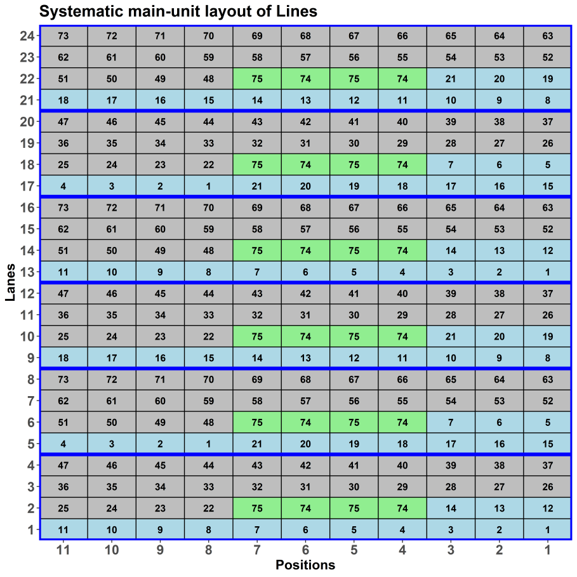
Using odw to get a design
— initial main-unit design
Zones-MainPositions cell
Aim to balance between 6 Zones the numbers of
  RILs (1:21) replicated 4 times (blue),
  Parents (74:75) replicated 12 times (green),
  RILs (22:73) replicated 3 times (grey).
> b <- 6
> r <- 4
> c <- 11
> maxit <-25
> search <- "tabu“
> main.sys <- cbind(fac.gen(list(Zones = b, Rows = r, MainPositions = c)),
+ Lines = factor(c(1:14, 74:75, 74:75, 22:47, #Z1
+ 15:21, 1:7, 74:75, 74:75, 48:73, #Z2
+ 8:21, 74:75, 74:75, 22:47, #Z3
+ 1:14, 74:75, 74:75, 48:73, #Z4
+ 15:21, 1:7, 74:75, 74:75, 22:47, #Z5
+ 8:21, 74:75, 74:75, 48:73))) #Z6
> main.sys <- within(main.sys, MainUnits <- fac.combine(list(Rows, MainPositions)))
The balancing is not essential, but an attempt to ensure that a balanced design is considered.

Slide 39

Recall the anticipated model
Zones-MainPositions cell
Mean + Zones + Lines + Conditions +
Lines:Conditions |
Mean + MainPositions +
Zones:MainPositions +
Zones:MainPositions:Rows +
Zones:MainPositions:Rows:Carts.
Several random terms.
  By default odw assumes that the variance
  component for Zones:MainPositions:Rows:Carts is one and the rest are 0.1 times it.
    That is, other than the residual error (or identity term), the components are small.
    Suppose this is OK, except that MainPositions is likely to be 0.5.
    Zones fixed is equivalent to assuming that the variance component is infinite.

Slide 40
Prepare to optimize the main-unit design
> #'### Randomize systematic design as an RCBD
> main.RCBD <- designRandomize(allocated = main.sys["Lines"],
+ recipient = main.sys[c("Zones", "MainUnits")],
+ nested.recipients = list(MainUnits = "Zones"),
+ seed = 71598)
> main.RCBD <- dplyr::left_join(main.sys[, -match("Lines", names(main.sys))], main.RCBD)
> #'### Use odw to set the variance parameters for the main-unit design
> main.ini <- odw(fixed = ~ Zones + Lines,
+ random = ~ MainPositions + Zones:(Rows + MainPositions),
+ permute = ~ Lines,
+ start.values = TRUE,
+ data = main.sys)
> vp.table <- main.ini$vparameters.table
> vp.table$Value[1] <- 0.5
> (vp.table)
Component Value
1 MainPositions 0.5
2 Zones:Rows 0.1
3 Zones:MainPositions 0.1
4 units!R 1.0
This nesting specifies that it is an RCBD randomization.
With this argument, returns an object that includes a variance parameter table.
MainPositions will be set to 0.5, as desired.

Slide 41
Using odw to get a near-A-optimal main-unit design
> #'### Optimize
> main.odw <- odw(fixed = ~ Zones + Lines,
+ random = ~ MainPositions + Zones:(Rows + MainPositions),
+ permute = ~ Lines,
+ maxit = maxit, search = search,
+ G.param = vp.table,
+ data = main.sys)
Initial criterion = 0.727305 (75 A-equations; rank C 74)
Criterion after 1000 initial random iterations: 0.709736
Criterion after tabu loop 1 is 0.707070
Criterion after tabu loop 2 is 0.706847
Criterion after tabu loop 3 is 0.706630
...
Criterion after tabu loop 25 is 0.706430
Hash table size 246
Final criterion after 25 tabu iterations: 0.706430
> main.lay <- main.odw$design
Need to supply the variance parameter table to the G.param argument.

Slide 42
How does the mixed-model design compare with a fixed-model design for the mixed model?
> main.fix.odw <- odw(fixed = ~ Zones*MainPositions + Zones:Rows + Lines,
+ permute = ~ Lines,
+ maxit = maxit, search = search,
+ data = main.RCBD)
Initial criterion = 1.066867 (75 A-equations; rank C 74)
Criterion after 1000 initial random iterations: 0.982207
Criterion after tabu loop 1 is 0.944825
Criterion after tabu loop 2 is 0.936775
...
Criterion after tabu loop 25 is 0.930943
Hash table size 385
Final criterion after 25 tabu iterations: 0.930943
> #'### Calculate A-measure under mixed model using the fixed design
> main.fix.lay <- main.fix.odw$design
> designAmeasures(mat.Vpredicts(target = ~ Lines - 1,
+ fixed = ~ Zones -1,
+ random = ~ MainPositions + Zones:(Rows + MainPositions) - 1,
+ G = as.list(vp.table$Value[-4]),
+ design = main.fix.lay))
all
all 0.740637
This compares with 0.706043, and is 1.05 times the mixed-model design. The sed would only be slightly inflated (3%).

Slide 43
Expand the main-unit design to a split-unit design
> #'### Expand main-unit design to add Carts with Conditions
> PA.sys <- cbind(fac.gen(list(Zones = b, Rows = r, MainPositions = c, Carts = 2)),
+ data.frame(Lines = factor(rep(main.lay$Lines, each=2), levels=1:75),
+ Conditions = factor(rep(1:2, times=264),
+ labels = c('0 NaCl','100 NaCl'))))
> #'### Randomize the whole design
> PA.lay <- designRandomize(allocated = PA.sys[c("Lines", "Conditions")],
+ recipient = PA.sys[c("Zones", "Rows", "MainPositions",
+ "Carts")],
+ nested.recipients = list(Rows = c("Zones", "MainPositions"),
+ Carts = c("Zones", "Rows",
+ "MainPositions")),
+ seed = 51412)
> PA.lay <- cbind(fac.gen(list(Lanes = nlanes, Positions = posns)),
+ PA.lay)
> #'### Add factors and variates
> PA.lay <- within(PA.lay,
+ {
+ xMainPosn <- as.numfac(MainPositions)
+ xMainPosn <- -(xMainPosn - mean(xMainPosn))
+ MainUnits <- fac.combine(list(Rows, MainPositions))
+ })
Repermute Rows
Permute Carts within
Zones-Rows-MainPositions cell

Slide 44
4. Summary of constructing nonorthogonal designs
More difficult to identify the systematic design for a nonorthogonal design.
  Not just a matter of using a standard, well-known design.
Still use designRandomize to ensure a valid randomization and designAnatomy to check the properties of any design.
For this, it remains necessary to:
  Divide factors based on allocation of factors (as well as fixed/random).
  Identify the crossing and nesting, which depends not only on the innate relationships, but also the model employed to account for anticipated variation.
Numeric covariates introduce partial aliasing (nonorthogonality between allocated terms).

Slide 45
Degrees of balance
Three degrees of balance have been encountered in the designs presented:
  Orthogonal, and so balanced: all canonical efficiency factors (nonzero eigenvalues) are one;
  Balanced, but nonorthogonal: some canonical efficiency factors are not one, however, they take just one value for (i) any recipient source or (ii) any allocated source when confounded with a particular recipient source.
  Unbalanced and so must be nonorthogonal: the canonical efficiency factors for at least one source of type (i) or (ii) above take more than one value.
As we go down this list:
  the degree of balance decreases and the complexity of the analysis increases;
One of the great advantages of balanced designs is that all the standard errors of estimates of contrasts for a source of type (ii) will be equal.
  All contrasts are treated equally.
  Easier to present the results.
  However, not always achievable.

Slide 46
Identifying an optimal design
Several methods available for selecting an optimal design:
  Deploy a standard design, like a randomized complete-block or split-unit design, known to be optimal
  – designRandomize can be used to obtain layouts for these.
  Manually constructing a design, including the use of design keys for factorial experiments (Patterson & Bailey, 1978), given enough knowledge of combinatorics.
  Consult a catalogue of designs (e.g. Cochran and Cox, 1957; Hinkelmann & Kempthorne, 2005; agricolae , de Mendiburu, 2021).
  Computer generation of designs:
    CycDesigN, odw, SAS, JMP.
Whichever method is used, it is necessary to have identified the anticipated model, perhaps implicitly for the first three methods but explicitly for computer generation.

Slide 47
Some caveats
Quoting Mead, Gilmour and Mead (2012):
  It is our opinion that … packages and catalogues provide a relatively small contribution to the overall designing of practical experiments … it is necessary to do most of the planning of the design before [they] are any help.
Specifying an anticipated model provides a formal basis for the initial planning process.
  For computer generation, the anticipated model must be identified,
  For the other methods of obtaining a design, the anticipated model needs to be identified, at least implicitly.
    For an RCBD to be appropriate, the model Mean + Treatments | Mean + Blocks + Blocks:Plots needs to be appropriate.
Also remember that a randomly computer-generated design is not a randomized design.

Slide 48
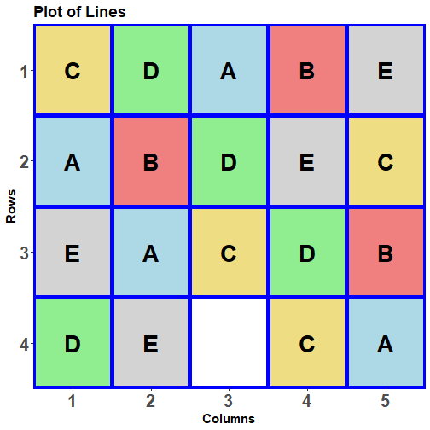
5. What happens when there is missing data?
Suppose the 18th plot in the YSD is lost.
How does this affect the design’s properties?
> #'## Set up a layout with a single missing value
> YSD.miss1.lay <- YSD.lay
> YSD.miss1.lay$Lines[18] <- NA
> #'## Get the anatomy of the layout
> YSD.miss1.canon <- designAnatomy(formulae = list(units = ~ Rows*Columns,
+ trts = ~ Lines),
+ data = na.omit(YSD.miss1.lay))
Need an NA for the plot, but cannot have an NA for designAnatomy.

Slide 49
The anatomy for a missing value
> summary(YSD.miss1.canon, which.criteria = c("aeff", "xeff", "eeff", "order"))
Summary table of the decomposition for units & trts (based on adjusted quantities)
Source.units df1 Source.trts df2 aefficiency xefficiency eefficiency order
Mean 1 Mean 1 1.0000 1.0000 1.0000 1
Rows 3 Lines 1 0.0500 0.0500 0.0500 1
Residual 2
Columns 4 Lines 4 0.0444 0.1968 0.0189 3
Rows#Columns 11 Lines 4 0.8948 0.9663 0.7681 3
Residual 7
Table of (partial) aliasing between sources derived from the same formula
Source df Alias In aefficiency xefficiency eefficiency order
Columns 1 Rows units 0.0500 0.0500 0.0500 1
Columns 4 ## Information remaining units 0.9870 1.0000 0.9500 2
The design is not orthogonal
Columns is orthogonalized to Rows, losing 1.3% in the process.
Columns is not orthogonal to Rows;
it is partially aliased with Rows;

Slide 50
The anatomy for a missing value
> summary(YSD.miss1.canon, which.criteria = c("aeff", "xeff", "eeff", "order"))
Summary table of the decomposition for plots & lines (based on adjusted quantities)
Source.units df1 Source.trts df2 aefficiency xefficiency eefficiency order
Mean 1 Mean 1 1.0000 1.0000 1.0000 1
Rows 3 Lines 1 0.0500 0.0500 0.0500 1
Residual 2
Columns 4 Lines 4 0.0444 0.1968 0.0189 3
Rows#Columns 11 Lines 4 0.8948 0.9663 0.7681 3
Residual 7
The design is not orthogonal
Lines confounding is no longer balanced.
Nor is it orthogonal to Rows.
Less Lines information confounded with Rows#Columns (cf 0.9375 for the YSD).

Slide 51
Confounding versus aliasing
4 Rows
5 Columns
5 Lines

5 treatments
20 units
Summary table of the decomposition for units & treats (based on adjusted quantities)
Source.units df1 Source.trts df2 aefficiency xefficiency eefficiency order
Mean 1 Mean 1 1.0000 1.0000 1.0000 1
Rows 3 Lines 1 0.0500 0.0500 0.0500 1
Residual 2
Columns 4 Lines 4 0.0444 0.1968 0.0189 3
Rows#Columns 11 Lines 4 0.8948 0.9663 0.7681 3
Residual 7
Table of (partial) aliasing between sources derived from the same formula
Columns 1 Rows units 0.0500 0.0500 0.0500 1
Columns 4 ## Information remaining units 0.9870 1.0000 0.9500 2
Aliasing refers to nonorthogonality between sources in the same tier (panel):
  i.e. both allocated or both recipient sources; e.g. Rows and Columns.
Confounding refers to nonorthogonality between sources from different tiers (panels):
  i.e. an allocated and a recipient source; e.g. Lines and Rows.

Slide 52
Confounding versus aliasing
Confounding and aliasing are about the relationships between sources.
An allocated (recipient) source can be aliased or partially aliased with another allocated (recipient) source.
  An aliased source is one that when the term for it is fitted, there is no information about its source available.
  A partially aliased source only loses some of its information to sources for previously fitted terms, e.g. Columns is partially aliased with Rows.
  Aliasing is to be avoided if possible, although sometimes it is purposefully employed (e.g. alias potentially small three-factor treatment interactions with treatment main effects in fractional factorial experiments).
An allocated source can be confounded or partially confounded with a recipient source.
  It is confounded with a recipient source when all information about it is associated with that recipient source.
  If only part of the information is associated with the recipient source, then it is partially confounded with the recipient source.
  Confounding or partial confounding is unavoidable in experiments.
  Confounding is preferred to partial confounding, if it is achievable (and provided there is a Residual for the recipient source).

Slide 53
Confounding examples
In an RCBD, Lines is confounded with Columns[Rows], i.e. all information about Lines is associated with the recipient source Columns[Rows].
Confounding
> summary(RCBD.canon)
Source.units df1 Source.trts df2 aefficiency eefficiency order
Mean 1 Mean 1 1.0000 1.0000 1
Rows 3
Columns[Rows] 20 Lines 4 1.0000 1.0000 1
Residual 16
Partial Confounding
Source.units df1 Source.trts df2 aefficiency xefficiency eefficiency order
Mean 1 Mean 1 1.0000 1.0000 1.0000 1
Rows 3 Lines 1 0.0500 0.0500 0.0500 1
Residual 2
Columns 4 Lines 4 0.0444 0.1968 0.0189 3
Rows#Columns 11 Lines 4 0.8948 0.9663 0.7681 3
Residual 7
In a YSD with a missing value, Lines is partially confounded with Rows, Columns and Columns[Rows], i.e. some information about Lines is associated with all recipient sources.

Slide 54
A missing treatment
How does a missing treatment affect the properties of the design?
> #'## Set up a layout with a missing Line
> YSD.missA.lay <- YSD.lay
> YSD.missA.lay$Lines[YSD.missA.lay$Lines == "A"] <- NA

Slide 55
The anatomy for a missing treatment
> #'## Get the anatomy of the layout
> YSD.missA.canon <- designAnatomy(formulae = list(units = ~ Rows*Columns,
+ trts = ~ Lines),
+ grandMean = TRUE, data = na.omit(YSD.missA.lay))
> summary(YSD.missA.canon, which.criteria = c("aeff", "xeff", "eeff", "order"))
Summary table of the decomposition for plots & lines (based on adjusted quantities)
Source.units df1 Source.trts df2 aefficiency xefficiency eefficiency order
Mean 1 Mean 1 1.0000 1.0000 1.0000 1
Rows 3
Columns 4 Lines 3 0.0909 0.0909 0.0909 1
Residual 1
Rows#Columns 8 Lines 3 0.9091 0.9091 0.9091 1
Residual 5
Table of (partial) aliasing between sources derived from the same formula
Source df Alias In aefficiency xefficiency eefficiency order
Columns 3 Rows units 0.0833 0.0833 0.0833 1
Columns 4 ## Information remaining units 0.9362 1.0000 0.9167 2
The design is not orthogonal
What has been the effect of the missing treatment?

Slide 56
Practical session for Nonorthogonal experimental design & analysis in R
Using dae and odw to obtain randomized layouts for nonorthogonal designs.
  An alpha design.
  A BIBD.
  A design with rows and columns for a Casuarina trial.
  A 25-line wheat experiment from Gilmour et al. (1995).
Again, you have only to follow the script that has been given.
There are some questions for you to answer about each design.

Slide 57
References
Brien, C. J. (2017). Multiphase experiments in practice: A look back. Australian & New Zealand Journal of Statistics, 59, 327-352.
Brien, C. J., & Demétrio, C. G. B. (2009). Formulating Mixed Models for Experiments, Including Longitudinal Experiments. Journal of Agricultural, Biological, and Environmental Statistics, 14, 253-280.
Brien, C. J., Sermarini, R. A., & Demetrio, C. G. B. (2023). Exposing the confounding in experimental designs to understand and evaluate them, and formulating linear mixed models for analyzing the data from a designed experiment. Biometrical Journal , 65 (7), 2200284. https://doi.org/10.1002/bimj.202200284.
Butler, D. G. (2022) odw: generate optimal experimental designs. (R package version 2.1.4, to be made available) https://mmade.org/.
Butler, D. G., Cullis, B. R., Gilmour, A. R., Gogel, B. J., & Thompson, R. (2020). ASReml-R reference manual (Version 4.1). Hemel Hempstead: VSN International Ltd.
Cochran, W. G., & Cox, G. M. (1957). Experimental Designs (2nd ed.). New York: Wiley.
De Mendiburu, F. (2021). agricolae: statistical procedures for agricultural research. R package version 1.3-5. URL http://cran.at.r-project.org/package=agricolae.
Gilmour, A. R., Thompson, R., & Cullis, B. R. (1995). Average Information REML: An Efficient Algorithm for Variance Parameter Estimation in Linear Mixed Models. Biometrics, 51, 1440-1450.
Kiefer, J. (1959). Optimum Experimental Designs. Journal of the Royal Statistical Society, Series B (Methodological), 21, 272-319.
Hinkelmann, K., & Kempthorne, O. (2005). Design and analysis of experiments Vol. 2 Advanced experimental design. Hoboken, N.J.: Wiley-Interscience.
Mead, R., Gilmour, S. G., & Mead, A. (2012). Statistical principles for the design of experiments. Cambridge: Cambridge University Press.
Patterson, H. D., & Bailey, R. A. (1978). Design keys for factorial experiments. Journal of the Royal Statistical Society, Series C (Applied Statistics), 27, 335-343.

