Slide 1



Designing comparative experiments using R
Topic III. Miscellaneous topics in experimental design & analysis
Chris Brien^{1,2}, Renata Sermarini³ & Clarice Demétrio³
¹ Australian Plant Phenomics Facility, University of Adelaide.
² UniSA STEM, University of South Australia.
³ESALQ, Universidade de São Paulo
(Software and materials at http://chris.brien.name/curso2024/)

Slide 2
Topic III. Outline
Systematic allocation and pseudoreplication.
Block-treatment interaction.
The varying roles of times factors.
Summary of confounding and aliasing.
Design for nested-factorial experiments.

Slide 3
Recall the factor-allocation paradigm for designing experiments
Brien & Bailey (2006); Brien & Demétrio (2009);
Brien, Sermarini & Demétrio (2023, Section 1).
Anticipated
model
Anticipated model determined in consultation with the researcher.
Shows the confounding and aliasing inherent in the design.
Anatomy table under a
homogeneous allocation model
Factor-allocation diagram
Design selection &
construction
Initial
allocation model
Homogeneous allocation
model
Prior
allocation model
Select a design that is optimal for the anticipated model.
Depicts the allocation.
Model derived from the allocation.
Modified versions of the initial allocation model.
  Homogeneous allocation and anticipated models should have the same terms, possibly simplified.

Slide 4
1. Systematic allocation and pseudoreplication
Brien, Sermarini and Demétrio (2023, Section 4.3)
It happens that randomization is not always desirable or possible.
A grapevine experiment is to be run in two greenhouses:
  One greenhouse is to be kept at ambient temperature and the other is to be cooled;
  Of the two greenhouses, one is naturally warmer than the other and so needs to be the warm greenhouse.
  So, randomization is not desirable.
Within each greenhouse, two salinity treatments (control and saline) are to be applied to 12 varieties.
The combinations of Heat, Salinity and Varieties are to be replicated 6 times.

Slide 5
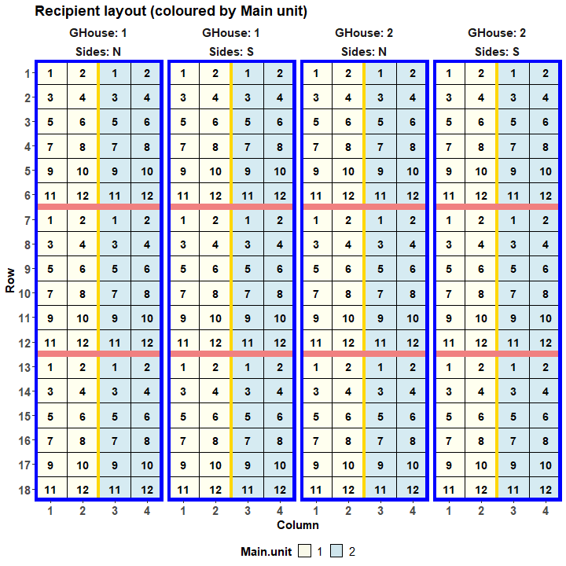
Grapevine design
(Numbers are pots.)
A split-split-unit design is to be
used:
  Heats are to be allocated to main units (Greenhouses)
  Within each greenhouse:
    2 Sides (blue rectangles),
    with 6 subunits per Side (pink and
    yellow lines separates subunits).
    Salinities allocated to subunits;
    Varieties to 12 pots (sub-subunits)
    in each subunit.
  Split-split-unit design because:
    Large differences between Salinities;
    Variety differences are the most important.

Slide 6
Grapevine design
Anticipated model:
  Mean + Heat * Salinity * Varieties |
  Mean + Ghouses + Ghouses:Sides + Ghouses:Sides:BRows + Ghouses:Sides:BCols + Ghouses:Sides:BRows:BCols + Ghouses:Sides:BRows:BCols:Pots.
Main units
Subunits
Subsubunits
2 Heats
2 Salinities
12 Varieties
2 Greenhouses
2 Sides in G
3 BRows in G, S
2 BCols in G, S
12 Pots in G, S, Br, Bc

  To balance Salinity, a 3  2 extended Latin square design, based on 2  2 Latin squares is to be used in each Side.
48 treatments
288 units

Slide 7
Generating the systematic design in R
2 Heats
2 Salinities
12 Varieties
2 Greenhouses
2 Sides in G
3 BRows in G, S
2 BCols in G, S
12 Pots in G, S, BR, BC

Generate Heat and Varieties in standard order; the 12 works as if a factor with 12 levels occurs in this position.
48 treatments
288 units
Generate the recipient factors indexing the pots.
> split.sys <- cbind(fac.gen(list(GHouse = 2, Sides = c("N", "S"),
+ BRows = 3, BCols = 2, Pots = 12)),
+ fac.gen(list(Heat = c("Warm", "Cool"), 12, Varieties = 12)),
+ Salinity = factor(rep(c(designLatinSqrSys(2),1,2,
+ designLatinSqrSys(2, start = c(2,1)),2,1),
+ each = 12, times = 2),
+ labels = c("Control", "Na")))
Extra rows.
Salinity has to be assigned using Extended Latin Squares (ELS).
Pair of ELS designs repeated twice, one pair for each GHouse.
Two Latin squares with different starting rows.

Slide 8
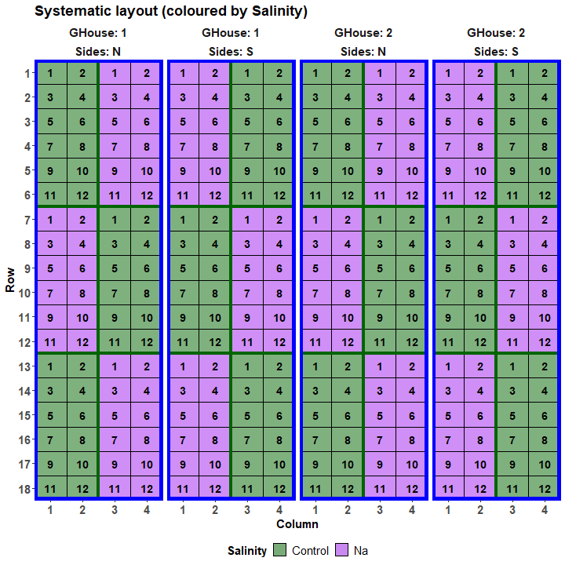
Systematic grapevine design
Numbers are Varieties.
Colours are Salinities.

Slide 9
Randomizing the grapevine design
2 Heats
2 Salinities
12 Varieties
2 Greenhouses
2 Sides in G
3 BRows in G, S
2 BCols in G, S
12 Pots in G, S, BR, BC
Use designRandomize from dae to randomize the systematic layout.
  The randomization is determined by the nesting relationships between the recipient factors.

48 treatments
288 units
> split.lay <- designRandomize(allocated = split.sys[c("Heat", "Salinity", "Varieties")],
+ recipient = split.sys[c("GHouse", "Sides",
+ "BRows", "BCols", "Pots")],
+ nested.recipients = list(Sides = "GHouse",
+ BRows = c("Sides", "GHouse"),
+ BCols = c("Sides", "GHouse"),
+ Pots = c("Sides", "GHouse",
+ "BRows", "BCols")),
+ except = "GHouse",
+ seed = 64131)
The except option allows the generation of a design, in which Heat is systematically allocated, while Salinity and Lines are randomized.
  The nested.recipients specifies the nesting shown in the pots panel; factors not nested are assumed to be crossed.

Slide 10
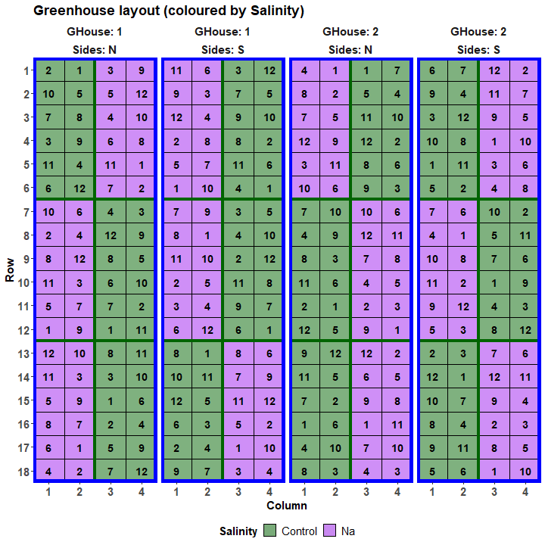
Grapevine design
Warm has been systematically assigned to the first Greenhouse.
Within a Side there are 2 columns (BCols) of main units:
  One has 2 subunits with Control and the other 2 with Na.
A complete set of the 12 Varieties is randomized within each subunit.

Slide 11
Properties of the grapevine design
Matches the nested.recipients
> split.canon <- designAnatomy(formulae = list(units = ~ GHouse/Sides/(BRows*BCols)/Pots,
+ trts = ~ Heat*Salinity*Varieties),
+ grandMean = TRUE, data = split.lay)
> summary(split.canon, which.criteria=c("aeff", "order"))
Summary table of the decomposition for units & trts (based on adjusted quantities)
Source.units df1 Source.trts df2 aefficiency order
Mean 1 Mean 1 1.0000 1
GHouse 1 Heat 1 1.0000 1
Sides[GHouse] 2
BRows[GHouse:Sides] 8
BCols[GHouse:Sides] 4 Salinity 1 0.1111 1
Heat#Salinity 1 0.1111 1
Residual 2
BRows#BCols[GHouse:Sides] 8 Salinity 1 0.8889 1
Heat#Salinity 1 0.8889 1
Residual 6
Pots[GHouse:Sides:BRows:BCols] 264 Varieties 11 1.0000 1
Heat#Varieties 11 1.0000 1
Salinity#Varieties 11 1.0000 1
Heat#Salinity#Varieties 11 1.0000 1
Residual 220
The design is not orthogonal
Heat is inextricably confounded with GHouse, an effect of the pseudoreplication.
Salinity (& Heat#Salinity) are not orthogonal, but most information is confounded with BRows#BCols[GH:S]. (Design property)
All Varieties effects are orthogonal.
But all orders are one and so it is balanced.

Slide 12
Prior allocation model for the grapevine design
  The confounding of Heat and GHouse, is exhaustive in that all GHouse information is mixed up with Heat differences (there is no GHouse Residual).
Summary table of the decomposition for units & trts (based on adjusted quantities)
Source.units df1 Source.trts df2 aefficiency order
Mean 1 Mean 1 1.0000 1
GHouse 1 Heat 1 1.0000 1
Sides[Ghouse] 2
BRows[GHouse:Sides] 8
BCols[GHouse:Sides] 4 Salinity 1 0.1111 1
Heat#Salinity 1 0.1111 1
Residual 2
BRows#BCols[GHouse:Sides] 8 Salinity 1 0.8889 1
Heat#Salinity 1 0.8889 1
Residual 6
Pots[GHouse:Sides:BRows:BCols] 264 Varieties 11 1.0000 1
Heat#Varieties 11 1.0000 1
Salinity#Varieties 11 1.0000 1
Heat#Salinity#Varieties 11 1.0000 1
Residual 220
The design is not orthogonal
  That is Heat and GHouse are inextricably mixed up together so that one cannot say which part of any difference associated with either factor is due to one or other of the factors.
  As a result, the initial allocation model will not fit.
  To have a prior allocation model that will fit, one of GHouse and Heat must be removed.

Slide 13
Prior allocation model for the grapevine design
GHouse is the obvious choice so that Heat and its interactions are retained.
  Mean + Heat * Salinity * Varieties | Mean + Ghouses + Ghouses:Sides + Ghouses:Sides:BRows + Ghouses:Sides:BCols +
  Ghouses:Sides:Brows:BCols + Ghouses:Sides:Brows:Bcols:Pots.
This model is a ”model of convenience”: it gives a fit.
However, it does not contain all the pertinent sources of variation in the experiment.
Summary table of the decomposition for units & trts (based on adjusted quantities)
Source.units df1 Source.trts df2 aefficiency order
Mean 1 Mean 1 1.0000 1
GHouse:Sides 3 Heat 1 1.0000 1
Residual 2
BRows[GHouse:Sides] 8
BCols[GHouse:Sides] 4 Salinity 1 0.1111 1
Heat#Salinity 1 0.1111 1
Residual 2
BRows#BCols[GHouse:Sides] 8 Salinity 1 0.8889 1
Heat#Salinity 1 0.8889 1
Residual 6
Pots[GHouse:Sides:BRows:BCols] 264 Varieties 11 1.0000 1
Heat#Varieties 11 1.0000 1
Salinity#Varieties 11 1.0000 1
Heat#Salinity#Varieties 11 1.0000 1
Residual 220
The design is not orthogonal
This revised anatomy shows that Sides variability will be used for judging the Heat effect.
But, Sides most likely underestimates the variability affecting the Heat effect because it does not include GHouse variability.

Slide 14
2. Block-treatment interaction vs inherent random variability
Brien, Sermarini and Demétrio (2023, Section 3)
So far analyses have been presented that assume no block-treatment interaction.
  For example, an RCBD for 5 Blocks, each of 5 plots for 5 Treatments:
Summary table of the decomposition for plots & trts
Source.units df1 Source.trts df2 aefficiency eefficiency order
Mean 1 Mean 1 1.0000 1
Blocks 4
Plots[Blocks] 20 Treatments 4 1.0000 1.0000 1
Residual 16
  No source for Blocks#Treatments occurs in the table.
  One might ask “Is Blocks#Treatments not the same as the Residual source?”
    Numerically it is the same: Blocks#Treatments has 16 df and it is the same subspace.
    However, the Residual represents the remainder of the Plots[Blocks] source after Treatments has been removed; hence, it represents variability between plots within blocks.
    This is a different source of variability to Blocks#Treatments that derives from the differential response to treatments in different blocks.

Slide 15
Adding block-treatment interactions to the anatomy
The homogeneous allocation model with block-treatment interaction is:
  Mean + Treatments + Blocks | Mean + Blocks:Plots + Blocks:Treatments.
  Here Treatments and Blocks are fixed, while their interaction is random.
    Random terms are those whose effects can be assumed to conform to a probability distribution;
    Random sampling of levels does not guarantee this and so is not a valid criterion.
    For a discussion see Brien, Sermarini & Demétrio (2023, Section 3.1, The anticipated model).
  This model gives no indication of the confounding – an anatomy is needed to explore this.
To get the anatomy, add *Blocks to the formula for trts:
> RCBD.canon <- designAnatomy(formulae = list(units = ~ Blocks/Plots,
+ trtblk = ~ Treatments*Blocks),
+ grandMean = TRUE, data = RCBD.lay)
> summary(RCBD.canon)
Note that which factors occur in each formula is related to the division into allocated (treatments) and recipient (factors), rather than into fixed and random.
  The units formula always has just the recipient factors.
  The second formula (trts or trtblk) always has the allocated factors. However, it may also have blocking factors that specify block-treatment interactions and the terms marginal to these interactions.

Slide 16
The anatomy with block-treatment interaction
Skeleton ANOVA
Summary table of the decomposition for plots & trtblk
Source.units df1 Source.trtblk df2 aefficiency eefficiency order
Mean 1 Mean 1 1.0000 1.0000 1
Blocks 4 Blocks 4 1.0000 1.0000 1
Plots[Blocks] 20 Treatments 4 1.0000 1.0000 1
Treatments#Blocks 16 1.0000 1.0000 1
Source | DF
Mean | 1
Blocks | 4
Treatments | 4
Treatments#Blocks | 16
  Note the exhaustive confounding of Plots[Blocks] by Treatments and Treatments#Blocks (there is no Plots[Blocks] Residual).
The anatomy includes sources for plot variability and the interaction:
  It shows that they are inseparable.
  Thus, the homogeneous allocation model is singular.
  To obtain a nonsingular, prior allocation model, one of Blocks:Plots and Treatments:Blocks must be removed from the model.
    Assuming no plot variability is unreasonable.
    So, remove Treatments:Blocks and acknowledge that any interaction will contribute to Blocks:Plots.

Slide 17
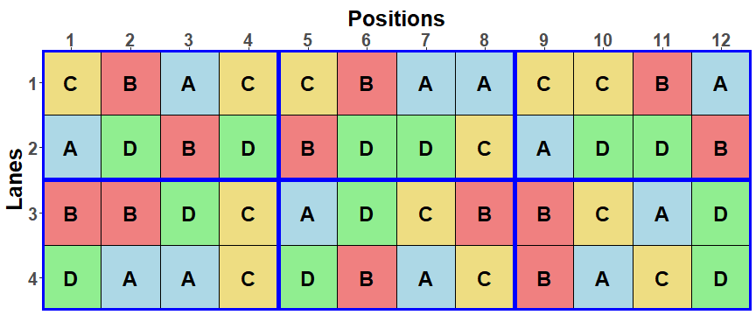
How to allow for block-treatment interaction?
Solution: add replicates within blocks.
Addelman (1969) recommends the Generalized Randomized Block Design (GRBD) for when block-treatment interactions are likely.
  Suppose a greenhouse experiment is to be run to investigate the responses to 4 Zinc levels by plants of a certain medic species and that there are 12 replicates of each level.
  Suppose that a block design is to be used, and that (i) Blocks are thought to be random and (ii) block-treatment interactions are anticipated.
  That is, the anticipated model is Mean + Zinc | Mean + Blocks + Blocks:Pots + Blocks:Zinc.
  It is decided to use a GRBD with 6 blocks and 2 replicates per block.
  It is the A-optimal design for the given units structure.

Slide 18
Allocation models and anatomy
6 Blocks
8 Pots in B
4 Zinc
Initial allocation model:
  Mean + Zinc | Mean + Blocks + Blocks:Pots.
Homogeneous allocation model (same as anticipated model):
  Mean + Zinc | Mean + Blocks + Blocks:Pots + Blocks:Zinc.
The anatomy can be obtained using the same designAnatomy call as for an RCBD with a block-treatment interaction.
4 treatments
48 units
Summary table of the decomposition for units & trtblk
Source.units df1 Source.trtblk df2
Mean 1 Mean 1
Blocks 5 Blocks 5
Pots[Blocks] 42 Zinc 3
Blocks#Zinc 15
Residual 24
  For this design, Pots[Blocks] can be separated from Blocks#Zinc.
Because the factor-allocation approach exhibits the confounding, the relationship between these two sources of variation can be seen.

Slide 19
3. The varying roles of times factors
Brien, Sermarini and Demétrio (2023, Section 4)
Experiments involving time as a factor are used to illustrate:
  Similar factors may be allocated or recipient factors;
  Recipient factors can be of interest to the researcher.
Three experiments where the role of times differs:
  An experiment in which measurements are made at different times on different units:
    times is an allocated factor and is of interest to the researcher.
  Repeated-measurements experiments, in which measurements are made at different times on the same entity (subject)
    A longitudinal experiment in which no factors are allocated to the different times and time differences are of interest.
    An experiment in which factors are allocated to different times for the same subject and time differences are not of intrinsic interest.
What insights into these experiments accrue from using the paradigm?

Slide 20
3.1 A standard greenhouse experiment with a randomized time factor
Brien, Sermarini and Demétrio (2023, Section 4.1)
In Topic I., we described a split-unit design in which 4 Zinc levels were to be investigated over 5 weeks for a species medic plants.
8 Blocks
5 MainUnits in B
4 Pots in B, M
5 Weeks
4 Zinc
20 treatments
160 units
The anticipated and initial allocation models were:
    Mean + Zinc + Weeks + Z:W | Mean + Blocks + B:MainUnits + B:M:Pots.
Commonly, the model for an experiment is formed by taking all treatment and blocking factors and form all main effects and interactions involving these factors.
  For this experiment, that would involve taking all combinations of Blocks, Zinc and Weeks.
We derive a homogeneous allocation model that includes all possible block-treatment interactions.
  Mean + Zinc + Weeks + Z:W | Mean + Blocks + B:Z + B:W + B:Z:W + B:MainUnits + B:M:Pots.
  In the traditional approach, the last 2 terms would be omitted.
Notes:
Split-unit = Split-plot

Slide 21
Using designAnatomy to summarize the confounding
> SUD.BT.canon <- designAnatomy(formulae = list(units = ~ Blocks/MainUnits/Pots,
+ trtblk = ~ Blocks*Zinc*Weeks),
+ grandMean = TRUE, data = SUD.lay)
> summary(SUD.BT.canon , which.criteria = "none")
Two formulae and a data.frame.
Primary division is according to units sources.
Summary table of the decomposition for units & trtblk
Source.units df1 Source.trtblk df2
Mean 1 Mean 1
Blocks 7 Blocks 7
MainUnits[Blocks] 32 Weeks 4
Blocks#Weeks 28
Pots[Blocks:MainUnits] 120 Zinc 3
Blocks#Zinc 21
Zinc#Weeks 12
Blocks#Zinc#Weeks 84
W is confounded with M[B].
Z and Z#W are confounded with P[B:M].
There are no Residual sources: units sources are exhaustively confounded by treat-blocks sources; as a result, M[B] not separable from B#W and P[B:M] not separable from B#Z#W.

Slide 22
3.2 A longitudinal experiment
Longitudinal experiments are an example of experiments in which there is one or more factors of interest that are recipient factors.
  Usually, the factors of interest are the allocated, treatment factors.
  Other common examples of recipient factors that of interest are Sex of animals in animal studies and Tasters in sensory experiments (Brien, Sermarini & Demétrio, 2023, Section 5).
Consider the medic experiment that investigated Zinc levels using a GRBD (Brien, Sermarini & Demétrio, 2023, Section 3.2).
  Suppose that the experiment is to be run in a greenhouse that can nondestructively measure responses daily using plant-imaging facilities:
    the plants are to be imaged over 14 days.
  The factor-allocation diagram is:
allocated
recipient
6 Blocks
8 Pots in B
14 Days
4 Zinc
Days groups the observations and is a blocking factor because it is
not allocated (cf split-unit design where Zinc and Weeks are allocated).
4 treatments
672 units

Slide 23
Models
Anticipated model:
  Extends the GRBD model by adding Days, and its interactions with the GRBD model terms.
  Also anticipated are:
    smooth trends over the Days and random deviations from these trends:
    D = td(D) + dev(D), where td stands for smooth trend and dev for deviations from trend.
    correlations between Days and heterogeneous variances for Days:
    gives the term B:P:sch(D), where sc stands for serial correlation and h for heterogeneous variances.
  Mean + Z + td(D) + Z:td(D) |
  Mean + B + B:P + dev(D) + Z:dev(D) + B:td(D) + B:dev(D) + Z:B + Z:B:D + B:P:sch(D).
Initial allocation model:
  Mean + Z | Mean + B + B:P + D + B:D + B:P:D.
Homogeneous allocation model:
  Swap Days to fixed and add terms for block-treatment interactions, that involve Z with B and D.
  Mean + Z + D + Z:D | Mean + B + B:P + B:D + Z:B + Z:B:D + B:P:D.
  Matches the anticipated model, but without the functions
  (lin, and hence dev, terms can be included in the anatomy via covariates).
Add functions to Homog model to yield the prior allocation model that matches the anticipated model.
6 Blocks
8 Pots in B
14 Days
4 Zinc
4 treatments
672 units

Slide 24
Using designAnatomy to summarize the confounding
> longi.BZD.canon <- designAnatomy(formulae = list(units = ~ (Blocks/Pots)*Days,
+ trtblk = ~ Blocks*Zinc*Days),
+ grandMean = TRUE, data = longi.lay)
> summary(longi.BZD.canon , which.criteria = "none")
Primary division is according to units sources.
There is no exhaustive confounding.
Summary table of the decomposition for units & trtblk
Source.units df1 Source.trtblk df2
Mean 1 Mean 1
Blocks 5 Blocks 5
Pots[Blocks] 42 Zinc 3
Zinc#Blocks 15
Residual 24
Days 13 Days 13
Blocks#Days 65 Blocks#Days 65
Pots#Days[Blocks] 546 Zinc#Days 39
Zinc#Blocks#Days 195
Residual 312
Same as for the GRBD.
However, D and B#D are units sources.
As for a split-unit design,
(i) there are two Residuals;
(ii) the block-treatment interactions involving Z and D are associated with the second Residual.

Slide 25
Why is “split-unit-in-time” misleading for longitudinal experiments?
It is the case that there are two Residual sources, the same as for a split-unit experiment.
  There is a Residual source for Zinc and another for Days and Zinc#Days.
  Hence, the name “split-unit-in-time”.
However, longitudinal experiments do not employ split-unit designs;
  Their allocations differ from a split-unit design.
8 Blocks
5 MainUnits in B
4 Pots in B, M
6 Blocks
8 Pots in B
14 Days
5 Weeks
4 Zinc
4 Zinc
4 treatments
672 units
20 treatments
160 units
  Days is not allocated to anything (Weeks is allocated).
  As a result, Zinc#Days is a block-treatment interaction (Zinc#Weeks is not).
  This means randomization tests are not available for Days and Zinc#Days.

Slide 26
4. Summary of confounding and aliasing
In comparative experiments,
  there is always some confounding; and
  there may be some aliasing.
All allocation, be it systematic, haphazard, spatial or randomized, results in confounding:
  designAnatomy does not distinguish between different types of allocation.
  Properly replicated treatments can be systematically allocated.
    The danger with systematic replication is that it will be confounded with any systematic trends associated with the factors to which it is allocated.
Pseudoreplication manifests as inextricable confounding.
Numeric covariates introduce partial aliasing (nonorthogonality between allocated terms).
Missing values introduce partial aliasing and confounding.

Slide 27
5. Design for nested-factorial experiments
Groups of similar treatments lead to nested factorials.
One common area is in breeding experiments where lines are naturally grouped (Welham et al., 2015, Sec. 8.4):
  A number of crosses with several selections from each cross;
  Plants from several countries with multiple provenances from each country (Casuarina experiment).
  Several clones from a few mothers.
  Several null lines each with a number of transgenic instances.
A second area is where there is a control treatment (Welham et al., 2015, Sec. 8.5) or there is natural set of nested comparisons amongst treatments:
  A fundamental grouping is of control and treated.

Slide 28
Several treatments and a control
For example,
  The control is a commercial line and the treatments are test lines;
Suppose:
  the RCBD on a 5  5 grid has one commercial and 4 test lines;
  The difference between the commercial and a test line is the prime comparison.
In this case, a factor comparing commercial and test lines could be included, say Types, and the prior allocation model modified to become:
  Mean + Types / Lines | Mean + Rows + Rows:Columns,
  where Types has the two levels comm and test.

Slide 29
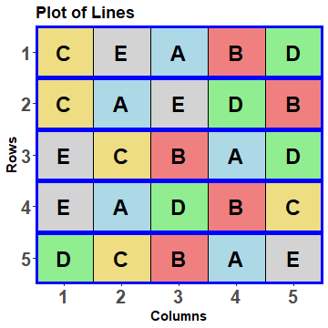
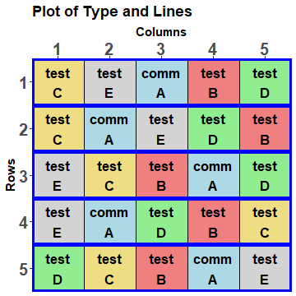
Add the factor Type to an RCBD layout
> RCBD.lay$Types <- fac.uselogical(RCBD.lay$Lines == "A",
+ labels = c("comm", "test"))
This designates level A as the comm(ercial) line and B‒E as the test lines.
So the factor Types divides the levels of Lines into two groups: one consists of A and the other of B‒E.
  An implication of this is that Types will be marginal to Lines.

Slide 30
Check the properties of the alternative model
Type nests Lines.
> RCBD.type.canon <- designAnatomy(formulae = list(units = ~ Rows/Columns,
+ trts = ~ Types / Lines),
+ grandMean = TRUE, data = RCBD.lay)
> summary(RCBD.type.canon)
Summary table of the decomposition for units & trts
Source.units df1 Source.trts df2 aefficiency eefficiency order
Mean 1 Mean 1 1.0000 1.0000 1
Rows 4
Columns[Rows] 20 Types 1 1.0000 1.0000 1
Lines[Types] 3 1.0000 1.0000 1
Residual 16
Types with 1 df represents the difference between the comm(ercial) mean and the tests mean (Lines B‒E).
Lines[Types] with 3 df represents the differences between Lines within each level of Types. Because there is only one Lines for comm, this represents the differences between the tests means (Lines B‒E).

Slide 31
The potential selected fixed model
The terms considered are Types / Lines = Types + Types:Lines.
  If Types:Lines is significant, the selected model becomes Types:Lines = Lines.
    There are differences amongst all of the Lines.
  If Types:Lines is not significant, the selected model becomes Types.
    There is a significant difference between the comm(ercial) lines mean and the mean of the test lines, there not being a significant difference between the test lines.
  However, if Types is not significant, then the model can be further reduced to a model involving just the (Grand) Mean.
    There is no significant difference between any of the Lines.
In summary, there are three potential fixed models, in order of increasing simplicity:
  Lines
  Types
  Mean

Slide 32
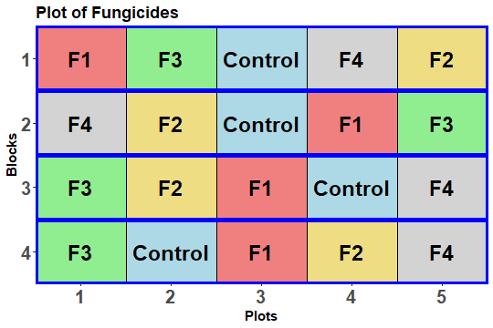
A randomized complete-block with double nesting
A potato field trial to investigate 5 Treatments, each replicated 4 times, is laid out using an RCBD.
  The treatments are a Control and 4 Fungicides, labelled F1 to F4;
  F1 and F4 use one mode of action, designated a;
  F2 and F3 use a second mode of action, designated b.
Set up 4 factors to decompose the 4 df for fungicides into single df sources.
  Types: Control vs Fungicide
  Modes: a vs b
  Modea: F1 vs F4
  Modeb: F2 vs F3

Slide 33
Adding nested factors to randomized layout RCBD.lay
Use fac.uselogical to create Types and fac.recast to create Modes.
> RCBD.lay <- within(RCBD.lay,
+ {
+ Types <- fac.uselogical(Fungicides == "Control",
+ labels = c("Control", "Fungicide"))
+ Modes <- fac.recast(Fungicides,
+ newlevels = c("Control", c("a", "b", "b", "a")),
+ levels.order = c("Control", "a", "b"))
+ })

Slide 34
Adding nested factors to randomized layout RCBD.lay
Creates a factor for each level of Modes, using the Fungicides levels for that level of Modes.
Use fac.multinested to create factors Modea and
Modeb.
> RCBD.lay <- with(RCBD.lay, cbind(RCBD.lay,
+ fac.multinested(nesting.fac = Modes,
+ nested.fac = Fungicides,
+ fac.prefix = "Mode")))
> head(RCBD.lay, n = 10) #first two blocks only
Blocks Plots Fungicides Types Modes ModeControl Modea Modeb
1 1 1 F1 Fungicide a rest F1 rest
2 1 2 F3 Fungicide b rest rest F3
3 1 3 Control Control Control Control rest rest
4 1 4 F4 Fungicide a rest F4 rest
5 1 5 F2 Fungicide b rest rest F2
6 2 1 F4 Fungicide a rest F4 rest
7 2 2 F2 Fungicide b rest rest F2
8 2 3 Control Control Control Control rest rest
9 2 4 F1 Fungicide a rest F1 rest
10 2 5 F3 Fungicide b rest rest F3
fac.multinested returns a data.frame.
ModeControl is the same as Types and so is redundant.
Wherever Fungicides has level F1 or F4, Modea has that level;
for all other levels of Fungicides, Modea the level rest.
Modeb similarly.

Slide 35
The anatomy for the nested factors
> RCBD.canon <- designAnatomy(formulae = list(plots = ~ Blocks/Plots,
+ trts = ~ Types/Modes/(Modea + Modeb)),
+ grandMean = TRUE, data = RCBD.lay)
> summary(RCBD.canon, which.criteria = "aeff")
Summary table of the decomposition for units & trts
Source.units df1 Source.trts df2 aefficiency
Mean 1 Mean 1 1.000
Blocks 3
Plots[Blocks] 16 Types 1 1.0000
Modes[Types] 1 1.0000
Modea[Types:Modes] 1 1.0000
Modeb[Types:Modes] 1 1.0000
Residual 12
The 2 Mode factors nested within Modes and Modes nested within Types.
The decomposition of the 4 df for Fungicides into single df; they correspond to a set of orthogonal contrasts.

Slide 36
Breeding experiments with naturally grouped lines
Suppose that there are 6 crosses, each with 4 selections, and there are to be 5 replicated plants from each selection.
Two possible designs are:
  An RCBD with the 24 selections randomized to each of the 5 blocks;
  A split-unit design with the 6 crosses randomized to main units and the 4 selections randomized to the 4 plots within each main unit.
For the split-unit:
  You might use the split-unit design if the variability of main units is greater than that of the plots and the comparison within a cross are of prime importance;
  Then the advantage is that comparisons between selections from the same cross are more precise than they would be for an RCBD;
  The disadvantage is that comparisons of selections from different crosses are less precise than they would be for an RCBD.

Slide 37
Split-unit design for breeding experiment
Anticipated model:
  Mean + Crosses / Selections |
  Mean + Blocks + Blocks:MainUnits + Blocks:MainUnits:Plots.
allocated
recipient
5 Blocks
6 MainUnits in B
4 Plots in B, M
6 Crosses
4 Selections
24 treatments
120 units
Generate the recipient factors indexing the units.
Systematic design:
> split.sys <- cbind(fac.gen(list(Blocks = 5, MainUnits = 6, Plots = 4)),
+ fac.gen(list(Crosses = 6), each = 4, times = 5),
+ fac.gen(list(Selections = LETTERS[1:24]), times = 5))
Need to generate Crosses and Selections separately.
Different levels for the Selections from different Crosses.

Slide 38
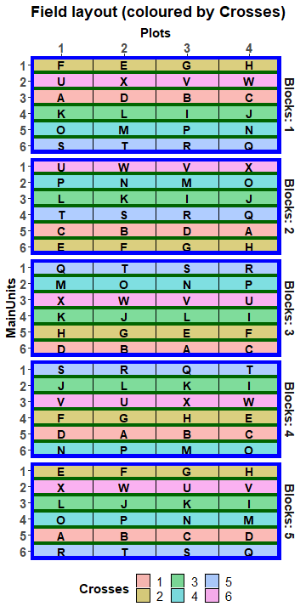
Use designRandomize to get a layout for the nested breeding experiment
Same randomization as for the standard split-unit design.
> split.lay <- designRandomize(
+ allocated = split.sys[c("Crosses", "Selections")],
+ recipient = split.sys[c("Blocks", "MainUnits", "Plots")],
+ nested.recipients = list(MainUnits = "Blocks",
+ Plots = c("Blocks", "MainUnits")),
+ seed = 316666)
That there is no Plots main effect in the anticipated model indicates that column differences are not expected.

Slide 39
Check the properties of the randomized design
> split.canon <- designAnatomy(formulae = list(units = ~ Blocks/MainUnits/Plots,
+ trts = ~ Crosses/Selections),
+ grandMean = TRUE, data = split.lay)
> summary(split.canon, which.criteria=c("aeff", "order"))
Summary table of the decomposition for units & trts
Source.units df1 Source.trts df2 aefficiency order
Mean 1 Mean 1 1.0000 1
Blocks 4
MainUnits[Blocks] 25 Crosses 5 1.0000 1
Residual 20
Plots[Blocks:MainUnits] 90 Selections[Crosses] 18 1.0000 1
Residual 72
Selections nested within Crosses.
Selections within Crosses confounded with Plots[Blocks:MainUnits];
18 df results from 3 df for each of 6 Crosses.

Slide 40
An alternative prior allocation model
The initial allocation model might be the same as the anticipated model.
However, this might be modified to yield a prior allocation model with a term for Selections differences for each of the Crosses:
  Mean + Crosses / (Selections1 + Selections2 + Selections3 + Selections4 + Selections5 + Selections6) |
  Mean + Blocks + Blocks:MainUnits + Blocks:MainUnits:Plots,
  where Selectionsi is a factor for the 4 Selections from Crosses i.
The dae function fac.multinested can create the 6 nested factors.

Slide 41
Generating separate factors for each Cross
A factor is created for each level of Crosses, using the levels of Selections for that level of Crosses.
> split.lay <- cbind(split.lay,
+ with(split.lay, fac.multinested(nesting.fac = Crosses,
+ nested.fac = Selections,
+ fac.prefix = "Select")))
> head(split.lay, n = 12)
Blocks MainUnits Subplots Crosses Selections Select1 Select2 Select3 Select4 Select5 Select6
1 1 1 1 2 F rest F rest rest rest rest
2 1 1 2 2 E rest E rest rest rest rest
3 1 1 3 2 G rest G rest rest rest rest
4 1 1 4 2 H rest H rest rest rest rest
5 1 2 1 6 U rest rest rest rest rest U
6 1 2 2 6 X rest rest rest rest rest X
7 1 2 3 6 V rest rest rest rest rest V
8 1 2 4 6 W rest rest rest rest rest W
9 1 3 1 1 A A rest rest rest rest rest
10 1 3 2 1 D D rest rest rest rest rest
11 1 3 3 1 B B rest rest rest rest rest
12 1 3 4 1 C C rest rest rest rest rest
Wherever level 2 of Crosses occurs Select2 has the levels E, F, G and H;
for all other levels of Crosses, Select2 has the level rest.

Slide 42
Check the properties for the prior allocation model
> split.multi.canon <- designAnatomy(formulae = list(units = ~ Blocks/MainUnits/Plots,
+ trts = ~ Crosses/(Select1 + Select2 +
+ Select3 + Select4 +
+ Select5 + Select6)),
+ grandMean = TRUE, data = split.lay)
> summary(split.multi.canon, which.criteria=c("aeff", "order"))
Summary table of the decomposition for units & trts
Source.units df1 Source.trts df2 aefficiency order
Mean 1 Mean 1 1.0000 1
Blocks 4
MainUnits[Blocks] 25 Crosses 5 1.0000 1
Residual 20
Plots[Blocks:MainUnits] 90 Select1[Crosses] 3 1.0000 1
Select2[Crosses] 3 1.0000 1
Select3[Crosses] 3 1.0000 1
Select4[Crosses] 3 1.0000 1
Select5[Crosses] 3 1.0000 1
Select6[Crosses] 3 1.0000 1
Residual 72
The 6 Select factors nested within Crosses.
The 6 x 3 df Select[Crosses] sources.

Slide 43
Practical session for Miscellaneous in experimental design & analysis in R
Using dae and odw to obtain randomized layouts for orthogonal designs.
  An animal feeding experiment.
  Block-treatment interactions for an experiment in which time is randomized.
  A longitudinal experiment that uses a GRBD.
  A detergent experiment.
  A Sultana spraying experiment.
  A Control treatment for an incomplete-block design.
  The Casuarina experiment (continued).
Again, you have only to follow the script that has been given.
There are some questions for you to answer about each design.

Slide 44
References
Addelman, S. (1969). The Generalized Randomized Block Design. The American Statistician, 23(4), 35-36.
Brien, C. J. (2017). Multiphase experiments in practice: A look back. Australian & New Zealand Journal of Statistics, 59, 327-352.
Brien, C. J. & Bailey, R. A. (2006). Multiple randomizations (with discussion). Journal of the Royal Statistical Society, Series B (Statistical Methodology), 68(4), 571-609.
Brien, C. J., & Demetrio, C. G. B. (1998). Using the randomisation in specifying the ANOVA model and table for properly and improperly replicated grazing trials. Australian Journal of Experimental Agriculture, 38(4), 325-334.
Brien, C. J., & Demétrio, C. G. B. (2009). Formulating Mixed Models for Experiments, Including Longitudinal Experiments. Journal of Agricultural, Biological, and Environmental Statistics, 14, 253-280.
Brien, C. J., Sermarini, R. A., & Demetrio, C. G. B. (2023). Exposing the confounding in experimental designs to understand and evaluate them, and formulating linear mixed models for analyzing the data from a designed experiment. Biometrical Journal , 65 (7), 2200284. https://doi.org/10.1002/bimj.202200284.
Kaps, M., & Lamberson, W. (2004). Biostatistics for animal science. Wallingford, UK: CABI Publishing.
Roberts, E. A. (1975). Accounting for components of error In V. J. Bofinger & J. L. Wheeler (Eds.), Developments in Field Experiment Design and Analysis (pp. 59-71). Slough: Commonwealth Agricultural Bureaux.
Welham, S. J., Gezan, S. A., Clark, S. J., & Mead, A. (2015). Statistical Methods in Biology: Design and Analysis of Experiments and Regression. Boca Raton: Chapman and Hall/CRC.

