Slide 1
A-Frame, WebVR, and the Power/Potential of OpenGL for Immersive Video
Notes:
Links to Glitch:
Cube: https://buttercup-ease.glitch.me/
Sphere: https://cake-face.glitch.me/

Slide 2
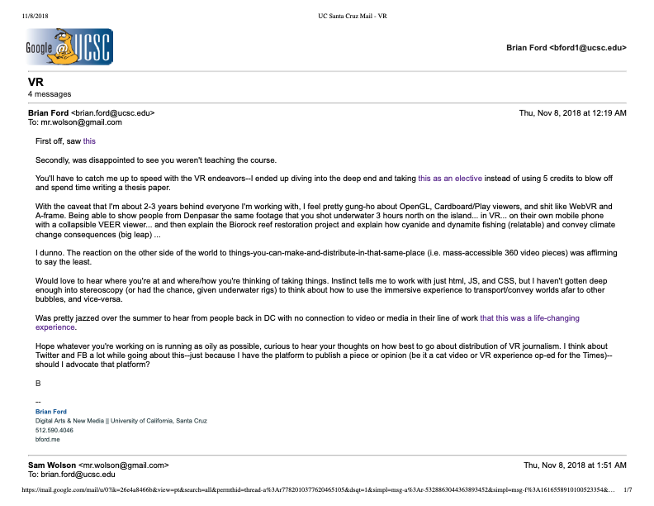
Cont.
Sam Wolson Led Me Here
(Access PDF dialogue locally on desktop)
Notes:
Link to Sam email chain here. (right tab)

Slide 3
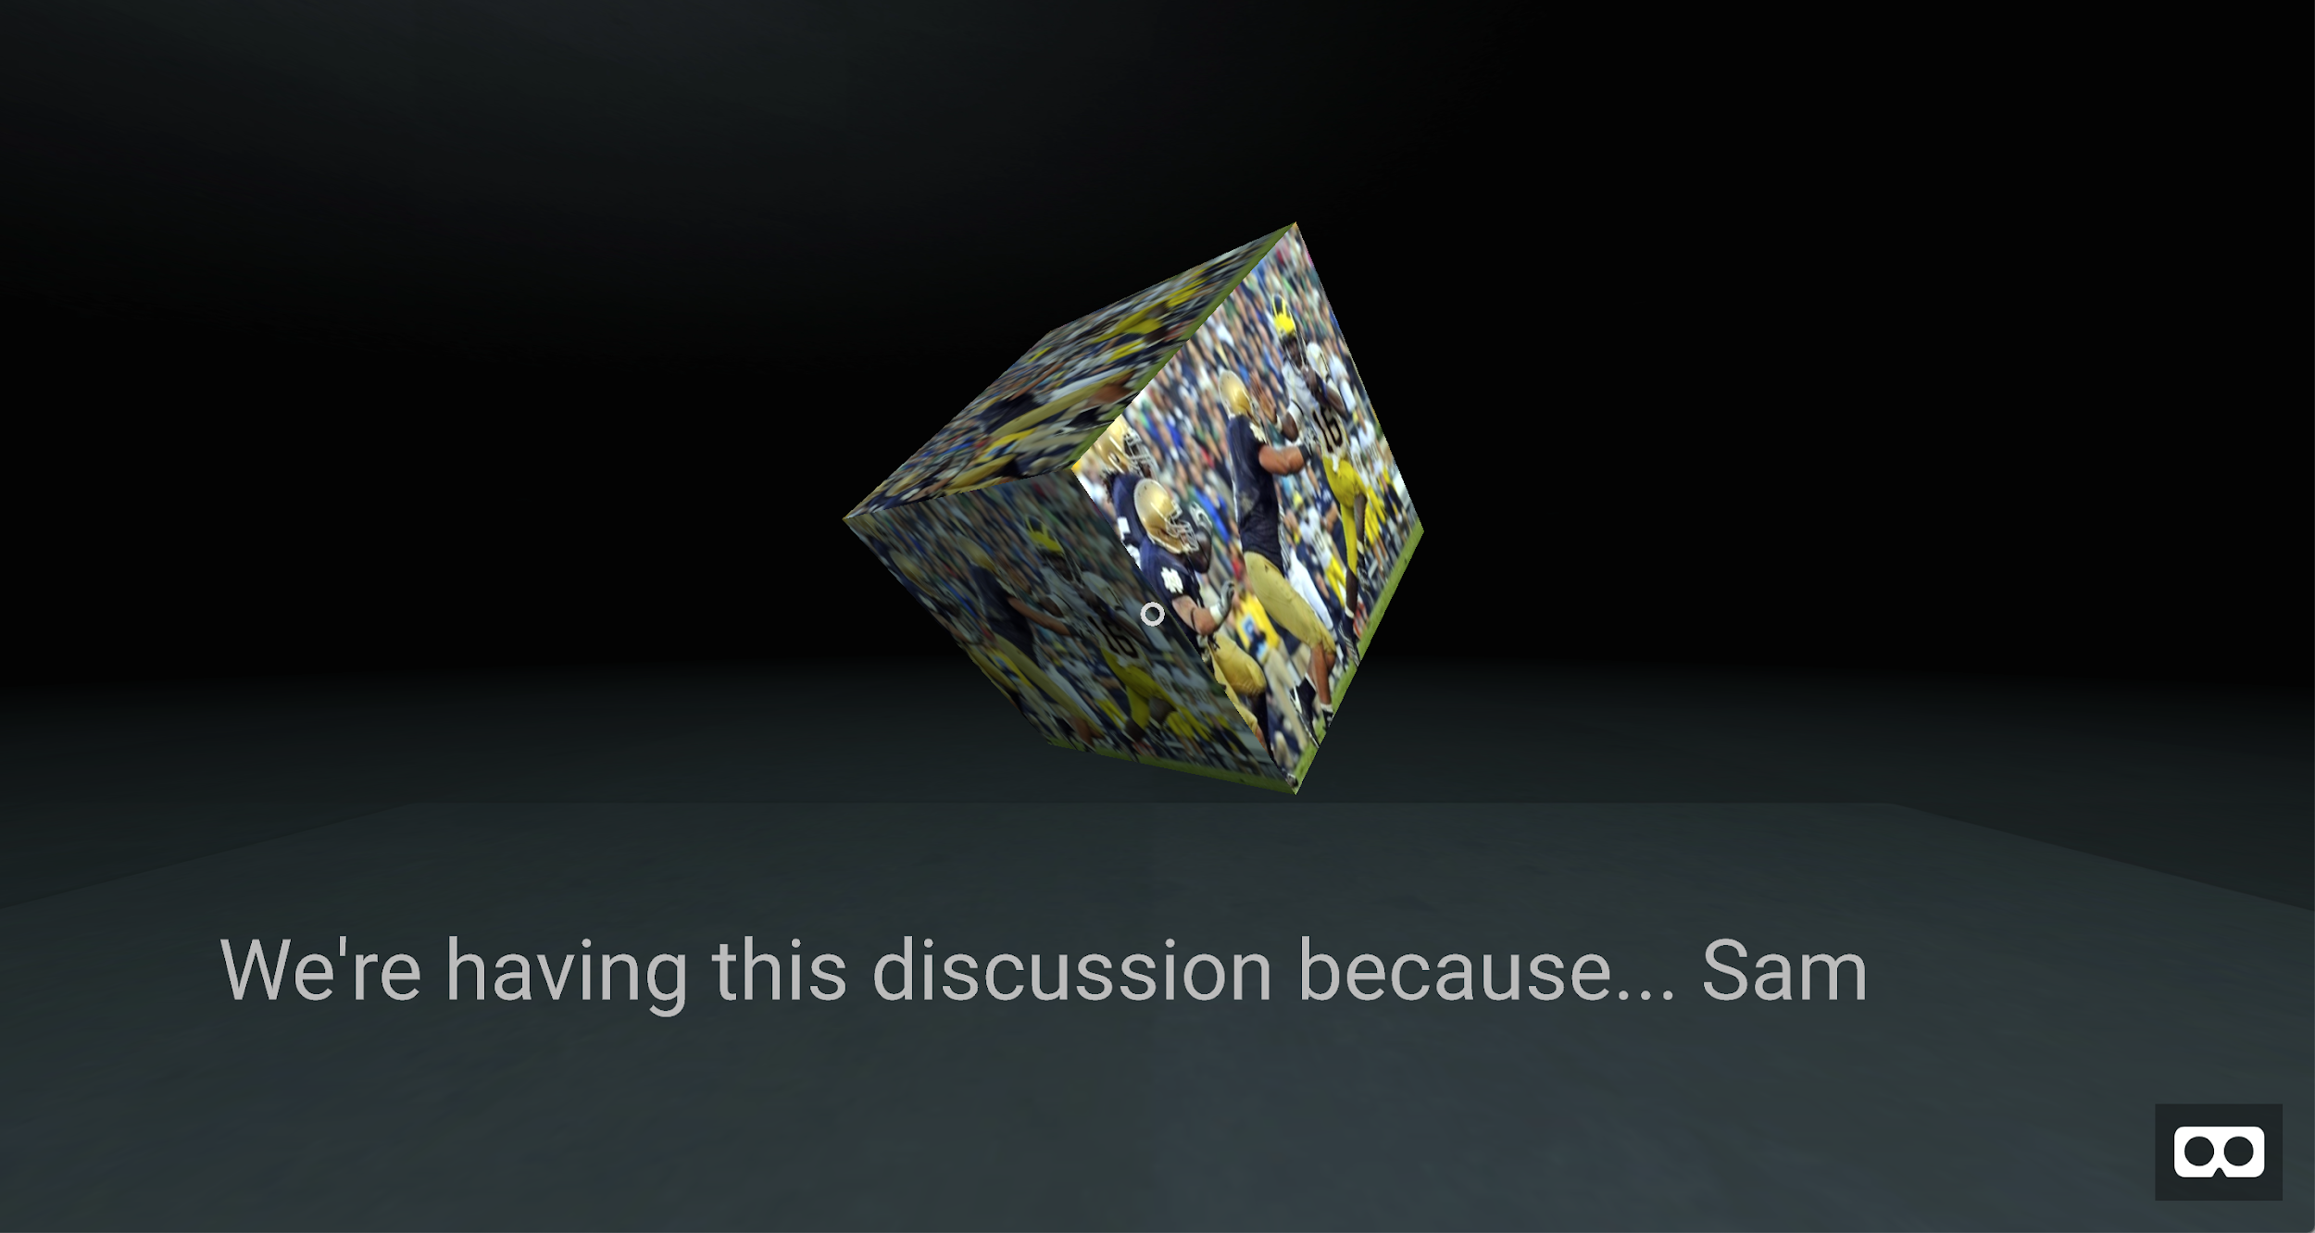
I’m here because, Sam
Notes:
https://buttercup-ease.glitch.me/

Slide 4
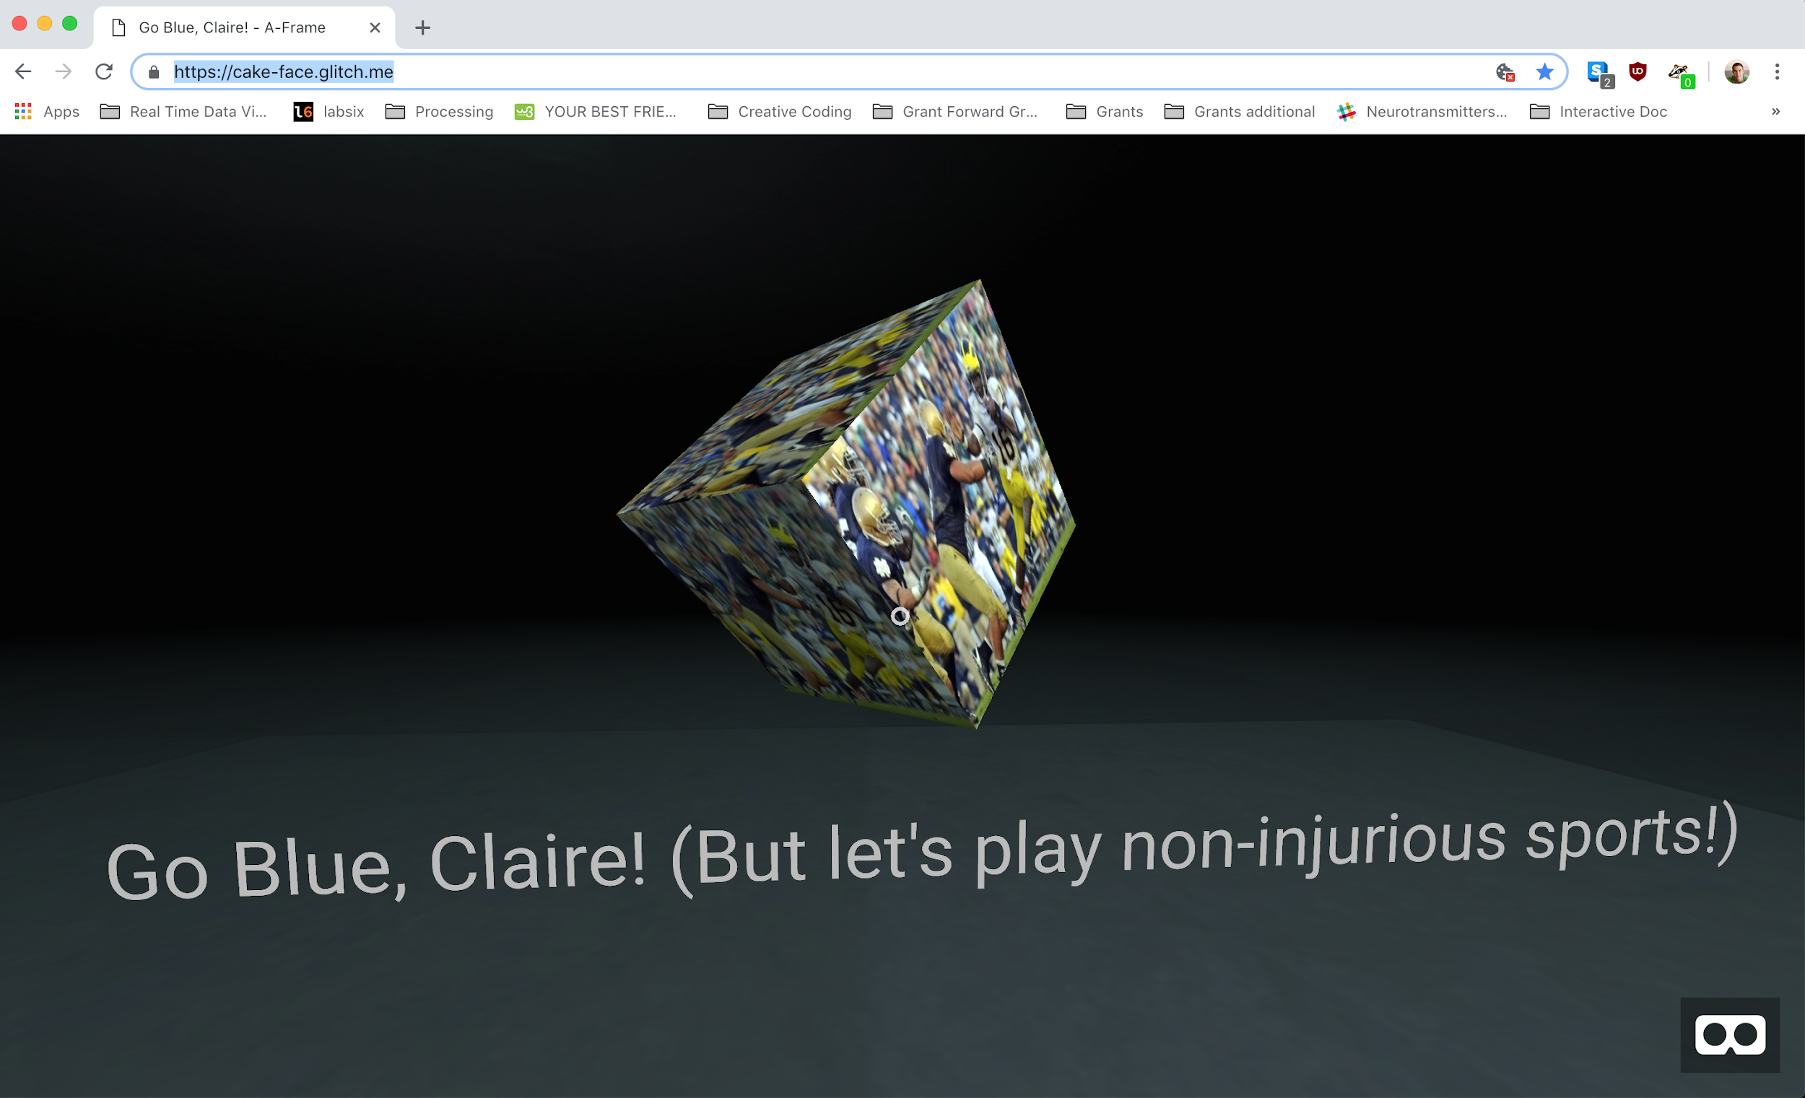
Notes:
Here, I used Glitch to alter some simple code made for A-Frame, viewable through Cardboard viewers to illustrate the simplicity of copying and altering open-source code and media. No fireworks or dazzle here. The implications are tremendous for mass-distribution and deployment of immersive experience though.

Slide 5
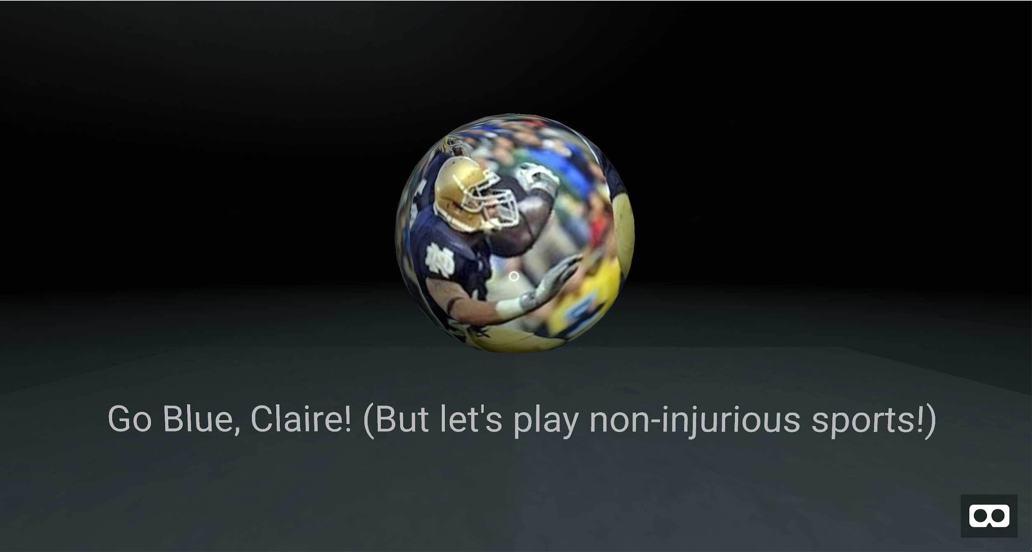
Instantly, we run into some issues
Notes:
https://cake-face.glitch.me/

Slide 6
Comp Media Fall 2018 Documentation
7 November 2018
Using A-Frame and the free-use Glitch platform, I’ve been able create basic, lightweight builds for immediate front-end deployment with text and simple 3D objects (spheres, cubes, cylinders) as well as tinker with the script to change environment lighting, color, and predetermined camera movement (this in addition to click-and-drag VR cardboard viewer experiences from a static standpoint).
Adding photos to the code has also been proven a simple exercise working with Glitch’s GUI and text editor, though at this point I’m still familiarizing myself with the capabilities, scene setup, and language involved with the Glitch 3D environment.
As Glitch is open source and free to use and “remix” under the MIT license, I’d like to continue to explore its boundaries with regard to mass-deployable, globally accessible 360º video and directional sound (e.g. incorporating an html link to a 360º video stitched together with directional, audio to the scene’s environment).
Taking well into consideration the caveat that my programming language abilities are at best, “conversational” with regard to HTML, JavaScript, and CSS in conjunction with each other, I do think that the realization of a polished rough cut of my thesis work documenting both the success and significance of the Biorock coral reef restoration and marine ecosystem regeneration methods deployed in Bali is possible by the end of this quarter.
For succinctness’ sake, I’ve copied a summary of my thesis project from a grant application submitted this past week below:
My thesis work is centered on investigating, applying, and determining the efficacy of immersive journalism through the use of virtual reality (VR) and 360º video and soundscapes.
I am currently in the process of applying these methods to create globally accessible VR experiences by filming and recording the Biorock accretion method of regenerating marine ecosystems, with a primary focus on coral reef restoration efforts in the village of Pemuteran, located on northern coast of Bali, Indonesia.
Immersive journalism is very much an inchoate medium--within it lies the potential to usher attention to global concerns such as the decimation of marine ecosystems that could previously only be observed and witnessed firsthand by individuals with the means to travel to remote sites and dive underwater. Recent developments in VR offer an unprecedented opportunity to convey the fragility, beauty, and magnitude of these underwater ecosystems to mass audiences as well as illuminate the ways in which we can successfully reverse the damage of human impact.
Only within the past three years have VR headsets and experiences become an accessible and affordable medium to global users, owing in large part to the development of the Google's Cardboard and Daydream platforms. Through the use of low-cost VR headsets compatible with the majority of smartphones sold on the world market, users worldwide are now able to experience immersive, 360º video simply via mobile phone, YouTube, and an Internet connection.
Though immersive journalism is still in its infancy, its potential is tremendous. Through this project, the visceral impact of VR journalism--specifically, when applied to remote, underwater environments—can be while simultaneously generating further interest and funding toward the development of sustainable, ecotourism.

Slide 7
Concluding Thoughts
Mass deployment of empathy through immersive platforms (visual and aural) is something VR is now capable of doing, in addition to presenting once-intractable, abstract, earthly societal issues, as well as solutions.

Slide 8
Where I am
Joined this course 3 weeks late and 2-3 years behind everyone’s programming capabilities.
I’m okay with this. I’m going to learn more from this class and the people in it than I would dedicating a free elective to writing a thesis abstract.

