Slide 1
Cortex Assignment
By Gennady (Gene) Brin

Slide 2
Agenda:
Introduction
Assignment Objectives
Tools and Assets used
Dashboard Access
Incident at a glance
Approach
Demo
Findings
Conclusion

Slide 3
Introduction: assignment objectives
Objectives for the assessment
Authenticate with Cortex XSIAM API
Pull Alerts from Cortex XSIAM:API endpoints to pull alerts from Cortex XSIAM
Store Alerts in Cloud Storage: Store alerts in the cloud
Presentation: Approach Used; the API endpoints used, and any observations about the alert schema or Cortex XSIAM in general

Slide 4
Introduction: tools and assets used
Language: Python
IDE: Jupyter
Notebook: gb_cortex.ipynb
AWS S3 Bucket: gbcortex
Cortex XSIAM demo tenant: https://cribldev.xdr.us.paloaltonetworks.com/dashboard
Region:United States - Americas
Serial Number:0220980000031005
Tenant ID:549564700725053890

Slide 5
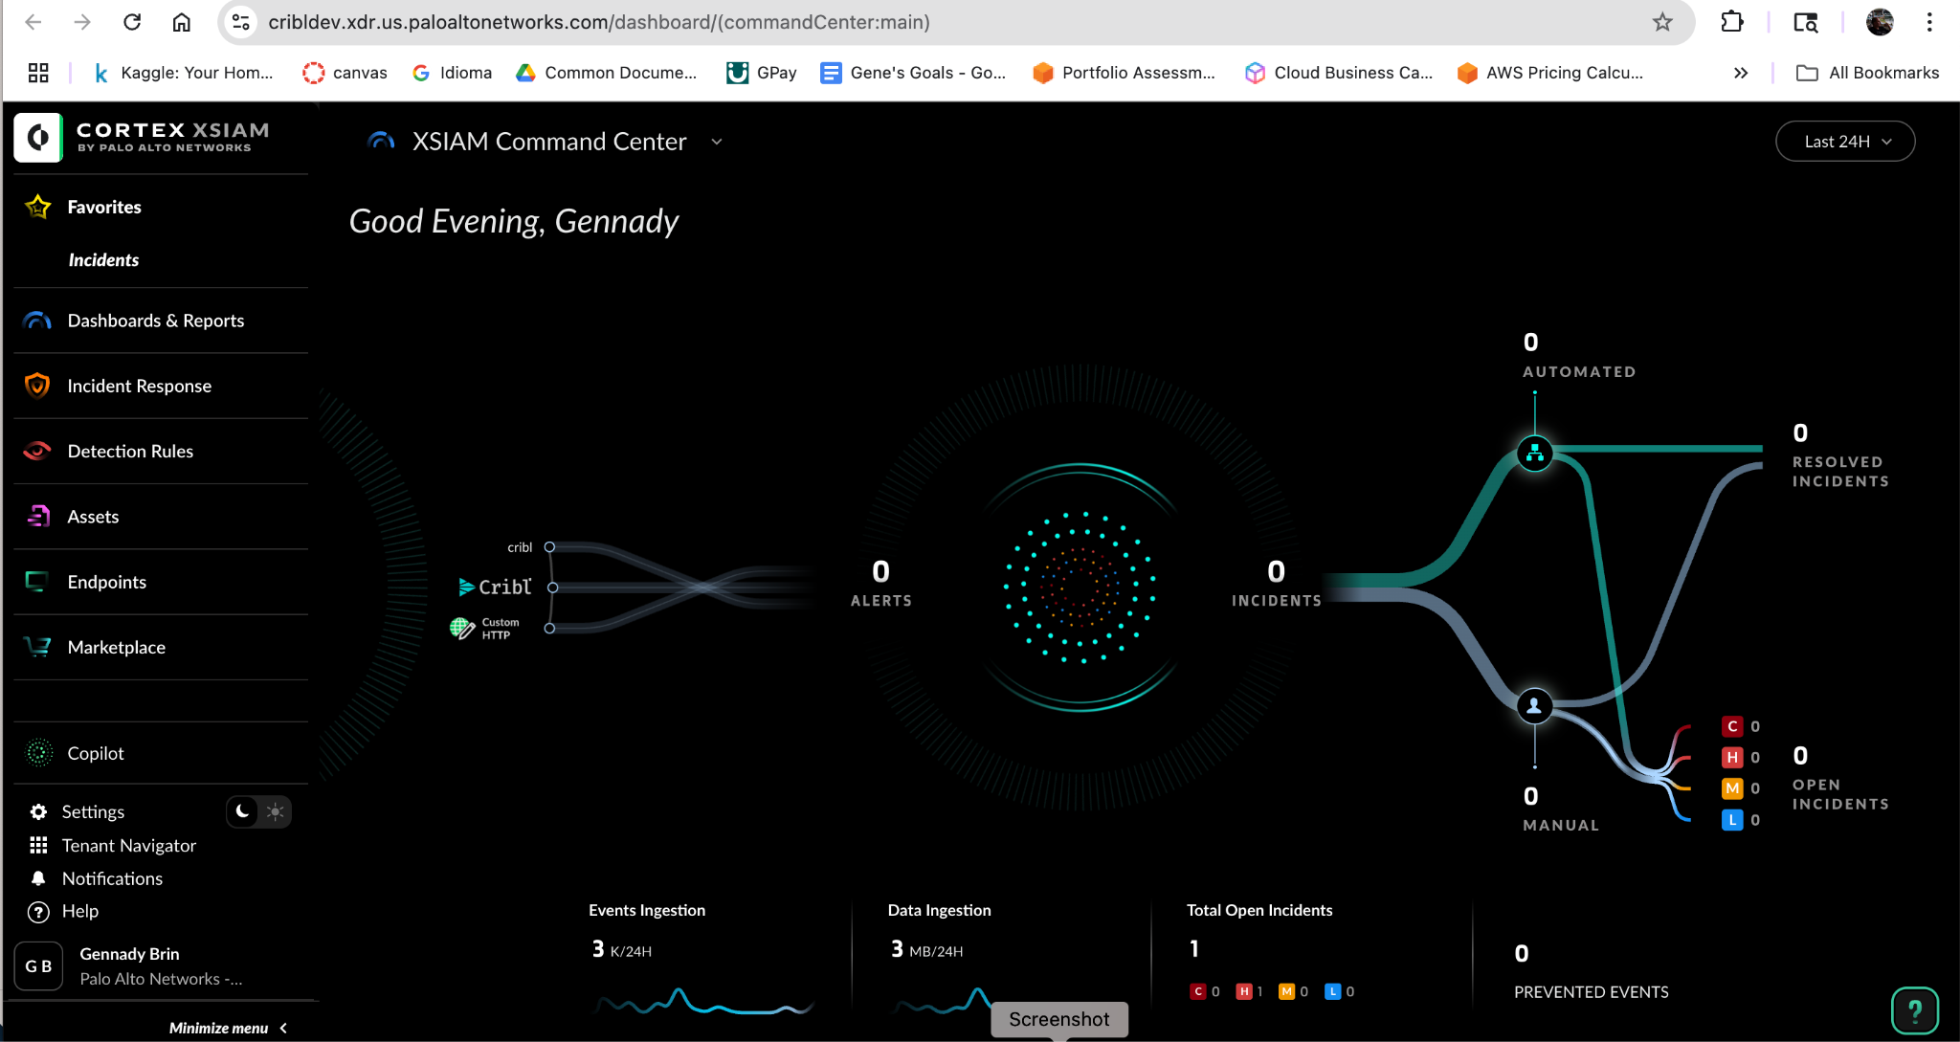

Slide 6
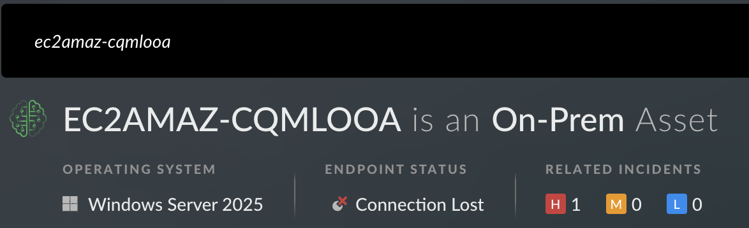
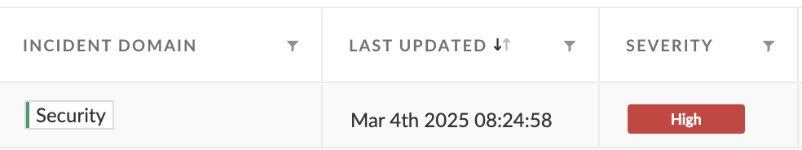
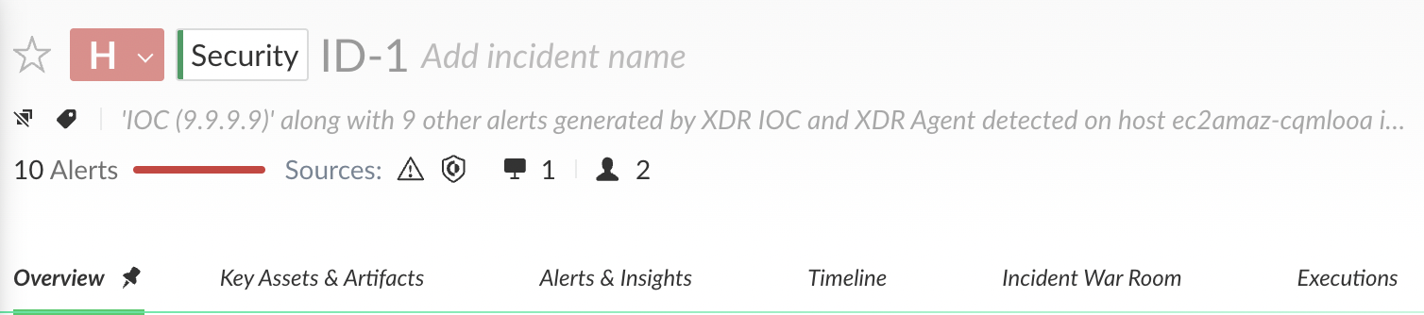
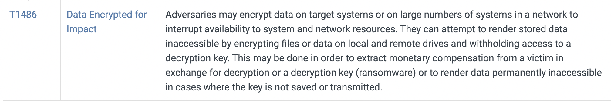
Introduction: Incident
https://attack.mitre.org/tactics/TA0040/

Slide 7
Approach
Modular
# === Main Execution ===
# Clear existing alerts folder in S3 for demo purposes
clear_s3_alerts_folder(S3_BUCKET_NAME, s3_client)
# Fetch all alerts and upload to S3
fetch_all_alerts(API_KEY)
# Verify the number of alerts uploaded to S3
verify_alerts_in_s3(S3_BUCKET_NAME, s3_client)
Outh - to store keys in the environment variables
*** Demo only - sensitive keys hard coded ***
Logging with feedback for each step via print statements
Sources: Cortex API Docs, Live Community, StackOverflow, ChatGPT 4.5
Notes:
stress the importance of secure credential management (environment variables, IAM roles) over hardcoding.**

Slide 8
Demonstration
Assignment docs walk through (to be uploaded into GitHub after presentation)
Cortex XSIAM dashboard
Cortex XSIAM API Docs
Jupyter Notebook
AWS S3 bucket with json objects

Slide 9
Findings
Target Host - EC2AMAZ-CQMLOOA - IPs: 172.30.2.130,172.30.1.133
10 alerts for a single incident: ID-1 (although 11 in total) on 03/04/25 (09:04:01 - 09:24:38)
Attack was initiated at 09:04:01
There were three ping requests 09:04:01 - 03
Following by two nslookup requests 09:04:13
Ransomware type activity (file encryption) was attempted on 09:24.38 from MS Edge Application
Attempt was Prevented by XDR Agent - blocked
310 is a custom alert - Medium (dummy?) - 03/17/25
9 alerts - XDR IOC malware (wicar.org, 9.9.9.9) - Detected - High
#12 - XDR Agent - attempt to encrypt files (ransomware) - Prevented - initiated by msedge.exe
#2; #3; #4 - XDR IOC - initiated by ping
#8, #9 - XDR IOC - initiated by nslookup
User - admin
5 alerts via MS Powershell
5 alerts via MS Edge

Slide 10
Findings
Get Alerts Multi-Events v2 - based on a description
Boto 3 Client connectivity - boto3.client()
Pagination - limit 100 alerts per page (one page retrieved)
Headers - right auth credentials
Filters - can request without filters or sort and filter per user’s need
Alerts Schema - can add filters to pull alerts based on needed fields like timestamp, type, status, severity, incident id, XDR agent, etc.
AWS S3 connectivity - appropriate IAM role with access policies for PUTs/GETs/DELETEs
This script can be modified into a playbook for automated investigation during incident triaging and investigations

Slide 11
Conclusion
Cortex XSIAM - Insider threats, ransomware, phishing, lateral movement, identity-based attacks, and more.
Automated Threat Detection and Response:
Automates threat detection, triage, investigation, and remediation using playbooks.
Reduces the mean time to detect (MTTD) and respond (MTTR) to incidents.
SOAR (Security Orchestration, Automation, and Response):
Built-in SOAR capabilities enable the automation of repetitive tasks and coordination across tools and teams.
XDR (Extended Detection and Response):
Security Analyst Workflow:
Provides dashboards, investigation tools, and case management to streamline analyst work.

