Slide 1
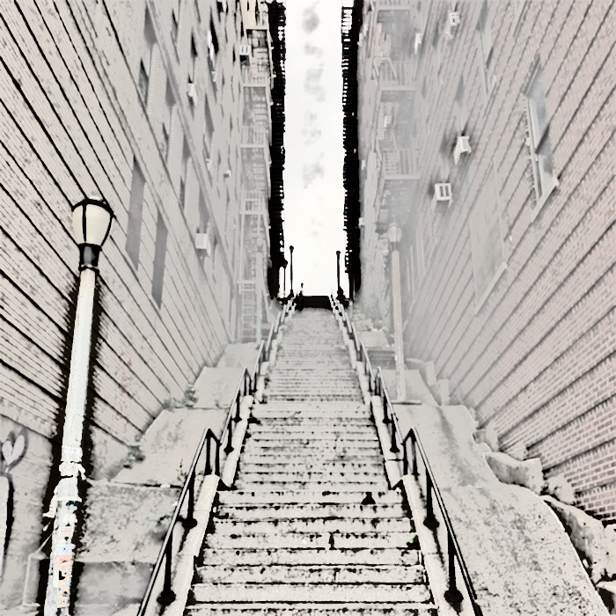
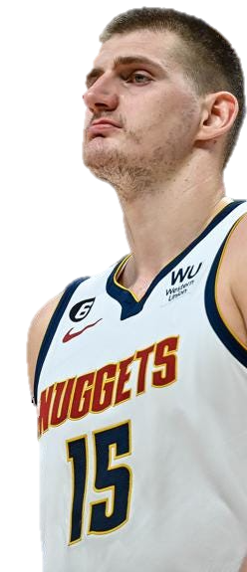

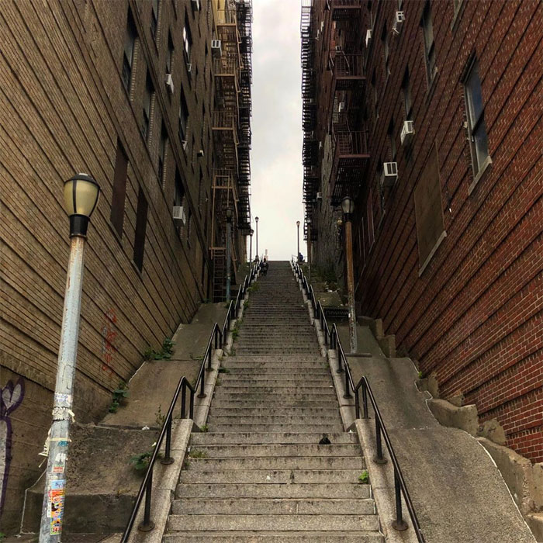
JOKER
NIKOLA JOKIĆ
Denver Nuggets C

Slide 2

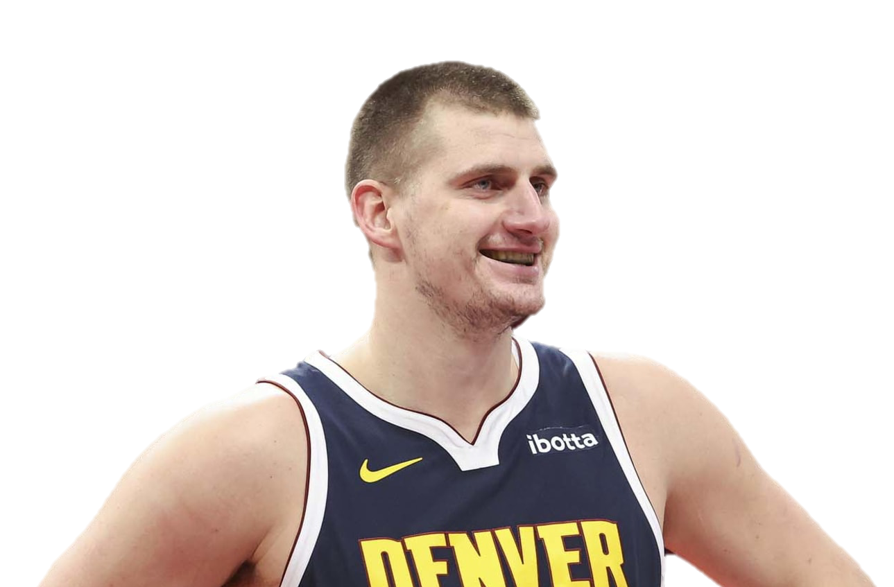

Gotham
NIKOLA JOKIĆ
Denver Nuggets

Slide 3
Gotham
NIKOLA JOKIĆ
Denver Nuggets

Slide 4

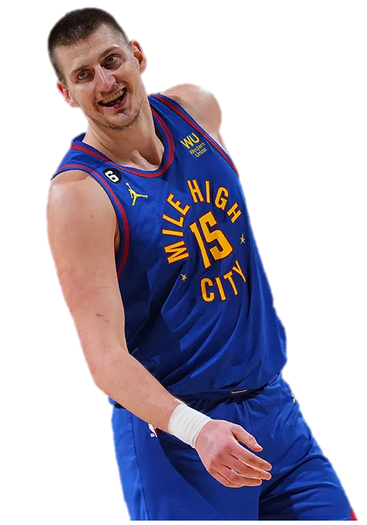
NIKOLA JOKIĆ
Denver Nuggets

