Slide 1
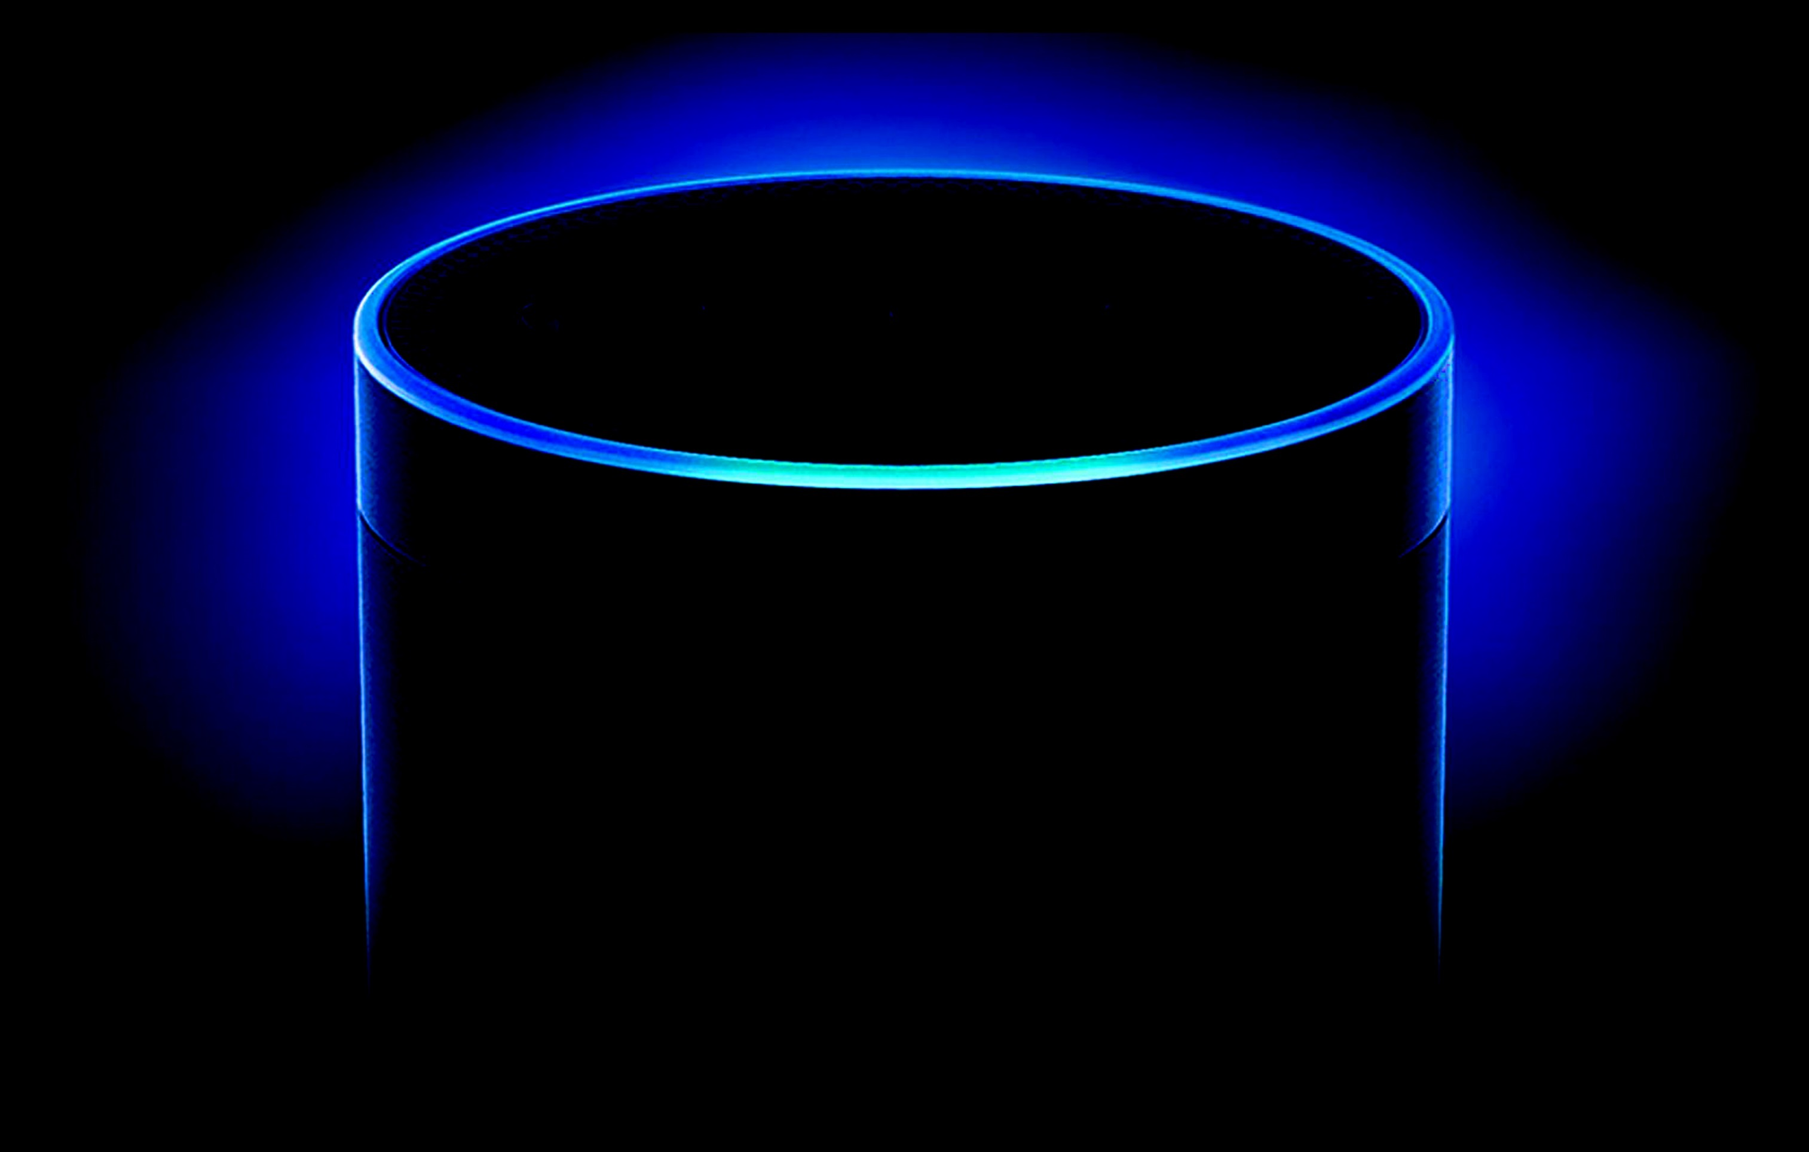
BRIGHTER API
Milind Mehta

Slide 2
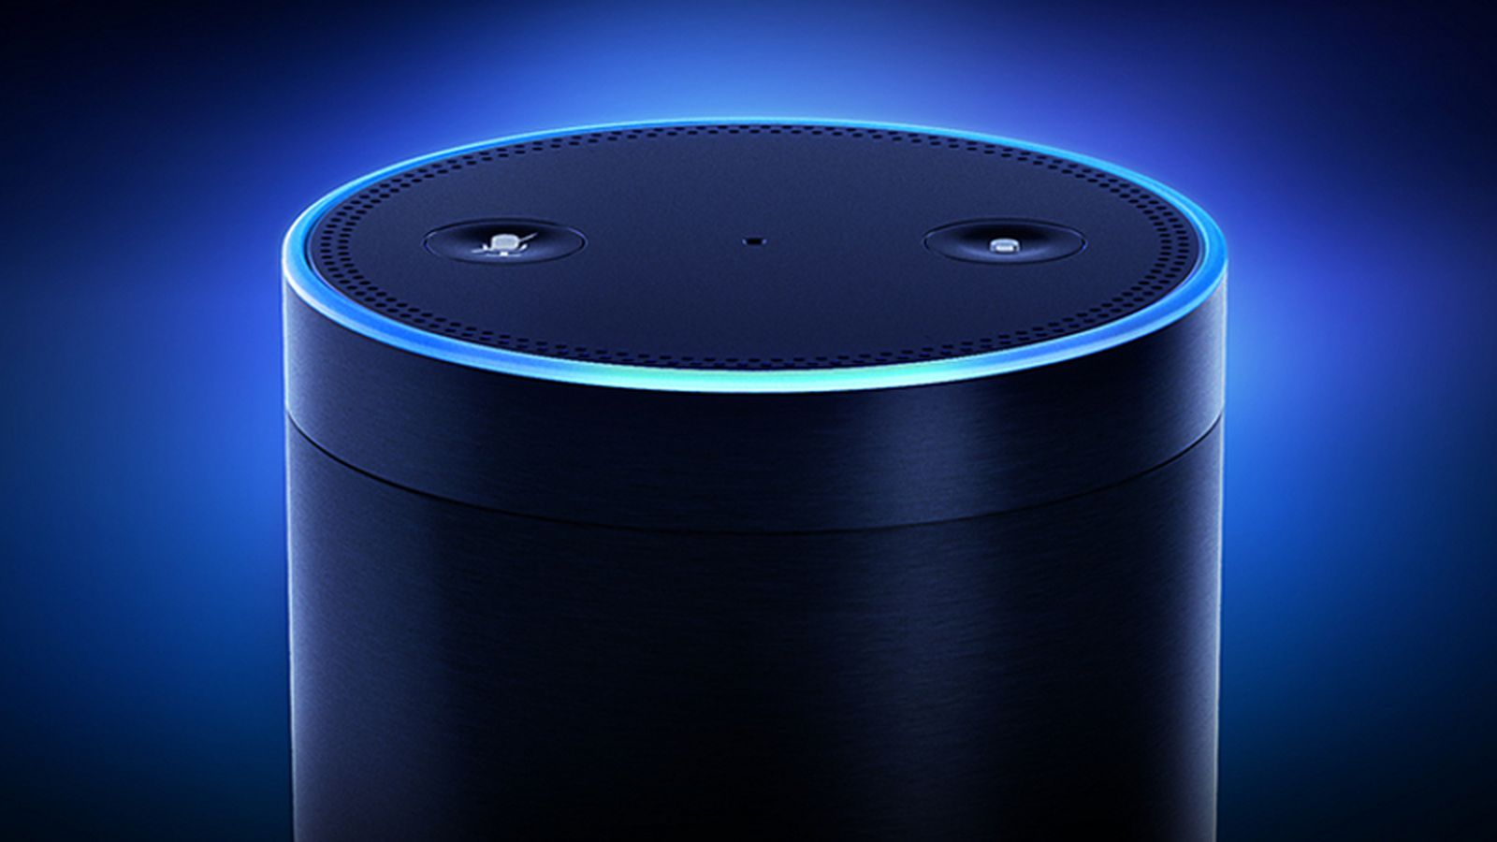

Amazon Echo

Slide 3
What is Amazon Echo?
Alexa is an intelligent personal assistant developed by Amazon, made popular by the Amazon Echo
and the Amazon Echo Dot devices developed by Amazon.

Slide 4
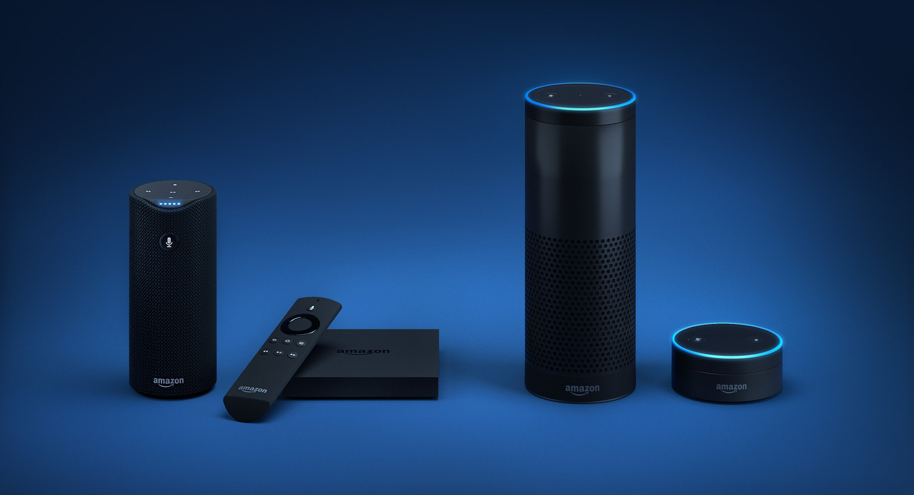
Amazon Echo & Alexa Family
Amazon Echo
Amazon Tap
Fire TV
Amazon Echo Dot

Slide 5
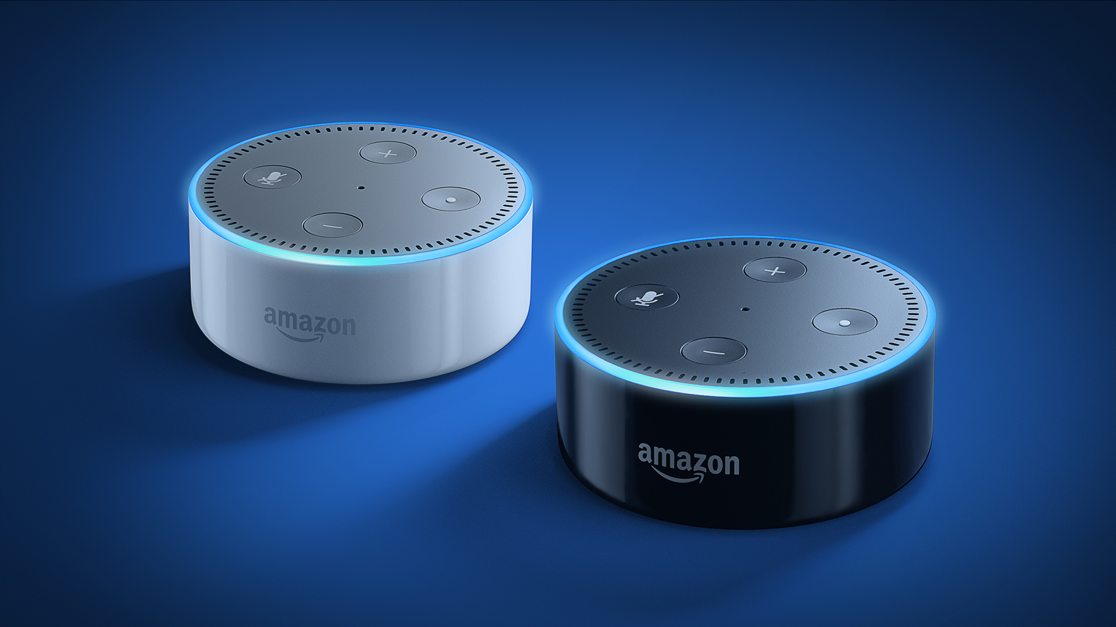
Amazon Echo Dot

Slide 6
Meet Alexa
Notes:
- Do you know Siri?
- Who directed Bhahubali
- Star Wars or Star Trek
- Set timer for 5 seconds
- Ask the Bartender how to make Singapore Sling
- Do you know Michale Klausen?
- Do you know Michael Jackson
- Open Sleep Sounds, Play Wind Chimes
- Open Translated, Translate "I love you" in Hindi, translate "I love you" in Thai.
6

Slide 7
Develop Alexa APP
Alexa : https://developer.amazon.com/alexa
  Skill Information
    Name
    Invocation Name

Slide 8
Develop Interaction Model
  Interaction Model
    Intent Schema
      These are intents for common actions that you can choose to implement in your custom skill without providing any sample utterances.
      An intent represents an action that fulfills a user’s spoken request. Intents can optionally have arguments called slots. Intents are specified in a JSON structure called the intent schema.
    Custom Slot Types
      A representative list of possible values for a slot. Custom slot types are used for lists of items that are not covered by one of Amazon’s built-in slot types.
    Sample Utterances
      The phrase a user might speak to signal that intent.

Slide 9
Develop Intent Schema
  {
  "intents": [
  {
  "slots": [
  {
  "name": "samplecode",
  "type": "SAMPLE_CODE"
  }
  ],
  "intent": "BrighterAPIIntent"
  },
  {
  "slots": [
  {
  "name": "bookingcode",
  "type": "AMAZON.NUMBER"
  }
  ],
  "intent": "BookingIntent"
  },
  {
  "intent": "AMAZON.PauseIntent"
  },
  {
  "intent": "AMAZON.ResumeIntent"
  }
  ]
  }

Slide 10
Develop Sample Utterances
  BrighterAPIIntent what is {samplecode}
  BrighterAPIIntent i would like know about {samplecode}
  BrighterAPIIntent tell me about {samplecode}
  BrighterAPIIntent what {samplecode} does
  BrighterAPIIntent What is my {samplecode} status
  BrighterAPIIntent tell me {samplecode} status
  BrighterAPIIntent {samplecode} status of
  BrighterAPIIntent when is next {samplecode}
  BookingIntent Status for {bookingcode}
  BookingIntent Booking Status for {bookingcode}

Slide 11
AWS Lambda Code
AWS Lamda : https://aws.amazon.com/lambda/

Slide 12
Thank you

